Slide 1
Roadmap for BBLR compensation for HiLumi LHC operation
HS – 22-1-2015
HL-TC
With contributions from:
R.Steinhagen (GSI), R.Veness, R.Jones, S. Redaelli, G. Tranquille, T.Lefevre, Y.Papaphillipou, G.Stancari(FNAL), A.Valishev (FNAL)

Slide 2
Outline
The project is broken down in four work-packages:
1) Demonstrator projects before LS2
( demonstrator installation in collimators, installation winter shutdown 2016-2017)
2) Related beam instrumentation and beam experiments : 2 D halo monitor, tune spectra
3) Optimization of parameters for HiLumi
→ done inside HL-WP2
4) BBLR compensation using e- lenses:
Try to make this part of a more generic R&D:
- Low energy e-beams as actuators on hadron beams

Slide 3
1) Demonstrator projects
Work consists of simulations, a workshop in summer 2015, SPS experiments in 2015/2016, LHC experiments in 2017
- simulations: Y.Papaphilipou et al, A.Valishev et al.
Aim: simulate possible beam observables with/without compensation, specify necessary instruments performance
- workshop: details still to be defined; summer 2015
aim: bring about 10 people from simulations together with about 10 instrumentation experts…see what is possible
- SPS experiments: next slide
- LHC experiments: following slides
Aim of this work-package is to have end of the year 2017 enough experimental evidence such that BBLR compensation becomes a “construction option” for HL-LHC.

Slide 4
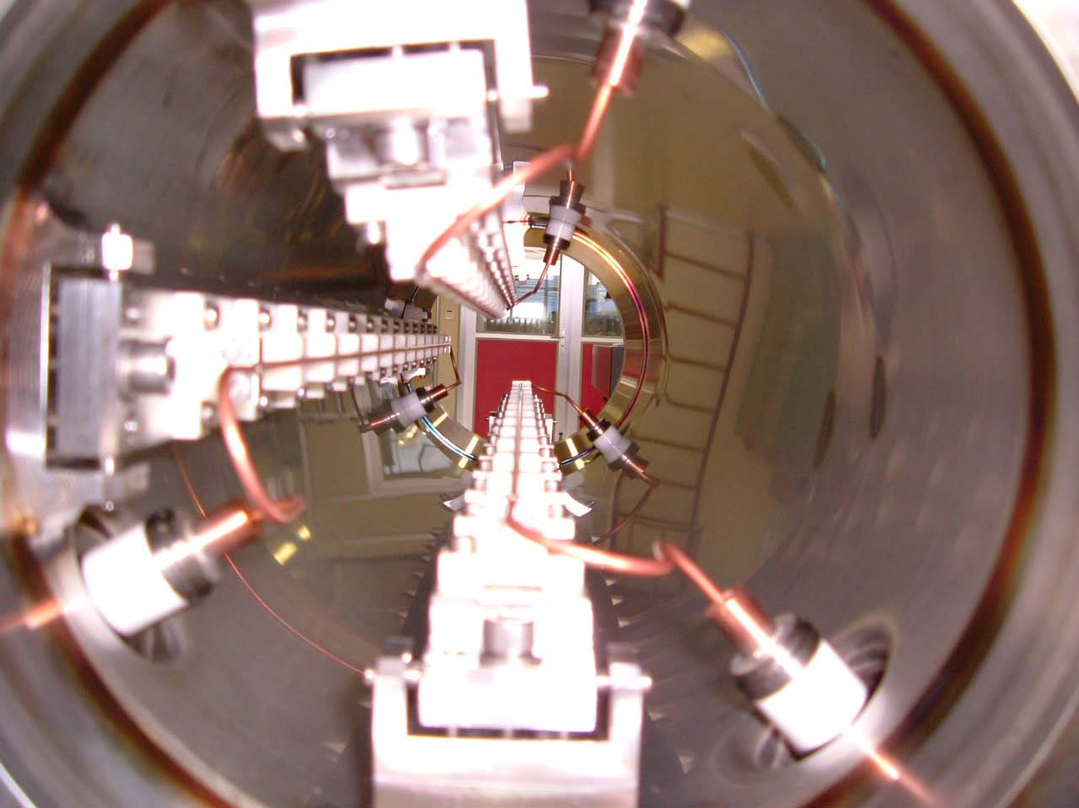
Wires at SPS
Two 60cm long 3-wire compensators installed in the CERN SPS
  Different “crossing” plane and even @ 45deg
Movable in vertical by +/- 5mm (remote controlled)
Water cooled
About equal beta functions in the transverse planes (~50m)
Separated by phase advance of 3deg (similar between BBC and long range interactions in LHC)
Powered with integrated DC current of up to 360A m (60 LR collisions in LHC)
Set-up re-evaluated during 2014 (powering), for MDs in 2015 (benchmarking wire models)
Effect of wire on orbit, tune, tunes-spread, coupling (alignment), resonance driving terms, beam distribution (tails)
Can be done at flat bottom in parallel MD cycle with new pulsed power supply
Beam brought close to the wire with closed bump (to be checked)

Slide 5
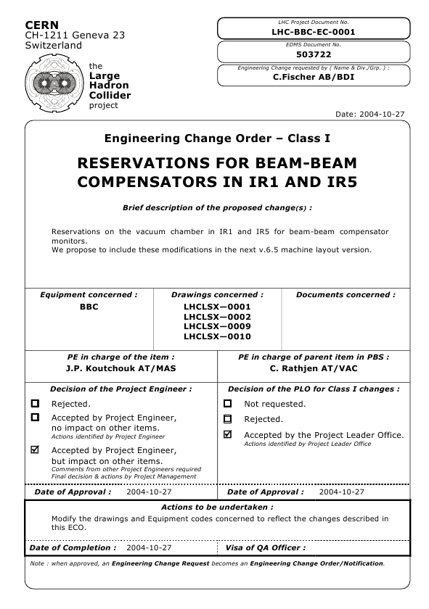
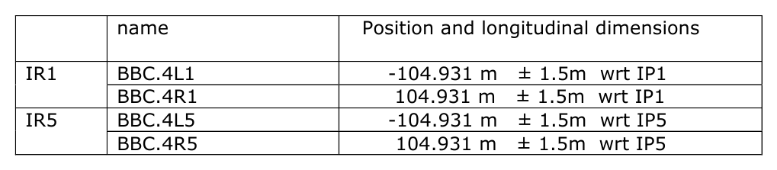
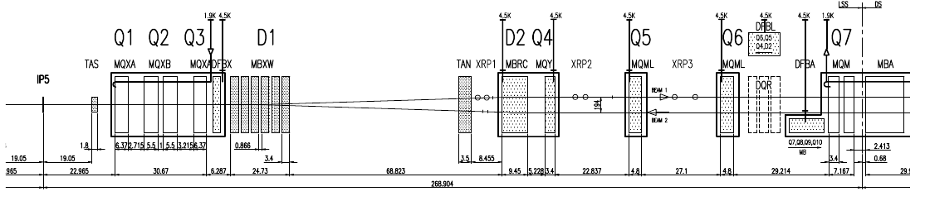
Initial Plans: LHC Beam-Beam Compensators I/III
Reservations around IR1&IR5, LHC-BBC-EC-0001:
Min. LRBB → BBC phase advance: Δμ ≈ 2.6° (→ 3.1°)
Symmetric beta-function: β_{x/y}≈ 1000 m (for β*= 0.55 m)
N.B. single vacuum pipe for B1 & B2: 110 mm full beam separation (only D1 only) (→ 165 mm, if shifted more towards TAN)
BBC
?
TCT
~105 m
B1
B2

Slide 6
Status Wire in jaw collimators
4 “wire in jaw“ collimators ordered from CINEL. Design finished in late 2014. Delivery during 2015, followed by qualification tests.
Installation in WS 2016/2017
Cost covered by HL-LHC
2 options:
1) full compensation of one beam: 1 collimator L&R in IP1 & IP5
2) compensation of both beams on the ingoing or outgoing side
= 2 collimators on the same side in IP1 & IP5
Presently the cabling has been pulled for option 2
Option 1 is preferable (Yannis dixit) in order to reduce the footprint in tune-space. This needs 4 independent power supplies due to asymmetries in the optics.
One option has to be taken soon.
Experiments to be done in 2017 depend on outcome of SPS studies, on progress of simulations and on available instrumentation.

Slide 7
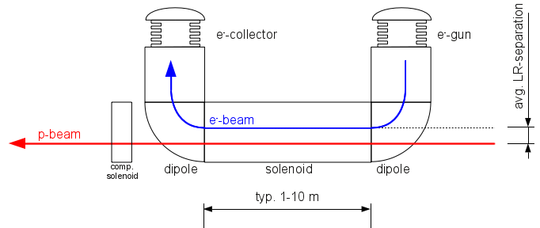
HL-LHC Option 3:
Local e-beam simulating 'wire'-like Field I/II
E-beam has by-design perfect 'wire' field distribution
similar to existing e-cooler, (hollow-) e-lenses used at Tevatron & RHIC, however: offset e-beam! → much lower requirements on transverse e-beam parameters (i.e. beam size, profile distribution etc.)
Still need large solenoid field to stiffen e-beam rigidity
no solid material close to beam → chance of being MP compatible @6-7σ
x2
(units are back-to-back)

Slide 8
Ad 1) workshop
Exact date and location of this workshop depends on progress on simulations and availability of experts
→ say summer 2015:
Show simulated observables
Explain potential of existing instruments
Understand possible new instruments
Evaluate experiments
About 20 participants (FNAL, BNL?, CERN)

Slide 9
2) Instrumentation development (1/2)
Tune-spectra: nothing done so far; needs simulation effort what can be measured with swept sine wave analysis
Halo Monitoring:
a) based on synchrotron light
b) beam–gas interactions
a) On the first look challenging due to high energy of LHC beams.
“ the synchrotron radiation cone (1/gamma) gets so narrow that the beam itself generates a significant diffraction pattern, which overwhelms the potential halo signal)
- 2 approaches will be tried in collaboration:
1) Shipment of a coronograph from KEK to CERN and installation of this device onto one BSRT (T. Mitsuhashi et al.)
Shipment in 2015, installation plans pending.
Presently optics simulations trying to reduce diffraction fringes by apodisation

Slide 10
Apodisation

Slide 11
2) Instrumentation development (2/2)
2) observation of Halo with a high dynamic range camera:
A. Fisher (SLAC) et al. + D. Rubin (Cornell).
This collaboration is presently being defined, not much progress expected in the beginning of this year, CERN experts busy with LHC start-up.

Slide 12
Beam profile measurements based on modern vertex detectors and beam-gas interactions
Rhodri Jones (CERN)
SLAC Halo Workshop (IBIC14)
Slides from:
Colin Barschel - TIPP 2014 third international conference on Technology and Instrumentation in Particle Physics
Plamen Hopchev - 9th DITANET Topical Workshop on Non-Invasive Beam Size Measurement for High Brightness Proton and Heavy Ion Accelerators, 16 April 2013

Slide 13
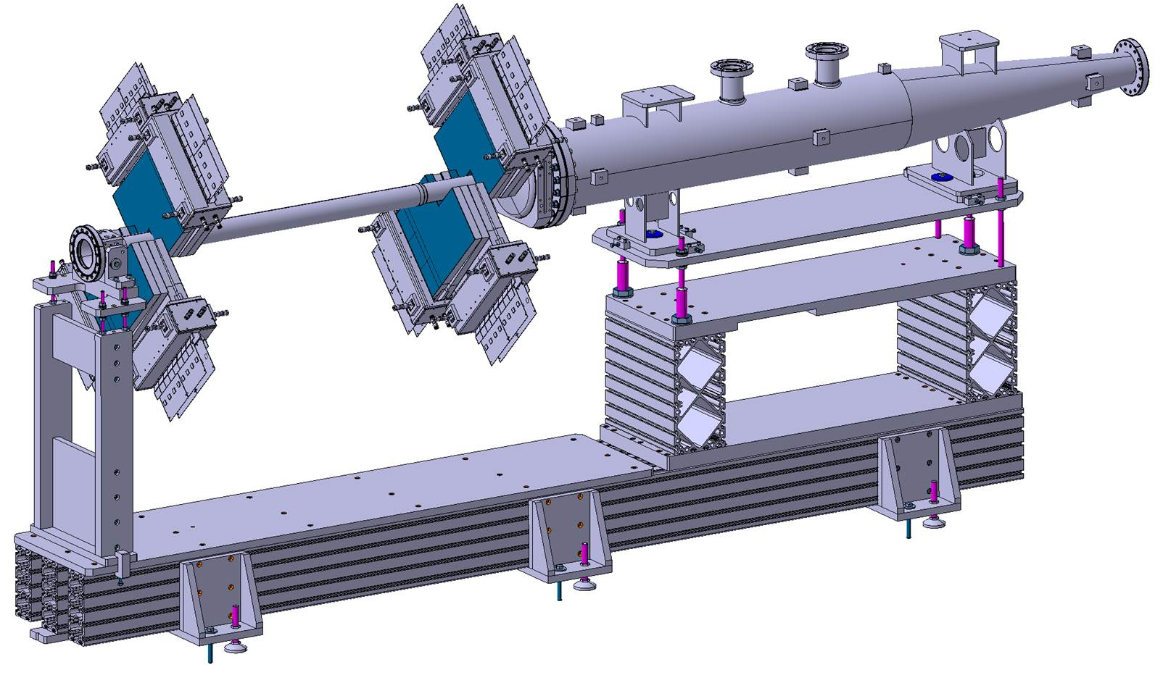
From LHCb to mini LHCb BGV

Slide 14
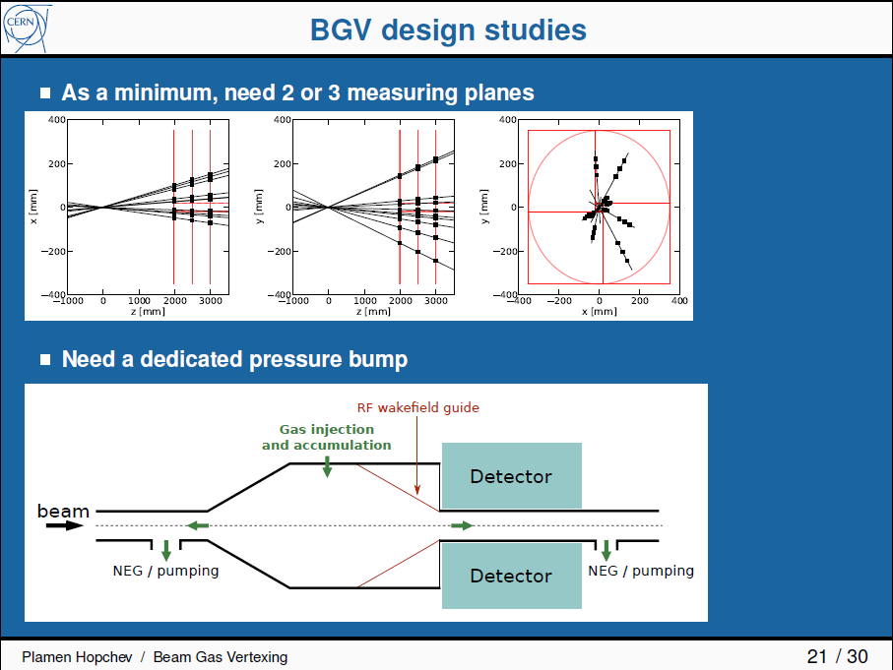

Slide 15
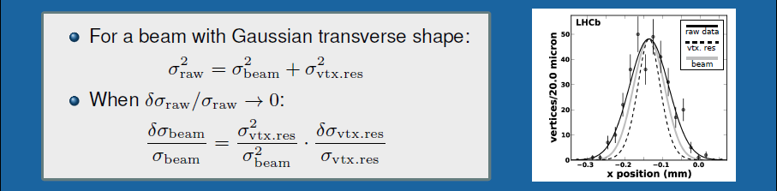
BGV for Halo?
No experience with trying to measure the halo at 4-6 sigmas
Need to deconvolve with tail of vertex resolution
Beam-gas rate will be orders of magnitude smaller at this radial distance
  Currently aim at 100Hz beam-gas per nominal bunch.
  Sampling 0.1% of bunch tail of the bunch ⇒ 0.1 Hz / bunch
Increasing the interaction rate
Measurement of “average” beam halo possible (2808 bunches)
Increase the pressure (limited by vacuum interlocks)
  factor 10 to 100 may be possible for short times
Combine with gas sheet?

Slide 16
4) R&D on BBLR Compensator implementation post LS3
Not part of the HL baseline
General consensus that « in jaw wires » not possible
- distance from beam too large
- ideal location for compensator in common beam pipe…second beam has to pass through the collimator jaw
Since 2013 proposed to study the replacement of the physical wire by an electron beam:
Presently definition of a collaborative project called:
« Low energy e-beams as actuators on hadron beams »

Slide 17
E- beam applications
So far:
- AD, LEIR & ELENA e-cooling (G. Tranquille et al.)
not further discussed; parameter space is very different, but same people at CERN + common technologies
Under study
- LHC beam cleaning (S. Redaelli et al.)
- LHC BBLR (H. Schmickler et al.)
Further request:
- Compensation of space charge effects in SIS18/SIS100 (GSI – FAIR project; P. Spiller et al.)
Needs a new feasibility study:
- Compensation of space charge effects in CERN PS, PSB
https://accelconf.web.cern.ch/accelconf/p07/PAPERS/THPAN074.PDF
GSI has submitted a request to the German BMBF for funding in order to simulate further details of this compensation. CERN is following (and complementing?) these simulations.

Slide 18
R&D needs
Increase of intensity of electron beam
(presently a few A) by a factor 2 to 5.
Fast modulation of the (DC) electron beam up to 40 MHz
(10% intensity modulation @ LHC for pacman bunches,
intensity modulation following bunch shape for space charge compensation)
Improved diagnostics (e-beam size in the overlap region, overlap of e-beam with p beam)
→ CERN will build a test-stand (mainly BE-BI)

Slide 19
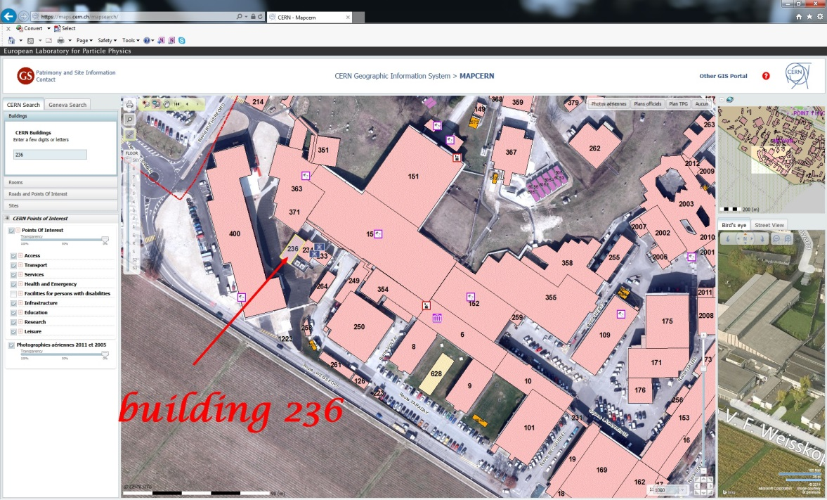
Teststand details
The BE-BI group has an test-stand for development on electron cooler equipment (LEIR, ELENA) in building 236.
There is space for an additional
test-stand in building 236.
Such a test stand is a complex
system composed of (cryogenic)
solenoid magnets, power supplies,
electron beam source and collector,
vacuum system and diagnostics.
Instead of building a complete new
installation FNAL has agreed to lend
the almost complete TEL-2 Tevatron
electron lens installation to CERN.
Presently building 236 is being
refurbished and TEL-2 should get to
CERN in the second half of the year
2015.

Slide 20
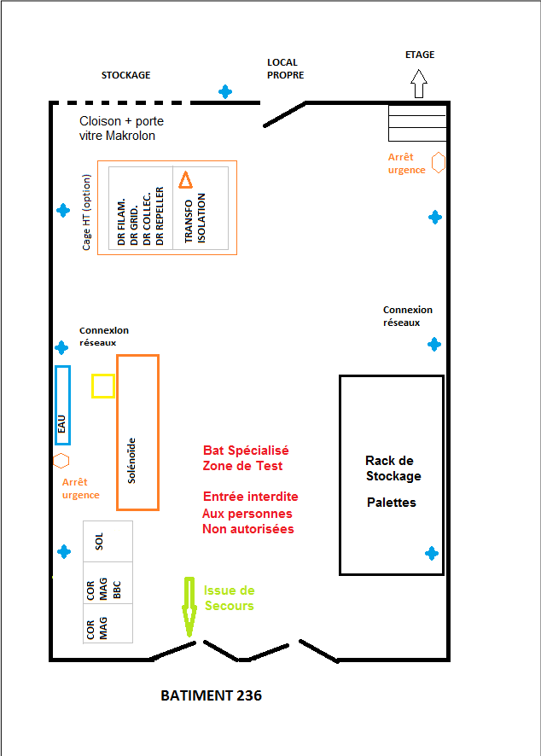
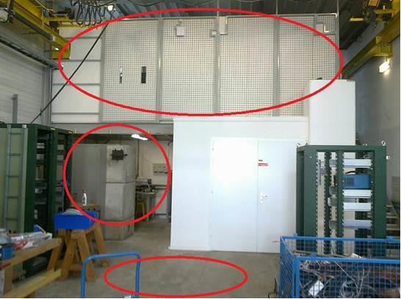
Inside building 236

Slide 21
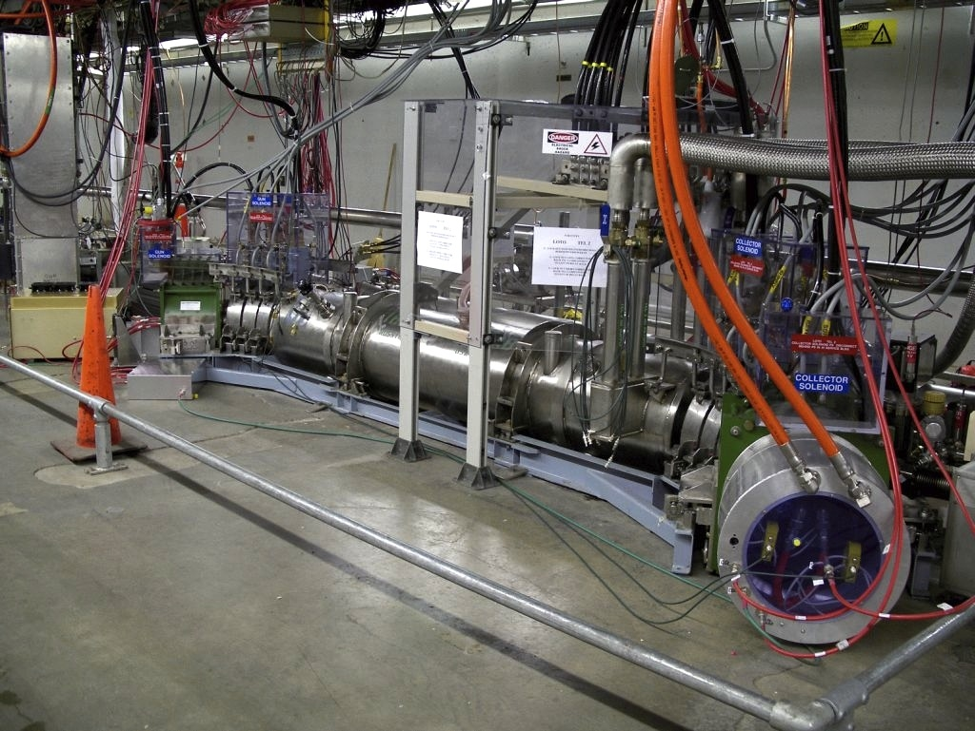

Slide 22
Outline of developments to be made
Pre-requisite: Import the technologies towards CERN engineers. Collaborations with FNAL & GSI
(BNL and COSY to be contacted)
Increase the electron beam current by a factor two to five.
Modulate the electron beam intensity by about 10% at 40 MHz; potentially with a low power steering grid.
Develop an instanteneous beam profile measurement at full beam power. An existing development for the CLIC drive beam (Adam Jeff, Liverpool University) could be adapted to the new geometry : Injection of a gas-curtain and measurement of the beam profile through ionization/fluorescence (2 following slides)

Slide 23
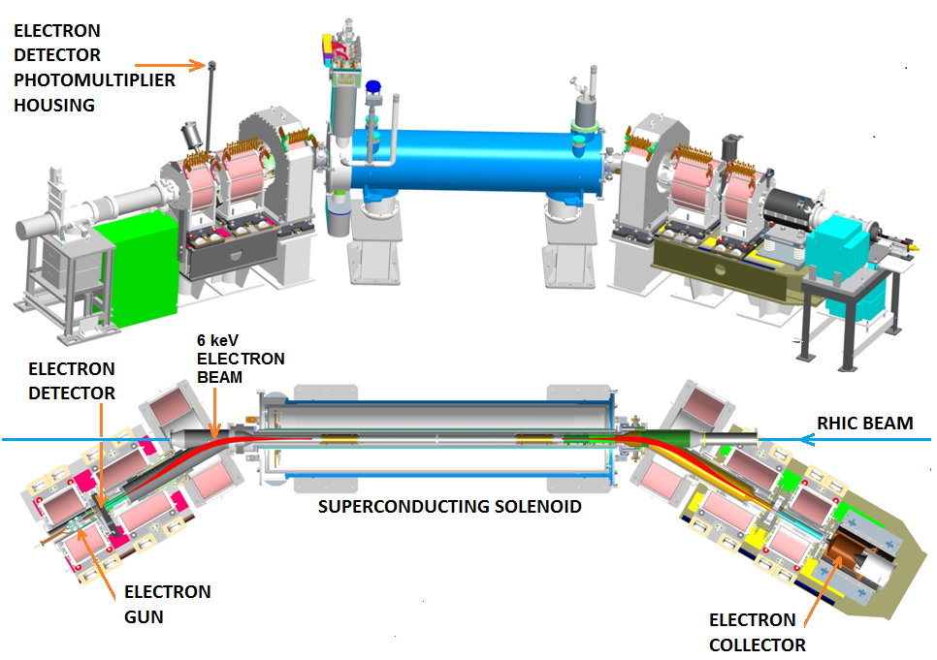
RHIC e-lens showing the location of the electron back-scattering detector (eBSD)
The beam-beam effect limiting RHIC luminosity will be mitigated with two electron lenses
The 2 m long electron and proton beams propagating in opposite direction in two ~6T solenoids have a width of ~300 μ rms.
The misalignment must be < 30 μ for the lenses to work properly.
Misaligned can do more harm than good.
BPMs are not quite good enough to guarantee satisfactory alignment.
We will use electrons backscattered by the protons as the “luminosity signal to achieve alignment
The system was recently successfully commissioned with 100 GeV/amu Au and ³He beams

Slide 24
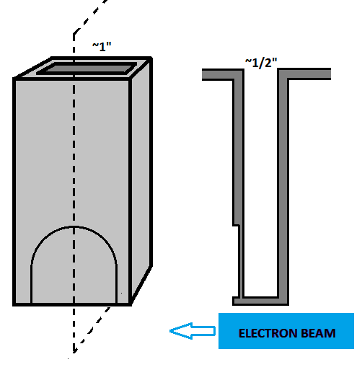
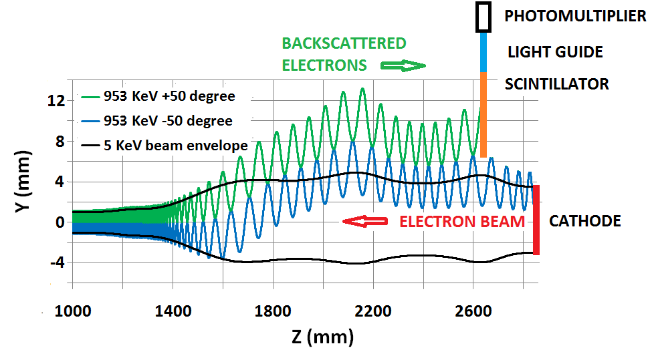
Schematic of the detector and of the electron trajectories
The electrons, scattered in small impact parameter collisions with the ions, reach the detector located close to the gun after traversing a thin vacuum window
~1 to ~20 MeV
The upward trajectory drift is due to the horizontal bend.
ION BEAM
(~5 keV)
End of ~2 m long,
6 T solenoid
5 keV electron beam envelope

Slide 25
Summary
Not a lot of news
The construction and installation of the wire in jaw collimators is going on, until WS 2016/2017 the SPS will be our only test bed. Options need to be chosen soon.
People are concentrating on
a) refining simulations
b) preparing advanced diagnostics
A test stand for e-lenses is prepared at CERN during 2015. Large collaborative interest.
Funding will only partly come out of HL-LHC, but also (hopefully) from other sources.
Refined cost schedule in 2 months from now.

