Slide 1
International review of the HL-LHC 11T Dipole for DS Collimation Coil production data Coil Technology
Debriefing
D. Smekens

Slide 2
Coil Production Status
Coil ID → | 101 | 102 | 103 | 104 | 105 | 106 | 107 | 108 | 109 | 110 | 111
Cable | Cu DUMMY | Cu DUMMY | WST DUMMY | RRP 54/61 DUMMY | RRP 108/127 | RRP 108/127 | RRP 108/127 | RRP 132/169 | RRP 132/169 | RRP 132/169 DUMMY | RRP 132/169
Winding Start Date | Jan 2011 | Oct 2011 | Nov 2012 | Feb 2013 | May 2013 | June 2013 | Sept 2013 | June 2014 | Aug 2014 | Sept 2014 | Nov 2104
Winding | GOOD | GOOD | GOOD | GOOD | GOOD | GOOD | GOOD | GOOD | GOOD | GOOD | GOOD
Curing | GOOD | GOOD | BAD | Difficult | GOOD | GOOD | GOOD | GOOD | GOOD | GOOD | GOOD
Reaction | GOOD | GOOD | - | Difficult | Difficult | GOOD | GOOD | BAD | GOOD
Impregn. | GOOD | GOOD | - | Difficult | Difficult | GOOD | Difficult | Difficult
Impregn. End Date | Jan 2014 | Feb 2013 |  | Aug 2013 | Jan 2014 | Feb 2014 | April 2014 | Sept 2014
Assembly (pairing) | 101 105 | - | - | - | 101 105 | 106 107
Cold Tests Date: | - | - | - | - | GOOD Jul14 | GOOD Nov14 | BAD Nov14
Autopsy Date: |  |  | Done Mar-13 | On going
Magnet | MBH SM101 |  |  |  | MBH SM101 | MBHSP101

Slide 3
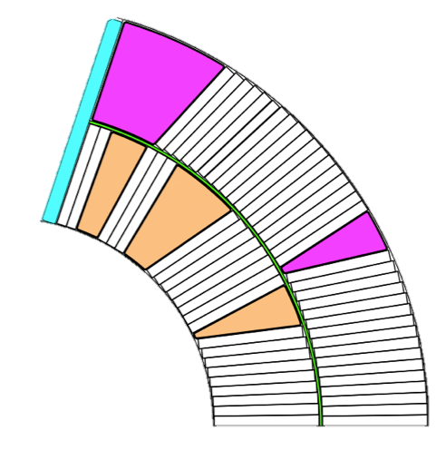
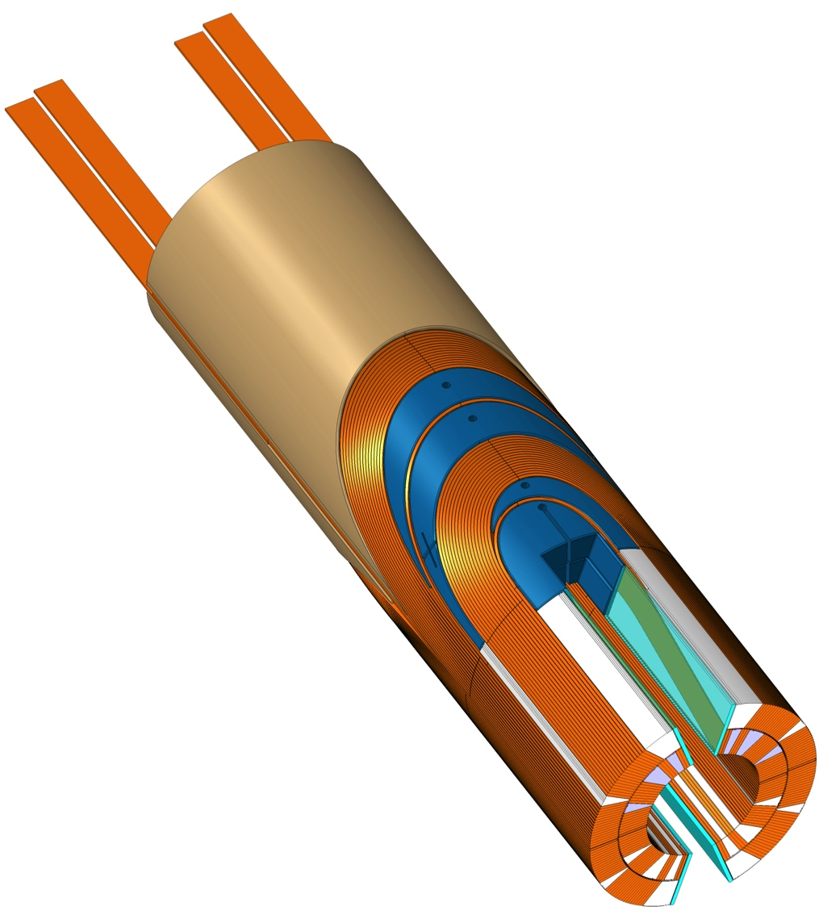
Inside Coils: Naming conventions
b
Insulated cable
Filler Wedge
Loading plate
Inter-layer
Inner ground wrap
Outer ground wrap
f
c
6
d
5
e
7
4
a
3
2
Mid-Plane
Filler Wedge
Loading Plate
Key
SLS Spacer w/Flex Legs
Saddle with integrated splice block
Nb₃Sn / Nb-Ti Splice
1

Slide 4
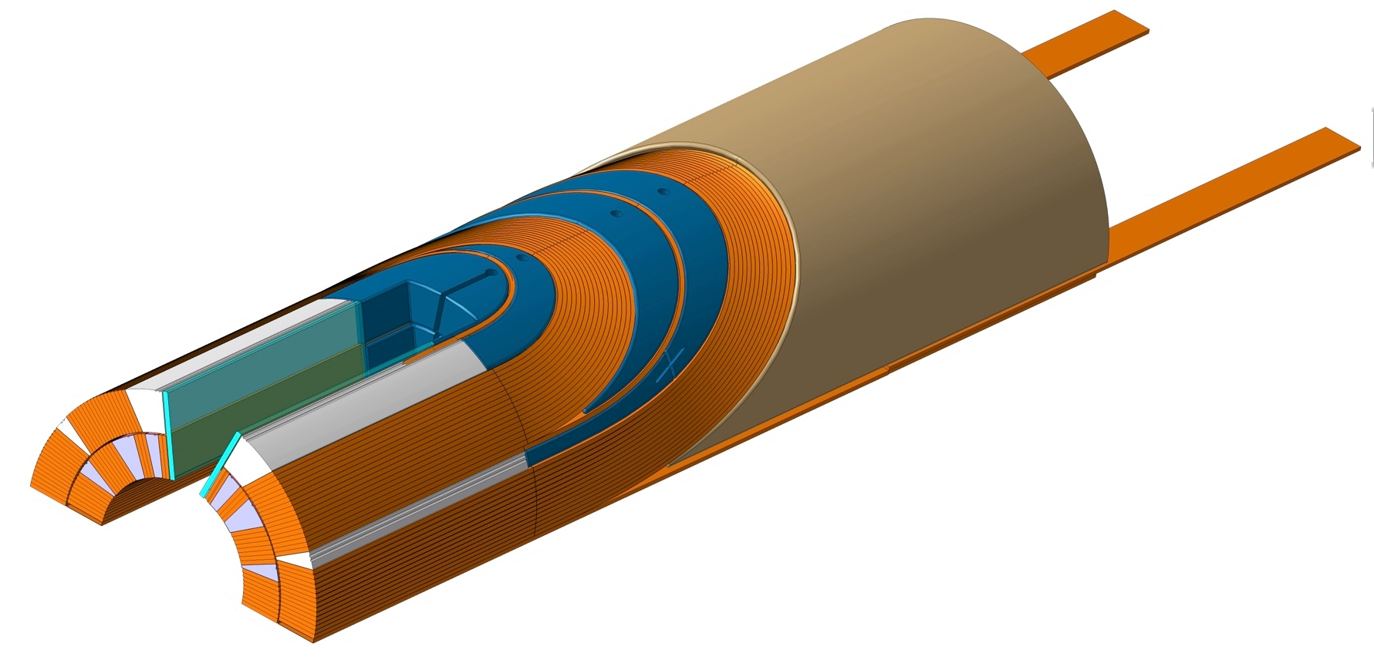
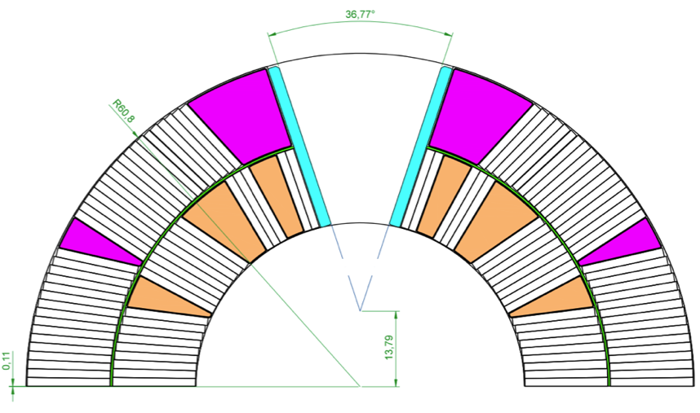
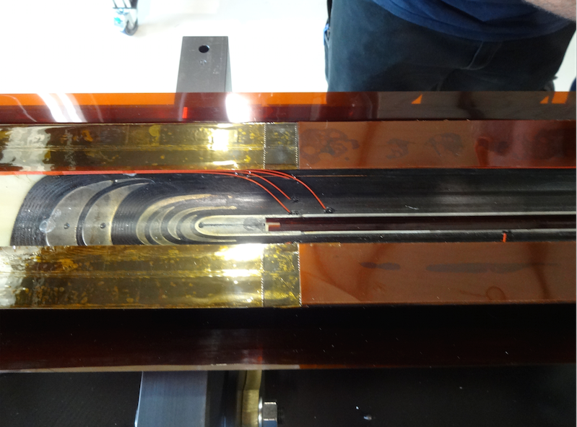
Loading Plate, Keys and Filler wedge
2
1
3
1. Filler Wedge
Aligns the outer layer with the inner layer
Encase the layer-jump
2. Loading Plate
Protects the turns of the inner layer’s last block
Distribute the azimuthal stress between both layers and minimize shear during collaring
Protects the layer jump
3. Keys
Makes the transition between the straight section (compression by shimming the poles) and the coil ends (shimming at mid-plane or radially)
Midplane shimming
of coil ends
(polyimide)
Coil 106 (view from inside bottom, inner layer)
The mid plane shimming of the coil end starts gradually at the end of the straight section

Slide 5
Implementation of Features, timeline
Coil ID → | 101 | 102 | 103 | 104 | 105 | 106 | 107 | 108 | 109&111
Cable | Cu | Cu | WST | RRP 54/61 | RRP 108/127 | RRP 108/127 | RRP 108/127 | RRP 132/169 | RRP 132/169
Insul. Thick. [mm] | S2/Mica 0.115 | S2 only ~ 0.115 | S2/Mica >0.15 | S2/Mica >0.15 | S2/Mica 0.115 | S2/Mica 0.115 | S2/Mica 0.115 | S2/Mica 0.107 | S2/Mica 0.107
Spacers | SLS | SLS | SLS | SLS-Flex | SLS-Flex | SLS-Flex | SLS-Flex | SLS-Flex | SLS-Flex
Saddles | SLS | SLS | SLS | SLS | SLS | G11 | G11 | G11 | G11
Wedges | 316L | 316L | 316L | ODS-Cu | ODS-Cu | ODS-Cu | ODS-Cu | ODS-Cu | ODS-Cu
Inter_layer | Nextel | E-Glass | Mica-QH | S-Glass | S-Glass | S-Glass | S-Glass | S-Glass | S-Glass
Binder | CTD1202 | CTD1202 | CTD1202 | CTD1202 | CTD1202 | CTD1202 | CTD1202 | CTD1202 | CTD1202
Splice | Pb-Ag | Pb-Ag | - | Pb-Ag | Pb-Sn | Pb-Sn | Pb-Sn | Pb-Sn | Pb-Sn
Gr.Wr. OD Gr. Wr. ID | Glass 0.1 Glass 0.1 | Glass 0.1 Glass 0.1 | - | Glass 0.1 Glass 0.1 | Glass 0.1 Glass 0.1 | None None | Glass 0.1 Glass 0.1 | Glass 0.1 Glass 0.1
Epoxy Impreg. | CTD 101K | CTD 101K | - | CTD 101K | CTD 101K | CTD 101K | CTD 101K | CTD 101K | CTD 101K
Remark | Short with spacers | Short with spacers - Splicing difficult | Insulation oversized- Disposed after curing | Insulation oversized- Splicing difficult | Short with saddle, Popped Strand, Azim. Oversized | ELQA OK - OK (no ground wrap) | ELQA OK - Dry spots after impreg. | ELQA OK - Impregn. defects | No binder in ends (In progress)

Slide 6
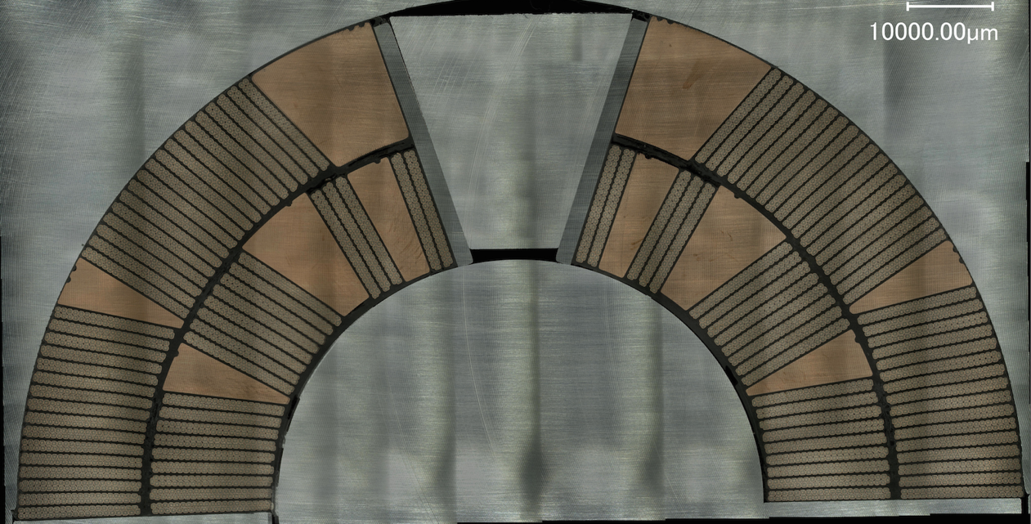
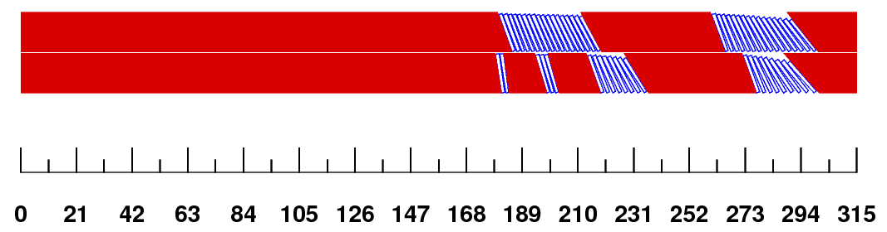
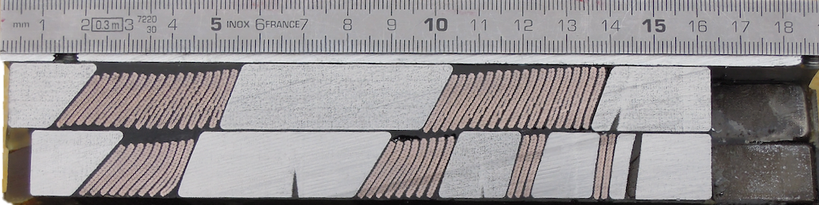
Winding – Curing: Characteristics
Winding Characteristics for 105-106-107
Cable Tension IL: 350 N / OL : 250N
Cable behaviour: RRP Stable
Binder+ heat gun to stabilize the cable in the heads
Respect of Coil Overall Length: ~ 6.. 10 mm extra length
Curing process: cables compressed to nominal above midplane
Electrical integrity: good
105 collapsed cable,
106, 107 OK
Nota: Correct position of the turns in the ends is now achieved (since coil 108)
Photographs :courtesy of X. Sarasola Martin, N Peray, L. Lambert

Slide 7
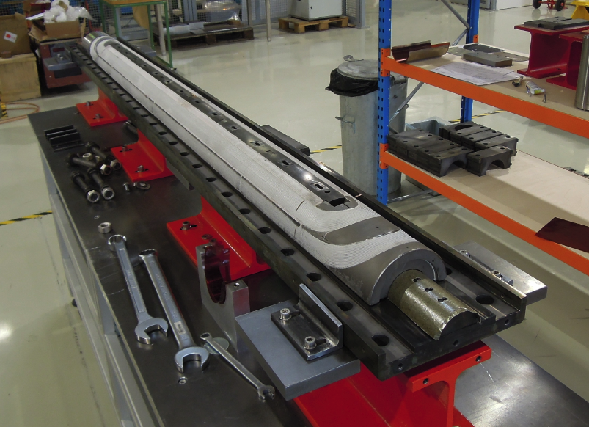
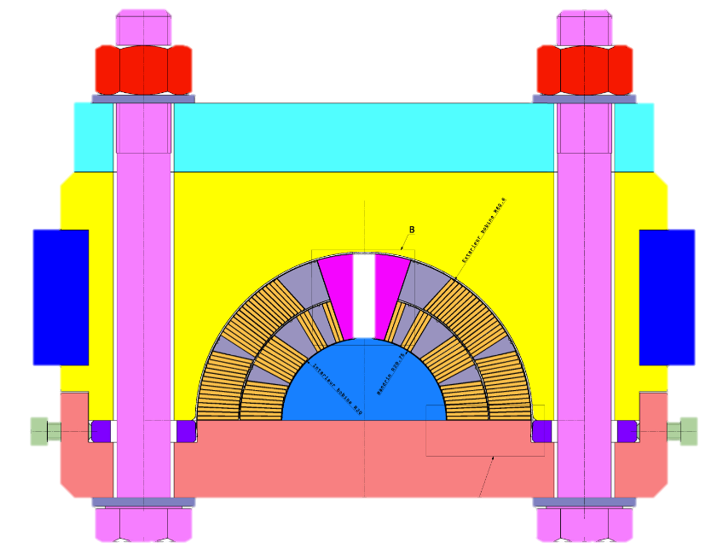
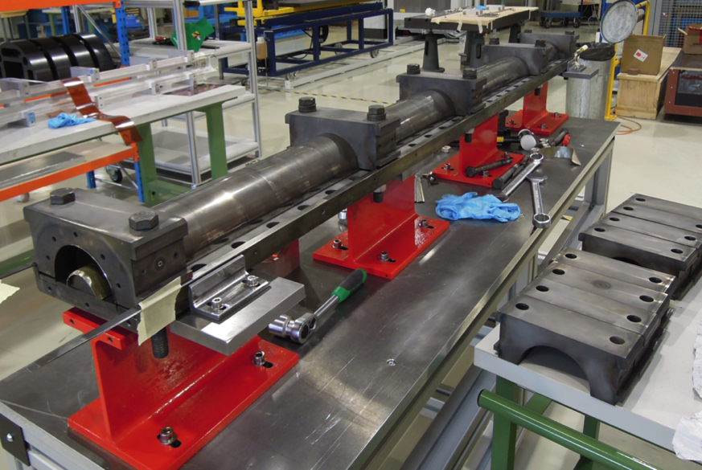
Reaction Fixture
Difference between coils 105-106-107
Coil 105 reacted in tool #1
Coil 106 reacted in tool #2
Coil 107 reacted in tool #2
Mica setup, cavity size: similar
105,106,107 NOSIG
NOSIG: No SIGnificant change

Slide 8
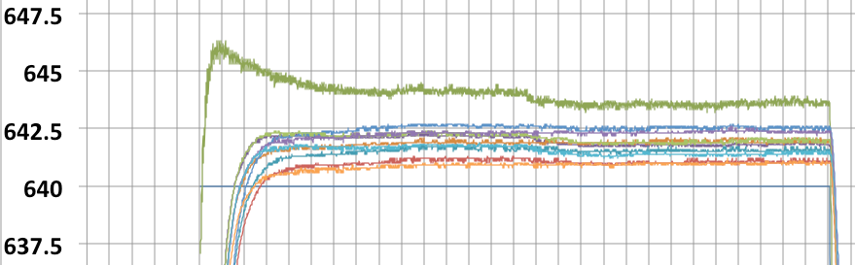
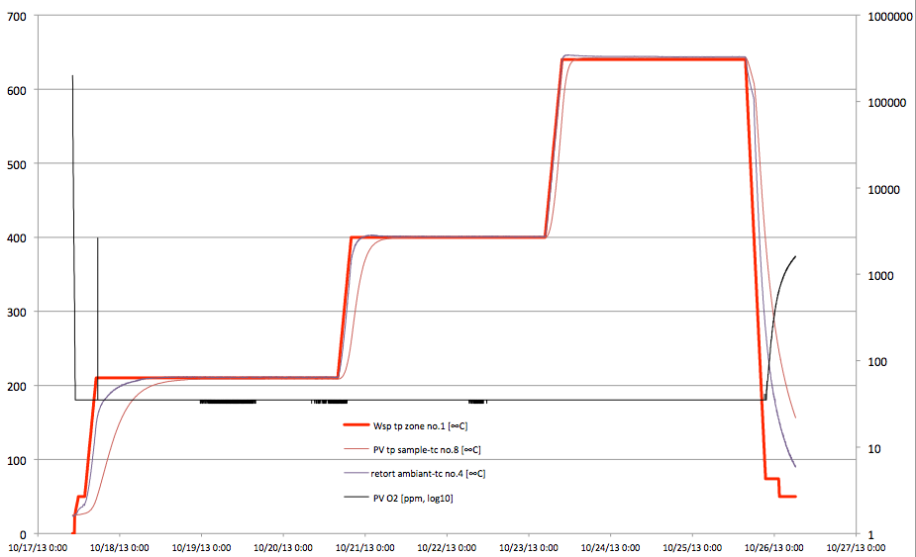
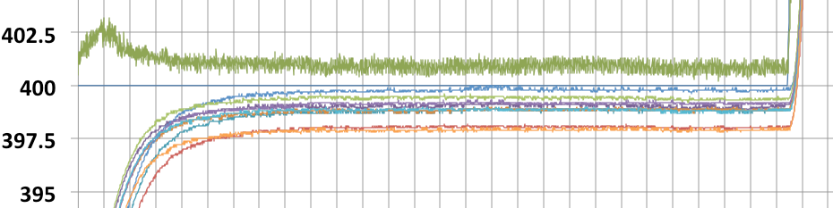
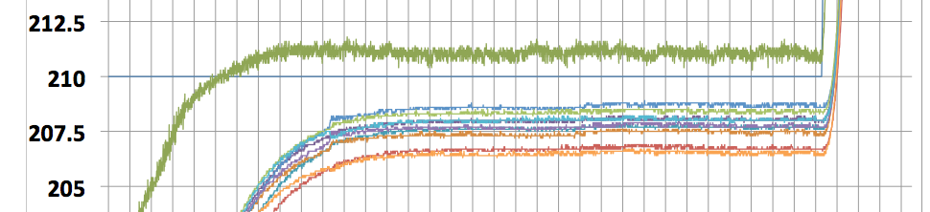
Reaction Cycle 105
Coil 105
OST RRP108/127
48h 210°C / 48h 400°C / 48h 640°C
Reaction date coil 105: Oct 2013
To be completed
Dwell duration
corrected to compensate for the inertia of the oven
71h 210°C / 57h 400°C / 54h 640°C
Sensor Calibration:
Previous calib. date: Sept.2012
Latest calibration: Nov. 2014 measured calibration drift at 640C : +6C
O₂ [ppm] (log₁₀ scale)
Green curve: Gas T in retort

Slide 9
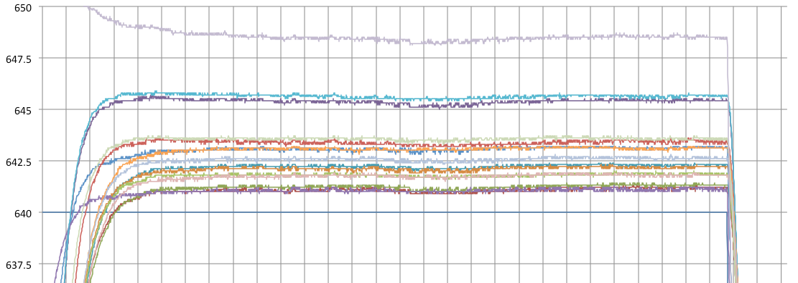
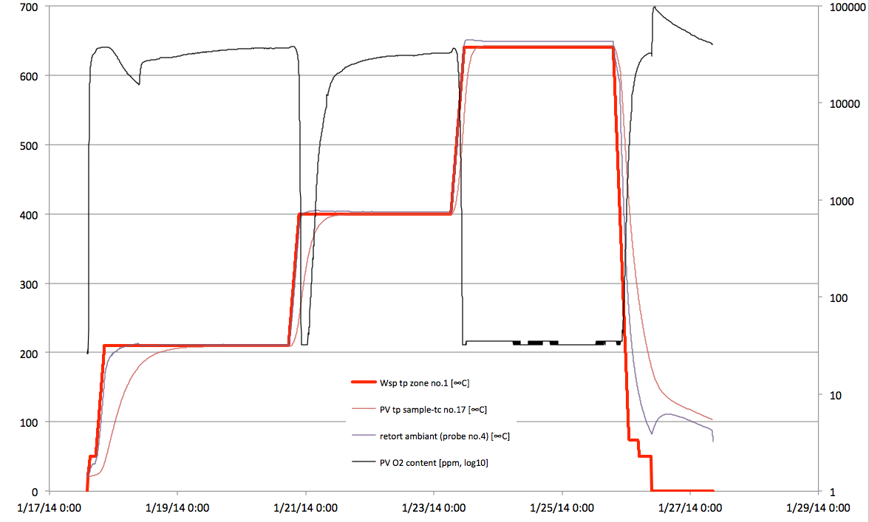
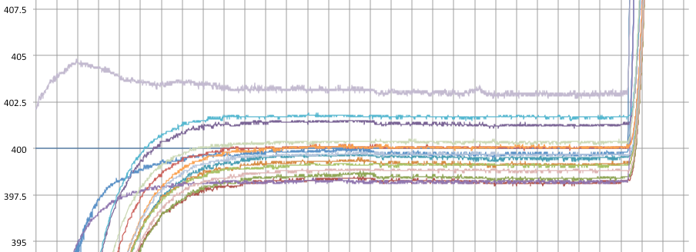
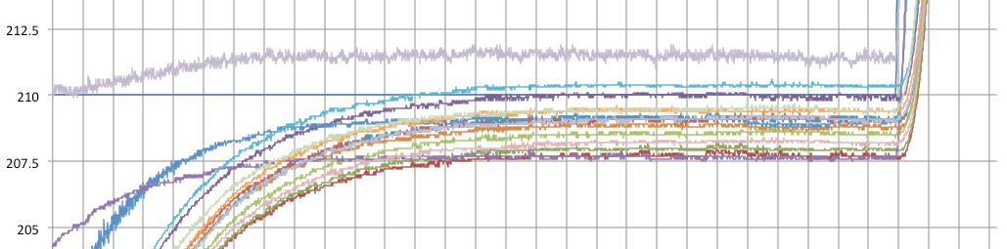
Reaction Cycle 106
O₂ [ppm] (log₁₀ scale)

Slide 10
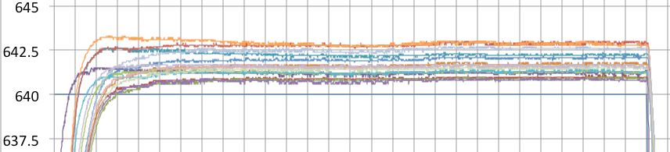
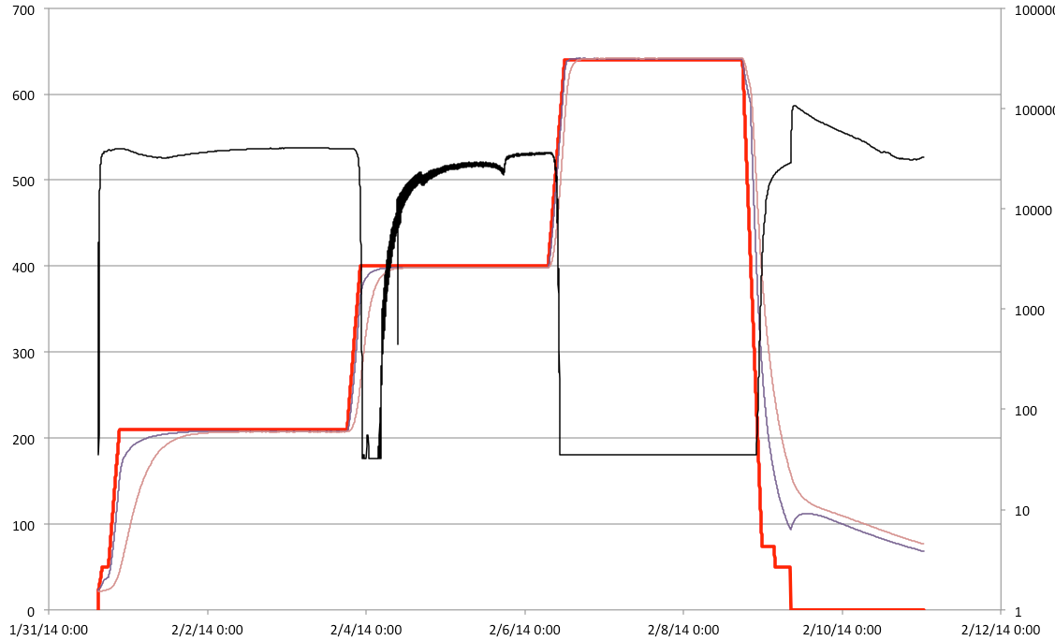
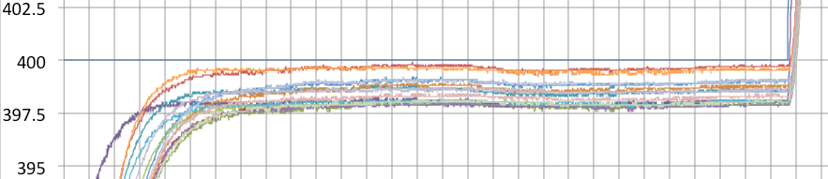
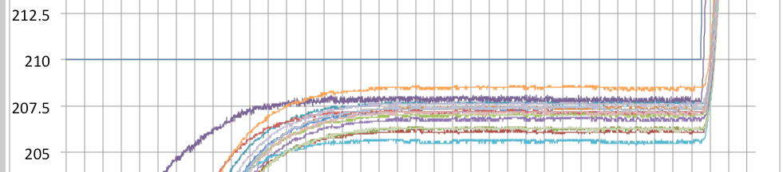
Reaction Cycle 107
O₂ [ppm] (log₁₀ scale)
105,106,107 NOSIG ; (O2 Sensor ?)

Slide 11
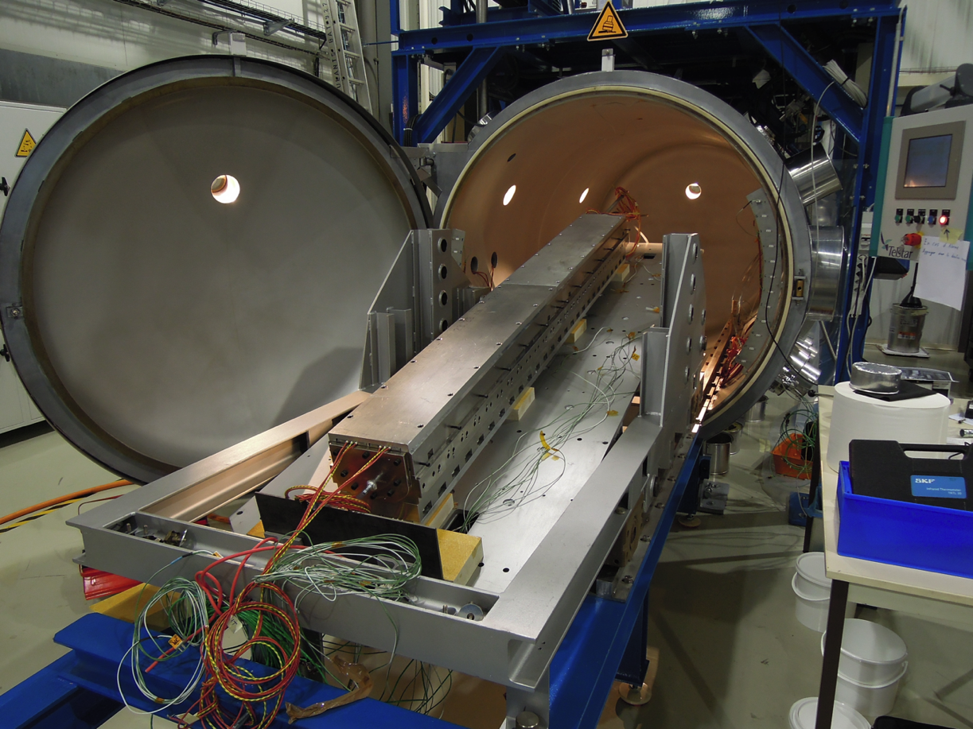
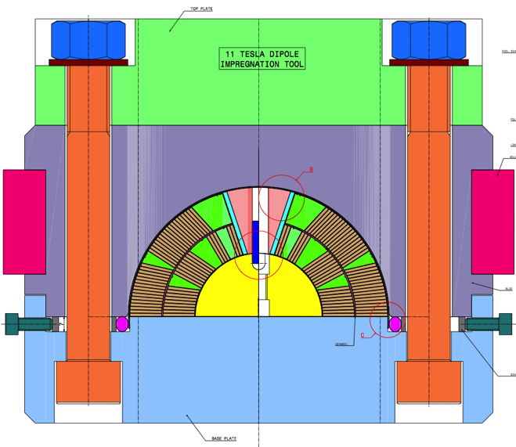
Tooling: Impregnation
 | 105 | 106 | 107
Insulated cable, ovesized insul. | +2% | +2% | +2%
Overcompression at curing | none | none | none
Ground wrap IL/OL | 0.1 / 0.1 | 0 / 0 | 0.1 / 0.1
Mitigation | Tool closed w/ shim | No ground wrap | Shorter seal foil
Result | Coil oversized | Good | Dry Spots
Coil 105,106 and 107 potted in tool #1
Tool#1: cavity radius 0.04 mm too small, and cavity center is 0.052 mm too low;
Cable Insulation is slightly oversized (0.115 instead of 0.1 mm wall thickness)
105,106,107, each followed a different solution to fit tool size

Slide 12
Summary
Coil generation 105/106/107 was made in 2013; improvements were already envisaged and some have already been implemented (see next slide);
105/106/107 are very similar coils, apart from ground wrap/impregnation quality;
Investigation on problems with coil 107 is based on data mining . No specific issue spotted for coil 107 apart from its dry spots
Waiting for coils 106 & 107 to be out of the magnet to detect anomalies;
Study of the geometry of impregnation tools is ongoing. Likely, impregnation tool #1 should be reworked (or not used anymore)

Slide 13
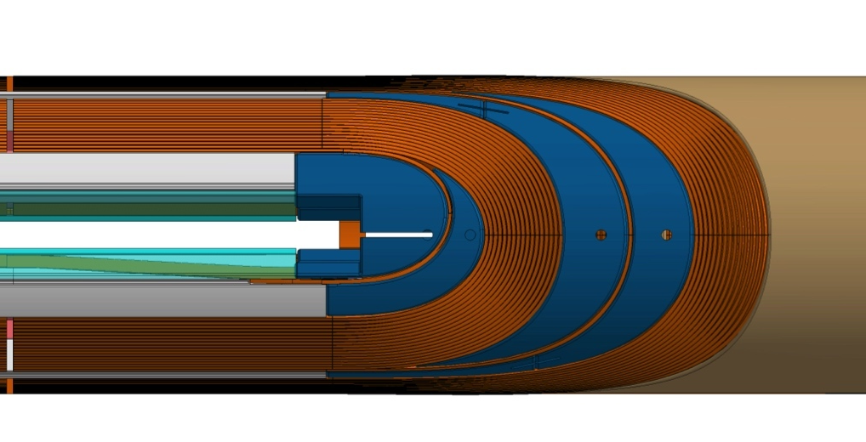
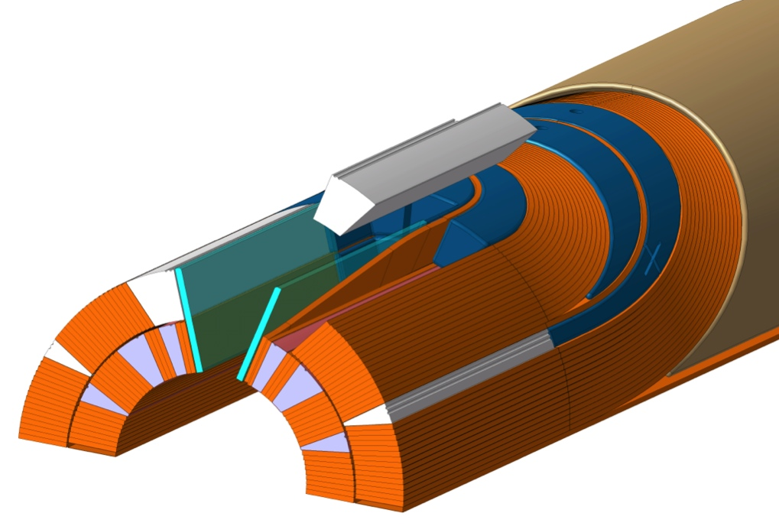
What’s going on and What’s next?
Winding:
0.107 mm instead of 0.115 (coil 108>)
Layer jump not clamped (1) (coil 111>)
No binder in the heads (no heatgun) (2) (coil 108>)
Reduce Gap for wedges (3) (coil 112>)
Wedges placed against spacers(3) (coil 112>)
Wedges not segmented (1.5 m long) (coil 112>) (option, tbc)
Curing:
Over-compression @ curing (+0.5mm) (coil 108>)
Reaction
Regularly Calibrated thermocouples (coil 109>)
More Witness samples (coil 109>)
O2 monitoring replacement (coil 112>) (tbc)
Impregnation
Better filling of gaps with dry fibre (3) (coil 109>)
Layer Jump support made from G11 (4) (coil 109>)
No ground wrap OL (coil 109>) (tbc)
Instrumentation
New Trace generation (VT) (coil 108>)
Less VTs on OL (coil 109>) (tbc)
Less glue to fix the trace (coil 109>) (tbc)
4
2
3
1
1
3

Slide 14
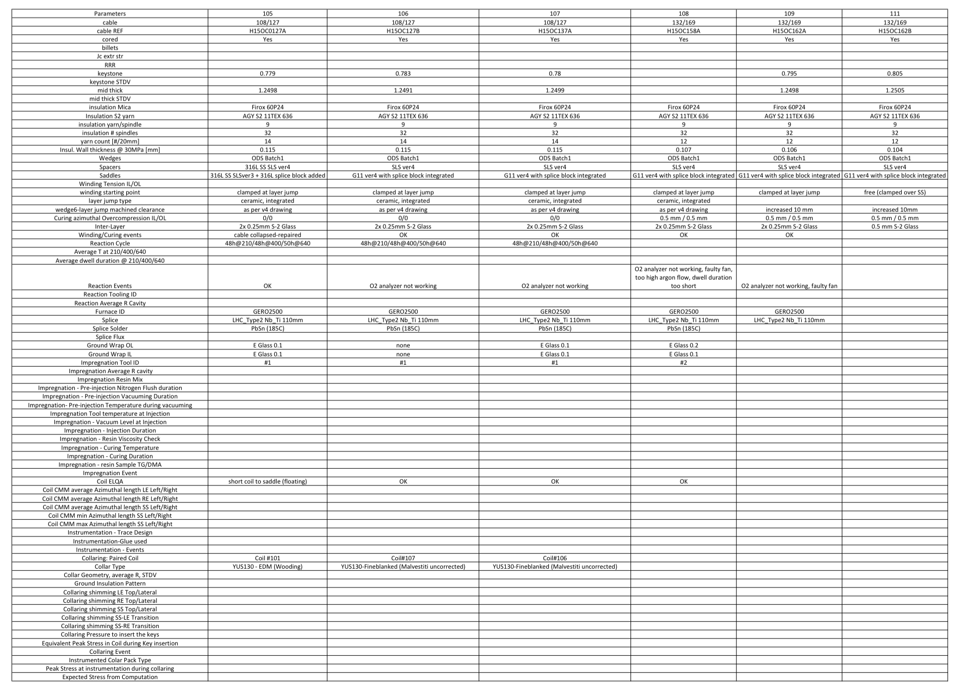
Parameters in play (many !)
Preparing comparison charts with relevant parameters. Study Ongoing. >70 parameters to study for a collared coil system

