Slide 1
Magnetic measurement and analysis on MBHSP101
L. Fiscarelli
Debriefing meeting on cold tests 27.01.2015

Slide 2
Outline
Magnetic measurement systems
Measurement results
  At cryogenic temperature
    TF
    Allowed multipoles
    Other multipoles
    σ of multipoles and mechanical tolerances
    Ramp rate dependence
    Magnetization
    Field repeatability
    Effect of temperature
  At ambient temperature (new results)
    Cold/warm correlation
New measurement shafts (update)
Conclusions

Slide 3
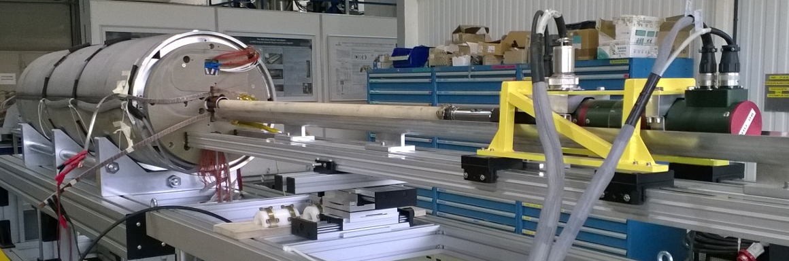
Measurement system 300 K
  Motor + encoder + slip-ring unit (MRU)
  Fast Digital Integrator (FDI)
  FuG low voltage power supply (40 V, 20 A)
  DCCT Hitec MACC-plus
  Search coil shafts (radius 22 mm, length 1.2 m)
  Flexible software Framework for Magnetic Measurements (FFMM)
Number of turns | (-) | 256
Inner width | (mm) | 13.41
Inner length | (mm) | 1195.6
Groove thickness | (mm) | 1.4
Magnetic surface | (m²) | 3.3669
Center radius | (mm) | 21.330
  A measurement is an average over 1.2 m

Slide 4
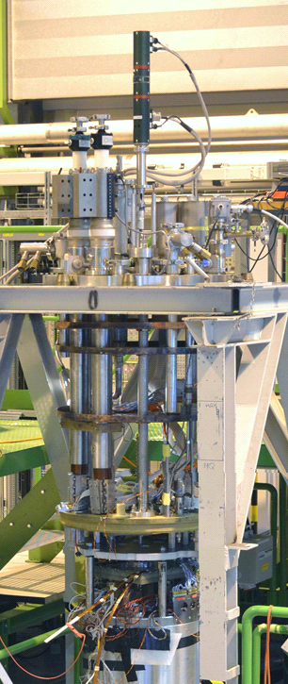
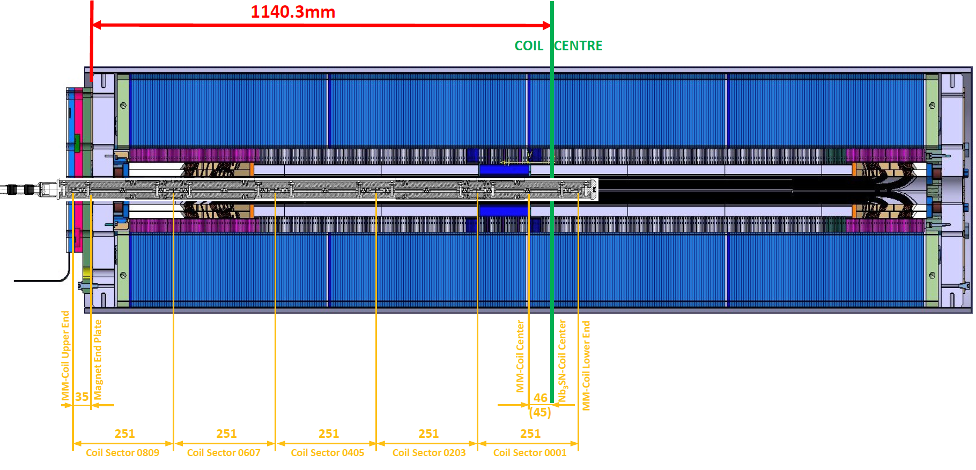
Measurement system 1.9 K
  Flexible software Framework for Magnetic Measurements (FFMM)
  Fast Digital Integrators (FDI)
  Motor + encoder + slip-ring unit (MRU)
  Vertical rotating shaft in liquid He
Number of turns | (-) | 150
Inner width | (mm) | 6.43
Inner length | (mm) | 250.00
Groove thickness | (mm) | 0.80
Magnetic surface | (m²) | 0.28197
Center radius | (mm) | 18.91
  A measurement is an average over 250 mm
pos.
5
pos.
4
pos.
3
pos.
2
pos.
1

Slide 5
Transfer function
Measurements vs model
Ambient temperature
I | 20 |  | A
center | +50 |  | units
1.9 K
I | 4 | 11 | kA
pos. 1 | -32 | +21 | units
pos. 2 | -27 | +29 | units
pos. 3 | -40 | +29 | units
At 1.9 K
-30 units measured on geometric
+55 units measured on saturation at 11 kA
At 300 K
+50 units measured on geometric

Slide 6
Allowed multipoles
Stair-step cycle
Simulated machine cycle
25 unit of change during up-ramp from 760
Decay and snap─back of ~1.2 units
  Reference radius 17 mm

Slide 7
Other multipoles
 |  | pos 1 |  | pos 2 |  | pos 3
 | Temp. | 1.9 |  | 1.9 |  | 1.9 |  | K
 | TF | 9.930E-04 |  | 9.934E-04 |  | 9.922E-04 |  | T/A
 | n | bn | an | bn | an | bn | an
 | 2 | 0.86 | 5.47 | -0.59 | 5.11 | -2.14 | 4.66 | units at 17 mm
 | 3 | 6.35 | -1.21 | 5.25 | -0.78 | 4.60 | -1.75
 | 4 | 0.30 | 1.72 | -0.51 | 0.99 | -0.19 | -0.26
 | 5 | 1.49 | 0.01 | 1.43 | 0.43 | 0.72 | 0.48
 | 6 | 0.01 | 0.49 | -0.15 | 0.70 | 0.04 | 0.49
 | 7 | -0.06 | -0.19 | -0.22 | -0.07 | 0.13 | 0.11
 | 8 | -0.01 | 0.10 | -0.02 | 0.01 | 0.03 | -0.01
 | 9 | 0.89 | -0.20 | 0.85 | -0.32 | 0.80 | -0.33
 | 10 | 0.00 | -0.00 | -0.01 | 0.00 | -0.02 | 0.01
 | 11 | 0.37 | -0.06 | 0.37 | -0.12 | 0.39 | -0.14
  Reference radius 17 mm

Slide 8
σ of multipoles and tolerances
 |  | measurements |  | tolerances
 | σ TF | 6.23 |  | - |  | units at 17 mm
 | n | σ bn | σ an | σ bn | σ an
 | 2 | 1.50 | 0.41 | 1.70 | 1.82
 | 3 | 0.88 | 0.49 | 1.08 | 1.18
 | 4 | 0.41 | 1.00 | 0.62 | 0.67
 | 5 | 0.43 | 0.26 | 0.35 | 0.39
 | 6 | 0.10 | 0.12 | 0.17 | 0.20
 | 7 | 0.18 | 0.15 | 0.10 | 0.10
 | 8 | 0.03 | 0.06 | 0.06 | 0.05
 | 9 | 0.04 | 0.07 | 0.03 | 0.02
 | 10 | 0.01 | 0.00 | 0.01 | 0.01
 | 11 | 0.01 | 0.05 | 0.01 | 0.01
σ of measured multipoles is compatible with random block displacements of 60 μm
small sample size for statistics
  Reference radius 17 mm

Slide 9
Ramp rate dependence
Small ramp-rate effects both on TF and multipoles.
Stainless steel core works well.
A/s | 0 | 10 | 20 | 40 | 80 | 0 | 10 | 20 | 40 | 80
 | Δ b_{n} at 5 kA (units) |  |  |  |  | Δ a_{n} at 5 kA (units)
1 | 0.00 | 1.01 | 1.71 | 3.73 | 8.27
2 | 0.00 | 0.10 | 0.05 | -0.03 | -0.20 | 0.00 | -0.05 | -0.11 | -0.12 | -0.13
3 | 0.00 | 0.03 | 0.05 | 0.06 | 0.16 | 0.00 | 0.02 | -0.04 | -0.15 | -0.30
4 | 0.00 | 0.02 | 0.05 | 0.09 | 0.21 | 0.00 | 0.01 | 0.02 | 0.04 | 0.10
5 | 0.00 | -0.04 | -0.05 | -0.10 | -0.17 | 0.00 | 0.00 | 0.00 | -0.01 | -0.01
6 | 0.00 | 0.00 | 0.00 | 0.05 | 0.10 | 0.00 | 0.01 | 0.02 | 0.02 | 0.01
7 | 0.00 | 0.02 | 0.00 | 0.01 | 0.00 | 0.00 | -0.03 | -0.01 | -0.03 | -0.01
8 | 0.00 | 0.03 | 0.03 | 0.04 | 0.05 | 0.00 | 0.01 | 0.00 | 0.02 | 0.01
9 | 0.00 | 0.00 | 0.00 | 0.01 | 0.01 | 0.00 | 0.00 | 0.01 | 0.01 | 0.04
10 | 0.00 | 0.00 | 0.00 | 0.00 | 0.00 | 0.00 | 0.00 | 0.00 | 0.00 | 0.00
  Reference radius 17 mm

Slide 10
Magnetization at 1.9 K
Difference on measured/modelled magnetization contribution on TF
Better agreement on b₃
  Reference radius 17 mm

Slide 11
Field repeatability
Above injection level the field is repeatable within the measurement precision both for TF and multipoles
  Reference radius 17 mm

Slide 12
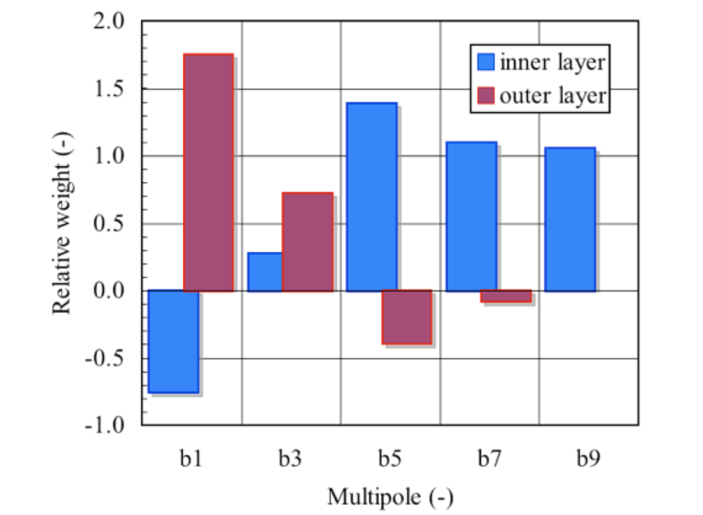
Effect of temperature
Magnetization contribution results to be
  larger at 1.9 K on TF
  smaller at 1.9 K on b₃
Measurements at 4.3 K show noise due to flux jumps
Courtesy of L. Bottura

Slide 13
Field repeatability at low field
At 1.9 K
Noise up to 600 A
Both on TF and multipoles
At 4.3 K
No noise at low current
Noise of smaller amplitude at higher current

Slide 14
Cold/warm correlation (centre)
 |  | centre |  |  | average 1,2,3 |  |  | centre
 | Temp. | 300 K |  |  | 1.9 K |  |  | 300 K
 | TF | 9.987E-04 |  |  | 9.929E-04 |  |  | 9.996E-04
 | n | bn | an |  | bn | an |  | bn | an
 | 2 | -0.13 | 3.73 |  | -0.62 | 5.08 |  | -0.05 | 2.32
 | 3 | 7.00 | -0.11 |  | 5.40 | -1.25 |  | 3.59 | -0.26
 | 4 | 0.16 | -2.60 |  | -0.13 | 0.82 |  | -0.10 | 0.39
 | 5 | 0.14 | 0.00 |  | 1.21 | 0.31 |  | 1.14 | 0.02
 | 6 | -0.03 | 0.25 |  | -0.03 | 0.56 |  | 0.00 | 0.23
 | 7 | 0.18 | 0.00 |  | -0.05 | -0.05 |  | -0.01 | -0.03
 | 8 | -0.09 | -0.21 |  | 0.00 | 0.03 |  | 0.00 | -0.02
 | 9 | 0.76 | 0.01 |  | 0.85 | -0.28 |  | 0.73 | -0.04
 | 10 | -0.07 | -0.08 |  | -0.01 | 0.00 |  | 0.02 | -0.02
 | 11 | 0.34 | 0.04 |  | 0.38 | -0.11 |  | 0.32 | 0.02
  Reference radius 17 mm

Slide 15
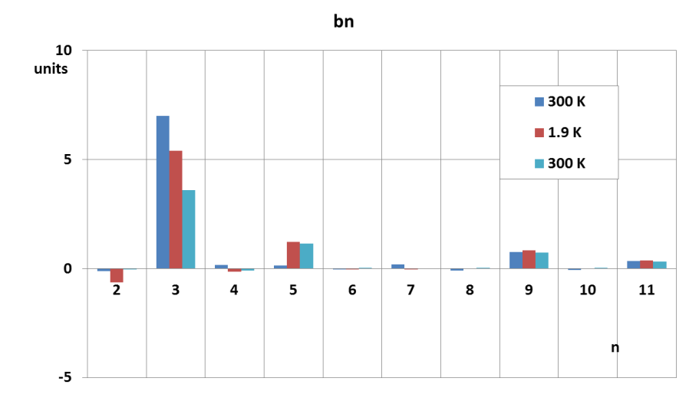
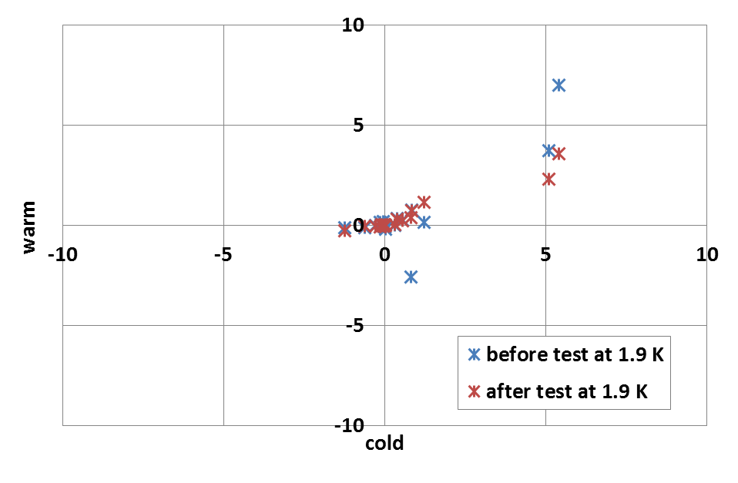
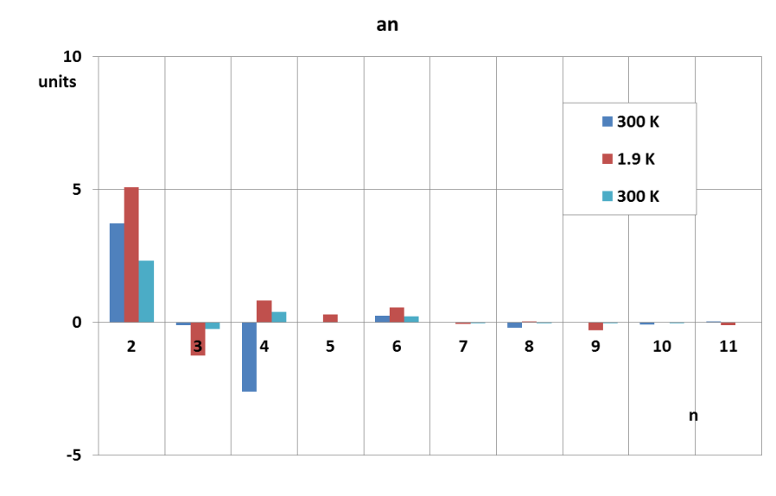
Cold/warm correlation (centre)
  Changes on multipoles before/after test at cold
  Better cold/warm correlation with results taken at warm after cold tests
  Anyway not perfect correlation
  Reference radius 17 mm

Slide 16
Cold/warm correlation (half magnet)
 | half magnet |  |  | half magnet |  |  | half magnet
Temp. | 300 K |  |  | 1.9 K |  |  | 300 K
TF | 7.35E-04 |  |  | 7.47E-04 |  |  | 7.36E-04
n | bn | an |  | bn | an |  | bn | an
2 | 2.38 | 4.57 |  | -0.68 | 3.89 |  | -2.07 | 2.28
3 | 10.56 | -2.12 |  | 8.77 | -2.63 |  | 6.80 | -2.08
4 | 0.33 | -2.78 |  | -0.12 | 0.70 |  | -0.44 | 0.43
5 | -0.96 | 0.22 |  | 1.28 | 0.43 |  | 0.15 | 0.22
6 | -0.03 | 0.33 |  | -0.05 | 0.46 |  | 0.07 | 0.18
7 | 0.30 | -0.12 |  | 0.10 | -0.01 |  | 0.09 | -0.12
8 | 0.05 | -0.08 |  | -0.02 | 0.02 |  | -0.01 | -0.01
9 | 0.55 | -0.02 |  | 0.72 | -0.30 |  | 0.57 | -0.03
10 | 0.00 | 0.00 |  | -0.01 | 0.01 |  | 0.01 | -0.02
11 | 0.23 | 0.02 |  | 0.33 | -0.09 |  | 0.24 | 0.02
  Reference radius 17 mm

Slide 17
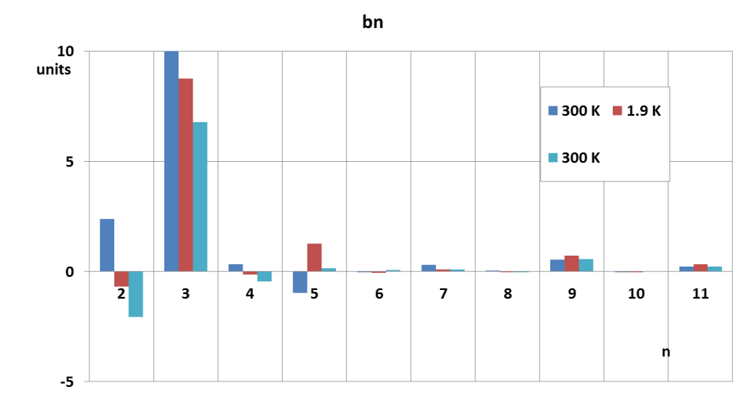
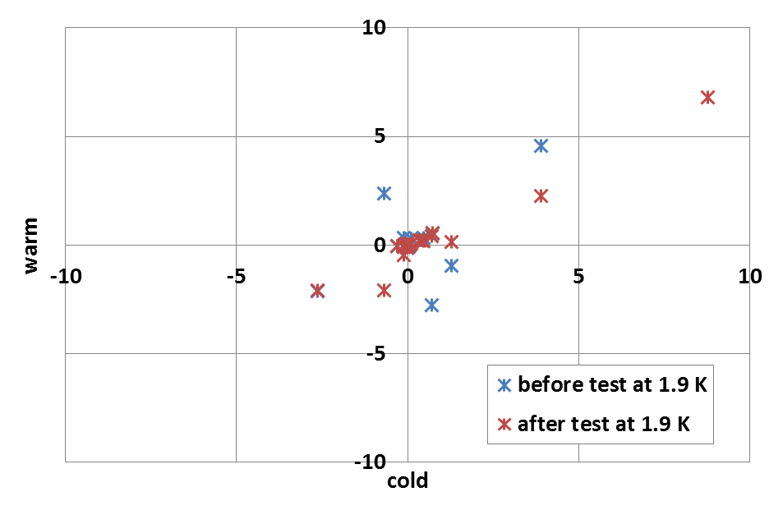
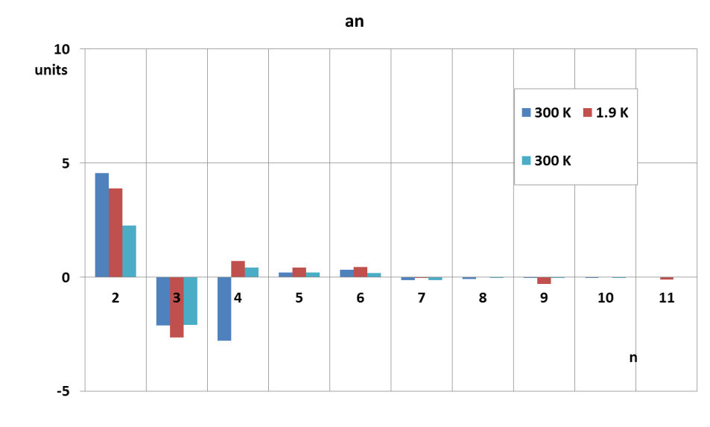
Cold/warm correlation (half magnet)
  Changes on multipoles before/after test at cold
  Better cold/warm correlation with results taken at warm after cold tests
  Reference radius 17 mm

Slide 18
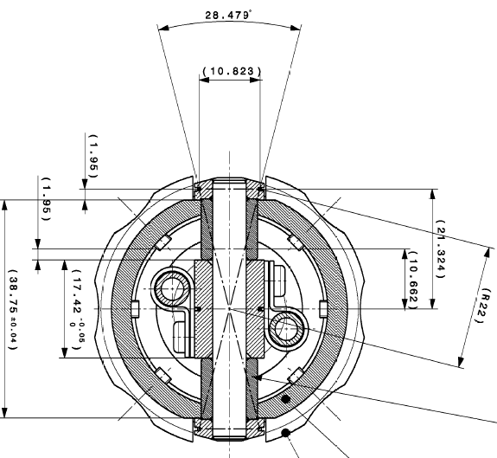
New shaft for 2-m models at 1.9 K
Design
7 sectors
Dipole compensation scheme (3 tangential coils/sector)
l = 434 mm to cover the coil heads, end field and splice region
l = 249 mm in the straight part
Measurement radius of 22 mm
Full rotation symmetry for high rotation speed
Possible use for quench location
Production baseline
Parts already Delivered
Coil winding on going - issue on compensation coils
New parts ordered
Assembly and Calibration Feb. 2015
Shaft operational Mar. 2015

Slide 19
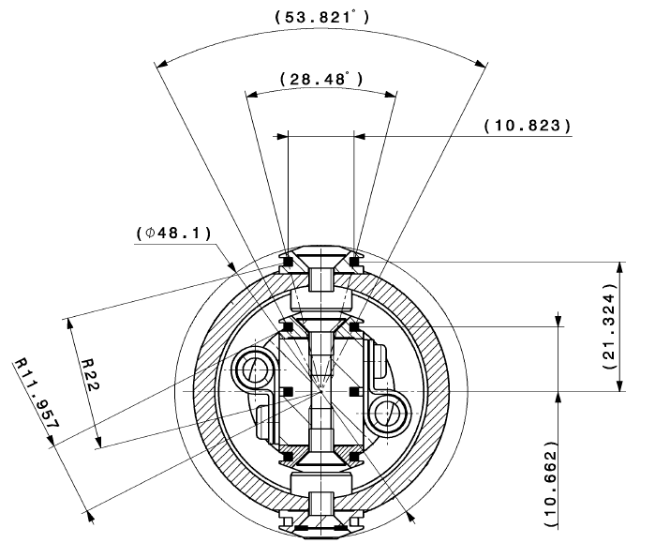
New shaft for models at 300 K
Shaft design
3 sectors, l = 130 mm/each
5 tangential coils/sector – due to an existing standard
Measurement radius 22 mm
Horizontal position
Production baseline
Design ready
Delivery expected next weeks
Coil winding Feb. 2015
Assembly and Calibration Mar. 2015
Shaft operational Apr. 2015

Slide 20
Conclusions
MBHSP101 has been tested at
  ambient temperature
  cryogenic temperature
  Measured geometric TF is in general agreement with model
  Saturation seems to be overestimated by the model
  Difference on measured/modelled magnetization contribution on TF
  Allowed multipoles are in agreement with model
Non-allowed are compatible with mechanical tolerances of 60 μm
Low ramp rate dependence (as expected)
Noise from flux jumps noticeable (?)
Cold/warm correlation improves after tests at 1.9 K (?)

Slide 21
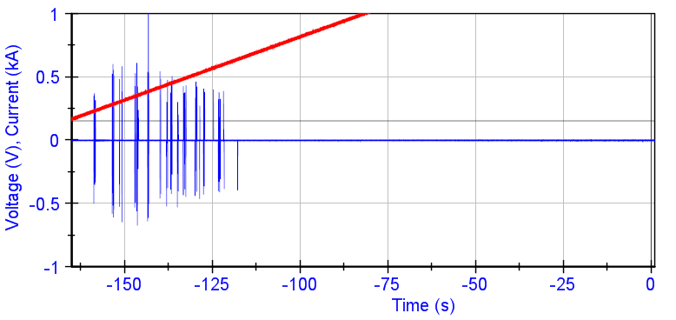
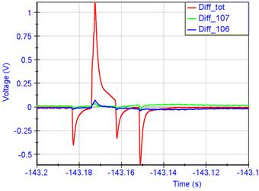
Annex 1: voltage jumps at 1.9 K
Courtesy of G. Willering

Slide 22
Annex 2: current cycles

Slide 23
Annex 3: b2 as function of current

Slide 24
Annex 4: a2 as function of current

Slide 25
Annex 5: b4 as function of current

Slide 26
Annex 6: a4 as function of current

