Slide 1

7-module Micromegas TPC test, results with a new resistive material
Deb Sankar Bhattacharya , on behalf of LC-TPC collaboration

Slide 2
Preview
LP-TPC in brief
Resistive foil Micromegas
Results
2 Phase CO2 cooling results

Slide 3
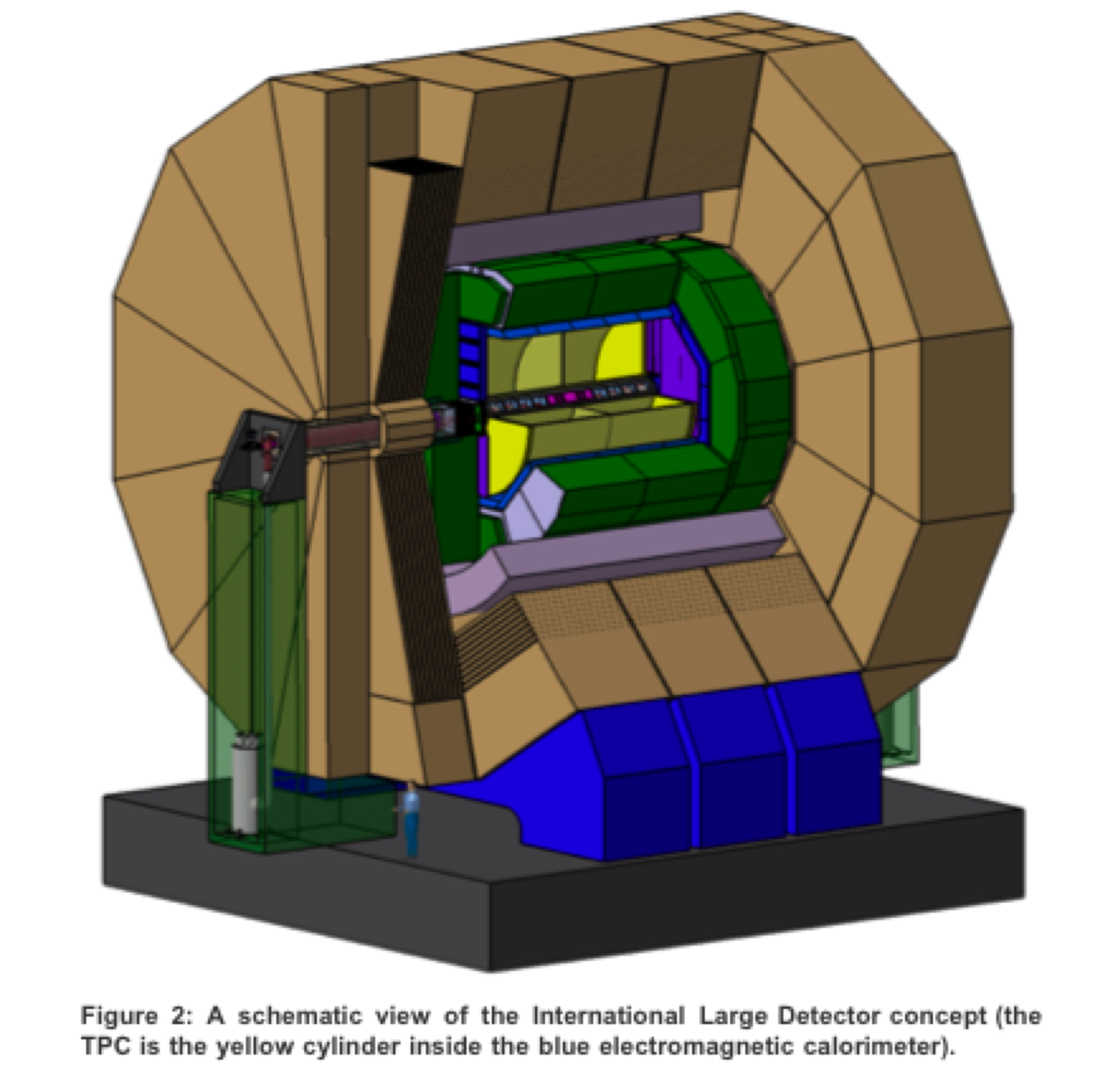
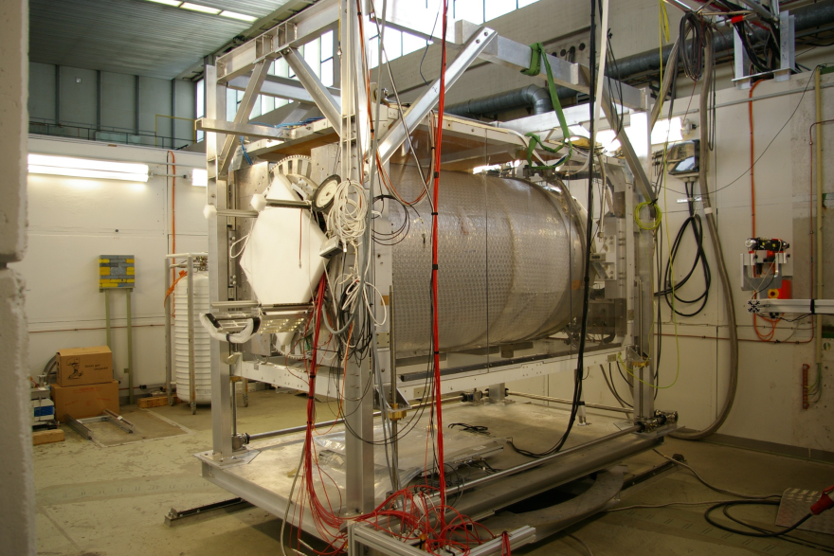
Proposed ILD
Large Prototype TPC at DESY
with 5 GeV electron beam
And 1 Tesla magnetic field

Slide 4
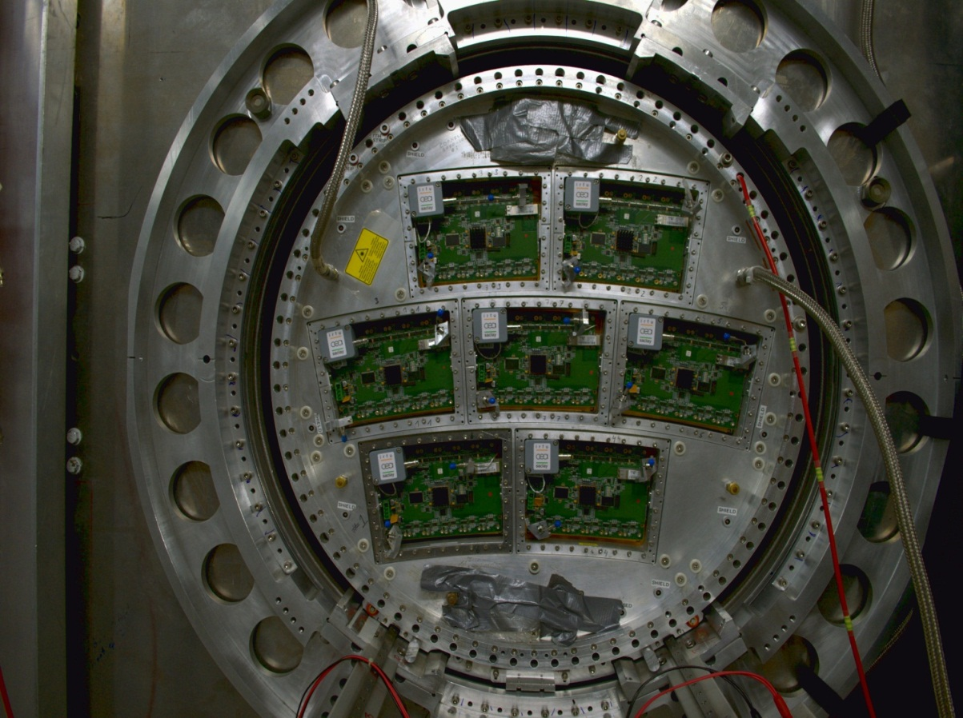
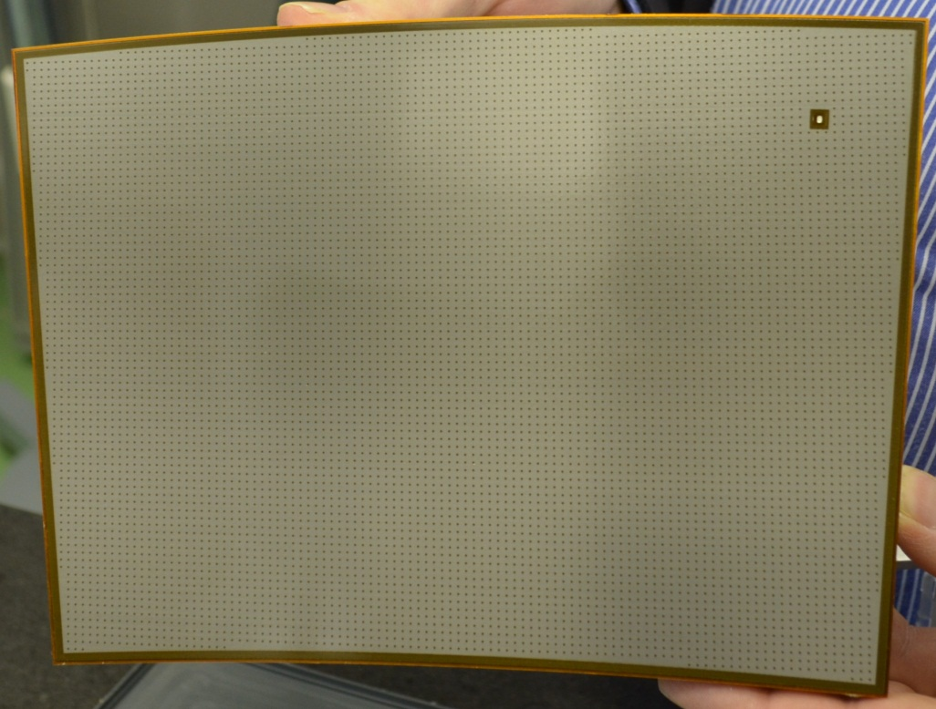
End plate of LP TPC
Micromegas module
Module size: 22 cm × 17 cm
24 rows × 72 columns
Readout: 1726 Pads
Pad size: ~3 mm × 7 mm

Slide 5
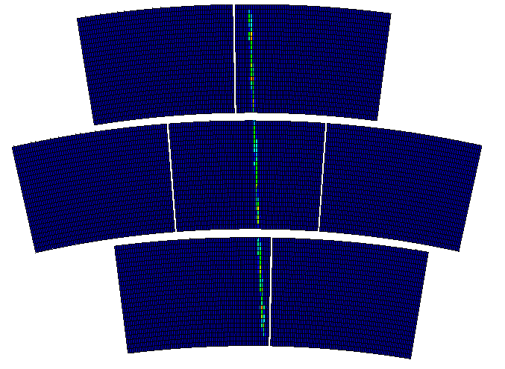
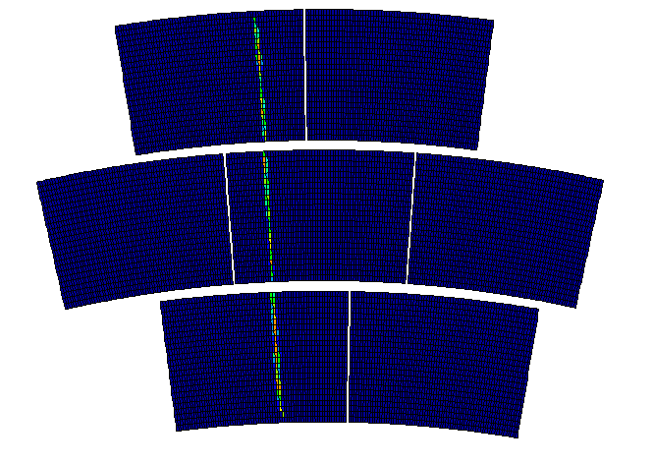
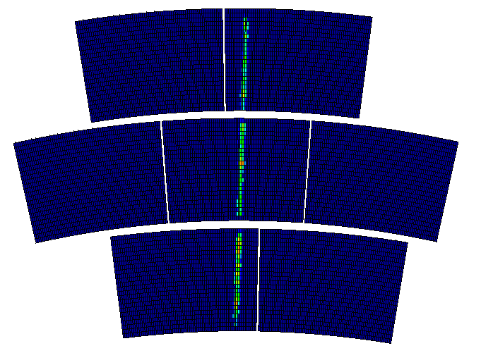
The first 2 weeks of this month we took data at different positions
At x = 30 mm
At x = -40 mm
At phi = 4

Slide 6


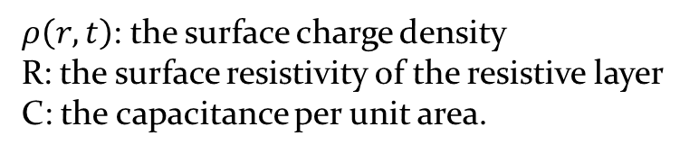
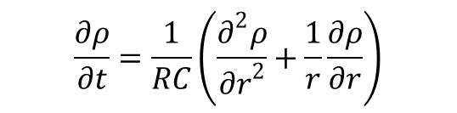
For bulk Micromegas, resolution
$$σ=w/√12$$
We are using resistive foil Micromegas where charge is dispersed
Equation for surface charge density function on the 2D continuous RC network:
$$\frac{∂ρ}{∂t}=\frac{1}{RC}\left(\frac{∂^{2}ρ}{{∂r}^{2}}+\frac{1}{r}\frac{∂ρ}{∂r}\right)$$
$ρ\left(r,t\right)=\frac{RC}{2t}exp\left(\frac{−r^{2}RC}{4t}\right)$
$ρ\left(r,t\right)$: the surface charge density
R: the surface resistivity of the resistive layer
C: the capacitance per unit area.

Slide 7


mesh
B
E
Amplification gap: ~100μm
resistive foil: ~75μm
$$σ=√(2t/RC)$$
insulator: ~100μm
pads
When values of R, C, t are applied,
It gives,
Charge dispersion $≅$ 2 mm
A new kind of resistive foil called Diamond Like Carbon is provided by Ochi
and two new Micromegas modules called ‘Black Diamond’ is prepared at Rui’s workshop.

Slide 8
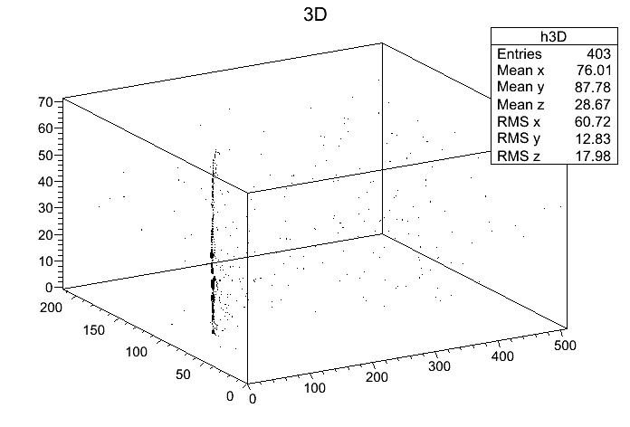
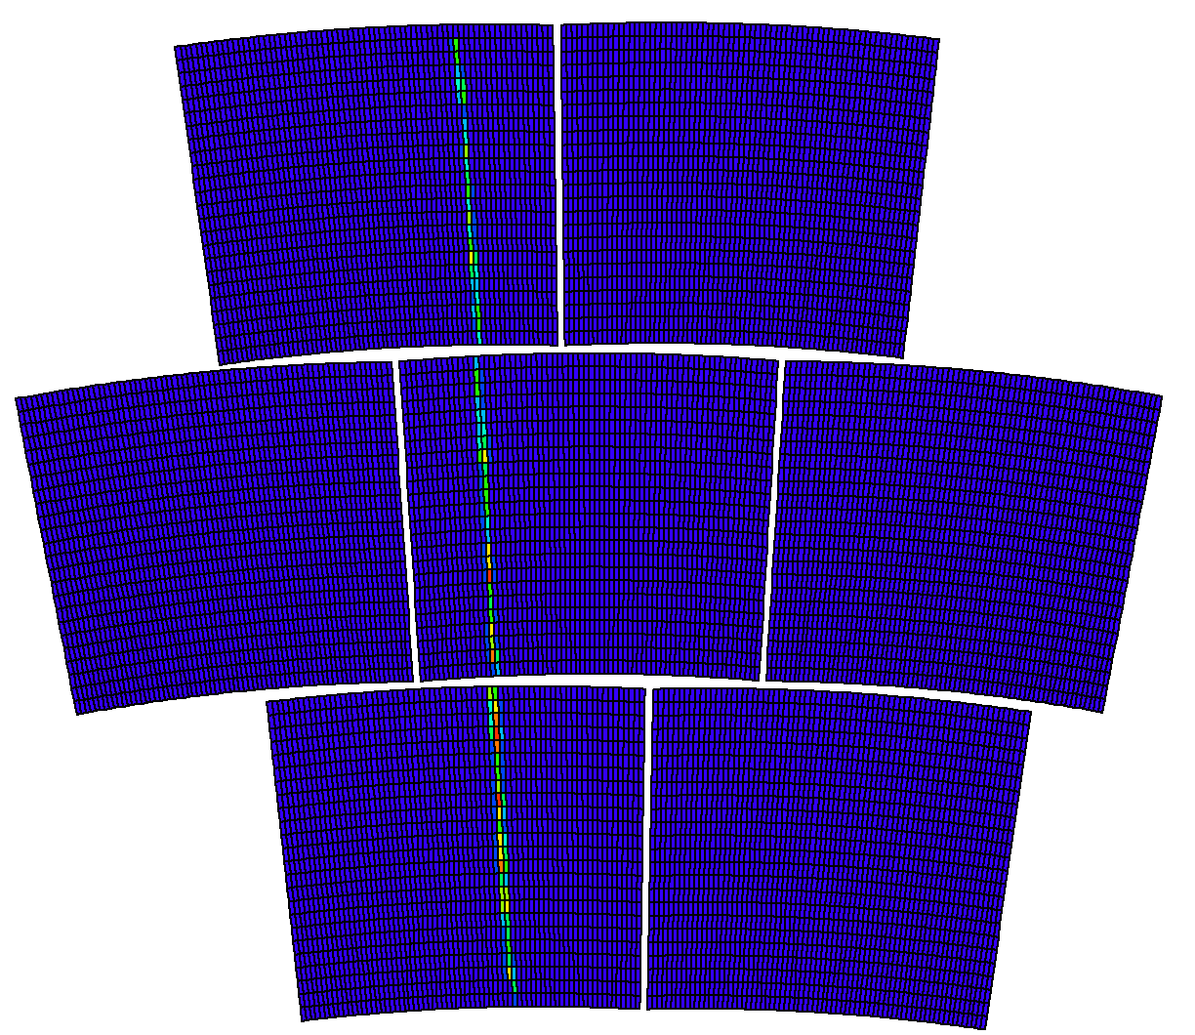
Track in 3-D space
Track on 7-module Micromegas
5-GeV electron beam
5-GeV electron beam

Slide 9
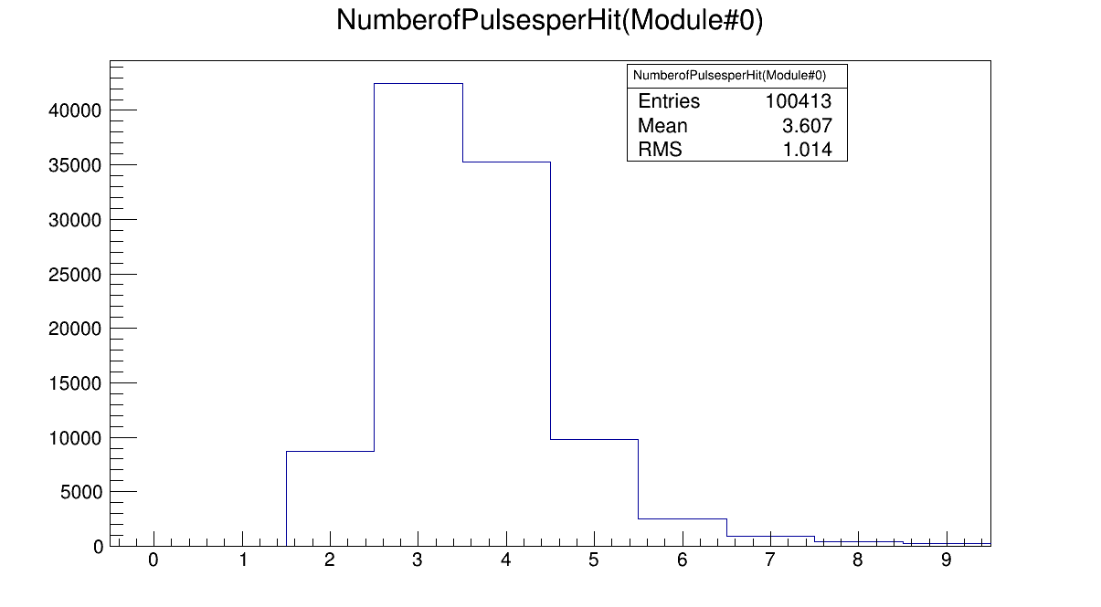
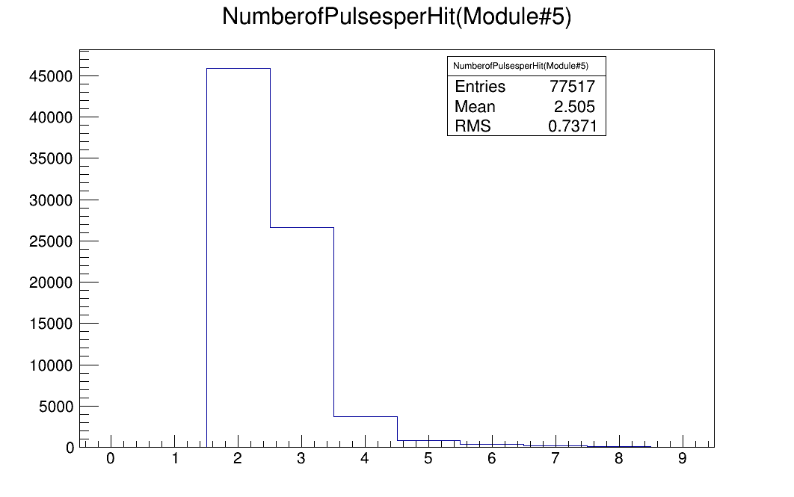
Number of Pulses per Hit
Comparison of Black Diamond and the old modules
RUN-05125, Drift field=140 v/cm, peaking time=100 nano second, B=1 T
Average pulse per hit =3.607
Average pulse per hit = 2.505
Diamond like carbon
Carbon loaded Kapton

Slide 10
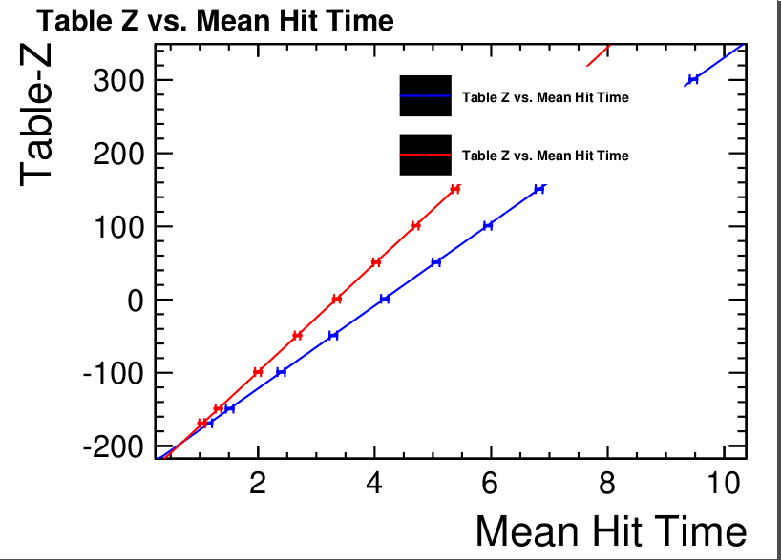
Measurement of drift velocity and T0
T0
micro second

Slide 11
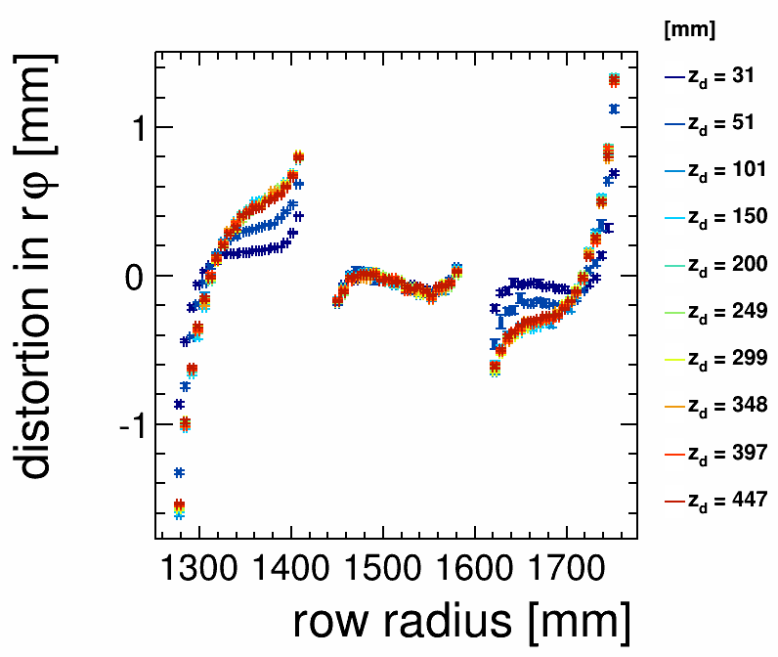
Distortion in r_phi
low field, B=1T, peaking time 100 ns, phi=0

Slide 12
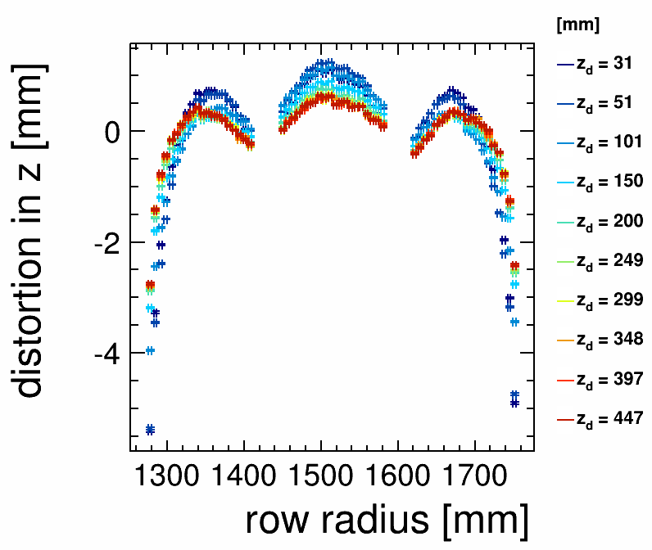
Distortion in Z
low field, B=1T, peaking time 100 ns, phi=0

Slide 13
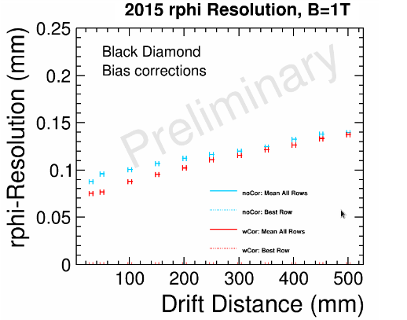
Resolution vs drift distance
Preliminary
Track fitting is done by ‘RowTripletBasedTrackFinder’

Slide 14
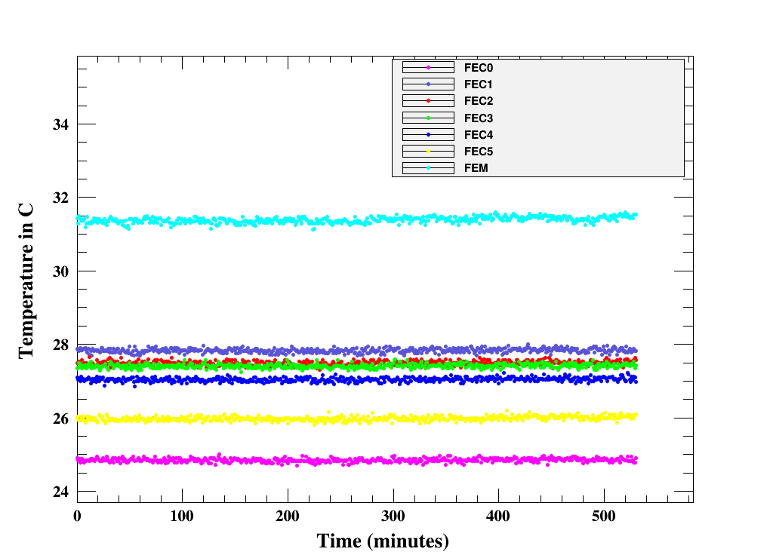
Temperature of all the FECs and the FEM of Module 6
Module 6

Slide 15
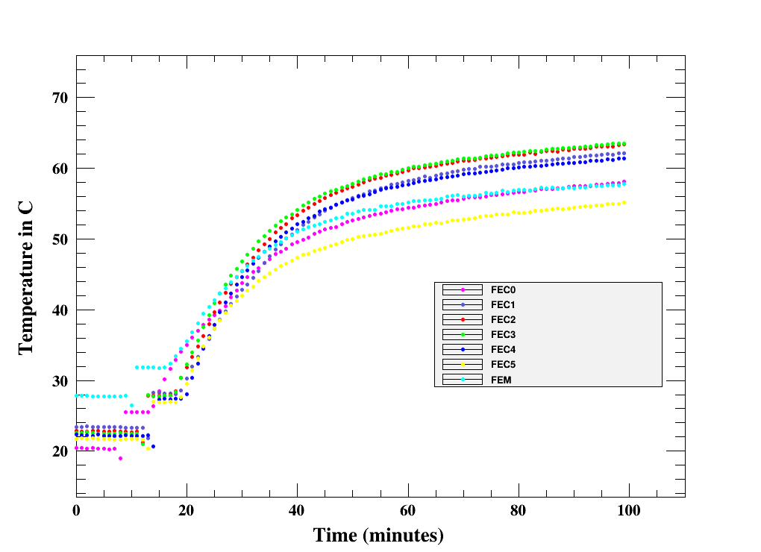
Rise of temperature when the cooling is stopped
Module 6

Slide 16
Summary
All the 7 Micromegas modules are well used to take data in different configurations.
In 1 Tesla field, the space resolution of Micromegas modules is below 100 micron.
Work in progress for more results.
Two Micromegas modules with resistive layer of Diamond Like Carbon (DLC)
have been tested and the result is satisfactory.
2 Phase CO2 cooling is used uninterruptedly for more than 80 hrs. Temperature of
individual Front End Cards (FECs) is stable within 0.5 degree C during the
experiment.
For better performance, the modules will be updated in near future.

Slide 17
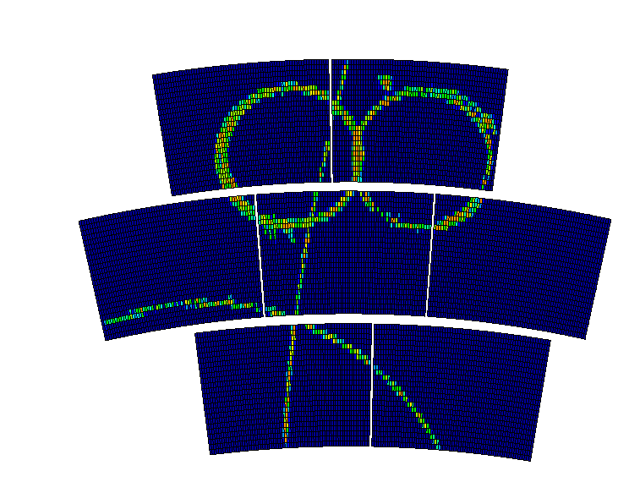
THANK You

