Slide 1


Current Status of our S.R. EDM exp.; Plans.
Yannis Semertzidis, CAPP/IBS and KAIST
13 February 2015
FCC WG on exp. With the CERN injectors
The experiment and prospects
Ready to write a CDR for 10⁻²⁹ e-cm
DOE visit to finalize the development plan
Opportunities for CERN

Slide 2
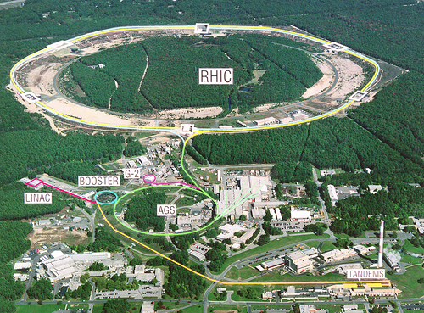
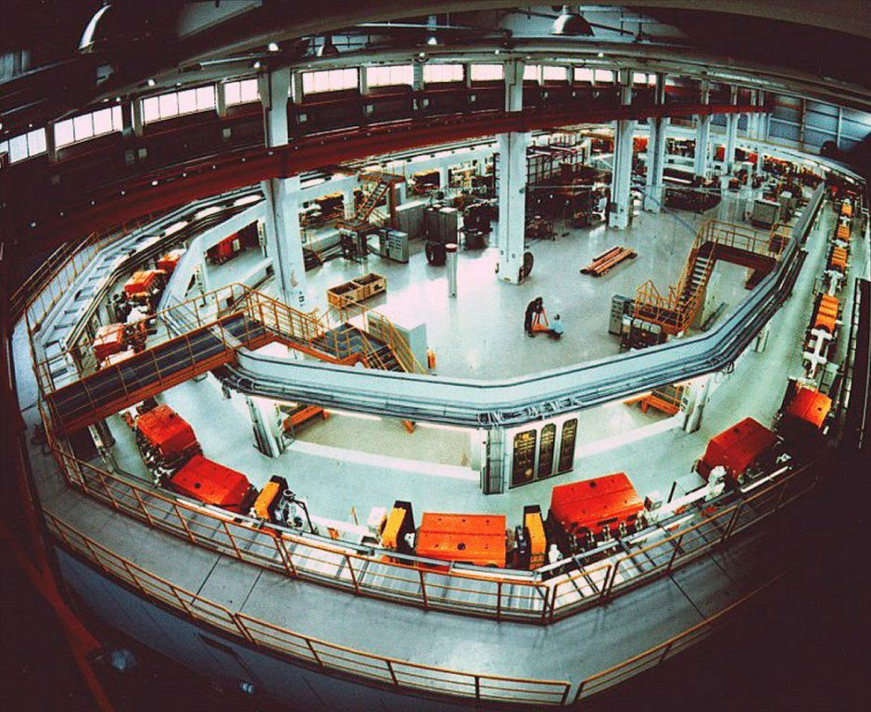
Two different labs could host the storage ring EDM experiments
COSY/IKP, Jülich/Germany: deuteron or a combination ring
AGS/BNL, USA: proton “magic” (simpler) ring

Slide 3
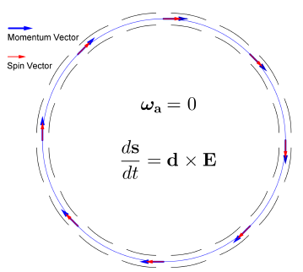
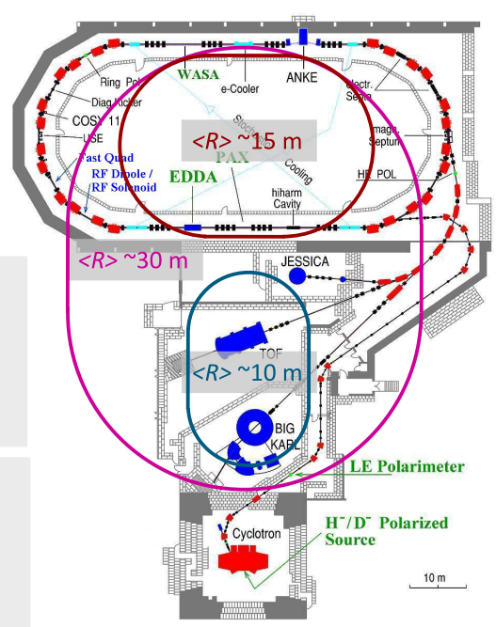
EDMs: Storage ring projects
pEDM in all electric ring at BNL or FNAL
Jülich, focus on deuterons,
or a combined machine
CW and CCW stored beams
(from A. Lehrach)

Slide 4
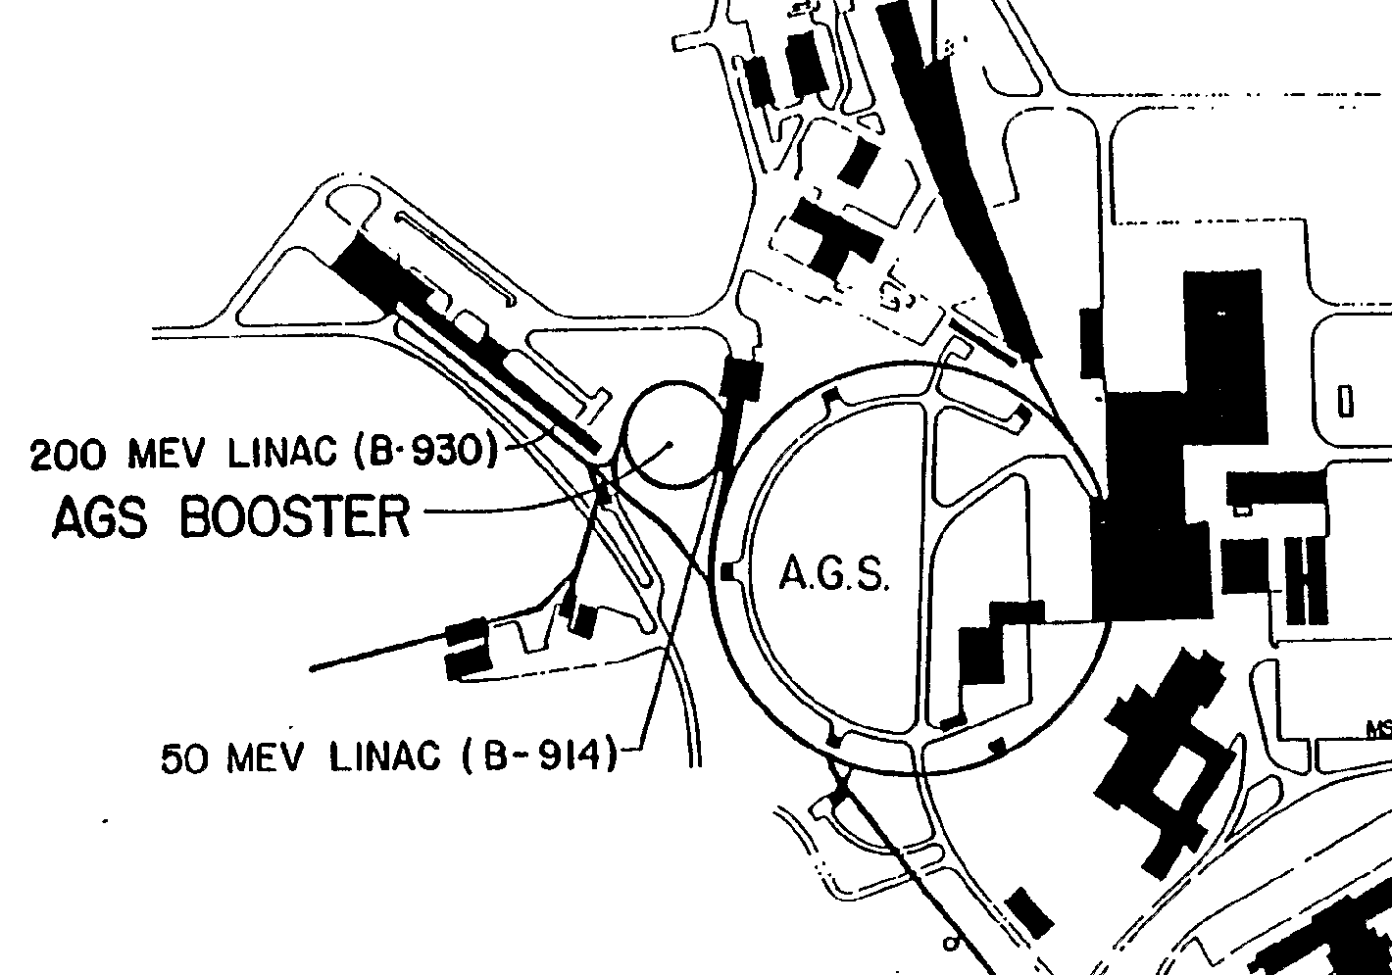
The proton EDM in the AGS tunnel at BNL
Circumference: 800m
Max E-field: 4.5MV/m

Slide 5
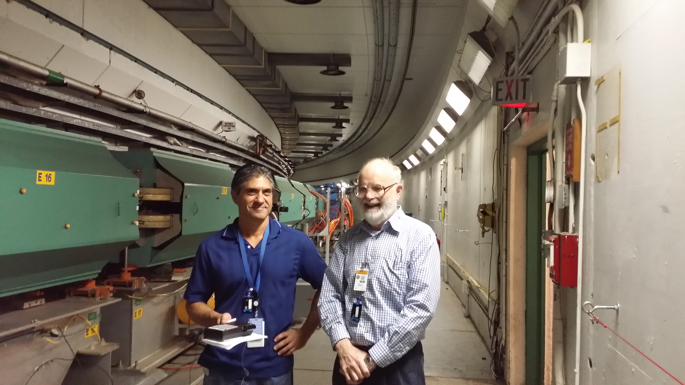
John Benante, Bill Morse in AGS tunnel

Slide 6
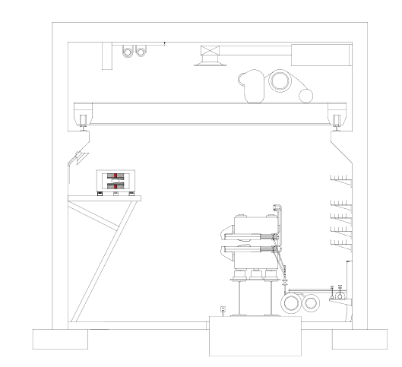
Residual Magnetic Field ( in Gauss) with Hall Probe
Location E20 upstream
180° 90°
0.14 0.18
0.20 0.19
0.23 0.17
0.52 0.44
Location F12 upstream
180° 90°
0.07 0.07
0.06 0.07
0.26 0.21
0.88 0.80
Location L5 upstream
180° 90°
0.03 0.06
0.05 0.06
0.26 0.26
0.25 0.28
The relative low fields justifies to use AGS tunnel.
(Measured by John Benante)
1
2
3
4

Slide 7
Emittance out of Booster
These intensity scan was done in 2009 with Booster input 3*10¹¹. Not much horizontal scan was done since then. The vertical scale is normalized 95% emittance.
The corresponding normalized rms emittance at 10¹¹ is 0.7π horizontal, 1.0π vertical for horizontal scraping.
vertical scraping
7
Intensity: 15~2e11 protons
@10¹¹
Horizontal scraping
V:6.1π
H:4.4π

Slide 8
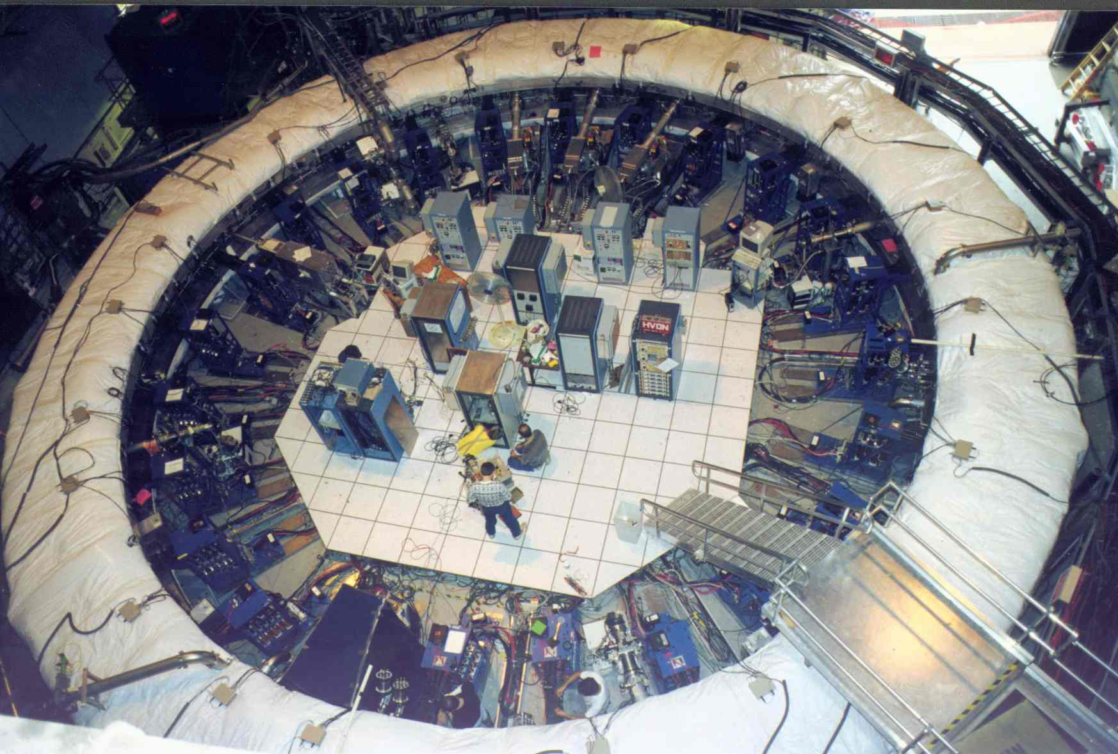
The Muon Storage Ring: B ≈ 1.45T, P_{μ} ≈ 3 GeV/c
Previous muon g-2 Experiment at Brookhaven National Laboratory

Slide 9
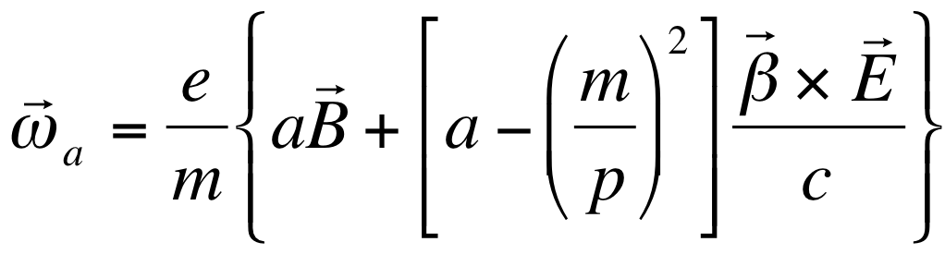
Breakthrough concept: Freezing the horizontal spin precession due to E-field
Muon g-2 focusing is electric: The spin precession due to E-field is zero at “magic” momentum (3.1GeV/c for muons, 0.7 GeV/c for protons,…)
The “magic” momentum concept was used in the muon g-2 experiments at CERN, BNL, and …next at FNAL.

Slide 10
The Principle of g-2
Spin vector
Moving: Non-relativistic case
Momentum vector
• B

Slide 11
Effect of Radial Electric Field
E-field are used to focus the beam vertically
Spin vector
Low energy particle
…just right
High energy particle

Slide 12
Effect of Radial Electric Field
Spin vector
…just right
, γ≈29.3
for muons “magic” momentum
(~3GeV/c)

Slide 13
Spin Precession in g-2 Ring
(Top View)
Momentum
vector
μ
Spin vector

Slide 14
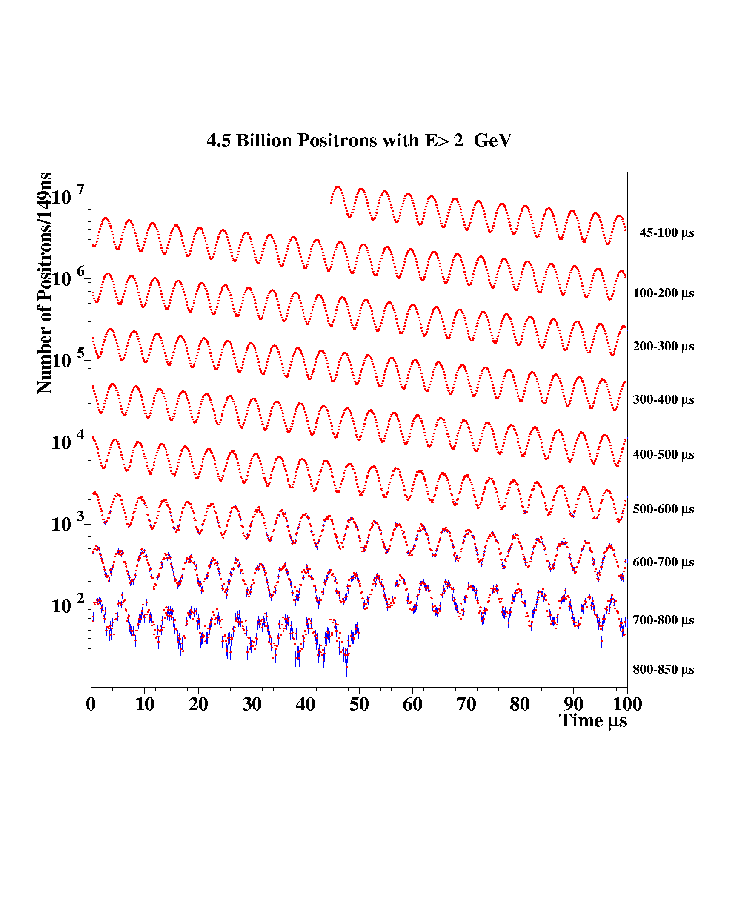
4 Billion e⁺ with E>2GeV

Slide 15
The proton EDM uses an ALL-ELECTRIC ring: spin is aligned with the momentum vector
at the magic momentum
Momentum
vector
E
Spin vector
As in muon g-2
experiment at
BNL and FNAL
E
E
E
Yannis Semertzidis, CAPP/IBS, KAIST
Notes:
Yannis Semertzidis, BNL
15

Slide 16
The proton EDM ring (alternate gradient)
Total circumference: 500 m
Straight sections are instrumented
with quads, BPMs, polarimeters,
injection points, etc, as needed.
Requirements:
Weak vertical focusing (B-field
sensitivity)
Below transition (reduce IBS)

Slide 17
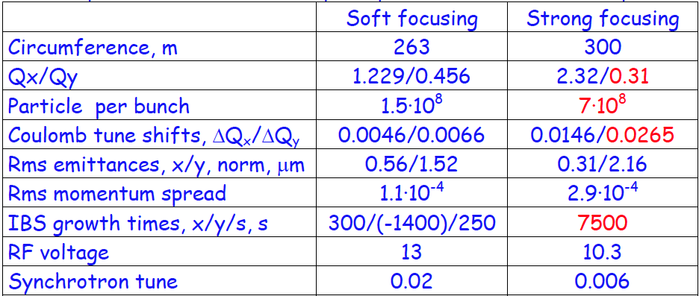
The proton EDM ring evaluation Val Lebedev (Fermilab)
Beam intensity 10¹¹ protons limited by IBS
, kV

Slide 18
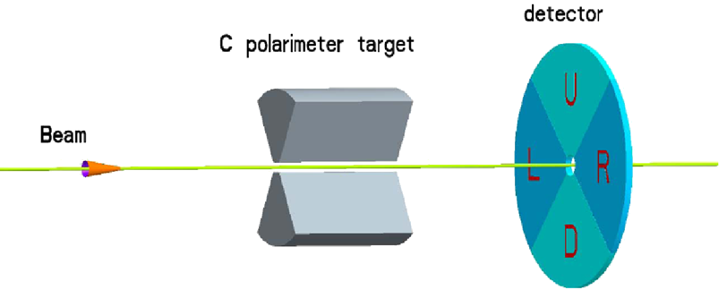
pEDM polarimeter principle (placed in a straight section in the ring): probing the proton spin components as a function of storage time
“defining aperture”
polarimeter target
Micro-Megas detector, MRPC, GEMS or Si.
Extraction: lowering the vertical focusing
carries EDM signal
increases slowly with time
carries in-plane (g-2) precession signal

Slide 19
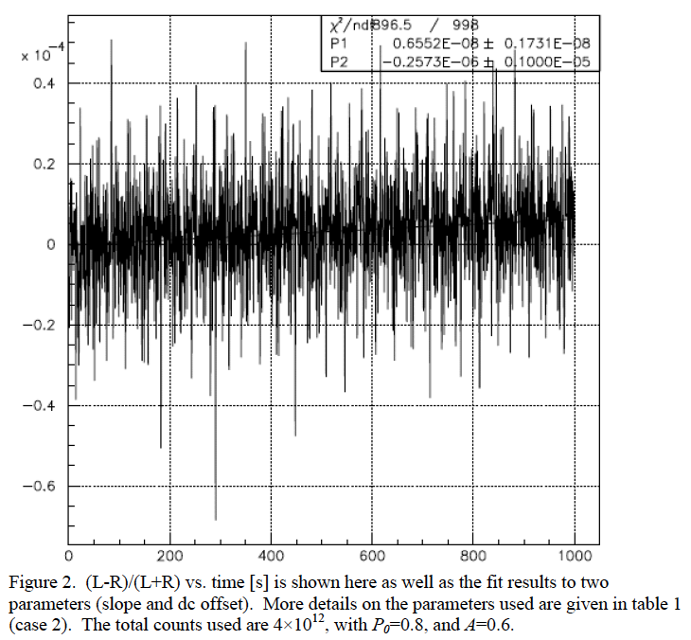
The EDM signal: early to late change
Comparing the (left-right)/(left+right) counts vs. time we monitor the vertical component of spin
M.C. data
(L-R)/(L+R) vs. Time [s]
Opposite helicity bunches
result to opposite sign slopes

Slide 20
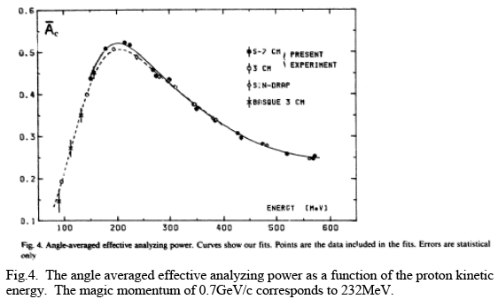
Large polarimeter analyzing power at P_{magic}!

Slide 21
Proton Statistical Error (230MeV):
τ_{p} : 10³s Polarization Lifetime (Spin Coherence Time)
A : 0.6 Left/right asymmetry observed by the polarimeter
P : 0.8 Beam polarization
N_{c} : 10¹¹p/cycle Total number of stored particles per cycle
T_{Tot}: 10⁷s Total running time per year
f : 0.5% Useful event rate fraction (efficiency for EDM)
E_{R} : 10.5 MV/m Radial electric field strength (83% azim. cov.)
σ_{d} = 10⁻²⁹ e-cm / year
Notes:
Yannis Semertzidis, BNL
21

Slide 22
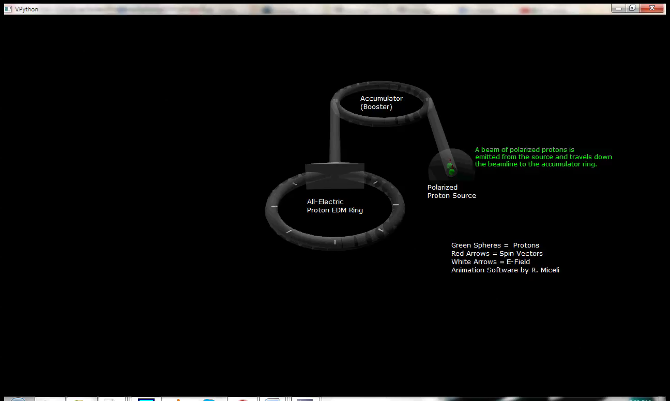
Proton EDM animation

Slide 23
Logistics
Large ring radius:
Moderate E-field 4.5MV/m (eliminates risk of bad current leak…)
Can have TiN coated aluminum (cheap).
Need 800m of magnetic shielding to 10-100nT. Current state of art.
State of the art SQUID-based magnetometers

Slide 24
E-field plate module: Similar to the (26) FNAL Tevatron ES-separators
Beam position
0.4 m
3 m

Slide 25
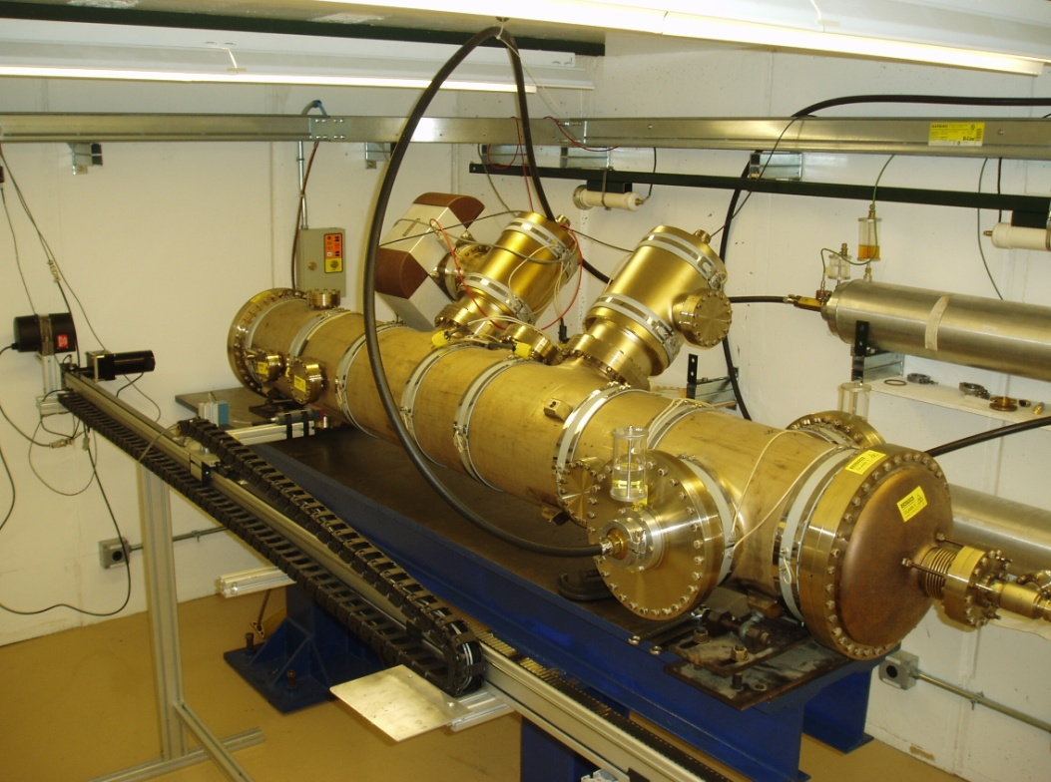
E-field plate module: Similar to the (26) FNAL Tevatron ES-separators
Beam position
0.4 m
3 m

Slide 26
Field Emission from Niobium
Work of M. BastaniNejad
Phys. Rev. ST Accel. Beams, 15, 083502 (2012)
Buffer chemical polish: less time consuming than diamond paste polishing
DPP stainless steel
Fine grain niobium
Large grain niobium
Single crystal niobium
Field strength > 18 MV/m
Conventional High Voltage processing: solid data points
After Krypton Processing: open data points

Slide 27
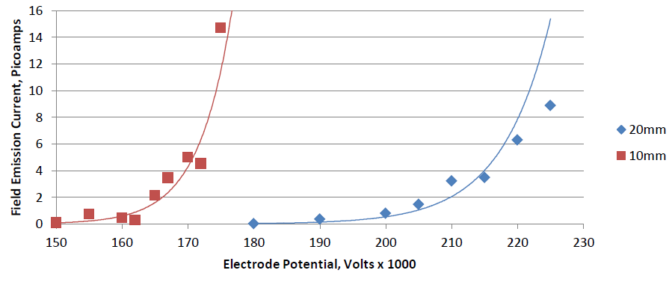
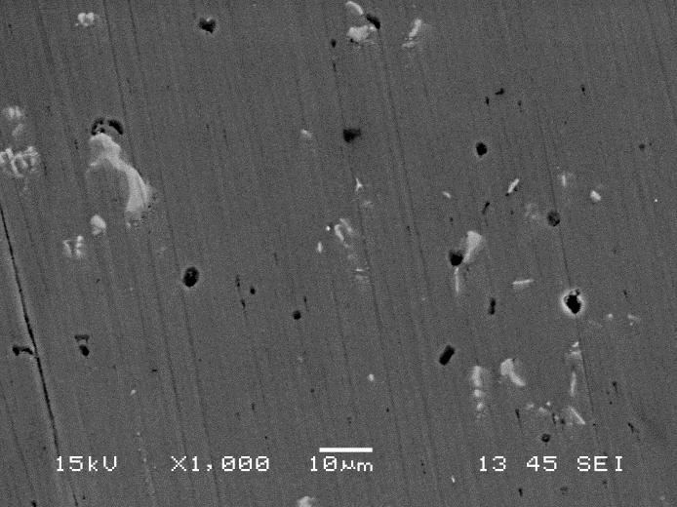
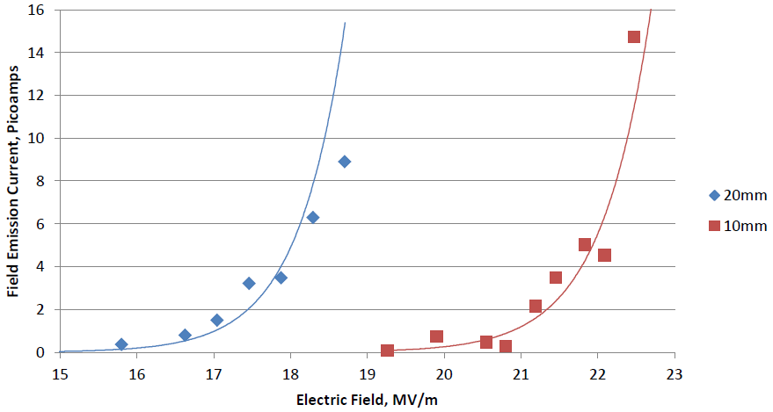
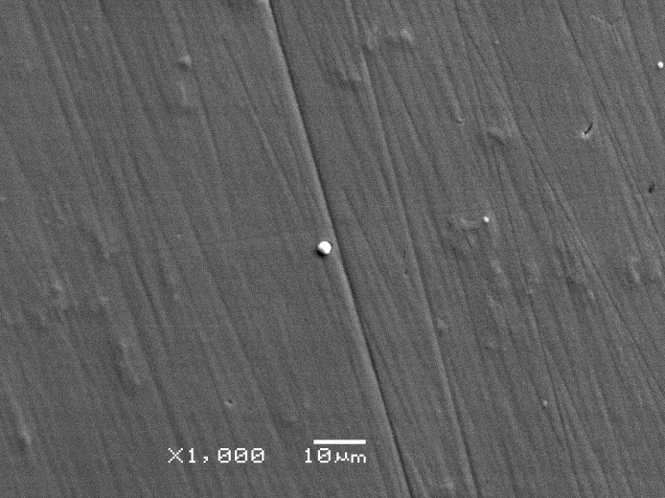
JLab results with TiN-coated Aluminum
No measureable field emission at 225 kV for gaps > 40 mm, happy at high gradient
Bare Al
Matt Poelker, JLab
TiN-coated Al
the hard coating covers defects
150 kV/cm
200 kV/cm
Work of Md. A. Mamun and E. Forman

Slide 28
Why a large radius ring?
Electric field needed is moderate. New techniques with coated Aluminium is a cost savings opportunity.
Horizontal Spin Coherence Time. The EDM effect is acting for time ~SCT.
Most ideal shape: circular with several straight sections.

Slide 29
Major characteristics of a successful Electric Dipole Moment Experiment
Statistical power:
  High intensity beams
  Long beam lifetime
  Long Spin Coherence Time
An indirect way to cancel B-field effect
A way to cancel geometric phase effects
Control detector systematic errors
Manageable E-field strength, negligible dark current
The storage ring Proton
EDM method has it all!

Slide 30
What has been accomplished?
Polarimeter systematic errors (with beams at KVI, and stored beams at COSY).
Precision beam/spin dynamics tracking.
Stable lattice, IBS lifetime: ~10⁴s (Lebedev, FNAL)
Spin coherence time 10³ s; role of sextupoles understood (using stored beams at COSY).
Feasibility of required electric field strength <5 MV/m, 3cm plate separation (JLab, FNAL)
Analytic estimation of electric fringe fields and precision beam/spin dynamics tracking. Stable!
(Paper already published or in progress.)

Slide 31
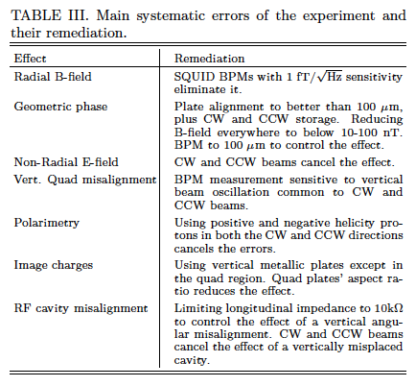
Systematic errors

Slide 32
Opportunities for CERN
Electric field strength issues, dark currents
Beam-based alignment, E-field plate alignment
Beam impedance reduction.

Slide 33
Technically driven pEDM timeline
2014
15
16
17
18
19
20
21
22
23
Two years systems development (R&D); Ring design; Installation.
Cost (2011, 2012 engineering cost): $70M + tunnel.
Proposed cost-sharing with AGS tunnel:
  Owned by DOE-HEP; DOE-NP partner with running costs.
Foreign contributions: electric field plates, vacuum chambers, SQUID-based magnetometers

Slide 34
Let’s indulge on sensitivity
Spin coherence time (10⁴ seconds), stochastic cooling-thermal mixing, …
Higher beam intensity, smaller IBS
Reliable E-field 15 MV/m with negligible dark current
>50% efficient polarimeter
Potential gain >10² in statistical sensitivity: 10⁻³¹ e-cm!

Slide 35
Spin Coherence Time: need >10² s
Not all particles have same deviation from magic momentum, or same horizontal and vertical divergence (all second order effects)
They cause a spread in the g-2 frequencies:
Present design parameters allow for 10³ s.
Much longer SCT with thermal mixing (S.C.)

Slide 36
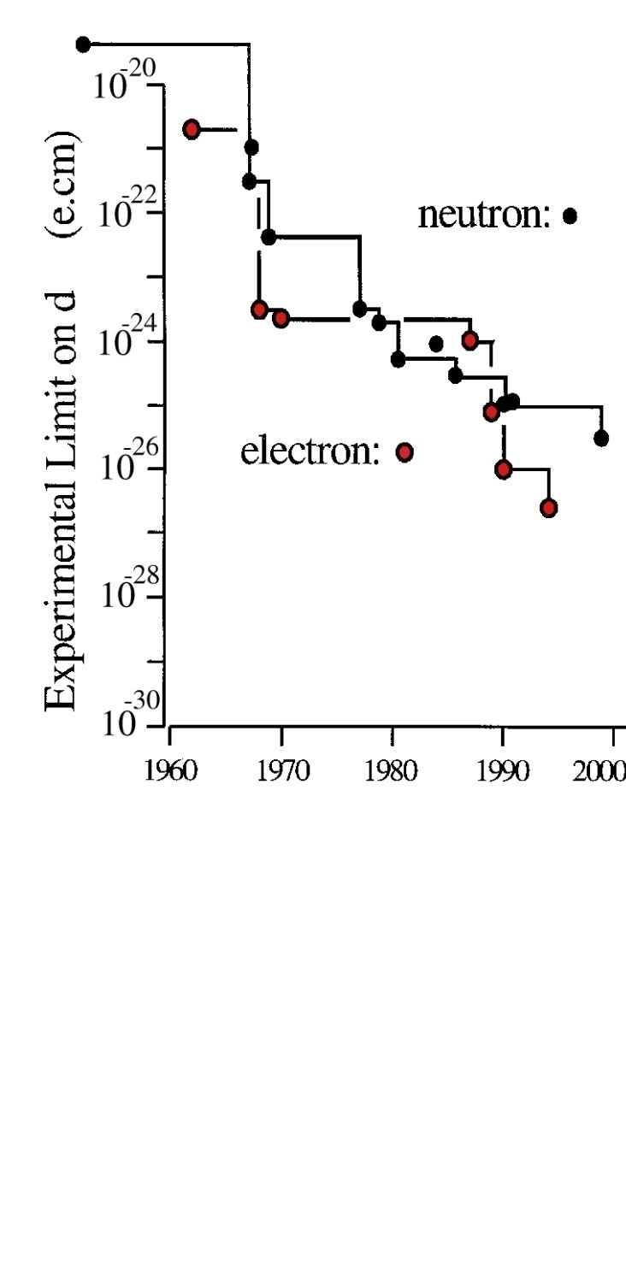
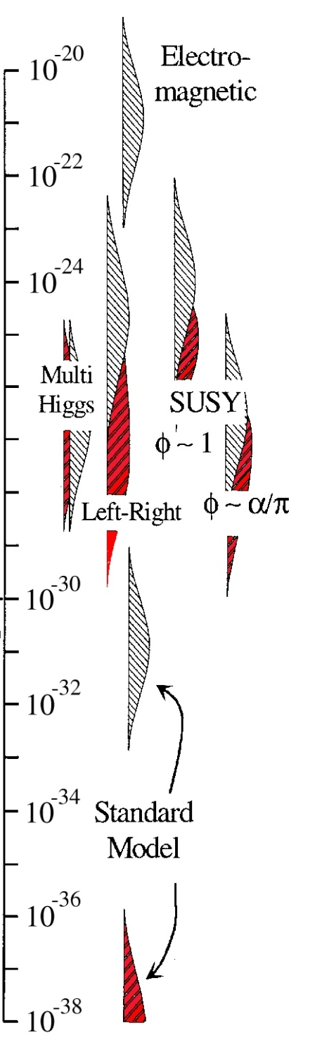
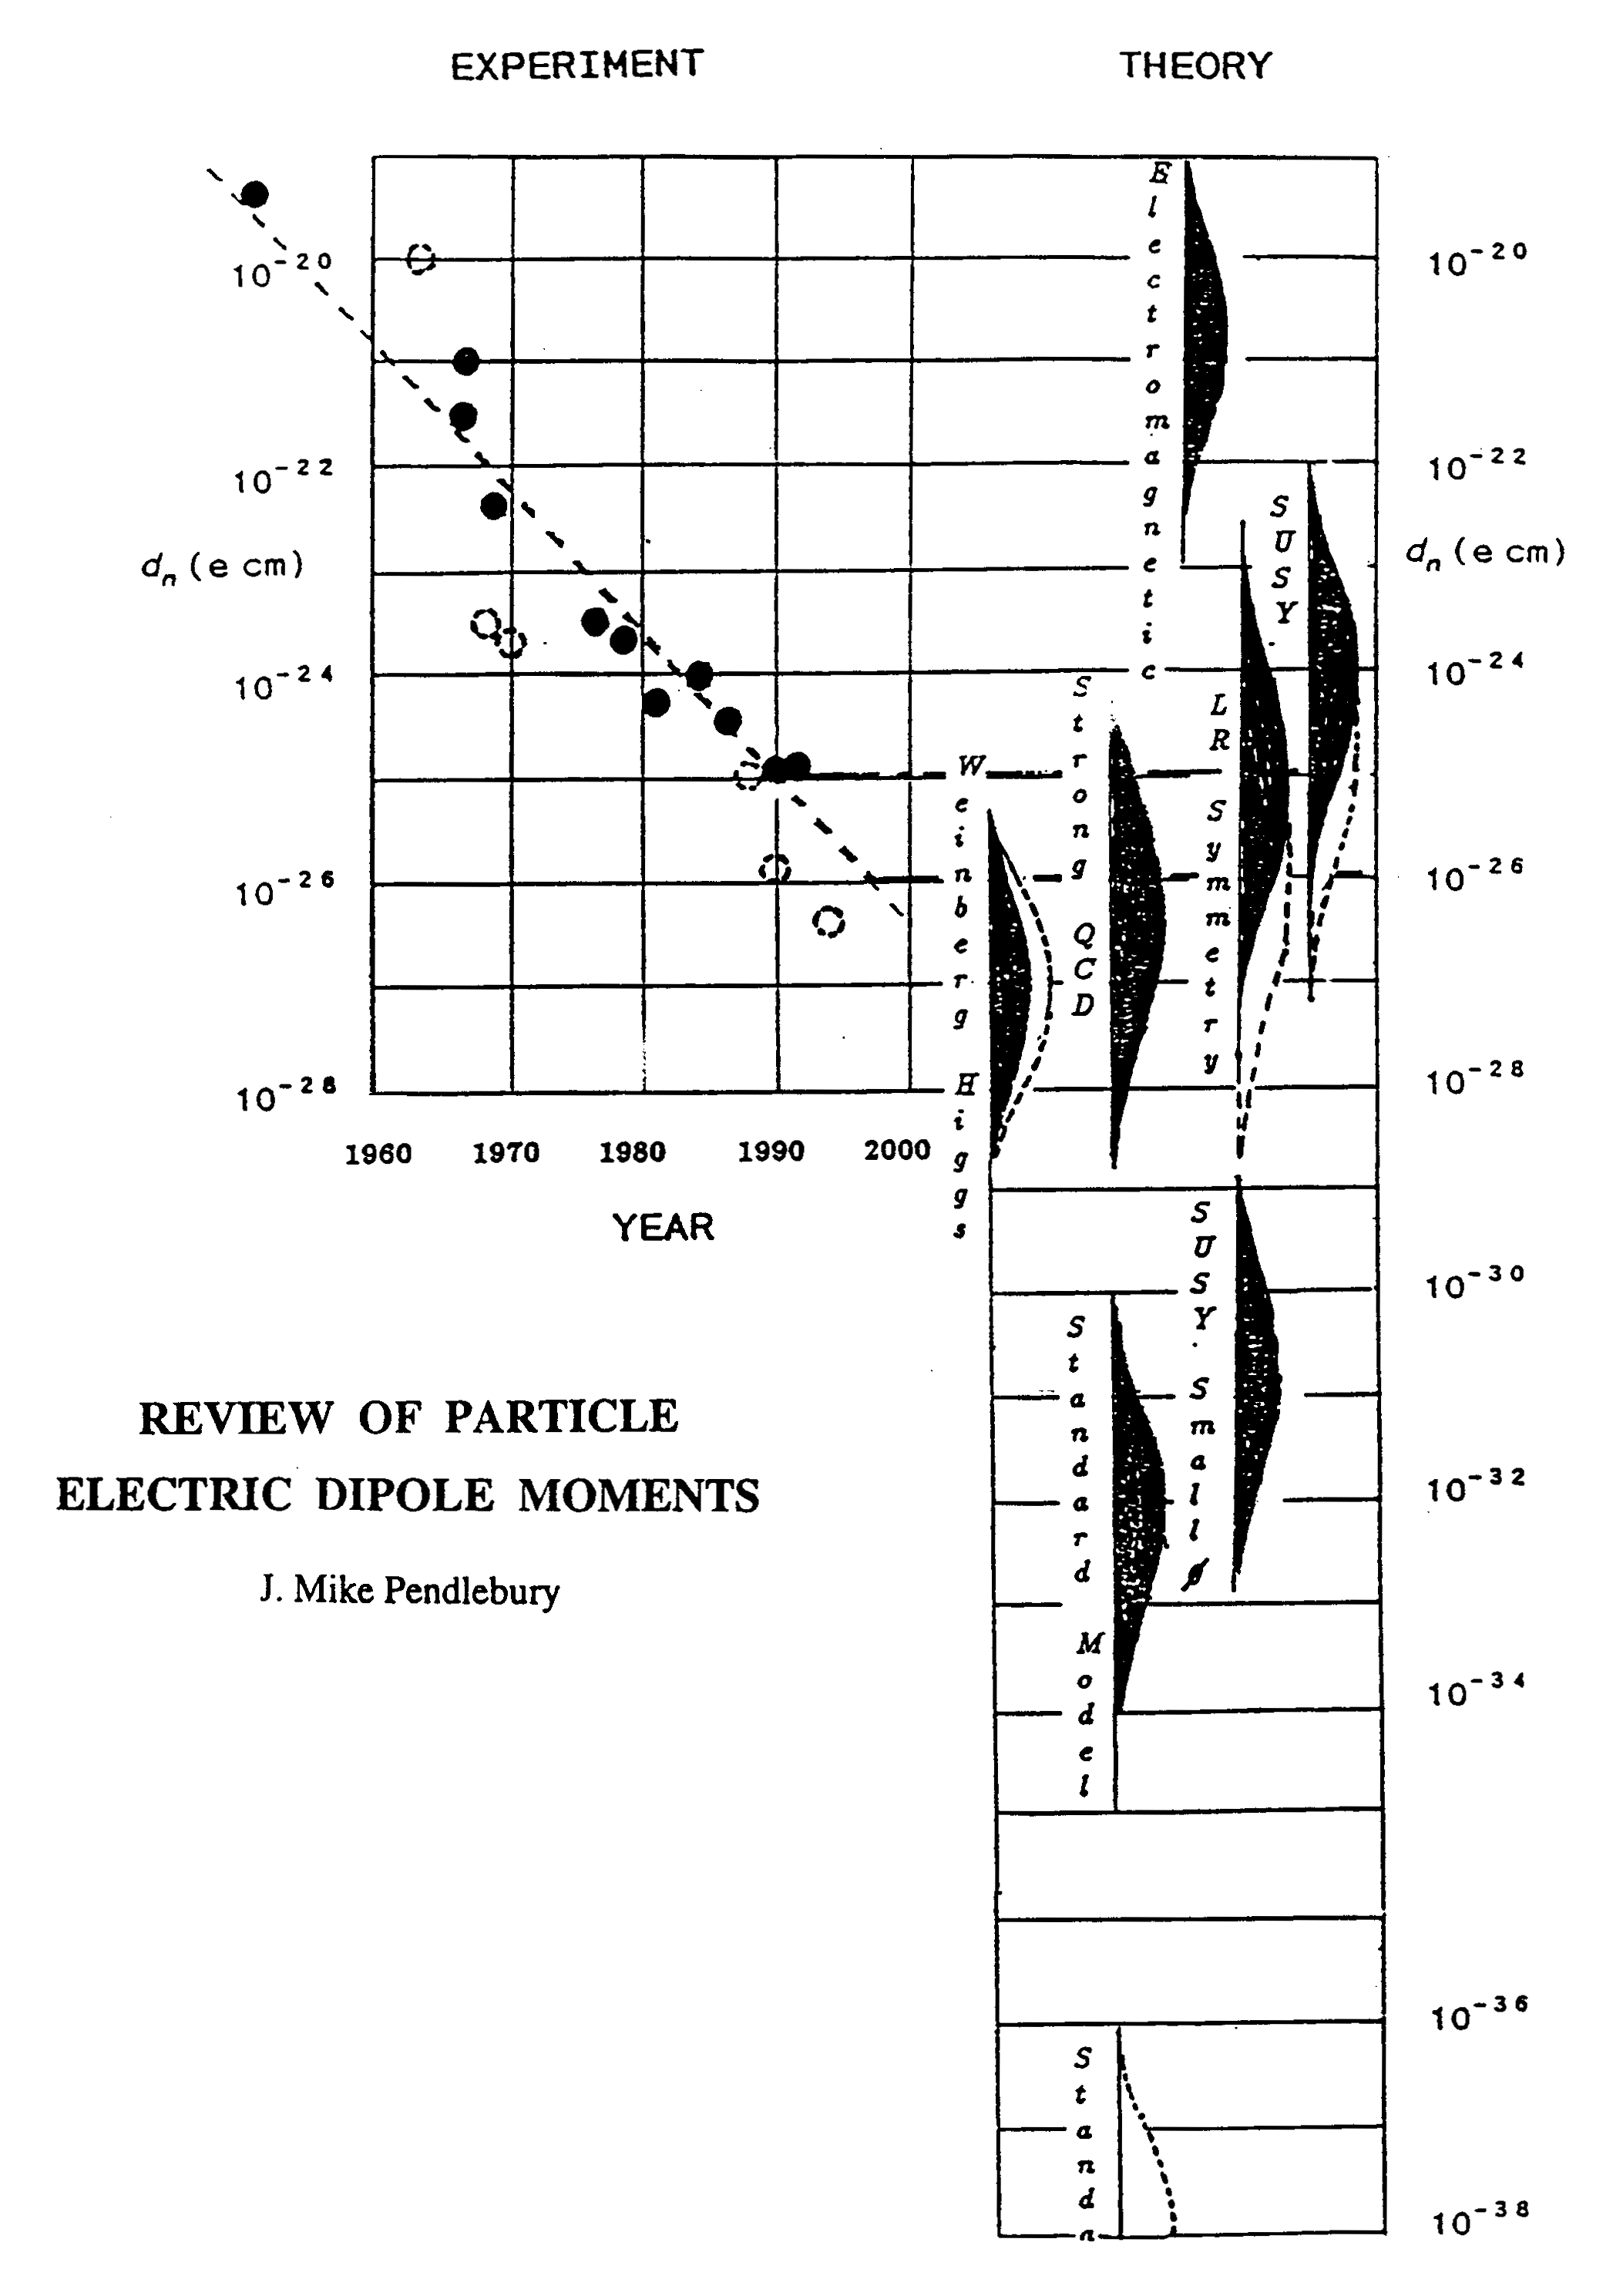
Sensitivity to Rule on Several New Models
Gray: Neutron
Red: Electron
If found it could explain
Baryogenesis
(p, d, n (or ³He))
n current
e current
GUT SUSY
Electroweak
Baryogenises
n target
p, d target
e target
Upgrade?
Statistics limited
Electron EDM new physics reach: 1-3 TeV
Much higher physics reach
than LHC; complementary
e-cm
J.M.Pendlebury and E.A. Hinds, NIMA 440 (2000) 471

Slide 37
Summary
Complementary to LHC; probes New Physics >10³ TeV.
The experiment is owned by HEP. Run by NP, hosted by CAD/BNL.
Work on the open questions. Opportunities for CERN impact.
Visit DOE OHEP with the plan.

Slide 38
Extra slides

Slide 39
Clock-wise (CW) & Counter-Clock-wise Storage
Total current: zero. Any radial magnetic field in the ring sensed by the stored particles will cause their vertical splitting.
Equivalent to p-bar p colliders in
Magnetic rings
Notes:
39

Slide 40

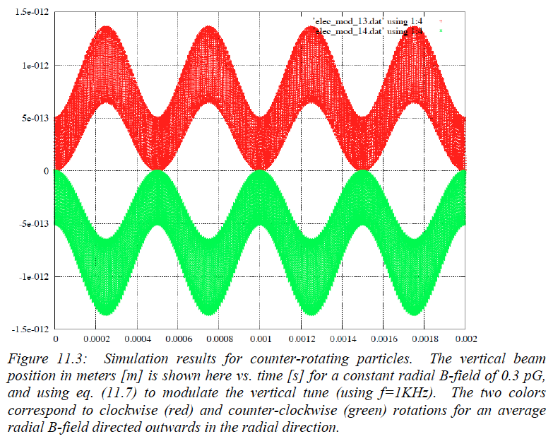
Distortion of the closed orbit due to N^{th}-harmonic of radial B-field
Clockwise beam
Y(ϑ)
The N=0 component
is a first order effect!
Counter-clockwise
beam
Time [s]

Slide 41
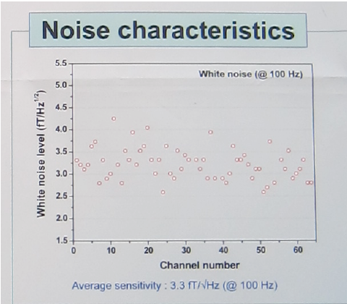
Total noise of (65) commercially available SQUID gradiometers at KRISS
From YongHo Lee’s group

Slide 42
B-field Shielding Requirements
No need for shielding: In principle, with counter-rotating beams.
However: BPMs are located only in straight sections → sampling finite. Nyquist theorem limits sensitivity to low harmonics of B_{r}. Most importantly the <B_{r}> may not be the true average when N= N_{SQUIDS}
Plan: B_{r}-field needs to be less than (1nT) everywhere and pay attention to N=80 B_{r}. (See Selcuk’s talk).

Slide 43
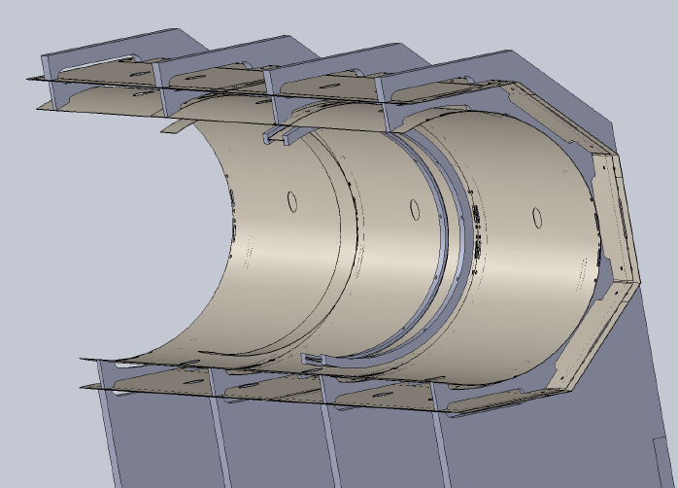
Peter Fierlinger, Garching/Munich
Under development by
Selcuk Haciomeroglu
at CAPP

Slide 44
To do list: EDM ring in AGS tunnel
Lattice. Alternate gradient. Operations below transition.
IBS lifetime estimation. Beam parameters: Intensity, polarization.
Ring impedance issues.
Feasibility of LHe line in the EDM ring. Need a cryo-engineer to evaluate.

Slide 45
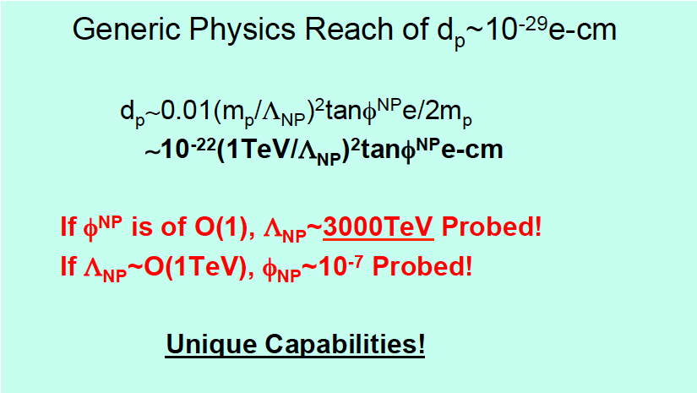
Marciano from CM9/Korea, last week

Slide 46
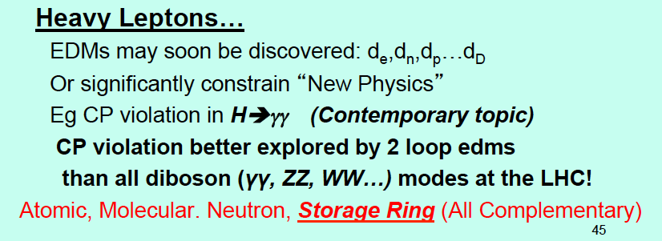
Marciano from CM9/Korea, last week
Outlook:

Slide 47
Feasibility of an all-electric ring
First all-electric ring (AGS-analog) proposed/built 1953-57. It worked!
Two encouraging technical reviews performed at BNL: Dec. 2009, March 2011.
Fermilab comprehensive review: Fall 2013. Val Lebedev considers the concept to be sound.
Cost (2011, 2012 engineering cost): $70M + tunnel.
Proposed cost-sharing if existing tunnel is used:
DOE-HEP $35M; DOE-NP $20M (+ running costs).
Foreign contributions: electric field plates, vacuum chambers, SQUID-based magnetometers.

