Slide 1

First thoughts on polarized protons in the FCC and injectors
Mei Bai, BNL and FZ Juelich
John Jowett, CERN

Slide 2
About this presentation
Section by Mei Bai
  Review of RHIC polarized protons
  Extrapolations to LHC
Section by John Jowett
  Very preliminary thoughts about what might be done with FCC-hh and its injectors
  Remarks about potential for EDM (p and deuteron)
Everything prepared at short notice without much opportunity for discussion

Slide 3
Section by mei bai

Slide 4
Reaching High Energy Polarized Protons Beyond RHIC?
Feb. 12-13, 2014
Polarized Lepton, Mainz, Germany

Slide 5
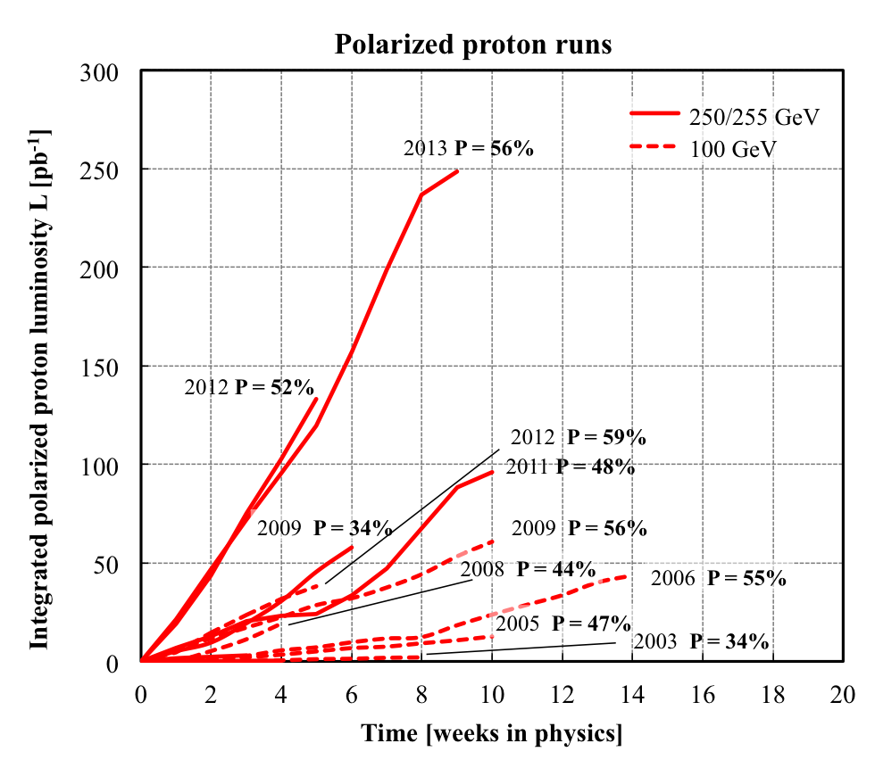
Status of High Energy Polarized Protons
RHIC has successfully accelerated polarized protons upto 255GeV with the dual snake setup. Polarization loss between injection and 100 GeV is negligible. 5-10% polarization loss between 100 GeV and 255 GeV was observed. Average store polarization of ~55% was achieved.
Courtesy of W. Fischer

Slide 6
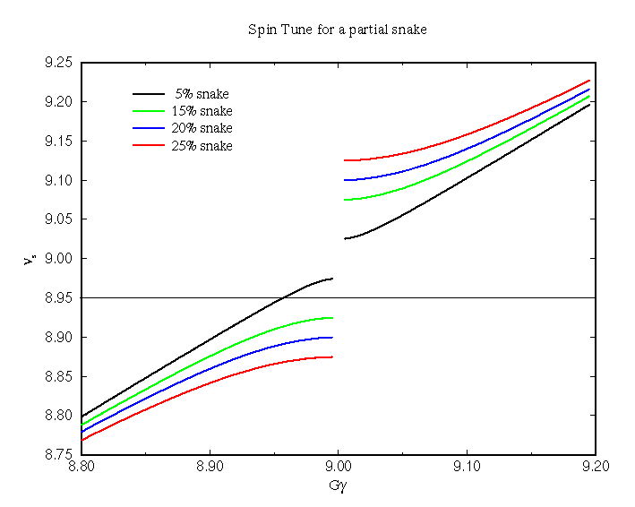
Polarized protons in the LHC injection chain
PS: beam energy similar to the AGS. Can use similar strategy, i.e. double partial snakes to overcome both imperfection and intrinsic spin resonances
A strong partial Siberian snake generates large spin tune gap for Gγ = n. With strong enough snake, gap is large enough to cover both imperfection and intrinsic spin resonances.
Note: With a strong snake, the stable spin direction will deviate from vertical direction
T. Roser “The Future of High Energy Polarized Proton Beams”, Spin Symposium, 2008, Charlottsville, VA
Imperfection resonance
Intrinsic resonance

Slide 7
Polarized protons in the LHC injection chain
SPS: much higher energy than RHIC
  Intrinsic spin resonance ε_{k} ~√βγ. i.e. the intrinsic resonance is about 40% stronger at 450GeV than the strong resonance in RHIC at 255GeV.
  Imperfection resonance ε_{k} ~βγ
    Tighter tolerance for beam parameters
  Recommend 3-pair snake setup for preserving polarization
  Question, can the SPS lattice accommodate multiple snakes?
 | Yrms required | Yrms achieved | ∆Qy required | ∆Qy achieved
RHIC | 0.5 mm | 0.1 mm | 0.003 | 0.005
SPS | 0.28 mm | -- | (need simulation to find out) | --

Slide 8
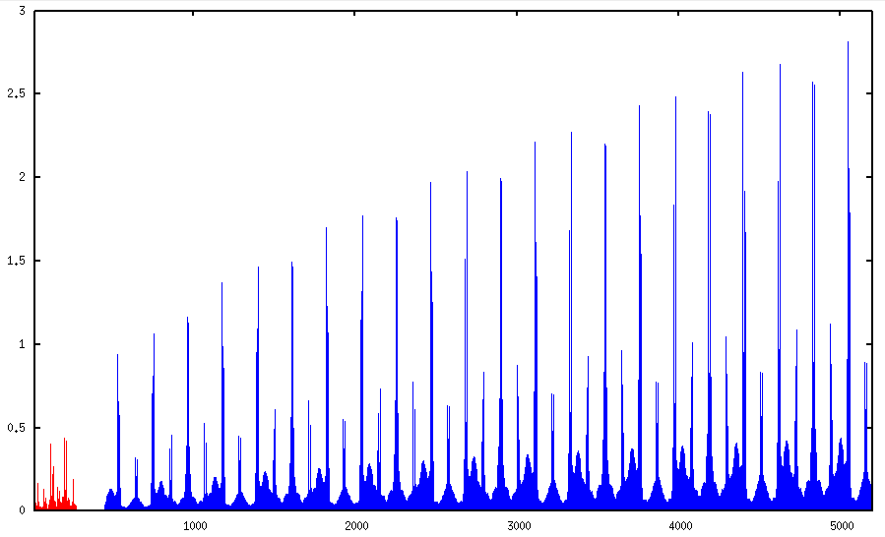
For LHC
Intrinsic resonance strength
Beam energy [GeV]

Slide 9
For LHC
S.R. Mane showed that for a single strong intrinsic resonance the spin tune does not depend on the beam emittance if the snake axes angle increases in equal steps from one snake to the next. This may be a good starting point for a multiple snake design.
2 Snakes (RHIC)
Δα = 90°
4 Snakes (HERA-p?)
Δα = 45°
6 Snakes (Tevatron?)
Δα = 30°, 90°
T. Roser “The Future of High Energy Polarized Proton Beams”, Spin Symposium, 2008, Charlottsville, VA
16 Snakes (LHC, replace 2 dipoles
per arc with snakes, ΔE ~ 1.4%)
Δα = 11.25°, 33.75°, 56.25°, 78.75°
8 Snakes (HERA-p?)
Δα = 22.5°, 67.5°

Slide 10
Polarization at low beta IR
Strong focusing in final focus triplets reduces beam polarization at IR
Spin rotation in triplet:
___ P_{σ}/P₀
___ P_{σ⊥}
T. Roser “The Future of High Energy Polarized Proton Beams”, Spin Symposium, 2008, Charlottsville, VA
RHIC
LHC

Slide 11
Summary
RHIC showed it is plausible to have polarized protons upto high energy
It is possible to build up polarized protons
Feb. 12-13, 2014
EUCARD workshop "Spin optimization at Lepton accelerators”, Mainz, Germany

Slide 12
Section by john jowett

Slide 13
Context
No polarized proton beams at CERN so far
  Some studies in the past
Studies elsewhere
  Earlier proton synchrotrons (ZGS, Saturne, AGS, …)
  Studies for HERA-p, SSC, … invoking ideas of resonance compensation, Siberian Snakes, …
  In recent years the very impressive success of RHIC operating as a polarized proton collider demonstrated many of the theoretical ideas

Slide 14
Questions to be answered
Are proton/deuteron EDM experiments possible at CERN ?
Assuming that the present injector chain up to LHC is used to inject into FCC-hh rings, can the existing machines be modified to accelerate polarized protons up to 4 TeV for injection into FCC-hh ?
Can polarization be preserved through acceleration up to 50 TeV in FCC-hh ?
  How much complication does this add to FCC project ?

Slide 15
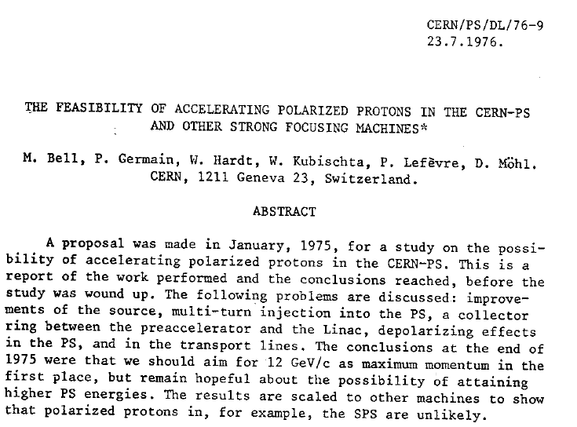
Earlier study for PS
Considered keeping Linac1 for polarized protons beside Linac2

Slide 16
Observation
Colliding polarized protons is a lot more complicated than colliding unpolarized protons!

Slide 17
Polarized protons for EDM at CERN?
Requires injection of polarized protons at special low energy (KE 250 MeV)
Could accelerate in Linac4, inject in special ring (YS talk?) from PS Booster
  Needs alternative polarized source
    Cf BNL source, current somewhat lower than design for Linac4 unpolarised source
  Acceleration in Linac4 preserving H⁻ polarization likely OK
  Compensate few depolarizing resonances in ramp of Booster (all 4 rings?), needs good control of orbit, etc.
  Polarimetry …
All probably feasible with necessary effort but no obvious synergy, and could even interfere, with normal LHC/FCC operation.
  Build another Linac →independent complex

Slide 18
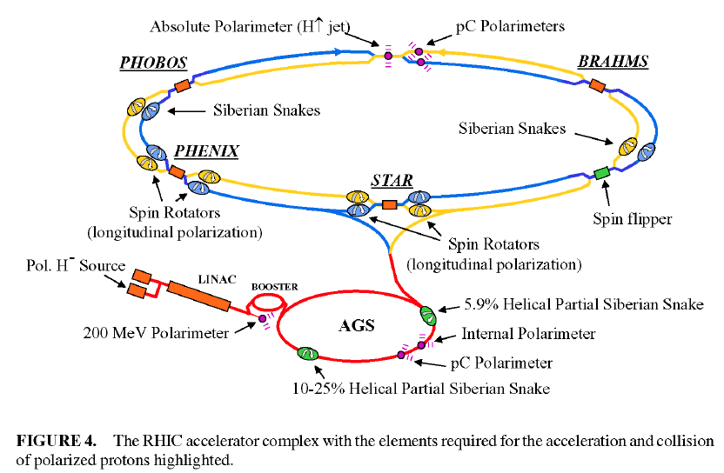
RHIC polarized proton complex
To get an idea of what is needed:
From T. Roser, SPIN2008

Slide 19
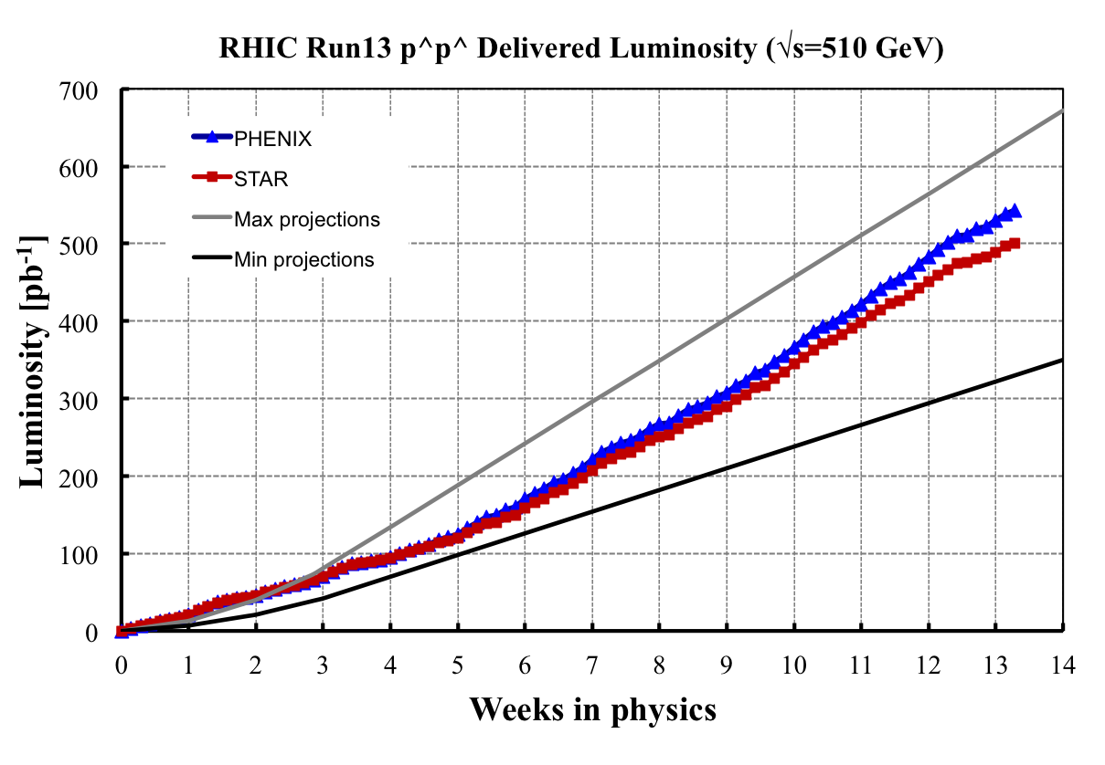
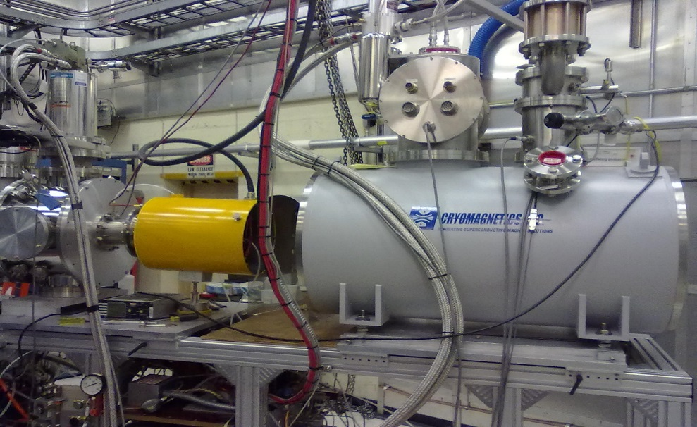
RHIC Run-13 RHIC II p↑+p↑ performance
> 0.5 fb⁻¹
p↑+p↑ luminosity from
Run-13 exceeds
all previous p↑+p↑
runs combined
From W. Fischer, BNL C-AD MAC, Dec 2014
https://indico.bnl.gov/conferenceDisplay.py?confId=898
new polarized source
stores with highest average pol.
H-jet measured polarization
(average over intensity, time, 14 best stores)
New Atomic
Beam Source
(ABS)
 | Run-12 | Run-13
Blue | 52.0% | 57.0%
Yellow | 58.2% | 57.7%
New superconducting
solenoid

Slide 20
Source, Linac4, PS Booster
RHIC OPPIS/ABS H⁻ source works well
  Install alternative source of similar type for Linac4, would deliver somewhat lower beam current than unpolarized source
  Linac4 cannot accelerate deuterons (might be possible with new ion source and Linac3)
  Polarization through Linac4 probably OK.
  Transfer to PS Booster ?
  Acceleration in PS Booster probably OK with careful compensation of a few depolarizing resonances.

Slide 21
PS, SPS, LHC, RHIC
Strategy established at RHIC could work in PS, SPS - see earlier slides by MB
  Need to check space for new equipment like snakes (variable direction dipole fields, eg, helical magnets at BNL)
Not clear how far one can go with LHC, FCC-hh
  Resonances become very strong (see slide by MB)
  Seems to require extreme orbit tolerances
  Many snakes, probably OK if included in design of FCC-hh, need to find space in LHC
  Polarimetry at high energy ?

Slide 22
Conclusions (all tentative!)
If there is a strong physics case for polarized protons in FCC, then it would need a serious effort to demonstrate feasibility (at first sight, it looks extremely difficult, maybe impossible).
  At the very least, a new level of complexity.
Substantial modifications to injectors will be necessary
  Long programme of staged implementation
  Polarized protons for EDM experiments probably possible with Linac4/PS Booster (but not deuterons). No obvious synergy with FCC.
Substantial additions to present basic FCC-hh design will be necessary. Experience shows that implementation of polarized beams as an upgrade never happens so they must be incorporated into the design from the beginning.

Slide 23
BACKUP SLIDes

Slide 24
History
Courant, Ruth, Montague, JMJ et al discussions in early 1980s
Montague Phys Rept
Bell et al estimate of 12 GeV polp in PS in 1970s
Never tried at CERN
Have to treat all machines in FCC injector chain
Polarization must be incorporated in machine design from the beginning, significant impact, never works as later add-on!
Considered in past for HERA-p ring, SSC, VLHC, …
Polarized protons now much better understood and demonstrated – spectacular success at RHIC

