Slide 1
TORCH: a possible application in LHCb
Roger Forty (CERN)
Rui Gao (Oxford)
TORCH (Timing Of internally Reflected CHerenkov light) is a detector concept for high-precision TOF over large areas
Under development as a possible addition to the LHCb upgrade
R&D project funded by the ERC (2013–16) between CERN,
Bristol and Oxford Universities, with industrial partner Photek (UK) Mainly focused on developing a suitable photon detector
Assuming the R&D is successful, a proposal will be made to LHCb for the full detector, which would be a client for the new TDC
New CERN ps TDC meeting, 12 February 2015

Slide 2
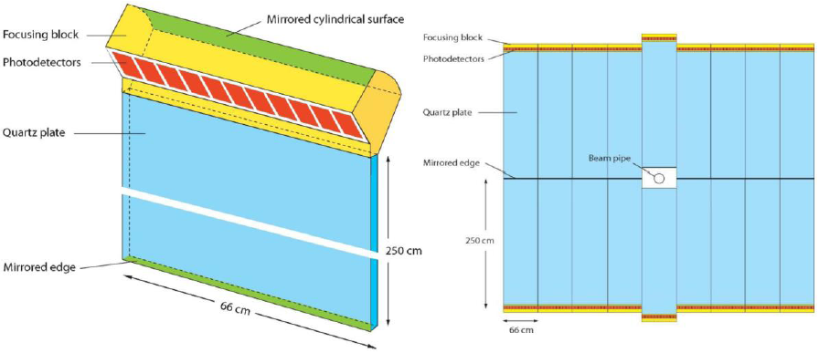
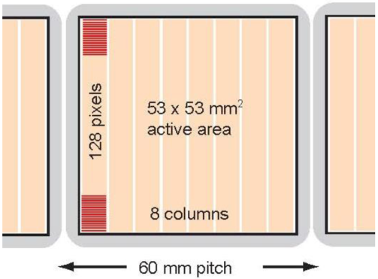
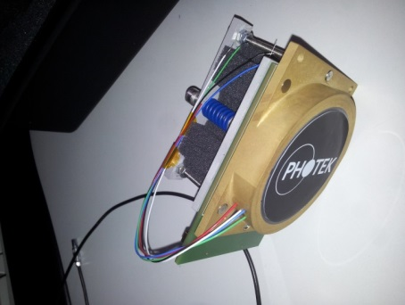
TORCH detector
Aiming for 10–15 ps resolution per track, to separate π/K < 10 GeV
Use Cherenkov light trapped in quartz plate, a la DIRC
Focused onto photon detectors around edge, ~ 50 ps / photon
Photon detector MCP-PMT: require
1. long lifetime (done, ALD coating)
2. fine pixellisation (in progress)
3. large active area (next year)
Assuming 1024 channels/MCP
Application in LHCb ~ 200 MCPs
→ ~ 3000 x 64 ch. readout chips
TORCH module
Layout for LHCb
MCP pixellisation
MCP prototype

Slide 3
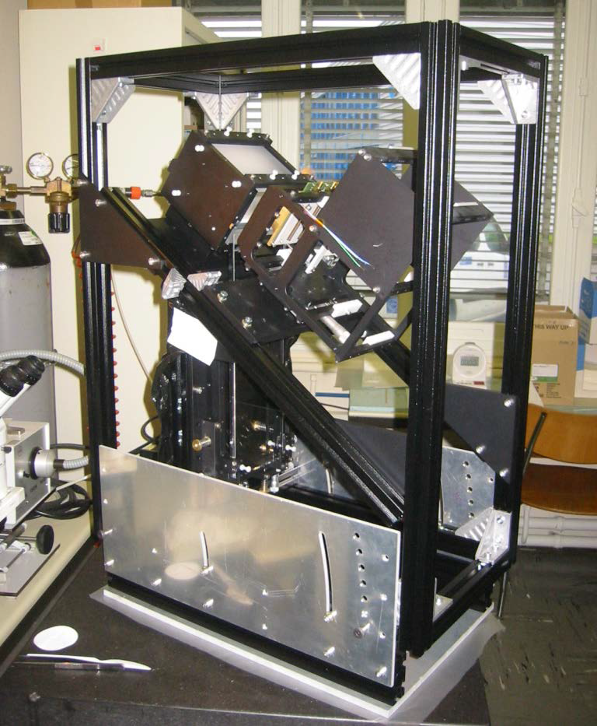
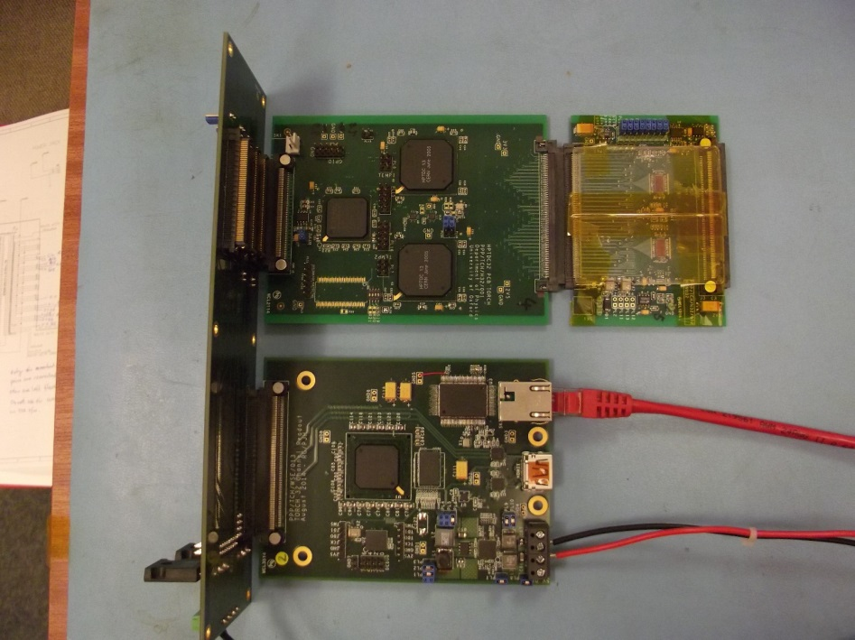
Prototyping
Test-beam setup
Prototype prepared for beam test this year
Read-out electronics: NINO + HPTDC
Aim to use TOT from NINO for charge measurement → charge division
Focusing +
MCP mount
Electronics
Electronics to read out MCP
Readout Board
35 x 12 x 1cm
quartz plate
Readout Adaptor
LHCb upgrade environment:
40 MHz collisions
High track multiplicity →
high rate ~ 500 kHz/ch.
NINO32
HPTDC

Slide 4
TORCH TDC Requirements -1
Background and constrains: TDC to be integrated with NINO32 (IRPICS-2) front-end and LHCb trigger-less readout.
Time reference: 40Mhz
Hit interface: LVDS is preferred so NINO32 can be connected directly
Hit rates: 1Mhz per channel average, local hit rate may be 5 time higher.
Hit pulse width: should be able to register NINO pulse (2.5-6ns)
Acceptable deadtime:5ns
Time resolution: 12ps binning is fine
Power supply: no particular requirements
Readout: GBT preferred, configurable via GBT-SCA

Slide 5
TORCH TDC Requirements-2
Trigger requirements:
  Non triggered 40Mhz LHCb trigger-less readout
            Data are aligned using BXID
            Readout only fine counter in TDC to save bandwidth
  Triggered mode are useful for test beams
    Latency: Programmable ranged hundreds nanoseconds,
    Rate: Less than 1Mhz, for test beams only
    Trigger window: Programmable up to 4095 x 25ns
How many TDCs do you need, when:
  Assuming 64-ch TDC, 3K in 5 years time if TORCH detector is approved,
  Individual samples for development
Radiation dosage: Less then 100krad/ year, (100krad/year is the estimated dosage for RICH 2 in upgrade)

Slide 6
The End

Slide 7
Back up slides

Slide 8
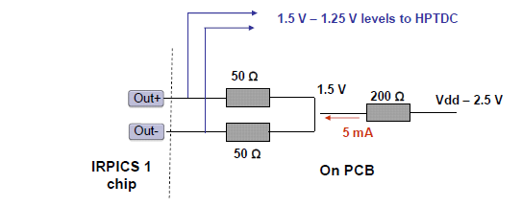
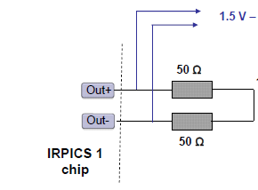
NINO32 interfacing to SLVS
Current circuit, IRPICS-1 to drive HPTDC - LVDS
IRPICS-2 has built-in LVDS drivers
AC couple to SLVS – overdrive the SLVS
IRPICS-1, Possible SLVS driver
200mV swing, 0.2V common voltage
40R
5mA transistor drivers
0.2v
40R
On PCB

