Slide 1
Current MDT Design & Limitation
Up to 18 mezzanine cards on each chamber with ASD & TDC ACISs
  Three 8 channel ASDs & one 24 channel TDC
  256 hit level 1 buffer & 64 hit readout buffer
  8 slot trigger buffer
  Serial Readout at 80 MHz to Chamber Service Module (CSM)
  Initialized via JTAG for ASD, AMT, and CSM through DCS system
  Operating in edge mode with triggers up to 100 KHz
Expected to handle up to 300 KHz tube rate operating in pair mode
  Observed to saturate at 60-70 KHz in highest rate chambers in small wheel
  Thought to be due to edge mode operation (after pair mode failure seen)
  Connected mezzanine to CSM via 100 Ω impedance controlled shielded cable

Slide 2
Why Upgrade
Handle Higher Rates – both tube rates & transmission rates
Store hits during Longer Latency
Buffer more triggers during readout
Need for MDT Trigger Data to Sharpen Pt threshold
  NSW provides 1 mr measurement of angle from IP
  Big Wheel needs similar to reduce feedthrough of soft muons at Level 1

Slide 3
Phase II Requirements
Readout Capability
  Rate capability to 300 KHz tube hits
  Deeper Level 1 buffering (any Level 0 handling?)
  Deeper Trigger buffering
  Faster Rate of Mezzanine to CSM data flow
  Longer Latency
  Fix some bugs – restore “pair mode”
Trigger Data Extraction
  Hit timing to 6.25ns bins
  Fast extraction to sector logic
  Fixed latency or BCID tagging?

Slide 4
Working Group Discussions
Three groups from original MDT development meet by-weekly
  Michigan/BNL, Japanese (KEK & others), MPI/LMU
  Goal is to see if we can converge on ideas for a proposal to ATLAS
Ideas under consideration (3-4)
  Modest change – keep the existing cables & motherboards to CSM
  Mid range change – add fast trigger cable to existing cables & motherboards
  Ambitious change – replace cables with fast serial links to CSM
  More ambitious change – send precision data off detector
Current state – evaluate rate & bandwidth requirements

Slide 5
General Needs for Phase II
For the TDC to be used in Phase II MDT upgrade in general, we need:
  Time bins similar to what we have now for the MDT, namely 0.78ns or better.
  Since the readout would be at Level 1, the latency for triggers needs to be 60us.
  A serial readout rate of 160 MHz (SDR or DDR) is necessary.
  Recovery of “pair mode”. Avoid some bugs in the current system.
  Trigger information would come directly from the ASD outputs for all but Michigan scheme.
The Michigan scheme would need:
  A trigger less readout to the CSM on two lines at 160MHz DDR with the CSM containing:
  The Level 1 buffer, trigger matching, and connection to the GBT
  Trigger primitives multiplexed to the sector logic on an independent fast fiber.
  Minimal latency of data to the CSM.
Push all data off detector requires trigger less TDC & a lpGBT at 9.6 GB/s

Slide 6
TDC Operates Trigger less
The TDC choices all operate in trigger less mode
  Trigger less mode provides channel buffer data only
  Data moves to output FIFO from channel buffers
  HPTDC operates in this mode (presumably new CERN TDC as well)
  VMM has only this mode
  FPGA TDC can be configured in this mode
Latency of data flow through TDC needs to be understood for trigger
  Simulation will surely answer this question definitively
  Handled by BCID offset sent with each hit

Slide 7
First Upgrade Question
Can the existing mezzanine to CSM cables & motherboard run faster?
  How fast? Is the highest rate compatible with Phase II requirements?
  How many pairs on the cable be allocated for Phase II data (two, it turns out)
What design works out best for keeping the existing cables?
  Must send level 1 trigger data to sector logic for sharper Pt threshold
  Operate with the existing cables? (What I am talking about today!)
  Operate with the existing cables & add a single fast pair to each mezzanine
  Replace all the cables and motherboards with a new fast serial protocol
Major issue for keeping the existing cables
  Very difficult (probably impossible) to have a fixed latency (requires BCID tag)

Slide 8
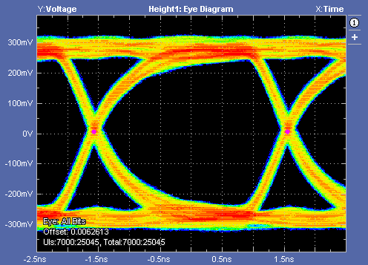
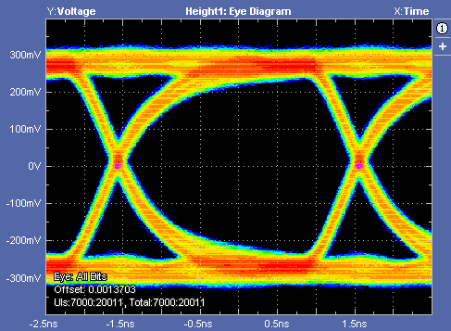
Eye diagrams
For the present MDT FE, we send 80 Mbps data to mezz cables
We want to see if these cables/motherboards can handle 320 Mbps with reasonable BER
Cable and MB’s eye diagram(320Mbps)
Test pattern : PRBS7
Cable and MB’s eye diagram(320Mbps)
Test pattern : PRBS31

Slide 9
BER results
We have run our setup for more than four hours and sent about 1 TB data using PRBS7 and PRBS31 patterns
No errors are found
Results are listed below:
In all, we observed nice eye diagrams & reasonable BER for mezzinane cables/CSM motherboards at 320 Mbps
We are working to test the cables/motherboards with a longer time period and determine the BER more precisely
Test pattern | Speed | Data bits | Errors | Upper limits on BER
PRBS7 | 320Mbps | 3.45E12 | 0 | 2.90E-13
PRBS31 | 320Mbps | 4.30E12 | 0 | 2.33E-13

Slide 10
Chapman Picture
Mezzanine
#0
4.8 GB Fiber
Fast Fiber
160 MHz
DDR
L1A
ASD &
24 channel
TDC
Readout
Trigger
Extraction
L1-Buffer
GBT
Mezz = 5 bits
Chan = 5 bits
Time = 2-3 bits
Offset = 3-4 bits
x5 Plus one
BCID
18
Total
2-bit @ 160 MHz DDR
L1A
Readout
ASD &
24 channel
TDC
L1-Buffer
Mezzanine
#17

Slide 11
Highest Data Rate for Readout & Trigger
Assume the highest rate is typified by 200kHz/tube
  Leads to 4.8 (4.13) MHz into L1 buffer = 0.14 hits/mezzanine/crossing
  Occupies 24% of TDC bandwidth to CSM (2 lines @ 160 MHz DDR)
    32 bits/hit depending on details of TDC
  Averages 250 slots in L1 buffer during 60μs latency
  Readout at 0.4 MHz L1 rate occupies 37% of GBT link to USA 15
  Trigger data occupies 40% of trigger bandwidth for 4.8 GB link, 16 bits/hit, and using 8/10 encoding.

Slide 12
The Maximum Rate Numbers
 | KHz/ | Rate into L1/ | Hits each* | Data each | Bit Rate per | Occupancy | Hits/10us | Hits/60us | Data Rate at | Occupancy
 | tube | TDC in MHz | TDC MHz | Beam CSX | TDC MHz | TDC>CSM | Latency | Latency | 0.4 MHz L1 | GBT link
Max | 200.0 | 4.80 | 4.13 | 0.14 | 132.20 | 20.66% | 41.31 | 247.88 | 1175 | 37%
 |  |  | % of hits | Data each | For 18 TDC | Bit Rate/ | Fiber Rate | Occupancy
 |  |  | seen | Beam CSX | /Beam CSX | Beam CSX | MHz | CSM > tgr
 |  |  | 86.07% | 0.14 | 2.48 | 60.00 | 1500.00 | 39.06%
Includes headers
& trailers
From each 24 channel TDC there are 0.14 hits/crossing.
Data rate for each mezzanine card with 32 bits/hit is 132.2 MHz
Each of 5 trigger hits is represented by a 5 bit channel number, a 5 bit mezz card number, a 2-3 bit sub-time, and a 4-3 bit BCID offset = 16 bits. If all hits are from the current BCID (sent also), all offsets are 0, otherwise they are -15 to -1 indicating a carryover hit. Trigger fiber assumed at 4.8 GB/s (8/10 code).
* Rate diminished by tube Dead Time

Slide 13
Issue: Trigger Latency Varies
Latency Issues
  Data transmission to CSM is de-randomized with BCID tag
  Data from CSM to sector logic is de-randomized, also BCID tagged
  Dead Time of round tubes (ASD constrained) keeps rate manageable
  Large, 6μs, latency means data at sector logic before Level 0 trigger
  BCID offsets assume no more than 16 crossing delay (400 ns)
Poisson distribution of hits at nominal maximum rate indicates
  Few 24 channel TDCs have more than 5 hits per crossing (mean 0.14/Chan)
  Typical number of hits in 18 mezzanines is 2.5/crossing (can send 5/crx)
  Dead Time limits growth beyond what can be handled within a few crossings
  Bandwidth occupancy is well matched to existing cables & single trigger fiber

