Slide 1


DETECTOR TECHNOLOGIES
Lecture 1: Principles of detection
- Generalities about detectors
- Interaction of particles with matter

Slide 2
Goal :
Observation and identification of final states
(whatever the processus)
A particle : Mass
Electrical Charge
Moment
Energy
Lifetime
(spin, flavour, color….)
A Detector : does not give any measurement.
Gives an information coming after an interaction with the particle

Slide 3
Energy deposition
- Limited (the particle goes almost undisturbed)
Momentum
Electrical charge (if magnet)
→ Trajectography
- Total (the particle stops)
Energy
Various processes
But first : some important notions
(supposed to be known ?)

Slide 4
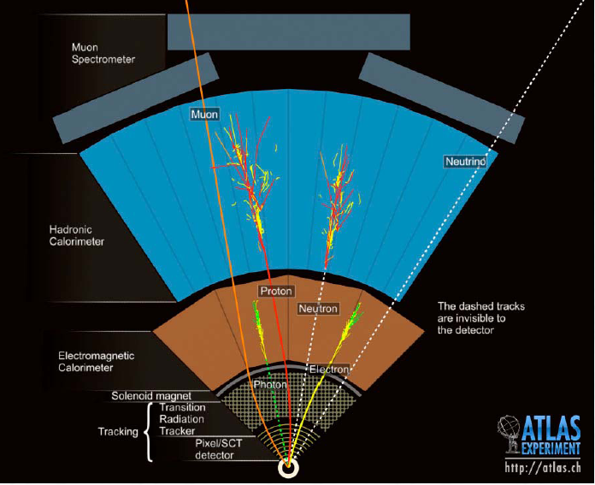
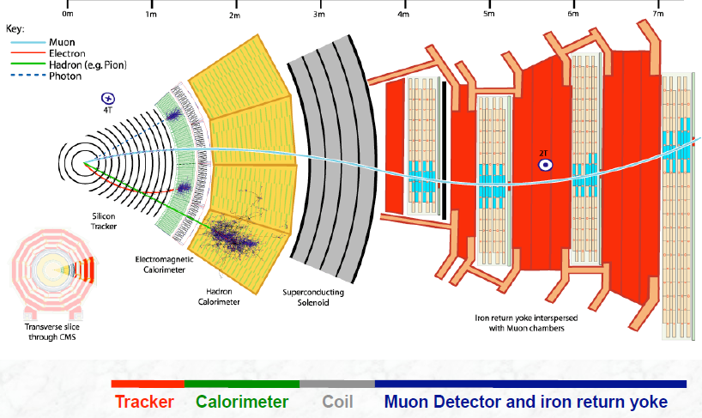
Types of detectors :
Trackers (position and momentum measurement)
Calorimeters (energy measurement)
Identifiers (identification of various types of particles)
Trigger counters

Slide 5

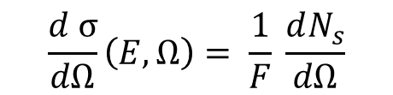
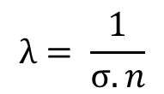
CROSS SECTION :
Probability of a phenomenon (interaction with the detector) to occur.
$$\frac{d σ}{dΩ}\left(E, Ω\right)= \frac{1}{F} \frac{dN_{s}}{dΩ}$$
F = incident flux of particles
Ns = emitted number of particles
Ω = Solid angle
σ (E) = $\int{dΩ \frac{dσ}{dΩ}}$
MEAN FREE PATH :
Average distance travelled by a particle between 2 consecutive interactions
in matter (detector) :
$$λ= \frac{1}{σ.n}$$
σ = total interaction cross section
n = number of interactive centers per unit volume

Slide 6
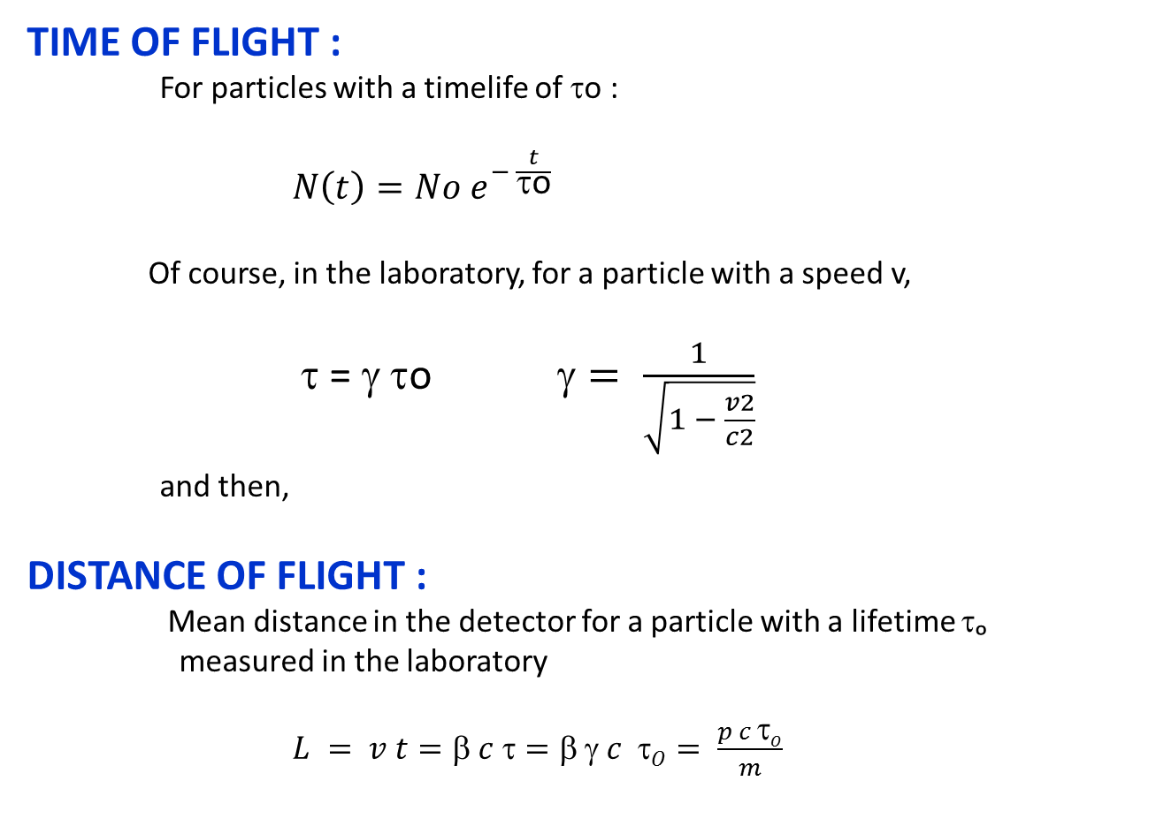
TIME OF FLIGHT :
For particles with a timelife of τo :
$N\left(t\right)=No e^{− \frac{t}{\text{τ}\text{o}}}$
Of course, in the laboratory, for a particle with a speed v,
τ = γ τo $= \frac{1}{\sqrt{1 − \frac{v2}{c2}}}$
and then,
DISTANCE OF FLIGHT :
Mean distance in the detector for a particle with a lifetime τₒ
measured in the laboratory
$L = v t=β c τ=β γ c τO= \frac{p c τO}{m}$

Slide 7
High energetic particle (particles at speed ≈ c
quasi-transparent detector
Particle | c τ (cm)
γ | ∞ (stable)
e⁺ / e⁻ | ∞ (stable)
µ | 6.6 10 ⁴
neutrino | ∞ (stable)
π^{O} | 2.5 10⁻⁶
π⁺ / π⁻ | 780
K⁺ / K⁻ | 371
K⁰_{s} | 2.7
K⁰_{l} | 1554
p | ∞ (stable)
n | 2.7 10 ¹³

Slide 8
INTERACTION OF PARTICLE WITH MATTER :
Depends on the type of interactions
ELECTROMAGNETIC : λ ≈ µm
ionization
pairs creation (e⁺ e⁻, electrons – holes…)
photon emission (Bremstrahlung, Cerenkov effect)
STRONG : λ ≈ cm
hadronic showers of neutrons
(but the observed signal will be due to EM interaction)
WEAK : λ ≈ 10¹⁵ m (neutrinos)
GRAVITY : ??
Depends on the type of particle
CHARGED
NEUTRAL
And of course, ENERGY, MEAN FREE PATH, LIFETIME

Slide 9
In order to detect a particle, it must
- interact with the material of the detector
- transfer some energy in a recognizable way (signal to be processed)
4 CLASSES OF PARTICLES
Heavy (m > m_{e} ) charged particles
Light (m ≈ m_{e} ) charged particles
Photons
Hadrons
3 POSSIBILITIES
Ionization (EM)
Radiation (EM)
Nuclear interaction (Strong)

Slide 10

HEAVY (m > m_{e} ) CHARGED PARTICLES : IONIZATION
Energy loss (energy transferred to the medium ) by ionization in MeV g⁻¹ cm²
Bethe-Bloch, 1932
Where : K = 4 π N_{A} r_{e}² m_{e} = 0.3071
A, Z : atomic mass and number relative to the medium
N_{A} : Avogadro’s number
T_{max} : maximum possible energy transferred to an electron in the medium
(see J. Collot’s lecture)
z : charge of the incoming particle
β, γ : relatives to the particle
→ dE/dX in MeV.g^{-1.}cm²
→ valid only for M>mμ
→ dE/dX depends on β,
→ dE/dX does not depend on M

Slide 11
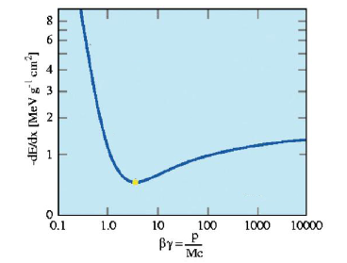
HEAVY (m > m_{e} ) CHARGED PARTICLES : IONIZATION
Non-relativistic
βγ = p/m < 1  -dE/dx α β^{-5/3}
Relativistic increase
βγ > 4  -dE/dx α 2 ln(γ)
βγ ≈ 4  Minimum Ionizing Particle (MIP)

Slide 12
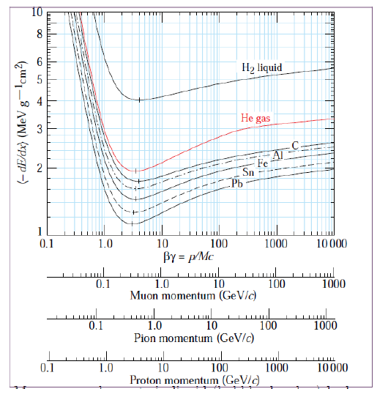
HEAVY (m > m_{e} ) CHARGED PARTICLES : IONIZATION
Relativistic rise :
- more distant collisions,
increasing the transverse
electric field with γ
Typical for
gas : 1.5
liquid : 1.1

Slide 13
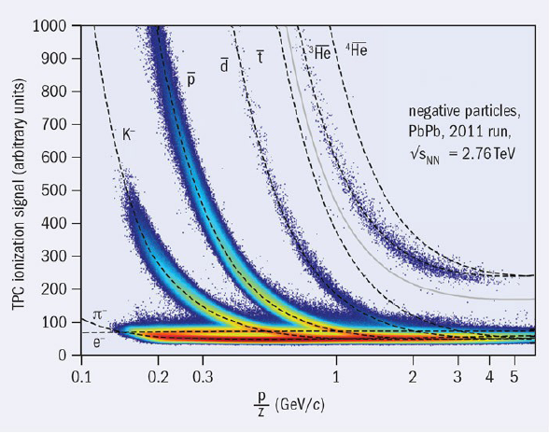
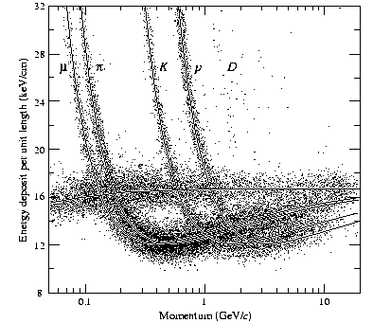
HEAVY (m > m_{e} ) CHARGED PARTICLES : IONIZATION
Direct identification by energy loss
in Ne-CO2 90-10 %
(ALICE TPC)
Direct identification by energy loss
in Ar-CH₄ 80-20 %
(DELPHI

Slide 14
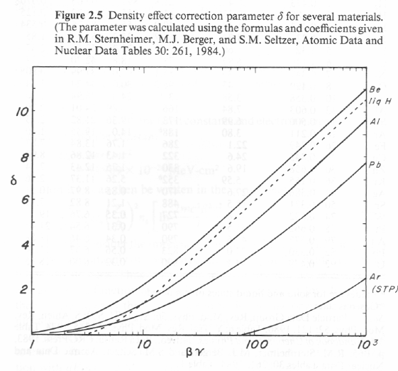
HEAVY (m > m_{e} ) CHARGED PARTICLES : IONIZATION
Corrections to the Bethe-Bloch formula :
Density effect : the density of the medium will have a screening effect on the relativistic rise (important for solids and liquids)
Solids
Liquids
Gaz

Slide 15
LIGTH (m≈me) CHARGED PARTICLES : IONIZATION
Corresponds to an energy loss by charged particle : Bethe-Bloch
But : small mass : electrons may be deflected
interaction electron – electron : collisions between identical particles
Bethe-Bloch :
Bethe-Bloch
For electrons

Slide 16
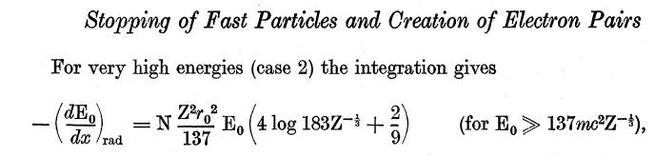


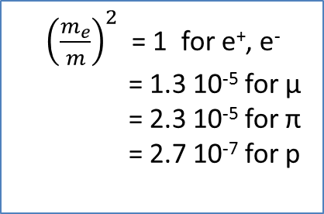
CHARGED PARTICLES : RADIATION (Bremsstrahlung)
For any charged particle :
When accelerated (or deccelerated), in the nucleus electric al field,
any charged particle emits photons
From :Bethe, H.A., Heitler, W., 1934. On the stopping of fast particles and on the creation of positive electrons
Z : médium
z, m, E : particle
${\left(\frac{m_{e}}{m}\right)}^{2}$= 1 for e⁺, e⁻
= 1.3 10⁻⁵ for µ
= 2.3 10⁻⁵ for π
= 2.7 10⁻⁷ for p
Up to 100 GeV, on can neglect the
Bremssttrahlung if particle ≠ e⁺ or e⁻

Slide 17

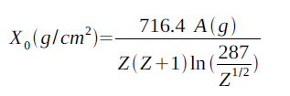
CHARGED PARTICLES : RADIATION (Bremsstrahlung)
For electrons,
Can be rewritten as
Xo : radiation length (characteristic of the medium)
Medium | Xo (g cm⁻²)
Hydrogen | 63.1
Helium | 94.3
Carbon | 42.7
Aluminium | 24.0
Iron | 13.8

Slide 18



CONSEQUENCE : CRITICAL ENERGY
The energy loss has 2 components :
- ionization (for heavy and energetic particles, it is ≈ constant
- radiation ( for heavy particles, it is almost negligible) proportional to E
The critical energy (Ec) is defined as the energy at which the two mechanisms are equal
For gas
For liquids and solids

Slide 19
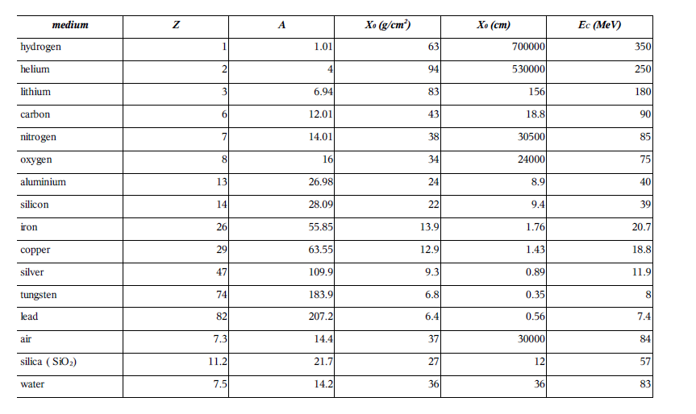
Note : table for electrons only (the most sensitive)
for other particles, it would scale to the square of the particle mass

Slide 20
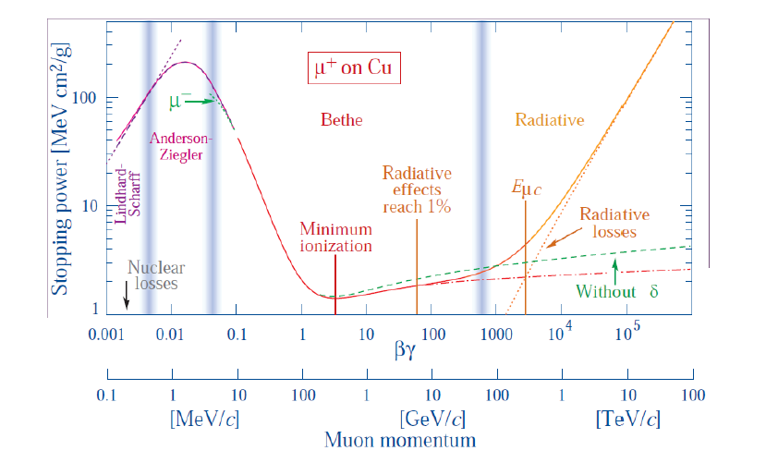
INTERACTION OF CHARGED PARTICLES

Slide 21
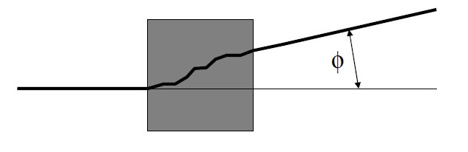

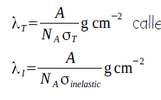
CHARGED PARTICLES (Hadrons) : Coulomb scattering and interactions
Hadrons are interacting mainly with the nucleus by (strong interaction)
- collisions (coulomb))
- interaction (strong force)
X
Phenomenon governed by the interaction lengths λ_{T} (collisions) and λ_{i} (interactions)

Slide 22
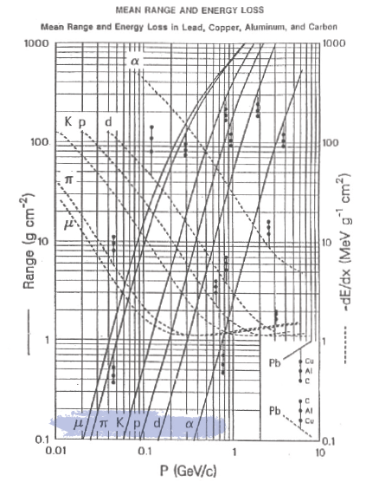
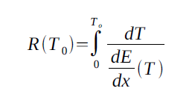
Range : measured of the stopping power
for various material
for different energies (momentum)

Slide 23
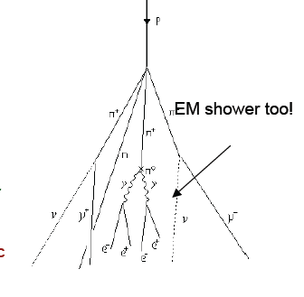
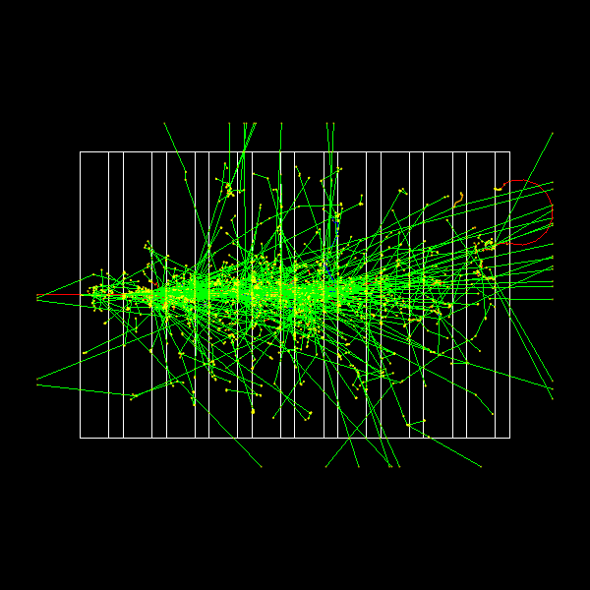
Hadronic shower : λ instead of X_{o}

Slide 24
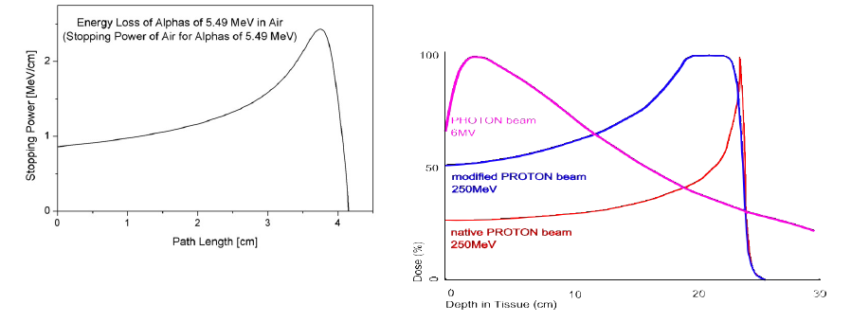
CONSEQUENCE : RANGE IN MATTER
In a medium a particle will loose its energy by any means
(ionization radiation, scattering) until it stops in the medium
Of course, it depens on the MASS and ENERGY of the incoming particle
Of course, it depens on the DENSITY and the THICKNESS of the medium
Almost negligible for High Energy Physics

Slide 25
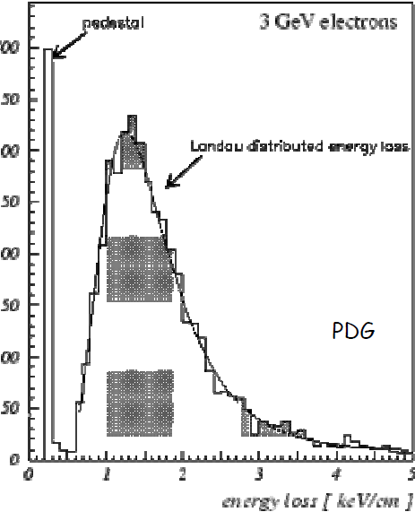

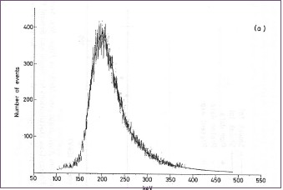
ENERGY LOSS DISTRIBUTION
The Bethe-Bloch formula describes the average energy loss of charged particles.
But there can be large fluctuations which have an effect on larger energy losses
The fluctuation around the mean is decribed by an asymetric distribution
Landau distribution :
In fact, for thin absorbers, the reality is more a convolution
of a Landau and a Gaussian distribution…
Energy deposited by 736 MeV/c proton in Silicon
(Xo = 9.4 cm , Ec = 39 MeV for electrons)

Slide 26
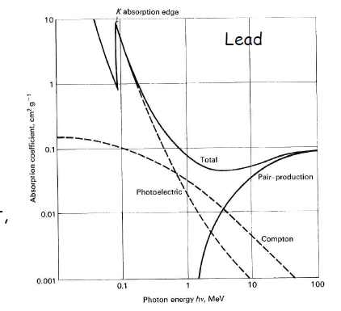
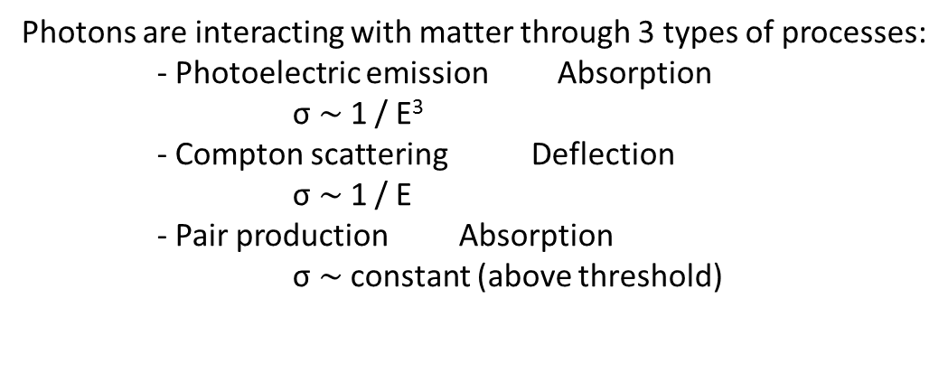
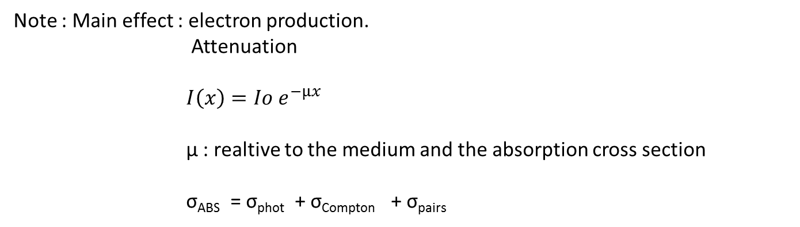
INTERACTION OF PHOTONS
Photons are interacting with matter through 3 types of processes:
- Photoelectric emission Absorption
σ $\sim$1 / E³
- Compton scattering Deflection
σ $\sim$1 / E
- Pair production Absorption
σ $\sim$constant (above threshold)
Note : Main effect : electron production.
Attenuation
$I\left(x\right)=Io e^{−µx}$
µ : realtive to the medium and the absorption cross section
σ_{ABS} = σ_{phot} + σ_{Compton} + σ_{pairs}

Slide 27
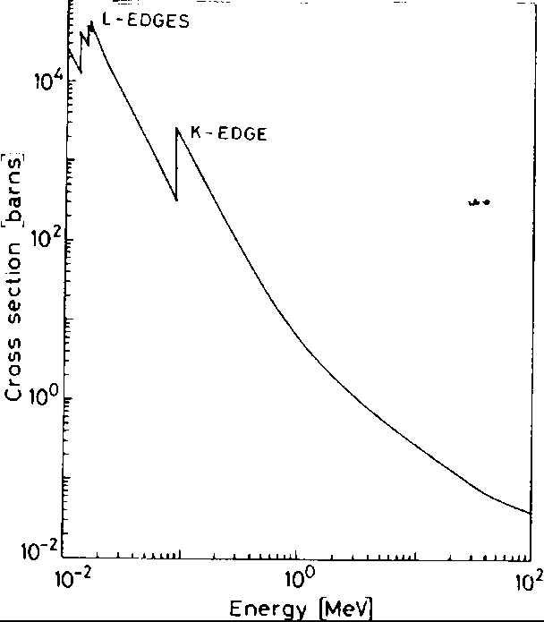
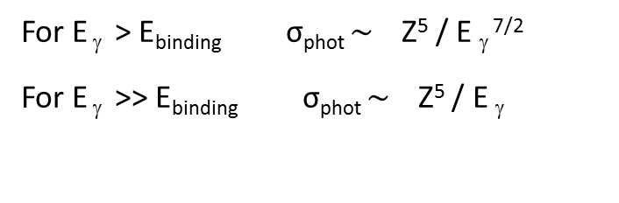
INTERACTION OF PHOTONS : PHOTOELECTRIC EMISSION
A. Einstein, 1905
γ + A A⁺ + e⁻
Again : Energy transfert to an electron :
E_{e} = E _{γ} - E_{binding}
For E _{γ} > E_{binding} σ_{phot} $\sim$ Z⁵ / E _{γ} ^{7/2}
For E _{γ} >> E_{binding} σ_{phot} $\sim$ Z⁵ / E _{γ}
Dominant process for E _{γ} < 100 keV

Slide 28
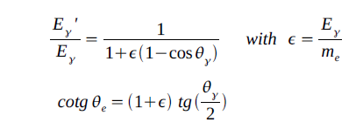
INTERACTION OF PHOTONS : COMPTON SCATTERING
hν’
hν
Θγ
e⁻
Θe
Θ_{e} can not be > /2
T
Cross section : calculated using QED :
Klein – Nishima formula
Intergating over Ω :
σ_{Compton} =
σ_{Compton} α Z / E _{γ}

Slide 29
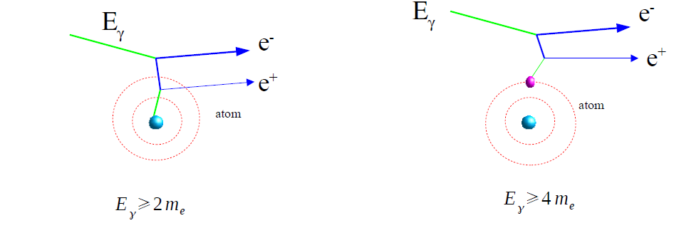
INTERACTION OF PHOTONS : PAIRS PRODUCTION
γ → e⁻ + e⁺
Needs a nucleus
or another electron…
Threshold :
And because m _{nucleus} >> m _{e}
Cross section :
For higher energies ( > 10 MeV) :
Note : If enough energy, the positron will annihilate with another electron,
producing another photon, which will annihilate in a pair …
Electromagnetic shower

Slide 30
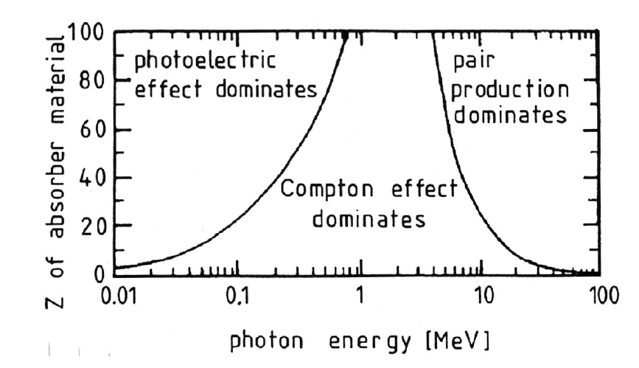

Slide 31
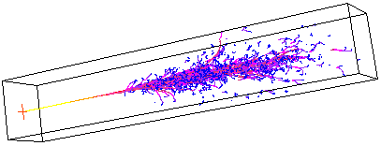
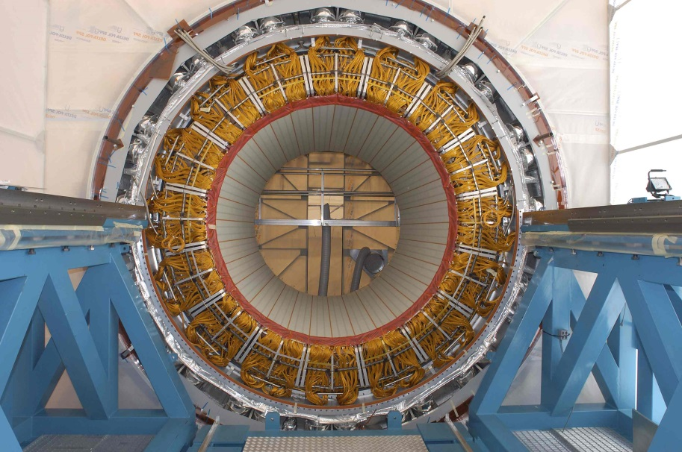
INTERACTION OF PHOTONS : PAIRS PRODUCTION
Note : If enough energy, the positron will annihilate with another electron, producing another photon, which will annihilate in a pair …
Electromagnetic shower
The ATLAS electromagnetioc calorimeter

Slide 32
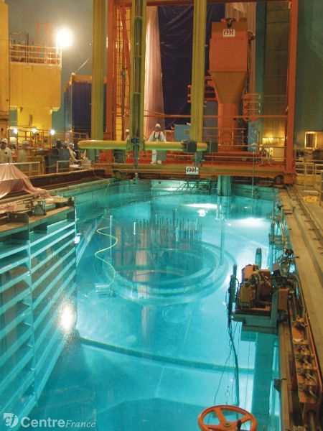
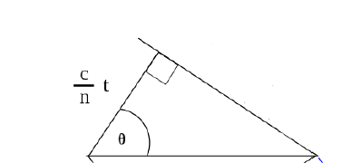



CERENKOV EMISSION
When a particle is moving faster than the velocity of ligth in a given medium
production of photons
Treshold : (n is the refractive index of the medium)
Photon production is rather small :
Energy loss is very small (can be neglected):
10⁻³ MeV.cm².g⁻¹ for solids
0.01 – 0.2 MeV.cm².g⁻¹ for He, H2
Typical : 0.35 µm < λ _{cerenkov} < 0.55 µm

Slide 33
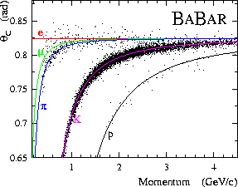
Identification of particles by measurement of Θ (Experience Babar)

Slide 34
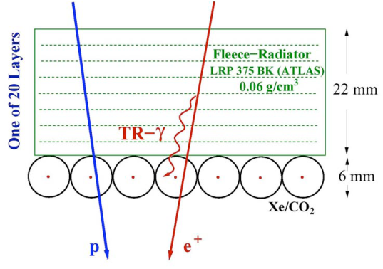


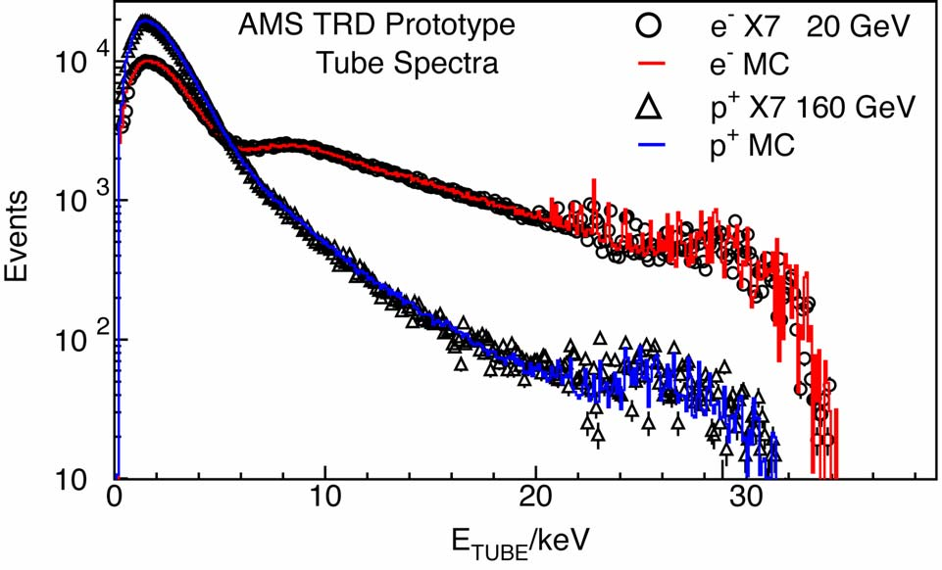
TRANSITION RADIATION
Transition radiation is a photon emission (X) occuring when a charged particle passes through inhomogeneous media, such as a boundary between two different media with different dielectric properties
Emission at an angle
Very low rate
In the momentum range 1 – 10 GeV, only electrons produce transition radiation with a relatively low probablity (1%) per boundary crossing.
Thus, a TRD is mostly used for electron identification.

