Slide 1


DETECTOR TECHNOLOGIES
Lecture 3: Semi-conductors
- Generalities
- Material and types
- Evolution

Slide 2
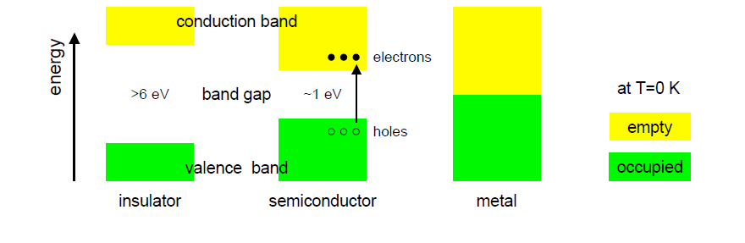
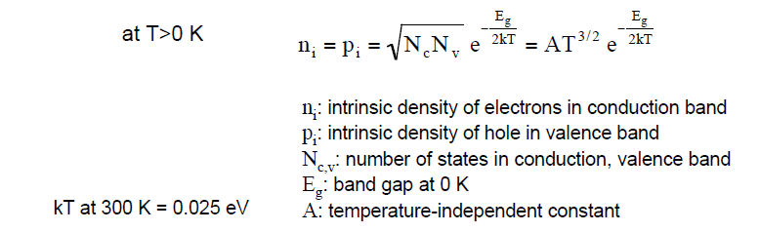
Semiconductors : generalities
Solid-States band structures :
Valence band : e– bond atoms together
Conduction band : e– can freely jump from an atom to another
At T ≠ 0 K
Electrons may acquire enough energy
to pass the band gap… Thermal condution

Slide 3
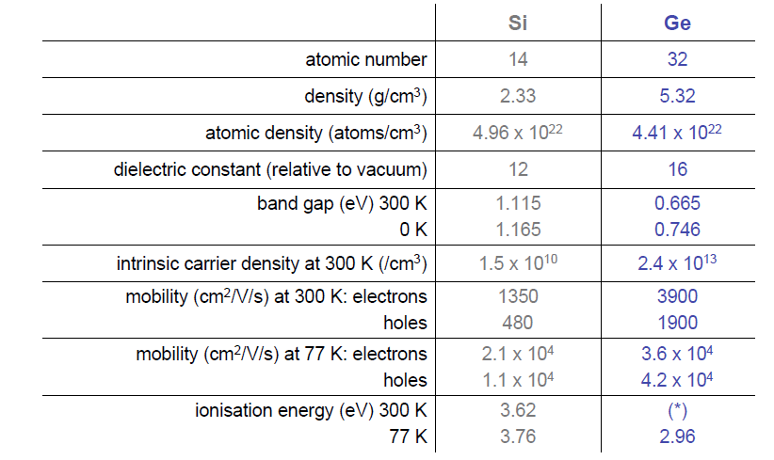
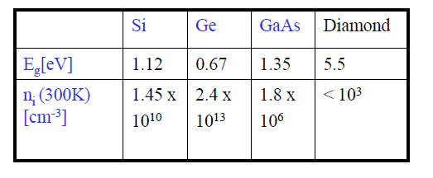
Semiconductors : generalities
Not the same !
(Thermal excitation + phonons)

Slide 4

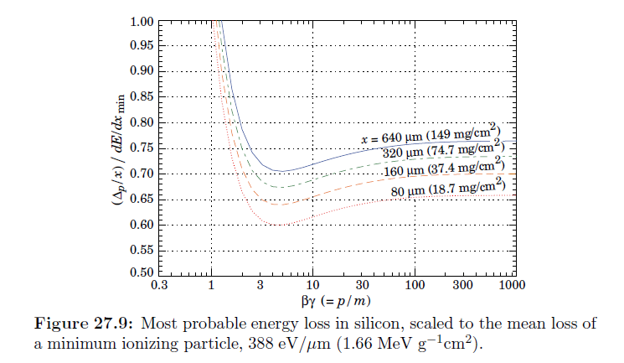
Semiconductors : generalities
Energy loss by a charged particle : Bethe-Bloch
Standard :
Energy loss :
electrons – holes pairs created
(NOT electrons – ions…)
If Field (even natural)
electrons migration
Electrical pulse
Information
Too simple !

Slide 5
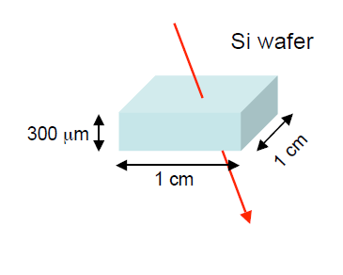
Semiconductors : generalities
One MIP in Silicon at 300°K
Energy loss : dE / dx ≈ 388 Ev/µm
Ionisation Energy : 3.62 eV
e – holes pairs created : 107/µm
For 300 µm : 3.2 10 ⁴ pairs created
Free charge carriers in the same volume :
≈ 4.5 10 ⁹
Signal is lost !
Solution : Depletion of the detector
- Doping
- Blocking contacts
Depletion : removing the maximum possible thermally excitable electrons

Slide 6
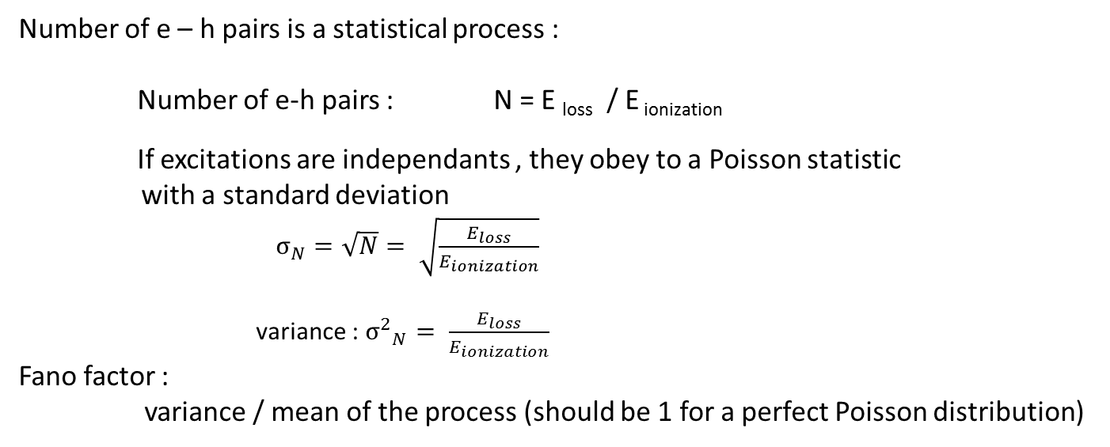
Semiconductors : generalities : the Fano factor
Number of e – h pairs is a statistical process :
Number of e-h pairs : N = E _{loss} / E _{ionization}
If excitations are independants , they obey to a Poisson statistic
with a standard deviation
$σ_{N}=\sqrt{N}= \sqrt{\frac{E_{loss}}{E_{ionization}}}$
variance : ${σ^{2}}_{N}= \frac{E_{loss}}{E_{ionization}}$
Fano factor :
variance / mean of the process (should be 1 for a perfect Poisson distribution)
Si | 0.115
Ge | 0.13
GaAs | 0.10
Diamond | 0.08
Fano factor related to energy resolution :
A Fano factor < 1 means that the energy resolution would be better than
Theoretically expected…

Slide 7
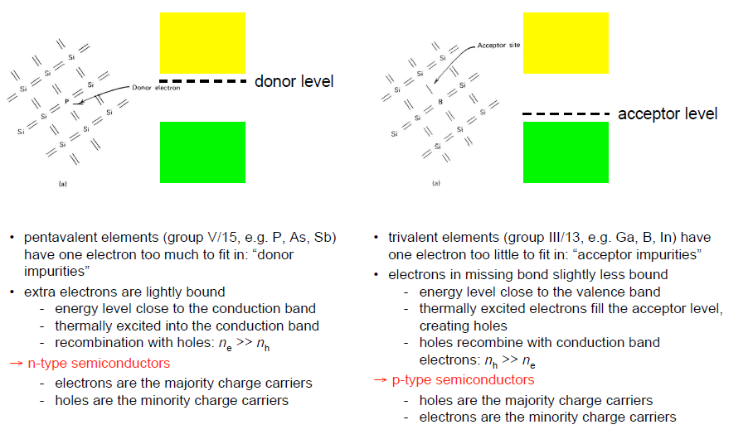
Semiconductors : generalities : p and n types
dopants :
Boron, Arsenic, Phosphorous, Gallium

Slide 8
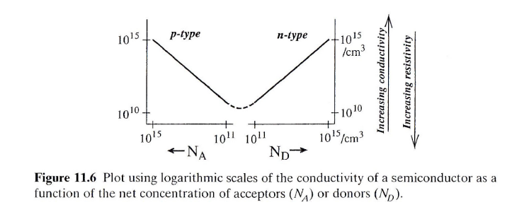
Semiconductors : generalities : p and n types
Typically : doping level for a Silicon Detector : 10 ¹² atoms / cm ³
Doping us usually done by ion implantation.

Slide 9
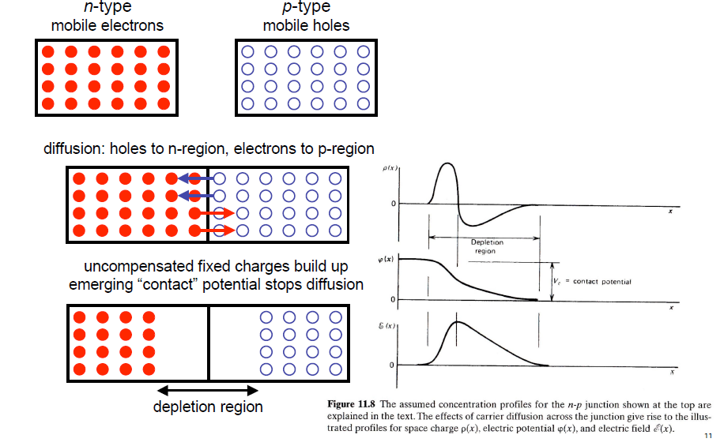
Semiconductors : generalities : junction detectors
A p-n junction is formed when a
single crystal of semiconductor is doped with acceptors on one side and donors on the other

Slide 10
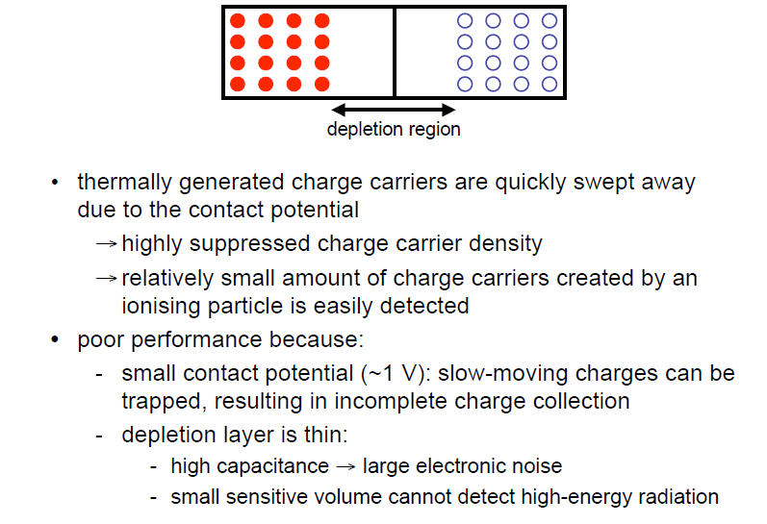
Semiconductors : generalities : junction detectors

Slide 11
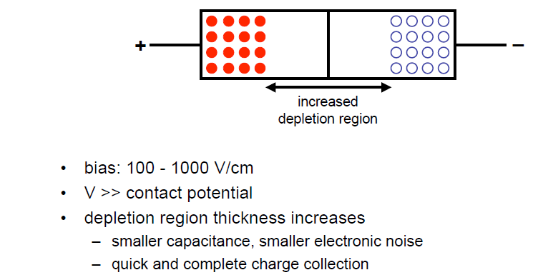
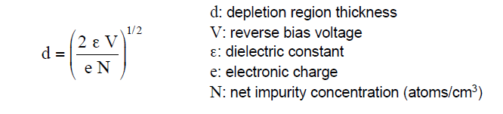
Semiconductors : generalities : reverse biasing scheme
The p – n zones will be used for contact
and to block (Blocking Contacts) the undesired noise

Slide 12
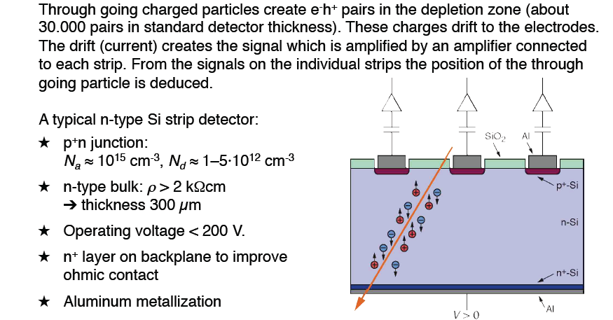
Semiconductors : generalities : building
DC Coupling Silicon detector

Slide 13
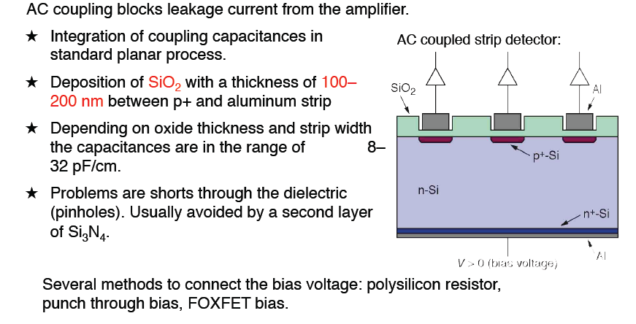
Semiconductors : generalities : building
AC Coupling Silicon detector

Slide 14
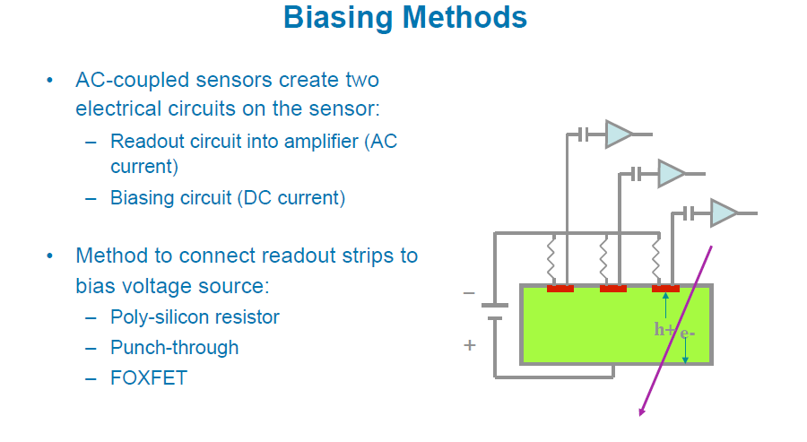
Semiconductors : generalities : building
AC coupled Si detectors create 2 electrical circuits :
- Read-out circuit to the amplifier (AC current)
- Biasing circuit (DC current)

Slide 15
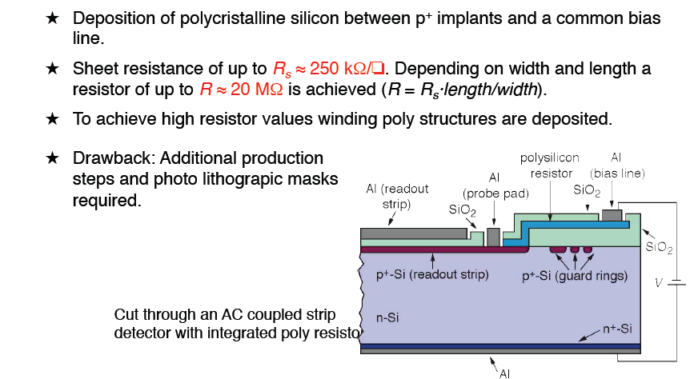
Semiconductors : generalities : building
AC Coupling Silicon detector : bias voltage system

Slide 16
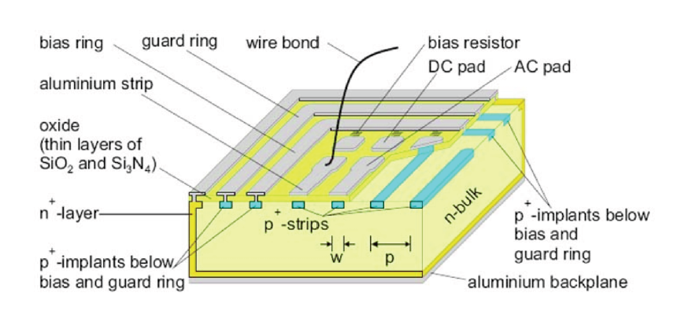
Semiconductors : Si detectors designs
Most commonly scheme AC + poly S-bias resistor

Slide 17
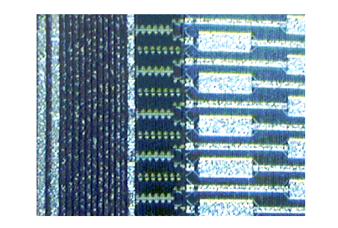
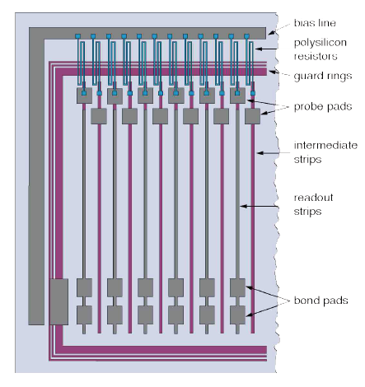
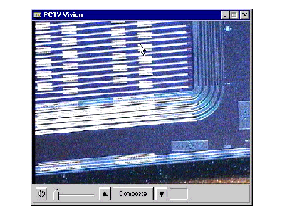
Semiconductors : Si detectors designs
CMS design
ATLAS design

Slide 18
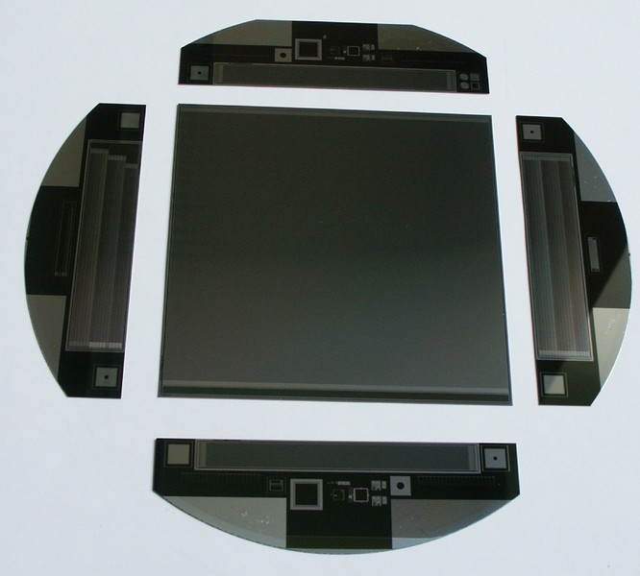
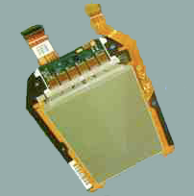
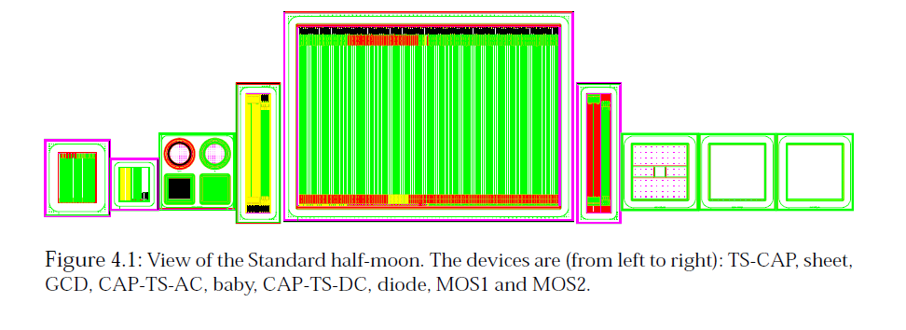
Semiconductors : Si detectors designs

Slide 19
Semiconductors : Radiation Damage
Two types of radiation damage :
• Bulk (Crystal) damage due to Non Ionizing Energy Loss (NIEL) - displacement damage, built up of crystal defects –
Change of effective doping concentration (higher depletion voltage, under- depletion) Increase of leakage current (increase of noise, thermal runaway) Increase of charge carrier trapping (loss of charge)
• Surface damage due to Ionizing Energy Loss (IEL) - accumulation of positive in the oxide (SiO₂) and the Si/SiO₂ interface – affects: interstrip capacitance (noise factor), breakdown behavior, …
Impact on detector performance (depending on detector type and geometry and readout electronics!) Signal/noise ratio is the quantity to watch
⇒ Sensors can fail from radiation damage !

Slide 20
Semiconductors : Effect of radiations
Loss of collected charges
(new 300 µm Silicon ≈ 24 000 e- for 1 MIP)
Trapping is characterized by an effective trapping time τ_{eff} for electrons and holes:
where

Slide 21
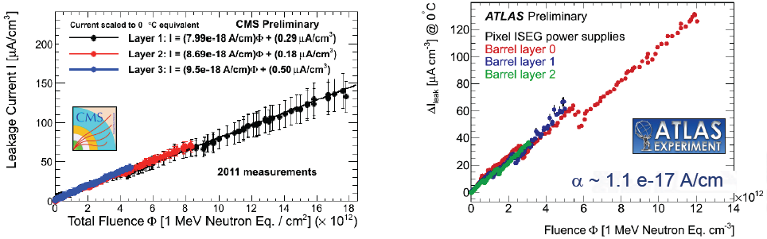
Semiconductors : Effect of radiations
Increase of Leakage current

Slide 22
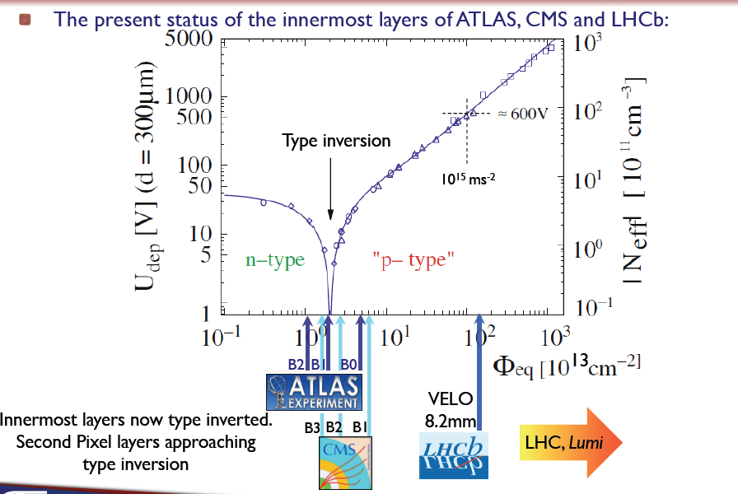
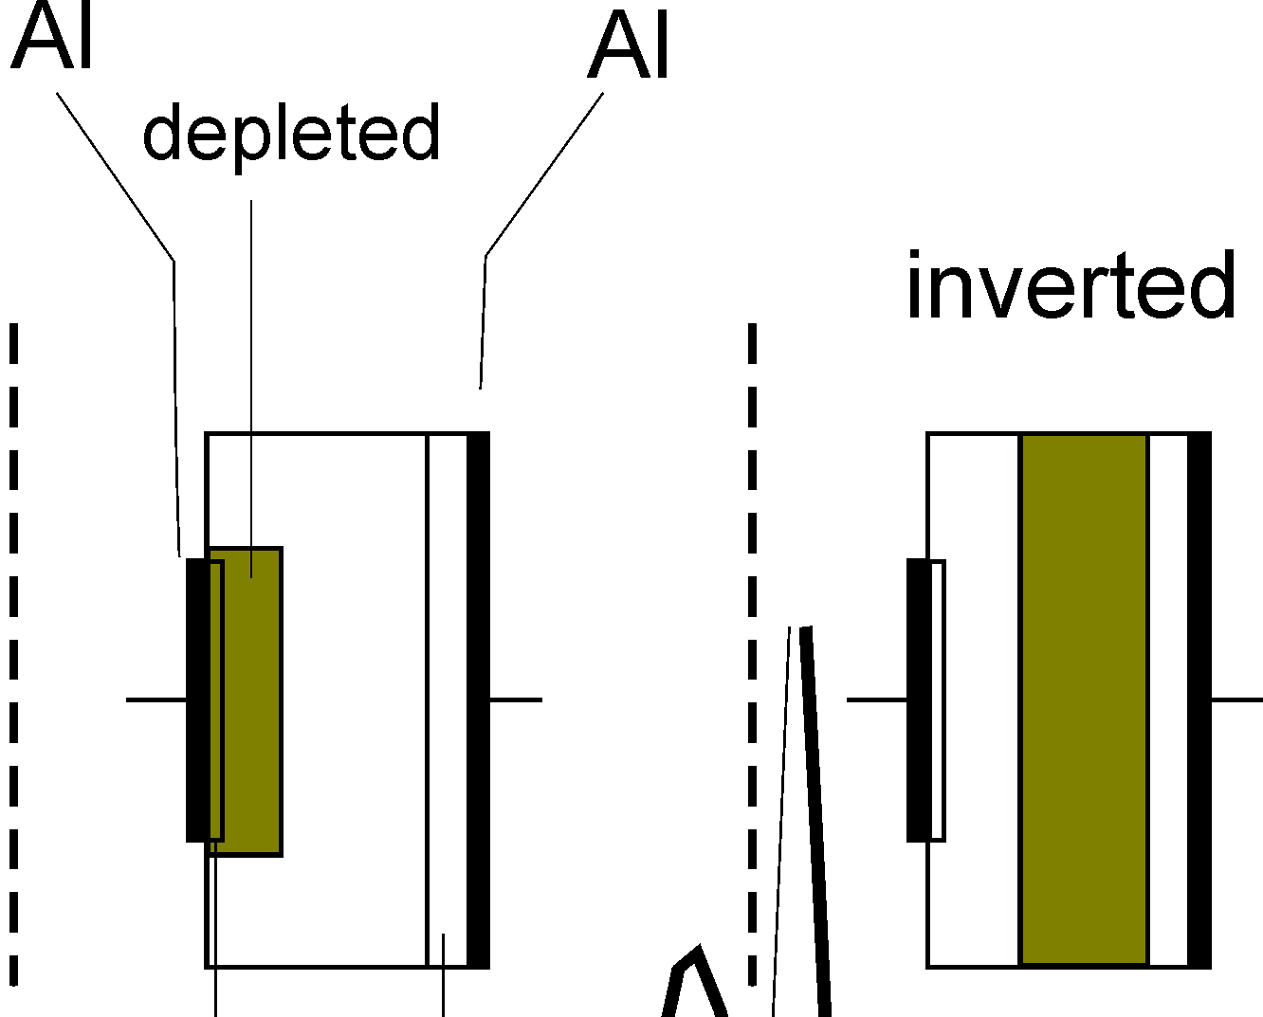
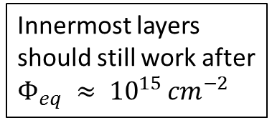
Semiconductors : Effect of radiations
Change in depletion voltage and type inversion
Innermost layers
should still work after
$Φ_{eq} ≈ {10}^{15 }{cm}^{−2}$
before inversion
p⁺
n⁺
p⁺
n⁺
after inversion

Slide 23
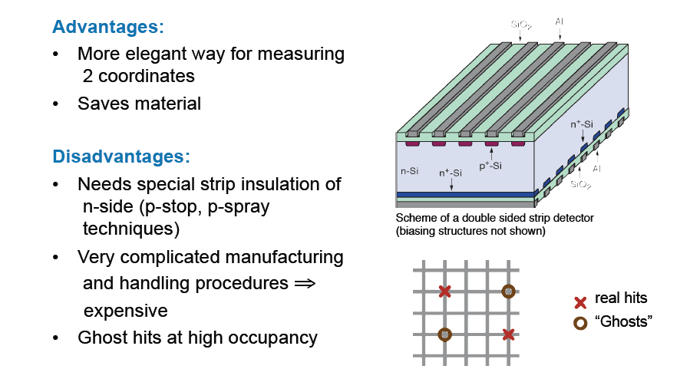
Semiconductors : 2-dimensional detectors
Double Sided Silicon Detectors (DSSD) Not much in use…

Slide 24
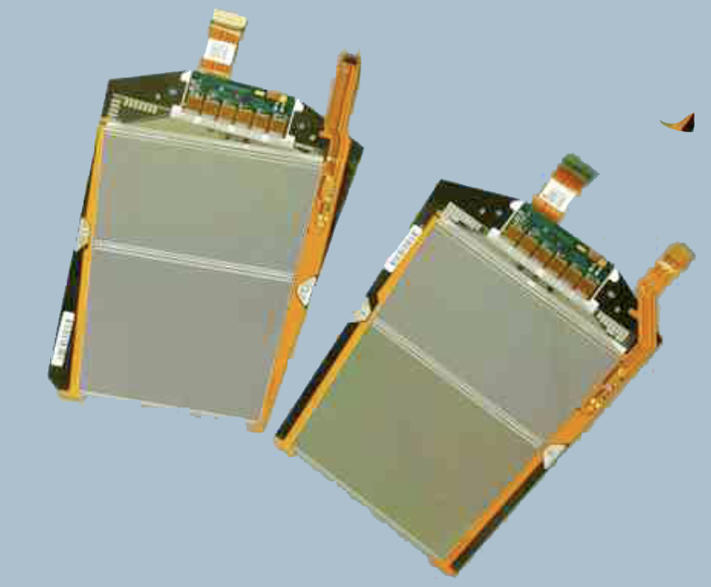
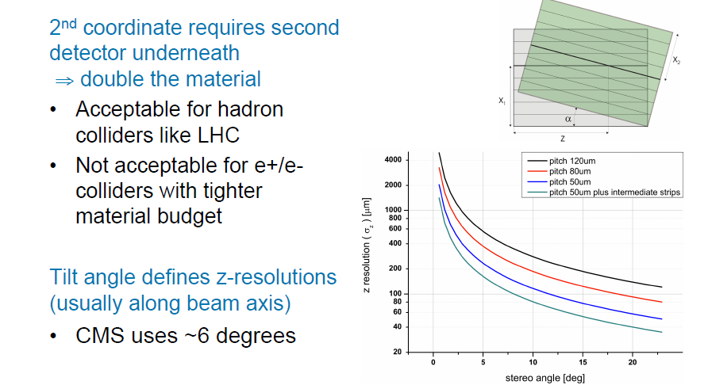
Semiconductors : 2-dimensional detectors
Stereo Modules

Slide 25
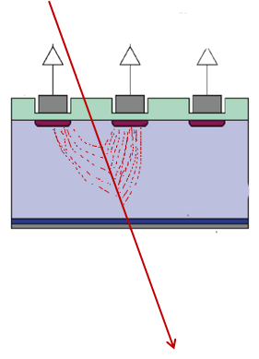
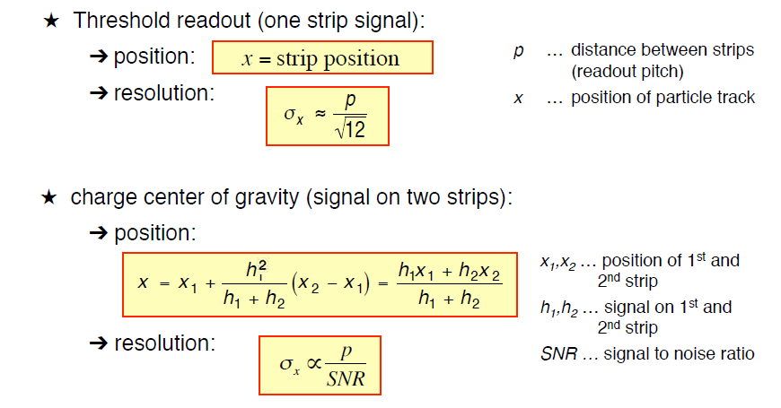
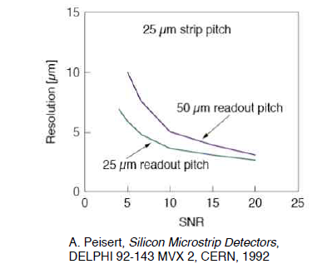
Semiconductors : Performance

Slide 26
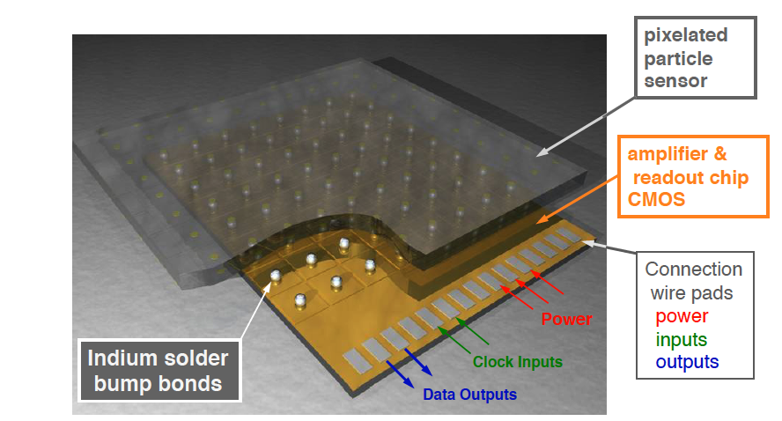
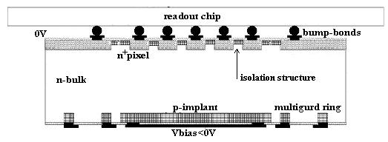
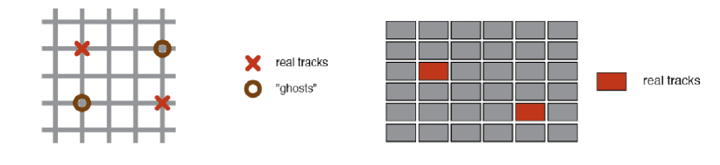
Semiconductors : Pixels Detectors
Pixel sizes :
ATLAS : 50 µm x 400 µm
CMS : 100 µm x 150 µm
ALICE : 50 µm x 425 µm

Slide 27
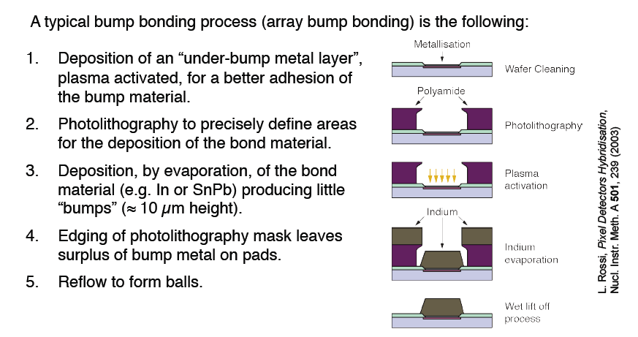
Semiconductors : Pixels Detectors
CONNECTION BY BUMP BONDING

Slide 28
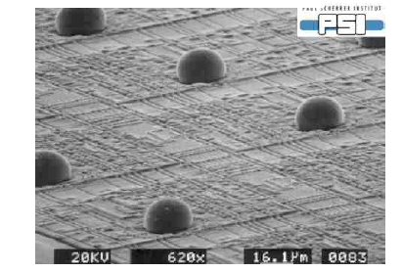
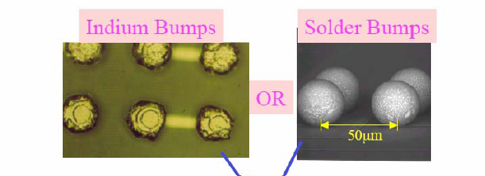
Semiconductors : Pixels Detectors
Pitch : 50 µm
(wire bonding typically 200µm)

Slide 29
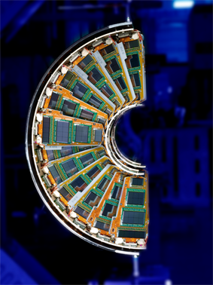
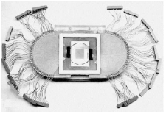
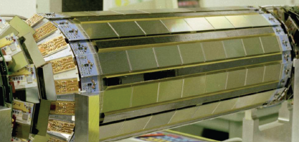
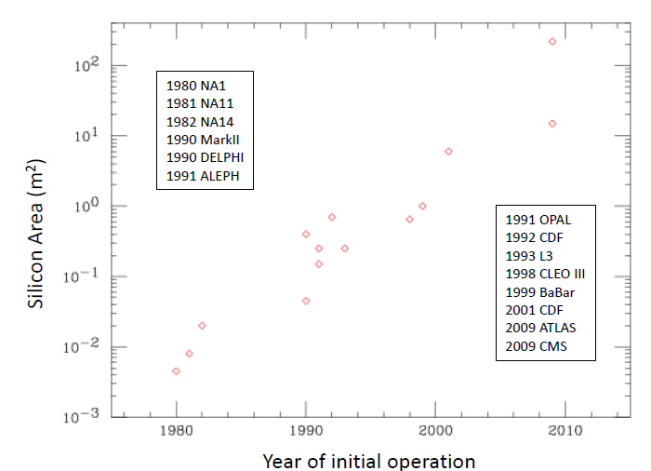
Semiconductors : Silicon history
CDF
NA 11
DELPHI
CMS ≈ 215 m²
ATLAS ≈ 61 m²
LHCb ≈ 12.5 m²
CDF ≈ 3.5 m²
ALICE ≈ 1.5 m²

Slide 30
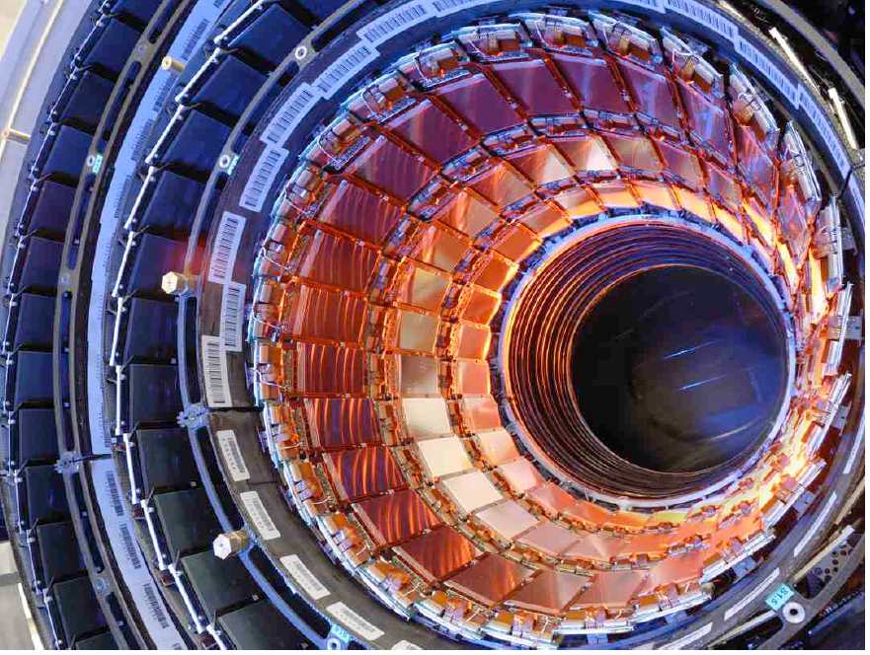
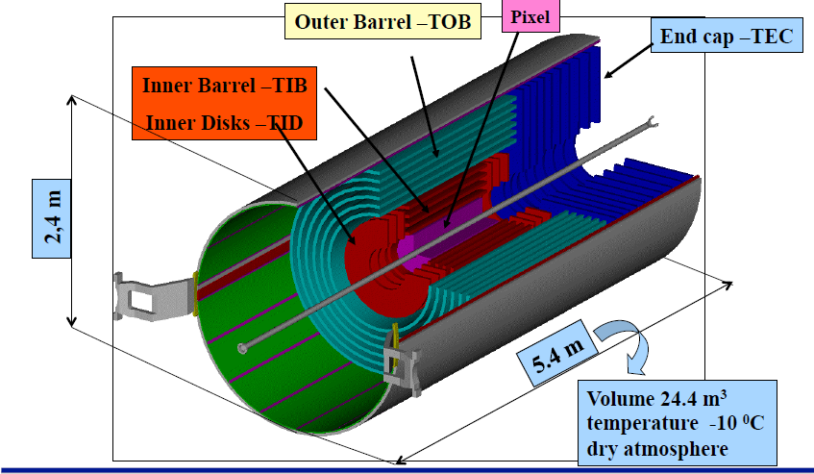
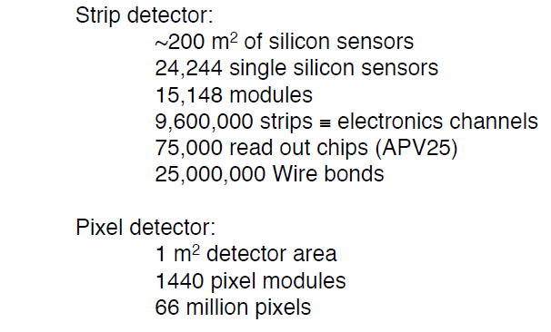
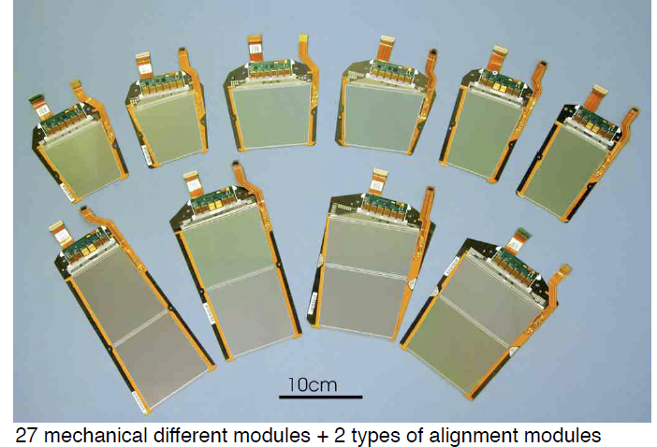
Semiconductors : CMS Silicon Detector

Slide 31
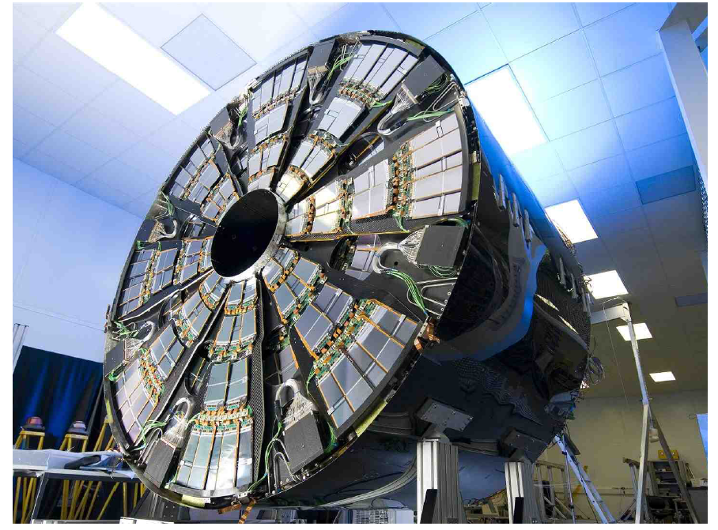
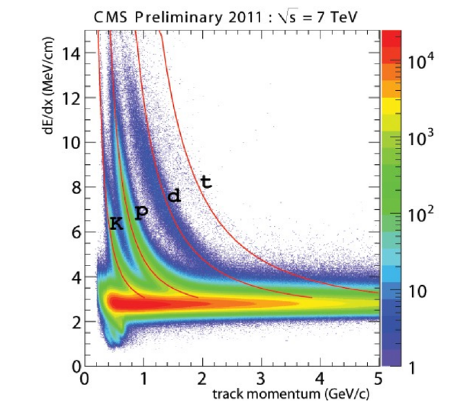

Semiconductors : CMS Silicon Detector

Slide 32





Semiconductors : ATLAS Silicon Detector

Slide 33



Semiconductors : ATLAS Silicon Detector

Slide 34

Semiconductors : CMS and ATLAS Silicon Detector

Slide 35

Semiconductors : Challenges and Evolutions
Main Challenge : The LHC at High Luminosity (2024 ?)
More tracks : Occupancy increases - Less resolution
More Flux : Radiation (bulk) damage

Slide 36



Semiconductors : Challenges and Evolutions
Reduce the Occupancy : Increase the granularity
Mini-strips sensors (reduce lenght from 10 cm to 5 cm)
- Increases the number of channels
- Increases the cost
- Increases the power to be dissipated
Reduce the matérial : Thin Si sensors
- Reduce the Charges Collected
Reduce the number of layers
- Reduce the overall Tracker efficiency
300 µm
150 µm

Slide 37
Semiconductors : Challenges and Evolutions
Change the material : Oxygenated Silicon
HE detectrors : FZ (Float Zone) Crystal - High resistivity > 3-4 kΩcm
- O2 contens < 50 10 16
New Materials : DOFZ : O2 doped FZ Silicon (Oxydation of wafer at high temperature)
MCZ (Magnetic Czochralki) - Less resistivity ≈ 1.5 kΩcm
- O2 contens > 5 10 ¹⁷
EPITAXIAL growth : Chemical Vapor Deposition on CZ substrate
EPI layer
CZ substrate
Oxygen concentration in DOFZ
Oxygen concentration in Epitaxial

Slide 38
Semiconductors : Challenges and Evolutions
24 GeV/c proton irradiation
Standard FZ silicon
type inversion at ~ 2×10¹³ p/cm²
strong N_{eff} increase at high fluence
Oxygenated FZ (DOFZ)
type inversion at ~ 2×10¹³ p/cm²
reduced N_{eff} increase at high fluence
CZ silicon and MCZ silicon
no type inversion in the overall fluence range (verified by TCT measurements) (verified for CZ silicon by TCT measurements, preliminary result for MCZ silicon) ⇒ donor generation overcompensates acceptor generation in high fluence range
Common to all materials (after hadron irradiation):
reverse current increase
increase of trapping (electrons and holes) within ~ 20%

Slide 39


Semiconductors : Challenges and Evolutions
MAPS (Monolithic Active Sensor) or CMOS (Complementary Metal Oxide Semiconductor)

Slide 40


Semiconductors : Challenges and Evolutions
3D Silicon Detectors
Manufacturing challenge
Electrodes : dead zones
Efficiency vs fluence

Slide 41

Semiconductors : diamonds
Diamond is better than Silicon
Does not need any doping
Better radiation hardness
Better thermal conductivity
Better speed (1psec vs 1 nsec)
Light insensitive
Multi-metalization possible
(test and physics)
But :
3 times less signal for MIPs (3.6 / 13)
Difficult to manufacture
Expensive
Diamond is not understood (at the moment)
Diamond detectors
 | CVD Diamond | Si
Z | 6 | 14
Energy Gap | 5,5 eV | 1,21 to 1,1eV
Resistivity | 10¹³ – 10¹⁶ Ωcm | 10⁵ – 10⁶ Ωcm
Breakdown | 10⁷ V/cm | 3.10⁵ V/cm
Mobility (electrons) | 2000 cm²/V/s | 1350 cm²/V/s
Mobility (holes) | 1600 cm²/V/s | 480 cm²/V/s
Displacement Energy (e⁻) | 43 eV/atom | 13 à 20 eV/atom
Pairs Creation | 13 eV | 3.6 eV
Charge Collection Distance | 250 μm | 100 m ?
Mean signal (MIP) | 3600 e⁻ / μm | 8900 e⁻ / μm
Dielectric Constant | 5.5 | 10 à 12
Thermal Conductivity (W/m·K) | 1600 - 2000 | 150
2 forms :
Polycristalline
Wafer 6 inches
Monocrystalline
max : 4 x 4 mm ²

Slide 42

Semiconductors : Diamonds
CCD : CHARGE COLLECTION DISTANCE
Energy loss (Bethe-Bloch 1932)
Charge transportation (Hecht 1932)
CHARGE COLLECTION DISTANCE :
δ = λe + λ_{h} = (μe τe +μ_{h} τ_{h} ) E
λ : mean drift distance (mean free path of the carrier)
μ : mobility
τ : lifetime
E : applied electric field
Si (mono) = 100m
Si (amorphe) =10 µm
Diam = 0(100µm)

Slide 43
Semiconductors : Diamonds
CCD : MEASUREMENT
Charge Collection Distance :
Collected charge:
Pairs / MIP : 3600 / 100 µ diamant)
CCD : Measurement of diamond quality (pCVD ou sCVD)
Détecteur de particules :
N_{électrons} (MIP) ~ 10 000
Epaisseur (Xo…) ~ 300 µm
CCD ~ 280 µm
1 V/µ

Slide 44




Semiconductors : Diamonds
Diamant ?
Natural diamond: Lots of impurities
Lots of defects
Diamant HPHT (High Pressure – High Temperature) 1940
P > 50 000 bars
T > 2000 °C
Monocrystal
Dimension (few mm²)
Impurities
Diamant CVD (Carbon Vapor Deposition) 1980
Plasma CH4 – H2 (+X…)
P ≈ 0,1 bar
T ≈ 1000 °K
Slow deposition on substrate
1 – 50 µm / heure

Slide 45

Semiconductors : Diamonds
CVD polycristallin (pCVD)
Croissance sur substrat indifférent (quasiment)
Processus lent (1 µm /heure)
DIfférenciation des tailles de cristaux
Processus industriel (couches minces)
1 mm = 1000 heures !!
Zone de Croissance
Gros cristaux
CCD OK
Substrat

Slide 46


Semiconductors : Diamonds
CVD monocristallin (sCVD)
Croissance exclusivement sur monocristal (racine HPHT)
Très faibles dimensions (typique 4 x 4 mm²)
Processus rapide (4 – 7 µm /heure)
Processus peu industrialisé
Cristal
Graine

Slide 47



Semiconductors : Diamonds
Finishing :
pCVD : Nucleation (small grains) supppresion)
sCVD : Seed suppression
Monocristal CVD
Métalisation (cf bonding)
Racine HPHT
Cleaning
Re- métalisation
charactérisation (CCD…)
JM Brom LAPP 22 juin 2012

Slide 48
Semiconductors : Diamonds
CVD monocristallin (sCVD)
Croissance exclusivement sur monocristal (racine HPHT)
Très faibles dimensions (typique 4 x 4 mm²)
Processus rapide (4 – 7 µm /heure)
Processus peu industrialisé
Cristal
Graine

Slide 49

Semiconductors : Diamonds
APPLICATIONS FOR HEP EXPERIMENTS
Beam Conditions Monitors
Beam Loss Monitors
BaBar
CDF
ATLAS – CMS - LHCb
Principe :
Continuous current measurement
with field E ~ 1 V / µ
MAPS vertical integration
(Heat Dissipation)
Since 2007
JM Brom LAPP 22 juin 2012

Slide 50
Semiconductors : Diamonds
CDF at Fermilab

Slide 51
Semiconductors : Challenges and Evolutions
Still plenty of questions about diamond:
Some diamond are Schottky diodes (start to be conductive)
?
On one side, diamond starts to be conductive
at + 100 V
I(V) curve : leakage current (2 faces)
from - 500V to + 500V

Slide 52


Semiconductors : Challenges and Evolutions
Still plenty of questions about diamond:
Influence of surface finishing
Number of electrons measured on the same diamond with 2 different metalization
?
Metal ( Au) by Evap : 14 000 e⁻ Metal (Al) by Plasma : 16 000 e⁻

