Slide 1
Searching for Monoenergetic Neutrinos Arising From Dark Matter Annihilation
Jason Kumar
University of Hawaii

Slide 2
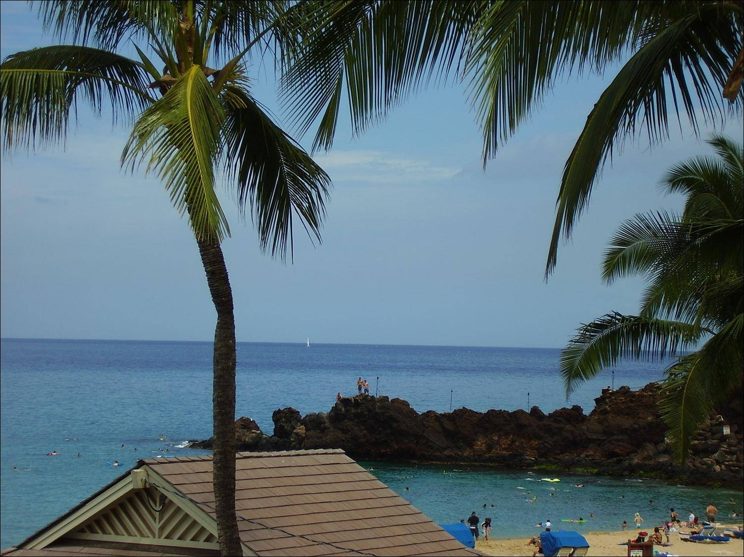
collaborators
Jin In
Carsten Rott
Pearl Sandick
Jennifer Gaskins
David Yaylali
1502. 02091, 15xx.xxxxx

Slide 3
dark matter and monoenergetic neutrinos
searches for dark matter using neutrino detectors
  dark matter collects in the core of the sun after scattering off solar nuclei
  annihilates to Standard Model products, and the neutrinos get out
  reach neutrino detector on earth
focus is typically on a smooth distribution of events above background
why?
  often assumed no direct annihilation to neutrinos
    neutrinos arise from decay of other SM states
  mostly have studied detection strategies in which neutrino energy can’t be fully reconstructed anyway
    see a smooth distribution of charged leptons
I’ll focus on a different possibility
  models in which dark matter can produce monoenergetic neutrinos
  detectors and strategies which can resolve a line signal

Slide 4
basic points
experiment
  electron neutrinos undergoing charged-current interaction will deposit almost all energy in the detector
  some neutrino detectors, like liquid scintillation detectors or liquid argon TPCs, can reconstruct energy and direction of incoming neutrino
    can determine if neutrino emanates from the sun
  sensitive to a line signal
theory
  in the absence of minimal flavor violation, or with non-Majorana dark matter, can easily have dark matter annihilate to monoenergetic neutrinos
  dark matter models which annihilate to u, d, s quarks produce plenty of π⁺, K⁺
    stop before they decay (producing more π⁺)
    produce monoenergetic neutrino

Slide 5
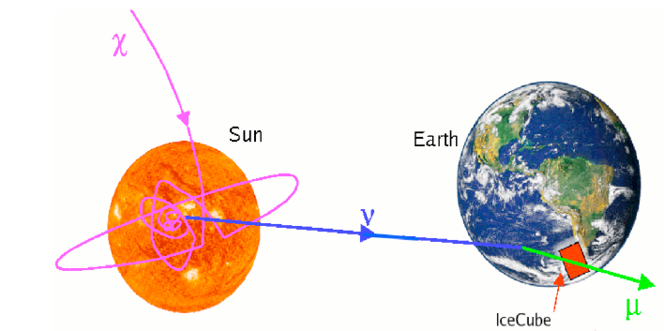
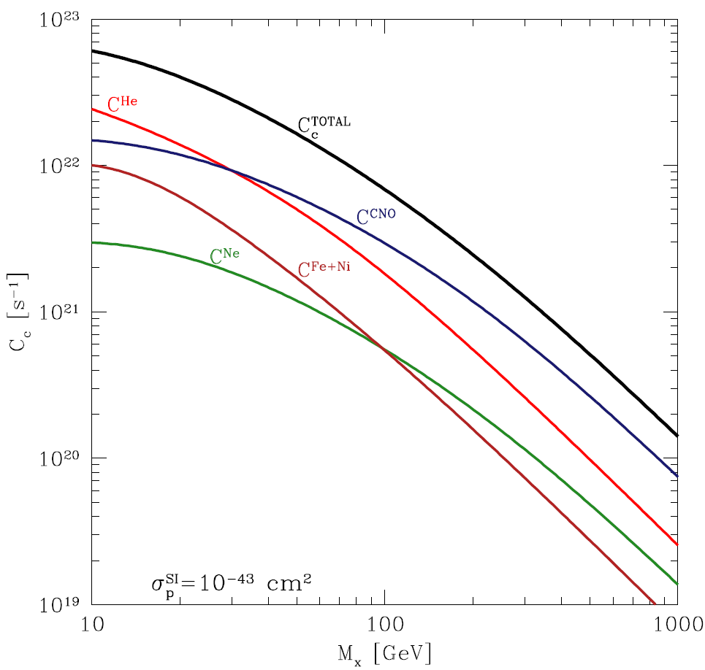
neutrinos from the sun
basic idea
  DM scatters off solar nuclei, loses energy through elastic scattering
  falls below v_{esc} → captured
    orbits, eventually collects in core
  DM annihilates to SM matter
  SM decay yields neutrinos → seen at detector
  DM in equilibrium → G_{C} = 2G_{A}
  so neutrino event rate probes DM capture rate (∝ σ_{SI} ,σ_{SD})
usually look for hard neutrinos
light hadrons stop before decaying → soft neutrinos
Dawn Williams
A. Zentner, arXiv:0907.3448

Slide 6
why (not) χχ→ν̅ν?
can understand just from angular momentum
for Majorana fermion, wavefunction is anti-symmetric
  L=0, S=0 or L=1, S=1
if outgoing fermions on z-axis
  L_{z}=0 ( Y_{lm}(θ=0,φ)≠0 only if m=0 )
  S_{z} = J_{z}
if S_{z}=0 need f, f̄ with same helicity
  not CP-conjugate
  need Weyl spinor mixing
  in MFV, mixing scales with mass
if S_{z}=±1 need f, f̄ with opp. helicity
  no mixing needed
J=0, L_{Z}=0 → S_{Z}=0
f̅_{R}
f_{L}
J_{z}=1, L_{Z}=0 → S_{Z}=1
f̅_{R}
f_{R}

Slide 7
monoenergetic neutrinos
this argument underlies the theoretical prejudice towards searches for the b̅ b, τ̅ τ and W⁺ W⁻ channels
but the chirality suppression arises from the assumption of Majorana fermion dark matter and minimal flavor violation
  certainly true for the CMSSM, but need not be true in general
  WIMPs need not be Majorana, and MFV can fail even in the general MSSM
if dark matter is a Dirac fermion, then the initial state can be L=0, S=1, J=1, so s-wave annihilation, but no mixing needed
if we drop minimal flavor violation, then mixing need not scale with mass
either way, χχ→ν̅ν branching fraction could be O(1)
  or χχ→ q̅q for q = u, d, s
worth studying these annihilation channels

Slide 8
why not light hadrons?
usually ignore χχ → q̅q for q=u,d,s
why? → another reason....
  u, d, s → light hadrons which stop in the sun before decay
  care about pions, kaons
  resulting ν spectrum is very soft
  large background, small detector effective area
but the stopping process produces a large number of pions
  trade a hard spectrum for a softer one, but with larger flux
  Beacom, Rott, Siegal-Gaskins (1208.0827)
q̅
q
π⁻
K⁺
π⁺
π⁰

Slide 9
spectrum
care about π⁺ and K⁺
  π⁰ → γγ
  π⁻ Coulomb-captured by nuclei, and absorbed
    doesn’t produce a lot of neutrinos
main relevant decay is π⁺, K⁺ → ν_{μ} μ⁺
  monoenergetic neutrino with E = 29.8 MeV (pion) or 235.5 MeV (kaon)
  oscillates into monoenergetic ν_{e} , and can produce a line signal
  muon stops in sun before decay
    μ⁺ → e⁺ ν_{e} ν̅_{μ}
    also get continuum ν_{e}, ν̅_{μ} from μ⁺ decay, but less distinctive
just need the fraction of DM energy which goes into stopped π⁺, K⁺
r ≡ fraction of center-of-mass energy which goes into π⁺, K⁺
  determine r in Pythia/GEANT
r_{π} ~ 0.1

Slide 10
resolving a line signal
essentially need two things
  full energy containment
  directionality of charged lepton track (for high energy)
need ν_{e}
  charged current interaction produces e±
  produces short-range cascade which is fully-contained in detector
  at high E_{ν}, muon is long-range
    reduces the effective volume
  at E_{ν} = 30 MeV, can’t produce muon
●
ν
θ
f ≡ fraction of events in θ_{cone}
f_{ν} ~ 0.4
f_{ν̅} ~ 0.8
reduces bgd at large E_{ν}
but at E_{ν}≈30 MeV, no direction

Slide 11
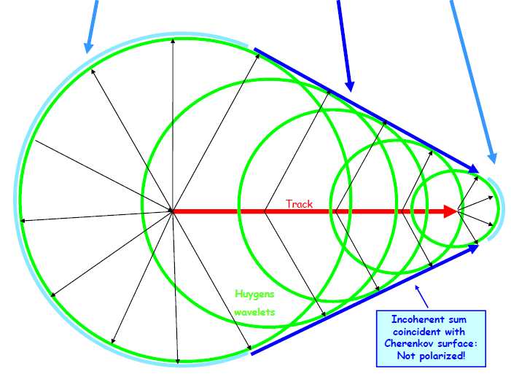
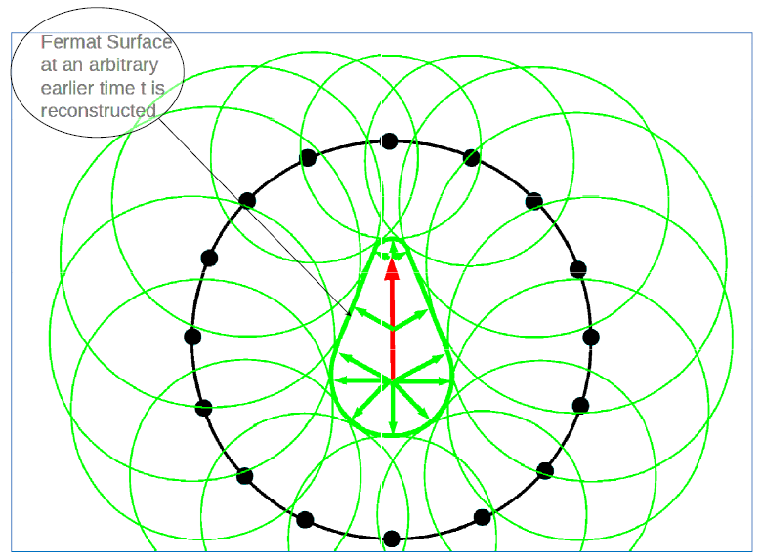
LS detector
scintillator produces a spherical burst of light
essentially a calorimeter
  easy to get total energy
  harder to get direction from a spherical burst of light
but timing of when PMTs are illuminated can be used to reconstruct charged lepton track
  essentially, Huygen’s principle
analysis of KamLAND data is on the way....
we’ll treat it as our benchmark detector ....
figures courtesy of John Learned

Slide 12
what we need....
we have the neutrino fluxes from the sun arising from DM....
we have estimates of the ν_{e} background
  at E > GeV (for χχ→ν̅ν)
  at E ~ 30-300 MeV (for meson decay)
charged current neutrino-nucleus scattering cross section
  for E > GeV, get σ ∝ E (DIS)
  for E ~ 30-300 MeV, more complicated
    cross sections smaller at low E_{ν}
Honda
Battistoni, Ferrari, Montaruli, Sala

Slide 13
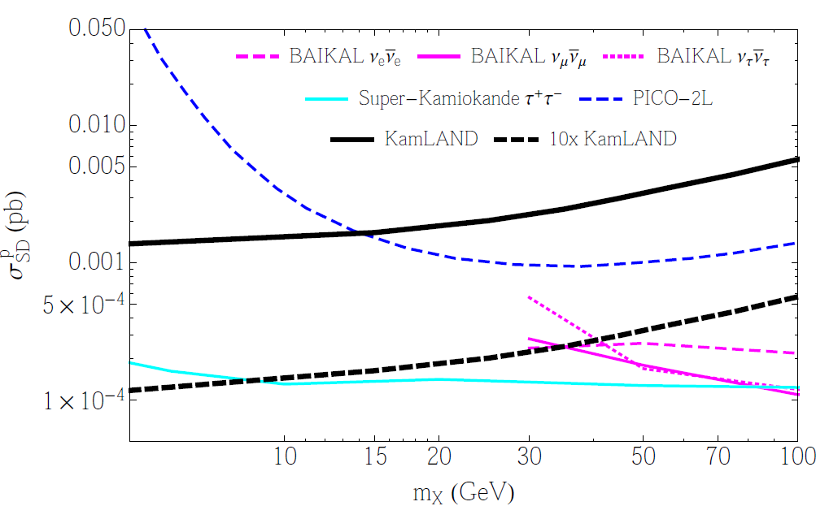
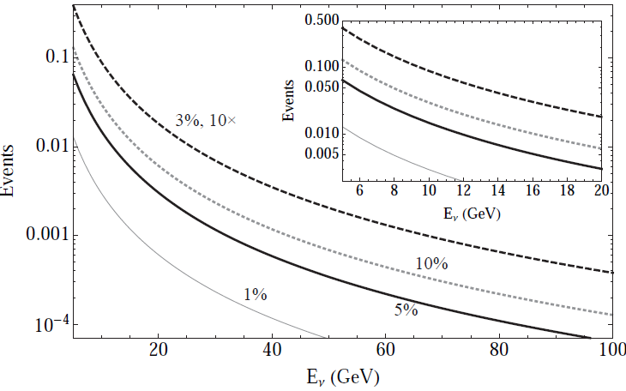
sensitivity at high energy
flavor-indep, 90% CL
benchmark = KamLAND
  V = 500 m³
  T = 3600 days
  ε ~ few % (5 %)
beats current DD limits
  no big suppression at low mass, unlike direct detection
Super-K wins
  larger exposure due to size
  SK has larger bgd., but KamLAND is signal limited
    can’t fully benefit from low background yet
  LBNE DUNE? → ε ~ 3 %, 10× exp.

Slide 14
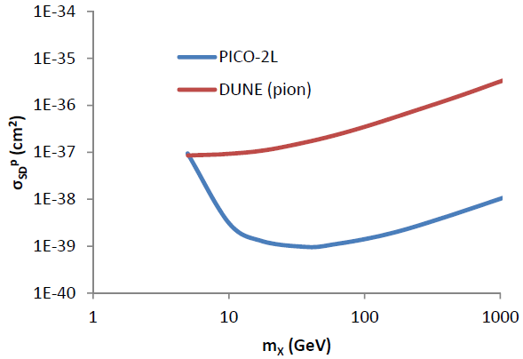
sensitivity for charged meson decay
  at low energy, take ε ~ 1 % for LS
  KamLAND is signal limited
    viable models produce < 1 event in KamLANDs exposure
    problem → σ_{νA} small at low E_{ν}
  DUNE could do much better (34 kT LAr TPC, 1 year)
    still negligible background
      1 year, ε ~ 10 %
    competitive with direct detection at ~ 5 GeV
  other neutrino searches not sensitive (focused on high-energy neutrinos)
90% CL

Slide 15
signal limited
look at π⁺ decay, 10 GeV, LArTPC
if ε ≲ 0.1, would need ~ 10 years to get a single bgd. event in a bin
S/B doesn’t depend on exposure or target, just on fluxes and energy resolution
if S = B, then σ_{SD}^{p} ≈ 0.07 pb ⨯ ε
E_{crit} exposure needed to get a single signal event at S = B (= 1)
  exposure = (M/kT) (T/yr)
to fully realize potential at 5% energy resolution, need 625 kT yr LArTPC detector
  LS → factor 8× larger

Slide 16
signal limited
consider monoenergetic neutrino signal at m = 10 GeV
  again at LArTPC, ε ~ 5%
compare to analysis of monoenergetic neutrinos from π⁺ decay
  background neutrino rate is about ~ 4900 smaller
  signal neutrino rate about ~ 13 times smaller (fixed σ_{SD}^{p})
    no enhancement arising from multiple pions
  effective area ~ 10⁴ ⨯ larger
    energy dependence of scattering cross section
at S/B = 1 limit, would have σ_{SD}^{p} ≈ 10⁻⁵ pb
  need a ~ 270 kT yr detector exposure to get ~ 1 signal event
χχ→ν̅ν channel has better sensitivity, smaller exposure, ... if it’s there
but to fully exploit either strategy, one would need an exposure similar to a 34 kT DUNE running for 10 – 20 years

Slide 17
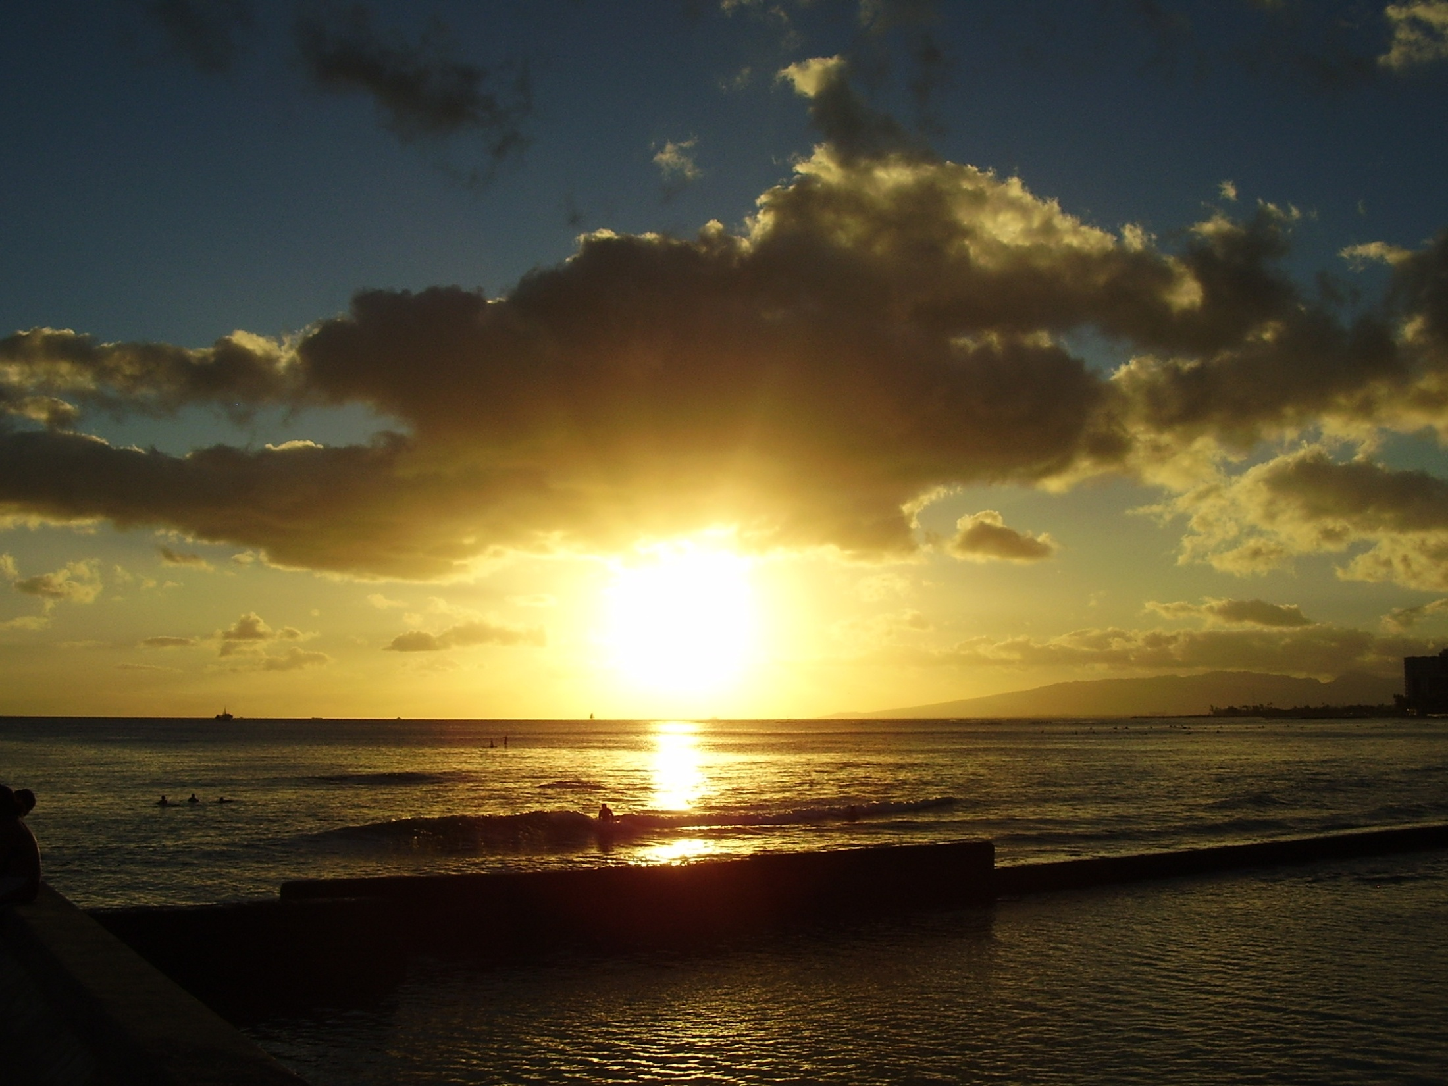
conclusion
dark matter annihilation in the sun can produce monoenergetic neutrinos
  need non-Majorana, or non-MFV, for direct annihilation to neutrinos
  or decays of numerous stopped π⁺
LS or LArTPC neutrino detectors can reconstruct energy and direction
  need electron neutrinos for fully-contained shower
reduced backgrounds
but current detectors are signal-limited, so need bigger detectors and larger run-times.... (DUNE? THEIA?)
Mahalo!

Slide 18
Back-up slides

