Slide 1
HTCondor Tutorial
YuChul Yang (Kyungpook National University)
- LHC Grid Computing School Feb. 04, 2015-

Slide 2
Contents
Introduction
Basic Condor (Hands-On)
cmsRun(CMSSW) using Condor (Hands-On)

Slide 3
Introduction to the tutorial
Introduction to the HT Condor : http://research.wisc.edu/htcondor
Introduction to the tutorial
  Batch system
    PBS(OpenPBS,Torque,…)
    LSF
    HTCondor
How to Submit Condor Jobs
Condor for CMSSW(cmsRun)
UserInterface(PC) Computer
job.sh 1 (short)
job.sh 2 (short)
job.sh 3 (short)
job.sh 4 (short)
…
job.sh N (short)
WorkNode1 : job.sh 1 (short)
WorkNode2 : job.sh 2 (short)
WorkNode3 : job.sh 3 (short)
WorkNode4 : job.sh 4 (short)
…
WorkNodeN : job.sh N (short)
Total : (LONG time)
Total : (SHORT time)

Slide 4
PART1 : Basic Condor
Requirements : account on ui02.sdfarm.kr

Slide 5
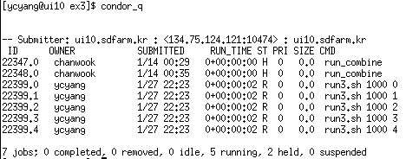

Basic Condor Command
Command | Basic Usage | Description
condor_submit | $> condor_submit [JobDescFile] | submit a job
condor_q | $> condoq_q [clusterID] | show status a jobs
condor_rm | $> condor_rm [clusterID] | remove jobs from the queue
condor_hold | $> condor_hold [clusterID] | hold jobs in the queue
condor_release | $> condor_release [clusterID] | release jobs in the queue
condor_tail | $> condor_tail [clusterID].[processID] | display the standard output
condor_status | $> condor_status | list summary of pool resources

Slide 6
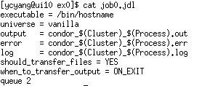
Exercise 0 : condor_submit
Hands-on : condor_submit [JobDescriptionFile]
$>mkdir ex0; cd ex0 $>cp ~ycyang/tut/condor/ex0/job0.jdl $>condor_submit job0.jdl
Result
$>ls -al ….. $>cat condor*.out wn????sdfarm.kr

Slide 7
Exercise 1 : condor_(q/hold/release/tail/rm)
Hands-on : condor_command [CluserID].[ProcessID]
$> mkdir ex1; cd ex1 $> cp ~ycyang/tut/condor/ex1/run1.sh $> cp ~ycyang/tut/condor/ex1/job1.jdl $> cat run1.sh $> cat job1.jdl $> condor_submit job1.jdl 2 job(s) submitted to cluster 22404. $> condor_q $USER $> condor_hold [ClusterID] $> condor_release [ClusterID] $> condor_tail [ClusterID].0 $> condor_rm [ClusterID].0
Result
$>cat condor_[ClusterID]_1.log

Slide 8
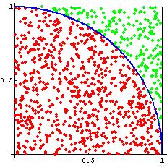
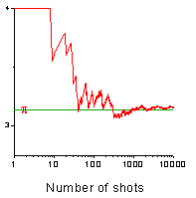

Exercise 2 : what is the value of pi(π)
Hands-on : user code running
$> mkdir ex2; cd ex2 $> cp ~ycyang/tut/condor/ex2/piCalc.exe $> ./piCalc.exe 10000 1 pi = 3.1376 Count: [ 784 / 10000 ] $> ./piCalc.exe 10000 2 $> … $> cp ~ycyang/tut/condor/ex2/job2.jdl $> condor_submit job2.jdl
$$π=4.0 ×\frac{Red}{Red+Green}$$
Result
$>~ycyang/tut/condor/ex2/merge.sh pi = 3.14159265359 in google.com your value = ???

Slide 9
PART2 : Condor for cmsRun
Requirements : 1. Experience with CMSSW,
2. CMS VOMS Account

Slide 10
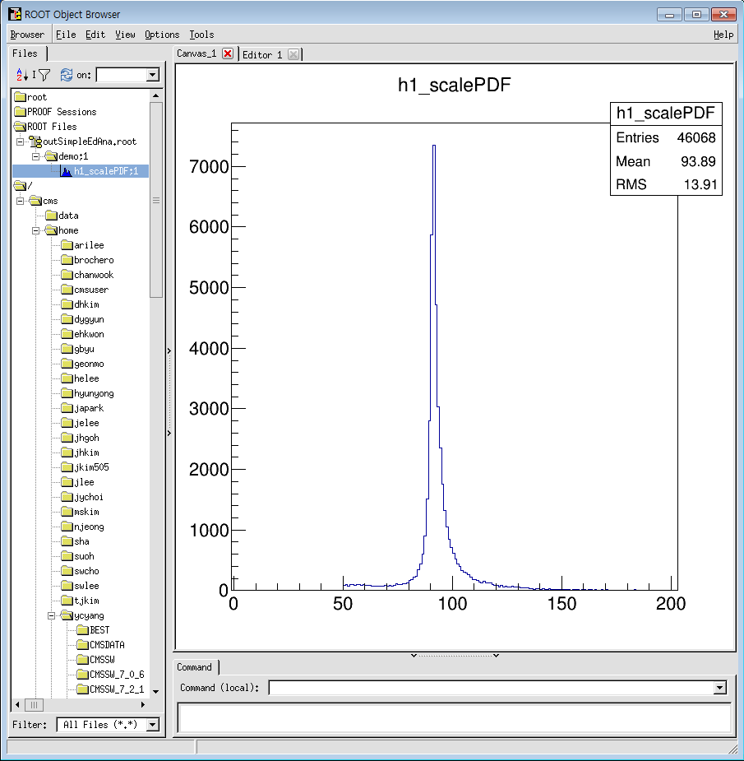
Exercise 0 : CMSSW on UI(ui10.sdfarm.kr)
Hands-on : CMSSW setup
$> export SCRAM_ARCH=slc6_amd64_gcc481 $> export VO_CMS_SW_DIR=/cvmfs/cms.cern.ch $> source $VO_CMSSW_DIR/cmsset_default.sh $> cmsrel CMSSW_7_2_2 #(= $CMSSW_BASE ) $> cd CMSSW_7_2_2/src $> cmsenv
Hands-on : Build User Code
$> cp –r ~ycyang/tut/cmssw/CMSSW_7_2_2/src/SimpleEdAna . $> scram b –j4 $> ls ../lib/slc6_amd64_gcc481/
Hands-on : cmsRun
$> cp ~ycyang/tut/cmssw/CMSSW_7_2_2/src/SimpleEdAna_cfg.py $> cmsRun SimpleEdAna_cfg.py $> root outSimpleEdAna.root

Slide 11

Not simple to do cmsRun on CondorWN
$CMSSW_BASE directory to WorkNode → Not Working
cmsRun using condor
  ??? $CMSSW_BASE path mismatch
  ??? user_module(lib), imported python configuration files
  ??? InputFiles for dataset
  ??? etc …

Slide 12
How to create the condor job
$CMSSW_BASE path → new release CMSSW_7_2_2 on worknode
user libraries → tar/copy $CMSSW_BASE/lib directory to worknode
python configuration files → pickle.dump(process, ‘file’) like edmConfigDump
input files in dataset → das_client.py (file_list and site)
JSON(select good lumi.) for collision data → process.source.lumisToProcess
voms-proxy; access inputfile in global CMS sites

Slide 13
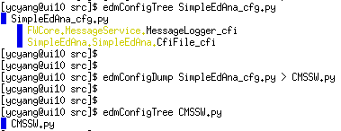
Exercise 1 : CMSSW.py or CMSSW.pkl
Hands-on : edm configuration files dump
$> edmConfigTree SimpleEdAna_cfg.py $> edmConfigDump SimpleEdAna_cfg.py > CMSSW.py $> edmConfigTree CMSSW.py
Hands-on : pickle.dump()
$> ~ycyang/tut/cmssw/CMSSW_7_2_2/src/makePSet SimpleEdAna_cfg.py $> ls CMSSW.pkl $> cp ~ycyang/tut/cmssw/CMSSW_7_2_2/src/RunPKL.py . $> cmsRun RunPKL.py

Slide 14
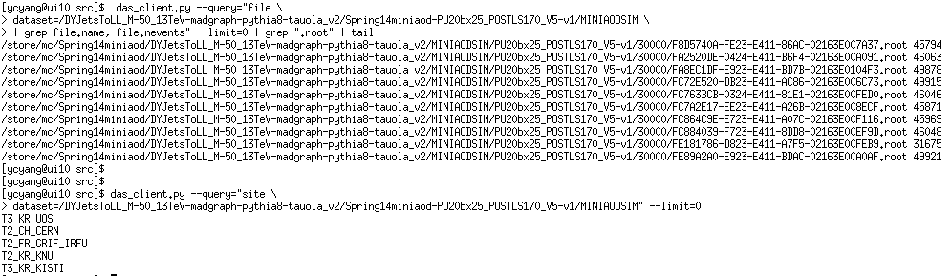
Exercise 2 : file list in CMS DATASET
Hands-on : das_client.py
$> export DATASET=/DYJetsToLL_M-50_13TeV-madgraph-pythia8-tauola_v2/Spring14miniaod-PU20bx25_POSTLS170_V5-v1/MINIAODSIM $> das_client.py --query=“file dataset=$DATASET | grep file.name, file.nevents” --limit=0 $> das_client.py --query=“site dataset=$DATASET” --limit=0

Slide 15
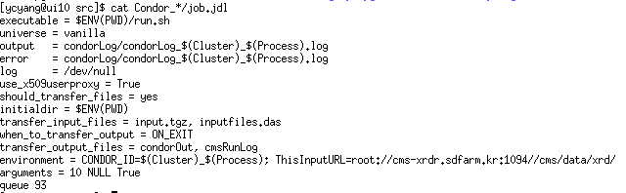
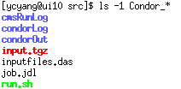
Exercise 3 : Create Condor Jobs for cmsRun
Hands-on : full example condor job for cmsRun
$> voms-proxy-init –voms cms $> ~ycyang/local/cmsUtil/cmsCondor.sh –cfg=SimpleEdAna_cfg.py –dataset=/DYJetsToLL_M-50_13TeV-madgraph-pythia8-tauola_v2/Spring14minaod-PU20bx25_POSTLS170-v1/MINIAODSIM –nfiles=10 $> ls Condor_*/ $> cd Condor_*/ $> vi job.jdl (queue 2) $> condor_submit job.jdl

Slide 16
Summary
Do by your hands
Question / Discussion
Ref> http://research.cs.wisc.edu/htcondor/manual/v7.6/2_5Submitting_Job.html

