Slide 1
RP measurements in prevision of PS-SWY operation (PACS-PASS)
J. Vollaire on behalf of DGS-RP
08/01/2013

Slide 2
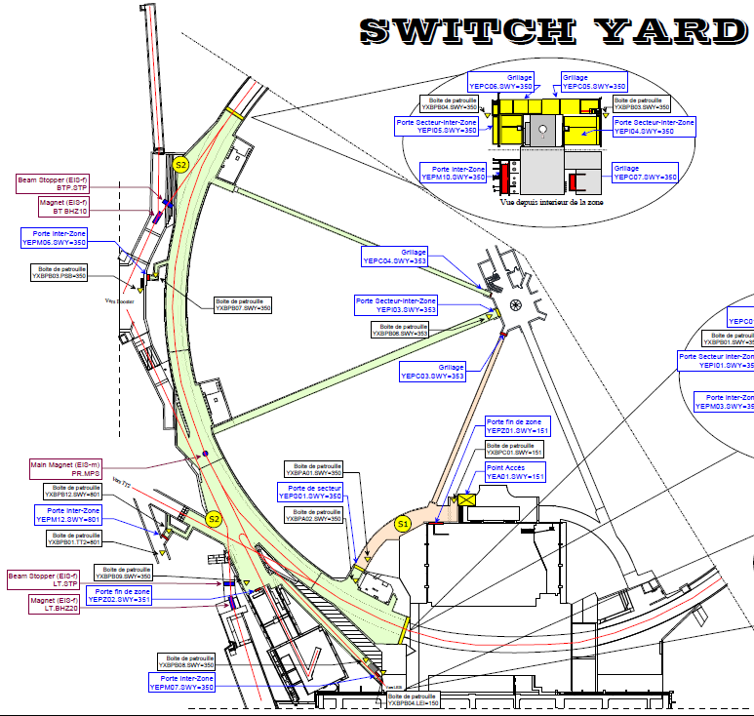
Motivation : SWY access mode
New access system:
Possibility to access part of the PS ring while the p beam is accelerated in the PSB (and sent to ISOLDE for example)
Definition of monitoring needs:
Assess the radiological conditions in case of beam losses at critical locations as regards to accessible areas
Accessible areas
Beam Loss (L2 - 50 MeV)
Beam Loss (PSB – 1.4 GeV)

Slide 3
Measurement conditions (1)
Linac2 beam – losses in transfer line to the PSB (no other beam in the PS) with different intensities (0.5 μA / 1 μA / 2 μA)
5 minutes of stable loss conditions needed for each measurement

Slide 4
Measurement conditions (2)
PSB beam – losses in BTY-BTP-BTM area (no other beam in the PS) with different intensities (0.5 μA / 1 μA / 2 μA)
Possibility to send the beam to the BTP.STP stopper and to the wall separating the PS-PSB (BHZ10 is not fail safe)
5 minutes of stable loss conditions needed for each measurement

