Slide 1
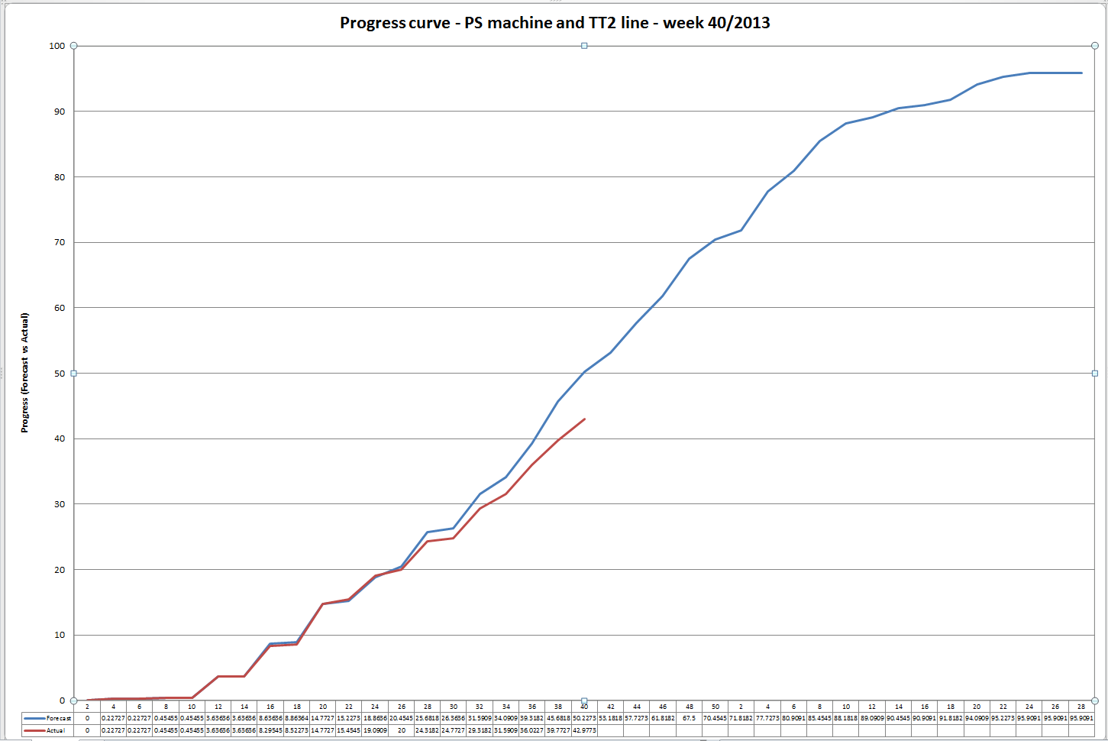
LS1 PS progress curve
3 weeks of delay (but still in time for start-up):
EN-EL, TE_MSC (Russian Team), BE-BI, GE-SE, GS-ASE (BIW), EN-CV…
15 ECR – 2 done

Slide 2
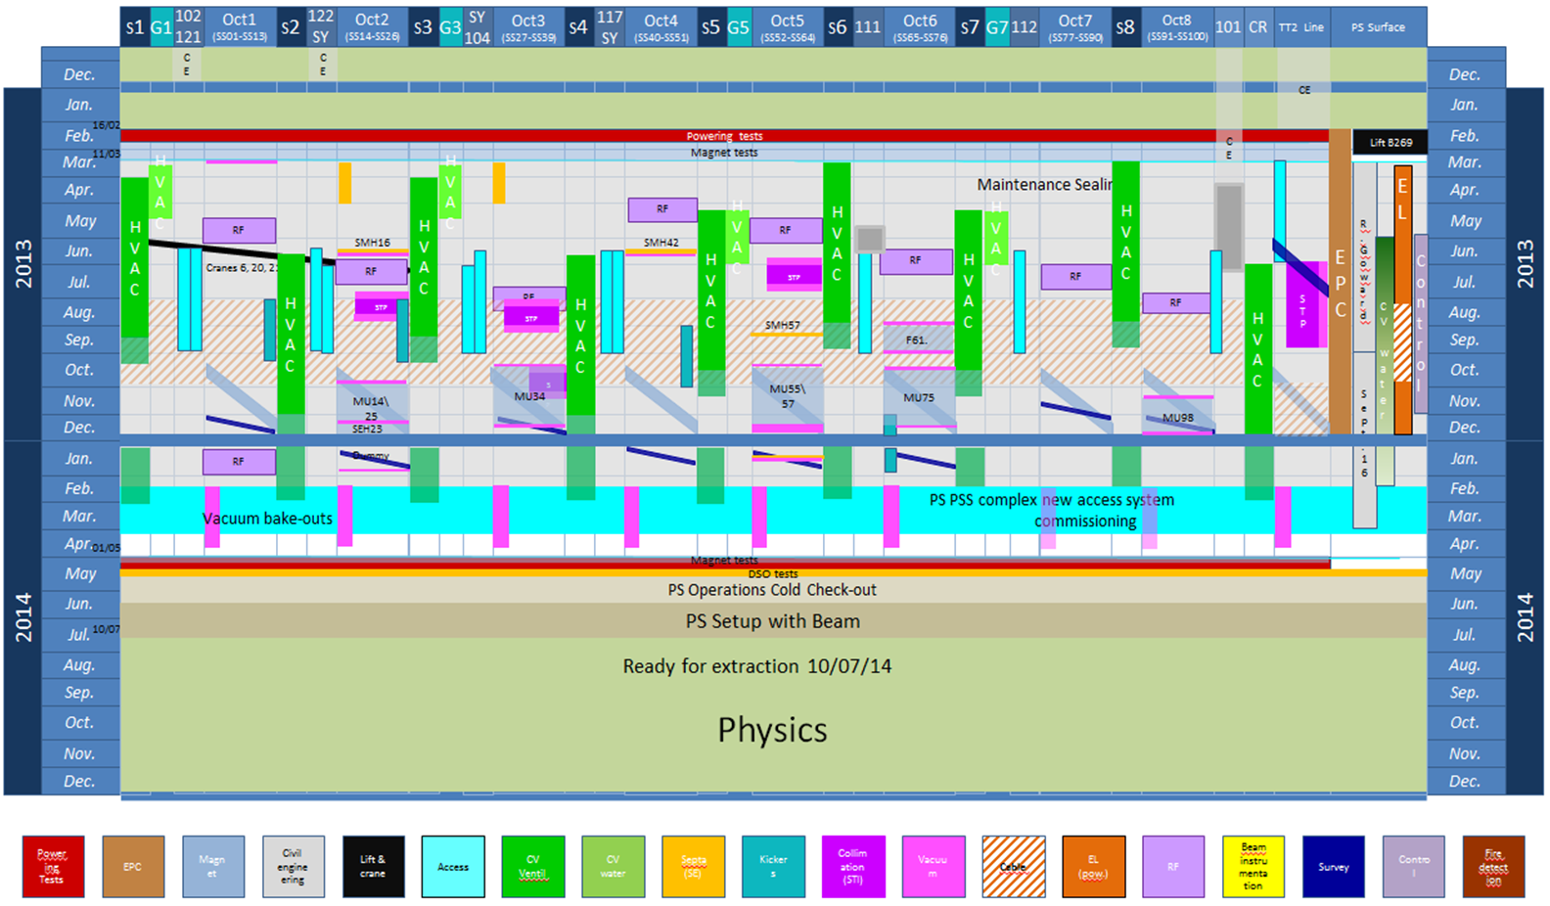
Week 33 (05/10/2013)! LS1 for PS ring is 66 weeks (to 24/05/2014)

Slide 3
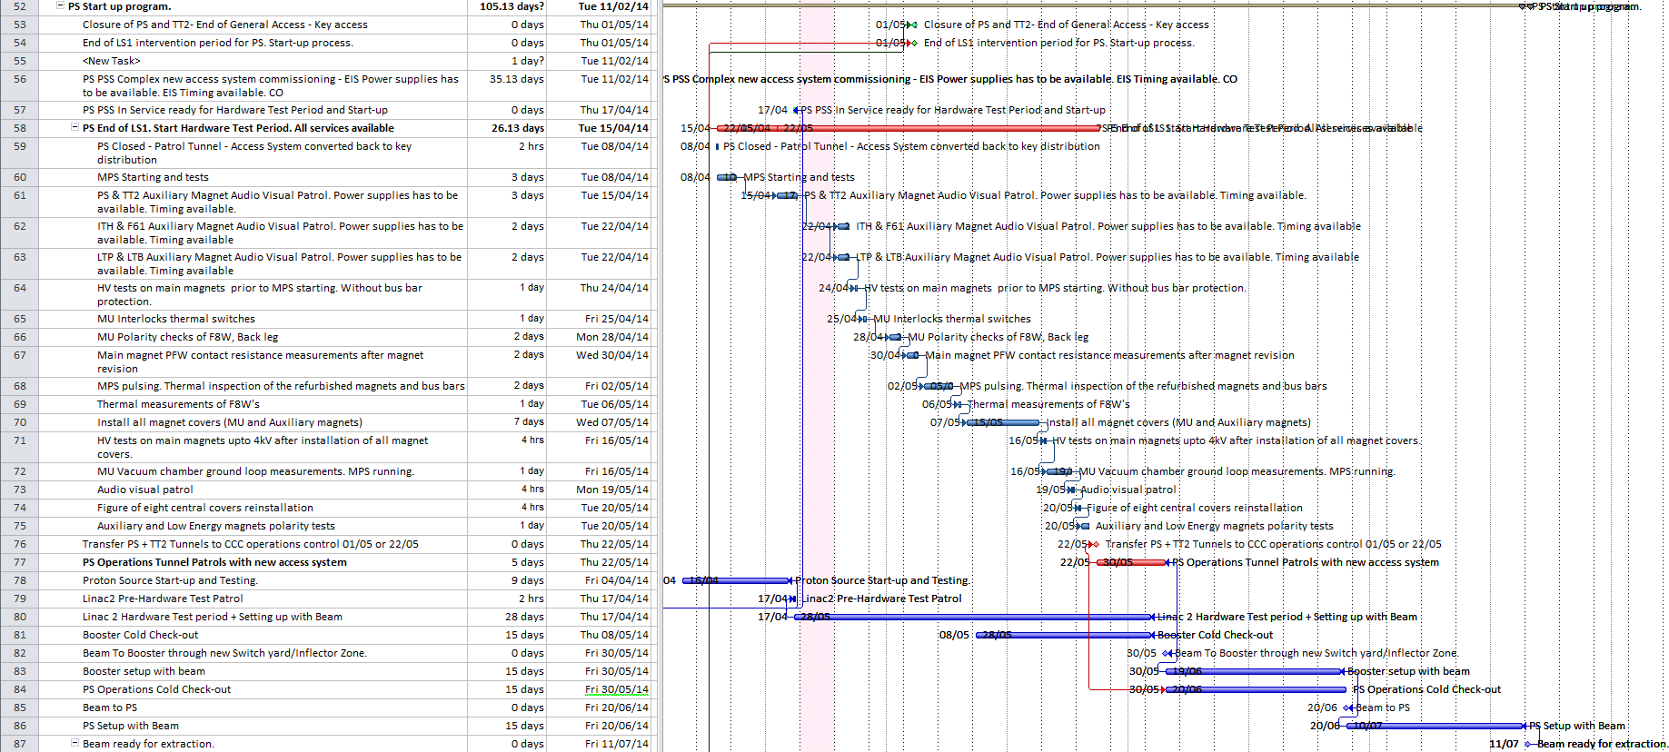
PS Start up program
Between 11/02 to 01/04 | 10 non-consecutive days, PS ring with No access, to validate Access System
From 01/04 until 07/04 | OP requests: DSO tests
From 08/04 until 21/05 | Magnet requests: HW tests
From 22/05 until 30/05 | OP will then take over the responsibility for the machine

Slide 4
Conclusion
www.cern.ch/ps https://ps.web.cern.ch/ps/
E-group: PS-coordination@cern.ch
PS Technical Coordination meetings
https://indico.cern.ch/categoryDisplay.py?categId=4505
PS Planning LS1 2011-2013 https://edms.cern.ch/document/1252091
LS1 Planning for all accelerators and areas under EN/MEF responsibility. http://www.cern.ch/LS1planning
CPS Shutdown Logbook. http://elogbook.cern.ch/eLogbook/eLogbook.jsp?lgbk=401
Thanks for your attention!

