Slide 1
SPS update on LS1
David Mcfarlane
SPS Technical coordinator
FOM (08/10/2013)

Slide 2
SPS LS1 schedule
Beam off : 11/02/13
Beam on: 13/10/14
Open Access : 25/03/13
Close Access : 27/06/14
Beam on
Cool down/RP survey and Magnet tests
Cool down
NO ACCESS
Survey
Survey
EPC works
Safety valves
Magnets
Survey
Survey
General
Maintenance
General
Maintenance
RF upgrade works
RF upgrade works
Cables
Magnets
Cables
Magnets
Magnets
18 KV
TT10 Consolidation
Magnets
Magnets
Survey
Kicker
Magnets
EPC works
Survey
Survey
Magnets
Kicker
General maintenance
18 KV
General Maintenance
Cooling tower 863
General Maintenance
General maintenance
Survey
Vacuum
Vacuum
Septa works
Ring-main
Cables
Ring-main
18 KV
Septa tests
Ring-main
Vacuum
Ring-main
Vacuum
Ring-main
General
Maintenance
Ring-main
Vacuum
Septa works
Ring-main
General Maintenance
Vacuum
Fibres
RAL
Fibres
Civil Engineering in TT10
RF Upgrade works
Cables
UA9 works
Survey
Horizontal
Vertical
smoothing
Civil Engineering
Cool down
Limited ACCESS
Remove
Civil Engineering
18 KV
Fibres
Civil Engineering
18 KV
Cables
Cables
TT20 pipework
Irradiated Cables
Septa
replacement
18 KV
Cables
EL Studies
Civil Engineering
Cables
CV studies
RAL
Magnets
RF Upgrade works
Civil Engineering
Vacuum
Magnets
CV works
Install
Cables
EPC Commissioning tests
Vacuum
DSO tests/HV tests
Cold check out & Start-up
Protons to the North Area
Protons to LHC
Ions to NA61
CV Controls upgrade
Re-route Cabling

Slide 3
Where are we now?

Slide 4
Main works to watch
TT10 Civil Engineering works
Replacement of “coated” magnets in BA5
Irradiated cable campaign in BA1

Slide 5
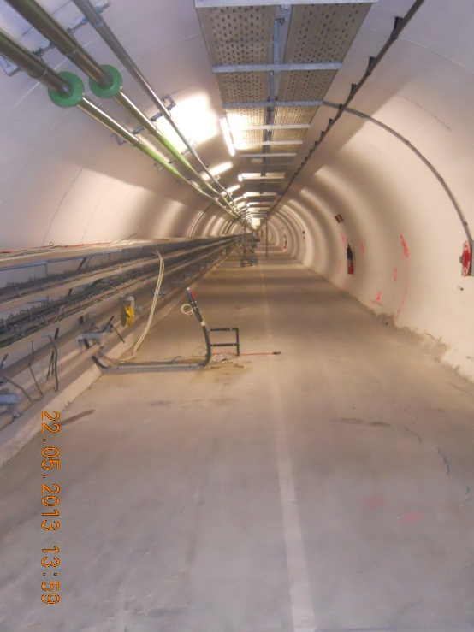
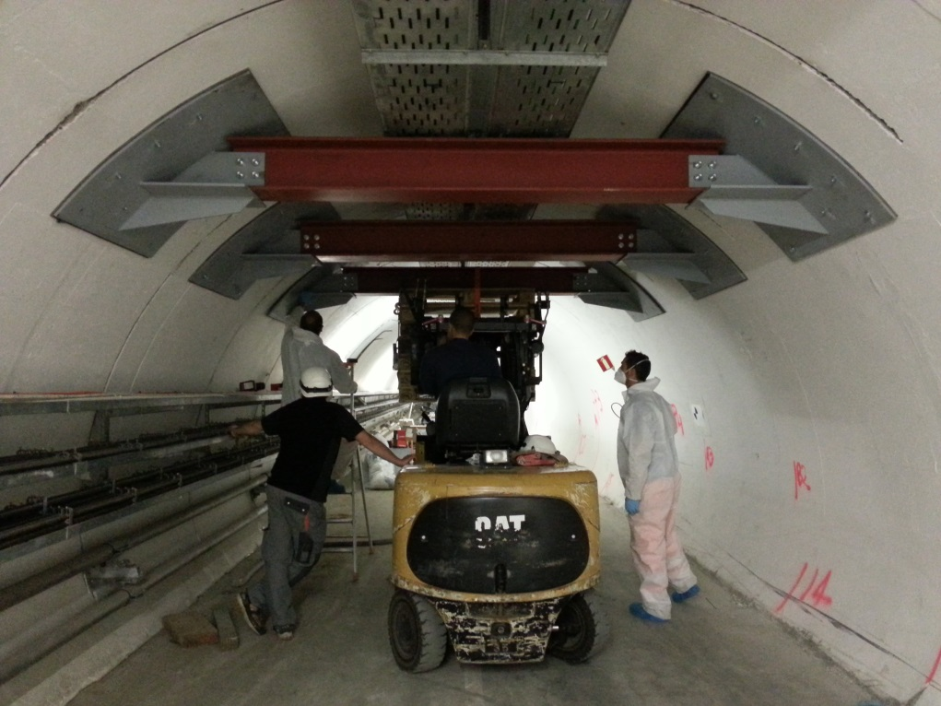
TT10 Civil Engineering works
The beam line and all associated equipment was removed from the areas where the structural integrity of the TT10 needs to be repaired.
Work from Civil engineering will continue in this area until the end of 2013.
The beam line and all associated equipment will be re-installed in January 2013.

Slide 6
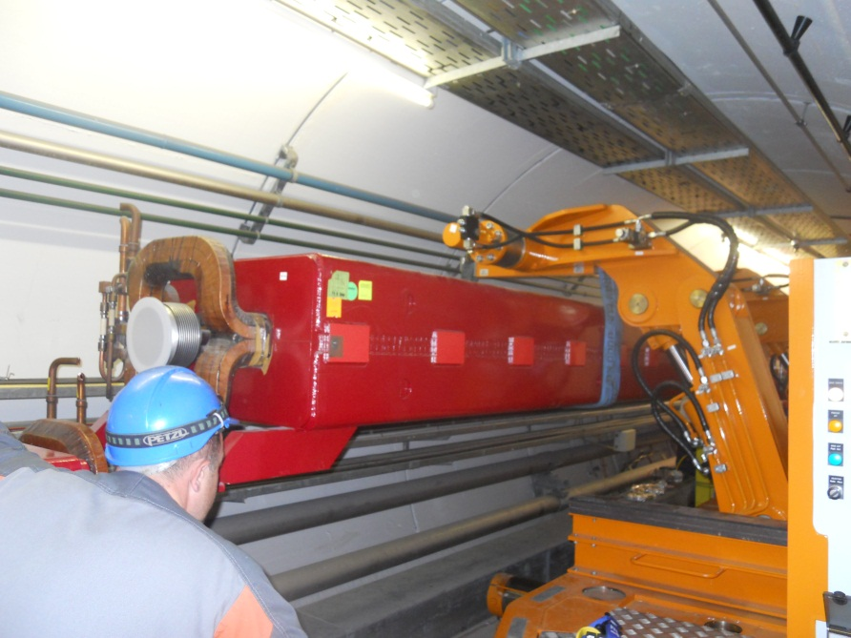
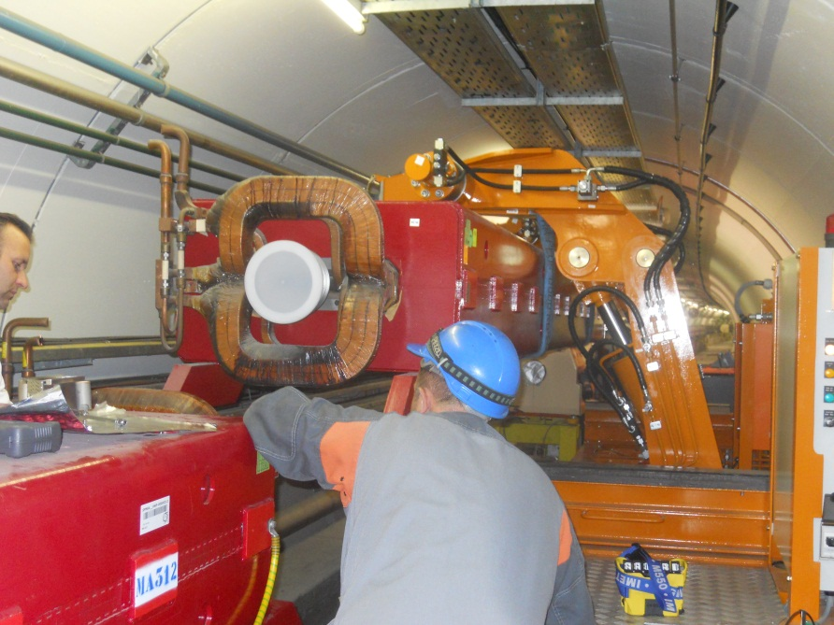
Replacement of “coated” magnets in BA5
16 main dipoles and 4 main quadrupoles were removed from sextant 5- at the beginning of LS1
These magnets will be put back into the machine in February 2014

Slide 7
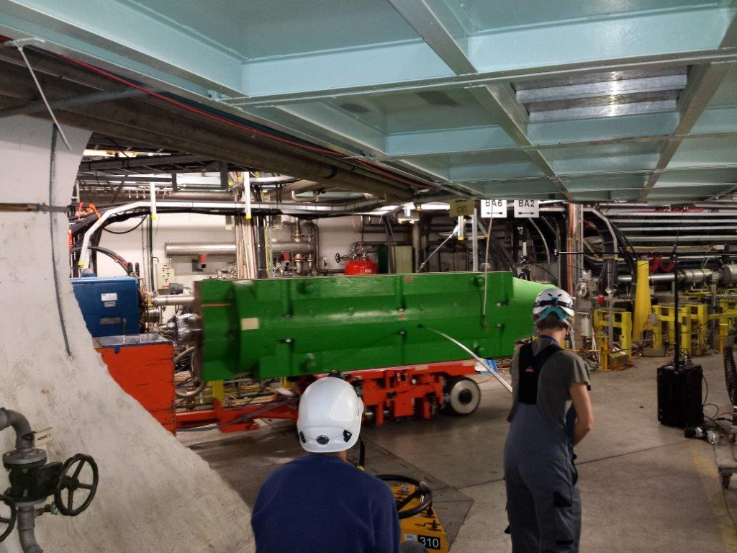
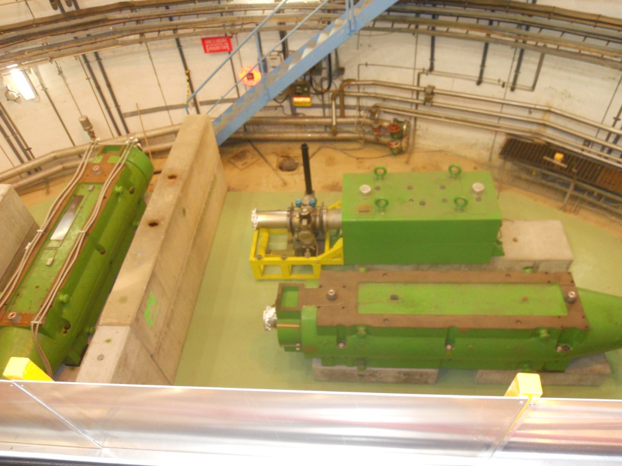
Irradiated cable campaign in BA1
All of the beam line and associated equipment has been removed from LSS1 and is being stored in ECX5.
  This was done to reduce the radiation levels in this area and improve access for EL.
The cable campaign has started today and will continue until the 26th March 2014.
All of the beam line and associated equipment will then be put back in place and re-comissioned in time for the closure of the SPS on Friday the 27th June 2014.

Slide 8
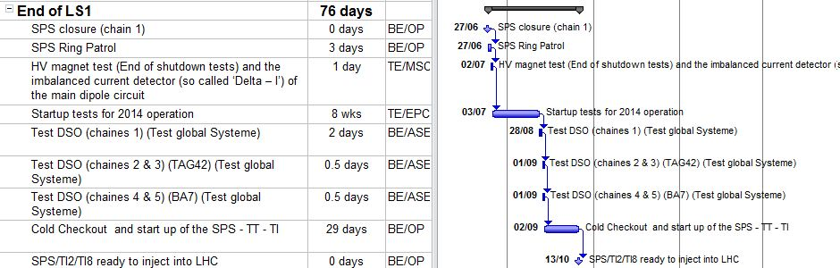
Start-up of the SPS

Slide 9
Closing comments
LS1 in the SPS is progressing according to the schedule.
All main works will be completed by end of May 2014 (except BA1)
We are on-target to close the SPS on Friday the 27th June 2014 and be able to give beam to the North area on the 13th October 2014. (as per the schedule)

