Slide 1
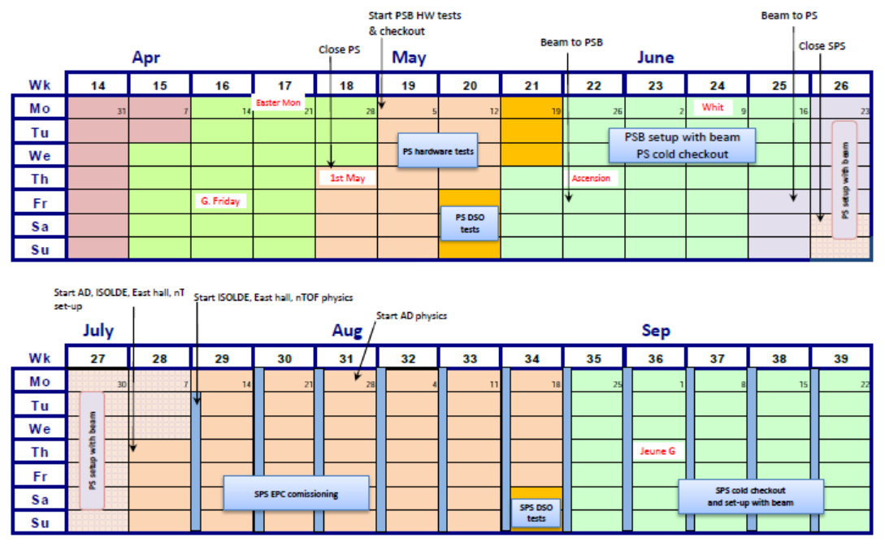
Proposal for Ar ion startup in 2014
Start LEIR HW tests
Ar in
Linac3
LEIR HW tests 19/5
Ar in Linac3
2/6
Ar in LEIR
16/6
Ar in PS
11/8
Ar in SPS
22/9
Ar to LEIR
Ar to PS
Ar to SPS
D.Manglunki – FOM 08/10/2013

