Slide 1
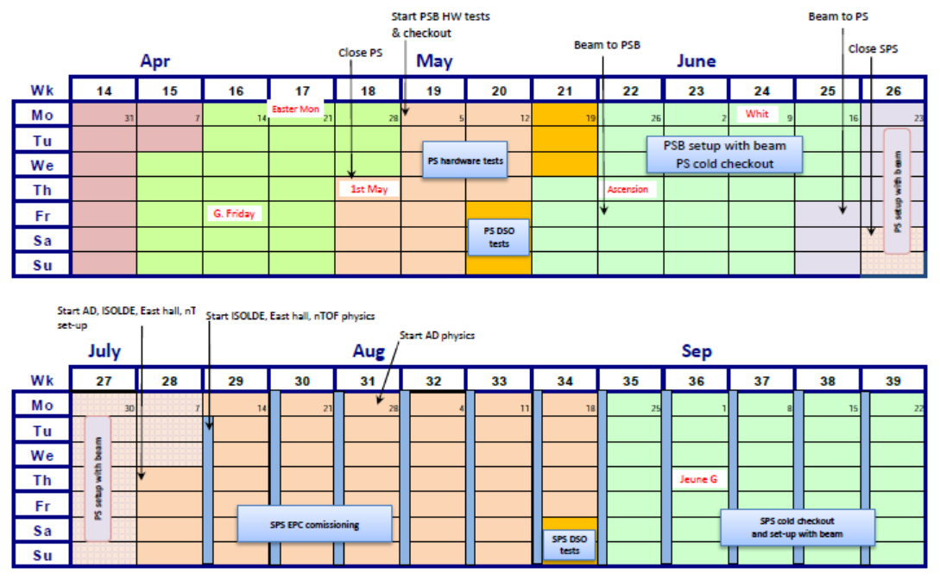
Proposal for Ar ion startup in 2014
Start LEIR Cold checkout
Ar in
Linac3
Start LEIR HW tests
LEIR HW tests 19/5
LEIR cold checkout
2/6
Ar in Linac3
16/6
Ar in LEIR
30/6
Ar in PS
18/8
Ar in SPS
22/9
Ar to LEIR
Ar to PS
Ar to SPS
D.Manglunki – FOM 05/11/2013

