Slide 1



Panagiotis Gkountoumis
National Technical University of Athens
Level-1 Data Driver Card of the New Small Wheel ATLAS experiment
HEP 2015, Athens
18/04/2015

Slide 2
Overview
NSW electronics
L1DDC
  General description
  Connectivity
  Rates
  Placement
L1DDC prototype 1
Roadmap to L1DDC prototype 2
Summary

Slide 3
NSW electronics trigger and dataflow
On-detector
Off-detector
sTGC - On NSW rim
USA15
From Big Wheel
pad TDS
pad trigger
Trigger processor
1/FEB
Possible duplicate removal
Sector logic
strip TDS
router
strip TDS
strip TDS
Trigger processor
sTGC
3/FEB
micromegas
ROD
ART
GBTX
TTC
Event monitor
VMM
VMM
MM
SCA
FELIX
network
ART
GBTX
FELIX
Config
# of VMMs per FEB:
MM: 8
sTGC: strips 5,6 or 7
sTGC pad 2 or 1
sTGC wire 1
ROC
ADDC
calibration
Trigger monitor
DCS
SCA
GBTX
E-links
Front end board
L1DDC
Bidirectional fiber
One way fiber
Twinax cable

Slide 4
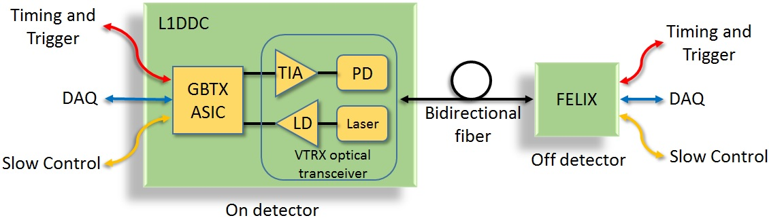
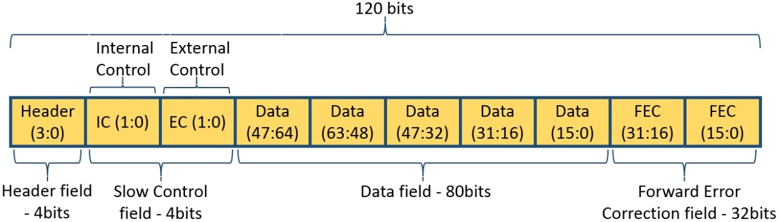
L1DDC connectivity
3 distinct paths to the front ends through one bidirectional link
DAQ data
  Level-1 data (Time, charge and strip address)
  Configuration data
  ASICS
    GBTX
    GigaBit TransImpendence Amplifier (GBTIA) – Photo Diode
    GigaBit Laser Diode (GBLD)) - Laser
Line rate 4.8Gbps
1 frame of 120bits @ 40MHz (25ns)
  Header 4 bits
  Slow control 4 bits
  Data 80 bits
  FEC 32bits (2 interleaved Reed-Solomon encoding)
Error correction and error detection
  Up to 16 consecutive corrupted bits can be corrected
User bandwidth 3.36Gbps
Frame format

Slide 5
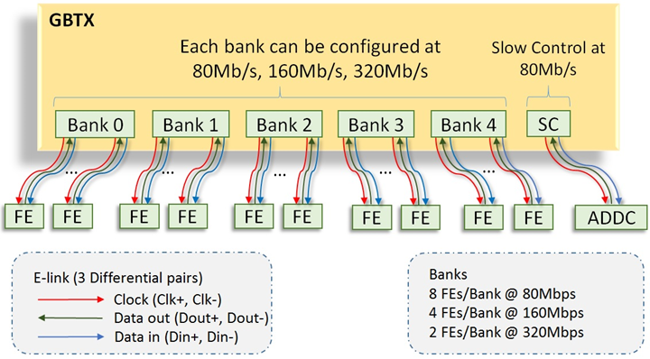
GBTX ASIC Connectivity
1 e-link has 3 differential pairs: Clock, Data out, Data in
Up to 40 front-ends can be connected to 1 GBTx combined in 5 banks
Each bank can support
  8 front ends @ 80Mbps
  4 front ends @ 160Mbps
  2 front ends @ 320Mbps
Each bank can be configured at different rate
1 L1DDC is connected to 8 micromegas FEs and 3 sTGC FEs
1 cable for FE to L1DDC connection
  1 e-link for the ROD
  1 e-link for the SCA
Slow Control channel @ 80Mbps dedicated to ADDC
E-links use Scalable Low-Voltage Signaling (SLVS), Vcm = 0.2V, swing 200mV

Slide 6
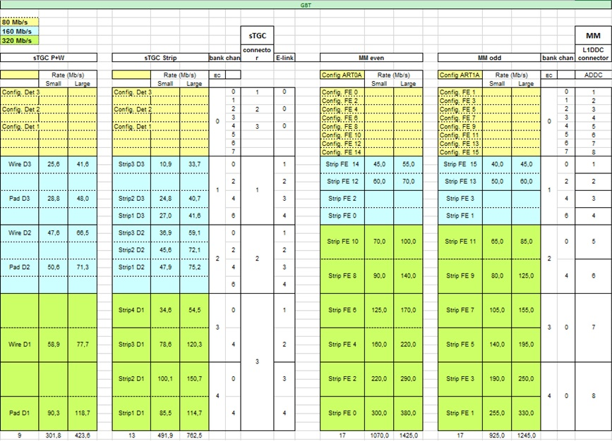
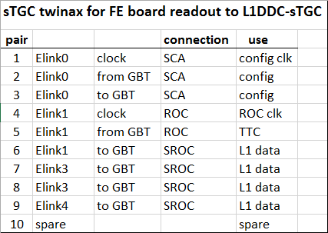
MMs and sTGC rates
MMs rates exceed maximum of e-link rate.
2 elinks/MMFE8 will be used for the inner portions (1 elink @ 320Mbps+1 elink@160 Mbps = 480Mbps).
3 sTGC FEs will be connected to 1 L1DDC (1 twinax cable and 10 differential pairs)

Slide 7
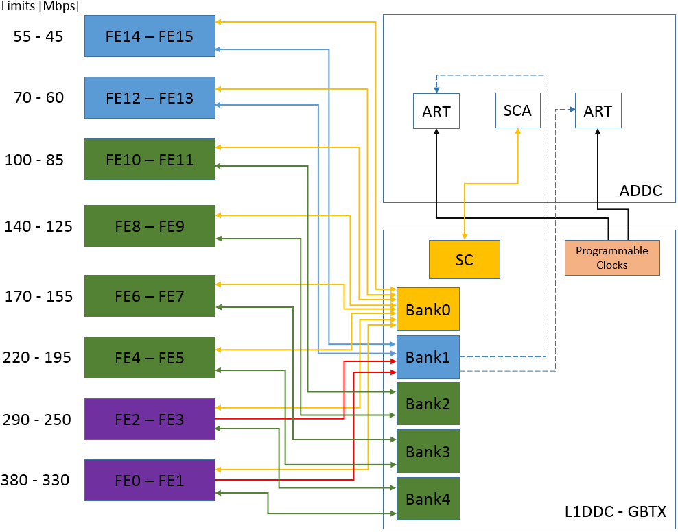
L1DDC connectivity with the MMFE8 and ADDC boards
SCA ASIC will be added to the ADDC board
  Slow Control channel of the GBTX will be used for the configuration of the SCA.
2 extra differential pairs (clocks) will be send from the L1DDC to the ADDC
  Either from the 8 programmable clocks of GBTX.
  Either form the two spares of the bank1.
E-link 80Mbps
E-link 160Mbps
E-link 320Mbps
Differential pair, L1 data
Differential pair, clock
Differential pair, BCR
80 Mbps
160 Mbps
320 Mbps
480 Mbps (320 Mbps + 160 Mbps)

Slide 8
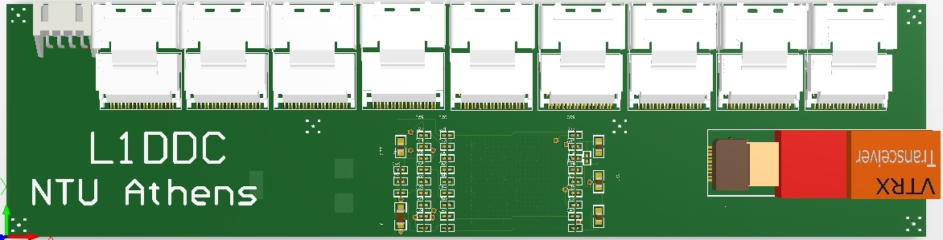
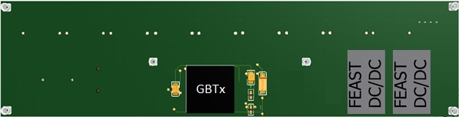
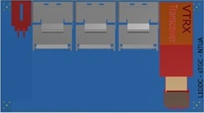

L1DDC
Different designs
  Micromegas
    200mm x 50mm
    9 mini SAS connectors (8 for FEs, 1 for ADDC)
  sTGC
    90mm x 50mm
    3 mini SAS connectors (3 for FEs)
Voltage levels
  2.5V Digital (VTRX)
  1.5V Analog (GBTX)
  1.5V Digital (GBTX)
Components
  GBTx ASIC, VTRX optical transceiver, 2 x FEAST DC-DC converter
  Power connector - Molex 0015912025
  Total power consumption: 3.5Watts (estimated)
1024 L1DDC boards
  16 front ends/plane
  1 L1DDC serves 8 front ends => 2 L1DDC/plane
  16 planes/sector -> 16 sectors/wheel -> 2 wheels in NSW
Top side of micromegas L1DDC
Bottom side of micromegas L1DDC
Top side of sTGC L1DDC
Bottom side of sTGC L1DDC

Slide 9
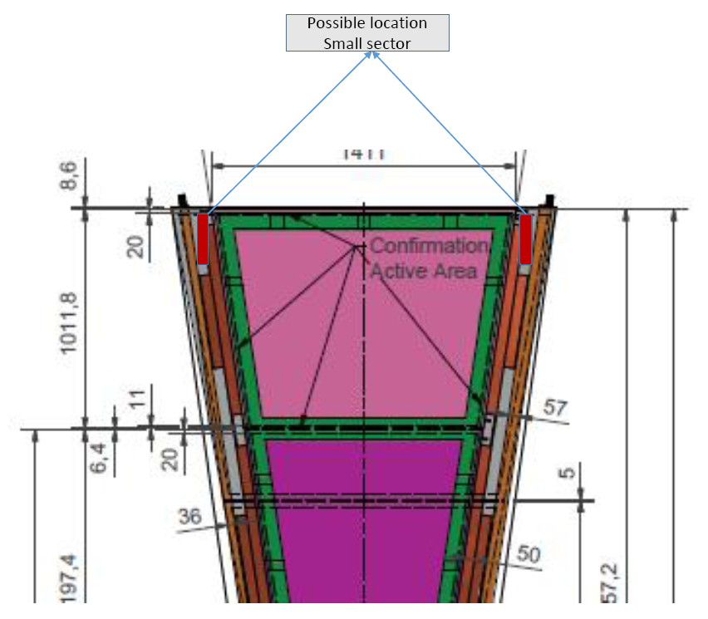
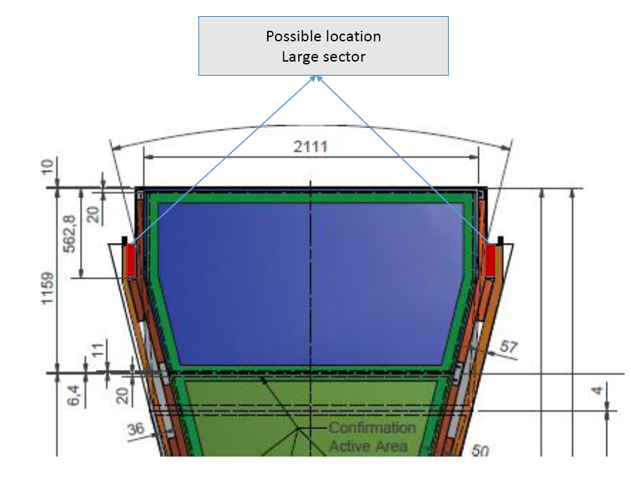
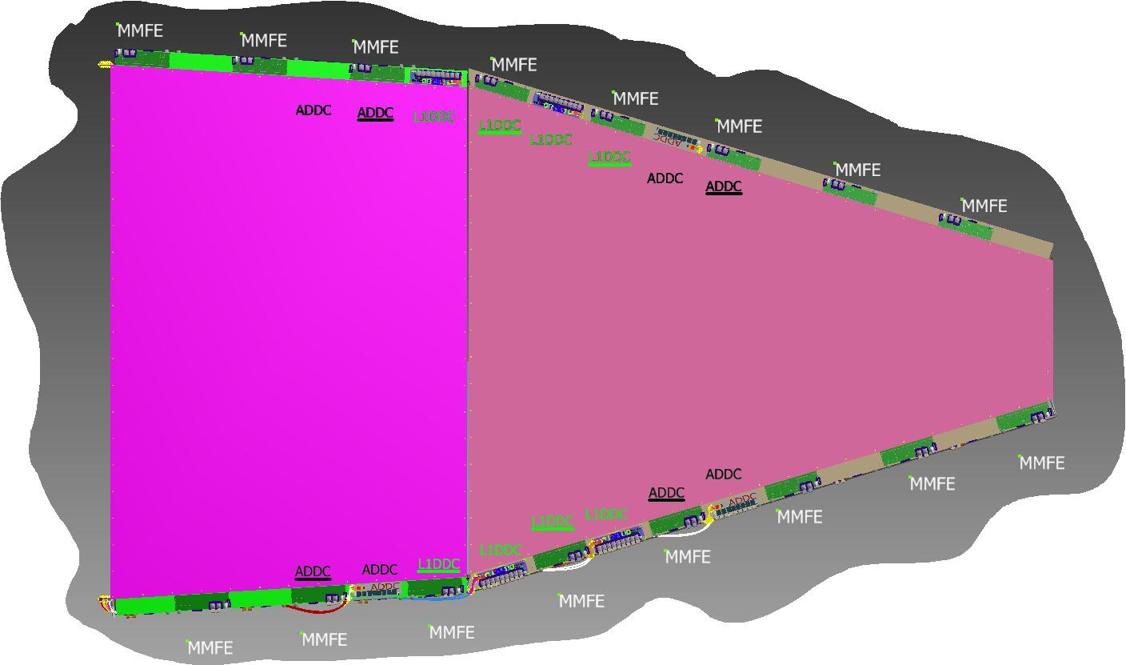
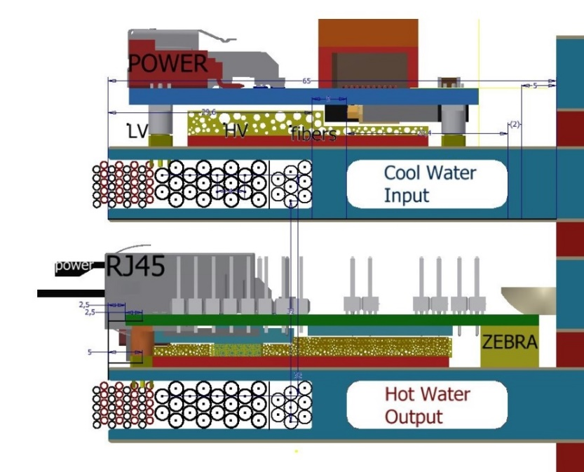
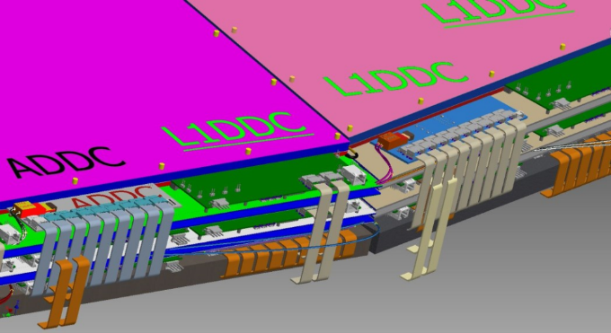
L1DDC placement
L1DDC will be placed radially on both sides of micromegas and sTGC detectors
1 L1DDC will serve the 8 front ends of the one side of each plane
For the micromegas L1DDC will be placed on the center to minimize the cable length
Elastic thermal foam will be used for better connectivity to the cooling channel
L1DDC placed on the sTGC detectors
L1DDC
Front
end
3D representations by A. Koulouris
L1DDC placed on the micromegas detectors

Slide 10
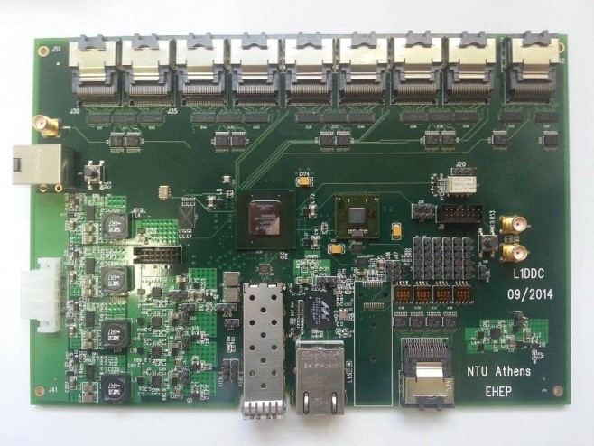
L1DDC - Prototype 1 & 2
To front ends
To ADDC
Prototype 1
  Already fabricated
  Size 210mm x 144mm
  Layers used : 14
  Alternative paths in case of GBTX failure
  Input voltage 3.6V - 42V
  GBTx, GBTIA & GBLD (VTRX) ASICs
  Xilinx FPGA Artix7 - xc7a200t-3FBG484
  SFP+, Gigabit Ethernet, VTRX, miniSAS 36p, SMAs
  Still in debugging process
  Board is functional
  No radiation tolerant board
Prototype 2
  Design in progress (same as final board)
  Size 200mm X 50mm
  12 Layers will be used
  Input voltage 5V - 12V
  Use only radiation hard components (GBTx, VTRX, FEAST)
  Can be tested in radiation and magnetic fields
  Estimate final power consumption
36p miniSAS
Mux-demux
Clock, Trigger-SMA
Trigger, Clock
- RJ45 input
GBTx ASIC
translators
Reference clock - SMA
power
FPGA JTAG
36p miniSAS, GBTx programmable clocks
Artix FPGA
SFP+
RJ45,
Gb Ethernet
VTRX
Top side of L1DDC prototype-1 board

Slide 11
Summary
L1DDC collects the Level-1 Data and distributes the TTC data to the front end and ADDC boards
L1DDC is a fully radiation tolerant board
Fulfills all ATLAS NSW upgrade requirements
Fully compliant with LHC rates
Has SEU mechanisms to assure signal integrity
Different L1DDC boards will be fabricated for micromegas and sTGCs detectors

Slide 12
Thank you
Questions?

Slide 13
Backup Slides

Slide 14
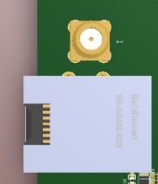
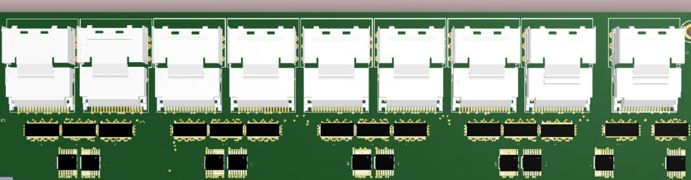
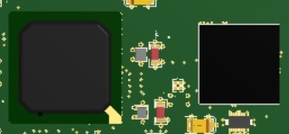
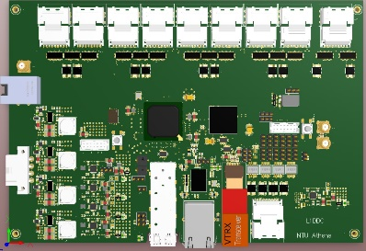
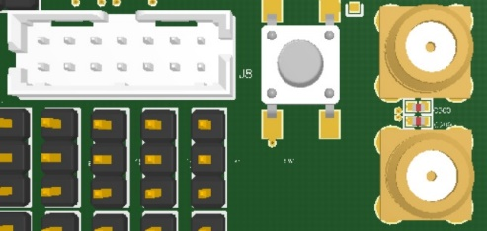
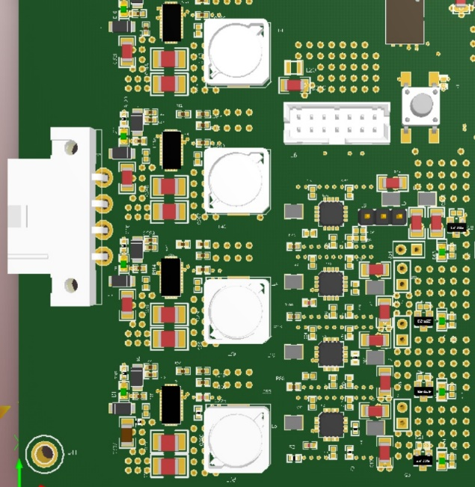
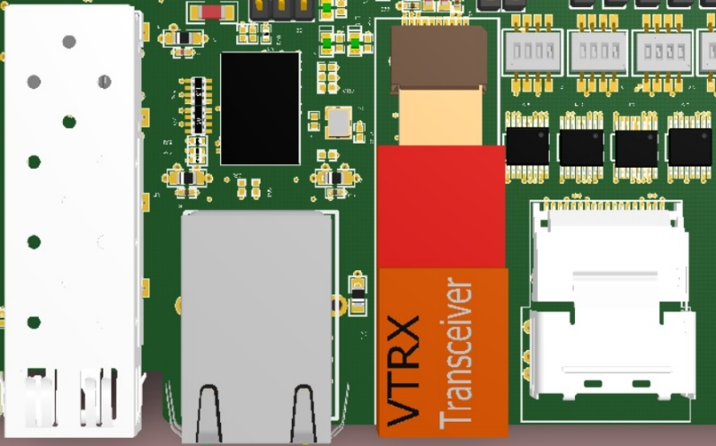
elinks
SMA - Trigger
RJ45 - Trigger and Clock
Artix-7
GBTx
SMA - Reference clock
JTAG
DC-DC
Power in
JTAG
Clock outputs
LDOs
SFP+
RJ45
VTRx

Slide 15
Technical characteristics
FPGA Artix 7
  Configures the GBTx
  Implements the I2C protocol for the communication with the configuration registers
  Reads and sends the data in case of GBTx failure
Inputs & outputs
  Detector side
    Elinks (LVDS or SLVS differential)
  Counting room side
    VTRX optical tranceiver
    10/100/1000 ethernet
    SFP
    SMA
Anything to LVDS translators (SN65LVDT122)
  Convert GBTx output (SLVS) to LVDS standard

Slide 16
Technical characteristics
Voltages Levels
  1.5V Digital (GBTx)
  1.5V Analog (GBTx)
  2.5V Digital (VTRx, FPGA) Direct from LTM4619
  3.3V Digital (efuses, SN65LVDT122) Direct from LTM4619
  1.2V Analog MGTAVTT (FPGA)
  1.0V Analog MGTAVCC (FPGA)
  1.0V Digital VCCINT, VCCBRAM (FPGA)
  1.8V Digital VCCAUX (FPGA)
4 LT8612 DC-DC Converters (replaces LTM4619)
  Single 6A output
Use of 6 ADP1755 LDOs to step down the voltage
  Singe output @ 1.2A
JTAG port
SMA & RJ45 for reference clock and trigger

Slide 17
Differential impendence
PCB Stack Up |  |  |  |  | Impedance
Layer | Type | Thickness (mil) |  |  | Single ended | OHM | Differential | OHM
Top side solder mask |  |  | 0,5 | mils
L1 | Top | copper + plating | 1,4 | mils |  |  | 4/4/4mils，100Ω +/- 10% | 97.48Ω
 |  | prepreg | 4 | mils
L2 |  | copper | 0,7 | mils
 |  | core | 8 | mils
L3 |  | copper | 0,7 | mils |  |  | 4/4/4mils，100Ω +/- 10% | 99.24Ω
 |  | prepreg | 8 | mils
L4 |  | copper | 0,7 | mils
 |  | core | 6 | mils
L5 |  | copper | 0,7 | mils |  |  | 4/4/4mils，100Ω +/- 10% | 97.85Ω
 |  | prepreg | 5 | mils
L6 |  | copper | 0,7 | mils |  |  | 4/4/4mils，100Ω +/- 10% | 97.85Ω
 |  | core | 6 | mils
L7 |  | copper | 0,7 | mils
 |  | prepreg | 4 | mils
L8 |  | copper | 0,7 | mils
 |  | core | 6 | mils
L9 |  | copper | 0,7 | mils |  |  | 4/4/4mils，100Ω +/- 10% | 97.85Ω
 |  | prepreg | 5 | mils
L10 |  | copper | 0,7 | mils |  |  | 4/4/4mils，100Ω +/- 10% | 97.85Ω
 |  | core | 6 | mils
L11 |  | copper | 0,7 | mils
 |  | prepreg | 8 | mils
L12 |  | copper | 0,7 | mils |  |  | 4/4/4mils，100Ω +/- 10% | 99.24Ω
 |  | core | 8 | mils
L13 |  | copper | 0,7 | mils
 |  | prepreg | 4 | mils
L14 | Bottom | copper + plating | 1,4 | mils |  |  | 4/4/4mils，100Ω +/- 10% | 97.48Ω
Bottom side solder mask |  |  | 0,5 | mils
TOTAL |  |  | 90,2 | mils
 |  |  | 2,291 | mm

Slide 18
L1DDC functionality
ART
Front End board connections – 8 FEB/L1DDC
mSAS
26p
mSAS
26p
mSAS
26p
mSAS
26p
mSAS
26p
mSAS
26p
mSAS
26p
mSAS
26p
mSAS
26p
SMA: Trigger
SMA: GBTx reference clock
RJ45
Trigger and time
Artix-7
GBTx
power
SFP+
VTRx
ethernet
mSAS
26p
Programmable clock output (8 clocks)

Slide 19
Send & receive data (FE side)
FE
FE
CBTL04083A
CBTL04083A
FPGA
GBTx
FPGA
GBTx
2 alternative paths to read and send the data
From FPGA in case of failure of GBTx
Directly from GBTx
CBTL04083A PCI Express Gen3 switch up to 8.3Gb/s
Low intra-pair skew: 5 ps typical
Low inter-pair skew: 35 ps maximum

Slide 20
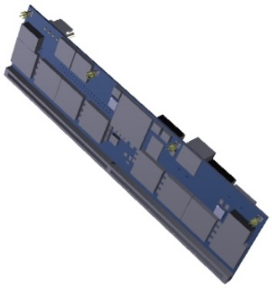
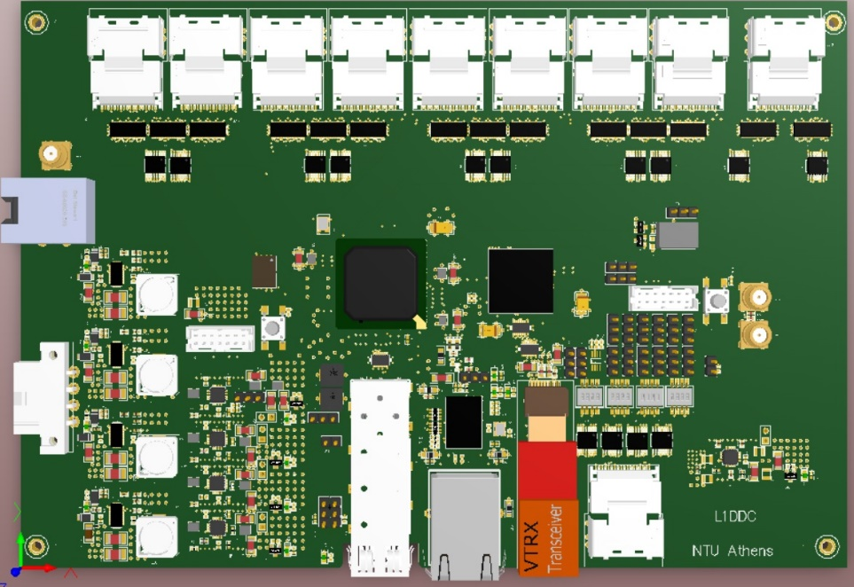
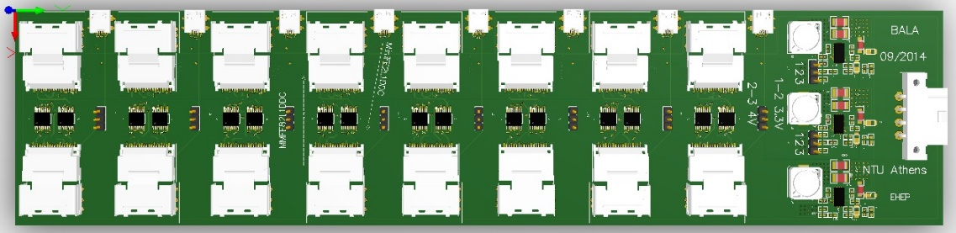
Connection with Mini2 Bucharest Board
BBALA adapter board
MMFE8
Anything → LVDS
SLVS or SSTL135
L1DDC
SSTL135
.
.
.
LVDS

Slide 21
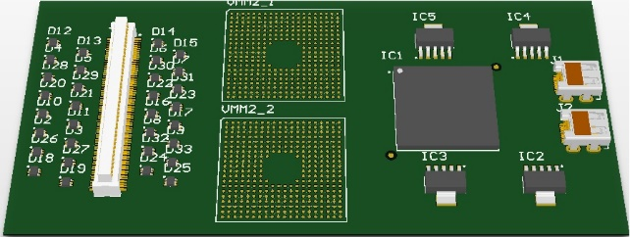
Connection with Mini2 Bucharest Board
BBALA adapter board
mini2
LVDS ← Anything
L1DDC
LVDS-SLVS-SSTL135
LVDS
.
.
.

Slide 22

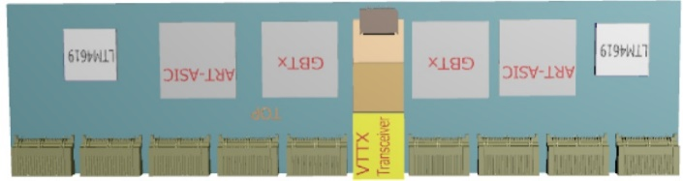

Connectivity: MMFE8 – L1DDC – ADDC
MMFE8-1
MMFE8-2
MMFE8-7
MMFE8-8
ADDC
……
L1DDC
Optical link

Slide 23
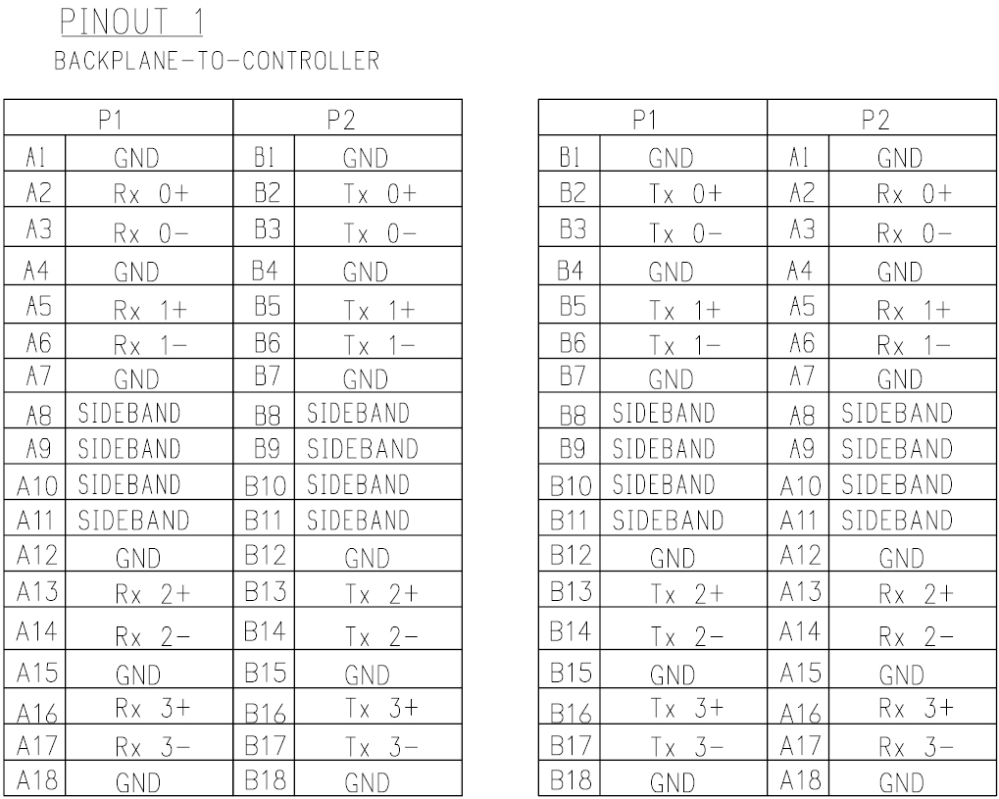
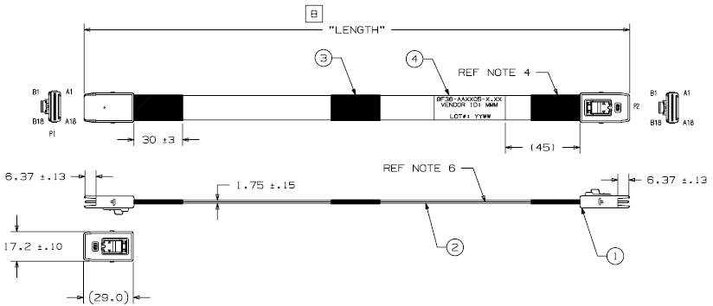
Twinax cables
3M mini SAS cables
36p positions
Part No 8F36-AAA105

