Slide 1
Working Group on Re-commissioning the Injector Complex
V. Kain, B. Mikulec

Slide 2
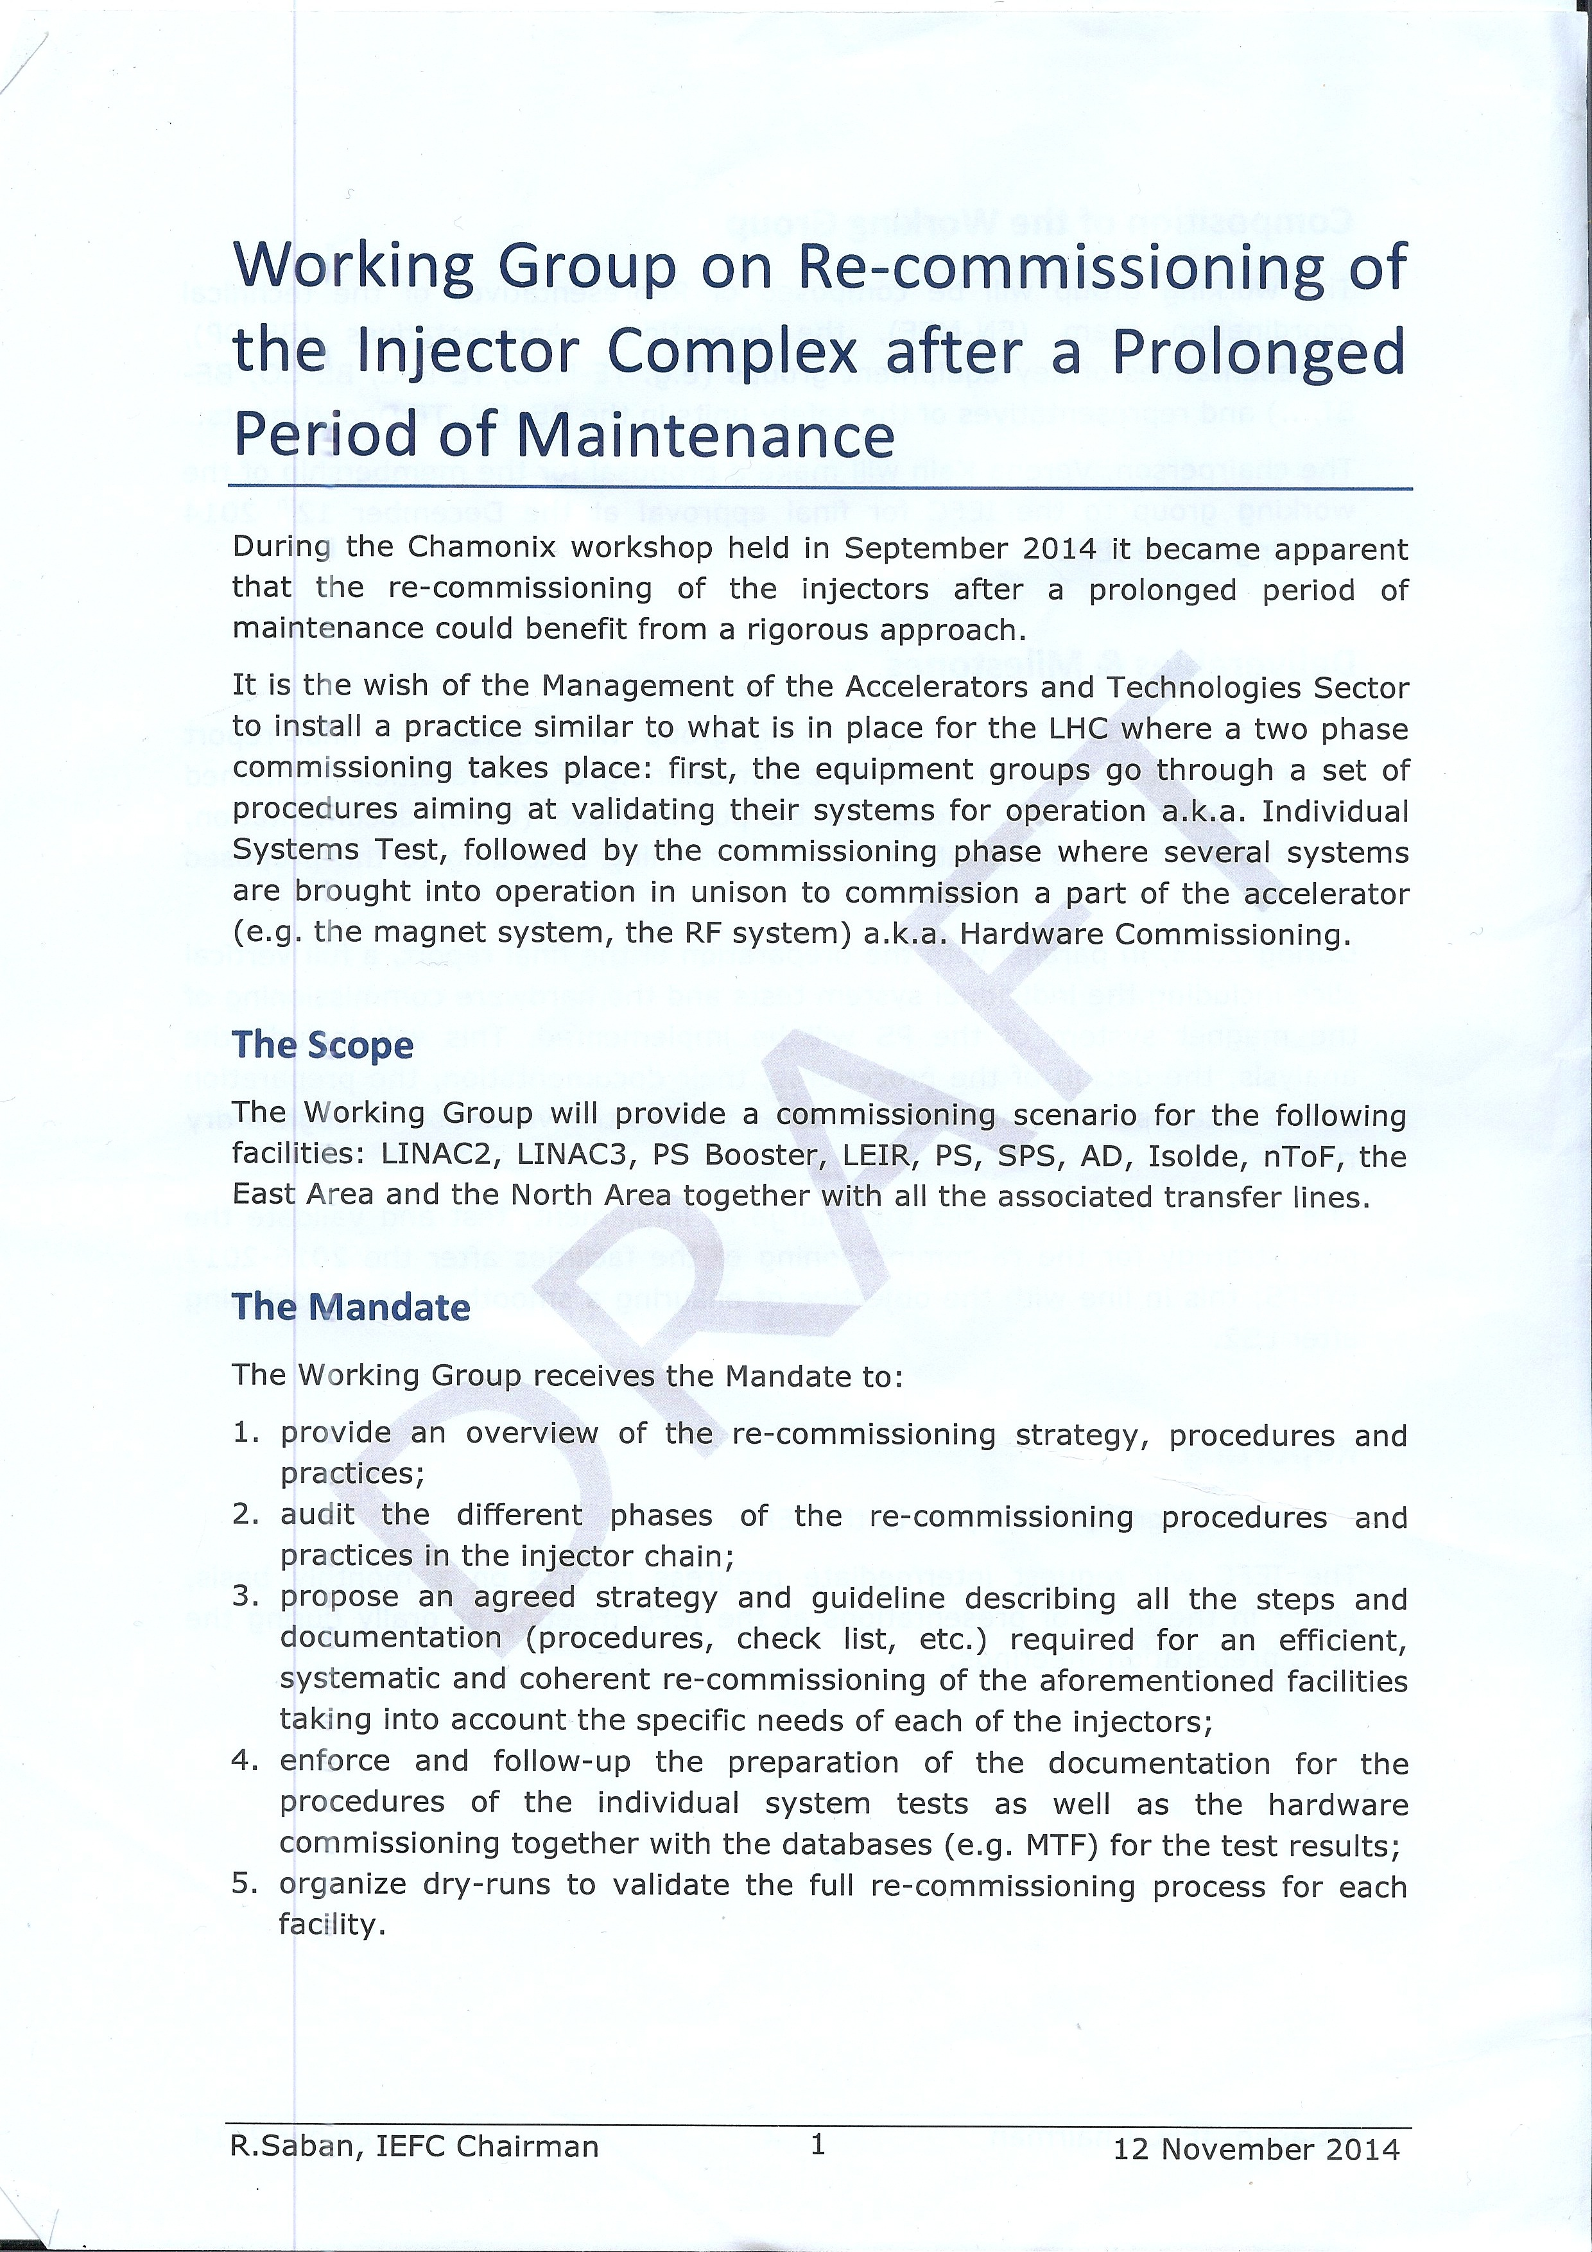
Mandate from IEFC

Slide 3
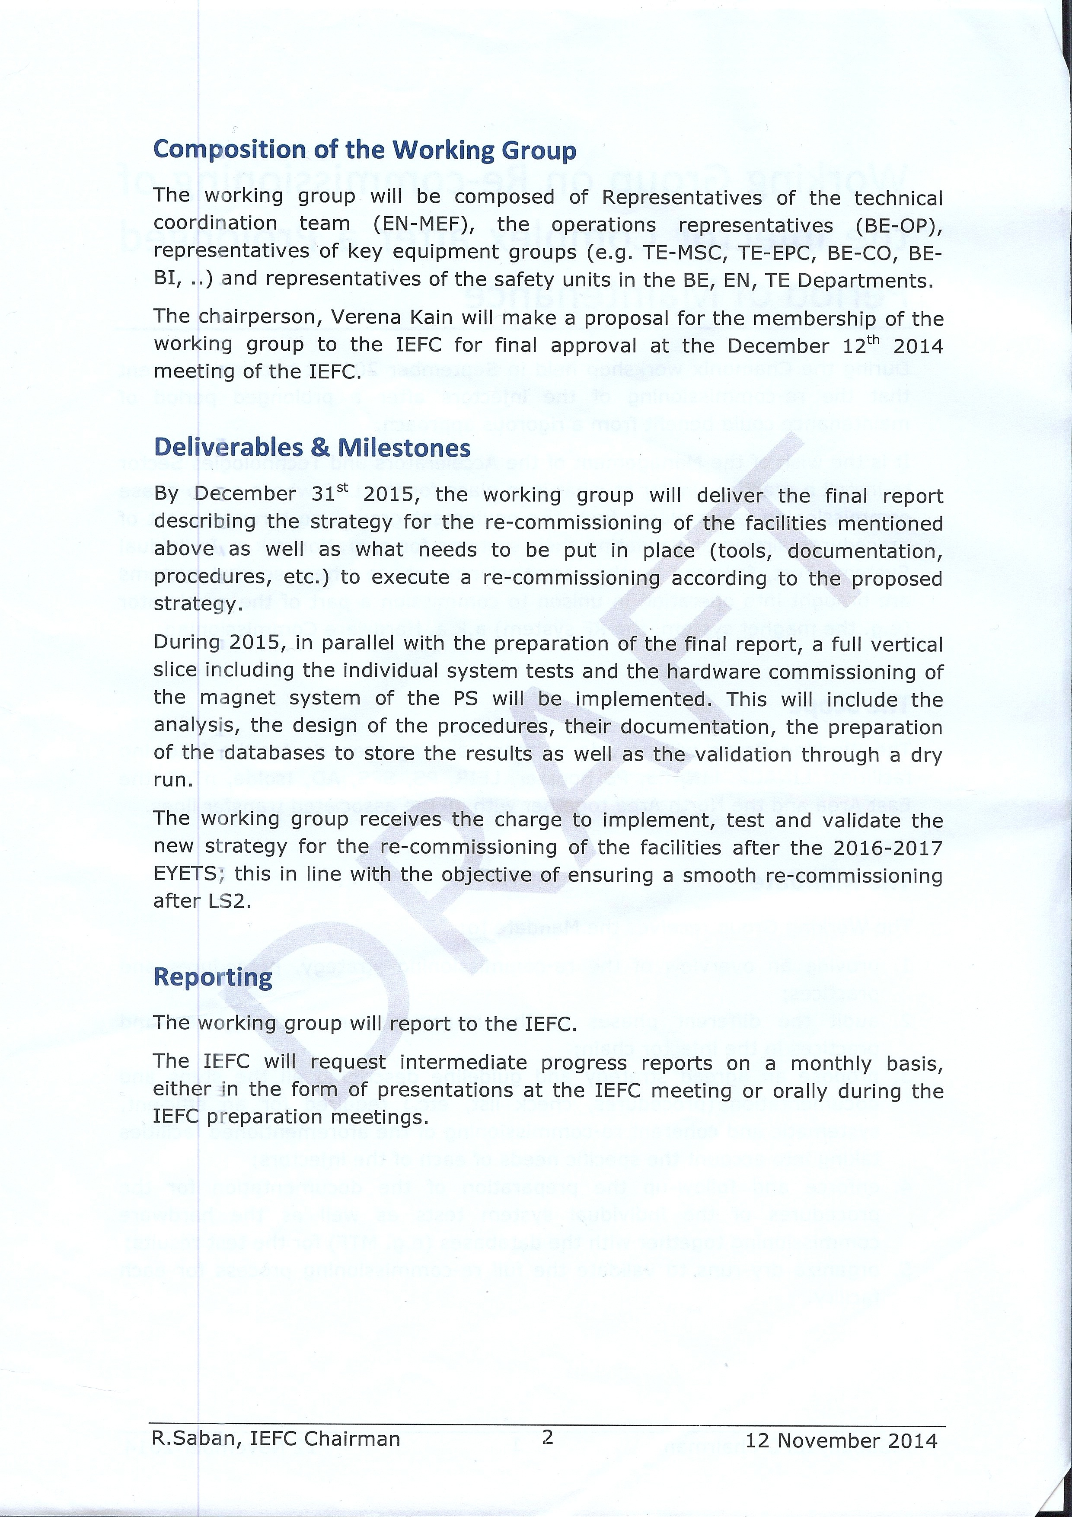
Mandate from IEFC

Slide 4
Mandate from IEFC
Provide an overview of the re-commissioning strategy, procedures and practices;
Audit the different phases of the re-commissioning procedures and practices in the injector chain;
Propose on agreed strategy and guideline describing the steps and documentation (procedures, check-list, etc.) required for an efficient, systematic and coherent re-commissioning of the aforementioned facilities taking into account the specific needs of each of the injectors;
Enforce and follow-up the preparation of the documentation for the procedures of the individual system tests as well as the hardware commissioning (dry run) together with the databases (e.g. MTF) for the test results;
Organize dry-runs to validate the full re-commissioning process for each facility.

Slide 5
Working Group Composition
The core: 2 members of each machine/facility (often shifters)
  SPS, PS, PSB, ISOLDE, LEIR, AD, LINACs
Chair : V. Kain. Deputy: B. Mikulec
Scientific secretary: B. Lefort
Bi-weekly meetings (Thursday afternoon)
At a later stage: involve shutdown coordination, equipment group representatives, representatives for experimental areas

Slide 6
Working Group Composition
LINACs (2/3/4): Detlef, Alessandra
PSB: Jose-Luis, Bettina
ISOLDE: Miguel, Jose Alberto
PS: Marc, Gabriel, Rende
AD: Bertrand, Tommy
SPS: Stephane, Jerome

Slide 7
Working Group Approach
Representatives from all machines around the table
3 PHASES:
Analyze commissioning and start-up after LS1
  What worked well? And why?
  Which areas need improvement? And why?
Define common approach across different machines
  Learn from each other; learn from the LHC if applicable
  Define how to test, what to test, when to test and who should test
  Formalize testing and follow-up: check lists
  E.g.: collaborative testing between equipment groups, OP and controls already before machine check-out – “Dry runs”
Implement and validate new approach

Slide 8
Working Group Goals
Establish common machine preparation culture across injectors
Prepare procedures / check lists and main test plans to be applied after every long shutdown
  First versions to be ready by end of 2015
Verify strategy for test procedures of full vertical slice
  Deployment on selected machines/systems for 15/16 YETS
Refinement and wider (full) deployment for 2016/17 EYETS

Slide 9
Preparation for next meetings

Slide 10
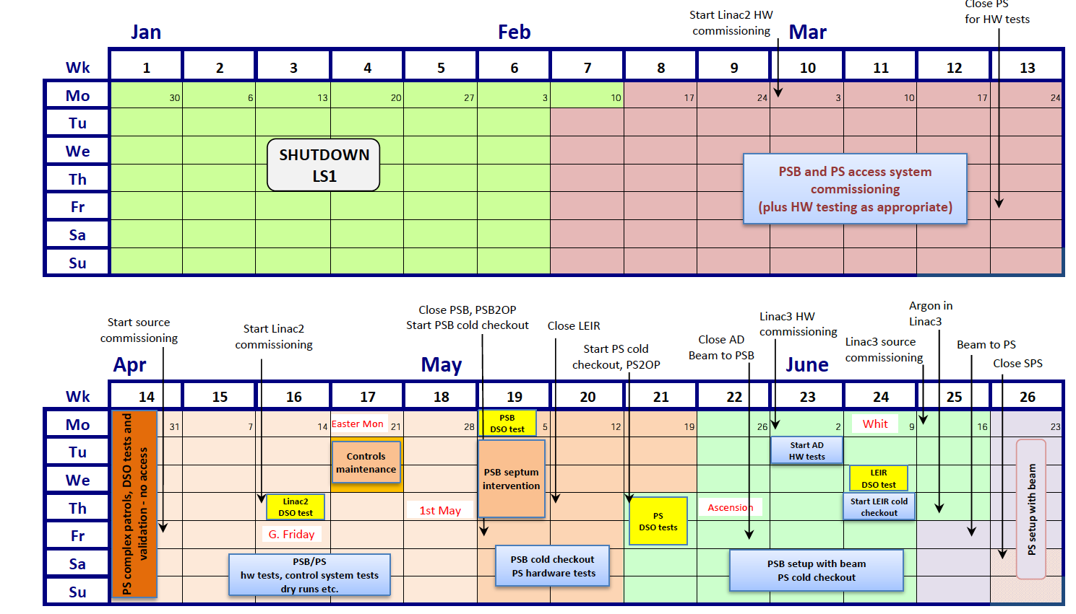
Schedule beginning of 2014
Usual phases: Hardware tests, cold-check out, beam commissioning

Slide 11
Per machine: summarize LS1 start-up experience
Describe the different phases in the start-up planning for your machine:
  Length of each phase? Who coordinated and prepared?
  How do you do the commissioning?
    Daily meetings?
    Check lists available for each phase/system/operational scenario?
    Tracking of progress?
    In which phase do tests from the control room start?
  Test coverage:
    Full vertical slice with all interfaces and applications?
    Which systems are tested, which are not? Tested by who?
    Including beam tests: corrector polarities, BPM gains,…
Résumé: What went wrong and why?
  Control system readiness? Hardware specialist availability/ priorities? Start-up during holiday period, not enough time,…
Résumé: What was good and why?

Slide 12
Next meetings
Will cover two to three machines/facilities per meeting.
We will get back to you a.s.a.p. to see with which machines we start

