Slide 1
FCC dump system
W. Bartmann, B. Goddard, R. Ostojic
FCC Dump Meeting, 14th Jan. 2015

Slide 2
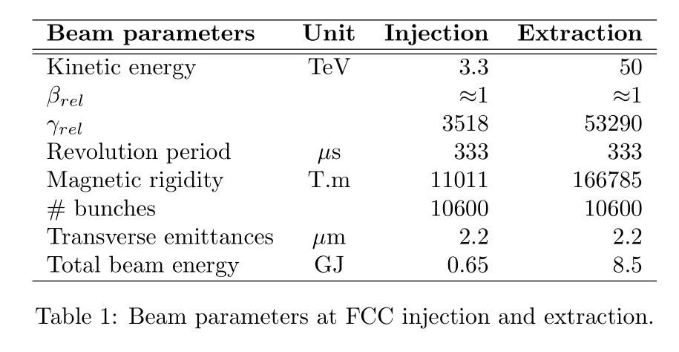
FCC-hh parameters

Slide 3
Basic assumptions on system concept – can change!
Signal (trigger) from interlock system
External dump block
2 dump systems (one per beam)
Full beam extracted in one turn, with abort gap
Fast kickers and septa to get out of ring lattice
Absorber system (“dump block”)
Dilution as needed – passive/active

Slide 4
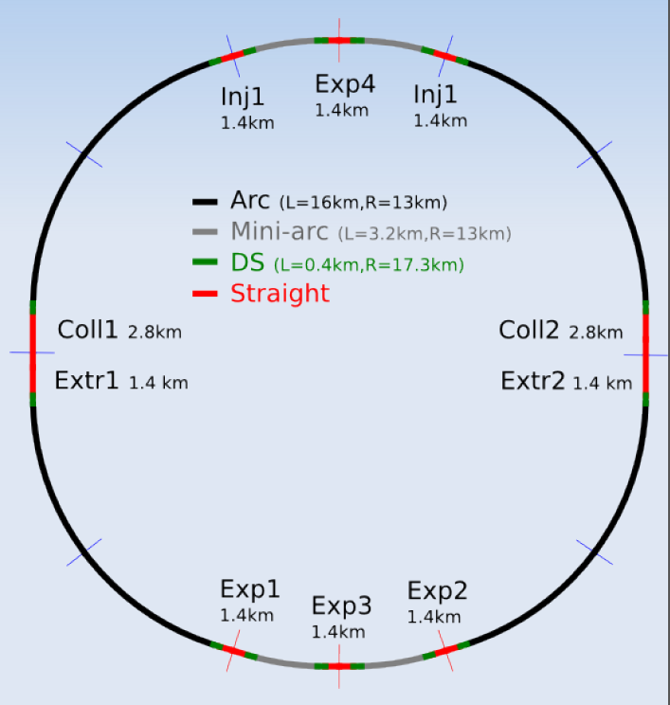
FCC layout
D. Schulte et al.

Slide 5
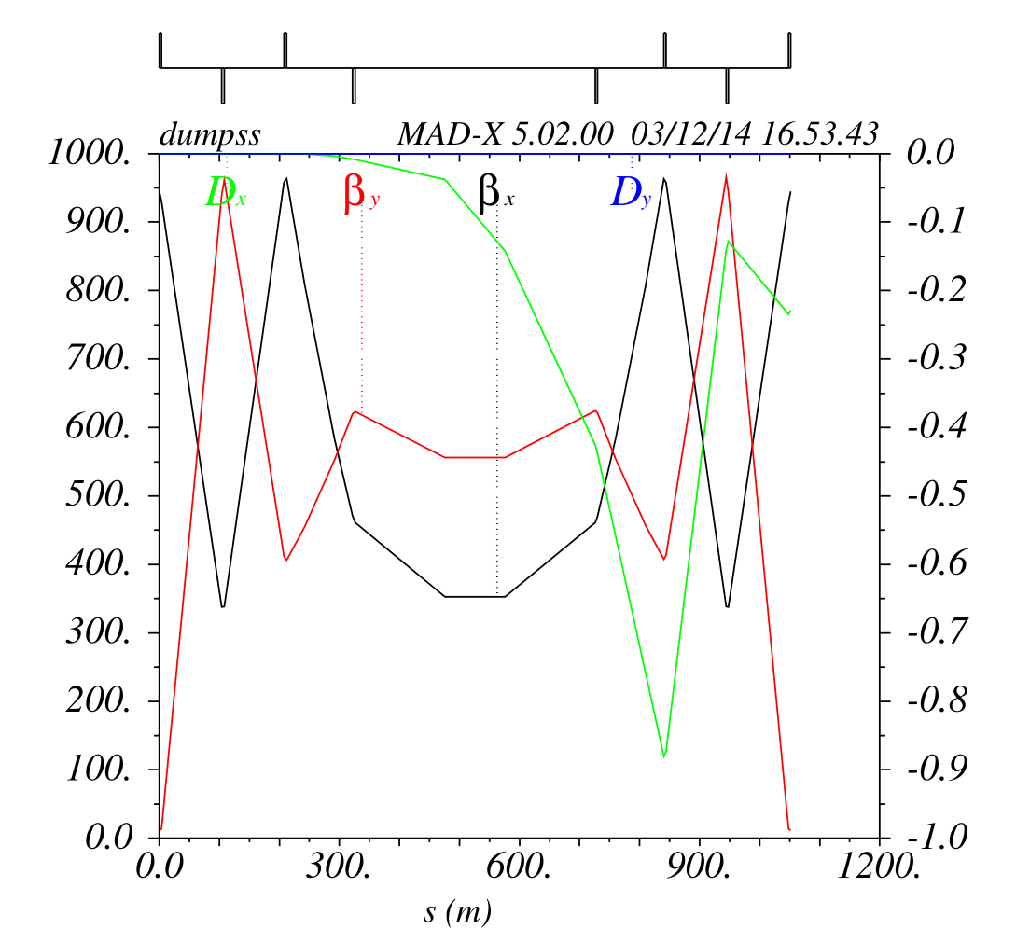
Conventional dump design
110 m
400 m
Rms sigma ~ 1 mm
Assume otherwise max of 0.5 mm
100 m
Quads of 4m length
500 T/m
Extract the two beams from different straight sections
Same plane deflections - or is Lambertson preferred?

Slide 6
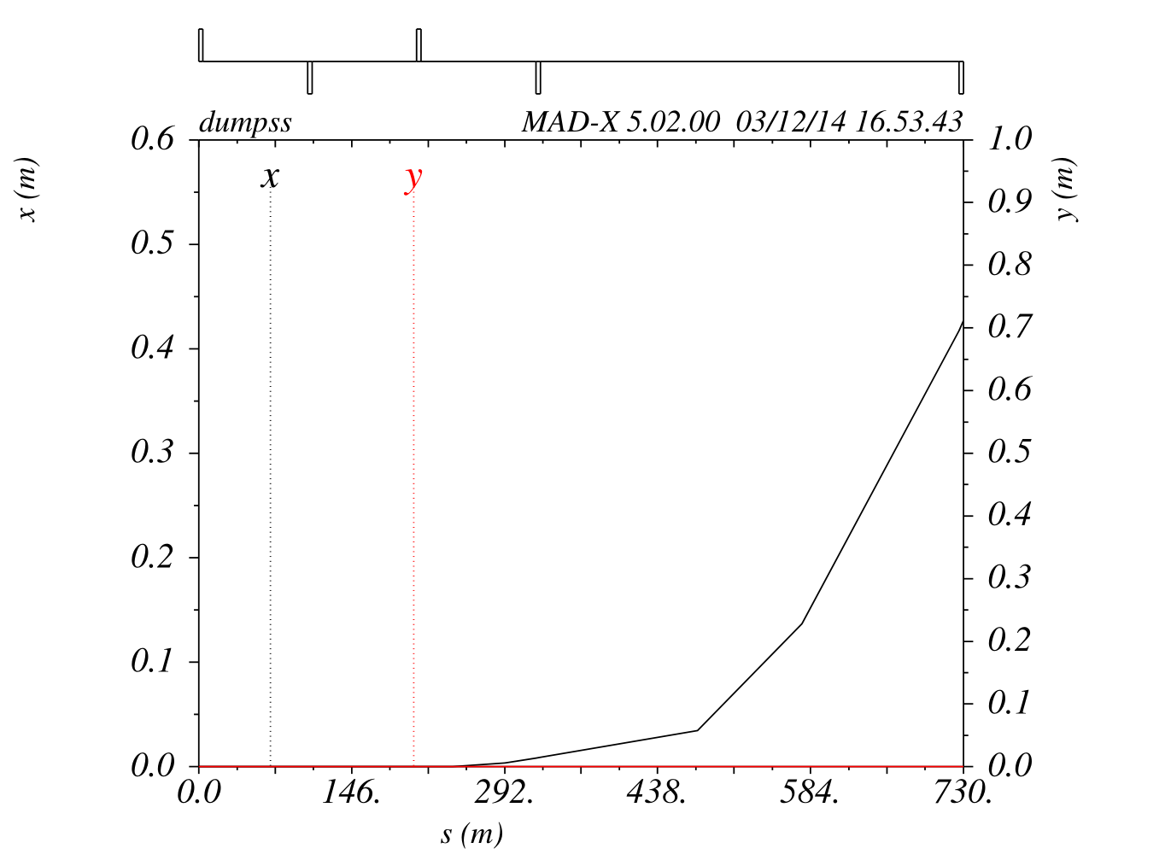
Extraction trajectory – no bump
MKE:
0.15 mrad
110 m drift
Q5:
9 mm offset
MSE:
35 mm offset at entrance
150 m drift to MSE
17 mm septum width
50 m for TCDQ
200 m for MSE
417 mm Q4 clearance
1.7 mrad, 284 T.m, 1.42 T

Slide 7
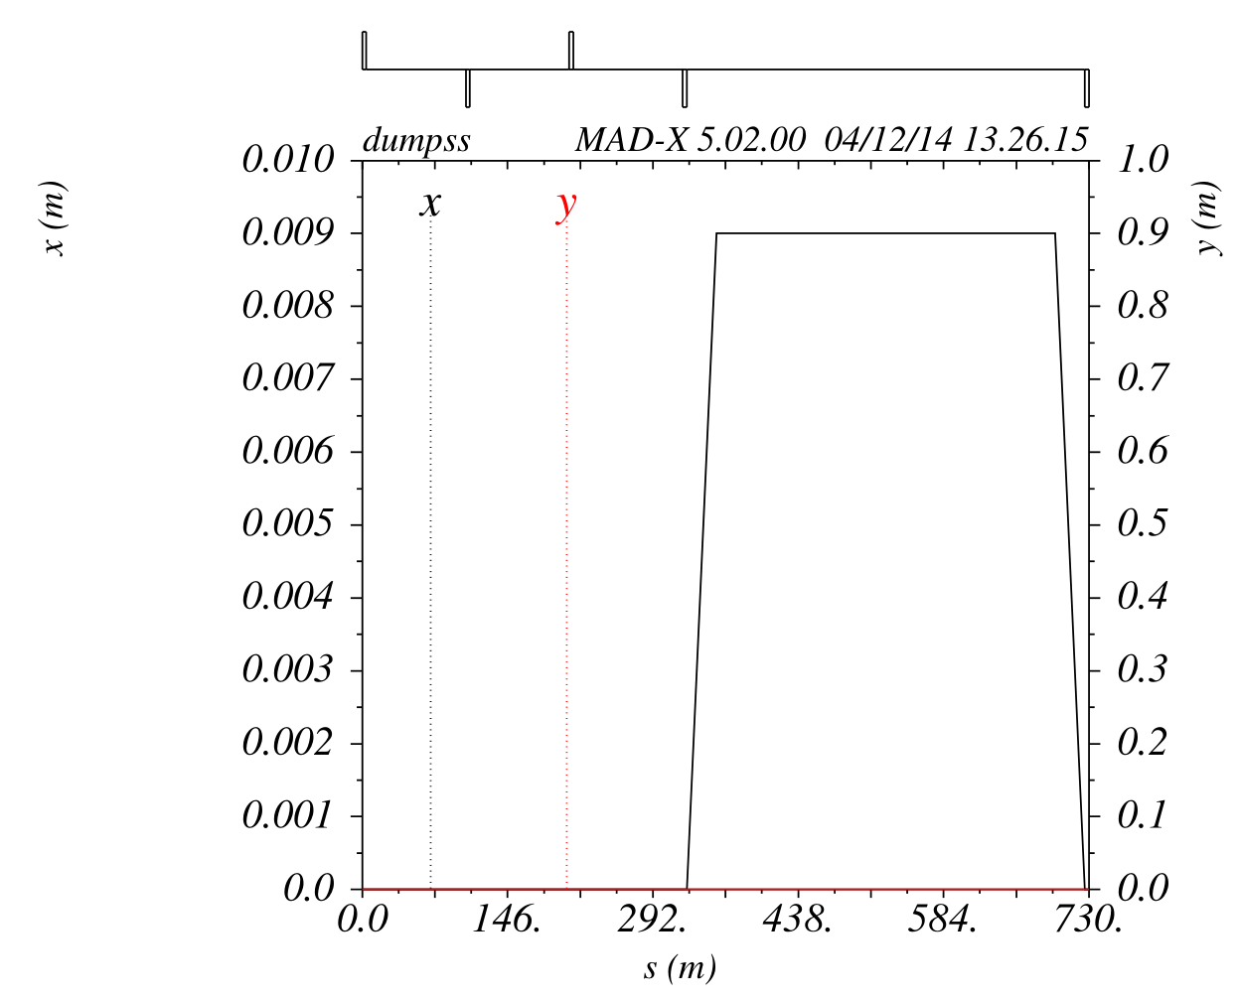
Extraction bump

Slide 8
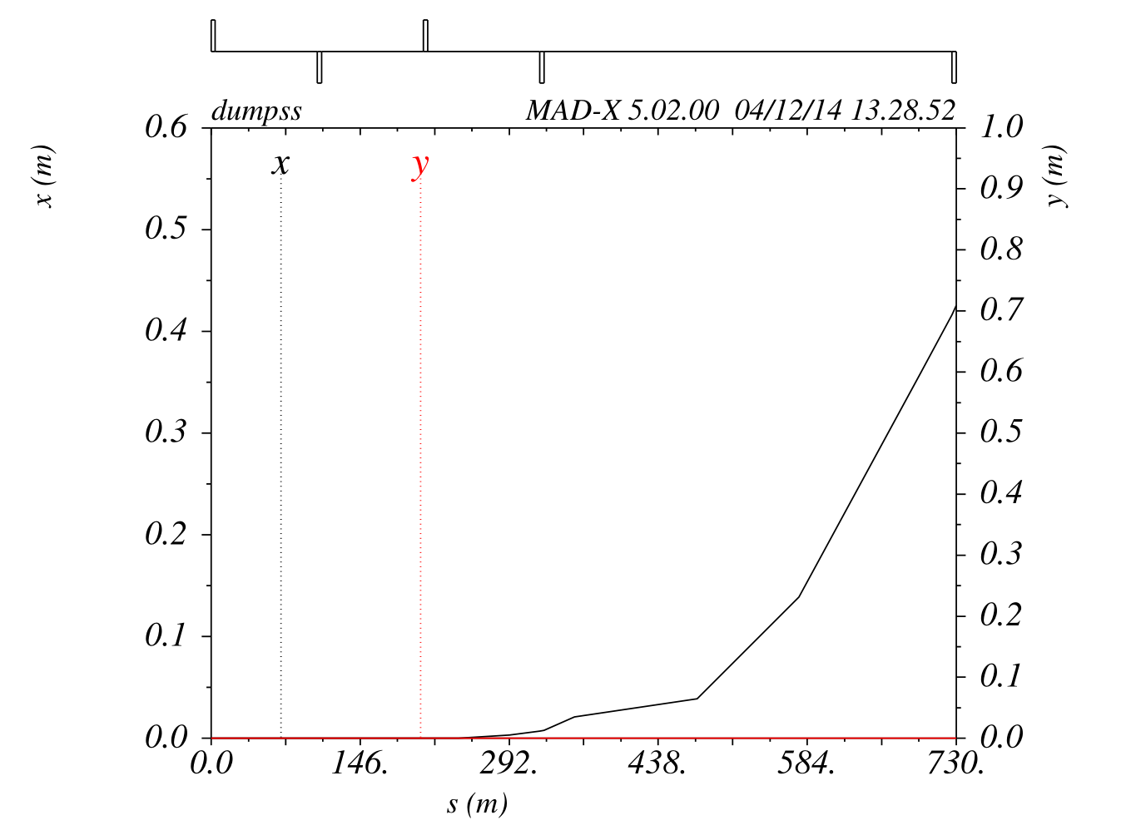
Extraction trajectory with bump
MKE:
0.15 → 0.13 mrad
110 m drift
Q5:
9 mm offset
Bump:
9 mm
0.3 mrad → 50 T.m
360 mm beam sep at bumper3
MSE:
35 mm offset at entrance
150 m drift to MSE
17 mm septum width
50 m for TCDQ+2 bumpers
200 m for MSE
417 mm Q4 clearance
1.7 mrad, 284 T.m, 1.42 T

Slide 10
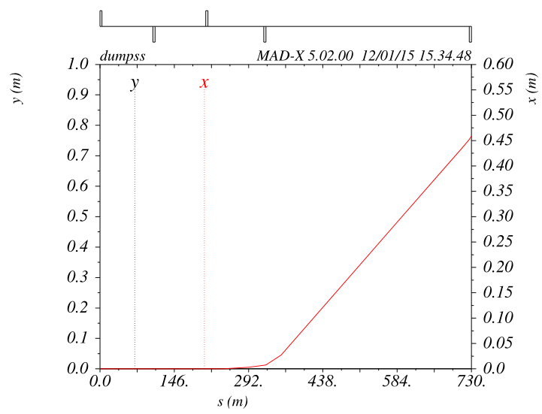
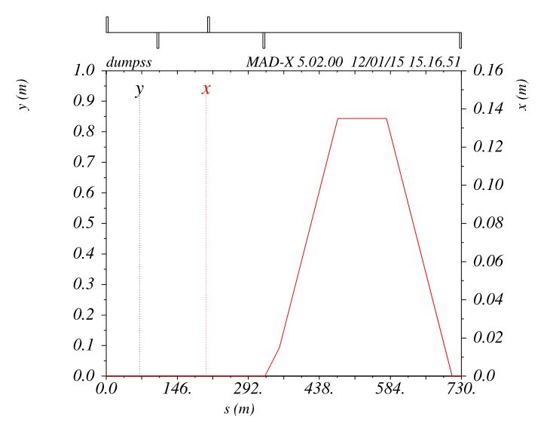
SSC like
Kicker still around quad
Septum is part of the bump
Region with better field quality used for circulating beam
2.0 mrad, 334 T.m
Half of the central drift (~200) needed to reach beam separation at MSD entrance
With 100 m of MSD not anymore NC
Bumpers:
  0.5 mrad, 84 T.m

Slide 11
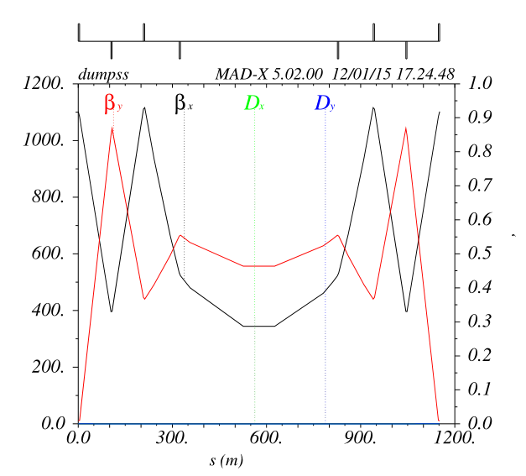
SSC like - opening up central drift
Without significantly increasing the max betas reach 500 m central drift
With 100 m each side for bumpers and auxiliaries leave 300 m for septum
334T.m, 1.2 T → again NC
Bumpers:
  0.5→0.35 mrad, 60 T.m

Slide 12
HW parameters
 |  | Kicker | Septum | Bumpers
B.dl | T.m | 3.3 - 50 | 22 - 334 | 7.7 - 120
Available system length | m | 100 | 300 | 50
Rise time | us | 10 | - | -
Flat top length | us | >340
GFR h/v | mm | 18/18 | 18/18 | 18/18
Challenges:
Radiation hardness
Reliability
Kicker: energy range for switch design, limit in kA/s, peak current, impedance
Septum: overall system length, energy range, powering

Slide 13
Input for dump block and protection devices
 | Unit | 25 ns | 5 ns
Bunch population |  | 1e11 | 0.2e11
# bunches |  | 10600 | 53000
Transv. emittance normalised | um | 2.2 | 0.44
Spotsize at dump (rms) for 1.5 km dump line | mm | 0.4 - 1.6 | 0.2 – 0.7
Total beam energy | GJ | 8.5 | 8.5
Average power (5 h fills) | kW | 500 | 500
Dump material, shielding
Dump line direction
Dilution pattern, frequency
Sweep pattern

Slide 14
Machine protection, reliability,…
Dump system reaction time
Asynchronous dump survival
Downstream (?) collimation system for ‘mopping up’
SIL level
Radiation
Fault tolerant/redundancy in design
Self-tests and post-operational checks

Slide 15
Absorber “block”: ideas….
10 m of low density graphite, with sweep/beta functions large enough to ensure remain below 10 kJ/g. Maybe kickers with SC dilution quads
Some few 100 m of passive 'spoiler' to make the blow-up, e.g. few cm thick graphite plates, spaced by 10-100 cm, to develop the shower with effectively low density - then a solid block of 10 m of graphite
Ppressurised water dump, a la ILC (18 MW designed!), with low enough energy deposition and high enough pressure to avoid boiling the water locally....(difficult, as need to keep delta T to maybe a few hundred degrees!)
Pressurised gas (N2?) dump, e.g. 1000 m of N2 at 15 bar, which is the same amount of material as 10 m of graphite....issues of scattered losses in the pipe, pressure rise when it heats up, whether N2 stays N2 after a while, local plasma formation and creation of low pressure channel, etc.
Solid block designed to melt, then resolidify when cold, e.g. lead, water (ice), ...

Slide 16
Conclusions
Assume dumps for the two beams in separated straights
Extraction with kicker and septum around quad supported by bump
  1.4 T for MSD → NC possible
SSC like extraction
  Septum part of the bump → easier for field homogeneity
  If central drift is opened up to 500 m (betamax ~1100 m) MSD can be NC with ~1.2 T
  Septum not needed to extract the beam
Dump block and protection devices
  Material (solid, liquid, gas), dilution, sweep pattern, …
Machine protection
  Define reaction time, SIL level, fault tolerance, redundancy

Slide 17
Reference collection?
http://lss.fnal.gov/archive/test-fn/0000/fermilab-fn-0514.pdf
http://accelconf.web.cern.ch/AccelConf/p93/PDF/PAC1993_3090.PDF
http://www.osti.gov/etde/servlets/purl/1045183/1045183.pdf

