Slide 1
LHC RF signals
P. Baudrenghien BE/RF

Slide 2
Numerology
For each ring:
  The 400 MHz RF defines 35640 buckets, spaced by one RF period, and numbered from 1 to 35640
  Bucket 1 is the first bucket after the 3 μs long abort gap (defined from bucket 34442 to 35640)
  Bunches in bucket 1 of the two rings collide in IP1 (and IP5)

Slide 3
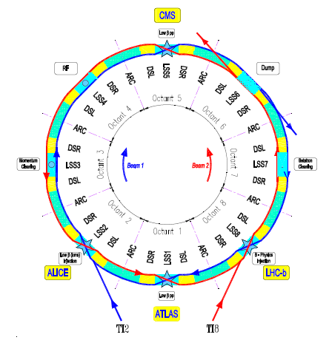
Bunch Numbering
Convention: bunches in bucket 1 of the two rings collide in IP1
FAQ
  Q: Bunches in bucket 1 of both rings meet in IP1 (and IP5). Can this be changed ?
  A: No but when we want to have single bunch collisions in another IP we inject in a different bucket of ring 2. For example for collision in IP2: Inject pilot in bucket 1 ring 1, and pilot in bucket 1 + 35640/4 = 8911 ring 2 .
By delaying the ring 2 injection bucket by ¼ turn we displace the collision point by 1 octant

Slide 4
Revolution Frequency or Orbit
For each ring:
  It is equal to the RF divided by the harmonic number, that is the number of RF periods per turn (h=35640)
  At a given place in the machine, and at a given beam energy (that is fixed RF frequency) the delay between the pulse and the passage of a bunch in bucket 1 is fixed from run to run

Slide 5
Bunch Clock
For each ring:
  It is 1/10 the RF frequency
  At a given place in the machine, and at a given beam energy (RF frequency) the delay between the edge of the Bunch Clock and the passage of a bunch will be fixed from run to run

Slide 6
Drifts
  Drift during the ramp: during the acceleration ramp due to the difference between signal transmission delay and the beam time of flight. For protons we have 6.5 ps/km, for ions 41.25 ps/km. Hopefully not a problem
  Drift during the year. Large drift (> 1 ns) caused by thermal effects on fiber SR4-CCR-ATLAS/LHCb/Alice. Shorter link SR4-CMS
  During a fill: small drifts due to thermal effects in SR4, luminosity optimization (crossing angle), and tides?

Slide 7
Drifts during fill: comparison BPTX DT ALTLAS (green) and CMS (violet)
Fill 3299, ~ 30 ps pk-pk
Data from J.P. Ochoa and G. Mikenberg

Slide 8
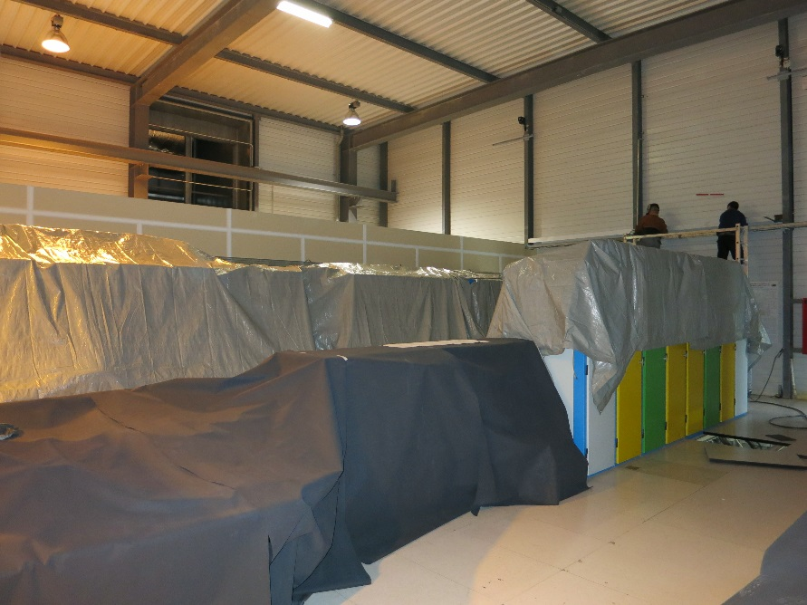
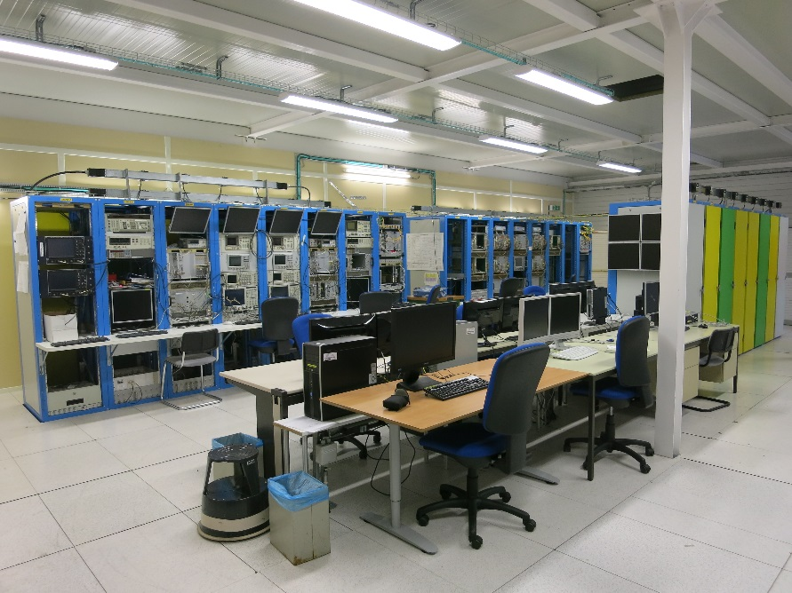
SR4 upgrade. More stable temp/humidity in 2015
LLRF racks in SR4 before and after renovation

Slide 9
Synchrotrons
RF frequency swing (proton)
  The acceleration ramp is defined in momentum (unit eV/c)
  We have
    Injection: 400.788 860 MHz (+- 10 Hz)
    4 TeV/c: 400.789 710 MHz
    6.5 TeV/c: 400.789 730 MHz
  The Bunch Clock is the RF divided by ten. The orbit (revolution frequency) is the RF divided by 35640 (h)

Slide 10
Synchrotrons
RF frequency swing (ions)
  The acceleration ramp is defined in proton-equivalent momentum p_{eq} (unit eV/c), i.e. the momentum of proton in the same magnetic field
  In a given magnetic field we have
  With Pb₂₀₈^{82+ ,} we have 2.51742798
    Injection: 400.784 220 MHz (+- 50 Hz)
    4 TeV/c: 400.789 660 MHz
    6.5 TeV/c: 400.789 700 MHz

Slide 11
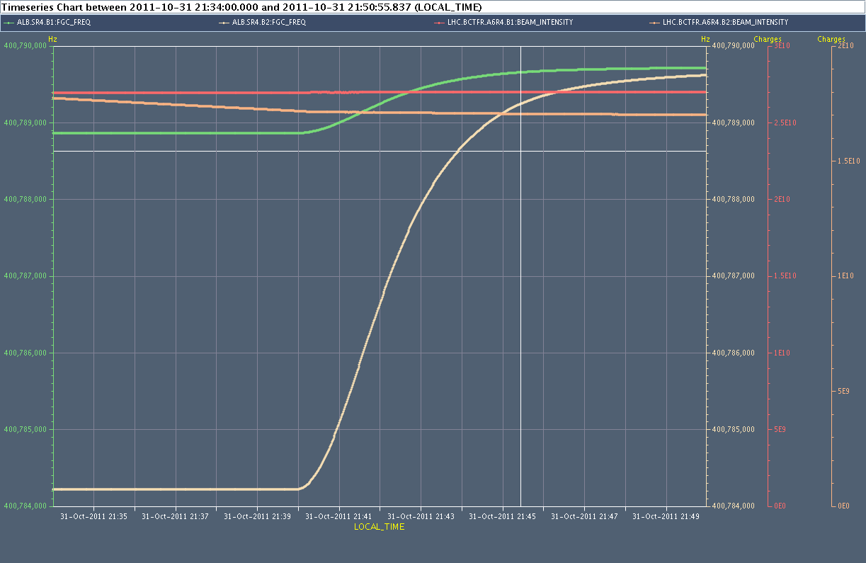
B1 references vs. B2 references
For p-p and Pb-Pb, the two RF are locked from injection -> can use B1 reference only
Por p-Pb, the lock is done at flat top only. B1 ref OK in collision but need to use both references for tracking during filling and ramping.
RF p
@ 3.5 Z TeV/c
we had 76 Hz difference @ 400.8 MHz
RF Pb

