Slide 1
RF
CMS
BTPX
Status
ALICE
ATLAS
LHCb

Slide 2
Outline
BPTX system - Reminder
BPTx Data Acquisition systems overview
Experience from Run1
DIP publications (Alick’s document)
Typical refresh rate and resolution
Is it sufficient for the cogging and the fine alignment?

Slide 3
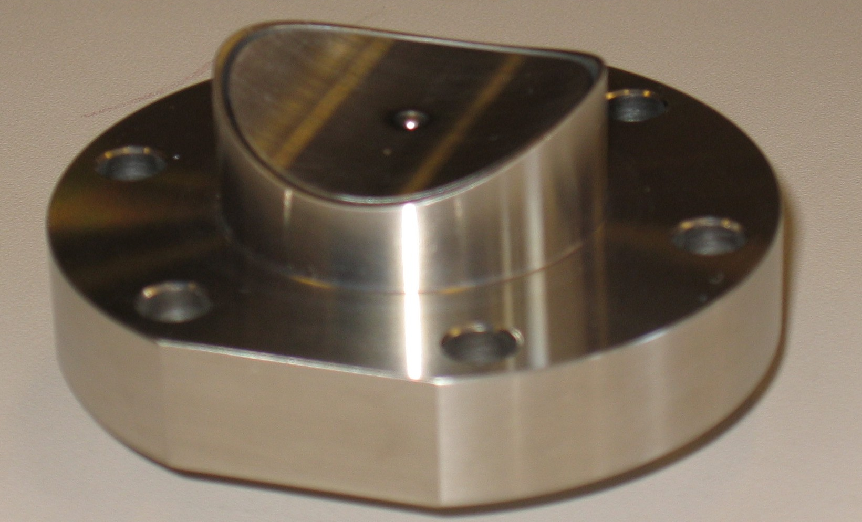
BPTx
Longitudinally Gaussian-shaped bunch produces a current of mirror charge on the button surface, which gives a voltage signal on the transfer impedance:
Basic model:
  “Differentiated Gaussian convolved with an exponential due to the RC”

Slide 4
Acquisition techniques
ATLAS, CMS
  Lecroy oscilloscopes monitoring BPTx1, BPTx2, and reference timing signals (BCx, Orbx)
  Good old setup, nothing changed since last run
  CMS has very little manpower to maintain this system.
ALICE, LHCb
  Custom VME board BPIM designed by Federico (ADC, Discriminator, TDC)
  The restart will be based on the legacy BPIM.
  A minor redesign is ongoing (for May 2015) to improve the resolution and allow the threshold to be negative or positive (see slide 6). This will also allow ALICE to use negative pulse shapes.
ALICE, ATLAS and LHCb rely on the BPTx measurements to compensate temperature drifts
of the timing signals

Slide 5
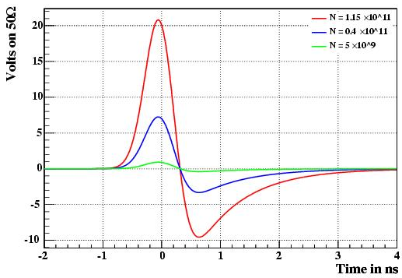
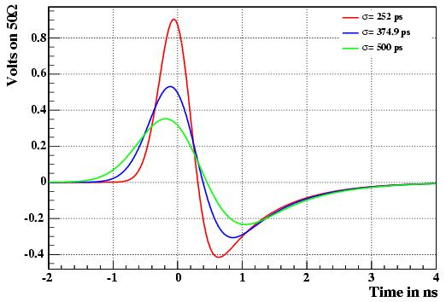
BPTx signals
0-crossing vs Intensity
0-crossing vs bunch length
Bunch passes the BPTX at t=0s
Bunch length Gaussian σ = 252ps (nominal at 7 TeV)
Nominal LHC intensity: 1.15 x 10¹¹ p/bunch
Zero-crossing independent of bunch intensity
σ = 375ps at injection,
σ = 252ps at 7 TeV → 100ps shift
Conclusion: Zero-crossing position depends on bunch length
Expected fluctuations in bunch length? If small, the timing info is preserved
From Christian Boccard & Thilo, 2005

Slide 6
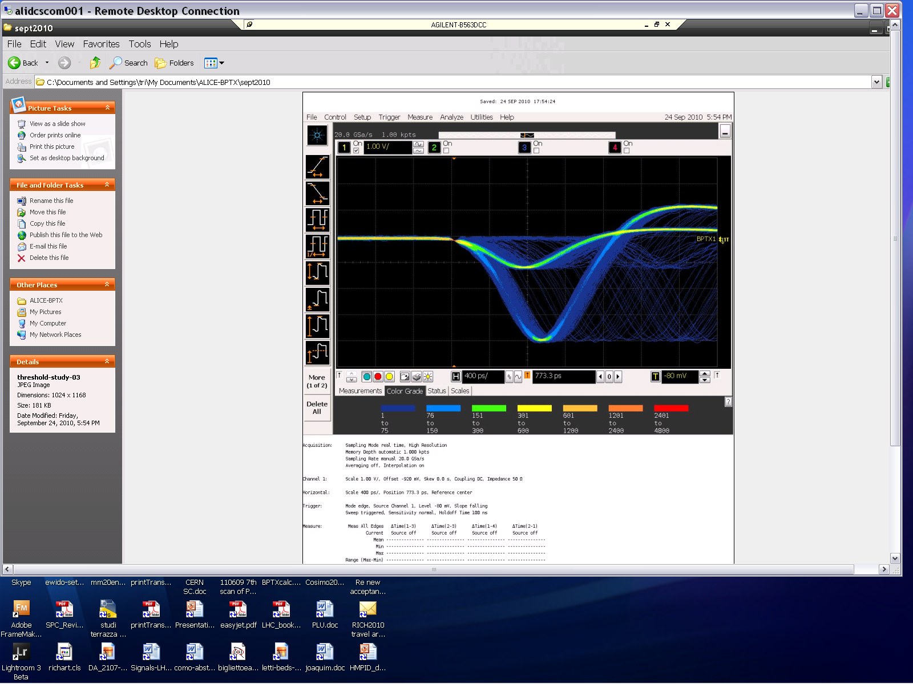
Experience from Run1
From Federico and Antonello
in Run1 LHCb and ALICE (as well as ATLAS and CMS) saw that for some fills the deltaT would slowly drift during a fill, sometimes even to 200ps, seen as a drift in the phase of beam1 or phase of beam2. This drift can be positive or negative, without evident correlation with intensity (sometimes beam2 was shifting while beam1 was the one loosing intensity).
LHCb investigated on the BPTx signal:
  The BPTX bipolar pulse has a zero-crossing which is not exactly at the zero-level voltage, as expected by simulations, but it is slightly shifted to the negative side of the pulse (-100mV).
  Even with a threshold at the exact zero-crossing, the measurement would drift a little with the change of intensity (as expected).

Slide 7
BPTX DIP publications
dip/EXPT/LHC/Timing/BPTX1 (idem for BPTX2)
Phase | Float | Time difference of time(BPTX1) - time(BCmain) + offset. BCmain is definded as the clock that each experiment decides to use to run its electronics. Offset is set at the start of running | ns | 0.1- 0.3 Hz
PhaseErr | Float | The RMS on the measurement of Phase | ns | 0.1- 0.3 Hz
wrongBucketFlag | Boolean | Flag indicating if the observed bunch pattern is not as expected. wrongBucketFlag = True means that the bunch pattern was not what was expected. | - | On Change
wrongBucketArray | Int[3564] | Integer array of RF bucket numbers for all locations where the bunch configuration is not as expected. A positive entry in the array idicates that a bunch was observed at the given RF bucket when none was expected, and a negative entry in the array idicates that a bunch was missing at the given RF bucket when one was expected. If there are no irregularities, the wrongBucketArray should be an array of 3564 zeros. | - | On Change
dip/EXPT/LHC/Timing/BPTX
deltaT | Float | time(BPTX1) - time(BPTX2). The value published is is an average over all bunch pairs that are supposed to collide at the given IP. | ns | 0.1-0.31Hz
deltaTErr | Float | The RMS on the measurement of deltaT | ns | 0.1- 0.3 Hz

Slide 8
Resolution & refresh rate
ALICE & LHCb: Resolution: ~30 ps . Measured over 40us of bunches every 5 seconds, then averaged over 10 measurements out of which average and sigma are calculated and published. Refresh rate: About 2 minutes to get down to ~30ps resolution
ATLAS Resolution: O(10ps) Refresh rate: About 2 seconds | CMS Resolution: Refresh rate:
Are the resolution and refresh rate ok for the RF ?
(mainly for the fine alignment, as the cogging is aiming for deltaT<2.5ns)
Does the RF have new BPM to measure the ‘deltaT’ at point 4?

