Slide 1
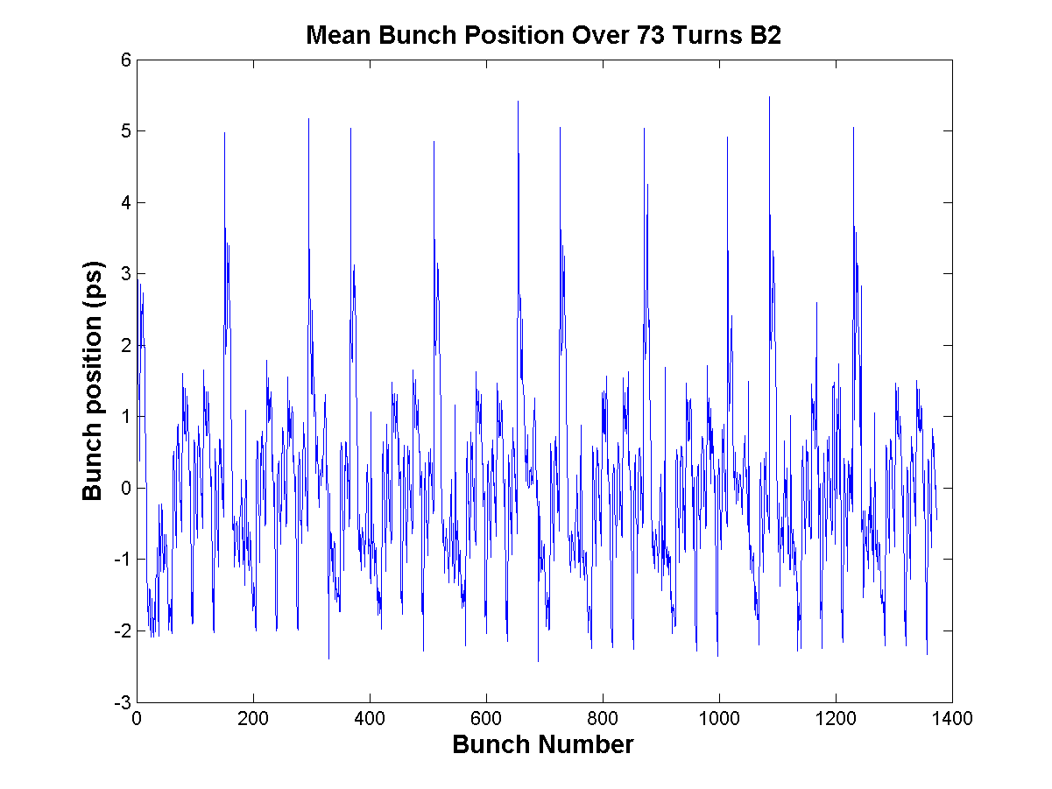
New Bunch Position Plot after LS1
  “After LS1, some modulation of the cavity phase will probably be implemented to help lower the RF power requirements
  The modulation of the cavity phase changes the bunch spacing and therefore the collision point. However the 65 ps displacement is small compared to the 1.2 ns 4-sigma bunch length
  As the filling pattern of the two rings is very similar, the phase modulations will cancel out in IP1 and IP5 and the resulting displacement of the collision vertex will be much smaller than the above 65 ps “
Current Bunch position (1440 bunches). No Cavity phase modulation.
Modulation of the cavity phase by the transient beam loading in physics for nominal conditions. 2835 bunches, 1.7E11 p/bunch, 25ns spacing
Courtesy of Themistoklis Mastoridis and Philippe Baudrenghien BE/RF

