Slide 1
NA 2014-2015 YETS: schedule week by week
S. Evrard

Slide 2
Week 51
Painting works in TA801 by Presiozo
Repair work of TT84 floor by CE contractor (4/5)
ED stop on 19/12
PR PA80 maintenance
Light modification H2 zone 152.
PPE132 shielding
XEMC.516 in PPE 124
Ouverture visee geometres H6 et H8
H6/H8 alignment campaign (TT82 & EHN1)

Slide 3
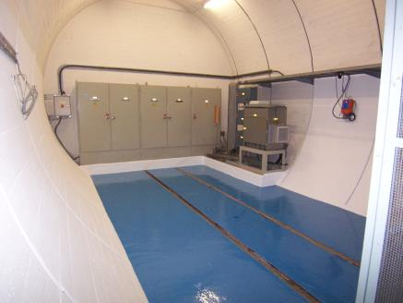
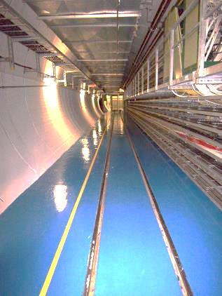
TA801 painting

Slide 4
Week 2
MCWV:
  Consignations
  Service removal
  Plexiglas protection removal
  Transport to B. 867
Light modification (and cabinet relocation, in week 3) H2 zone 142.
PPE132 shielding
PR PA80 maintenance
MNP22 (Ship) to be moved - CANCELED
Installation XTDV GIF: in progress
EHN1 gallery cleaning: not started
H6/H8 alignment campaign (TT82)

Slide 5
Week 3
Remplacement de 4 réducteurs de pression sur T2 T4 T6 et TCSC (F. Moro) S3,4,5
Repair work of TT84 floor(last section)
MCWV:
  Transport to B. 867
PR 537 (TCC2) maintenance
EHN1 gallery cleaning
Light modification H2 zone 132.
H2: zone 142/134 steel beam installation (with QNL500 & QNL 524 removal/reinstallation)
H6/H8 alignment campaign (TT82&TCC2)
magnet MBW.043089 exchange
Starter exchange on TDC2 lights. Cubicle exchange in mezzanine (TCC2 led light control)

Slide 6
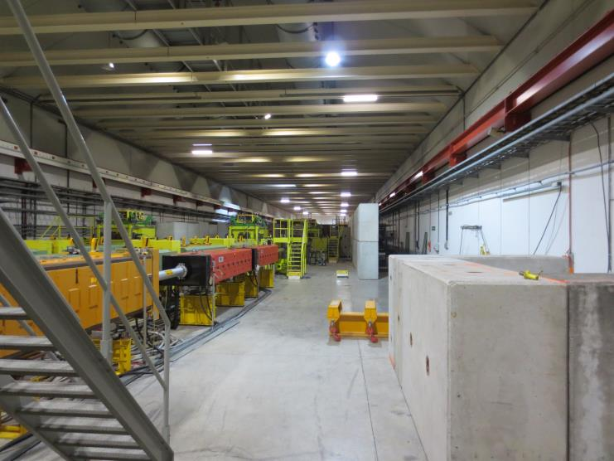
TCC2 led light control

Slide 7
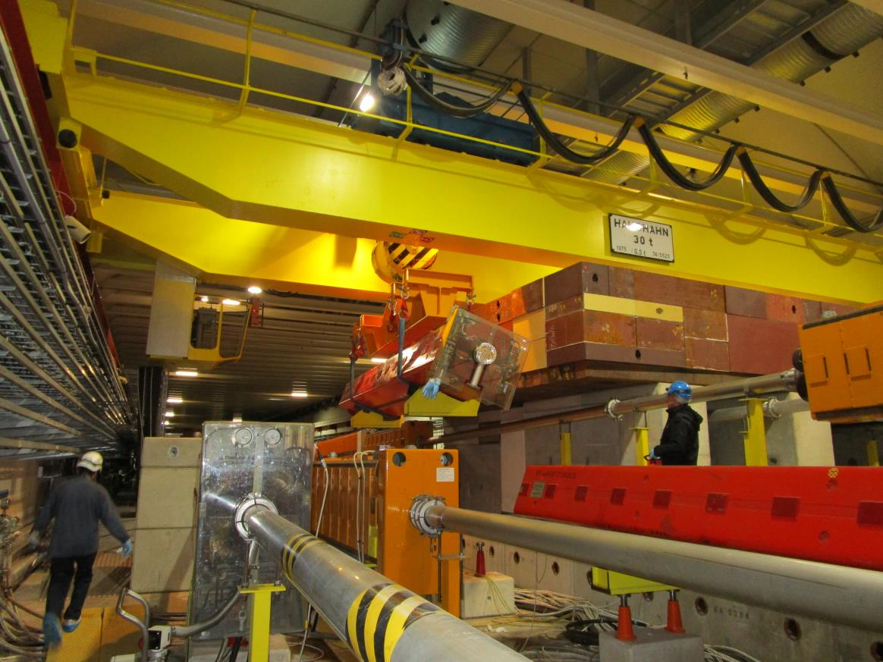
Magnet MBW.043089 exchange in TCC2

Slide 8
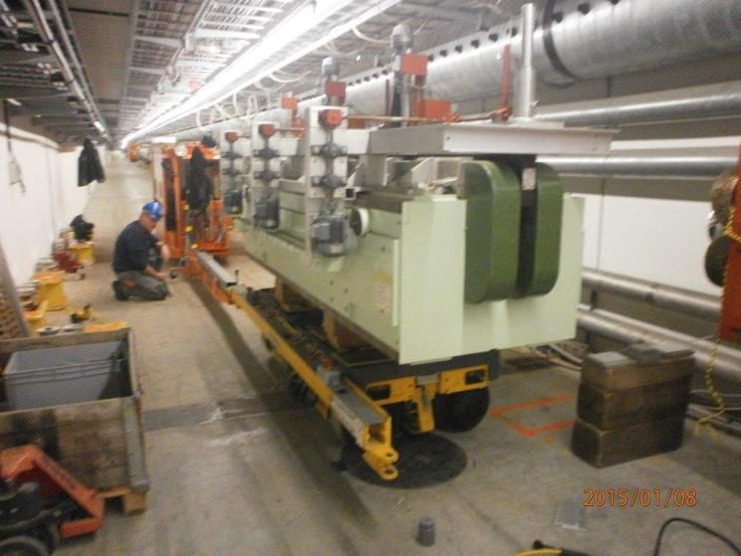
MCWV transport from TT84 to B.867

Slide 9
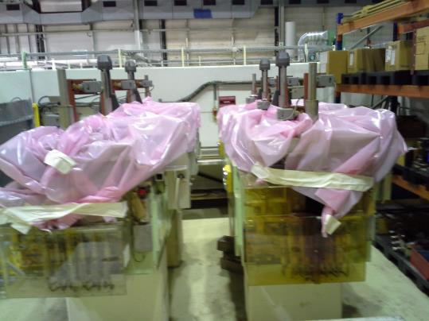
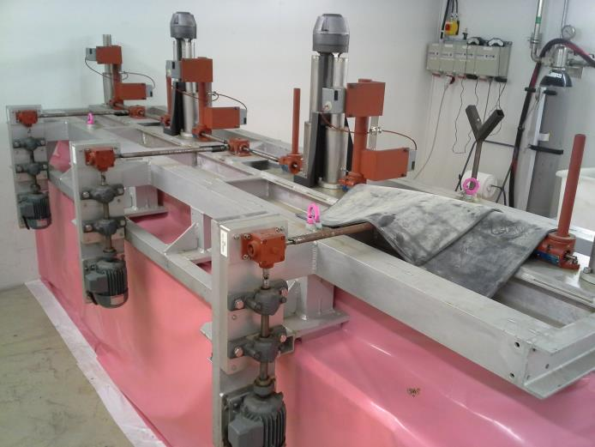
MCWV repair @ 867

Slide 10
Week 4
Remplacement de 4 réducteurs de pression sur T2 T4 T6 et TCSC (F. Moro) S3,4,5
H6/H8 alignment campaign (TCC2)
Target T2 T4 T6 upgrade (preparation)
Slot for magnet MBW.043089 exchange(Friday)
Open survey shielding at the end of TCC2(by Wednesday) and TT83 door (by Tuesday)
Overhead crane load test (PA80 & TCC2)
MDX magnet installation
MDX service connexion
Covers on DC cable cumbs (Test + implementation)
ILS tetra installation

Slide 11
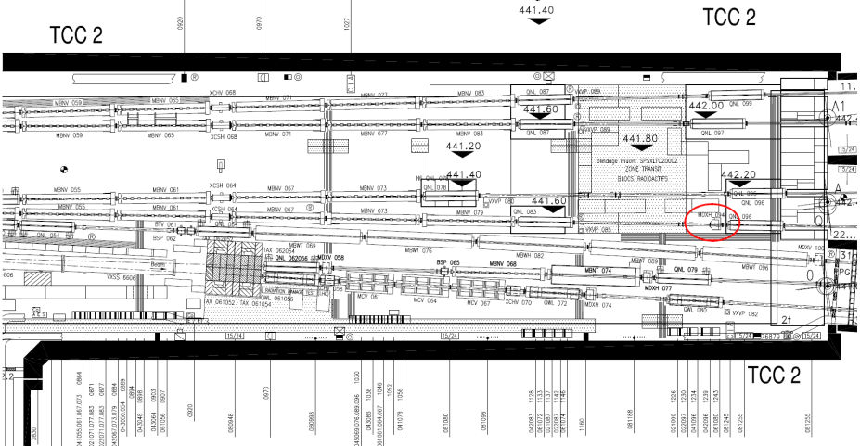
TCC2 new MDX.042.094

Slide 12
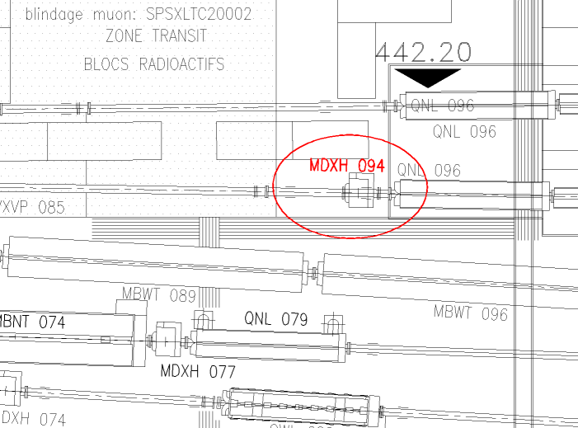
TCC2 new MDX.042.094

Slide 13
Week 5
MDX magnet installation
MDX service connexion
Target T2 T4 T6 upgrade (target box, monitors and motors)
Water leaks TDC2
  Réparation des fuites et/ou remplacement des vannes si réparations impossible S5 (B. Bannister)
Remplacement de 4 réducteurs de pression sur T2 T4 T6 et TCSC (F. Moro) S3,4,5
H6/H8 alignment campaign (TCC2)
H6 collimator exchange
Reserve slot for magnet MBW.043089 reinstallation
MBPL 498 magnet to be installed in H4_134
Re-Connexion of vacuum pipes, collars,.. H6 & H8.

Slide 14
Week 6
Contingency week
H6/H8 Visual patrol (after survey)
Alignment of new magnets (MDX, MCW, MBPL, collimator H6)
Closure of all the areas on Friday 6th at noon
OP patrol on Friday 6th PM

Slide 15
Week 7
DSO tests on 09/02 AM
Beam to SPS: 09/02 PM
Scan EHN1
!! NEXT MEETINGS on FRIDAY at 9.00 !!
Later
MCWV repair and reinstallation before
MCWV control cable replacement
restart of P+ run in April

