Slide 1



AWS Monitoring and Auditing
Steven Bryen - WorldWide Public Sector
sbryen@amazon.com
@steven_bryen

Slide 2
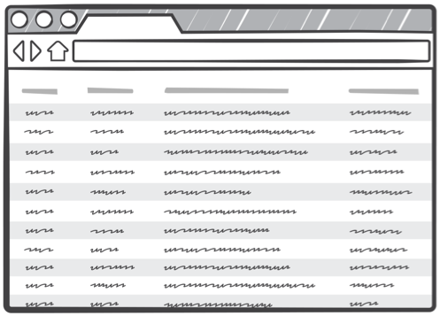
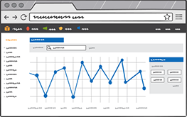

CloudWatch
CloudTrail
CloudWatch
Logs

Slide 3
AWS CLOUDWATCH
Monitor AWS cloud resources and the applications you run on AWS

Slide 4





SIMPLE MONITORING EXAMPLE
AutoScaling
Service
AutoScaling Group
CloudWatch
Alarm
Notes:
Simple example of monitoring in AWS, AWS AutoScaling and CloudWatch services enable users to programatically react to alerts based on policy.
In this basic example an instance sends an alert to CloudWatch notifying it of CPU over 80% for 5mins, Cloudwatch alert is sent to Autoscaling Service which adds/removes resources based on policy.

Slide 5


CUSTOM CLOUDWATCH METRICS
AutoScaling
Service
AWS CLI
EC2 Instance
CloudWatch
Alarm
Notes:
Going beyond the basics, its also possible to send custom metrics to scale based on. Achievable via the AWS CLI you can send application events to cloud watch and then autoscale based on them.

Slide 6




NOTIFYING 3RD PARTY APPS
AutoScaling
Service
AutoScaling Group
CloudWatch
Alarm
Simple Notification
Service
Notes:
Cloud watch is actually integrating with Autoscaling through SNS
You can configure your SNS Topics to also notify other services when an alarm is triggered.
Built in support for Mobile Push, SMS (In the USA) and Email. Also has POST to HTTP endpoint which enables you to extend further.
Services such as NewRelic, StackDriver etc integrate with Cloudwatch.

Slide 7
AWS CLOUDTRAIL
Records AWS API Calls and provides logs

Slide 8
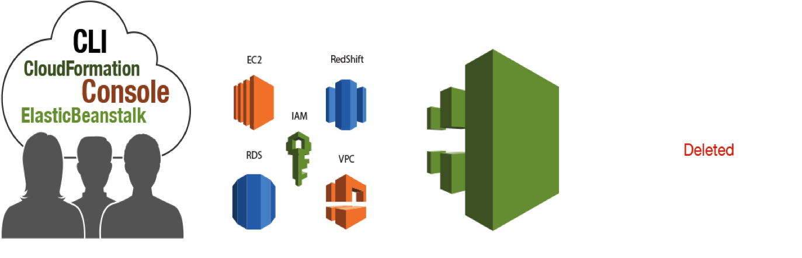
Introduction to CloudTrail
Customers are making API calls...
On a growing set of services around the world
CloudTrail is continuously recording API calls...
And delivering log files to customers

Slide 9









AWS CloudTrail Partners
Notes:
Also CloudWatch Logs integration (discuss shortly)

Slide 10
What can you answer from CloudTrail event?
Who made the API call?
When was the API call made?
What was the API call?
Which Resources were acted upon in the API call?
Where was the API call made from and made to?

Slide 11
Use Cases
Security Analysis
  Use log files as an input into log management and analysis solutions to perform security analysis and to detect user behaviour patterns.
Track changes to AWS resources
  Track creation, modification, and deletion of AWS resources such as EC2 instances, VPC security groups and EBS Volumes
Troubleshoot Operational Issues
  Identify the most recent actions made to resources in your AWS account
Compliance Aid
  Easier to demonstrate compliance with internal policies and regulatory standards

Slide 12
AWS CLOUDWATCH LOGS
Aggregate, monitor and store logs

Slide 13
CloudWatch Logs
Part of Amazon CloudWatch Service
  Launched Summer 2014
Uses an agent/CLI/SDK to put log & log metric data into CloudWatch
Can centralize logs for individualized viewing by instance
Can put metrics base on filters applied to content in log files

Slide 14
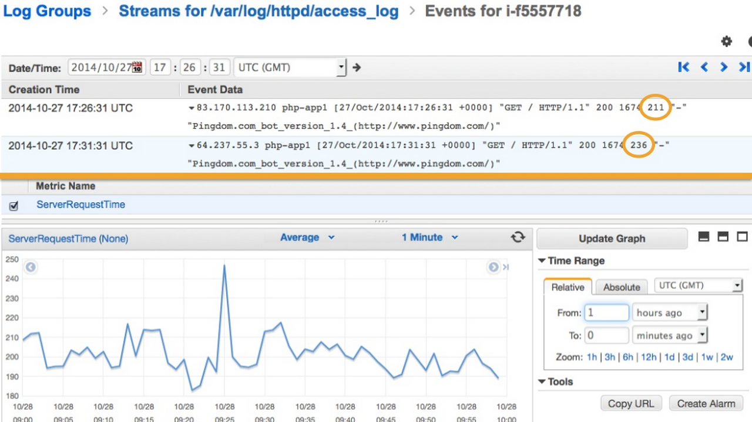

Slide 15
Use Cases
Monitoring for errors, exceptions, HTTP responses
Longer term, off-box storage of logs
Tailing host logs without connecting to host
Correlate system status with change events

