Slide 1

Overview of iThemba LABS
Simon Mullins
iThemba LABS
High Energy Particle Physics Workshop, iThemba LABS, 11-13 February 2015

Slide 2
Outline :
Accelerator Mass Spectrometry (AMS) at iThemba LABS (Gauteng)
Rare Isotope Beam (RIB) Project at iThemba LABS (Cape)
High Energy Particle Physics Workshop, iThemba LABS, 11-13 February 2015

Slide 3
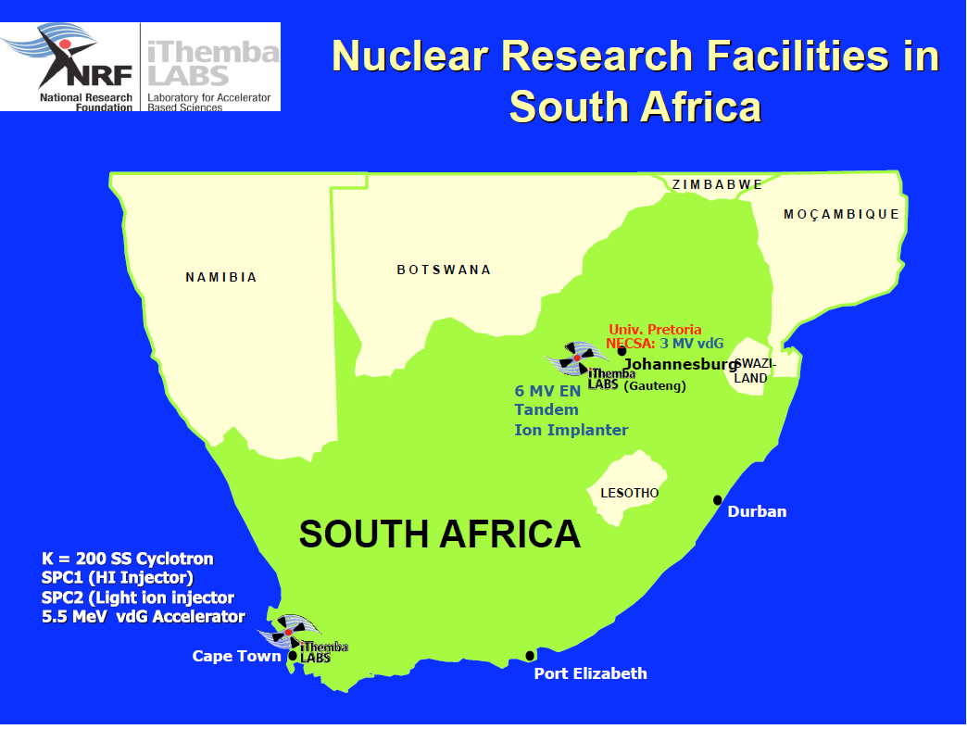
High Energy Particle Physics Workshop, iThemba LABS, 11-13 February 2015

Slide 4
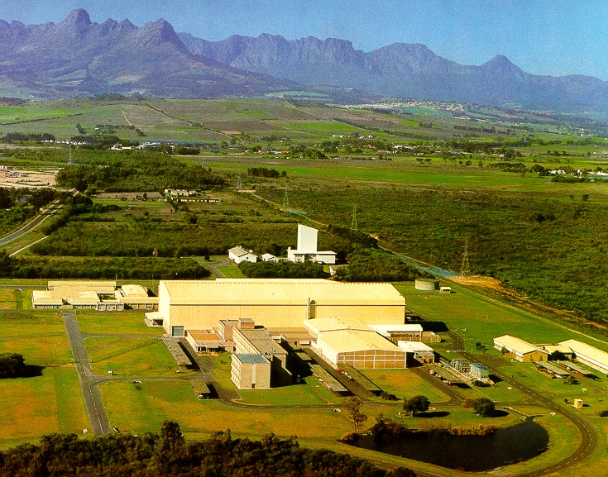
iThemba LABS in the Cape (Mother Ship)
High Energy Particle Physics Workshop, iThemba LABS, 11-13 February 2015

Slide 5
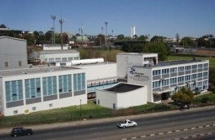
iThemba LABS in Gauteng (AMS about to fly)
High Energy Particle Physics Workshop, iThemba LABS, 11-13 February 2015

Slide 6
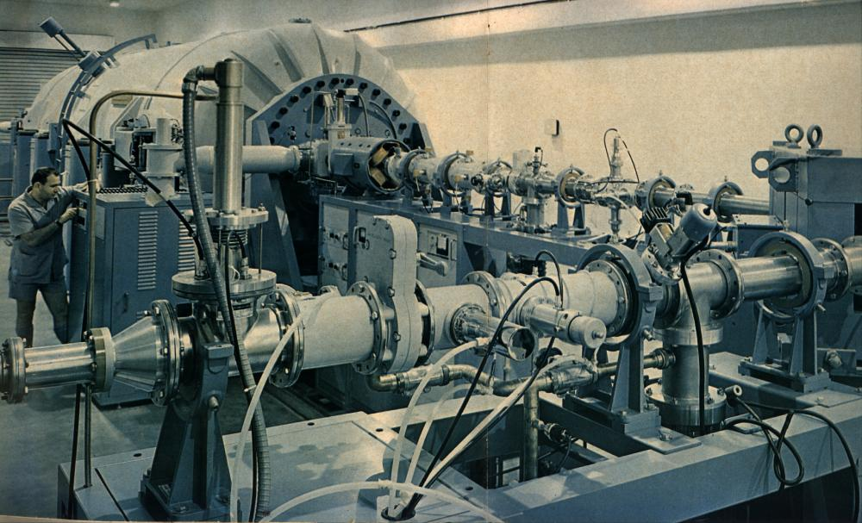
Tandem Accelerator beam-injection system at the (then) Schonland Research Institute along with Miklos Rebak.
High Energy Particle Physics Workshop, iThemba LABS, 11-13 February 2015

Slide 7
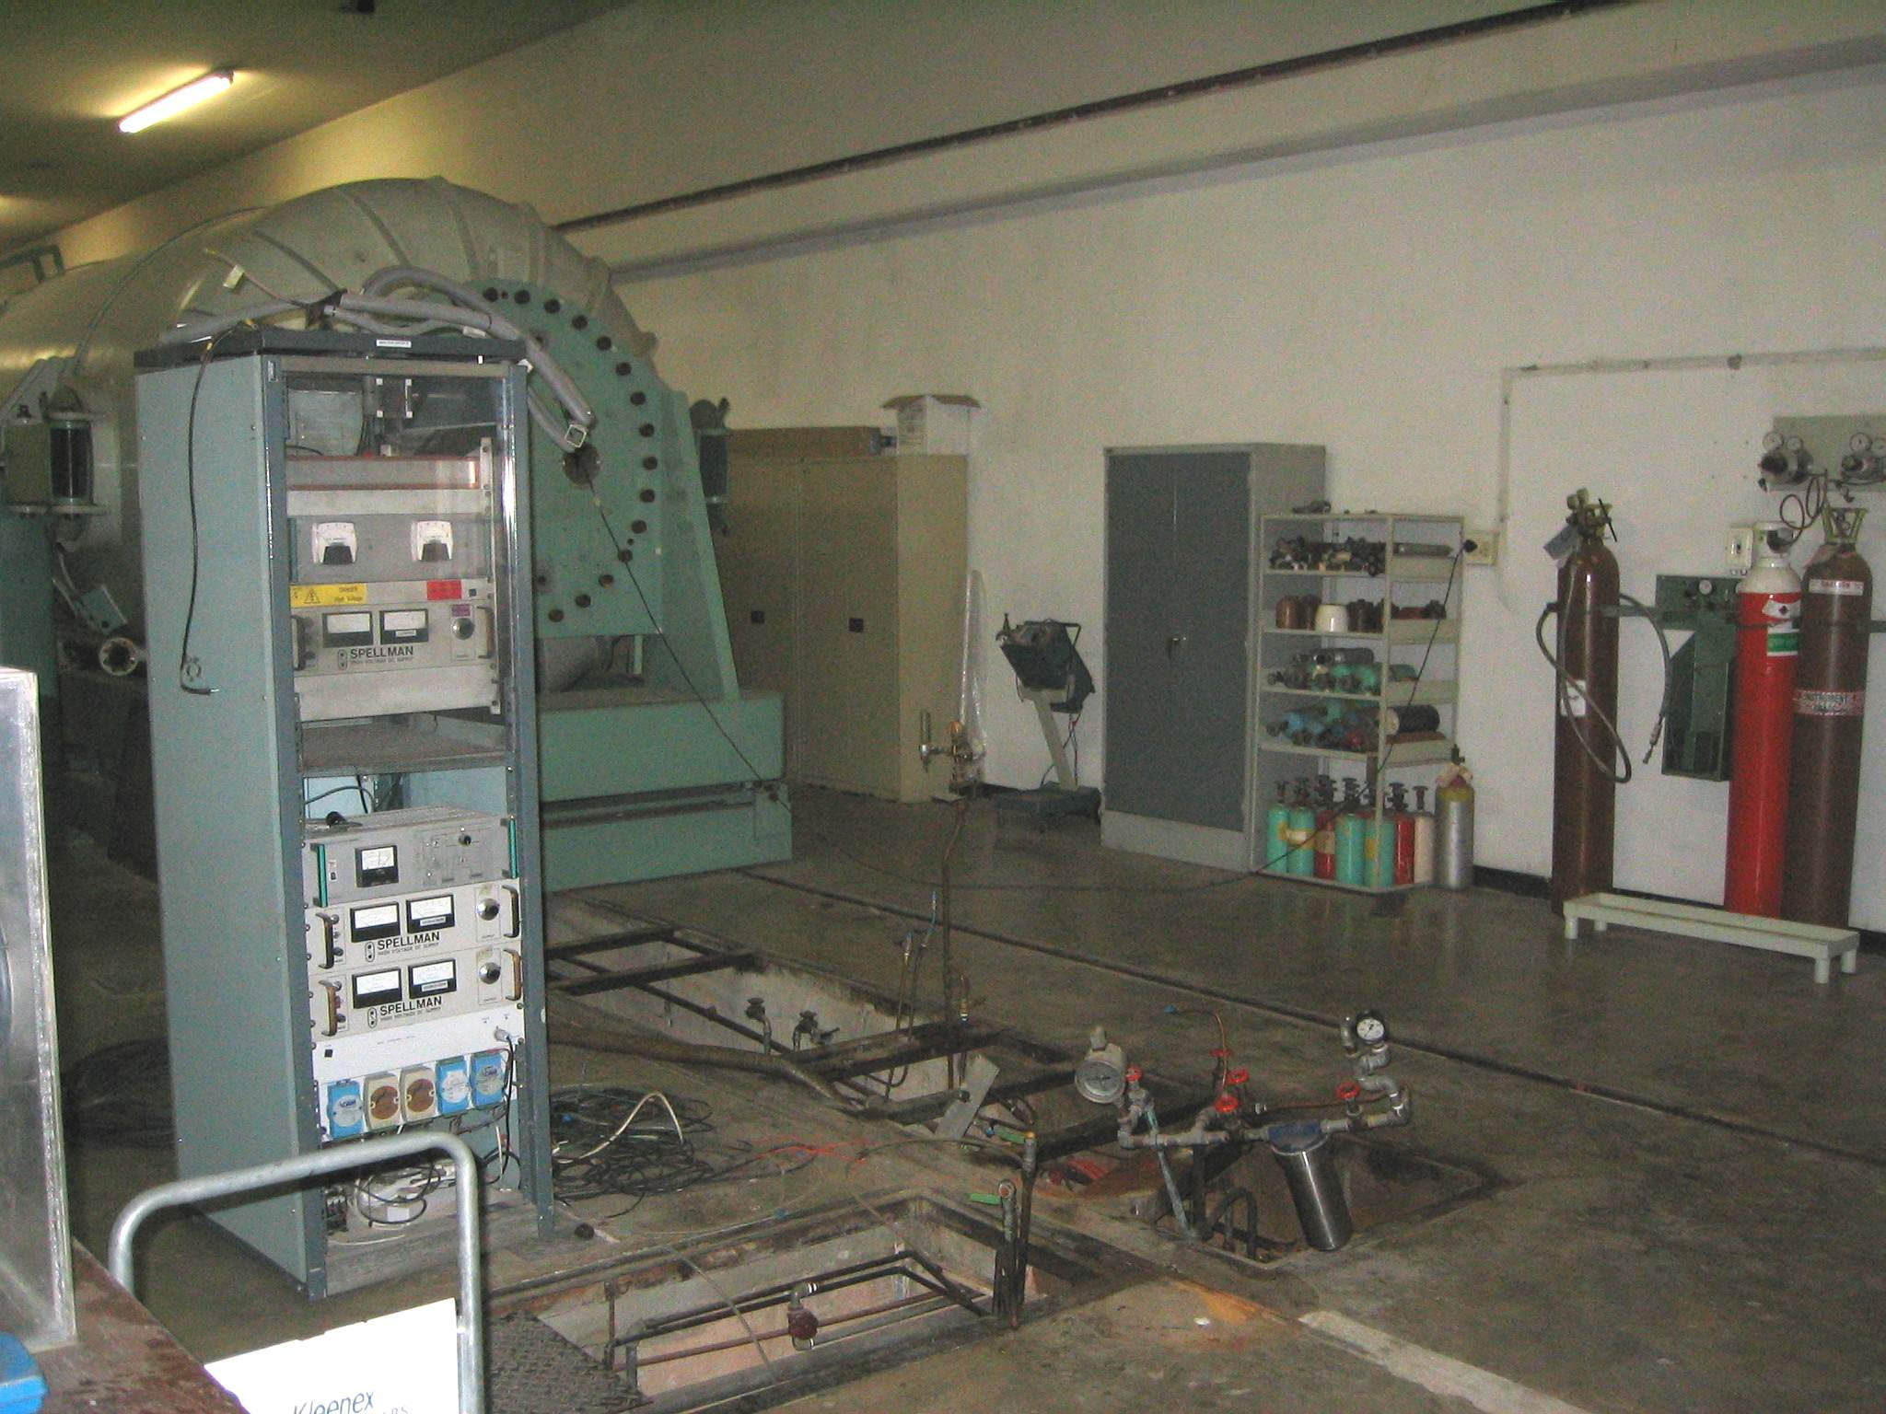
Old Injection System no more
High Energy Particle Physics Workshop, iThemba LABS, 11-13 February 2015

Slide 8
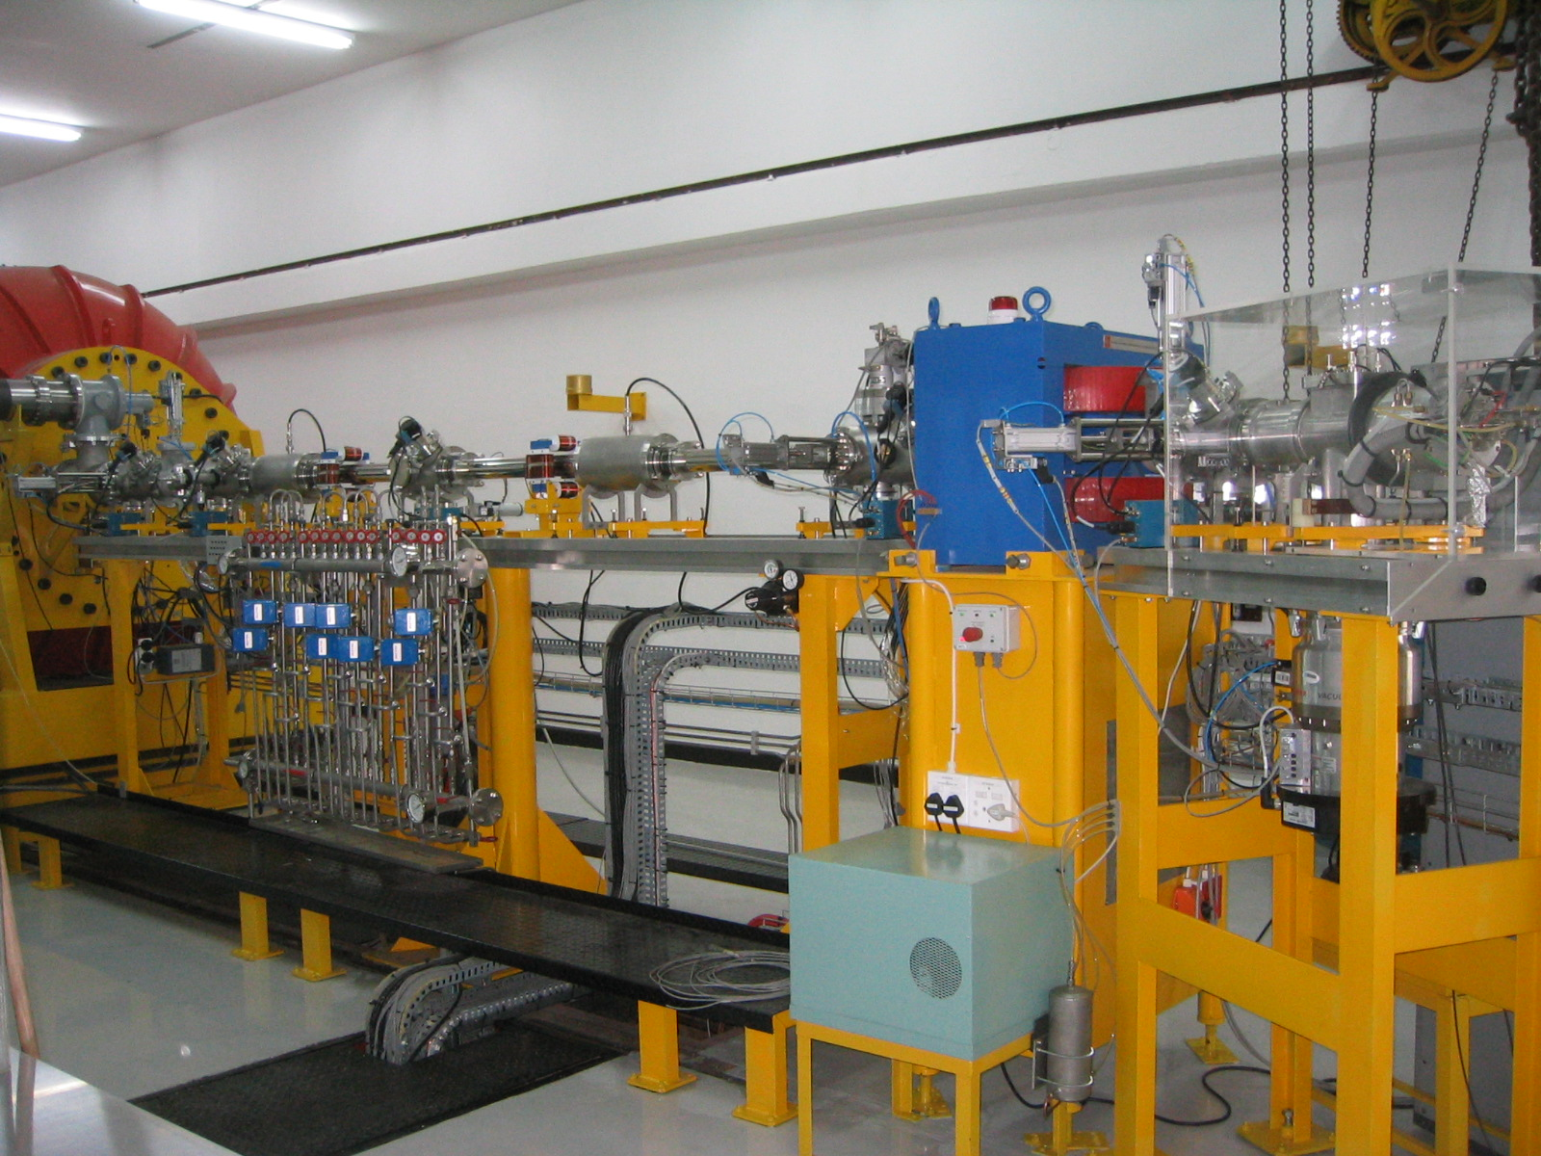
Injection Side of the Tandem Accelerator after Refurbishments
High Energy Particle Physics Workshop, iThemba LABS, 11-13 February 2015

Slide 9
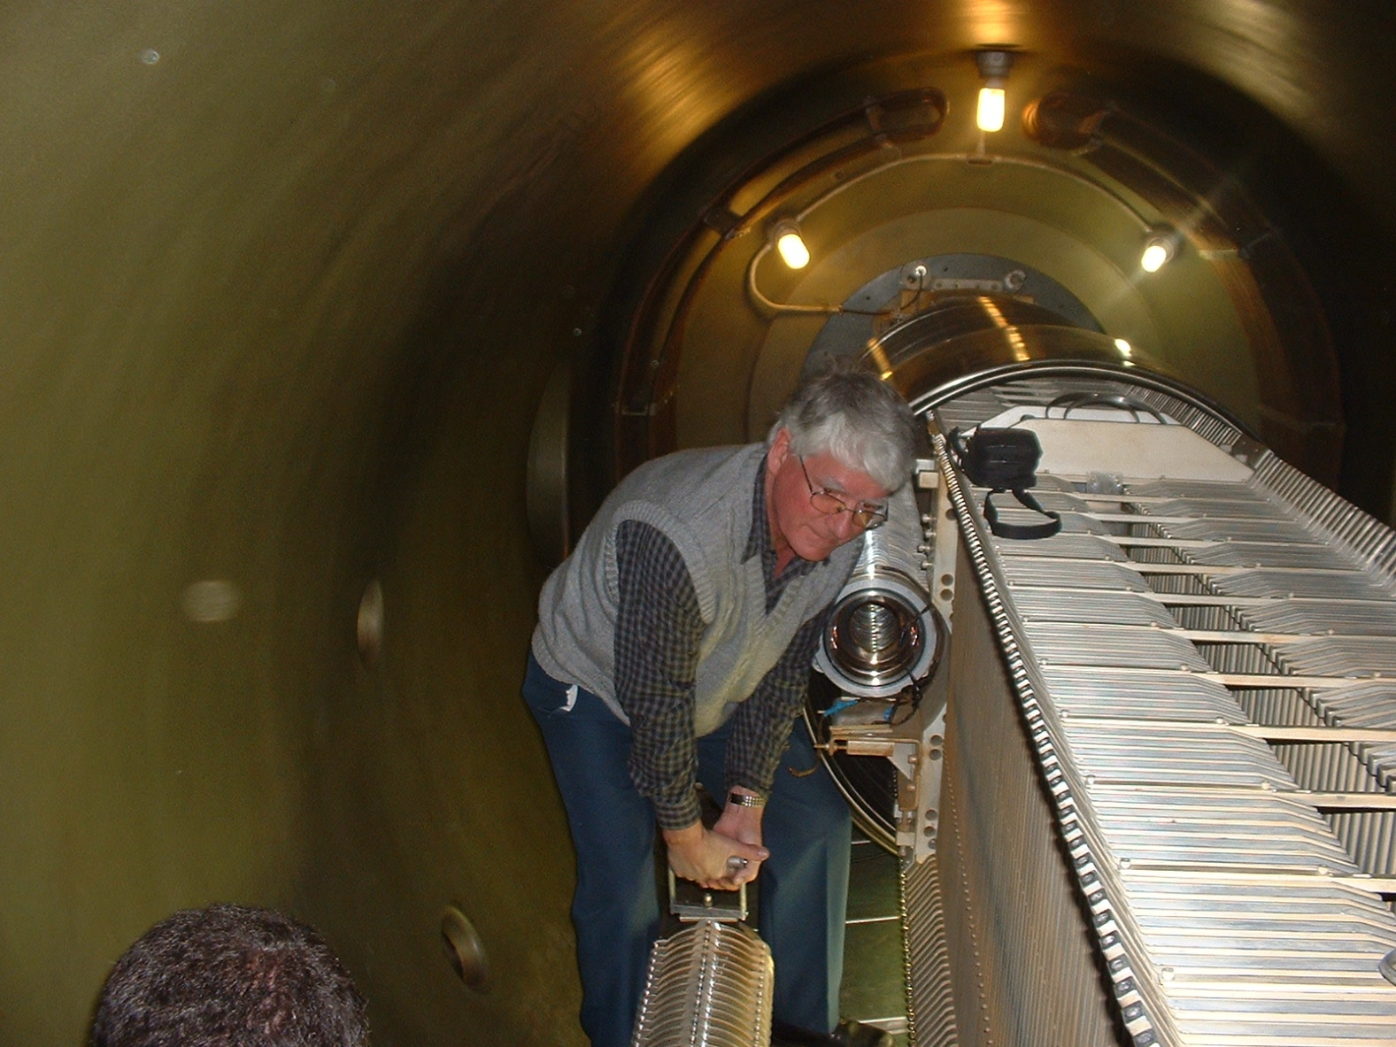
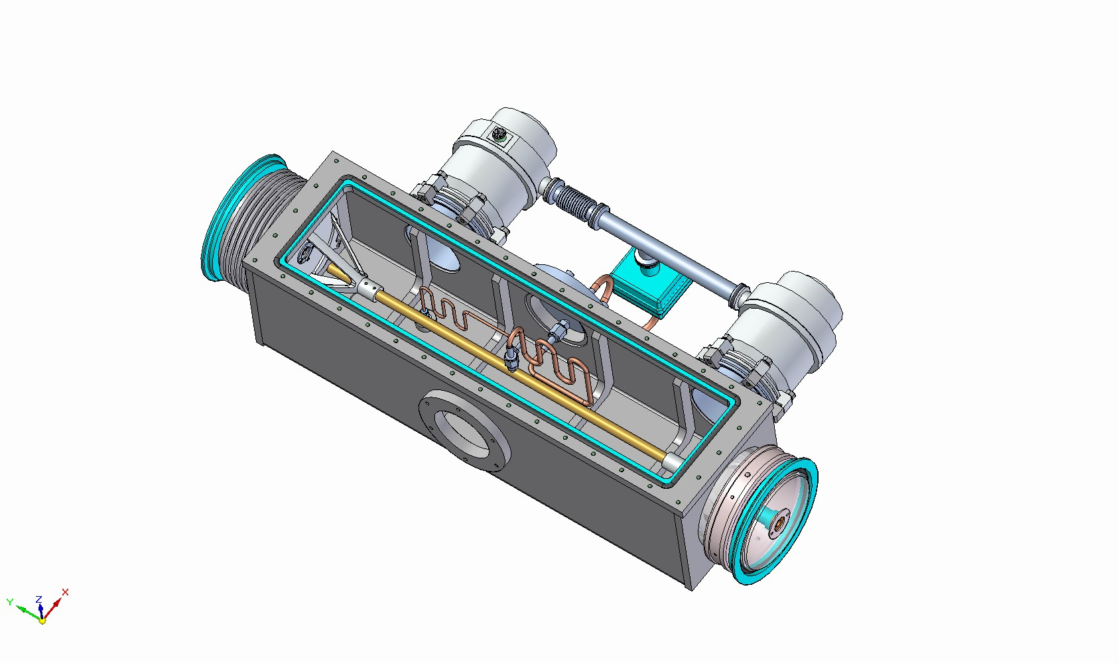
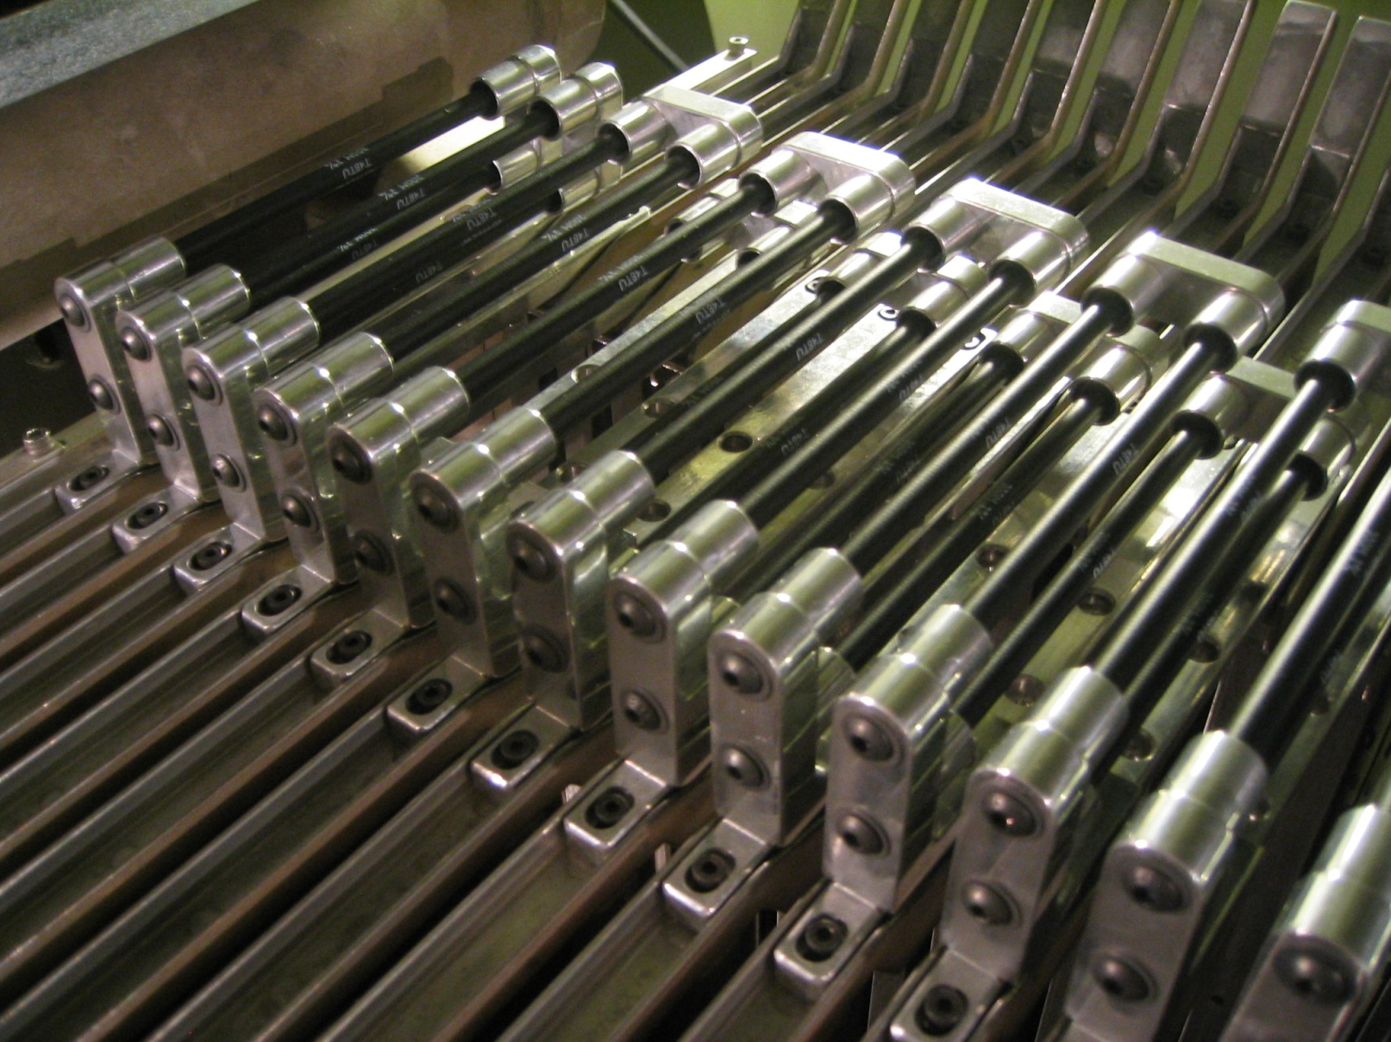
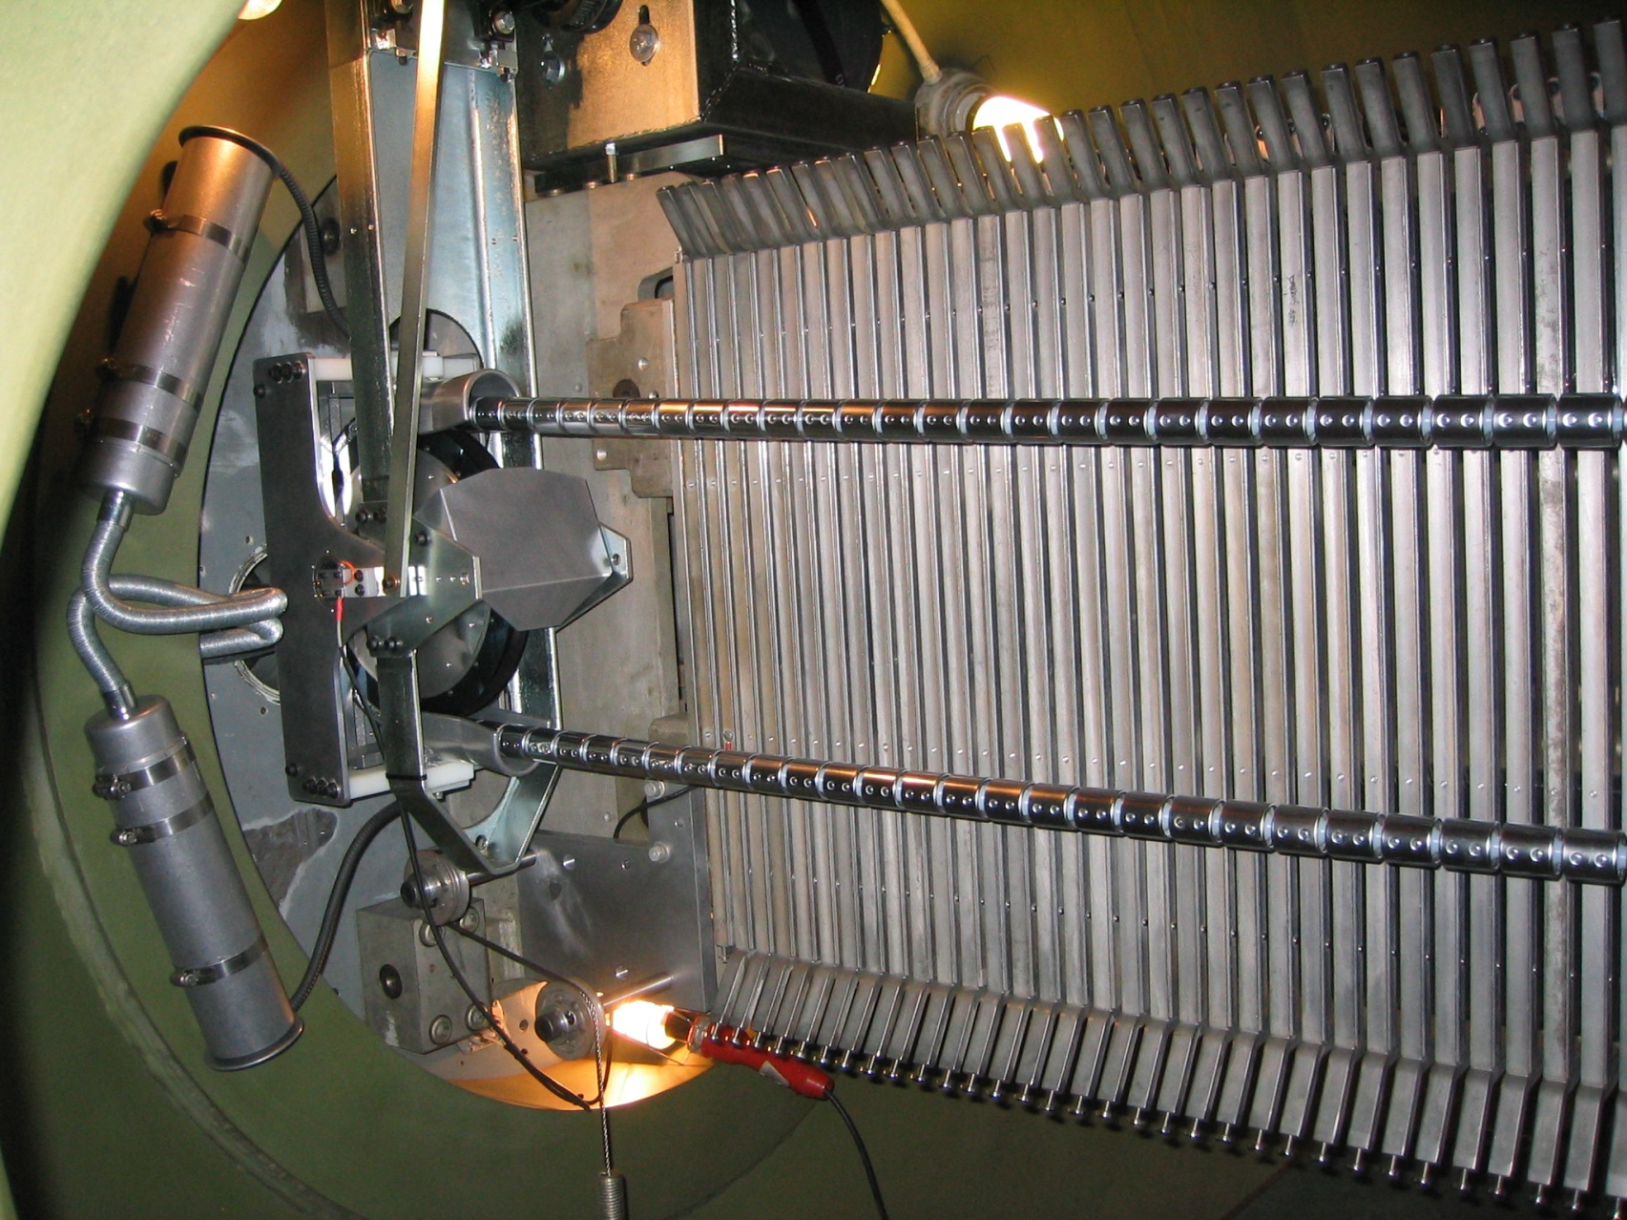
Pelletron & gas stripper box installation in 6 MV EN Tandem Accelerator
High Energy Particle Physics Workshop, iThemba LABS, 11-13 February 2015

Slide 10
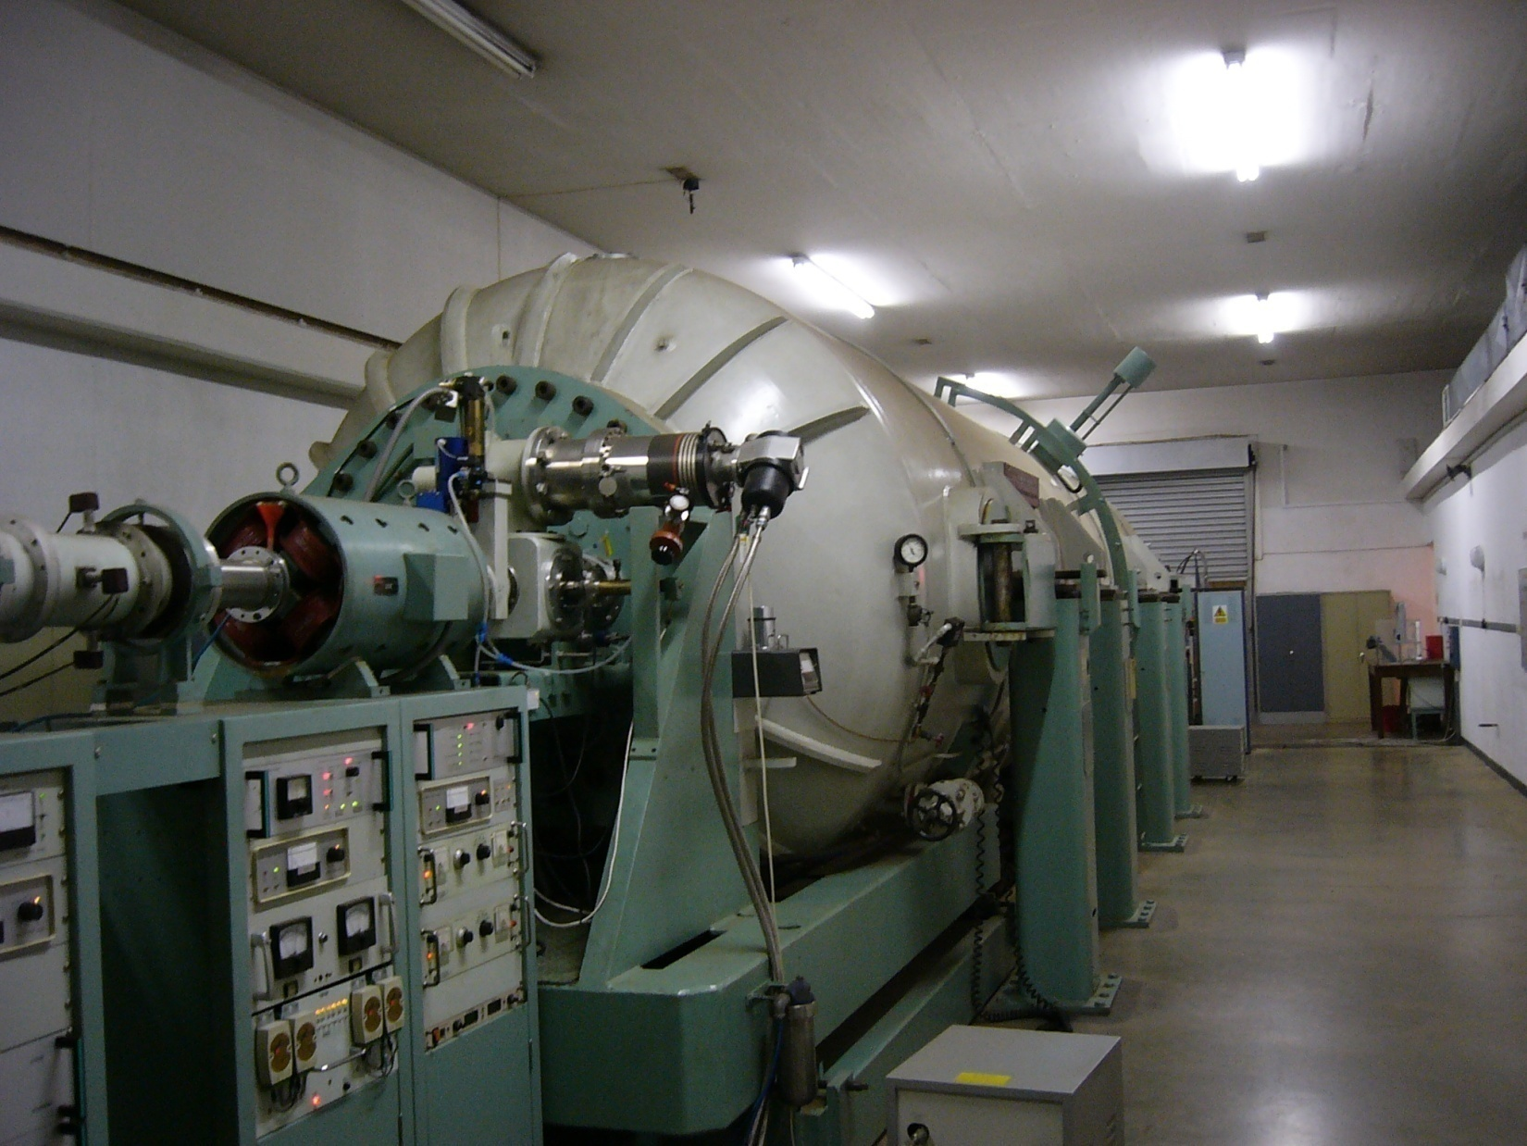
High Energy Extraction side of Tandem before the refurbishment
High Energy Particle Physics Workshop, iThemba LABS, 11-13 February 2015

Slide 11
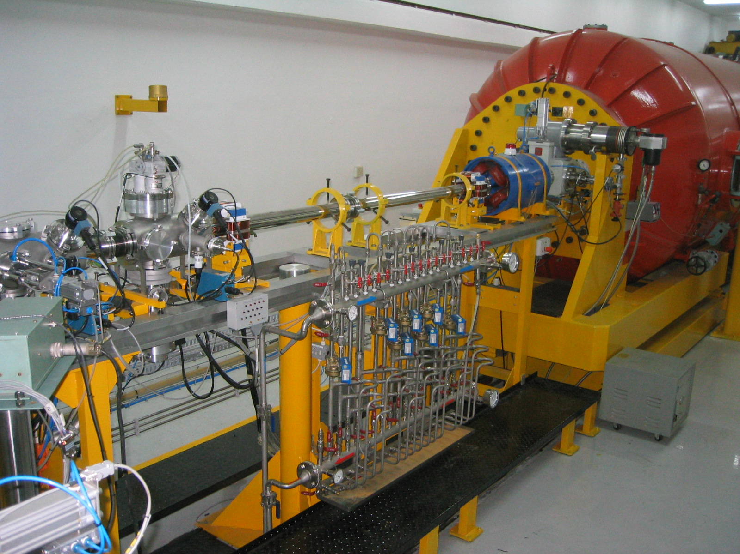
Extraction beam line of tandem accelerator post-refurbishment
High Energy Particle Physics Workshop, iThemba LABS, 11-13 February 2015

Slide 12
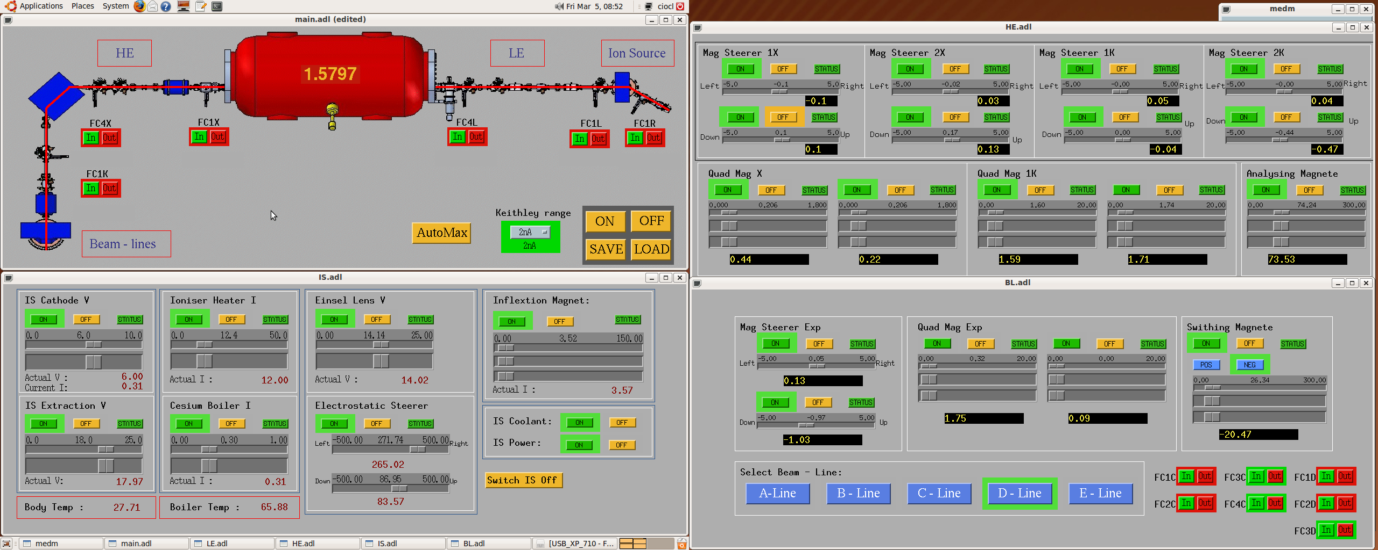
EPICS control system implemented for tandem accelerator
High Energy Particle Physics Workshop, iThemba LABS, 11-13 February 2015

Slide 13
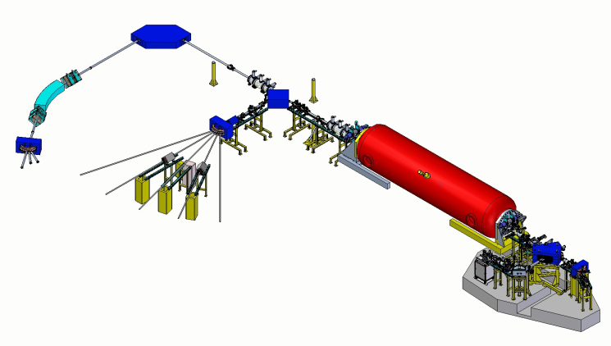
Layout of AMS system for iThemba LABS Gauteng
High Energy Particle Physics Workshop, iThemba LABS, 11-13 February 2015

Slide 14
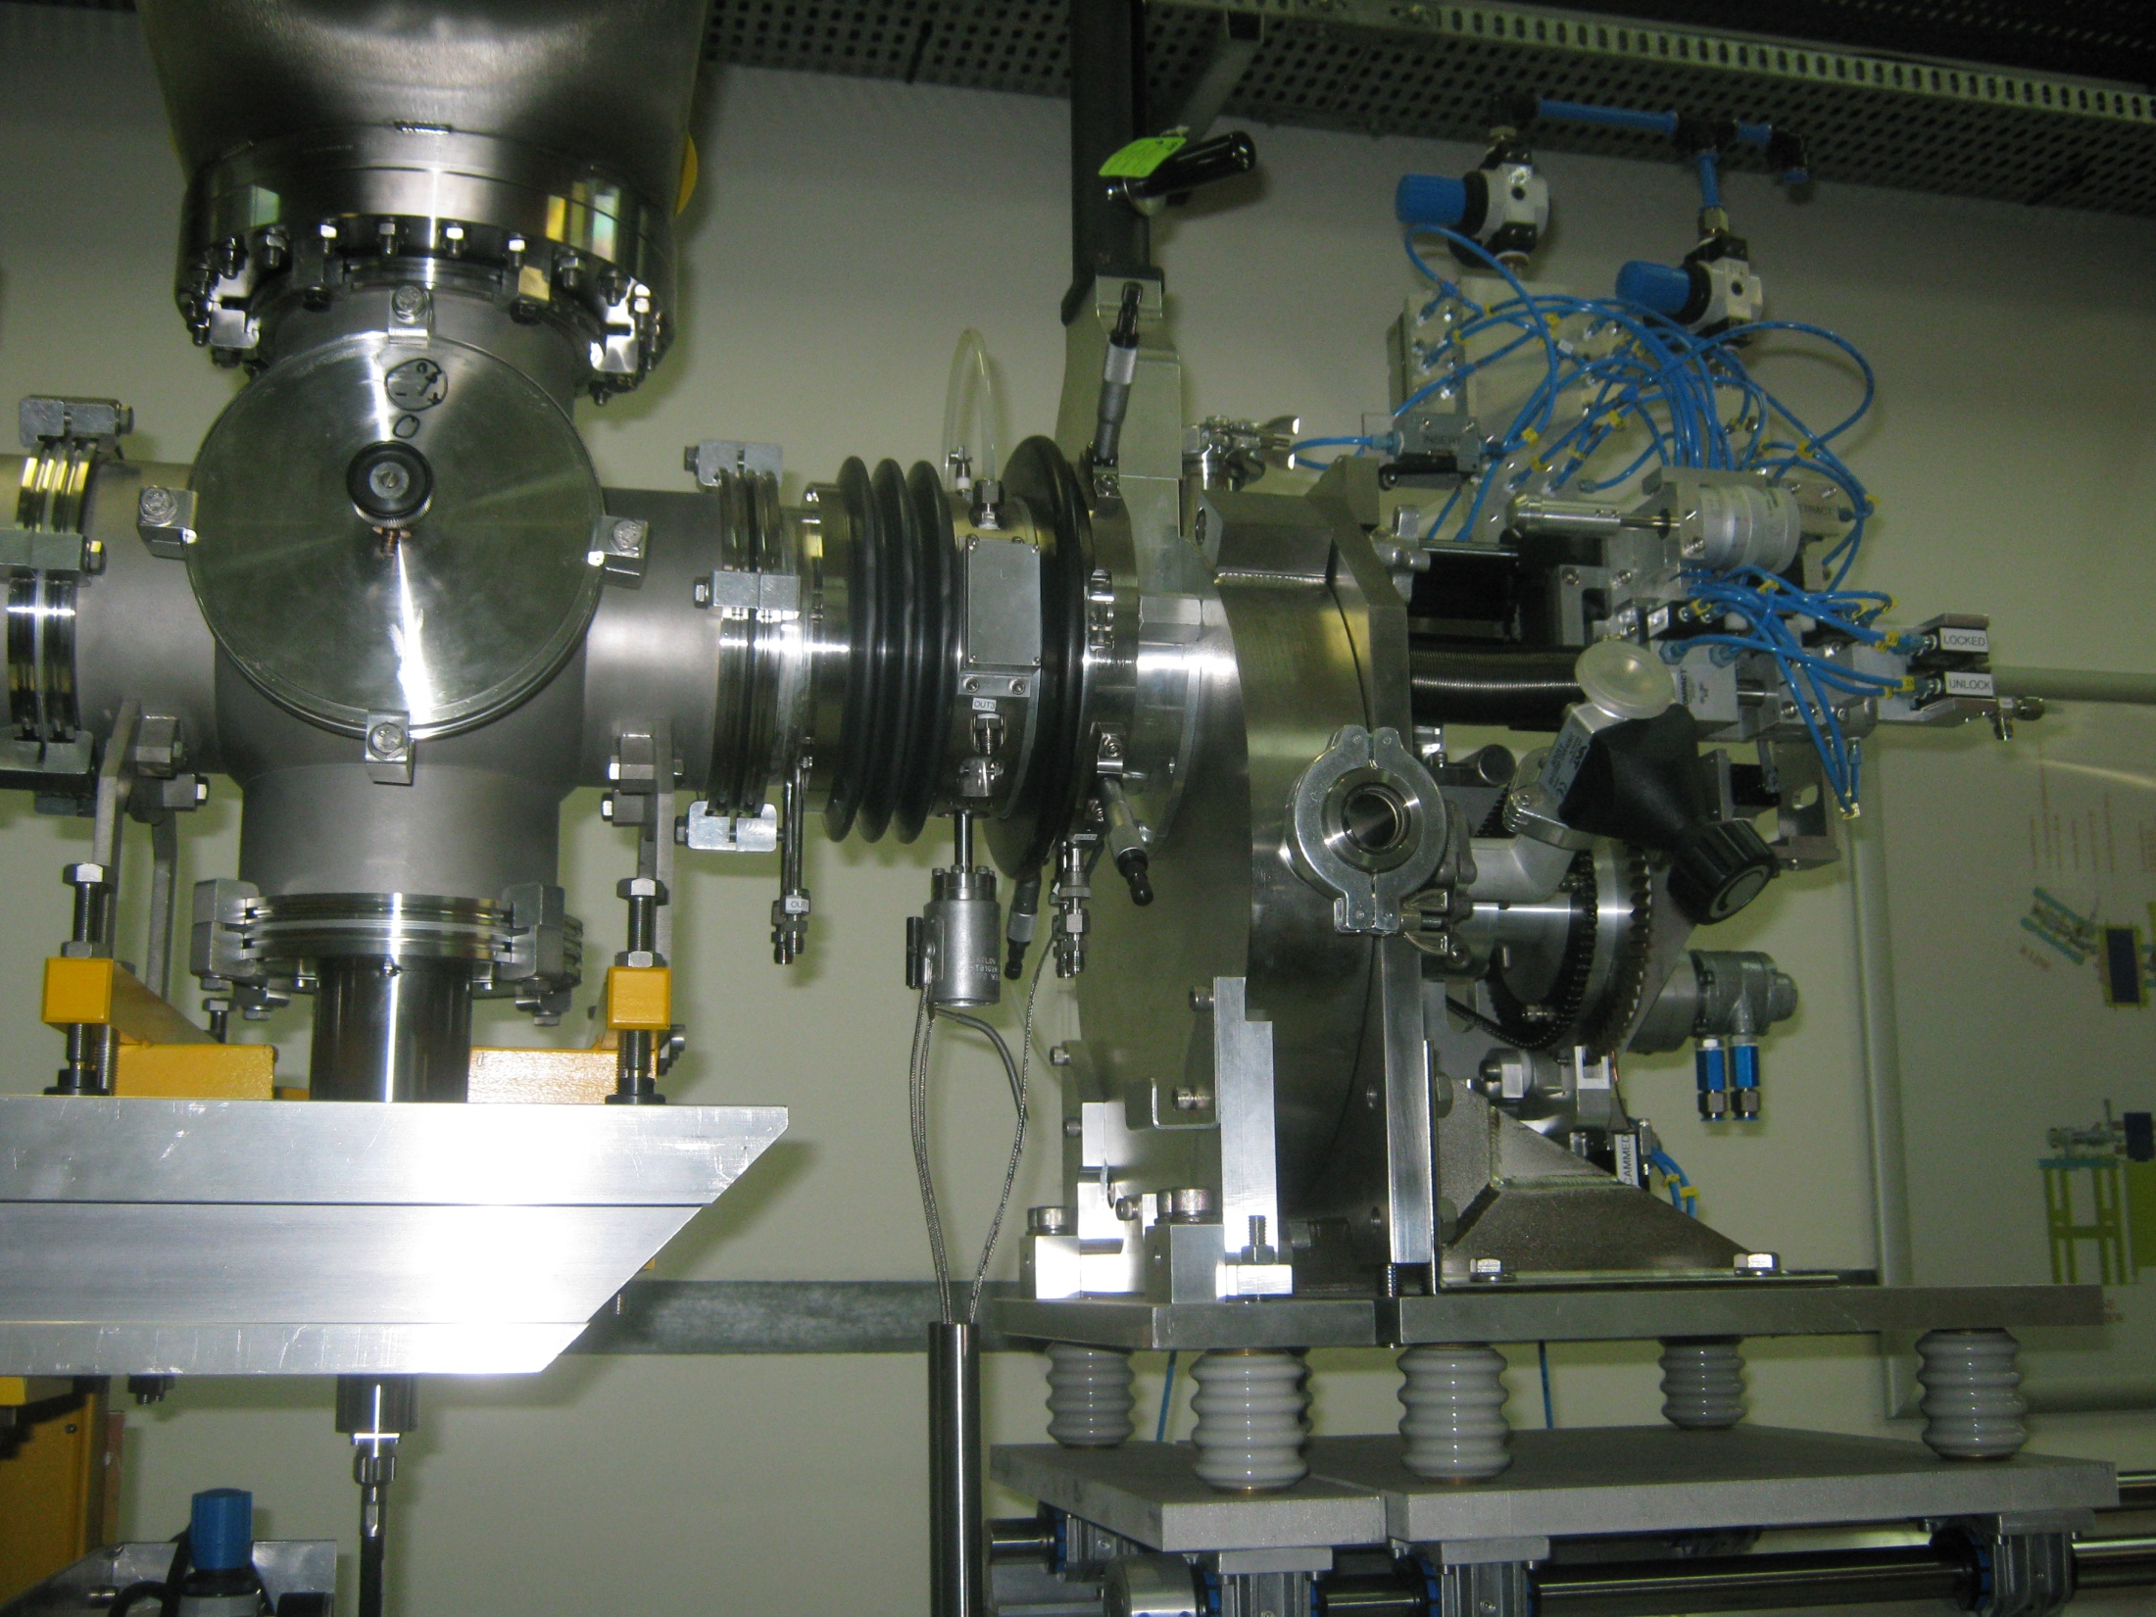
Negative Ion Source by Cesium Sputtering using the LLNL design (IAEA-funded)
300 micro A Carbon 12
13/12/2009
High Energy Particle Physics Workshop, iThemba LABS, 11-13 February 2015

Slide 15
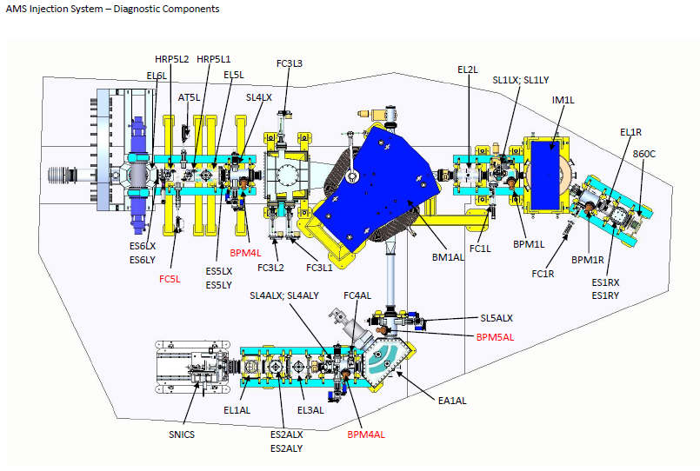
Plan view of Low-Energy Injection System with BPMs
High Energy Particle Physics Workshop, iThemba LABS, 11-13 February 2015

Slide 16
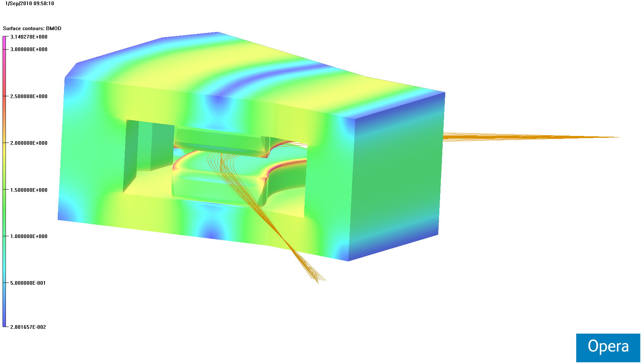
Low Energy 90 Degree Bending Magnet
High Energy Particle Physics Workshop, iThemba LABS, 11-13 February 2015

Slide 17
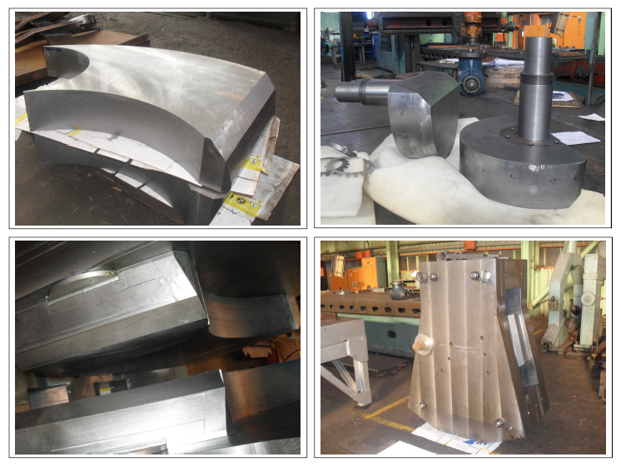
Low Energy Injection Magnet manufactured in KZ-N
High Energy Particle Physics Workshop, iThemba LABS, 11-13 February 2015

Slide 18
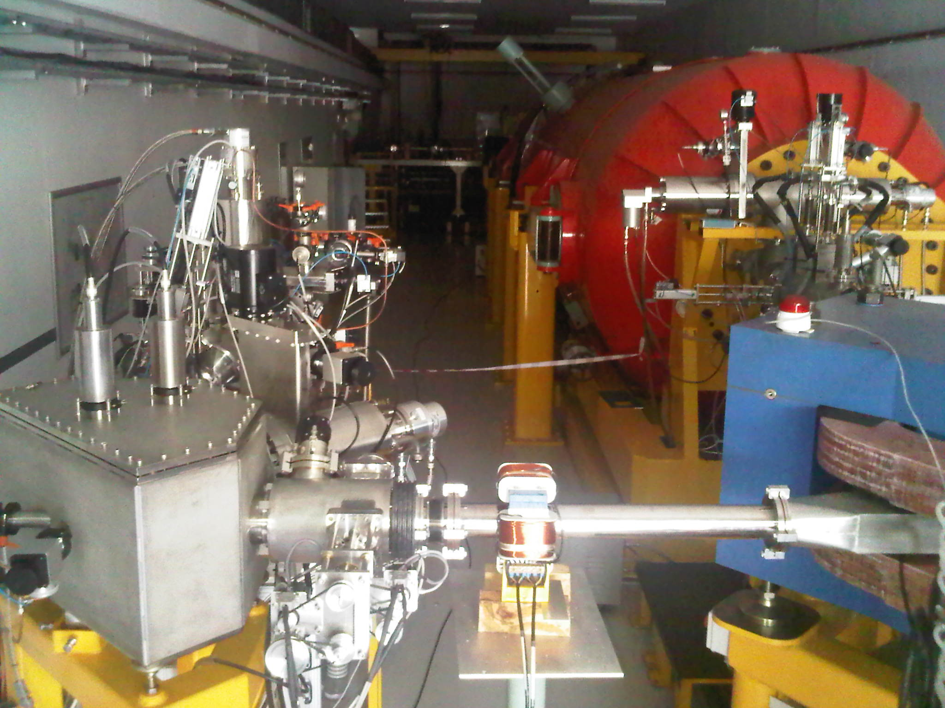
Low-Energy Injection System under commissioning Dec’2012/Mar 2013
High Energy Particle Physics Workshop, iThemba LABS, 11-13 February 2015

Slide 19
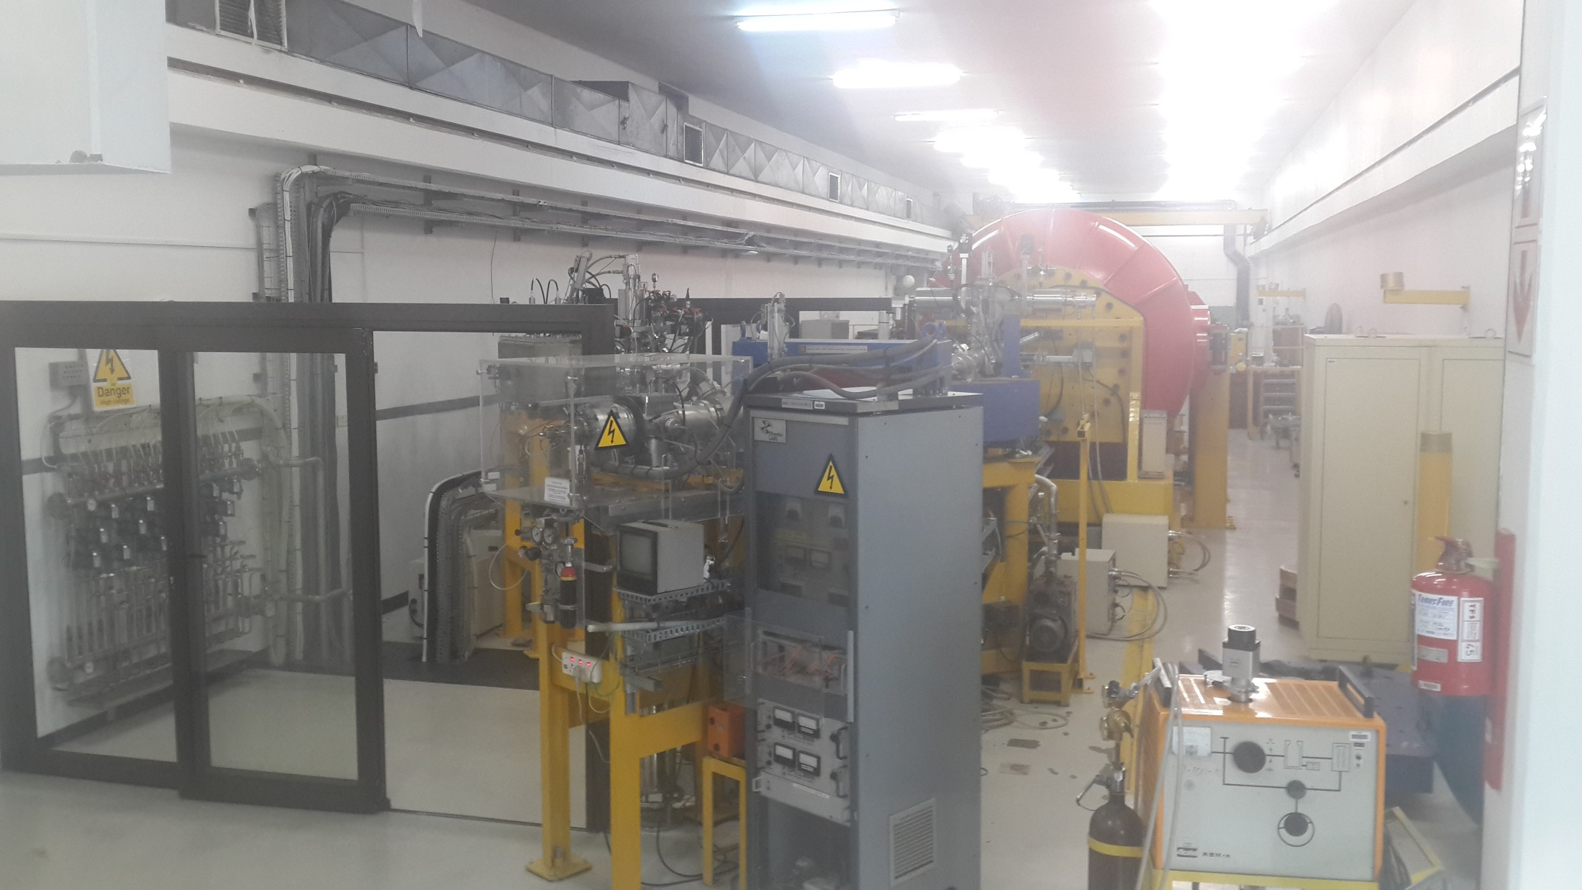
March 2014 : Further commissioning of LEIS
High Energy Particle Physics Workshop, iThemba LABS, 11-13 February 2015

Slide 20
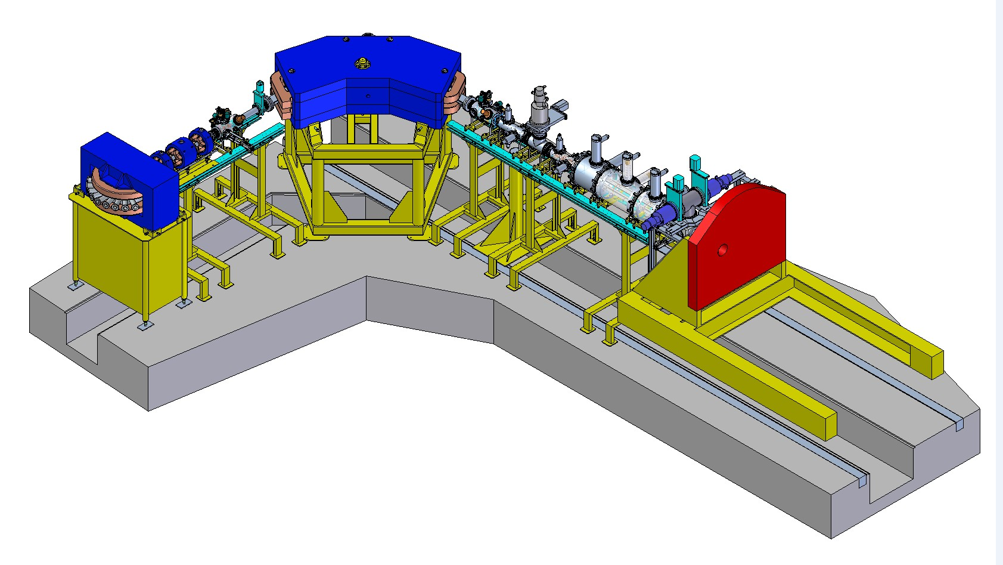
Rebuilt existing pre-AMS high energy beam lines:
Replaced analyzer magnet with larger magnet (better mass*energy product)
Replaced magnetic elements with electrostatic devices – AMS requirement
Replaced magnetic doublet after analyzer magnet with triplet arrangement
High Energy Particle Physics Workshop, iThemba LABS, 11-13 February 2015

Slide 21
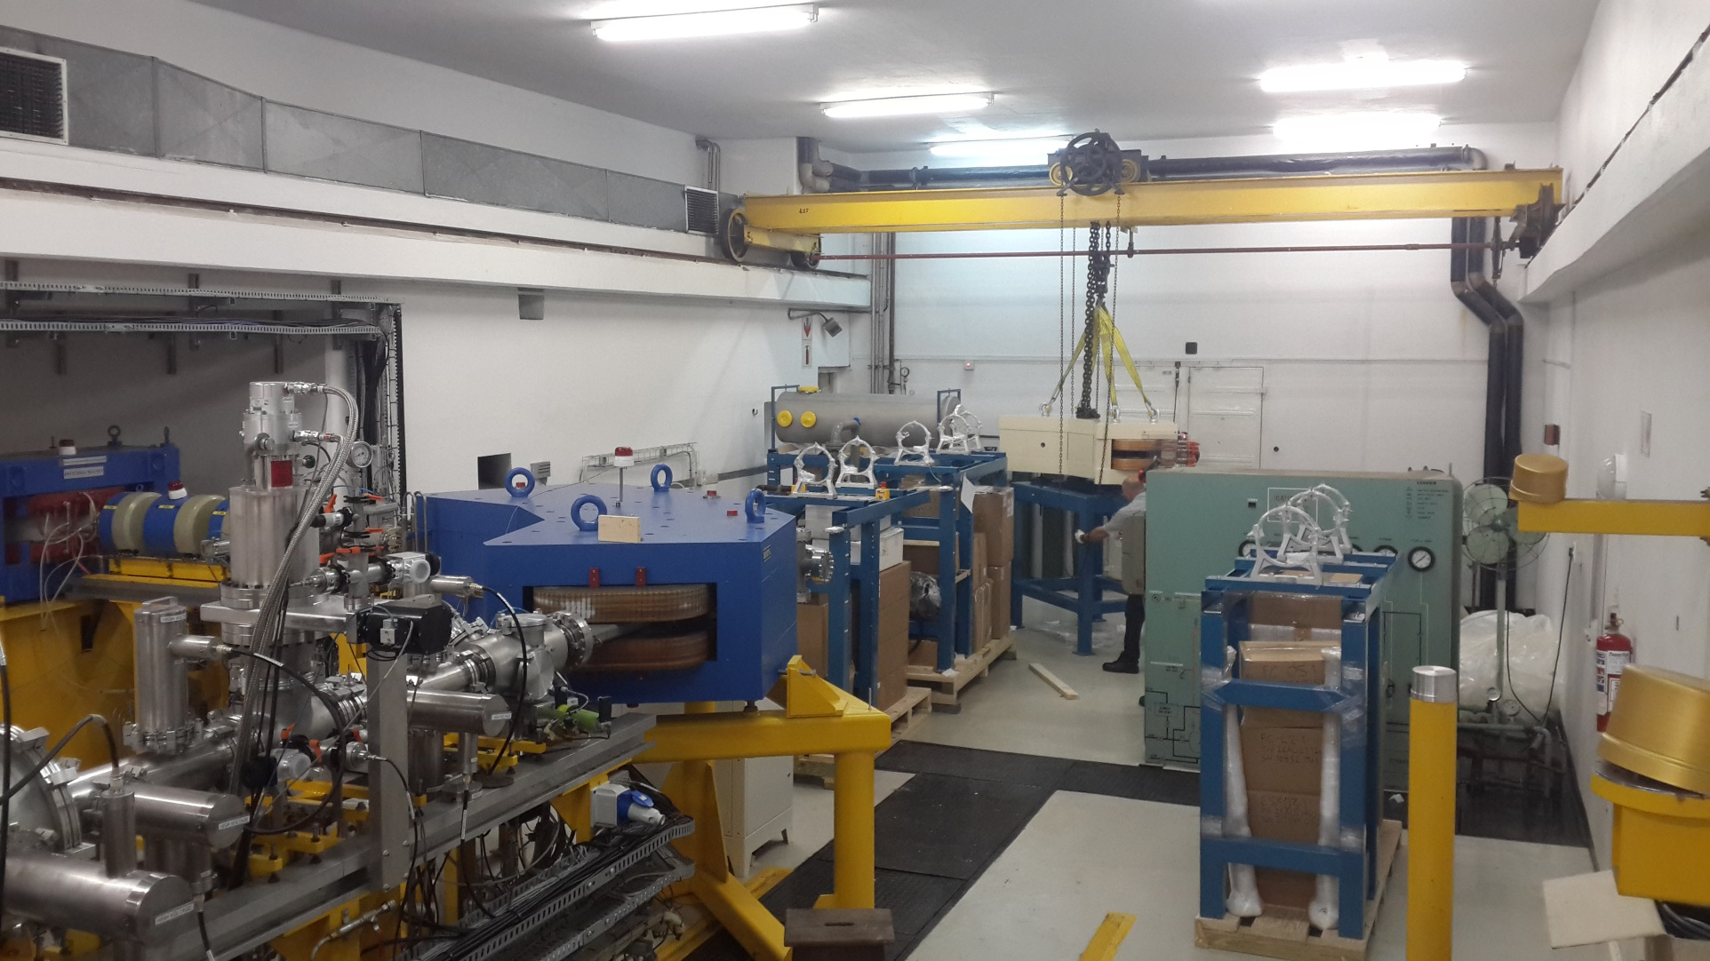
March 2014 : National Electrostatics Corporation (NEC) High Energy Analysis System under Installation (replica of SUERC system)
High Energy Particle Physics Workshop, iThemba LABS, 11-13 February 2015

Slide 22
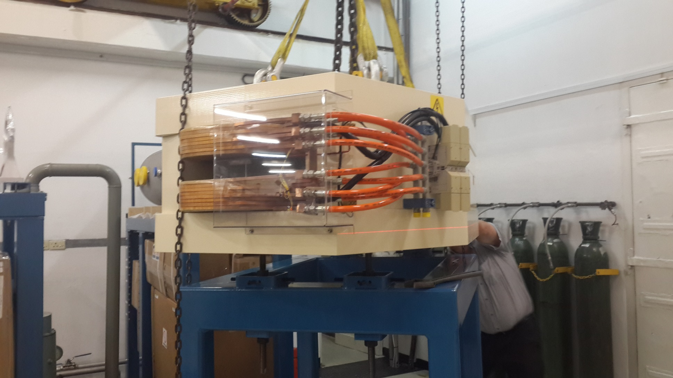
March 2014 : High Energy Analyzing Magnet under Installation
High Energy Particle Physics Workshop, iThemba LABS, 11-13 February 2015

Slide 23
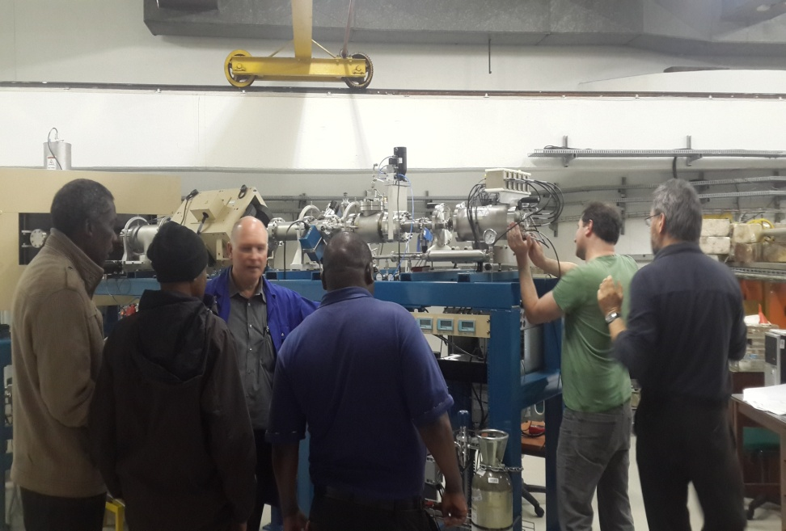
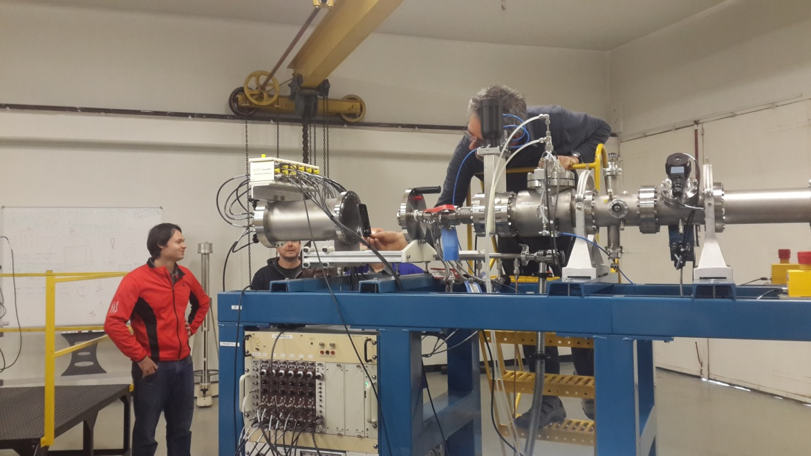
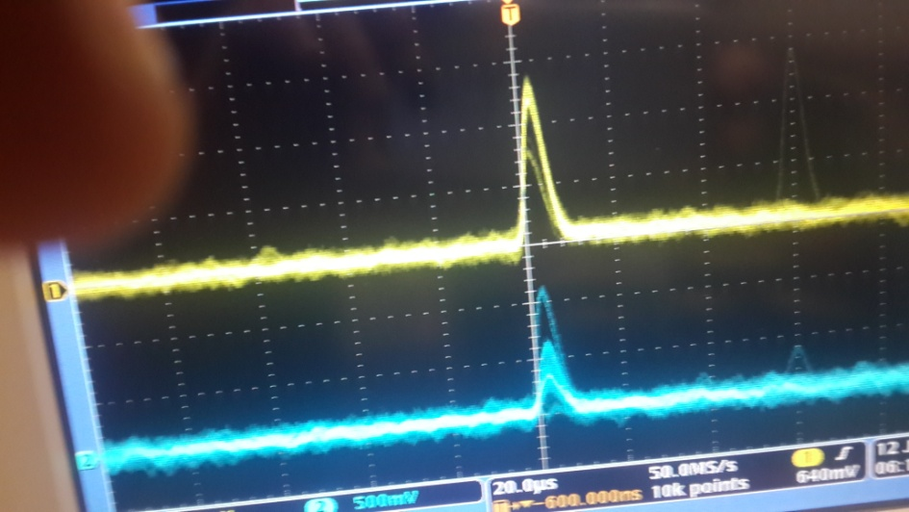
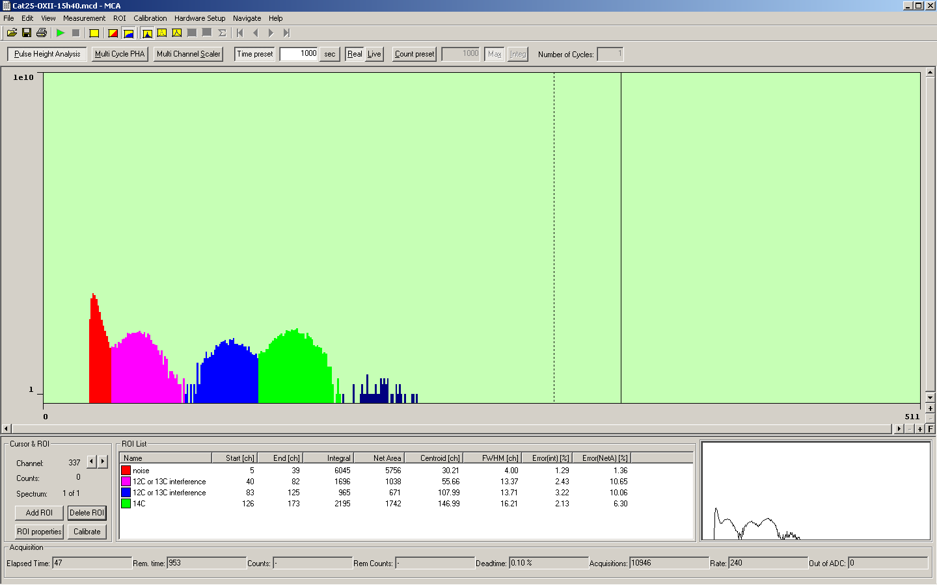
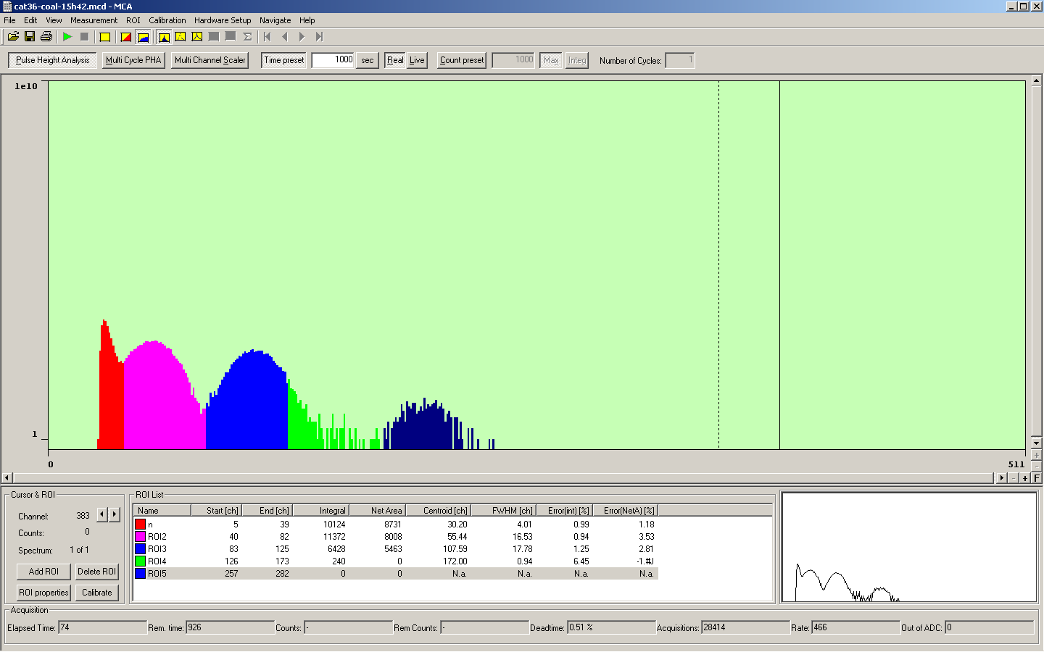
July 2014 : First commissioning of complete AMS system
High Energy Particle Physics Workshop, iThemba LABS, 11-13 February 2015

Slide 24
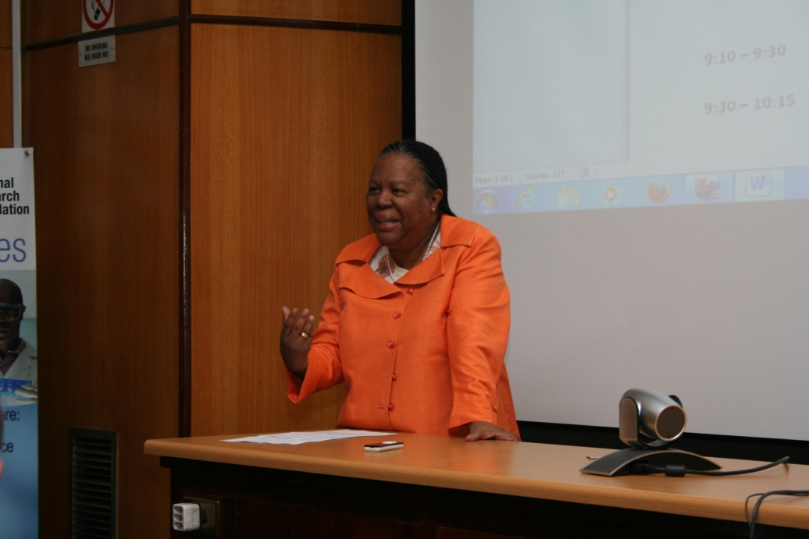
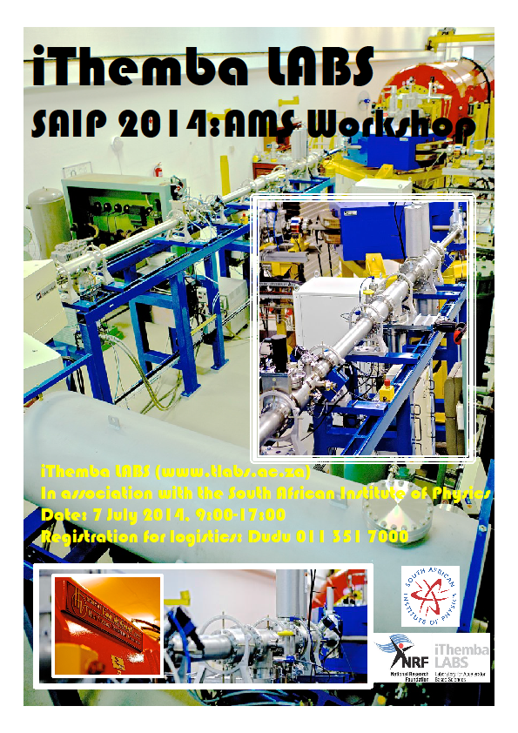
7th July 2014 : SAIP2014 AMS Workshop at iThemba LABS : opening address by the Hon. Mrs Naledi Pandor, Minister of Science and Technology, who later declared Africa’s first AMS facility open
High Energy Particle Physics Workshop, iThemba LABS, 11-13 February 2015

Slide 25
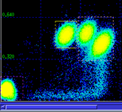
July 2014 : First fully operational detection of ¹⁴C ions via AMS in Africa from Ox-II standard supplied by Tom Brown of CAMS, LLNL, USA
E →
ΔE →
High Energy Particle Physics Workshop, iThemba LABS, 11-13 February 2015

Slide 26
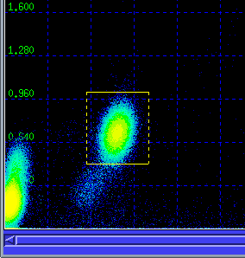
November 2014 : First detection of C14 ions by iThemba LABS AMS team (alone!)
E →
ΔE →
High Energy Particle Physics Workshop, iThemba LABS, 11-13 February 2015

Slide 27


Users : Centre of Excellence for Palaeosciences (hosted by University of the Witwatersrand)
High Energy Particle Physics Workshop, iThemba LABS, 11-13 February 2015

Slide 28
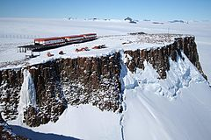
Users : South Africa Antartic Programme
(¹⁰Be in ice-cores)
High Energy Particle Physics Workshop, iThemba LABS, 11-13 February 2015

Slide 29


Users : Rock Art Research Institute (University of the Witwatersrand)
High Energy Particle Physics Workshop, iThemba LABS, 11-13 February 2015

Slide 30
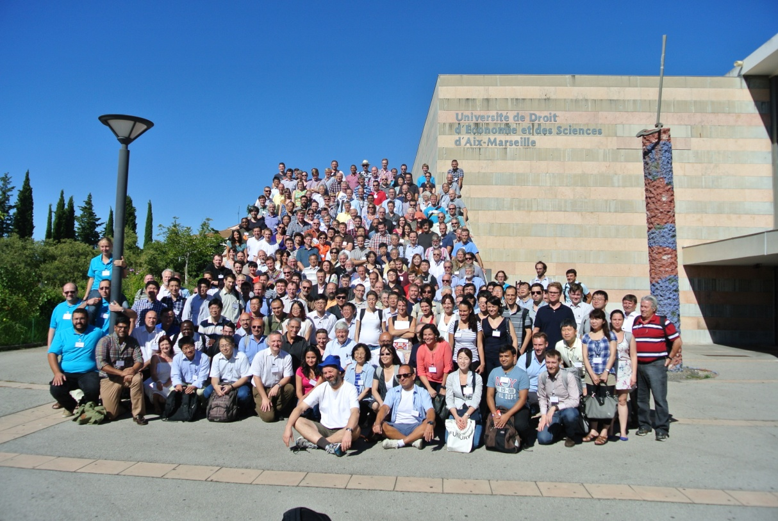
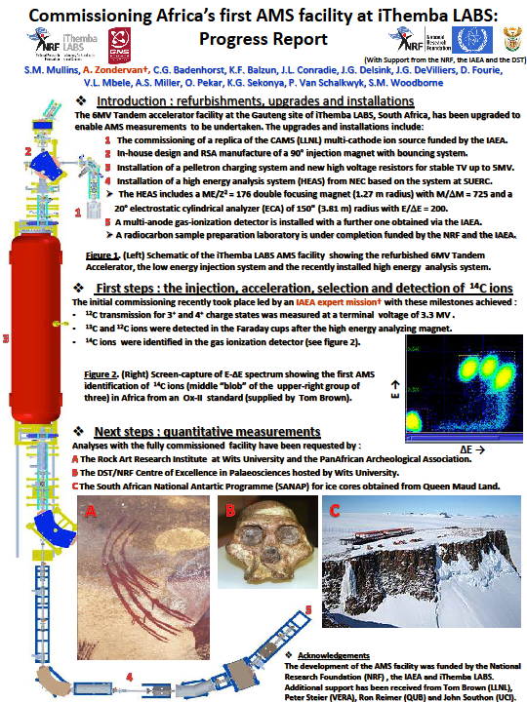
August 2014 : Poster presented at AMS-13 conference in Aix-en-Provence, France
High Energy Particle Physics Workshop, iThemba LABS, 11-13 February 2015

Slide 31
Back to iThemba LABS in the Cape……
High Energy Particle Physics Workshop, iThemba LABS, 11-13 February 2015

Slide 32
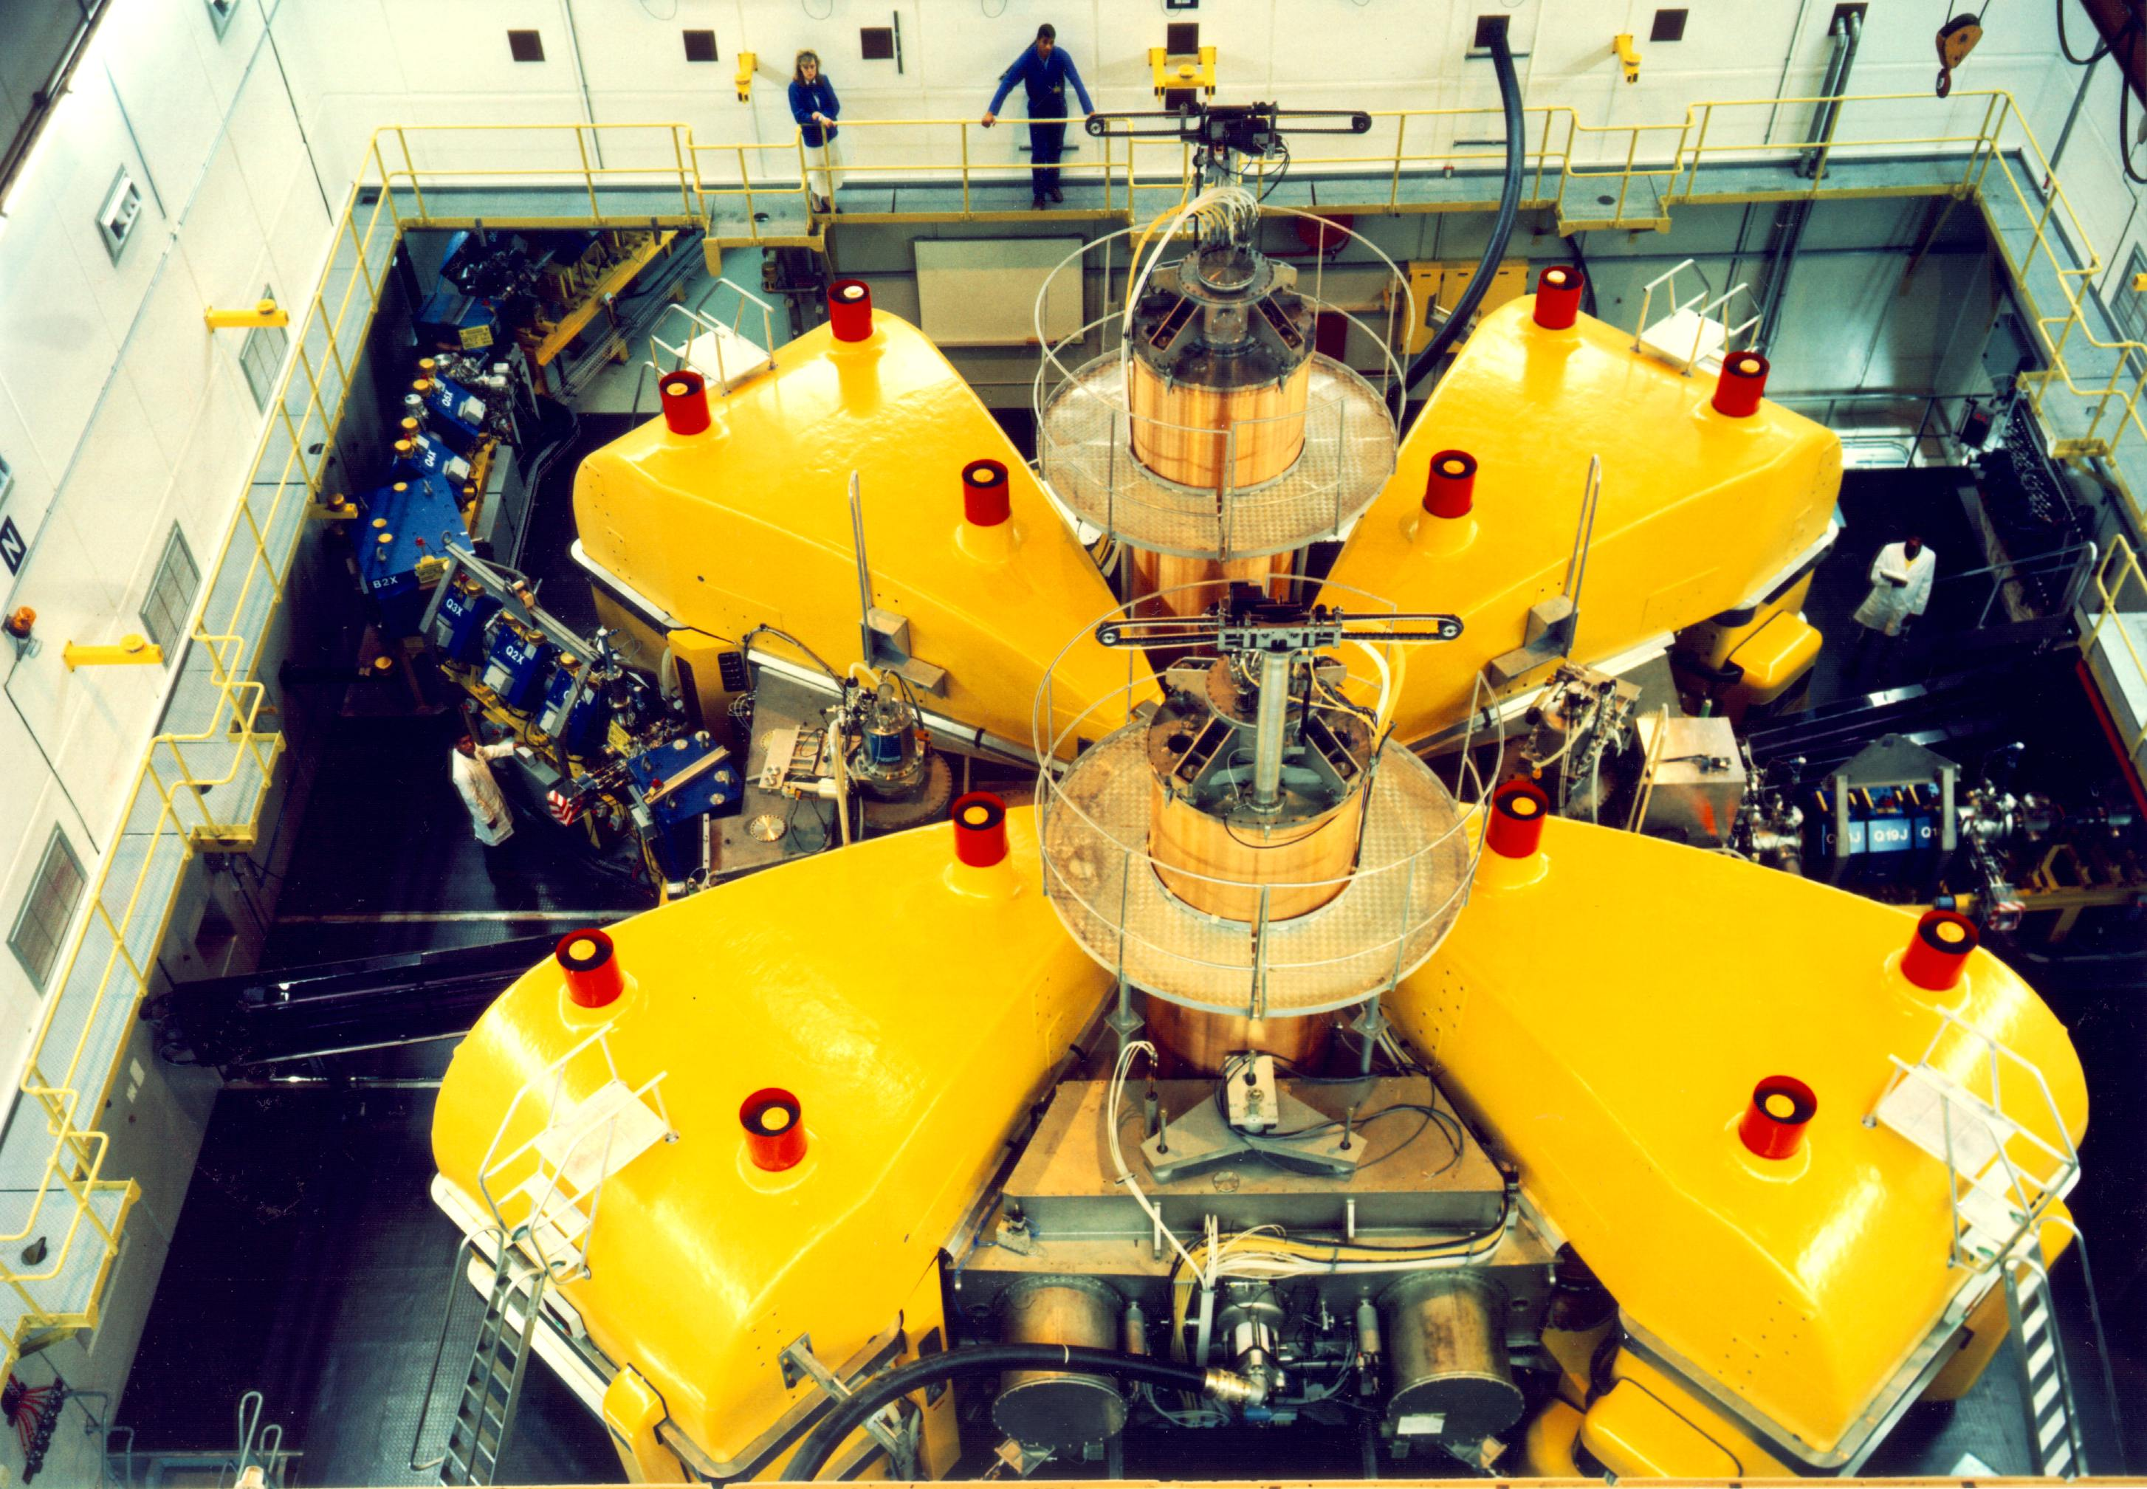
Separated-Sector Cyclotron (SSC)
Most Powerful Accelerator in Southern Hemisphere
Rf-system
High Energy Out
Low Energy In
Rf-system
Sector Magnet
High Energy Particle Physics Workshop, iThemba LABS, 11-13 February 2015
Notes:
This shows the separated-sector cyclotron. It has four separate magnet sectors with a diameter of 13 m. The RF-system consists of two lambda-half resonators that can operate in the frequency range 7 to 26 MHz. The dee voltage is 220 kV at a power level of 80 kW per resonator. Although it has been designed for a maximum proton energy of 200 MeV but has delivered proton beams of 227 MeV. The beam is inflected with two bending magnets and a magnetic channel and extracted with two septum magnets. Typically the cyclotron delivers a 85 µA beam of 66 MeV protons for radioisotope production with 100% transmission through the machine. Higher beam currents are available but better production target cooling is required for reliable operation at higher intensities.

Slide 33
Multi-User Facility
Proton Therapy: 200 MeV p
Neutron Therapy: 66 MeV p, ~ 40μA
Isotope Production: 66 MeV p, up to 350μA
Nuclear Physics: various beams
High Energy Particle Physics Workshop, iThemba LABS, 11-13 February 2015
Notes:
33
This slide shows the layout of our facilities. Beams from the variable separated-sector cylotron, that has a maximum energy of 200 MeV for protons, are directed to vaults for the production of radioisotopes, proton- and neutrontherapy and nuclear physics experiments. Light ions, pre-accelerated in the first solid-pole injector cyclotron with a K-value of 8 are used for therapy and radioisotope production. For radioisotope production and neutrontherapy a 66 MeV proton beam is used and for protontherapy a 200 MeV beam. The second solid-pole injector cyclotron with a K-value of 10 (which you see here) is used for pre-acceleration of heavy ions and polarized protons from these two external sources

Slide 34
SSC Beam Schedule
◊ Nuclear Physics
© Neutron Therapy
© Proton Therapy
© Energy Change
© Isotope Production
High Energy Particle Physics Workshop, iThemba LABS, 11-13 February 2015
Notes:
34
Beam is delivered to the different users for 24 hours per day and seven days per week. Radionuclide production and neutron therapy run from 16h00 on Mondays until 5h00 on Fridays. Patients are treated during day time and between treatments the beam is switched to the radionuclide production vault and the intensity is increased to 85μA. On Mondays and Fridays a 200 MeV beam is used for proton therapy and over the weekend beams of light and heavy ions as well as polarized protons, pre-accelerated in a second solid-pole injector cyclotron. In spite of this very tight schedule it remains difficult to satisfy the beam requirements of the different users. We are therefore in the process of increasing the beam intensity for the production of radioisotopes as well as installing and planning additional beam lines for the same purpose. It is planned to produce radioisotopes on two different targets simultaneously.

Slide 35
Proton Therapy
Present Schedule Restricted to 2 “Fractions” / week
Brain tumours
If schedule allowed 5 “Fractions” / week
Paediatric tumours
Tumours close to critical structures
Brain tumours
Gastro-intestinal tumours (rectum, liver, pancreas)
Prostate tumours
Lung tumours
Recurrent tumours
High Energy Particle Physics Workshop, iThemba LABS, 11-13 February 2015

Slide 36
Proton-therapy computer-controlled treatment set-up at iThemba LABS
High Energy Particle Physics Workshop, iThemba LABS, 11-13 February 2015

Slide 37
Proton Therapy : Delivered in “fractions”
High Energy Particle Physics Workshop, iThemba LABS, 11-13 February 2015

Slide 38
Neutron therapy treatment vault at iThemba LABS
High Energy Particle Physics Workshop, iThemba LABS, 11-13 February 2015

Slide 39
Neutron therapy treatment at iThemba LABS
High Energy Particle Physics Workshop, iThemba LABS, 11-13 February 2015

Slide 40
Nuclear Physics Research
Nuclear Structure
  Pairing Isomers
  Pairing Vibrations
  Tetrahedral Shapes
  Hyperdeformation
  Chirality
  Giant Resonances
Nuclear Reactions
  Fusion Barrier Distributions
  Incomplete Fusion
  Astrophysical reactions
  Production of intermediate mass fragments
  Reaction Mechanisms
High Energy Particle Physics Workshop, iThemba LABS, 11-13 February 2015

Slide 41
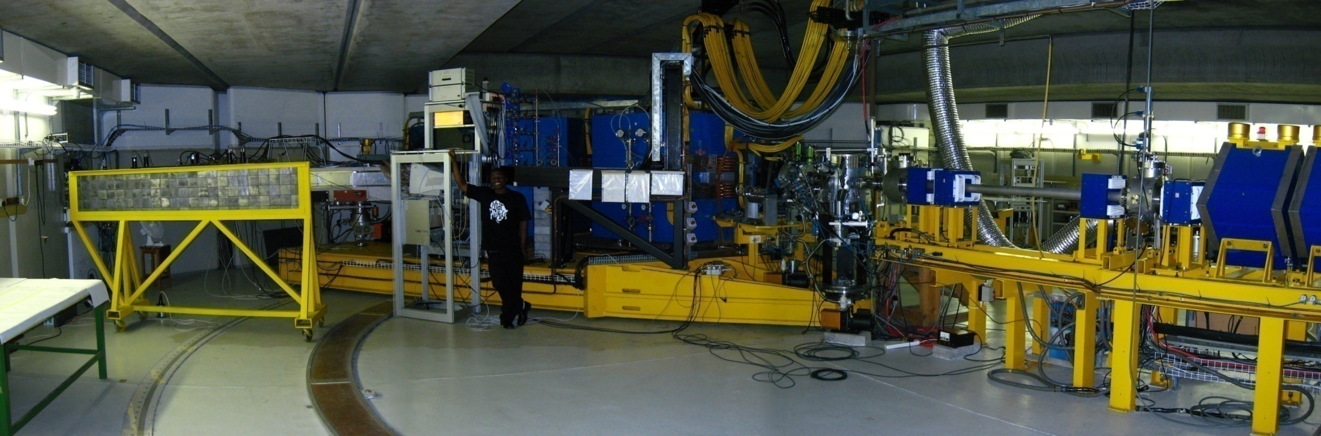
Nuclear Physics Research
K600 Spectrometer
High Energy Particle Physics Workshop, iThemba LABS, 11-13 February 2015

Slide 42
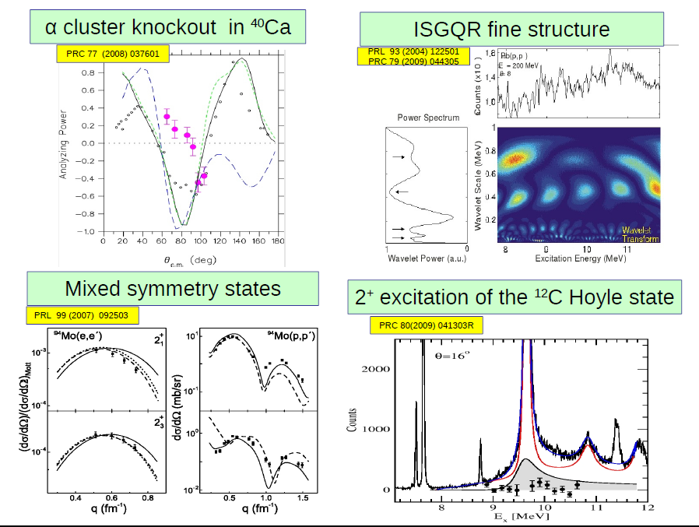
Research results published in high-impact, internationally-recognized journals :
High Energy Particle Physics Workshop, iThemba LABS, 11-13 February 2015

Slide 43
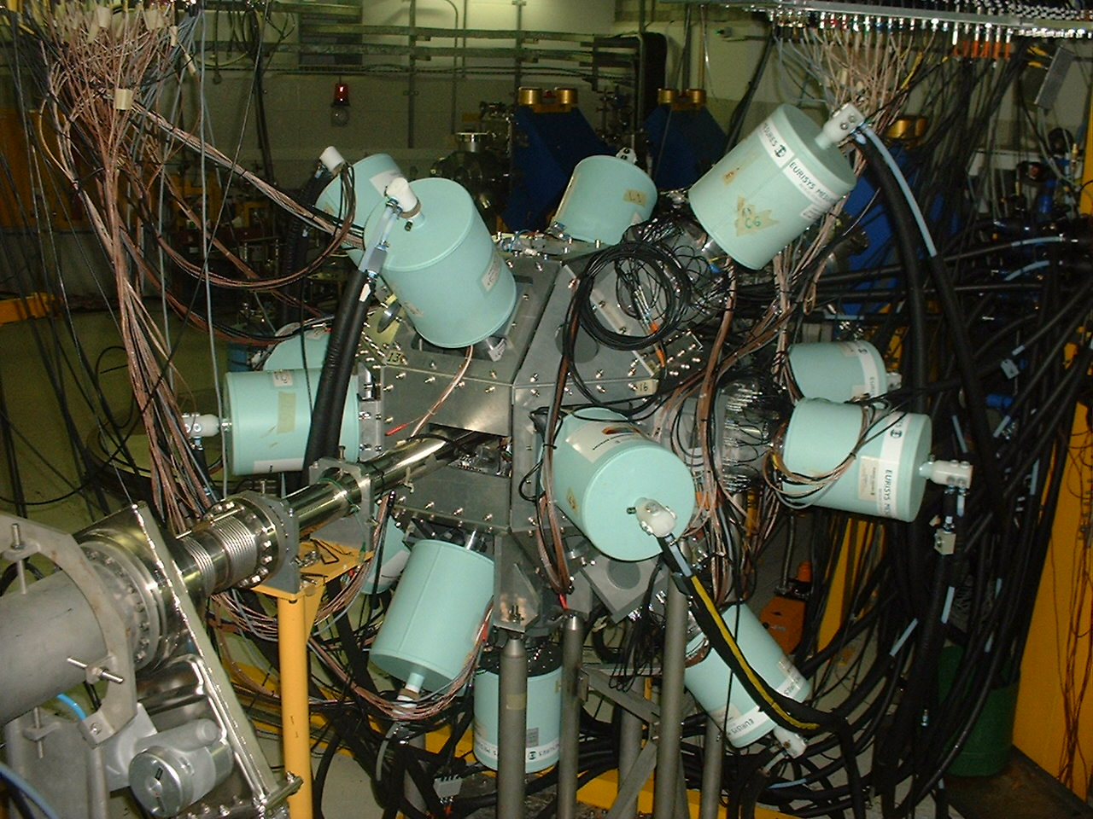
AFRODITE at iThemba LABS γ-ray spectroscopy
Nuclear Physics Research
9 Compton Suppressed
Clover detectors
8 LEPS detectors
High Energy Particle Physics Workshop, iThemba LABS, 11-13 February 2015

Slide 44
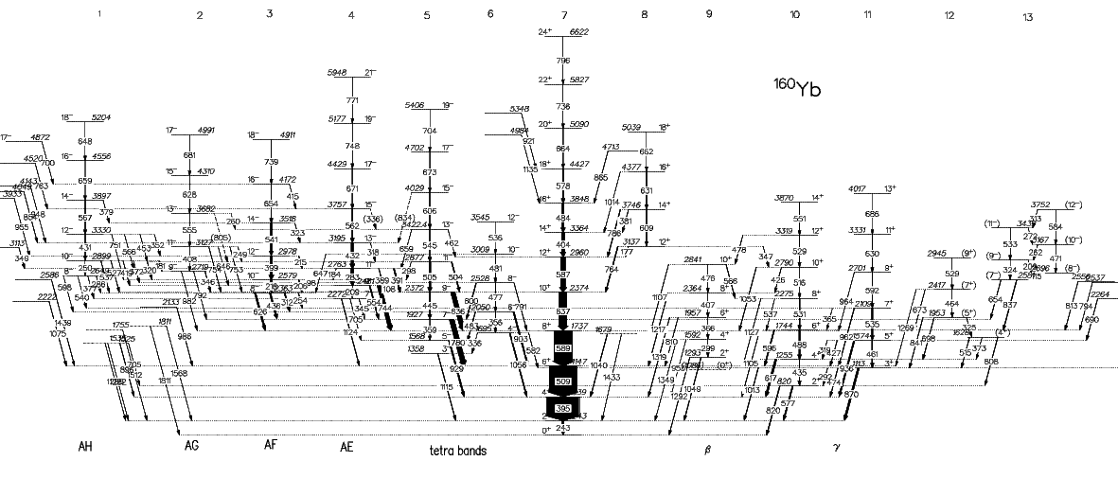
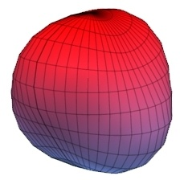
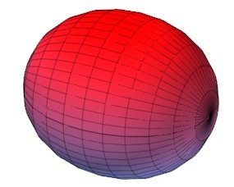

“search for a tetrahedral nucleus”
¹⁴⁷Sm(¹⁶Ο,3n)¹⁶⁰Yb
?
High Energy Particle Physics Workshop, iThemba LABS, 11-13 February 2015

Slide 45
The Future of ABS in SA : A New Cyclotron at iThemba LABS
Isotope Production off SSC (uses 66 MeV p beam) (neutron therapy to be terminated?)
Free SSC for use by Physics and proton therapy only (PT to get 230 MeV machine?)
More than doubles physics beamtime
Two accelerators allow the production of rare isotope beams using the ISOL method
High Energy Particle Physics Workshop, iThemba LABS, 11-13 February 2015

Slide 46

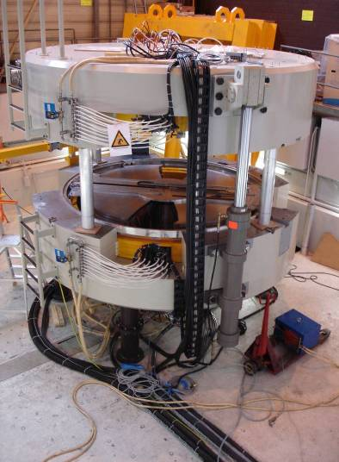

C70 GENERAL DESCRIPTION
Diameter < 4m
Weight > 120t
Magnetic Gap: 30mm
Magnetic field: 1.55T
Extraction Radius: 1.2m
2 exit ports
SPES design
Particles: H⁻ / D⁻ / He²⁺/ HH⁺
Variable Energy : 15 MeV → 70 MeV
extraction Systems:
    Stripper → H⁻ / D⁻
    Deflector → He²⁺/ HH⁺
Performances:
    750µA H⁻ → 70MeV Current upgrade up to 1.5mA
    35µA He²⁺ → 70MeV
High Energy Particle Physics Workshop, iThemba LABS, 11-13 February 2015
Notes:
POSTER → William Beeckman, TUPRA08 Machining & Assembly
Advantage of a commercial solution: fixed time for delivery, performances already tested.

Slide 47
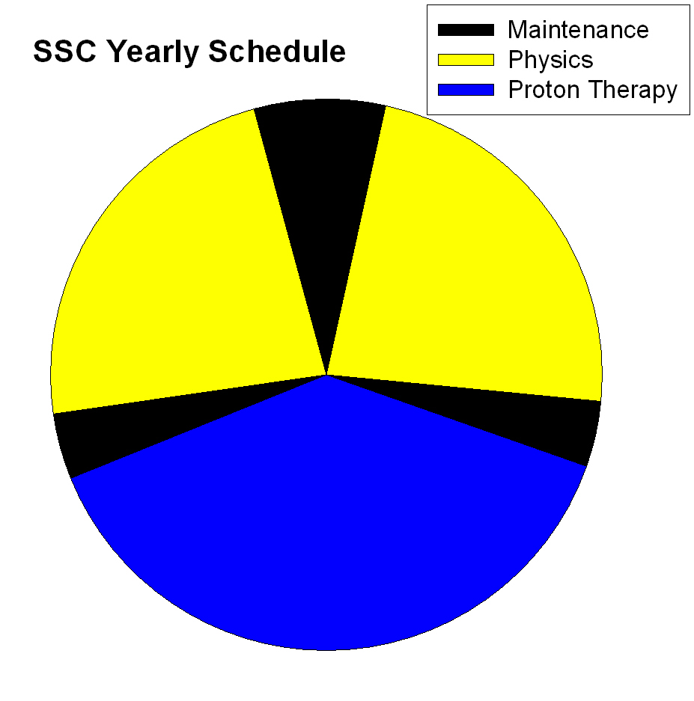
4
weeks
12 weeks
12 weeks
2 weeks
2 weeks
20 weeks
High Energy Particle Physics Workshop, iThemba LABS, 11-13 February 2015

Slide 48
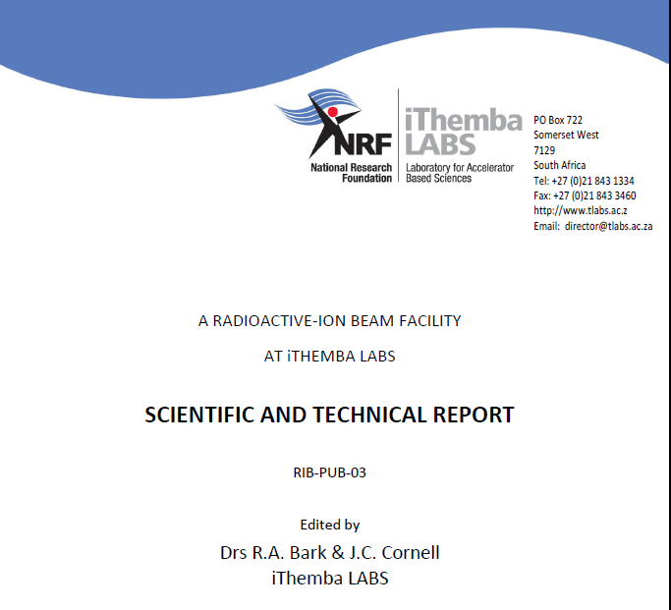
http://www.tlabs.ac.za/radioactive-ion-beam/
High Energy Particle Physics Workshop, iThemba LABS, 11-13 February 2015

Slide 49

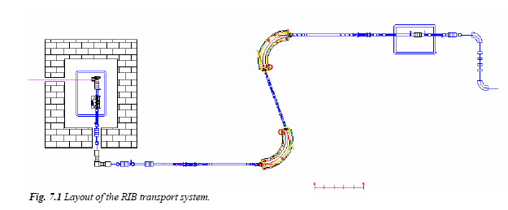
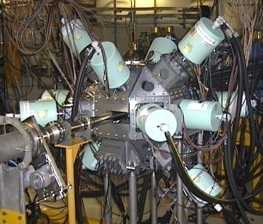
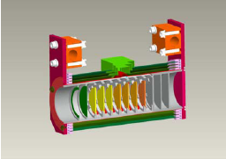
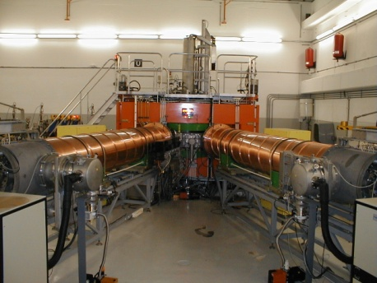

RIBs - HOW? - Isotope Separation Online : ISOL
New
Accelerator
RIB
Production
target
1⁺ ion – source &
mass selector
Charge
Breeder
injector
SSC
Experiment
High Energy Particle Physics Workshop, iThemba LABS, 11-13 February 2015

Slide 50
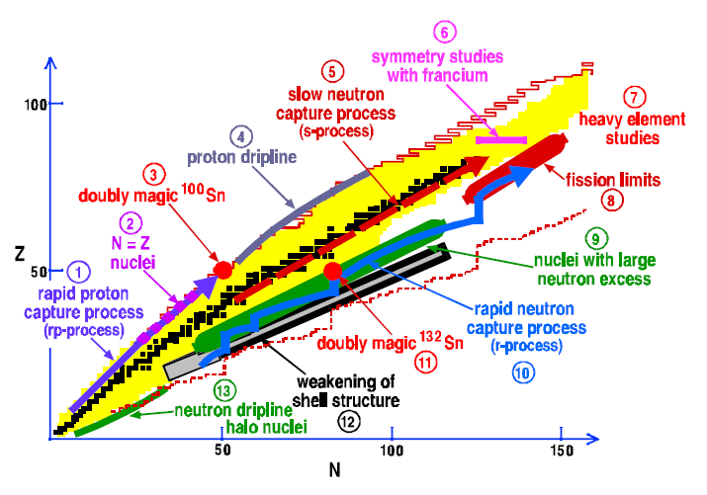

Nuclear Physics: Why Rare Isotope beams ?
High Energy Particle Physics Workshop, iThemba LABS, 11-13 February 2015

Slide 51


Origin of the elements: astrophysical r-process
High Energy Particle Physics Workshop, iThemba LABS, 11-13 February 2015

Slide 52


Predictions of Nuclear Masses Compared with Experiment
High Energy Particle Physics Workshop, iThemba LABS, 11-13 February 2015

Slide 53

Which Rare Isotope Beams?
Beams for material sciences
  ⁷Be, ²²Na, ²⁸Mg, ³¹Si, ³⁸Cl, ⁴⁷V, ⁴²K, ⁴³K,
  ⁶⁵Ni, ⁶⁷Cu, ⁶⁷Ga, ⁶⁹Ge, ⁷¹As, ⁷³Ga, ¹¹⁰Sn,
  ¹¹¹Ag, ¹¹³Ag, ¹¹⁷Cd, ¹¹⁹Sb
^{6,8}He
Proton Rich ?
Neutron Rich: Fission Target
Proton –rich ⇒different target per beam
Neutron-rich ⇒ one ²³⁸U target; 100 beams
High Energy Particle Physics Workshop, iThemba LABS, 11-13 February 2015

Slide 54



Reaching the neutron rich: FISSION URANIUM
High Energy Particle Physics Workshop, iThemba LABS, 11-13 February 2015

Slide 55

Proposed layout of the RIB facility at iThemba LABS
High Energy Particle Physics Workshop, iThemba LABS, 11-13 February 2015

Slide 56


RIB production
Location for future injector
Low-energy
beamlines
Charge breeder
Mass analyser
Beam cooler
RIB production
stations
Target / ion-
source
maintenance
Robot
Target storage
High Energy Particle Physics Workshop, iThemba LABS, 11-13 February 2015

Slide 57

Demonstrator with “Unaccelerated” RIBs
RIB ion-source Test Station + β-decay + Materials
Possible location of RIB test ion-source
High Energy Particle Physics Workshop, iThemba LABS, 11-13 February 2015

Slide 58

Demonstrator to test Legnaro SPES target/ion-source – under MoU
High Energy Particle Physics Workshop, iThemba LABS, 11-13 February 2015

Slide 59

High Energy Particle Physics Workshop, iThemba LABS, 11-13 February 2015

Slide 60


RIB demonstrator : low energy (LE) Beams for Materials Research
High Energy Particle Physics Workshop, iThemba LABS, 11-13 February 2015

Slide 61


Example : Solid State Physics at ISOLDE (LE RIBs)
Lattice location of Fe in Diamond
K. Bharuth-Ram et al.
⁵⁹Mn (t_{1/2} = 4.6s) implanted into
Diamond, decays to ⁵⁹Fe which
β-decays with t_{1/2} = 45 days
Electron emission channeling
Measurements indicate that
65% of Fe atoms lie within 0.2 Å
From a substitutional site
High Energy Particle Physics Workshop, iThemba LABS, 11-13 February 2015

Slide 62


Instrumentation
High Energy Particle Physics Workshop, iThemba LABS, 11-13 February 2015

Slide 63




http://www.tlabs.ac.za/news-3/
High Energy Particle Physics Workshop, iThemba LABS, 11-13 February 2015

Slide 64
Summary:
There is world-class infrastructure and expertize in Accelerator-Based Nuclear Sciences in South Africa, but this needs to be funded at a level to continue to development and deliver
Deliver what? High-impact research outputs and highly skilled people
Partnerships between National Facilities (like iThemba LABS), HEIs and the Nuclear Power Sector need to be strengthened and expanded
S/He who hesitates is lost! We need to start to invest now to enable these partnerships to deliver!
High Energy Particle Physics Workshop, iThemba LABS, 11-13 February 2015

Slide 65
Acknowledgements:
AMS : the NRF, the DST, the IAEA and colleagues at iThemba LABS (Cape and Gauteng)
RIB : Dr Rob Bark (Project Leader)
Thank you for your attention
High Energy Particle Physics Workshop, iThemba LABS, 11-13 February 2015

Slide 67
SSC Beam Schedule
◊ Nuclear Physics
© Neutron Therapy
© Proton Therapy
© Energy Change
© Isotope Production
High Energy Particle Physics Workshop, iThemba LABS, 11-13 February 2015
Notes:
67
Beam is delivered to the different users for 24 hours per day and seven days per week. Radionuclide production and neutron therapy run from 16h00 on Mondays until 5h00 on Fridays. Patients are treated during day time and between treatments the beam is switched to the radionuclide production vault and the intensity is increased to 85μA. On Mondays and Fridays a 200 MeV beam is used for proton therapy and over the weekend beams of light and heavy ions as well as polarized protons, pre-accelerated in a second solid-pole injector cyclotron. In spite of this very tight schedule it remains difficult to satisfy the beam requirements of the different users. We are therefore in the process of increasing the beam intensity for the production of radioisotopes as well as installing and planning additional beam lines for the same purpose. It is planned to produce radioisotopes on two different targets simultaneously.

Slide 68



iThemba LABS
Radionuclide Distribution Network
Africa 3
Australia 2
Asia 19
Canada 2
Europe 31
USA 12
High Energy Particle Physics Workshop, iThemba LABS, 11-13 February 2015

Slide 69
Radio-Nuclide Production (primarily medical) [HoD : Dr Clive Naidoo]
Many customers, both international & local
How to boost production rate?
Higher beam current (as long as targets can take it)
“Flat-Topping”
High Energy Particle Physics Workshop, iThemba LABS, 11-13 February 2015

Slide 70
THE EFFECT of FLAT-TOPPING RF-VOLTAGE ACROSS THE ACCELERATION GAP
f₀
f₀+f₃
f₃
High Energy Particle Physics Workshop, iThemba LABS, 11-13 February 2015
Notes:
The effect of flat-topping of the dee voltage is shown in this figure. Since the resonators of a cyclotron have to be tuned to obtain high dee voltages for modest power input the voltage in a resonator is sinusoidal as indicated by the blue line (f₀). Because of the finite beam pulse length all the ions do not cross the acceleration gap at the same time with the result that an energy spread is introduced in the beam. For a low energy spread and a small beam width at extraction the beam pulse length has to be limited with slits in the center of a cyclotron, but this means that a lower beam intensity is obtained. With the superposition of a harmonic (f₃) on the main dee voltage an effective dee voltage with a flat top (f₀ + f₃) is obtained. A low energy spread in the beam can be obtained for long beam pulses and high beam intensities. The harmonic voltage need be superimposed on the main dee voltage – a separate resonator, operating at the harmonic frequency, can be used.

Slide 71

Solid-pole injector cyclotron 1 (SPC1)
High Energy Particle Physics Workshop, iThemba LABS, 11-13 February 2015

Slide 72
Separated-Sector Cyclotron (SSC)
Rf-system
Rf-system
Sector Magnet
High Energy Particle Physics Workshop, iThemba LABS, 11-13 February 2015

Slide 73

FLAT-TOPPING IN A NUTSHELL
IMPROVE BOTH THE BEAM QUALITY AND INTENSITY OF THE 66 MeV p⁺ BEAM
Without Flat-topping => pure sinusoidal rf-voltage for acceleration
SSC
SPC1
BUNCHER
18°
8°
320 µA
It’s GOOD
120 µA
With Flat-topping
SSC
SPC1
BUNCHER
45°
45°
15°
650 µA
300- 500
It’s much
µA
BETTER !
High Energy Particle Physics Workshop, iThemba LABS, 11-13 February 2015

Slide 74




Layout of the beam splitter
High Energy Particle Physics Workshop, iThemba LABS, 11-13 February 2015

Slide 75

Electrostatic channel – a mirror image of PSI design
High Energy Particle Physics Workshop, iThemba LABS, 11-13 February 2015

Slide 76

Magnetic channel
High Energy Particle Physics Workshop, iThemba LABS, 11-13 February 2015

Slide 77






High Energy Particle Physics Workshop, iThemba LABS, 11-13 February 2015

Slide 78


Beam direct behind the electrostatic channel
Beam in front of the magnetic channel
High Energy Particle Physics Workshop, iThemba LABS, 11-13 February 2015

Slide 79

Measured beam current on the two target stations
High Energy Particle Physics Workshop, iThemba LABS, 11-13 February 2015

Slide 80
iThemba LABS cGMP Radiopharmaceuticals
Supply over 60 local Nuclear Medicine Hospitals and Private Clinics
High Energy Particle Physics Workshop, iThemba LABS, 11-13 February 2015

Slide 81
iThemba LABS
Long-Lived Radionuclides
Supply over 60 clients worldwide
High Energy Particle Physics Workshop, iThemba LABS, 11-13 February 2015

Slide 82
Targets for radionuclide production
Radionuclide | Target | Energy window (MeV)
⁶⁷Ga | Zn Ge | 34.3 → 18.1 60.7 → 38.7
⁶⁸Ge | Ga “Ga₂O” | 34.0 → 2.4 34.0 → 0.0
⁸¹Rb | RbCl | 62.6 → 57.7
⁸²Sr | Rb | 61.5 → 39.4
¹⁰⁹Cd | Ag | 34.0 → 0.0
¹²³I | NaI | 62.6 → 47.6
⁸⁸Y | SrCl | 34.0→ 0.0
²²Na | Mg | 61.5 → 40.0
¹⁸F | [¹⁸O]Water | 18.0 → 0.0
High Energy Particle Physics Workshop, iThemba LABS, 11-13 February 2015

Slide 83


Bombardment Station-HBTS
Produce:
⁶⁷Ga, ¹²³I and ⁸¹Rb
⁶⁸Ge, ⁸²Sr, ²²Na, ⁸⁸Y, ⁵⁷Co and ¹⁰⁹Cd
HBTS Target and target holders
Horizontal Beam Target Station (HBTS)
66 MeV proton beam with an intensity of 80-90 µA
High Energy Particle Physics Workshop, iThemba LABS, 11-13 February 2015

Slide 84



Bombardment Station-VBTS
Produce in Tandem
⁸²Sr/⁶⁸Ge
²²Na/⁶⁸Ge
VBTS Thick Target Holders
Vertical Beam Target Station (VBTS)
66 MeV proton beam with an intensity of ~250 µA
VBTS Tandem targets
High Energy Particle Physics Workshop, iThemba LABS, 11-13 February 2015

Slide 85


RNP Control Room
Automated Transport System
Upgrade of control systems such as cooling systems, interlocking systems and transport system.
High Energy Particle Physics Workshop, iThemba LABS, 11-13 February 2015

Slide 86


Upgrade of Targetry Cooling Systems for dual beams
Helium Cooling Systems that can deliver 70 m³/hr to operate two bombardment stations simultaneously
Water Cooling Systems that can deliver in total 300 L/min to operate two bombardment stations simultaneously
High Energy Particle Physics Workshop, iThemba LABS, 11-13 February 2015

Slide 87

Tandem target for the production of ⁸²Sr and ⁶⁸Ge
Aluminium capsule
Niobium capsule
66 MeV protons
RbCl
(8.6 g)
Gallium
HAVAR foils
∅ 20 mm
Ga material: 99.99% (40 g)
65.762 MeV
36.635 MeV
62.579 MeV
61.476 MeV
40.013 MeV
38.444 MeV
36.866 MeV
34.364 MeV
2.364 MeV
High Energy Particle Physics Workshop, iThemba LABS, 11-13 February 2015

Slide 88


Chemical Processing Facilities
¹⁸F-Automated Chemical Processing Hot Cells
Manual Manipulator Hot Cells
High Energy Particle Physics Workshop, iThemba LABS, 11-13 February 2015

Slide 89



3 X Independent Clean Rooms
⁶⁸Ge/⁶⁸Ga
¹⁸F-FDG
¹²³I /⁶⁷Ga
High Energy Particle Physics Workshop, iThemba LABS, 11-13 February 2015

Slide 90


Dispensing Facilities
Comecer Hotcells & Timothea Dispensing Facilities
High Energy Particle Physics Workshop, iThemba LABS, 11-13 February 2015

Slide 91



Quality Control Facilities
MicroLab
18F-FDG Quality Control
High Energy Particle Physics Workshop, iThemba LABS, 11-13 February 2015

Slide 92

Quality Control Microlab
High Energy Particle Physics Workshop, iThemba LABS, 11-13 February 2015

Slide 93




Packaging and Dispatch
As per IATA (International Air Transport Assoc’) Regulations
High Energy Particle Physics Workshop, iThemba LABS, 11-13 February 2015

