Slide 1
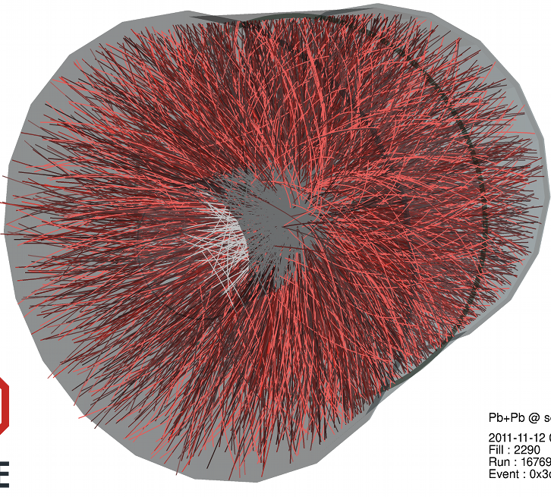


Experimental Heavy-Ion Physics
High Energy Particle Physics Workshop 2015
University of the Witwatersrand, Johannesburg
Tom Dietel – University of Cape Town

Slide 2
Outline
Quark-Gluon Plasma and Heavy-Ion Collisions
Flow and Collectivity
Jet Quenching
Heavy-Flavor Production
Photons

Slide 3
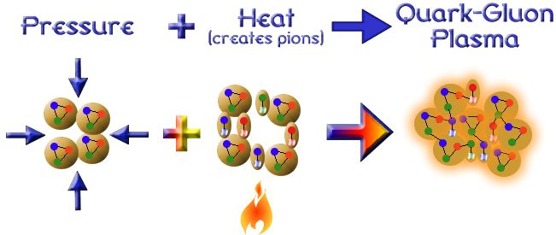
Quark-Gluon Plasma
Compression
reduce distance between nucleons
Heating
thermally create pions
fill space between nucleons
hadrons overlap
quarks roam freely over large volume (deconfinement)
Quark-Gluon Plasma

Slide 4
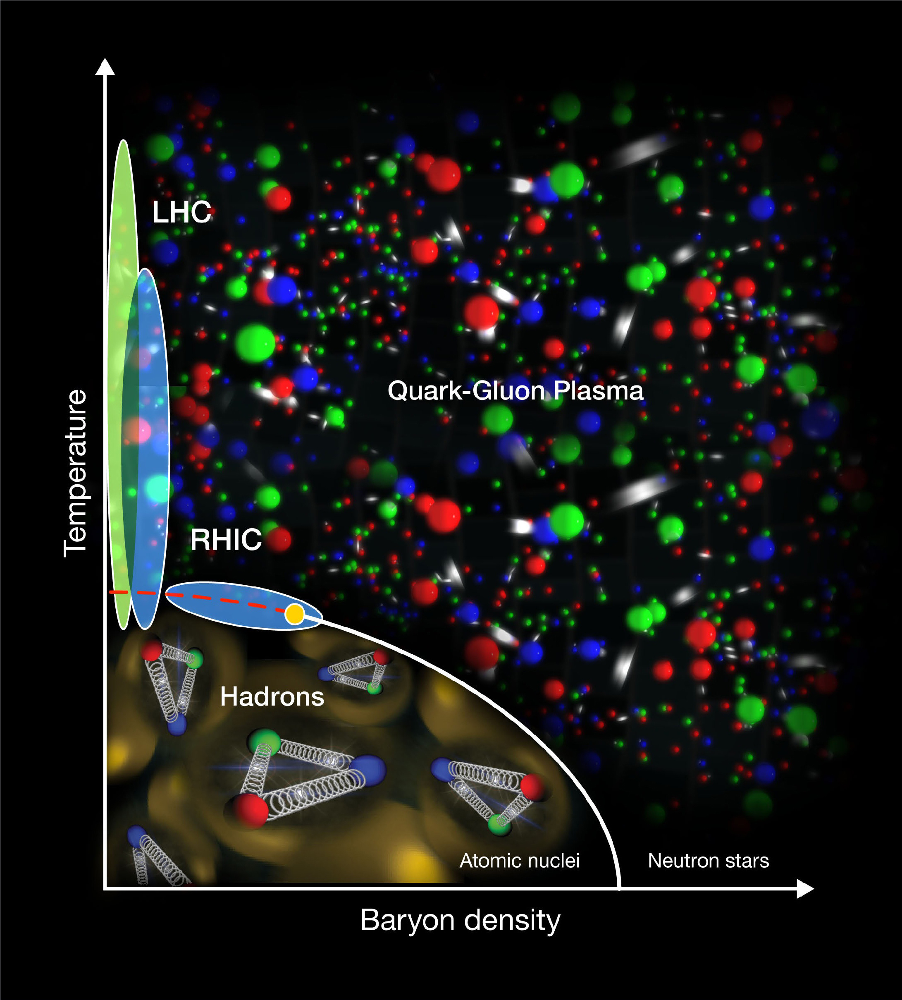
Phase Diagram of Nuclear Matter
High density or high temperature
→ QGP
phase transition at 170 MeV ≈
2 trillion Kelvin
Accessible with accelerators: RHIC, LHC

Slide 5

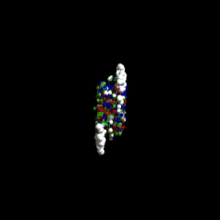
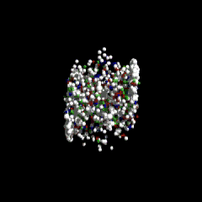
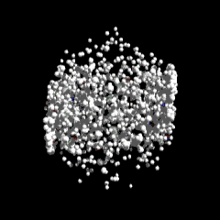
Heavy-Ion Collisions
Collisions of Heavy Nuclei
Pb-Pb @ √s_{NN} = 2.76 TeV
Quark-Gluon Plasma
deconfined phase of quasi-free quarks and gluons
LHC–highest energy HI collisions
  hottest and longest lived QGP
  ideal environment
Hadronisation
fragmentation and quark coalescence produce hadrons
formed after end of QGP phase
thousands of particles
Photons
no final state interaction
direct signal from all phases of collision

Slide 6
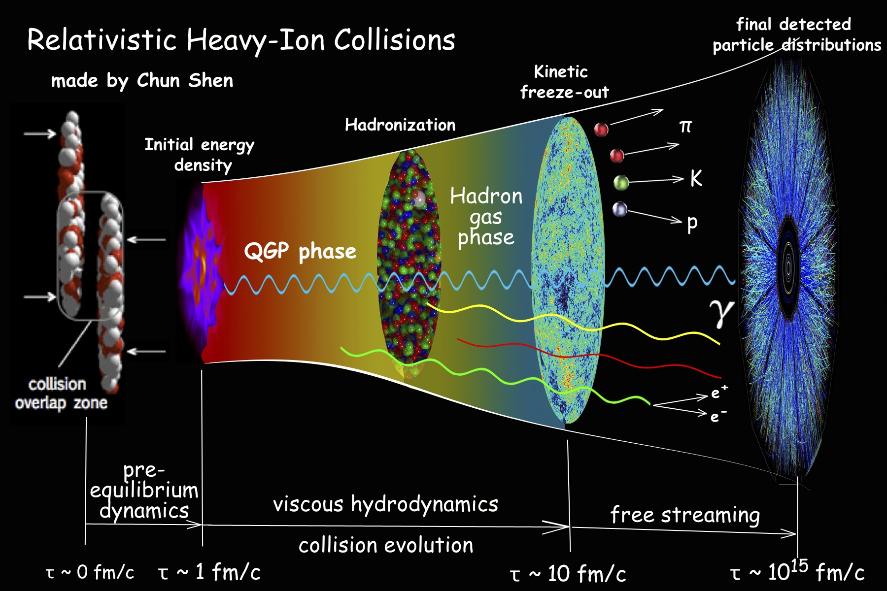
The Little Bang

Slide 7
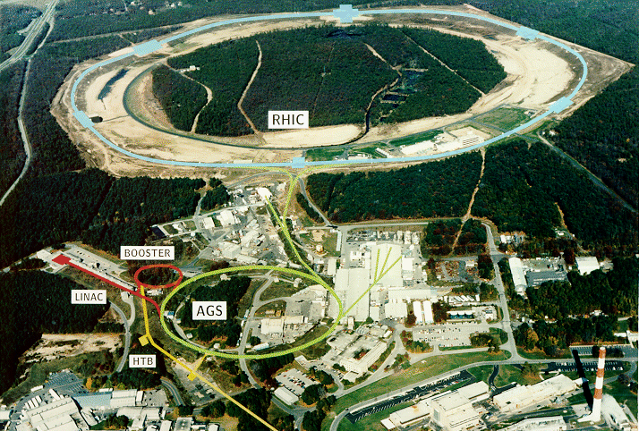




Relativistic Heavy Ion Collider
since 2000
Au-Au @ √s_{nn} 200 GeV
Brookhaven National Lab
Long Island, NY, USA
Notes:
spin program

Slide 8
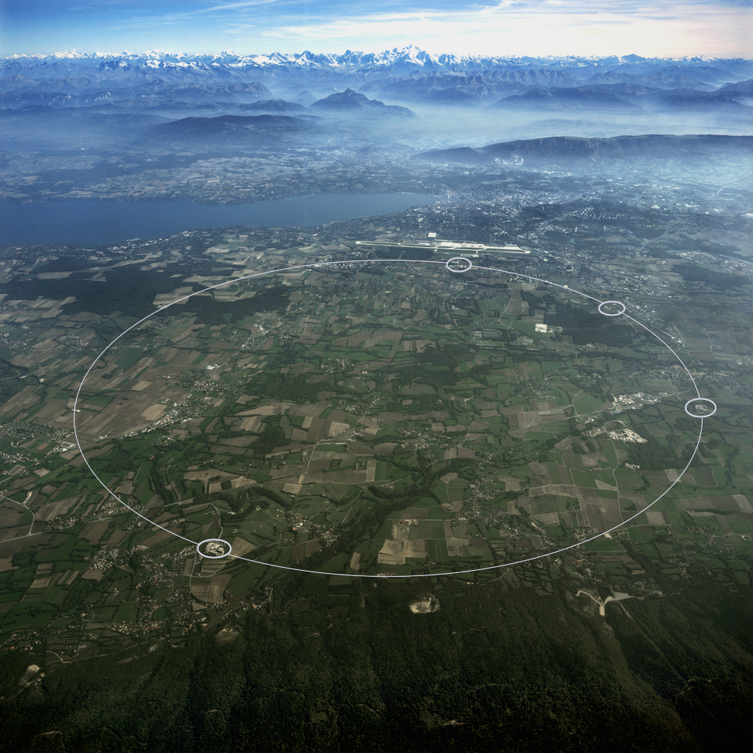
LHCb
ATLAS
ALICE
CMS

Slide 9
Probing the QGP
scattering experiments
external illumination
not possible
bulk: products from the medium
QGP expands, cools down, hadronises
particle species, spectra, flow
hard probes
production in collisions
rare → traceable
interaction with medium
energetic quarks → jets, quarkonia

Slide 10
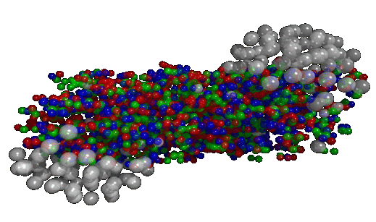
Centrality
Spectators
central
Energy in beam
direction (E_{ZDC})
Participants
peripheral
central collisions: small impact parameter, many participants, many collisions between participants
peripheral collisions: large impact parameter, few participants, mostly spectators
system size
b: impact parameter
N_{part}: number of participants
N_{coll}: number of nucleon-nucleon collision
percentile of total cross section, e.g. 0-5% most central collisions

Slide 11
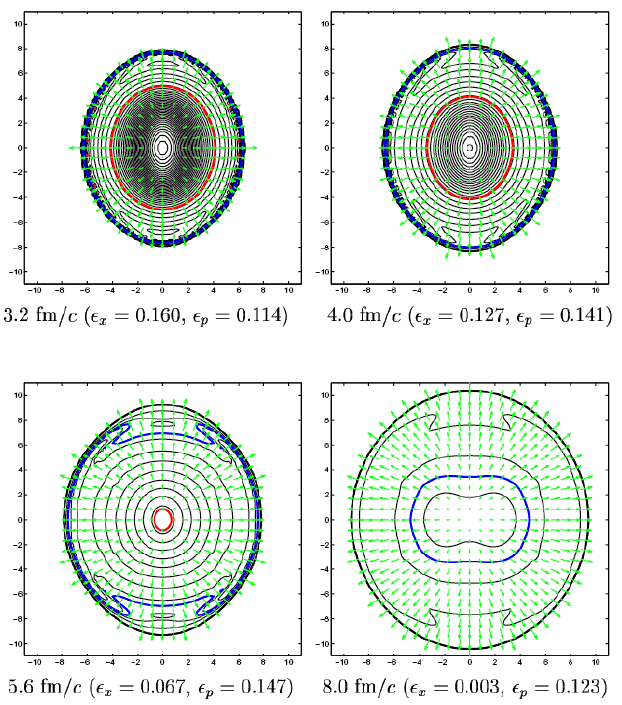
Relativistic Hydrodynamics
Initial Conditions
  geometry and density in collision region
  Glauber vs. Gluon Saturation (e.g Color-Glass Condensate CGC)
  thermalization time T0
Medium Properties
  equation of state (EOS)
    QGP or hadron gas
  viscosity η
  mean free path λ
Relativistic Euler Equation
  evolution of density and motion with time

Slide 12
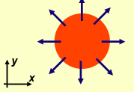
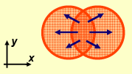

Collectivity
Radial flow
  Only type of transverse flow that occurs also at impact parameter b = 0
  Influences the shape of p_{T} spectra (transverse expansion)
Elliptic flow
  Caused by anisotropy in overlap region for b ≠ 0 (pressure gradient)
  Needs early thermalization
Directed flow
  Built up during pre-equilibrium phase
  Decreases with increasing CMS energy

Slide 13
Elliptic Flow
Anisotropy (almond shape) in the overlap region translates in anisotropy in the momentum distribution
Caused by different pressure gradients in and out of the reaction plane
Needs:
  Early thermalisation
  Strong coupling
reaction plane (x-z)
y
z
x

Slide 14
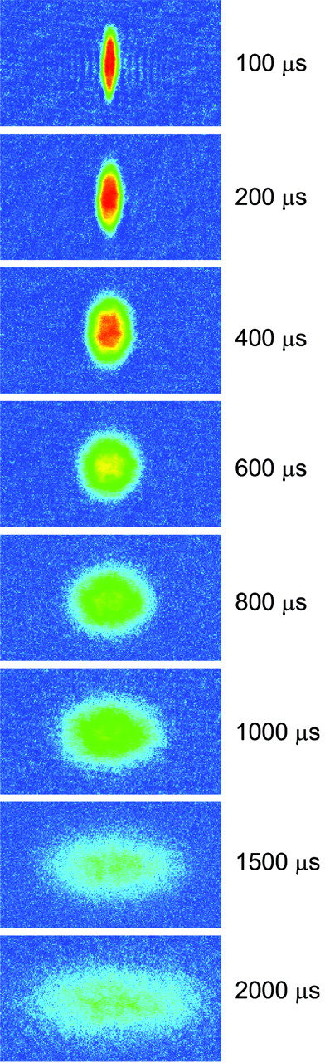
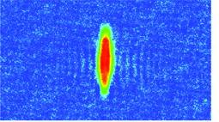
Analogy: Strongly Coupled Atoms
Time after releasing
atoms from trap
Cold atomic gas (⁶Li, T = 10⁻⁶ K)
Tuneable coupling (Feshbach resonance)
Weak coupling:
No momentum anisotropy
Strong coupling: Collective elliptic flow
O’ Hara et. al
Science 298 (2002) 5601

Slide 15
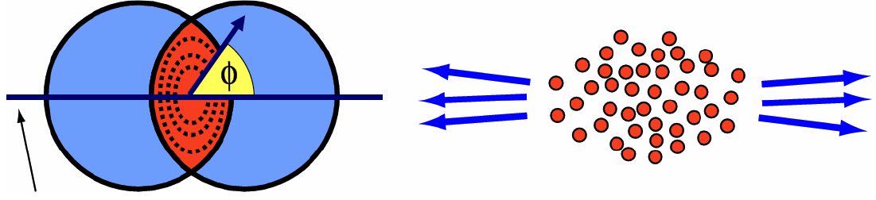
Fourier Expansion
space anisotropy
momentum anisotropy
reaction plane (RP)
Fourier expansion of the particle distribution with respect to the reaction plane (ϕ = ϕ_{particle} - ϕ_{RP})
v₁: Magnitude of directed flow (vanishes at mid-rapidity)
v₂: Magnitude of elliptic flow

Slide 16
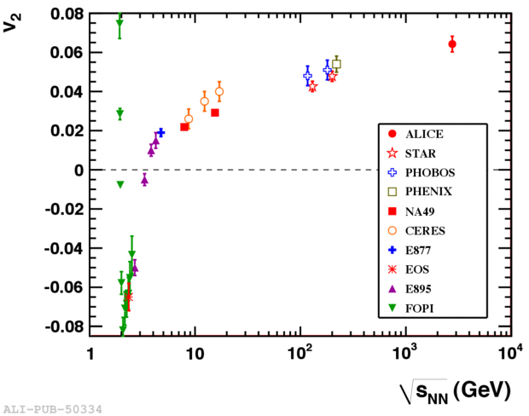
Integrated Elliptic Flow
Phys. Rev. Lett. 105, 252302 (2010)
Increasing elliptic flow from SPS via RHIC to LHC
Notes:
20-30% centrality bin

Slide 17
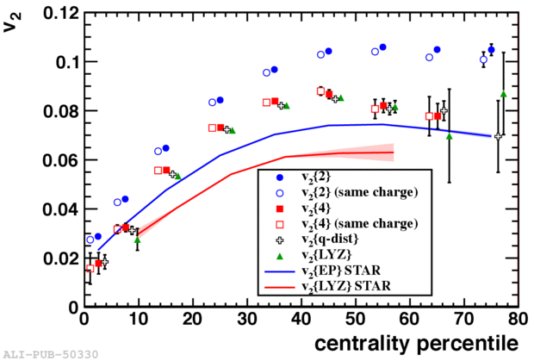
Centrality Dependence
Phys. Rev. Lett. 105, 252302 (2010)
Largest elliptic flow for (semi-)peripheral collisions
Central collisions have small initial anisotropy

Slide 18
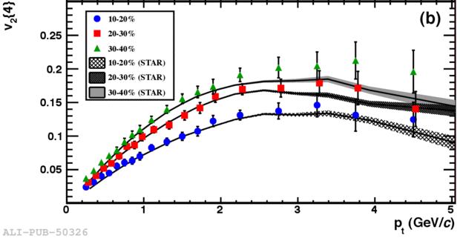
Elliptic Flow
Phys. Rev. Lett. 105, 252302 (2010)
v₂(p_{T}) similar at STAR / RHIC and ALICE / LHC

Slide 19
Identified Particle v2 at RHIC
v2(pT) driven by radial and elliptic flow
kinetic transverse energy KE_{T} = m_{T} –m removes mass bias
perfect constituent quark scaling (NCQ)

Slide 20
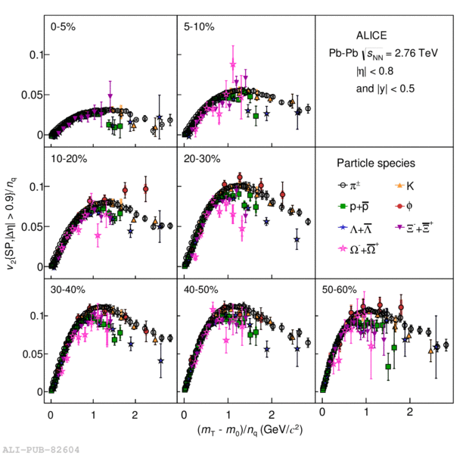
Identified particle v₂ at LHC
arXiv:1405.4632 [nucl-ex]
NCQ scaling only approximate at LHC
Concidence at RHIC?

Slide 21
Comparison with Hydro Models
arXiv:1405.4632 [nucl-ex]
VISHNU: hydro + hadronic cascade
good agreement for π, K, φ
disagreement for p, Λ, Ξ
Precision data and models needed!

Slide 22
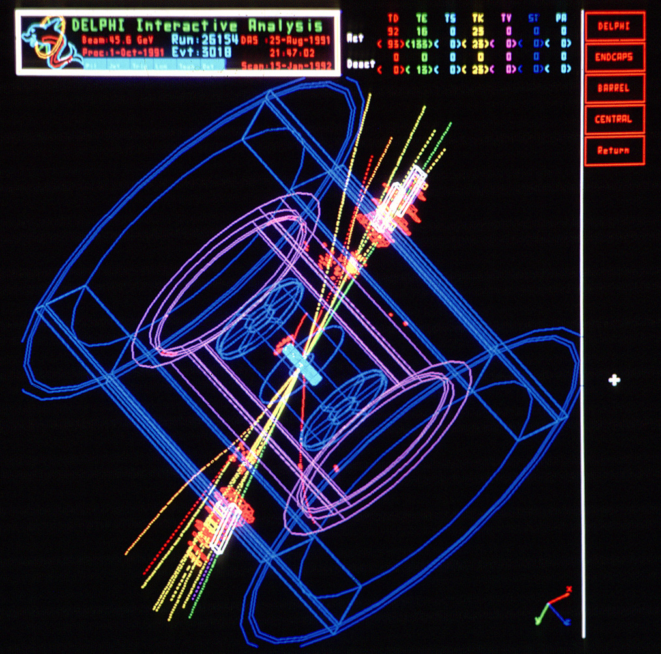
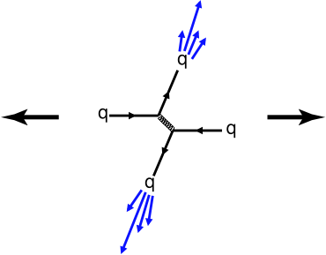
Hard Processes – Jets
Parton collisions (q-q, q-g, g-g)
small cross section for high momentum transfer →high p_{T} partons
Fragmentation
bunches of hadrons from
parton → jet of particles

Slide 23
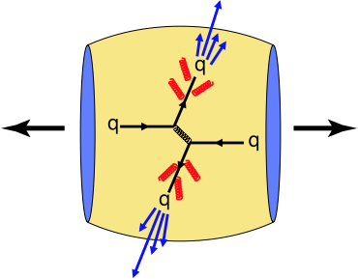
Jets Quenching
hard production process
  well understood in pQCD
propagation in medium
  gluon-Bremsstrahlung
  collisions with partons
  energy loss – „jet quenching“
jet modifications carry information about parton-medium interaction
→ probe of the medium

Slide 24
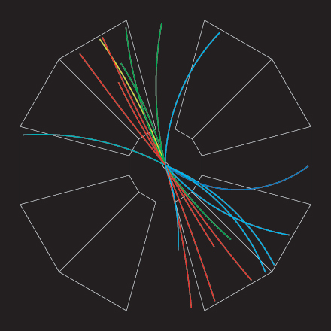
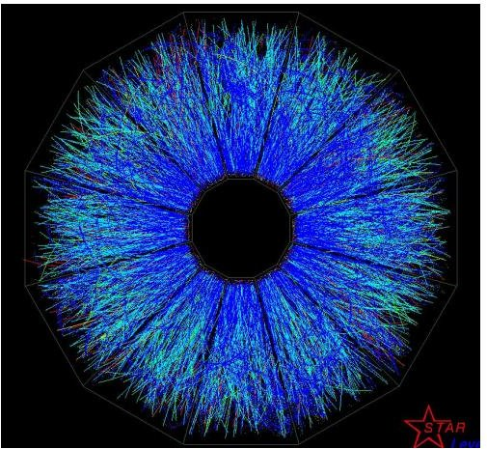
Jets in Heavy Ion Collisions

Slide 25
High p_{T} Hadron Suppression
Nuclear Modification Factor
  ratio of single particle production in AA and pp collisions
  normalized with N_{coll}: number of nucleon-nucleon collisions
pp × N_{coll}

Slide 26
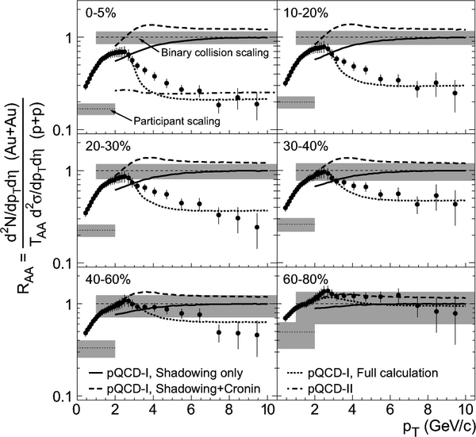
R_{AA} by STAR @ RHIC
no modification in peripheral collisions
strong suppression (factor 5) in central collisions
smooth transition from peripheral to central
consistent with parton energy loss

Slide 27
R_{AA} by CMS

Slide 28
Single Particle Spectra
Jet Quenching:
shift from high to low jet energies
fewer hard jet fragments
suppression of high-p_{T} single particle spectra
  strongest for central Pb-Pb
  absent in p-Pb
Phys Rev Lett 110, 082302

Slide 29
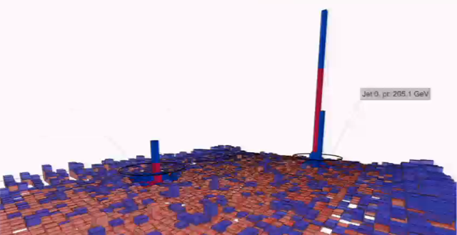
Asymmetric Di-Jets
di-jets in pp are created (almost) balanced
energy loss of one jet can lead to momentum imbalance
study via di-jet imbalace:

Slide 30
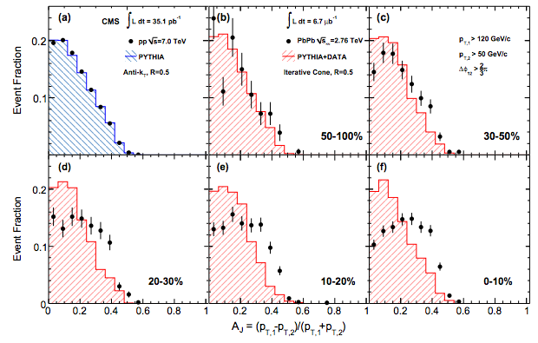
Di-Jet Imbalance
largest asymmetry in central AA
evidence for quenching of at least one jet

Slide 31
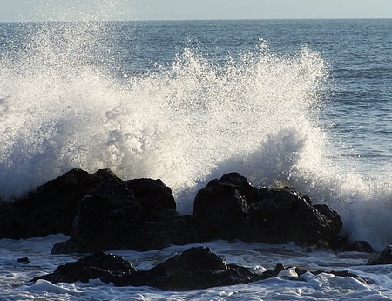
Heavy Quarks in the QGP
What is the mass dependence of jet quenching?
Do heavy quarks (c,b) flow with the QGP?

Slide 32
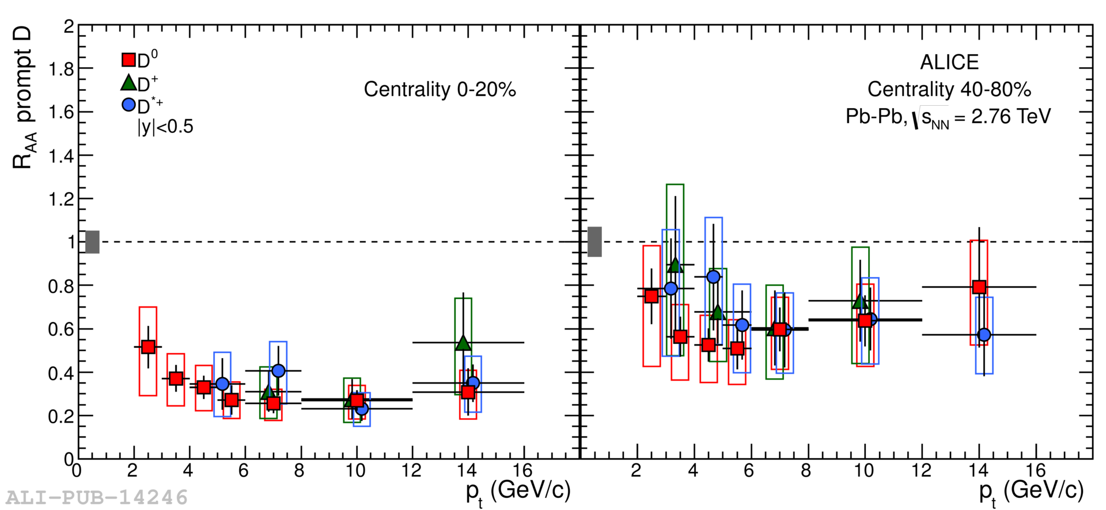
D-Meson Nuclear Modification Factor
D meson R_{AA} (0.3 for central collisions) slightly higher than for charged hadrons (0.15)
→ considerable energy loss

Slide 33
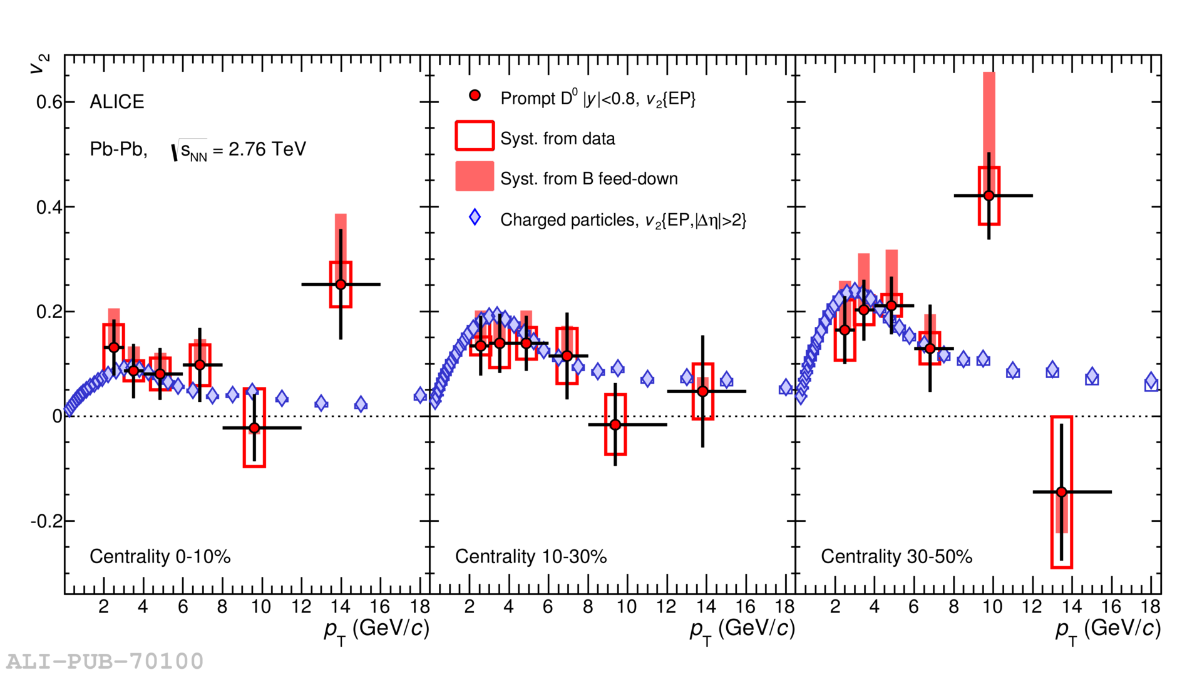
D-Meson Anisotropy
significant anisotropy!
→ heavy charm quarks participate in hydro expansion

Slide 34
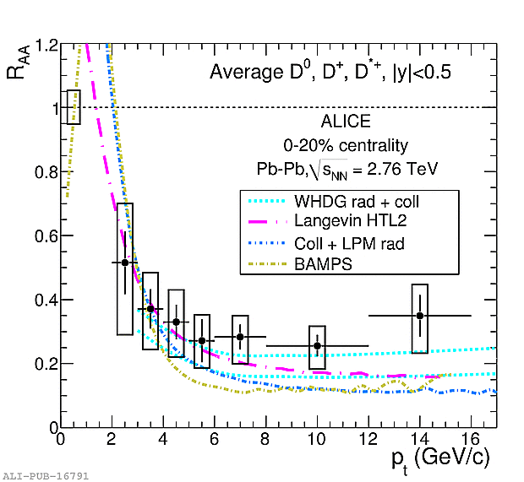
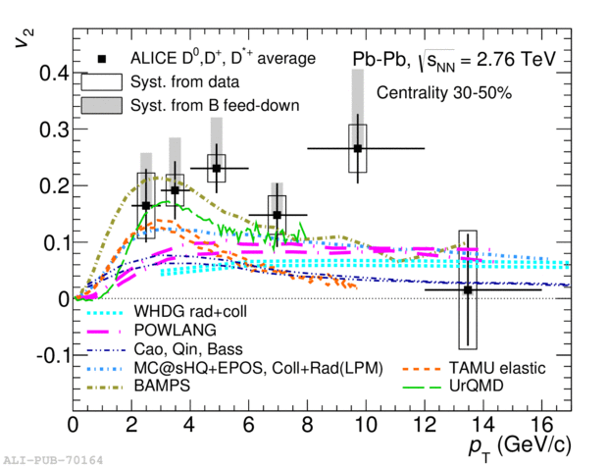
Model Comparison
Extensive model comparison
no simultaneous description of R_{AA} and v₂
theoretical and experimental improvements necessary!

Slide 35
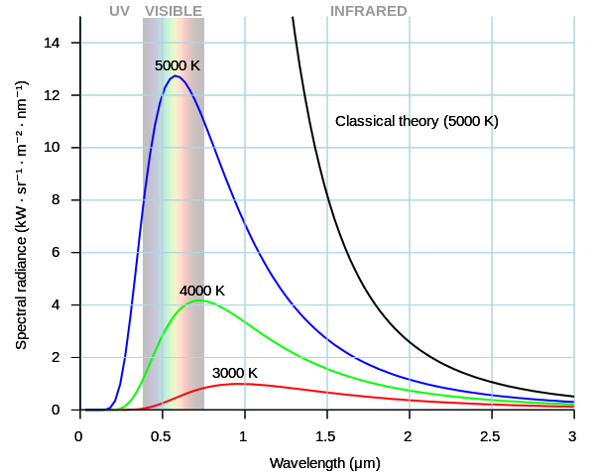
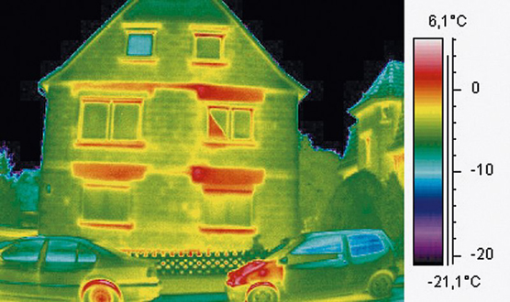
Thermal Photons
Planck’s law and approximation for high photon energies
measure temperature via thermal photons
in analogy to IR thermometer and thermal imaging
complicated by expansion of source

Slide 36
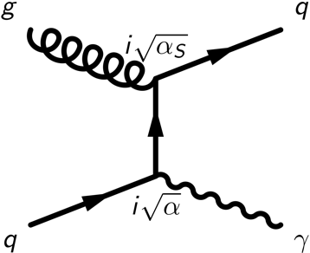
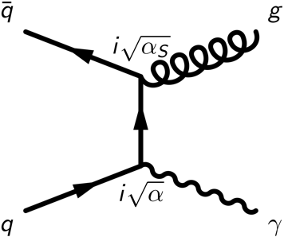
Photons from Hard Processes
creation in hard initial scatterings: same for pp, pA, AA
photons escape QGP without interaction
ideal reference for hard processes: comparison of jets and photons

Slide 37
Background: Meson Decays
0-20%
π⁰
η
Good invariant mass resolution
even in Pb-Pb collisions
40-60%

Slide 38
Isolated Photon R_{AA} by CMS
unmodified photon production at high p_{T}
prompt photons
hadron suppression is final state effect → energy loss

Slide 39
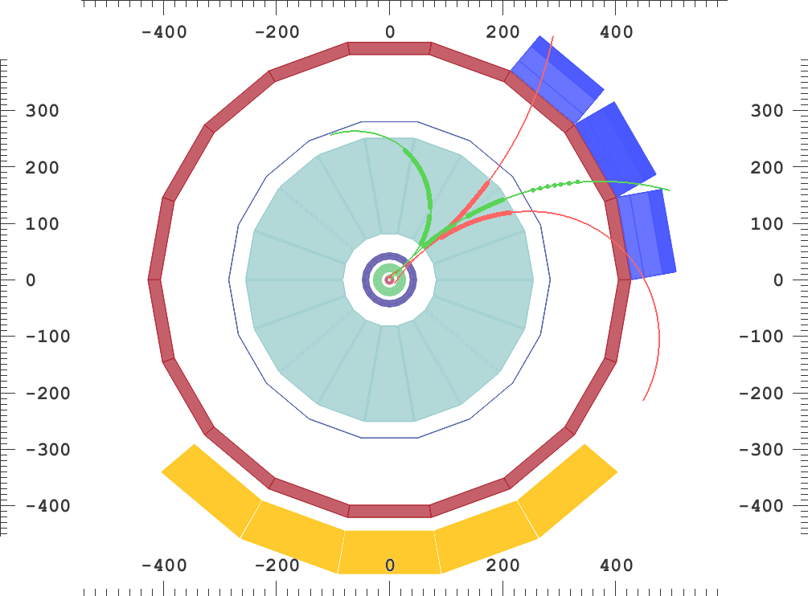
Photons at low p_{T}: Conversions
Photon conversions
γ → e⁺e⁻
in detector material
low conversion probability≈8.5%
π⁰,η reconstruction
with 2 conversions
low efficiency
good momentum resolution at
low p_{T}

Slide 40
Direct Photon Measurement
Inclusive photons
  N_{incl} = N_{direct} + N_{decay}
Need to separate signal from background
  decay photons: π⁰,η → γγ
Statistical separation
  N_{direct} = N_{incl} – N_{decay}
problem:
  small signal
  large uncertainties
trick
  measurement via N_{incl} / N_{decay}
  cancellation of uncertainties

Slide 41
Direct Photon Spectra
high p_{T}: prompt (NLO) photons
low p_{T}: direct photon excess, exponential slope
slope parameter: 221 ± 28 MeV (PHENIX), 304 ± 51 MeV (ALICE
thermal photons?

Slide 42
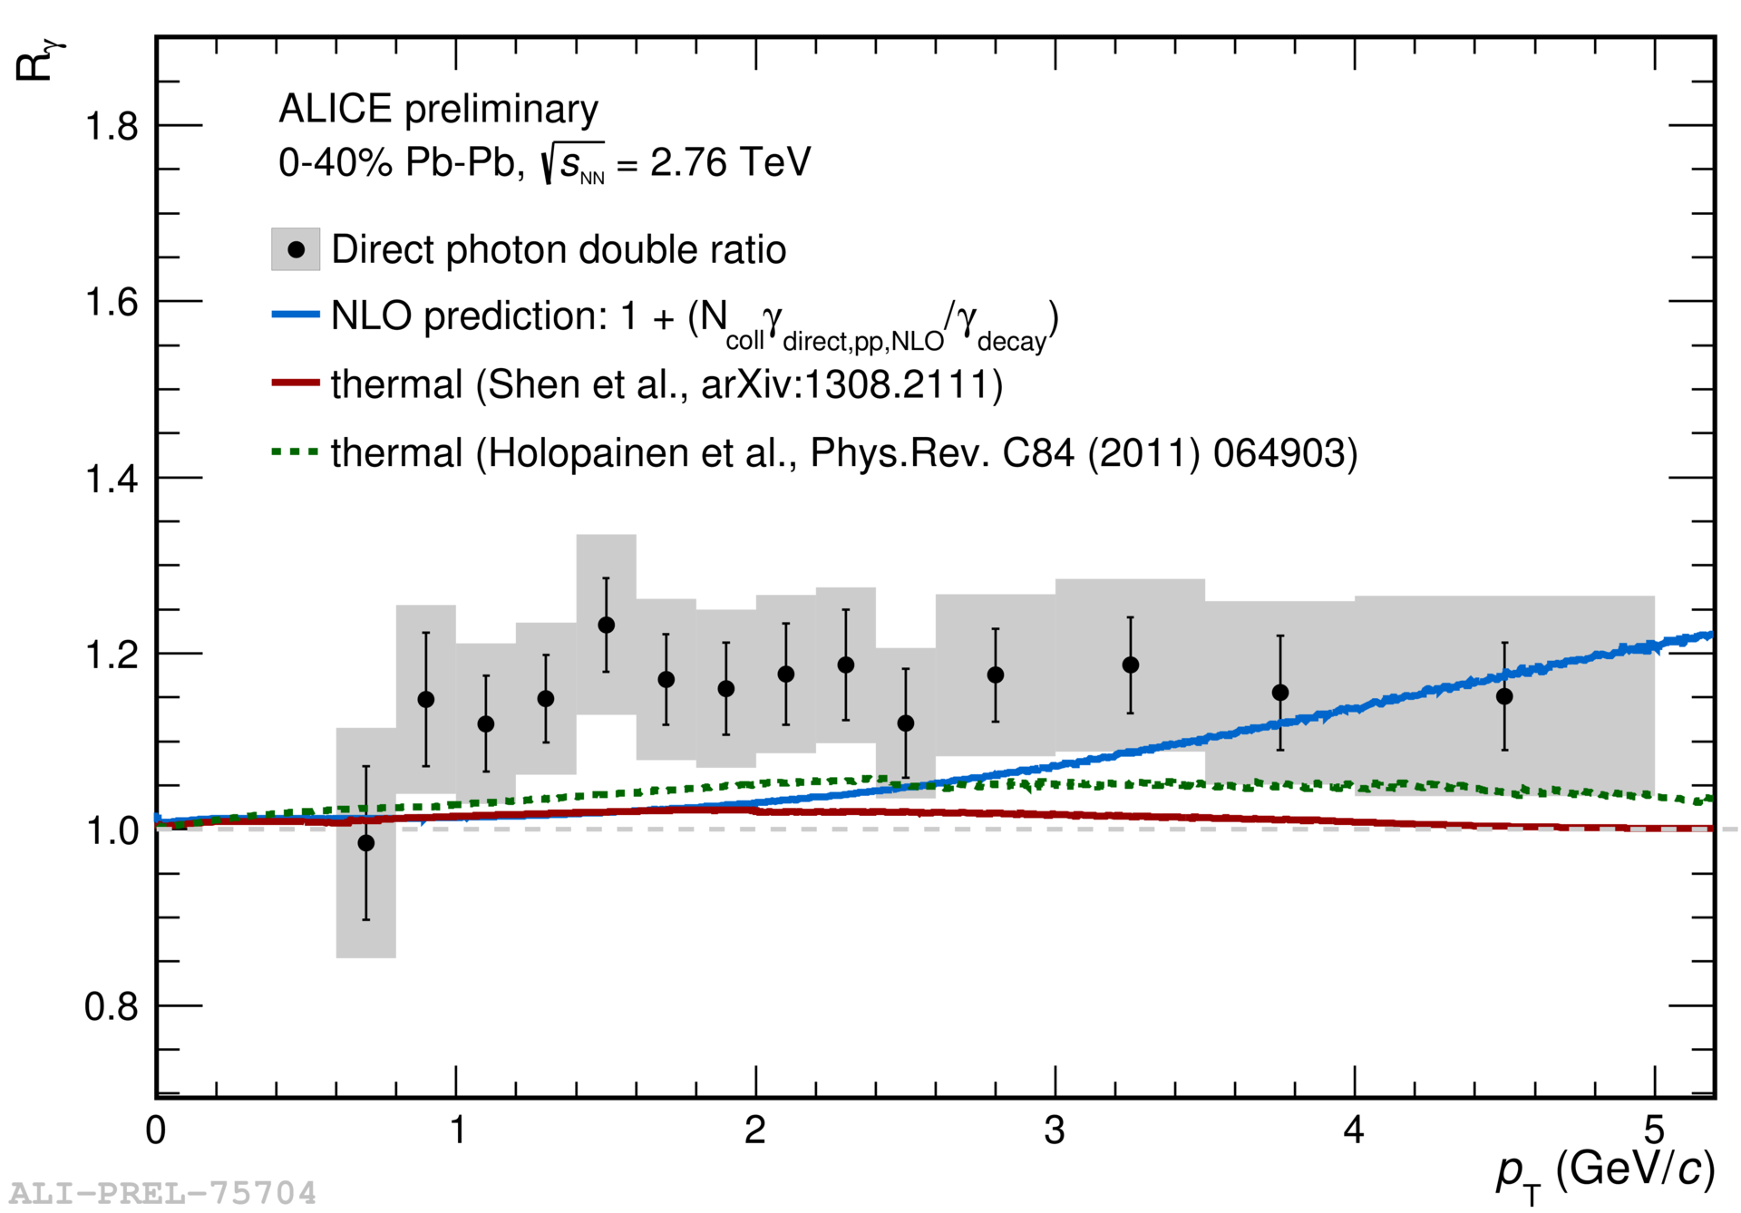
Comparison with Theory
disagreement between theory and experiment

Slide 43
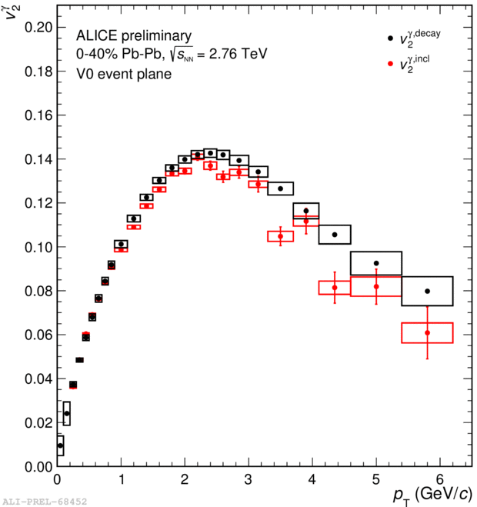
Photon v₂
Flow depends on photon source:
thermal: emitted by flowing medium
prompt: isotropic
decay photons: follows from pion flow
What do we expect?
early emission
→ high temperature
→ small anisotropy
late emission
→ low temperature
→ large anisotropy

Slide 44
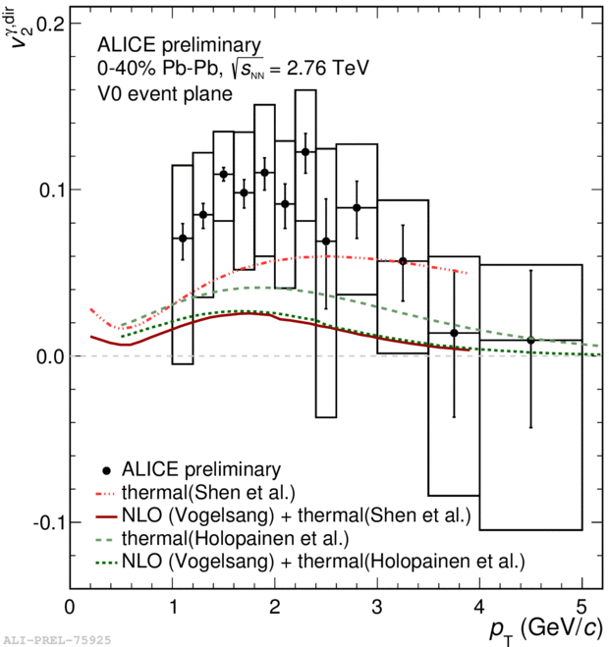
Direct Photon Anisotropy
^{PRL 109, 122302 (2012)}
Large flow signal, not reproduced by models
Do we understand photon production?

Slide 45
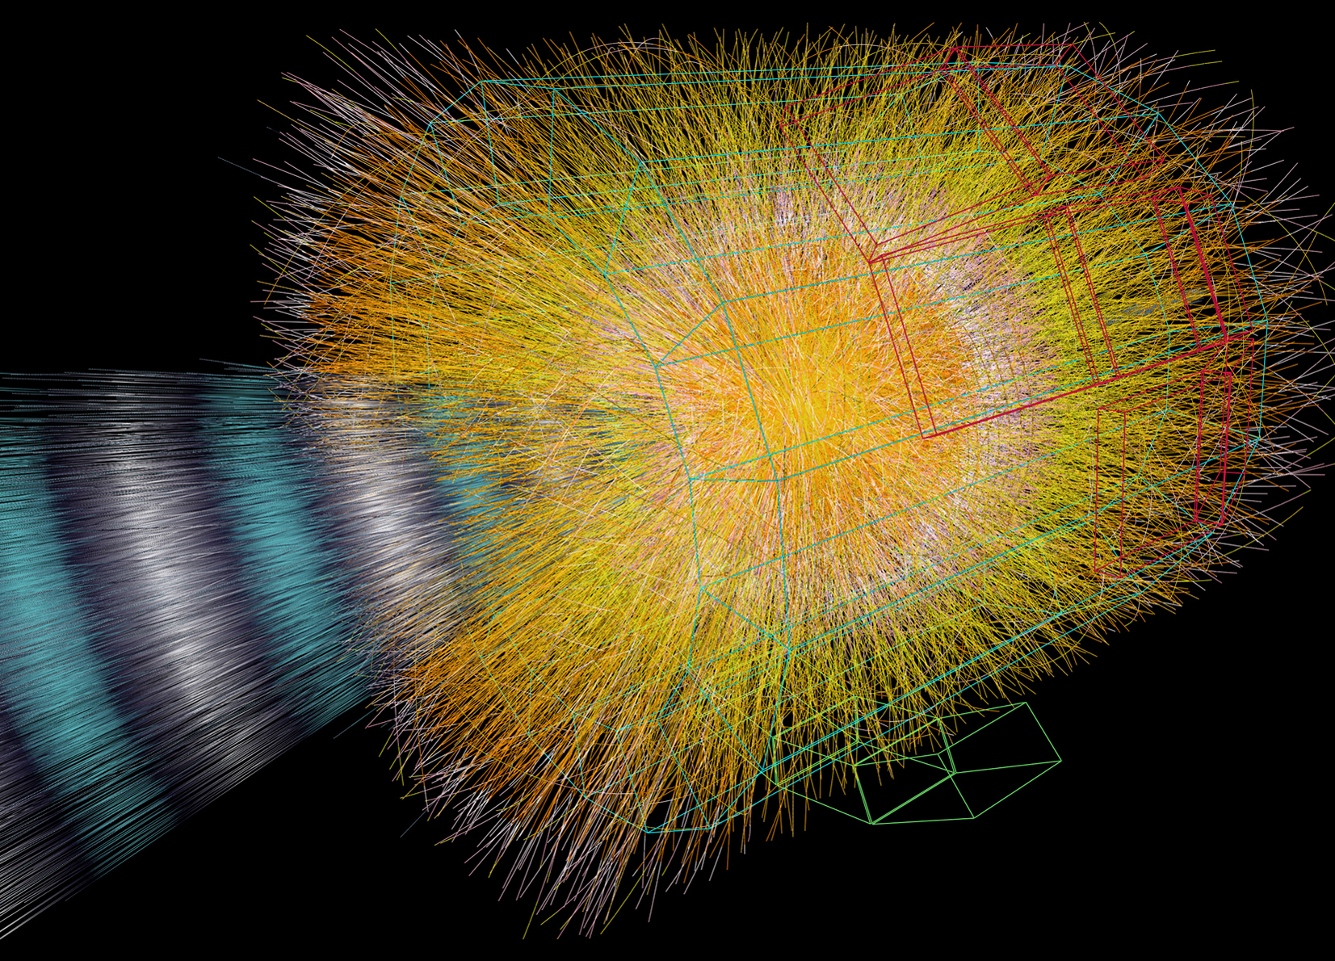
Summary & Outlook
Quark-Gluon Plasma established
flow, jet-quenching…
Precision measurements are coming
heavy quarks, photons…

