Slide 1
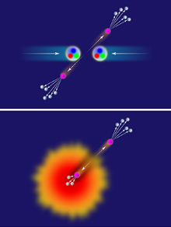
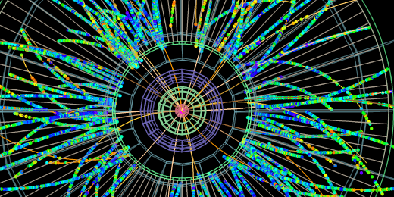
Short Path Length Energy Loss in the QGP from pQCD
Isobel Kolbé
University of Cape Town

Slide 2
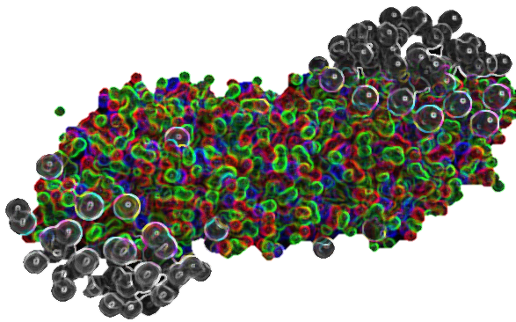
Outline
Why Heavy Ions
What has been done?
What needs to be done and why?
How will we do it?

Slide 3
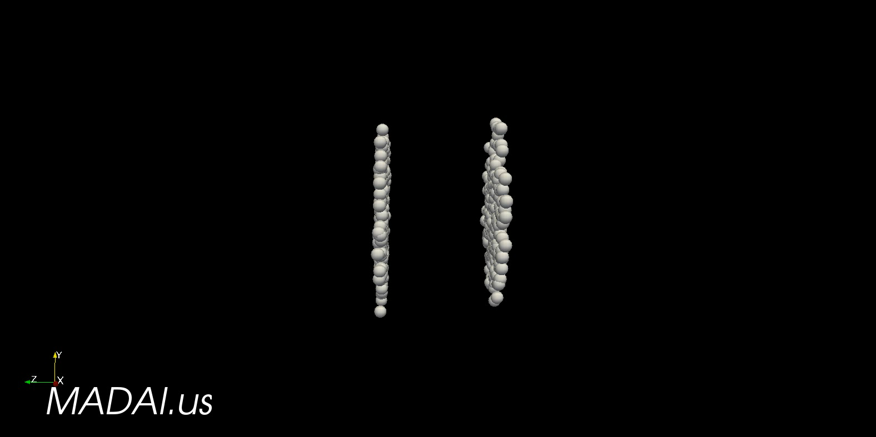
Why
pp
What are we doing?
Why heavy ions?
Why hard probes?
  Self generated probes
  Sensative to all time scales
Will loose energy in the medium
pA
AA

Slide 4
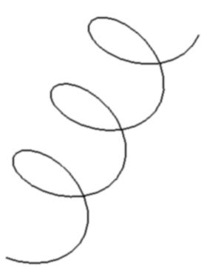
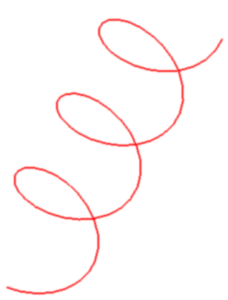
The current state of affairs

Slide 5
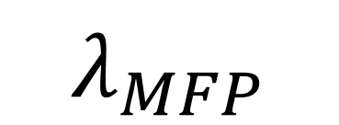
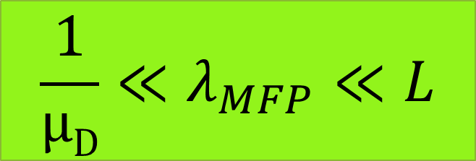
$$\frac{1}{μD}≪λ_{MFP}≪L$$
1
L
μ_{D}
$$λ_{MFP}$$

Slide 6
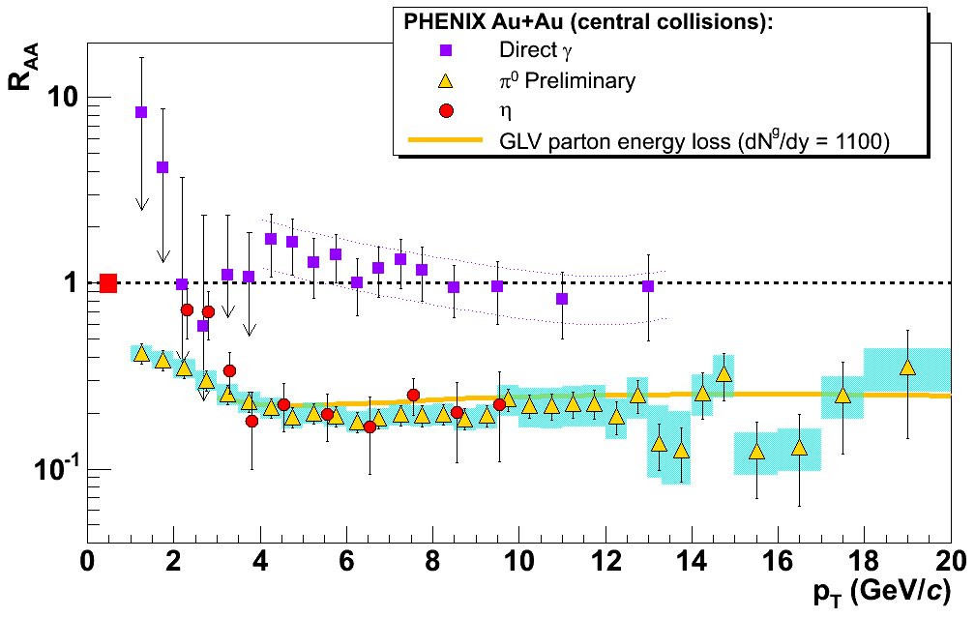

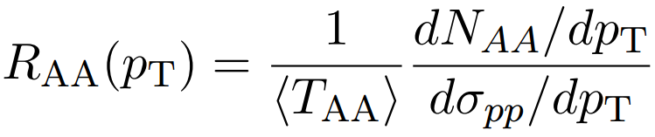
# in AA
pp in AA
# in pp
Observed
Expected

Slide 7
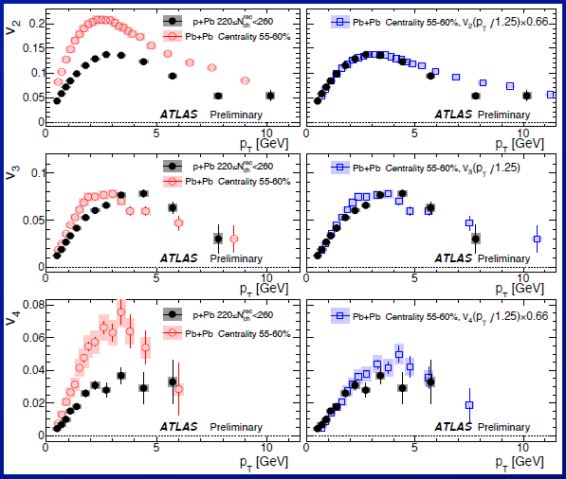
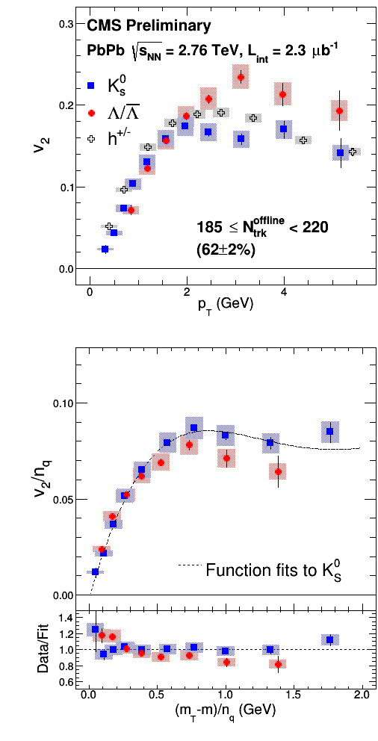
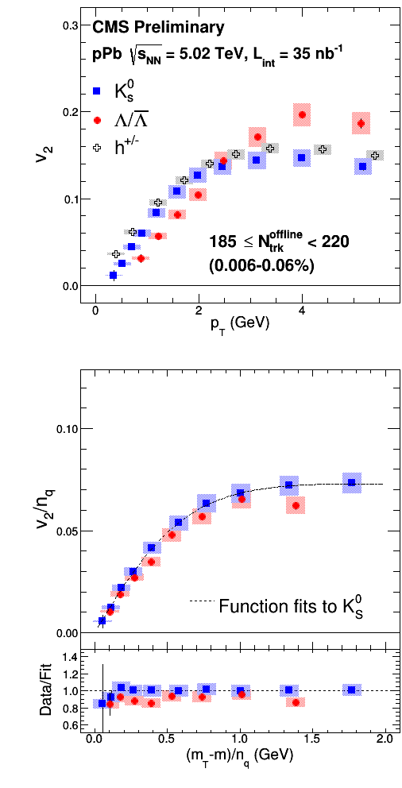
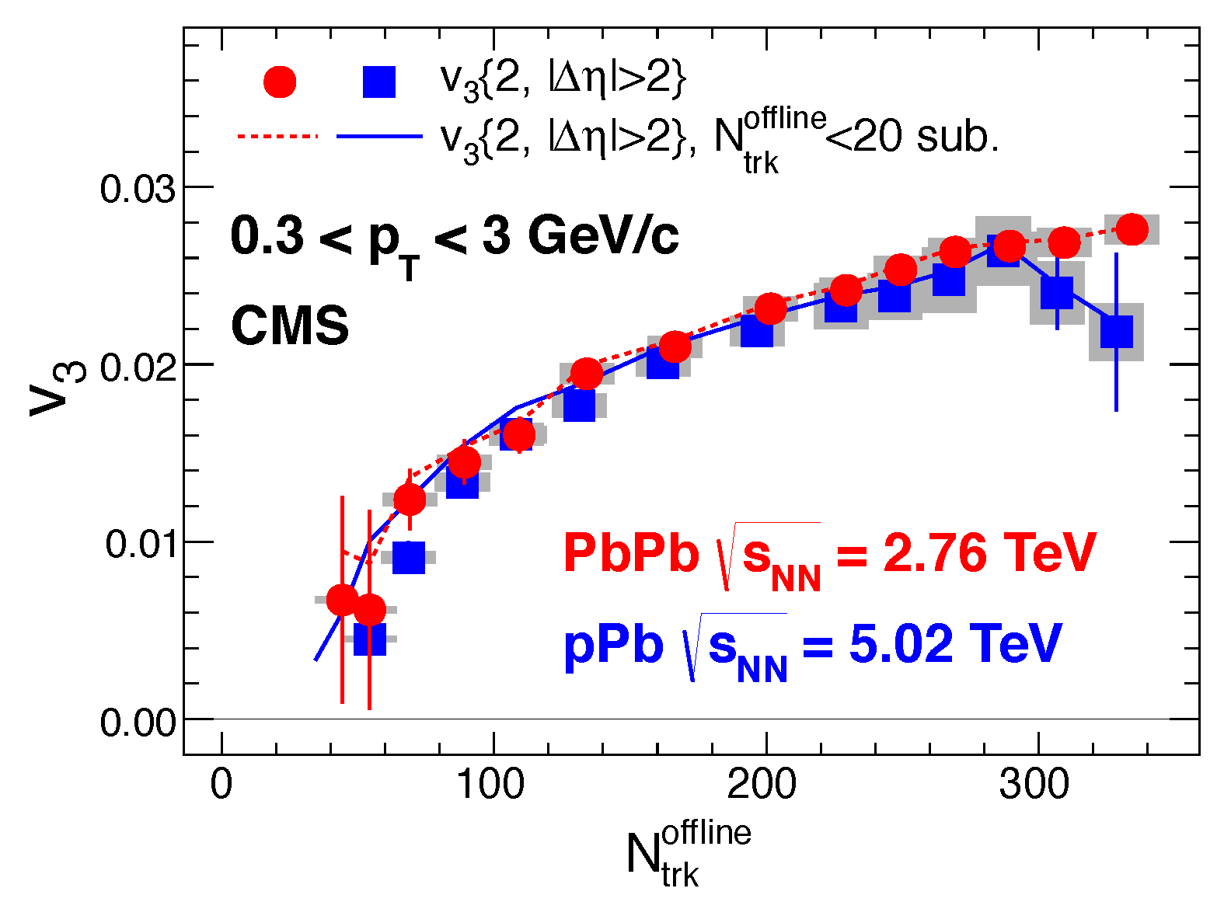
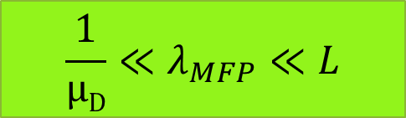


What needs to be done and why?
Recent evidence for QGP in p-A
But the system is small – original assumptions don’t hold
Relax length scale.
?
$$\frac{1}{μD}≪λ_{MFP}≪L$$
$$Eliptic Flow$$
PbPb pPb
$$Triangular Flow$$
(event multiplicity)

Slide 8
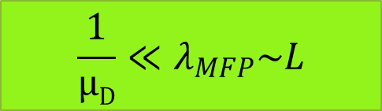

$$\frac{1}{μD}≪λ_{MFP}≪L$$
$$\frac{1}{μD}≪λ_{MFP}\sim L$$
1
L
L
μ_{D}
$$λ_{MFP}$$

Slide 9
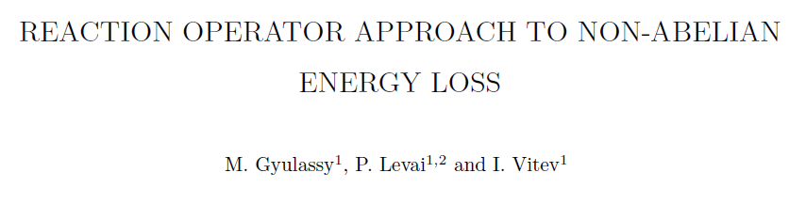
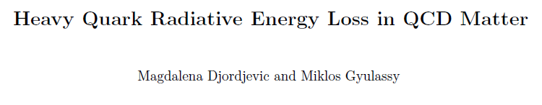
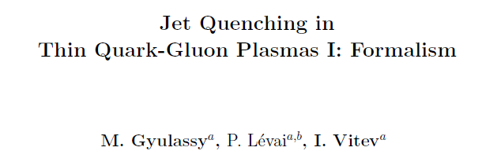
How will we do it?

Slide 10
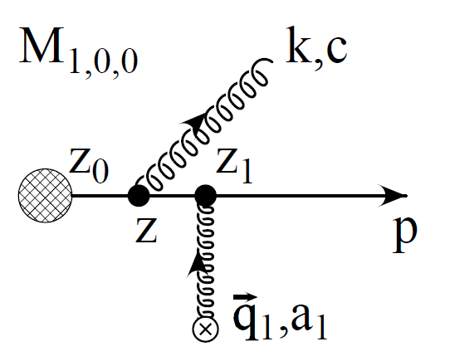
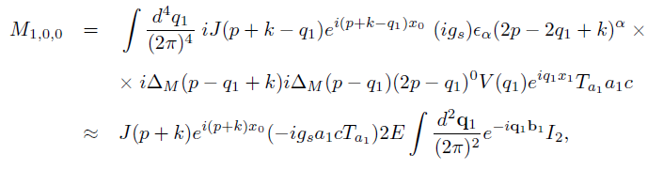
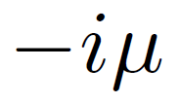


Slide 11
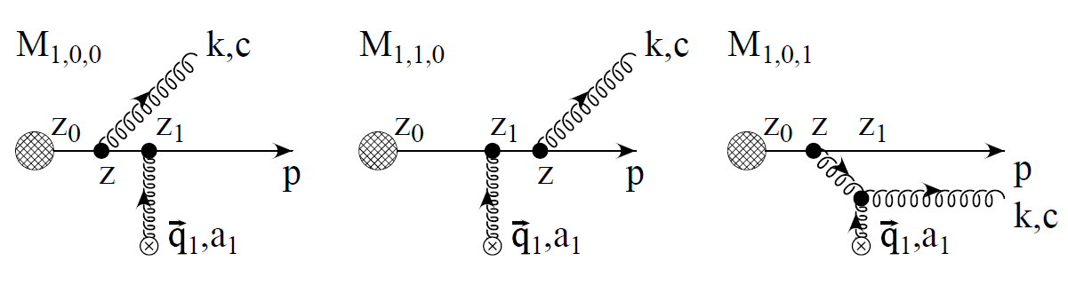
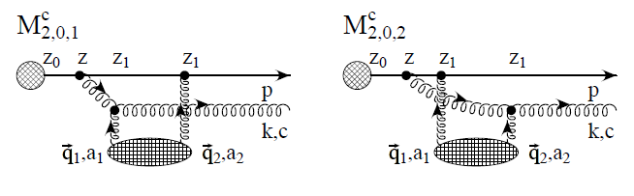
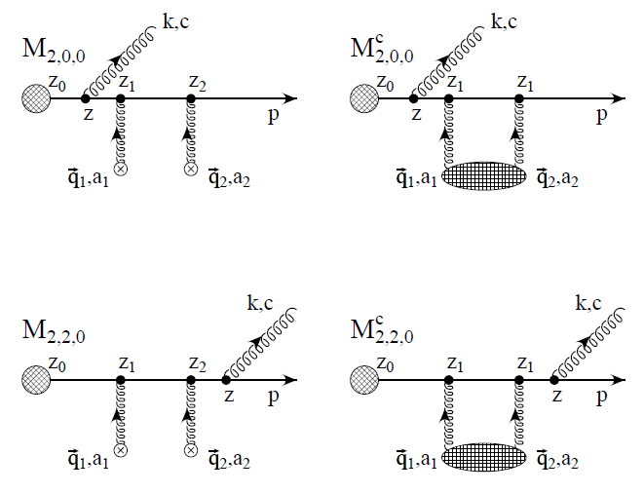
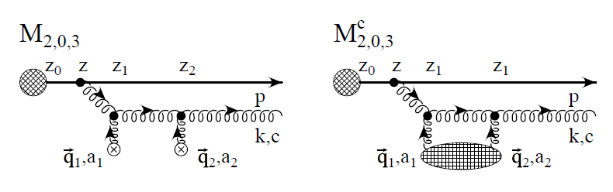
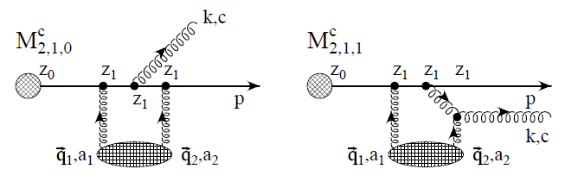

Slide 12
So, off to work!

