Slide 1
Measurement of The Higgs Boson Transverse Momentum and Its Sensitivity to Beyond Standard Model Physics
David Gossman
Supervised by Prof. B. Mellado
10 February 2015
Notes:
Cover

Slide 2
Introduction
  Theory
Problem and Reason for Study
What was done
Results
Conclusions

Slide 3
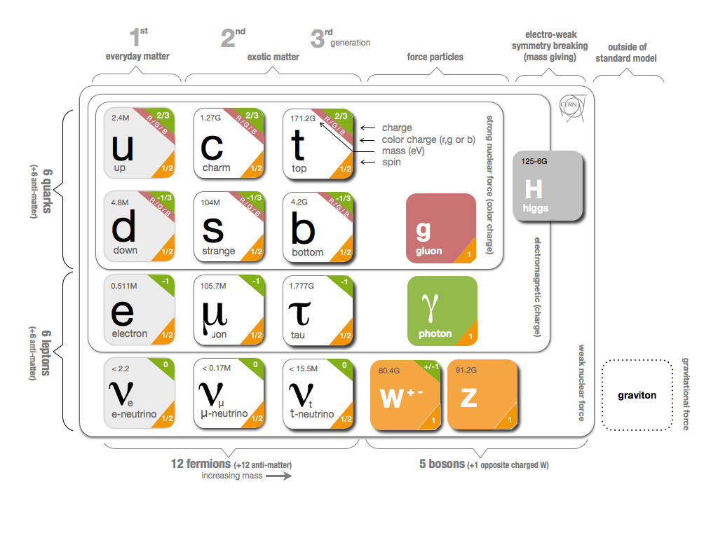
Theory: Standard Model
12 Fermions
  Matter particles
  Spin 1/2
  6 quarks and 6 leptons
  3 Generations
4 Gauge Bosons
  Force carriers
  Spin 1
  Photon – EM
  W±, Z – Weak
  Gluon – Strong
1 Scalar Boson
  Higgs
  Gives mass

Slide 4
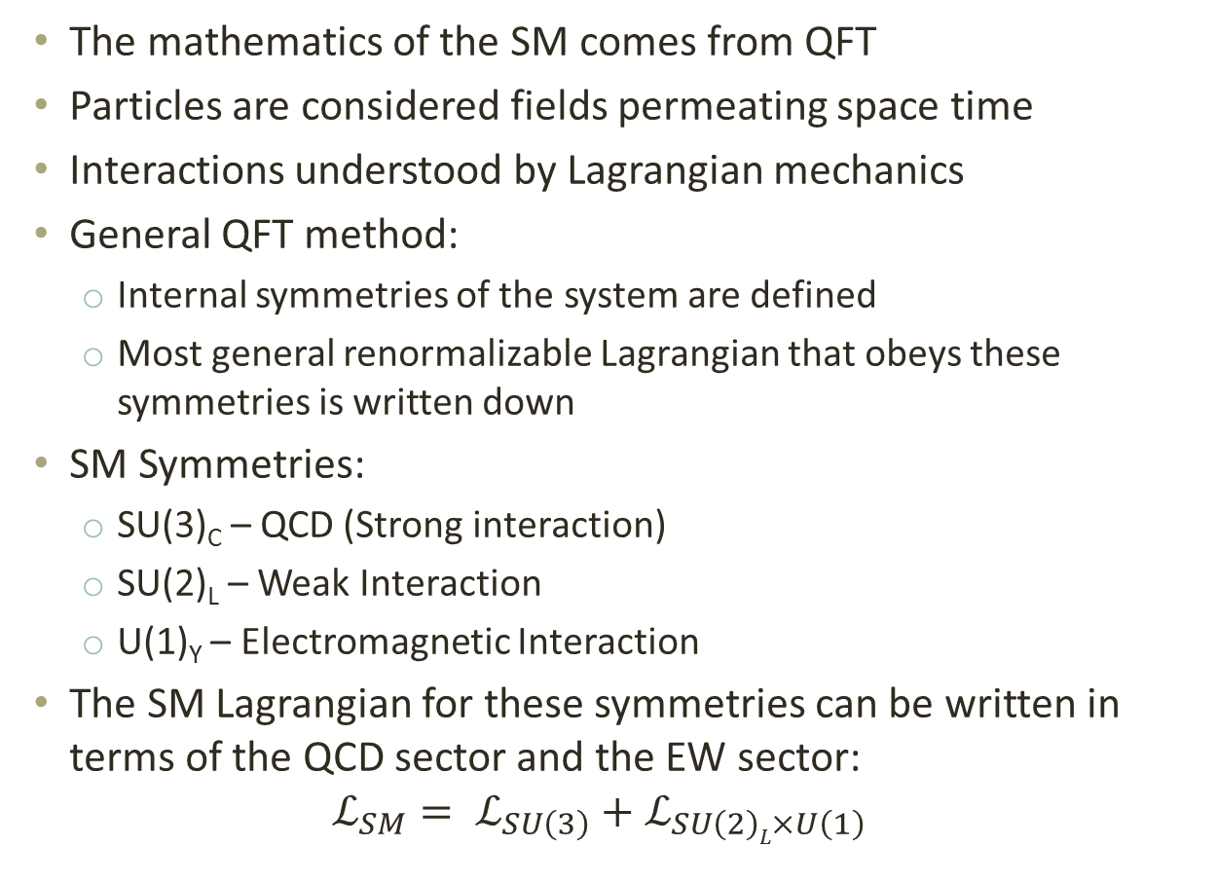
Theory: Standard Model
The mathematics of the SM comes from QFT
Particles are considered fields permeating space time
Interactions understood by Lagrangian mechanics
General QFT method:
  Internal symmetries of the system are defined
  Most general renormalizable Lagrangian that obeys these symmetries is written down
SM Symmetries:
  SU(3)_{C} – QCD (Strong interaction)
  SU(2)_{L} – Weak Interaction
  U(1)_{Y} – Electromagnetic Interaction
The SM Lagrangian for these symmetries can be written in terms of the QCD sector and the EW sector:
$$ℒ_{SM}= ℒ_{SU\left(3\right)}+ℒ_{SU\left(2\right)L×U\left(1\right)}$$
Electroweak interaction
Notes:
Particles are considered fields that permeate space-time and the interactions between the fields are understood by Lagrangian mechanics. In QFT the internal symmetries of the system are usually defined, and then the most general renormalizable Lagrangian that obeys these symmetries can be defined. In SM there are three fundamental interactions; the strong, the weak and the electromagnetic. The electromagnetic and weak interactions can however be combined into one interaction called the electroweak interaction. The gauge symmetry of SM is SU(3)×SU(2)×U(1) where each of the factors are said to give rise to the three interactions. [5] SU(3) for Quantum Chromo Dynamics (QCD), the strong interaction, SU(2) for the weak interaction and U(1) for the electromagnetic interaction.
In gauge theory the redundant degrees of freedom in the Lagrangian are referred to as gauges. We then have a symmetry group (such as SU(3) in QCD) that defines the transformations between these gauges. Associated with the symmetry group are group generators for which there necessarily arises vector fields or gauge fields for each, which must be added to the Lagrangian in order to ensure its gauge invariance. The quantization of these vector fields result in what are gauge bosons. For example SU(3) has 8 group generators which result in the 8 gluons in QCD. Now a form of the SM Lagrangian which obeys SU(3)XSU(2)XU(1) gauge invariance can be written down in which all the particles have no mass which is a problem because there is a vast amount of experimental data saying fermions and W and Z bosons have mass and furthermore if we simply give these particles mass the gauge invariance of SU(2)XU(1) is violated.

Slide 5
Theory: Gauge Theory
Redundant degrees of freedom in the Lagrangian: Gauges
Symmetry group that defines the transformations between these Gauges (SU(3)_{C} for QCD)
Group generators of Symmetry groups give rise to vector fields
Vector fields added to Lagrangian, ensure invariance under transformations: gauge invariance.
The quantization of these vector fields are then gauge bosons.
For example SU(3)_{C} has 8 group generators giving the 8 gluons in QCD
Now the most general renormalizable SM Lagrangian that obeys SU(3)_{C}XSU(2)_{L}XU(1)_{Y} gauge invariance predicts all the particles to be massless.
Simply adding mass violates SU(2)_{L}XU(1)_{Y} gauge invariance.
Notes:
In gauge theory the redundant degrees of freedom in the Lagrangian are referred to as gauges. We then have a symmetry group (such as SU(3) in QCD) that defines the transformations between these gauges. Associated with the symmetry group are group generators for which there necessarily arises vector fields or gauge fields for each, which must be added to the Lagrangian in order to ensure its gauge invariance. The quantization of these vector fields result in what are gauge bosons. For example SU(3) has 8 group generators which result in the 8 gluons in QCD. Now a form of the SM Lagrangian which obeys SU(3)XSU(2)XU(1) gauge invariance can be written down in which all the particles have no mass which is a problem because there is a vast amount of experimental data saying fermions and W and Z bosons have mass and furthermore if we simply give these particles mass the gauge invariance of SU(2)XU(1) is violated.

Slide 6
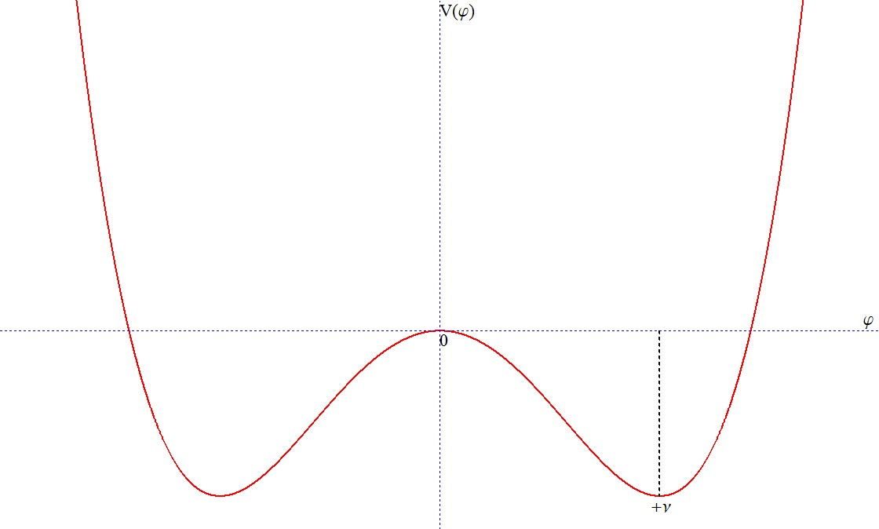

Theory: Spontaneous EW Symmetry Breaking
$V\left(φ\right)=\frac{1}{2}μ^{2}φ^{2}+\frac{1}{4}λφ^{4}$
$ℒ_{φ}={\left(D^{μ}φ\right)}^{†}{(D}_{μ}φ)−V\left(φ\right)={\left(D^{μ}φ\right)}^{†}{(D}_{μ}φ)−\frac{1}{2}μ^{2}φ^{2}−\frac{1}{4}λφ^{4}$
By requiring λ > 0 and $μ^{2}<0$, $V\left(φ\right)$
2 minima at $φ=±ν=±\sqrt{−{μ^{2}}/λ}$
in order to give the W± and Z bosons mass while leaving the photon massless the scalar field $φ$ is defined as a complex doublet:
$$φ=\left(\begin{matrix}φ^{+} \\ φ^{−}\end{matrix}\right)=\frac{1}{\sqrt{2}}\left(\begin{matrix}φ_{1}−iφ_{2} \\ φ_{3}−iφ_{4}\end{matrix}\right)$$
Choose $φ_{1}=φ_{2}=φ_{4}=0$ and $φ_{3}=\frac{1}{\sqrt{2}}{\left(−\frac{μ^{2}}{λ}\right)}^{\frac{1}{2}}=\frac{1}{\sqrt{2}}\left(\begin{matrix}0 \\ ν+h\end{matrix}\right)$
Notes:
So as a solution we add a scalar potential to the electroweak term of the legrangian that is a function of a scalar field. Which in essence is symmetric but causes a spontaneous symmetry breaking (the same sort of thing is seen in condensed matter physics). Roughly speaking the coupling to this scalar field gives the weak bosons and fermions their masses. This is referred to as the Higgs mechanism and the quantization of this scalar field is the predicted Higgs boson.

Slide 7
Beyond the Standard Model (BSM)
Deficiencies in the Standard Model:
Inconsistent with general relativity
Matter–antimatter asymmetry
Neutrino oscillation
Dark matter and dark energy
Etc.…
BSM Examples:
Supersymmetry
Minimal Supersymmetric Standard Model (MSSM)
Next-to-Minimal Supersymmetric Standard Model (NMSSM)
String theory
M-theory
Etc.…
Notes:
Neutrino oscillation: Neutrinos starting in a particular lepton flavour can later be measured in another flavour. Indicates non zero mass\
Strong CP problem: there is no known reason for CP symmetry to be conserved in QCD but no evidence that it is not.
Since these theories reproduce current phenomena, the question of which theory is the right one, or at least the "best step" forward can only be settled via experiments, and is one of the most active areas of research in both theoretical and experimental physics at the moment.

Slide 8
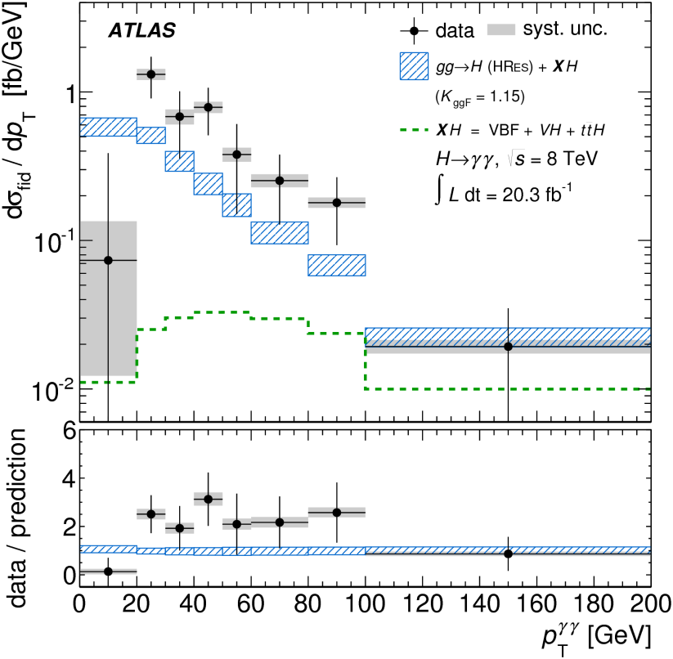
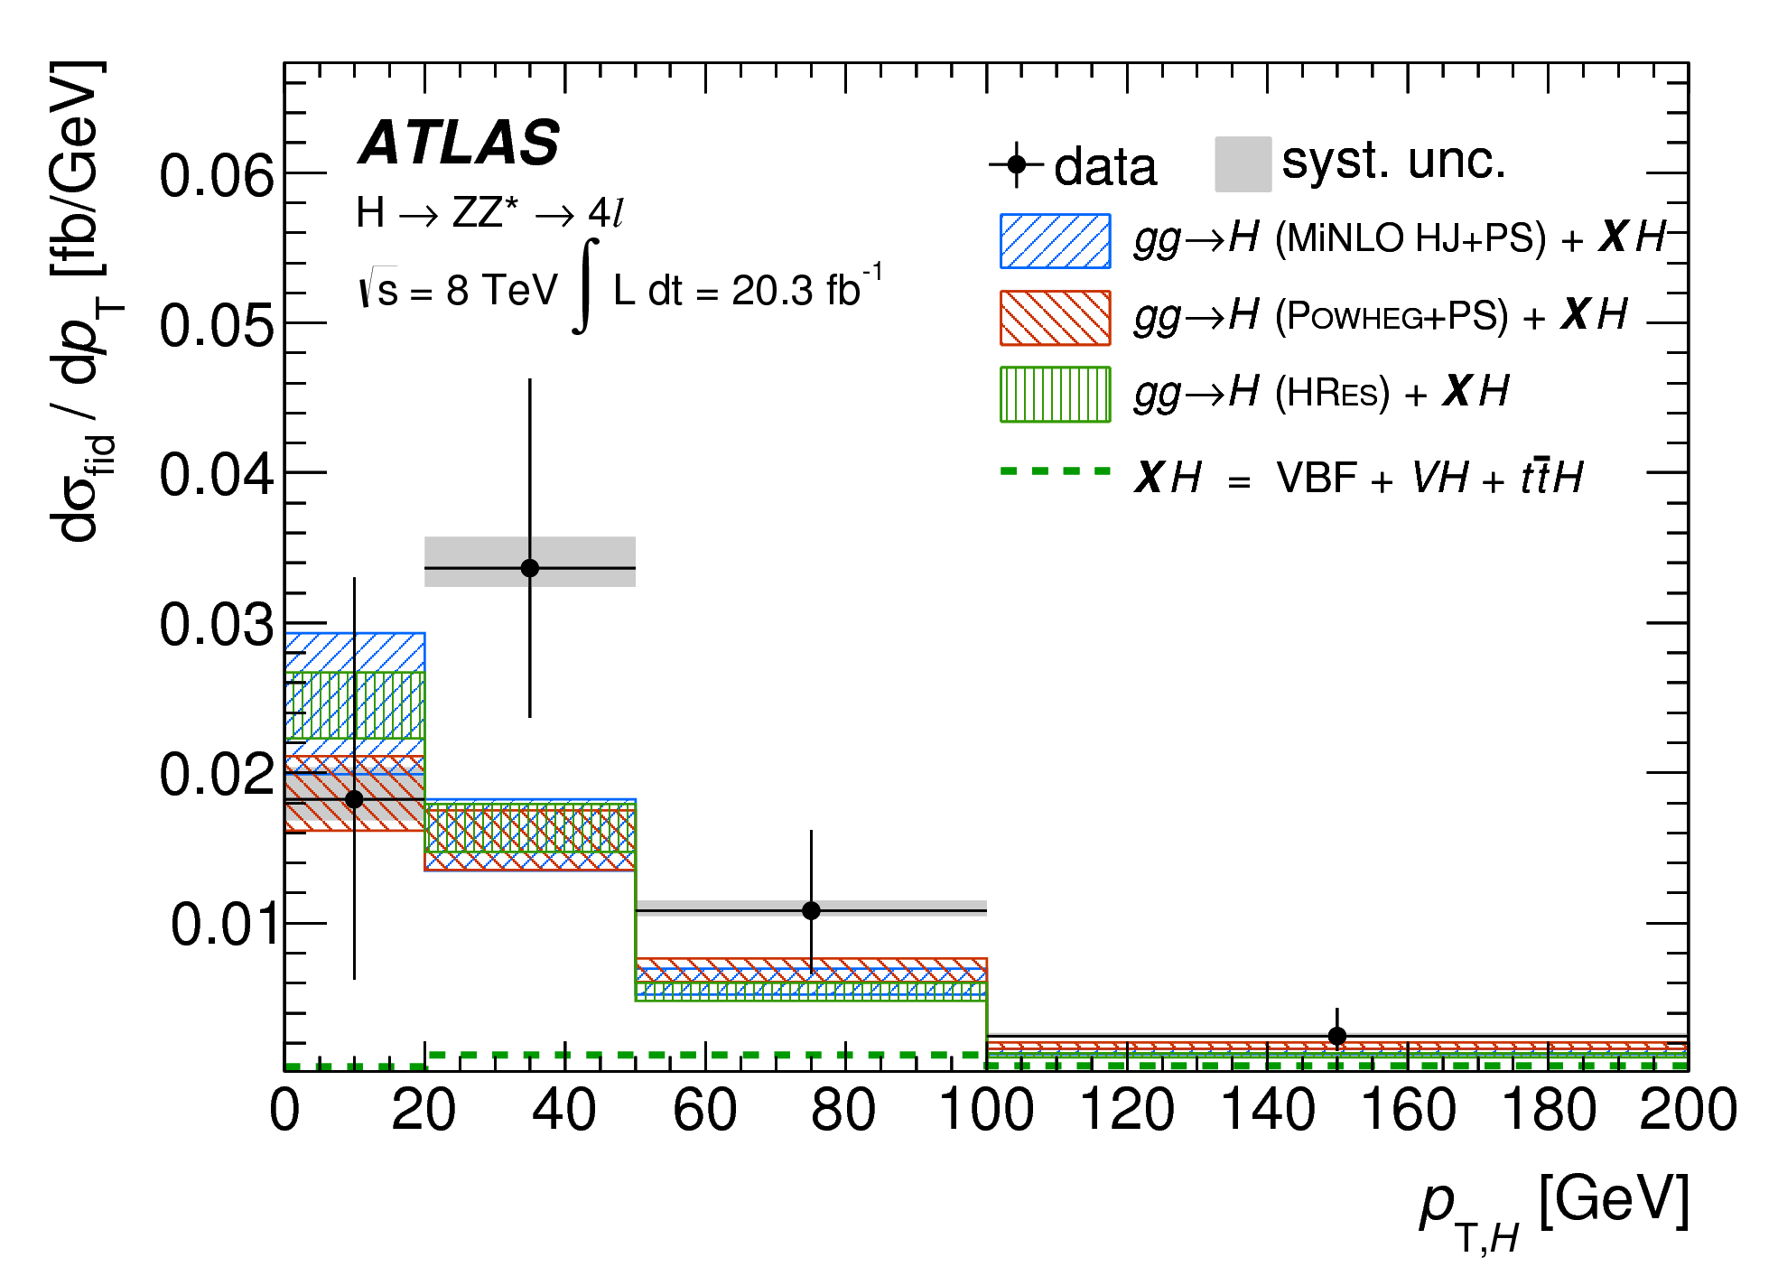
Problem: ATLAS Data
Notes:
The reason why I did what I did is because the data collected at ATLAS as well as at CMS for Pt of Higgs production show a structure that does not correlate with theory around 40 to 100 GeV. One can see the data has got higher cross-sections than predicted over this range. This discrepancy could be the result of a statistical fluctuation (i.e. we got lucky) and it doesn’t truly represent what happens, an error in the model (i.e. QCD is not properly understood for this process) or it could indicate new physics. The reason we don’t believe the descrepancy is due to a statistical fluctuation is that the same structure was observed at both ATLAS and CMS.

Slide 9
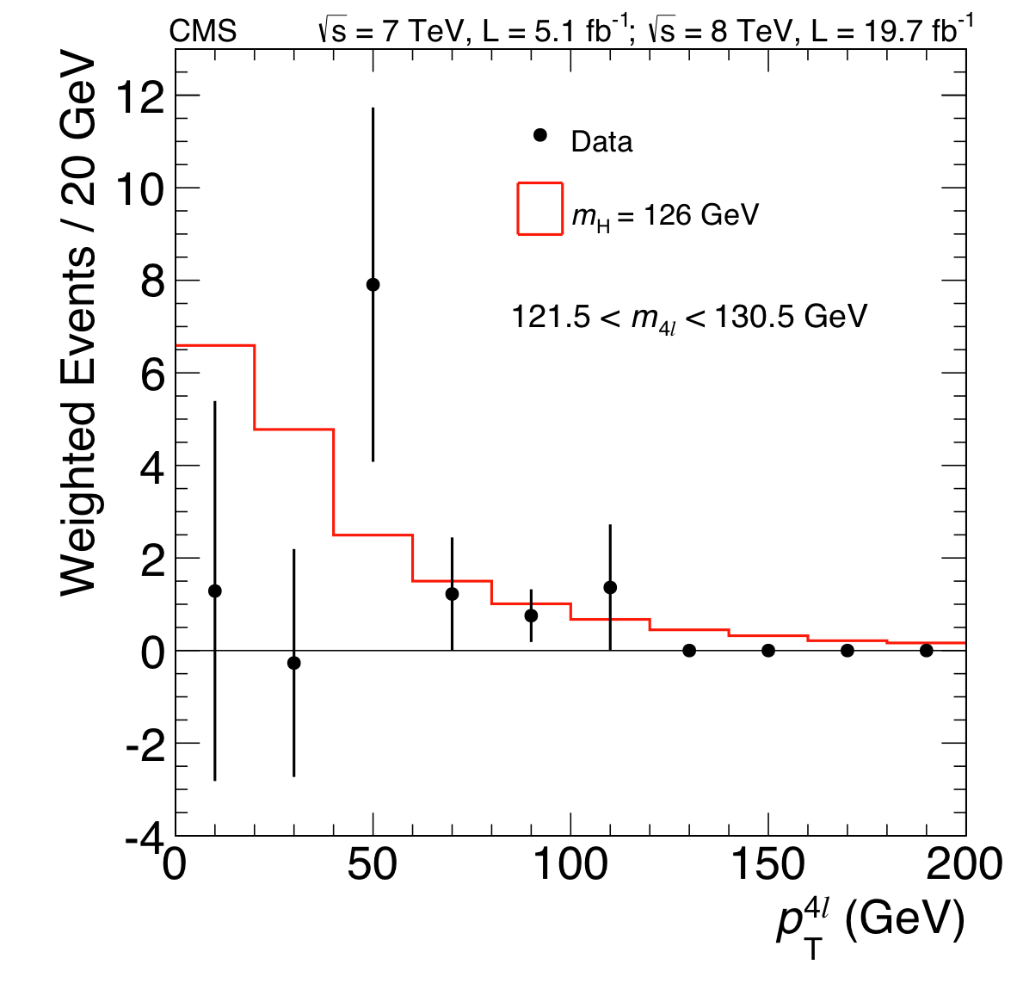
Problem: CMS Data
Notes:
And since the two detectors use different physical mechanisms to detect partials, the same statistical error is unlikely.

Slide 10
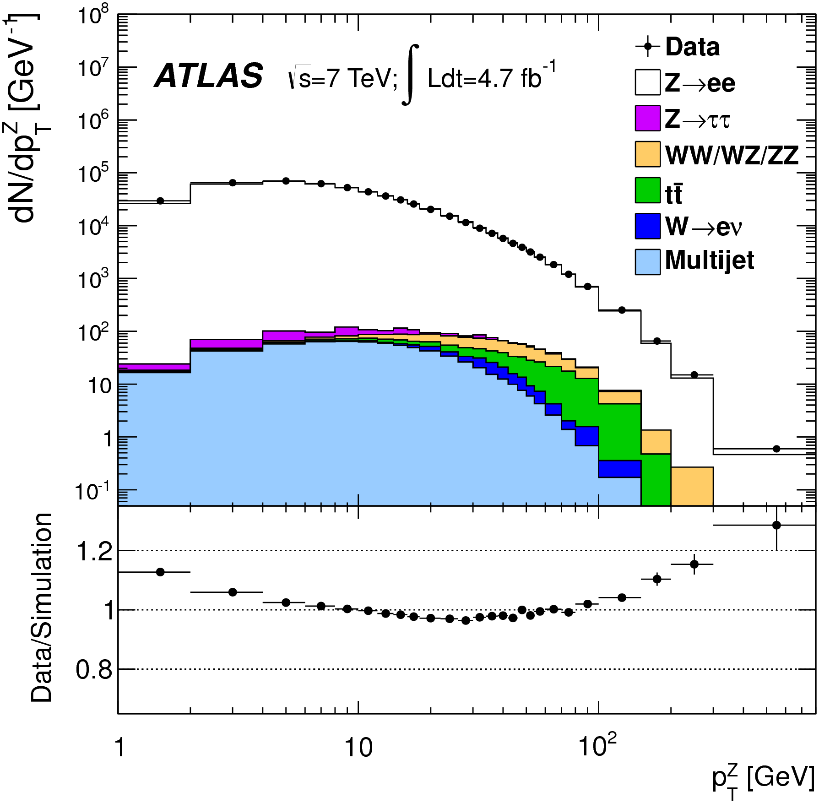
Problem: Z Boson Production
Notes:
And the reason we don’t believe the descrepancy is due to an error in the model is that the data for Z boson production at ATLAS indicates that the theory and the data correlate quite well particularly for the region where we see discrepancies for the Higgs. Which compels us to believe that our model for the Higg could not be as far off as it is. Thus this structure may indicates new physics.

Slide 11
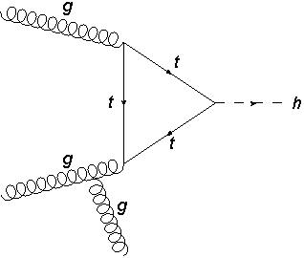
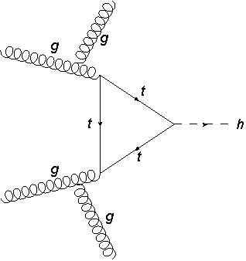



What was done
Monte Carlo Simulation (MadGraph)
Higgs Effective couplings to gluons model
Two processes: $p p ⟶h j$& $p p ⟶h j j$
Centre of mass energies: 8TeV to 14TeV in 1TeV steps
$$gg⟶gH$$
$$gg⟶ggH$$
Notes:
I used MadGraph (simulation software) to simulate p p -> h j and p p -> h j j processes for different centre of mass energies at the CERN LHC. Which provided cross-section data pertaining to Higgs production at the respective energies.
The Higgs Effective couplings to gluons model is an extension of the SM where Higgs bosons couple directly to glouns. In the SM these couplings are present through a heavy (top) quark loop but if m_{h}<2 m_{t}, the mass of the heavy top quark as an approximation can be taken as infinity. Which results in effective couplings between gluons and Higgs bosons. The dominant way in which the Higgs acquires Pt is through the emption of gluons.

Slide 12
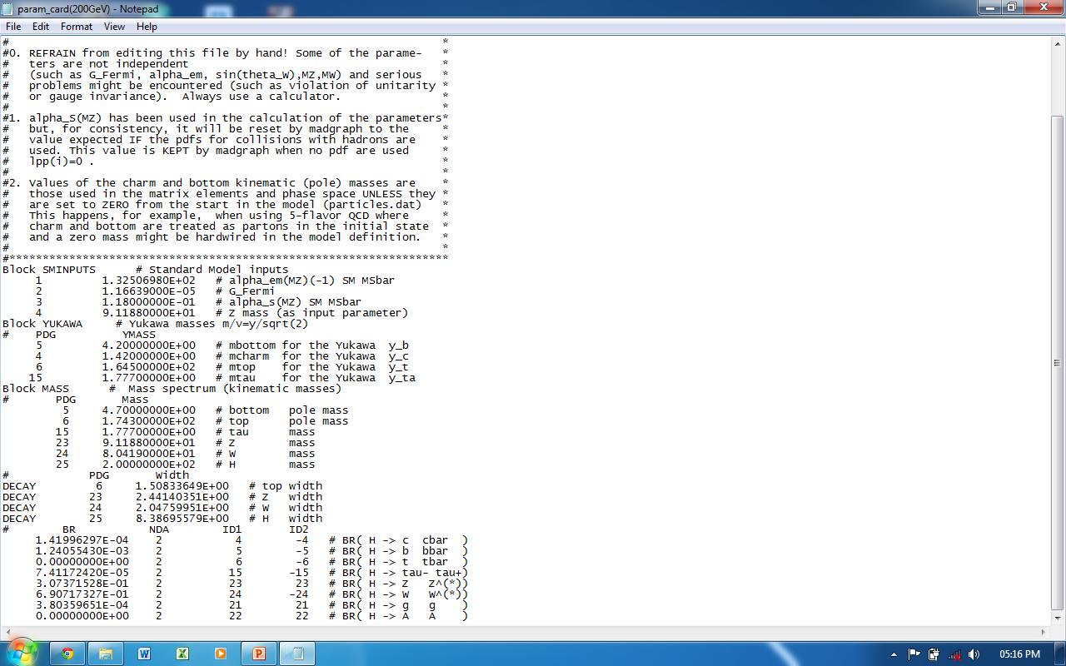
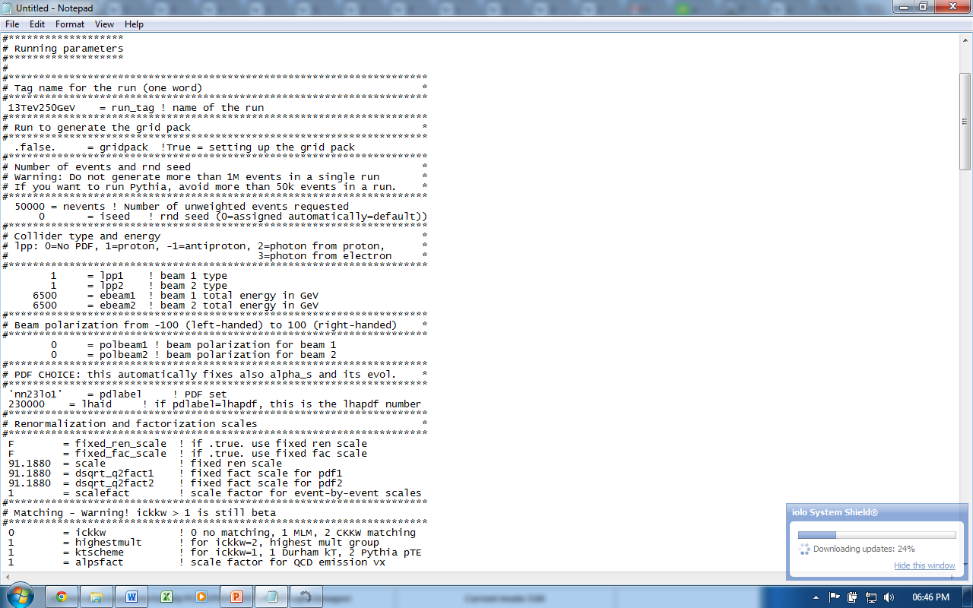
Parameters

Slide 13
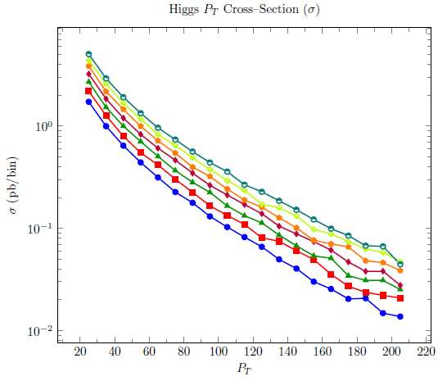
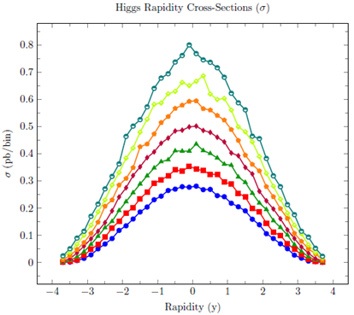
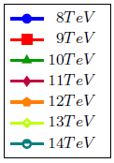
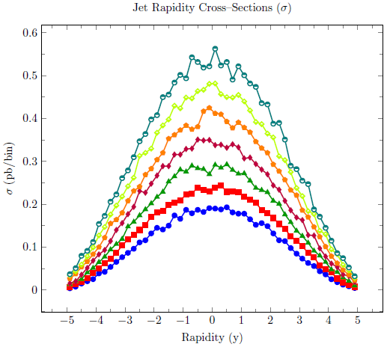
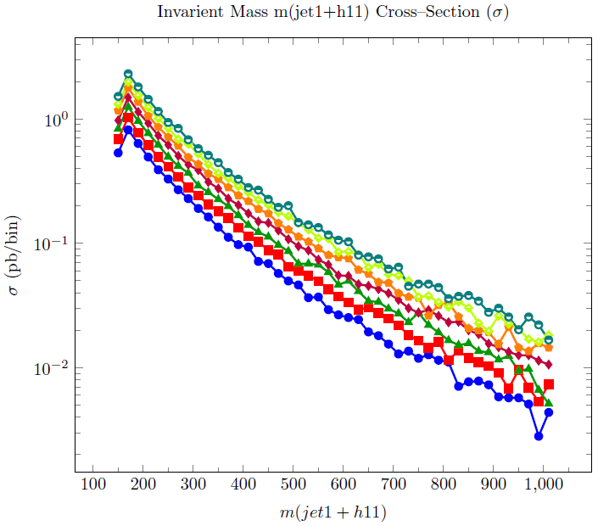
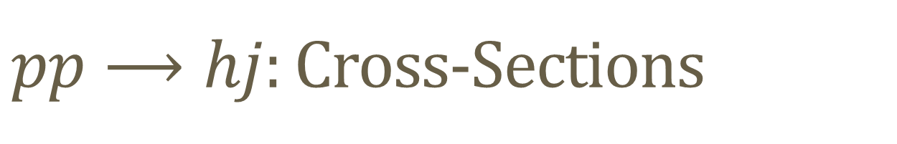
$pp⟶hj$: Cross-Sections
Notes:
Cross-Sections at different centre of mass energies.

Slide 14
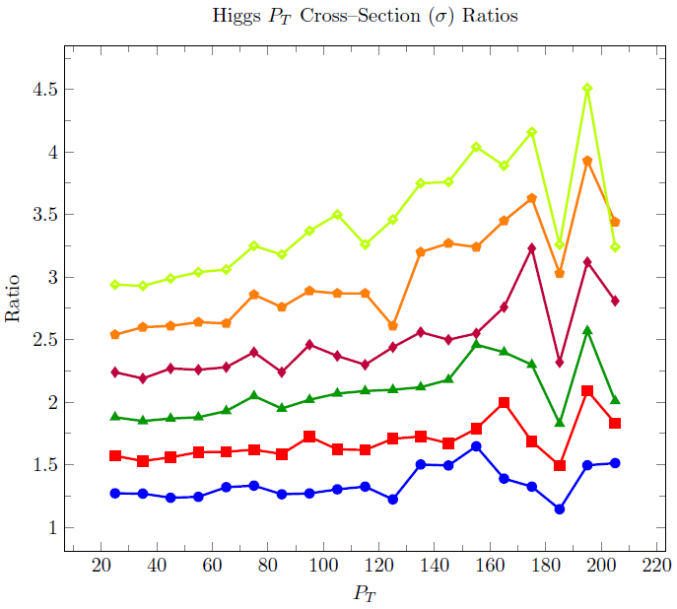
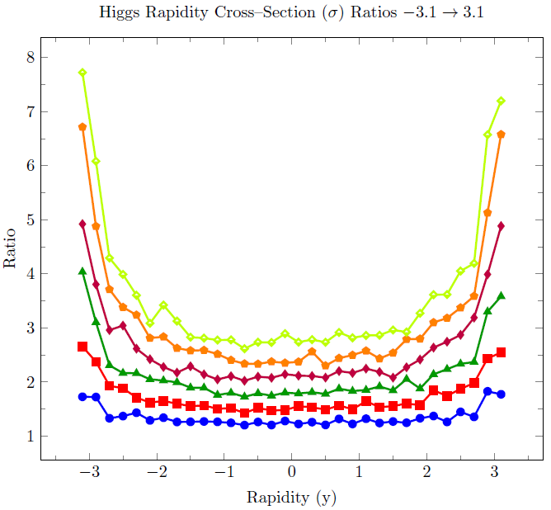
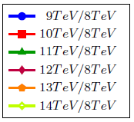
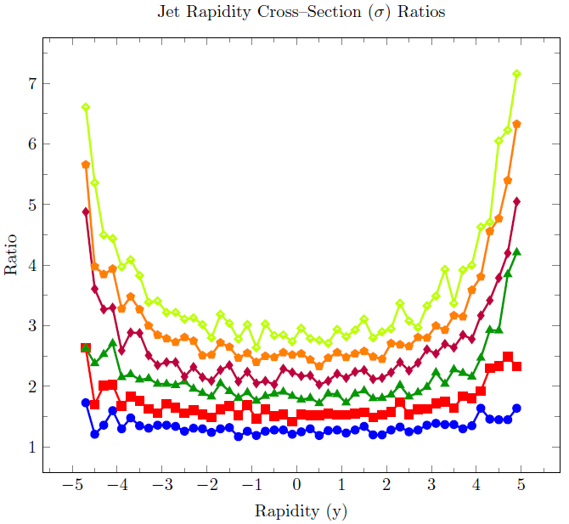
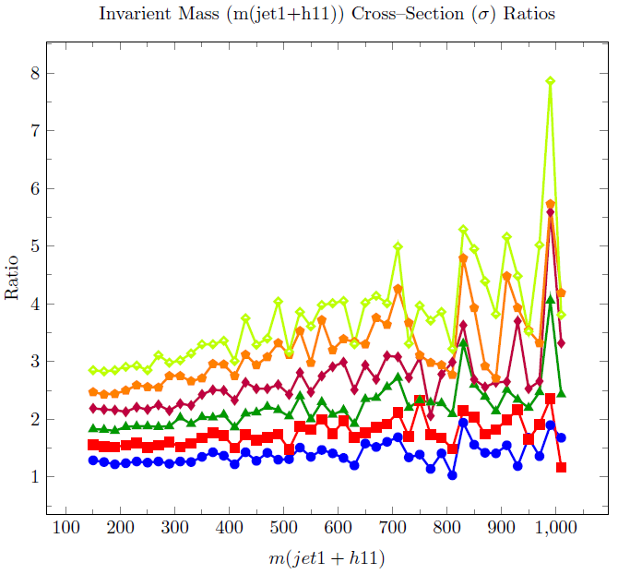
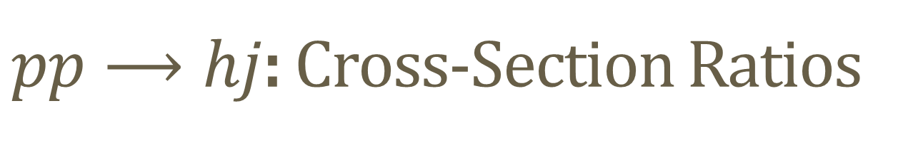
$pp⟶hj$: Cross-Section Ratios
Notes:
Cross-section ratios of different centre of mass energies to that of 8TeV

Slide 15
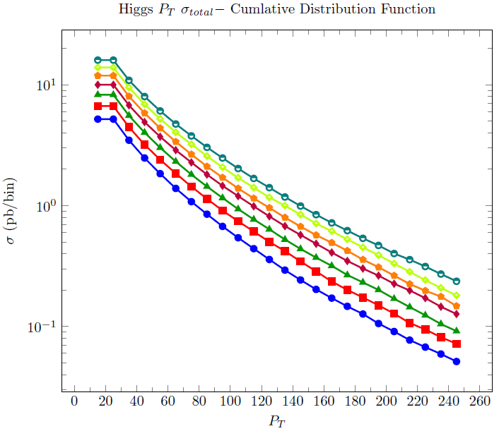
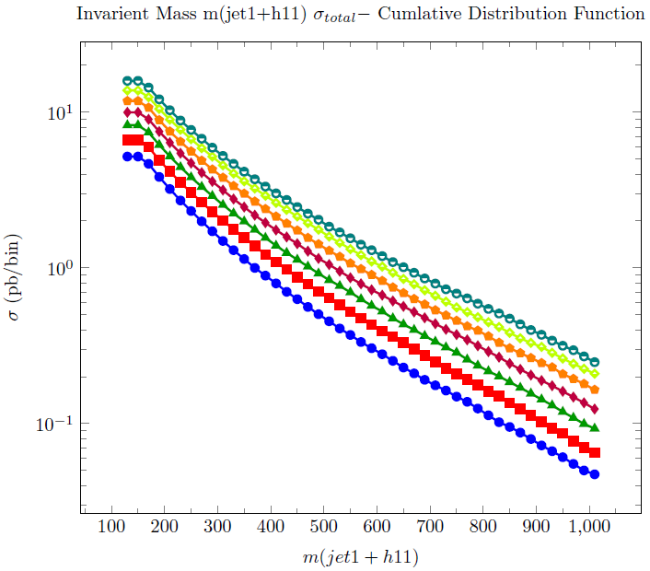
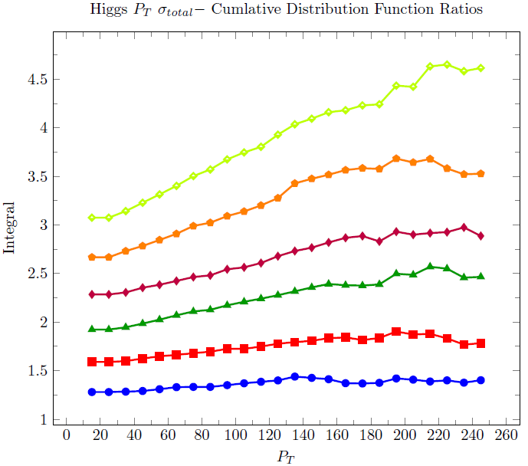
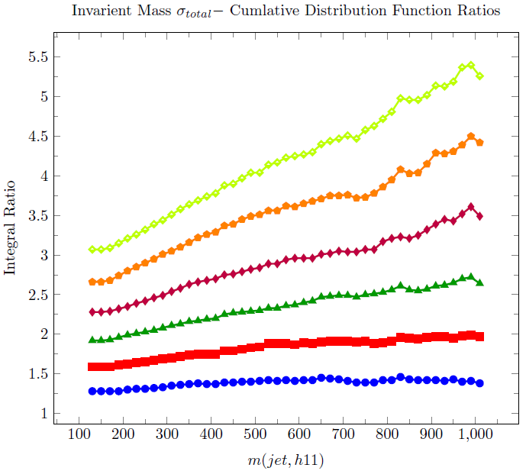
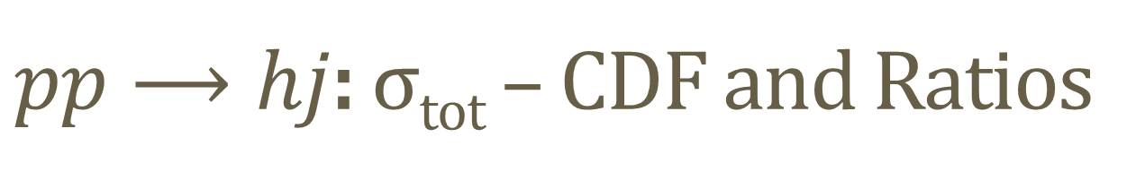
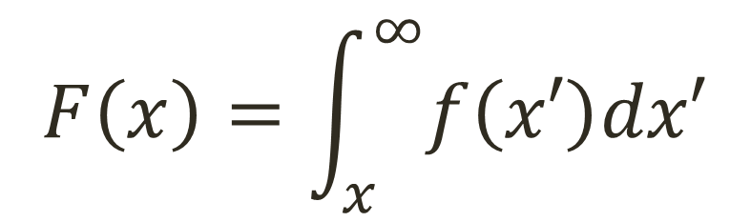
$pp⟶hj$: σ_{tot} – CDF and Ratios
$$F\left(x\right)=\int_{x}^{∞}{f\left(x′\right)dx′}$$
Notes:
Plots of the total cross-section – the CDF and the ratios of these at different centre of mass energies to that of 8TeV.

Slide 16
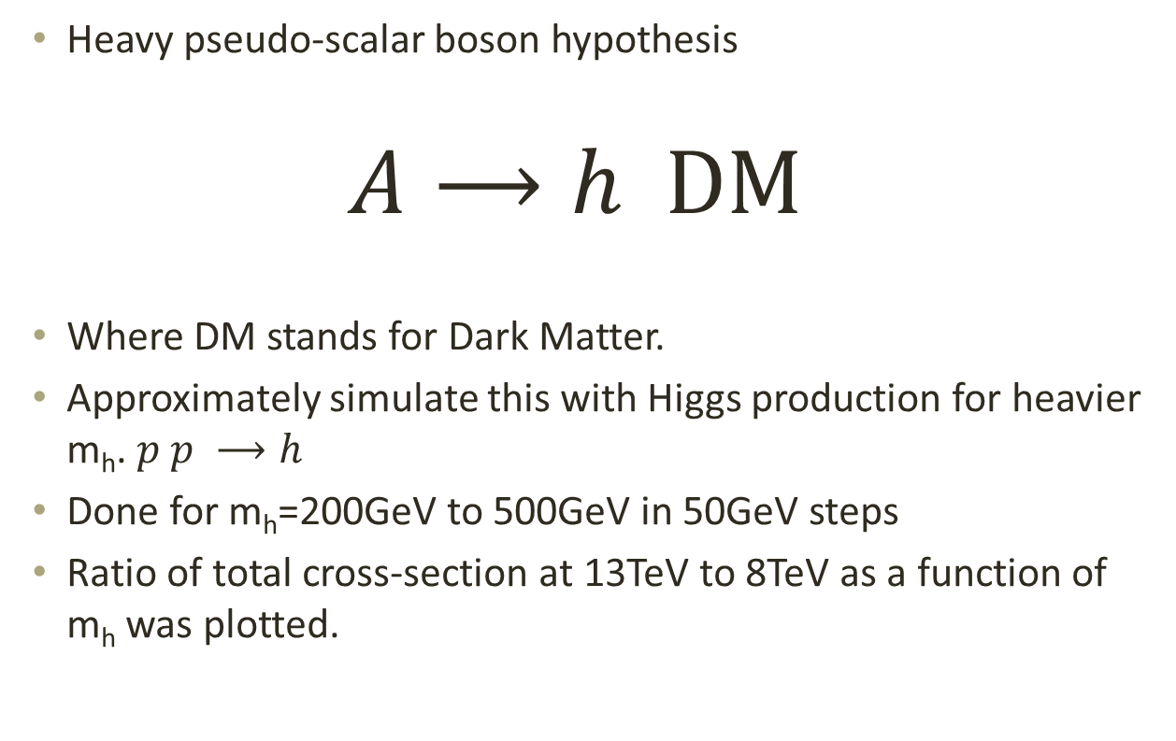
Heavy Pseudo-Scalar Boson Hypothesis
Heavy pseudo-scalar boson hypothesis
$$A⟶h DM$$
Where DM stands for Dark Matter.
Approximately simulate this with Higgs production for heavier m_{h}. $p p ⟶h$
Done for m_{h}=200GeV to 500GeV in 50GeV steps
Ratio of total cross-section at 13TeV to 8TeV as a function of m_{h} was plotted.
Notes:
One hypothesis is that there is a heavier pseudo-scalar boson being produced that decays into the Higgs boson and a Dark Matter particle. This emission of the DM particle will result in the Higgs Boson acquiring transverse momentum.

Slide 17
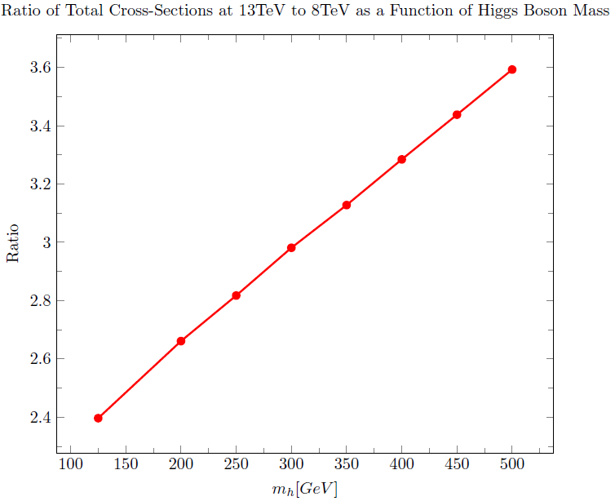
Heavy Pseudo-Scalar Boson Hypothesis: Results

Slide 18
Conclusions
The first simulations give predictions based on QCD and the SM which will provide a useful comparison for the data obtained at CERN for 13TeV and highlight areas of disagreement.
They show that as the energy at the LHC increases we expect to have more Higgs bosons produced.
They indicate that the rate at which the Higgs bosons, at higher P_{T} values, increases with increasing energy.
The excess P_{T} seen in the data can be explained by a Heavy pseudo-scalar boson emitting Dark Matter and a Higgs boson, giving the Higgs extra P_{T} above what is predicted.
The second simulations show that if a Heavy pseudo-scalar boson is being produced then we should see the cross-section increase faster than for SM h.

Slide 19
Questions?

Slide 20
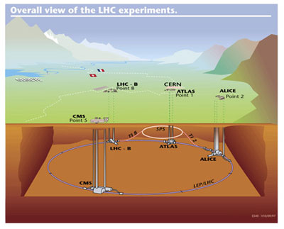
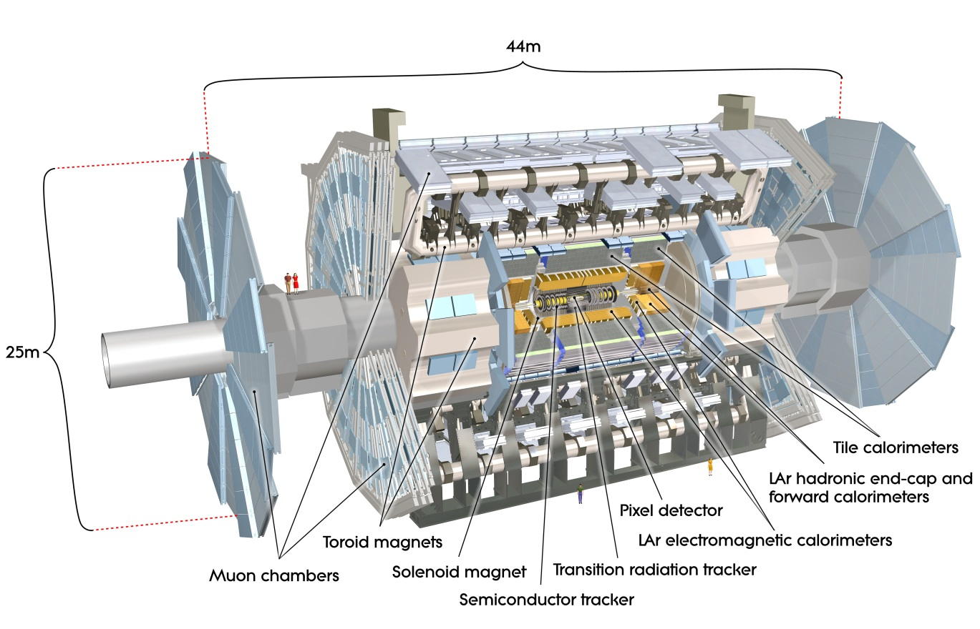
CERN Large Hadron Collider
Largest Particle Accelerator
27km circumference
Collides protons
2 Separate beam pipes
Collide at 4 locations
Detectors:
  ATLAS
  CMS
  ALICE
  LHCb
Courtesy of CERN (http://home.web.cern.ch/)
ATLAS Experiment © 2014 CERN
Notes:
ATLAS, CMS – General purpose detectors, that investigate a wide range of physics.
ALICE – is a heavy-ion detector designed to study the physics of strongly interacting matter at extreme energy densities, where a phase of matter called quark-gluon plasma forms.
LHCb - investigating the slight differences between matter and antimatter by studying a type of particle called the "beauty quark", or "b quark"

Slide 21
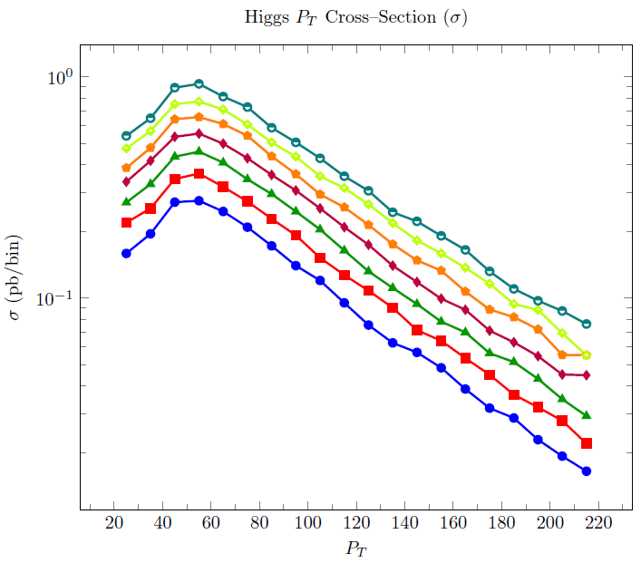
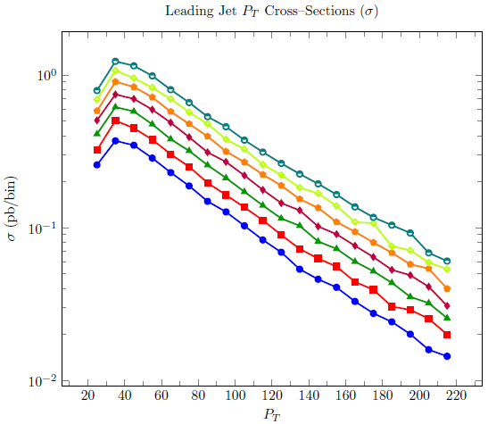
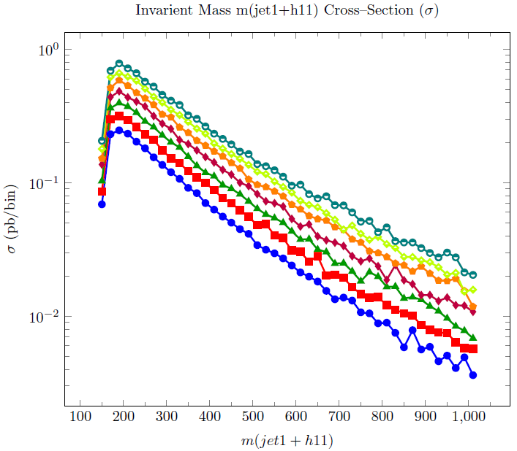
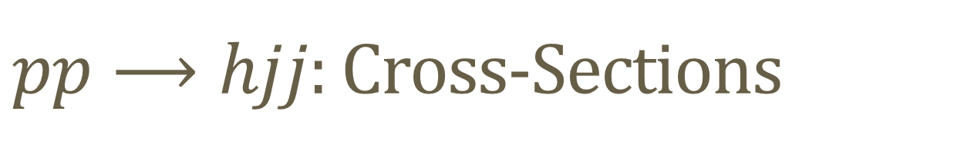
$pp⟶hjj$: Cross-Sections
Notes:
pp to h j j Cross-sections higgs pt, leading jet Pt and invariant mass

Slide 22
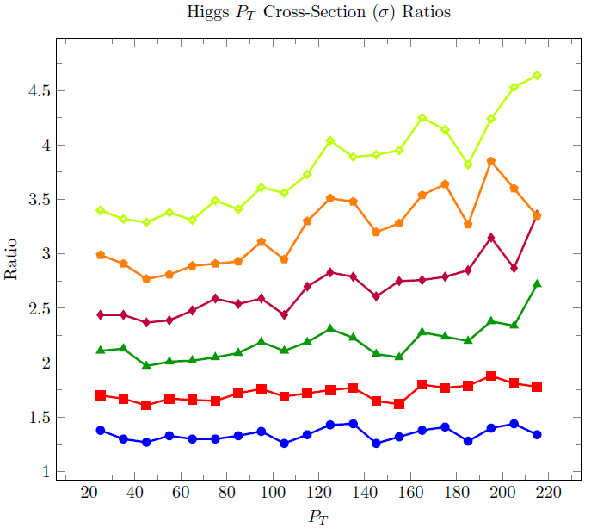
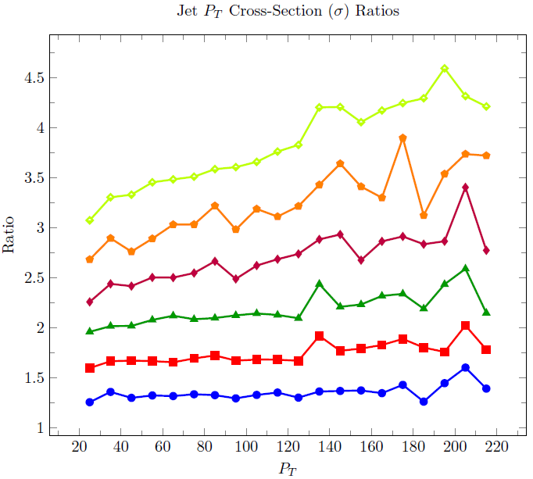
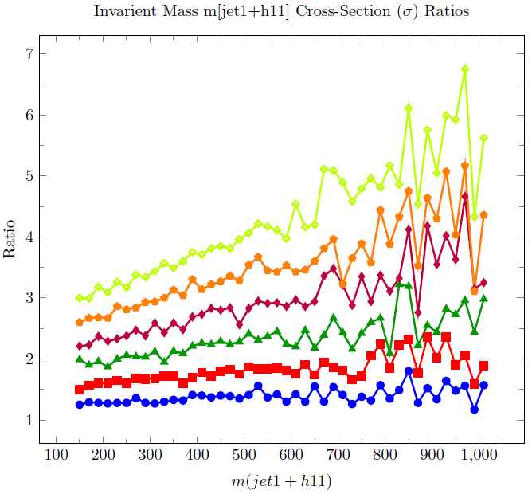
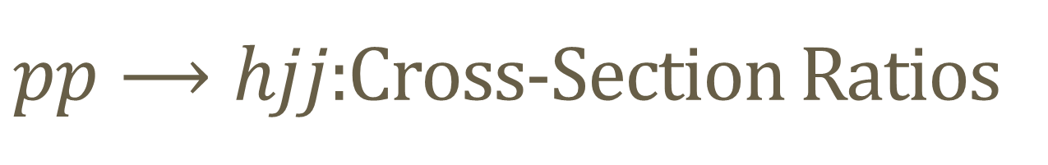
$pp⟶hjj$:Cross-Section Ratios
Notes:
Cross-section ratios

Slide 23
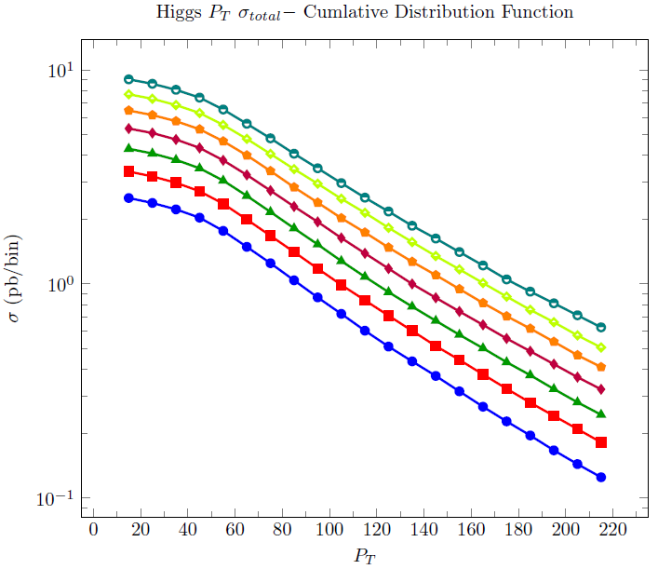
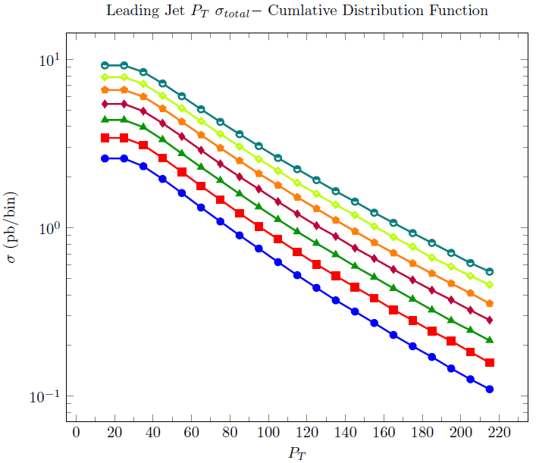
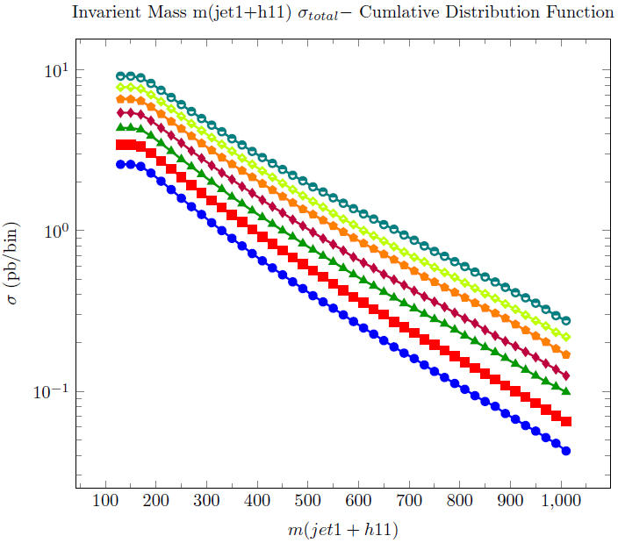
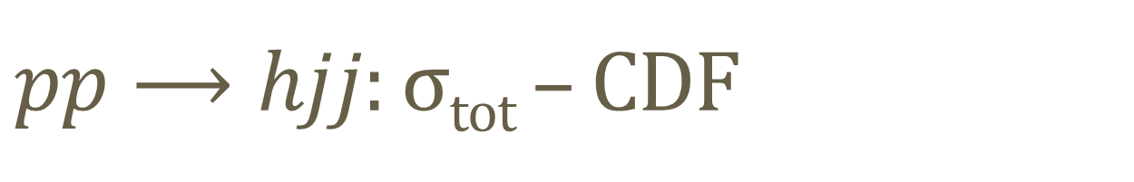
$pp⟶hjj$: σ_{tot} – CDF
Notes:
Total cross-section - CDFs

Slide 24
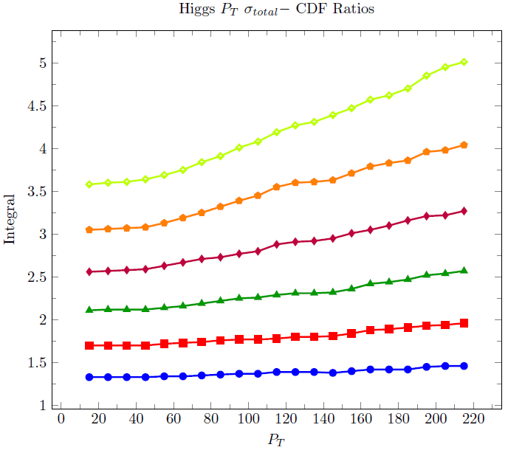
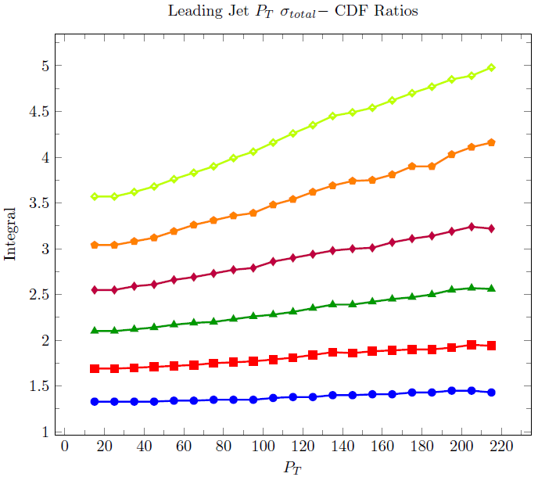
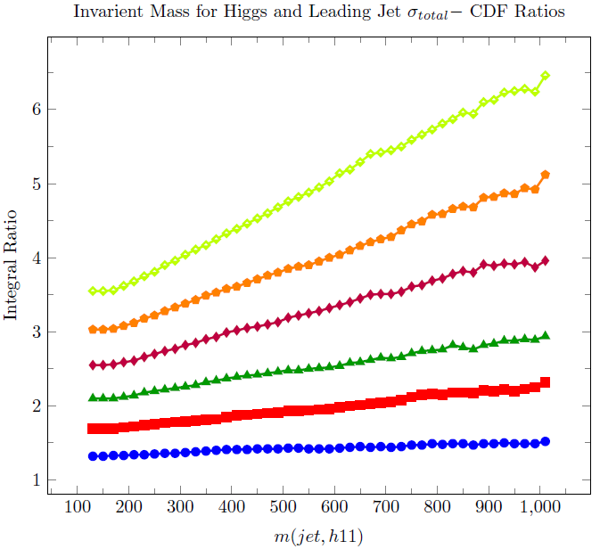

$pp⟶hjj$: σ_{tot} – CDF Ratios
Notes:
Why did I do this: Basically to give predictions as to what we expect to see as the running energy at the LHC increases to 13TeV next year. Which is usfull in that it allows us to quickly compare the results that are obtained to the theory.
But there is also another reason.

