Slide 1
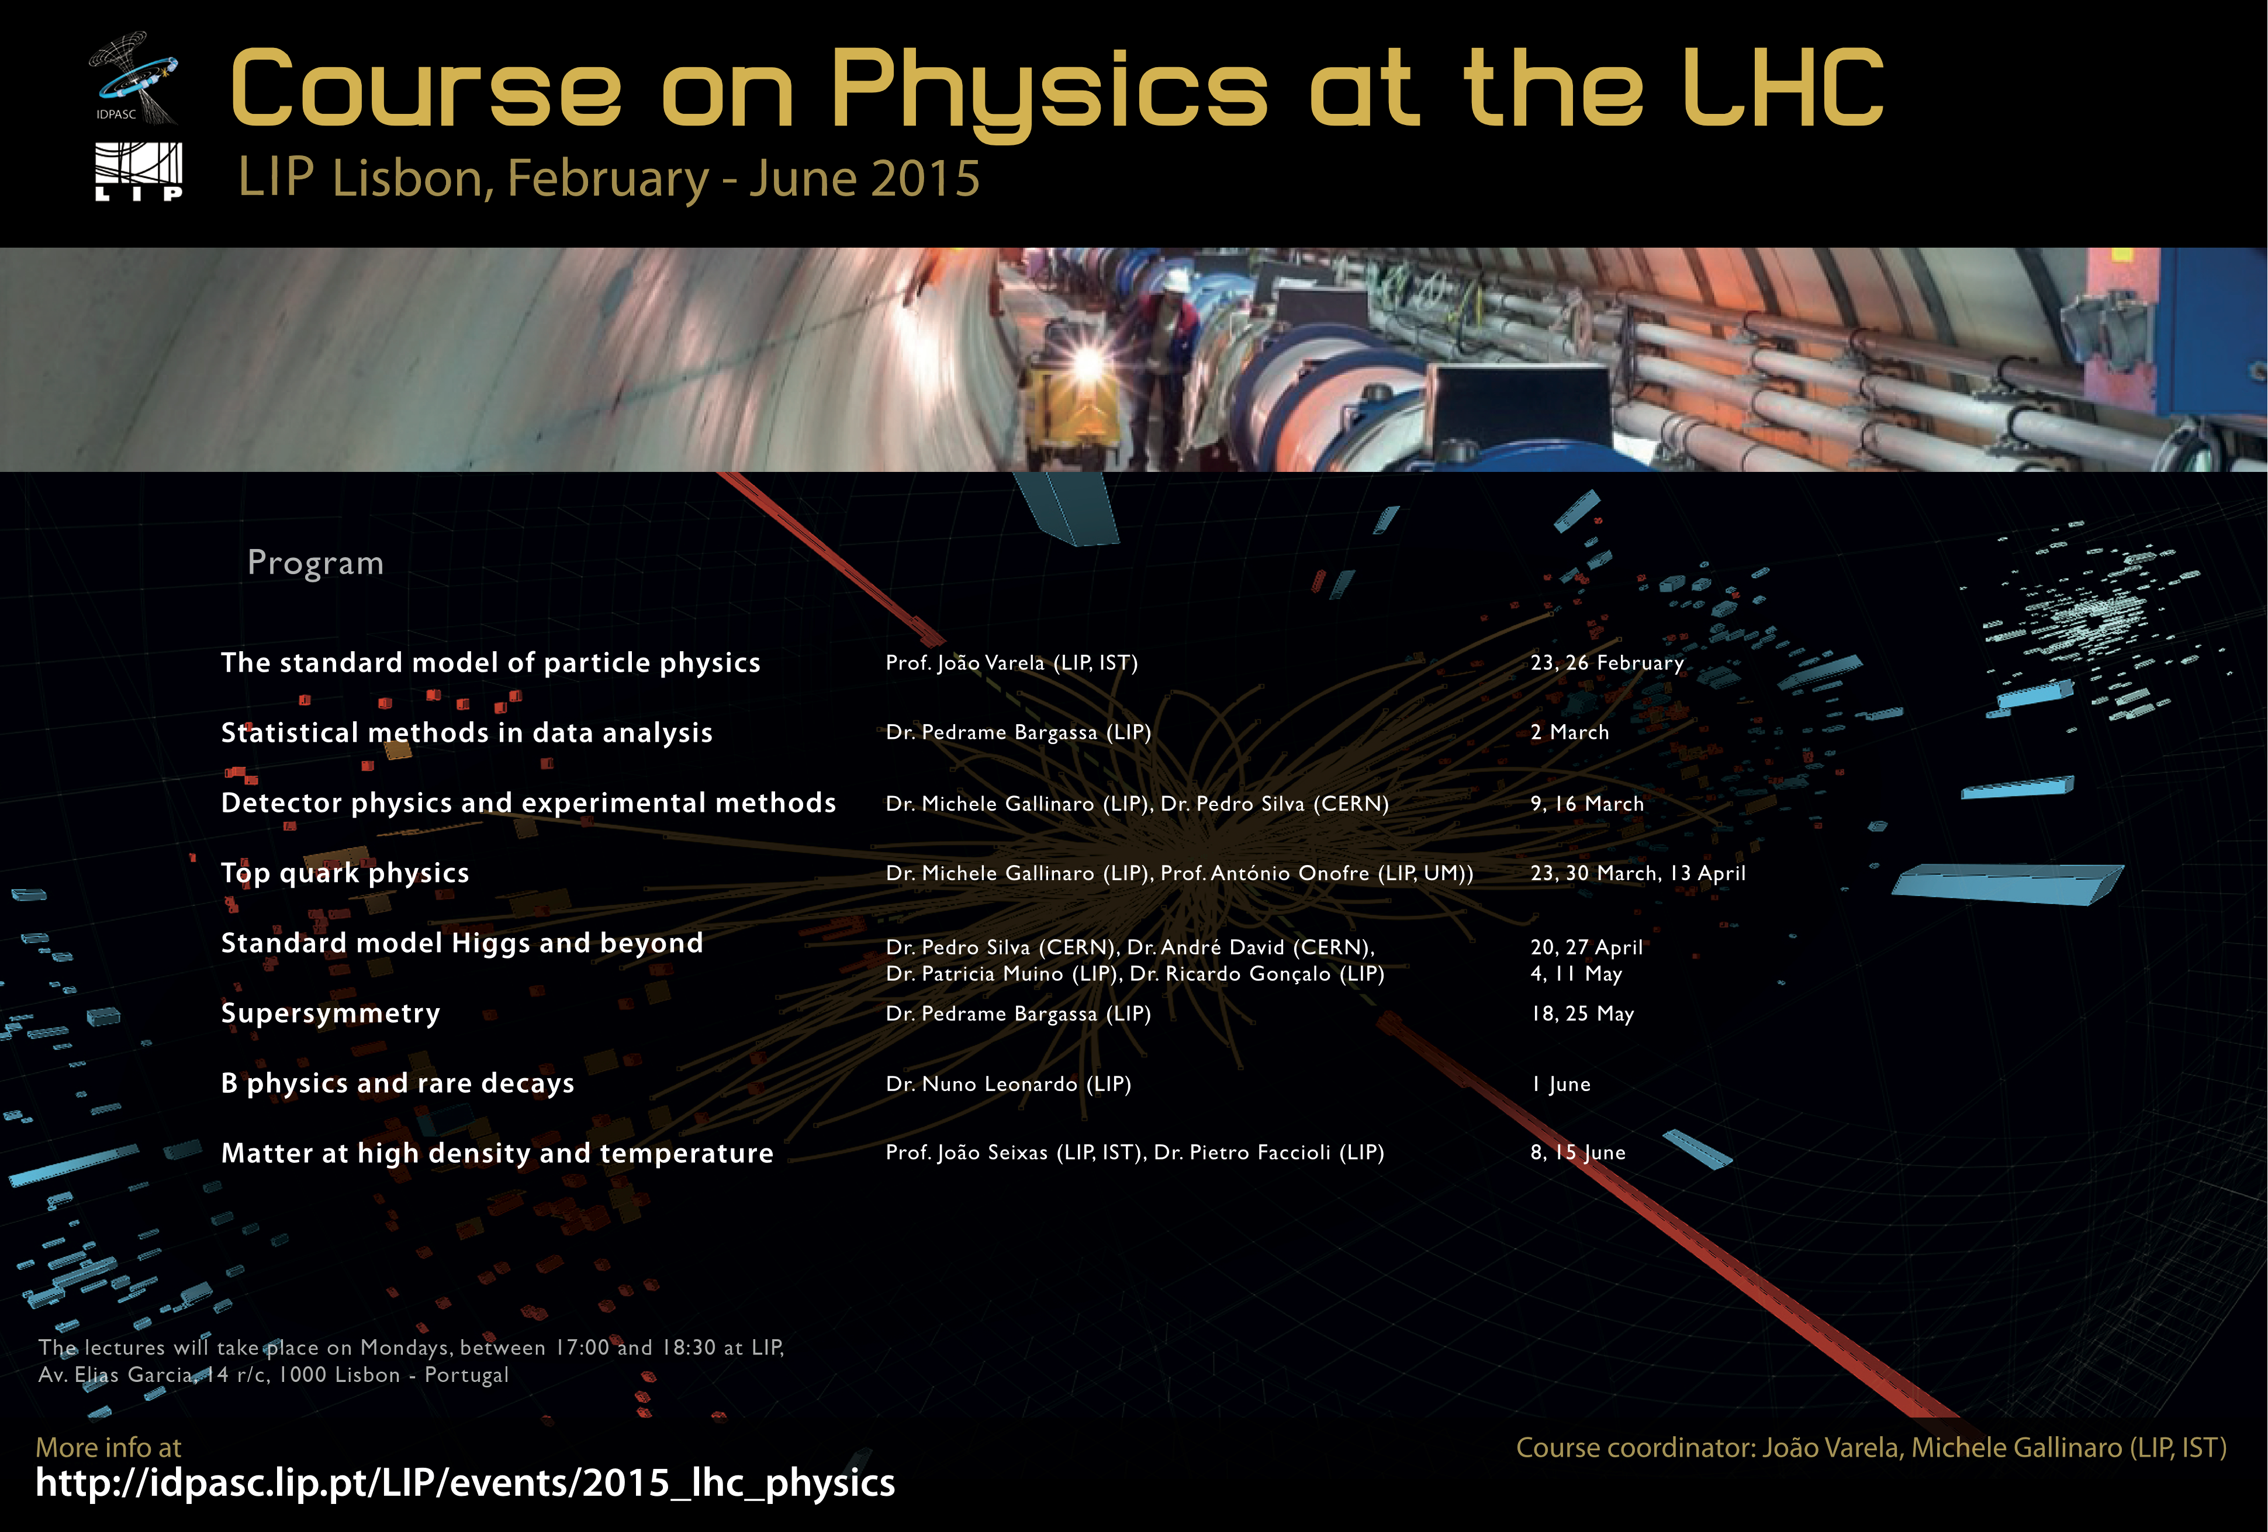
J. Varela, LIP/IST
March 15, 2013

Slide 2
Introduction
Specialized course on the Physics at the Large Hadron Collider organized by LIP in the framework of IDPASC.
The objective of the Course is to introduce the physics, analysis methods and results on the physics of the LHC experiments.
Emphasis is placed on the search for new physics.
Benchmark channels in proton-proton collisions will be discussed in detail:
  identification of the objects involved
  signal and background properties
  background estimation and S/B discriminants
  estimation of systematical errors
  extraction and interpretation of the final results

Slide 3
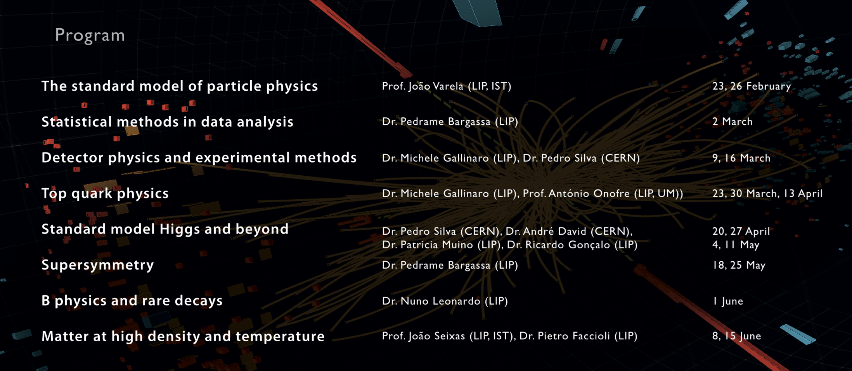
Program

Slide 4
Required background
The course is intended for under-graduate or graduate students having basic training in Particle Physics:
Basic concepts
Elementary constituents of matter and interactions. Quantum numbers and conservation rules. Spin and symmetry groups. Relativistic kinematics. Cross-section. Natural units. Mass and lifetime. Resonances.
Structure of matter
Elastic scattering and form factors. Inelastic scattering experiments. Nucleon structure functions. Scale invariance. Quark model. Parton distribution functions. Introduction to QCD.
Fundamental interactions
Introduction to QED. Fermi interaction. Parity violation. Currents V-A and weak doblets. W and Z bosons. Cabibbo angle. Neutral currents. Electroweak interaction. Gauge symmetries. The Higgs mechanism. Weinberg-Salam model. CP violation.

Slide 5
Background bibliography
F. Halzen and A.D.Martin, ' Quarks and Leptons ', John Wiley and Sons (1984)
D. Griffiths, ' Introduction to Elementary Particles ', John Wiley and Sons (1987)
B.R.Martin, G. Shaw, ' Particle Physics ', John Wiley and Sons (1999)

Slide 6
The standard model of particle physics
Lecture1
The LHC physics case
The LHC experimental program

Slide 7
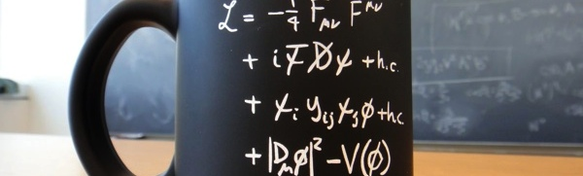
The LHC physics case

Slide 8
Particle Physics
Particle physics is a modern name for the centuries old effort to understand the basics laws of physics.
Edward Witten
Aims to answer the two following questions:
  What are the elementary constituents of matter ?
  What are the forces that determine their behavior?
Experimentally
  Get particles to interact and study what happens

Slide 9
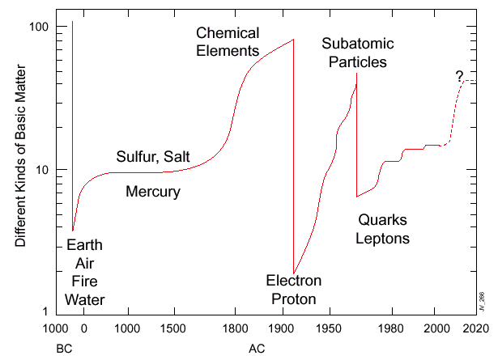

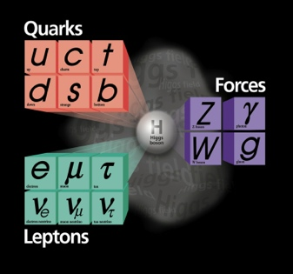
Constituents of matter along History
Quarks and
Leptons

Slide 10

The Standard Model
Over the last ~100 years: The combination of Quantum Field Theory and discovery of many particles has led to
The Standard Model of Particle Physics
  With a new “Periodic Table” of fundamental elements
One of the greatest achievements of 20th Century Science
Matter particles
Force particles

Slide 11
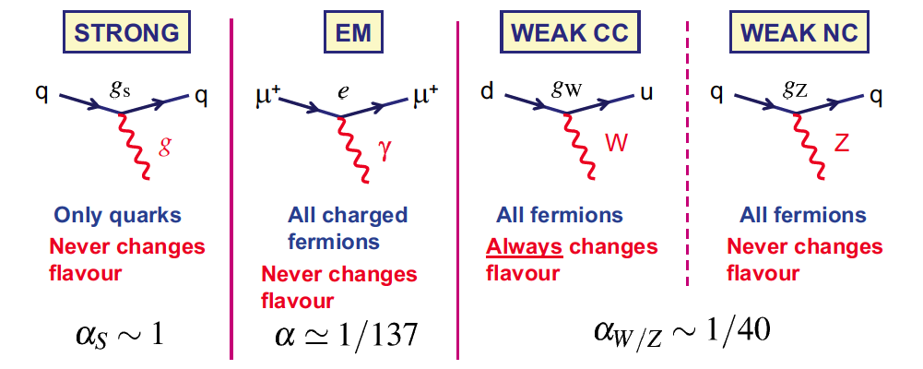
Standard model interactions
The interaction of gauge bosons with fermions is described by the Standard Model
Gluons
massless
Photon
massless
W+, W-
very massive
Z⁰
very massive

Slide 12
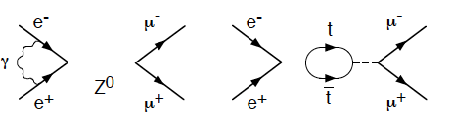
Quantum field theory
A particle-antiparticle pair can pop out of empty space (“the vacuum”) and then vanish back into it
  These are Virtual particles.
t
.
.
Vacuum Fluctuation
Involving top quarks
Other examples of Virtual particles:
t
This has far-reaching consequences
  The structure of the universe depends on particles that don’t exist in the usual sense
  We do not see these particles in everyday life
  We must recreate the state of the early hot universe to make them

Slide 13
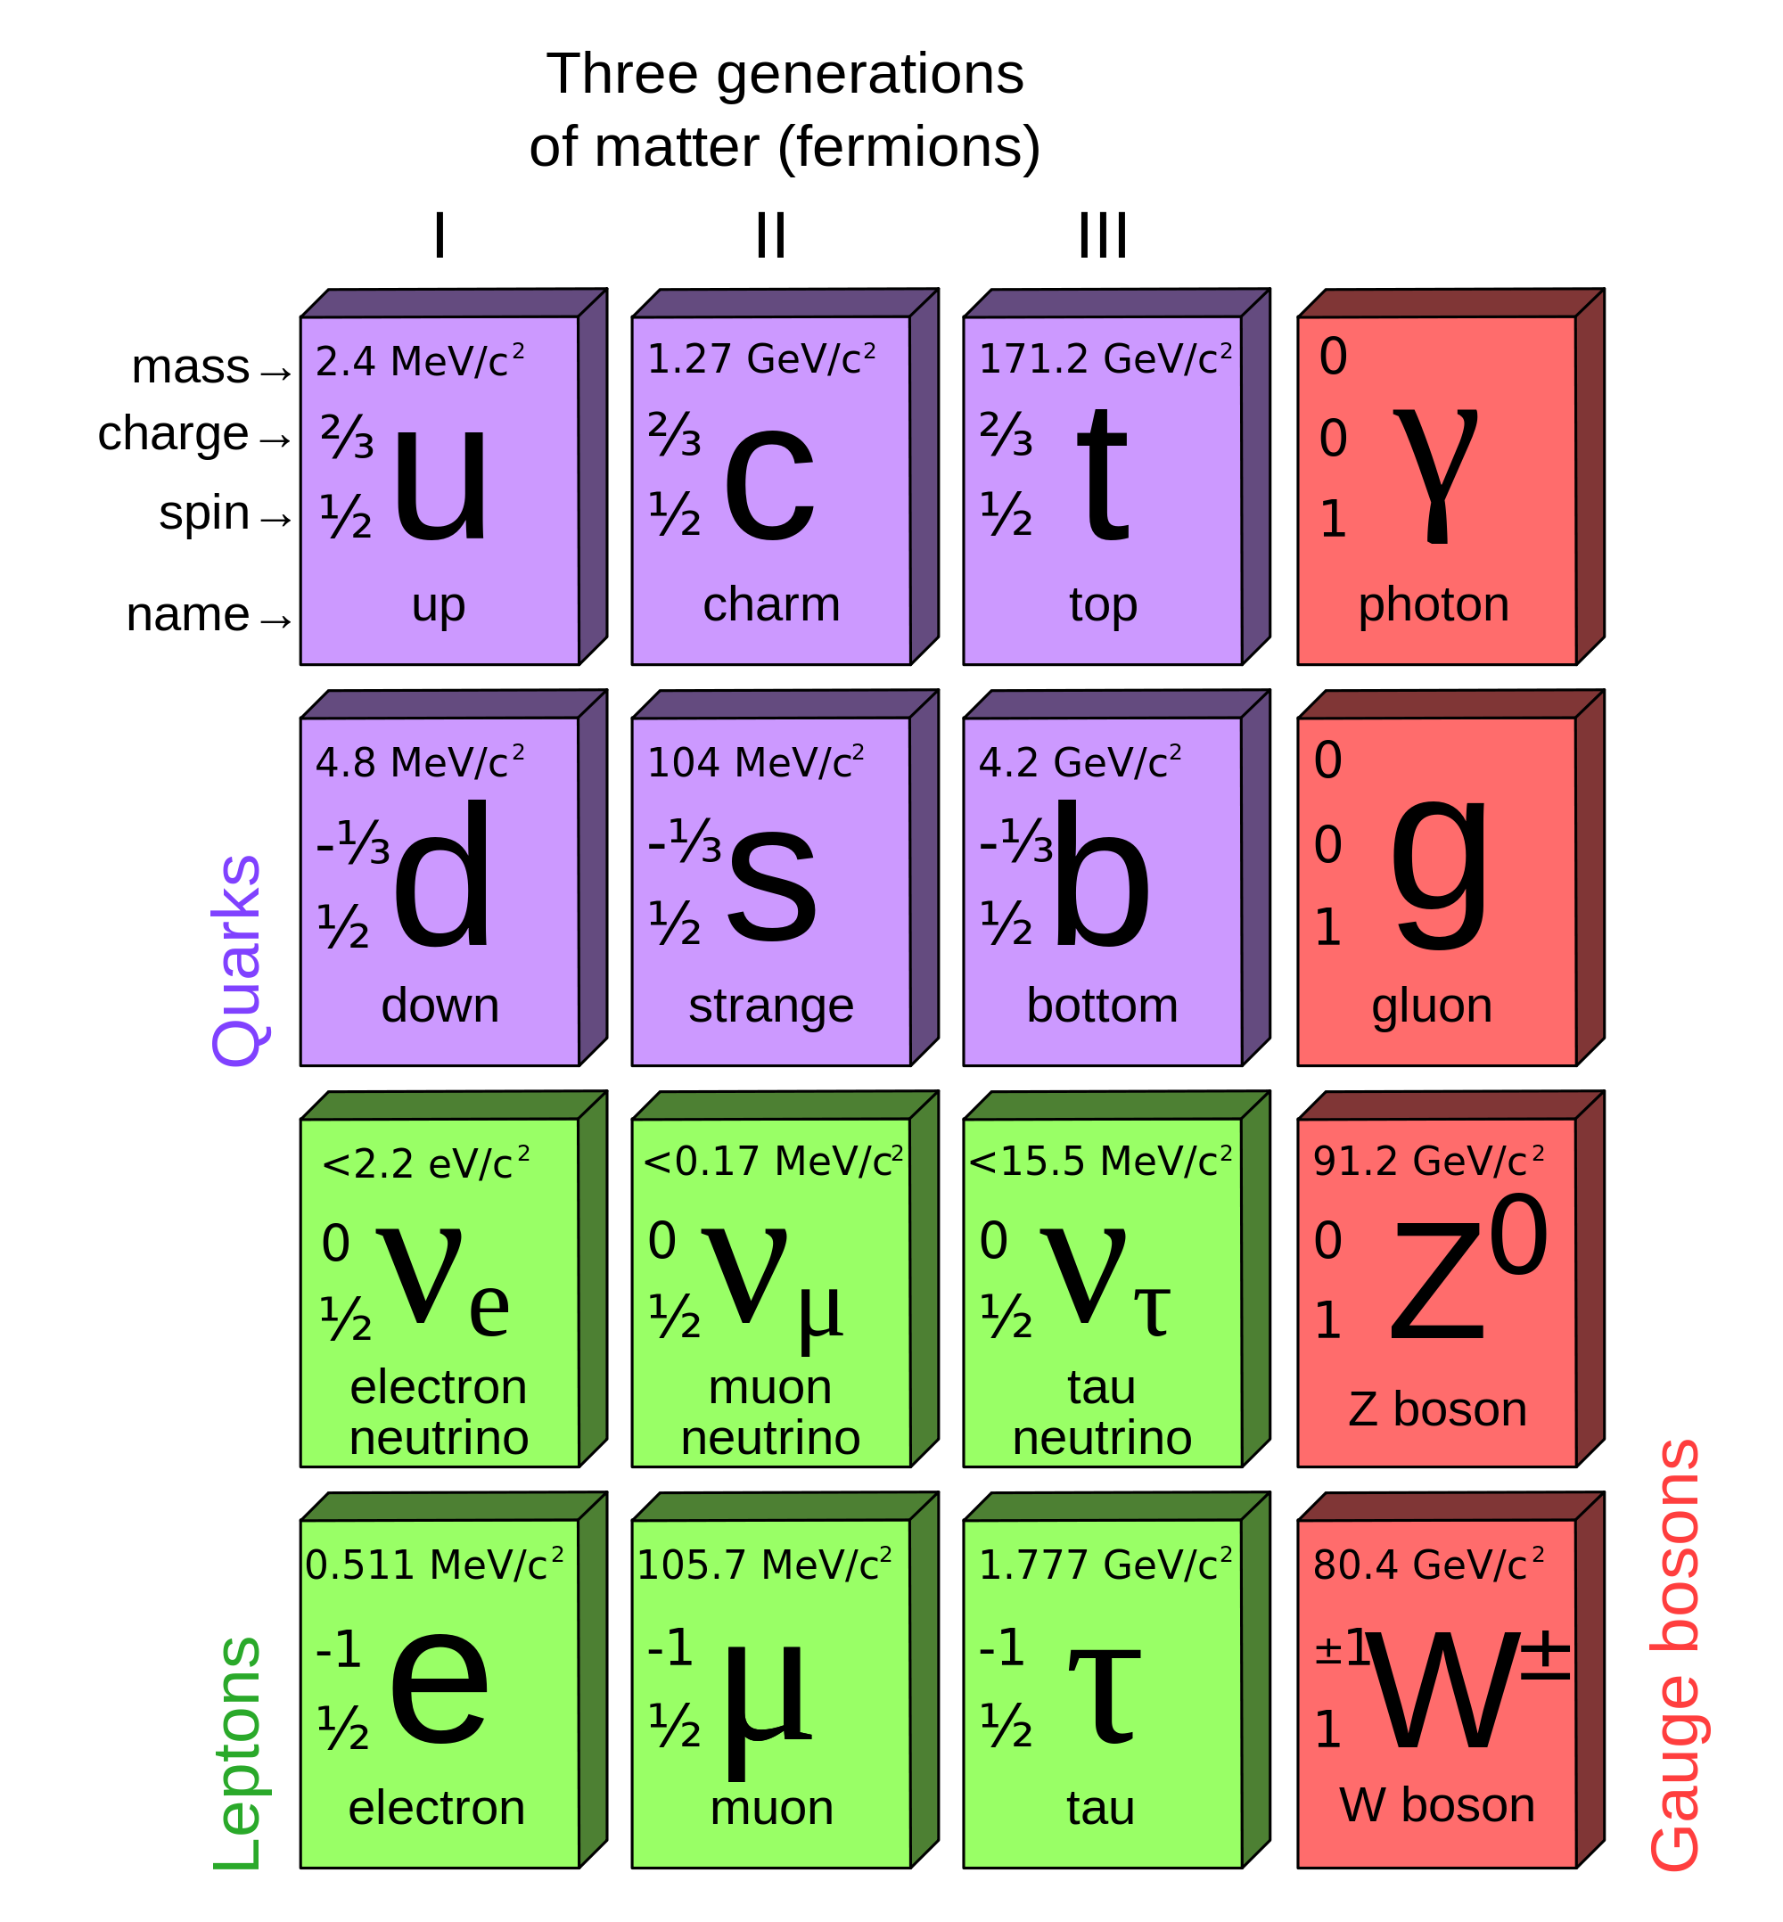
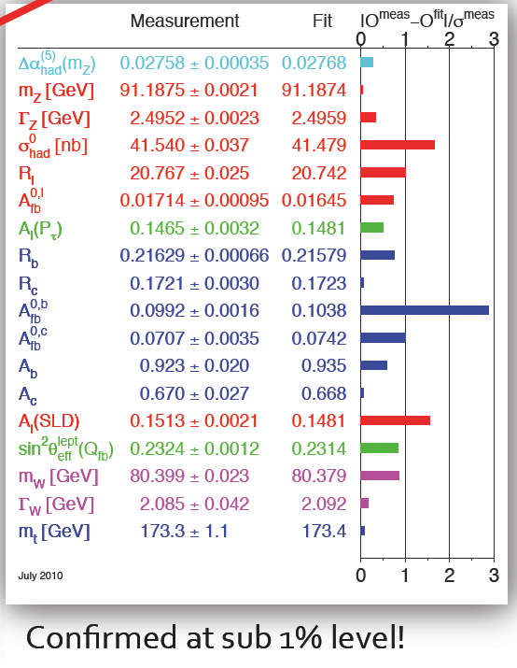
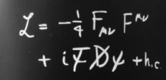
SM confirmed by data
STANDARD MODEL
OF ELEMENTARY PARTICLES

Slide 14
What’s missing?
A “funny” thing happened on the way to the modern theory of quarks, leptons, force fields, and their quanta:
The equations only made sense if all the bosons, and all the quarks and leptons, had no mass and moved at the speed of light!

Slide 15
The Higgs
In the simplest model the interactions are symmetrical and particles do not have mass
The symmetry between the electromagnetic and the week interactions is broken:
  - Photon do not have mass
  - W, Z do have a mass ~ 80-90 GeV
Higgs mechanism:
  mass of W and Z results from the interactions with the Higgs field

Slide 16
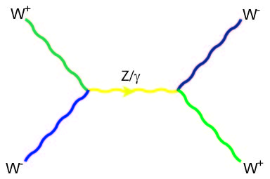
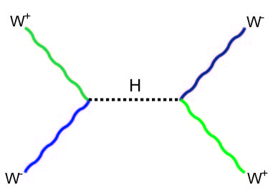


Added bonus
Non-zero average value of the Higgs field can also give masses to the quarks, electrons and muons – to all point-like particles.
Old theoretical problem affecting the quantum theory of the weak force :
  the probability of two W’s interacting becomes larger than 1 at high energies (> 1 TeV).
This is solved by the Higgs field!
+

Slide 17
Beyond the standard model
The Standard Model answers many of the questions about the structure of matter. But the Standard Model is not complete; there are still many unanswered questions.
Why do we observe matter and almost no antimatter if we believe there is a symmetry between the two in the universe?
What is this "dark matter" that we can't see that has visible gravitational effects in the cosmos?
Are quarks and leptons actually fundamental, or made up of even more fundamental particles?
Why are there exactly three generations of quarks and leptons? What is the explanation for the observed pattern for particle masses?
How does gravity fit into all of this?

Slide 18
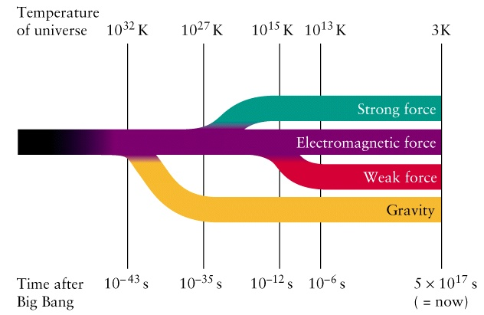
Forces and expansion of the Universe
E=k. T
k=8.62 10⁻⁵ eV K⁻¹
LHC

Slide 19
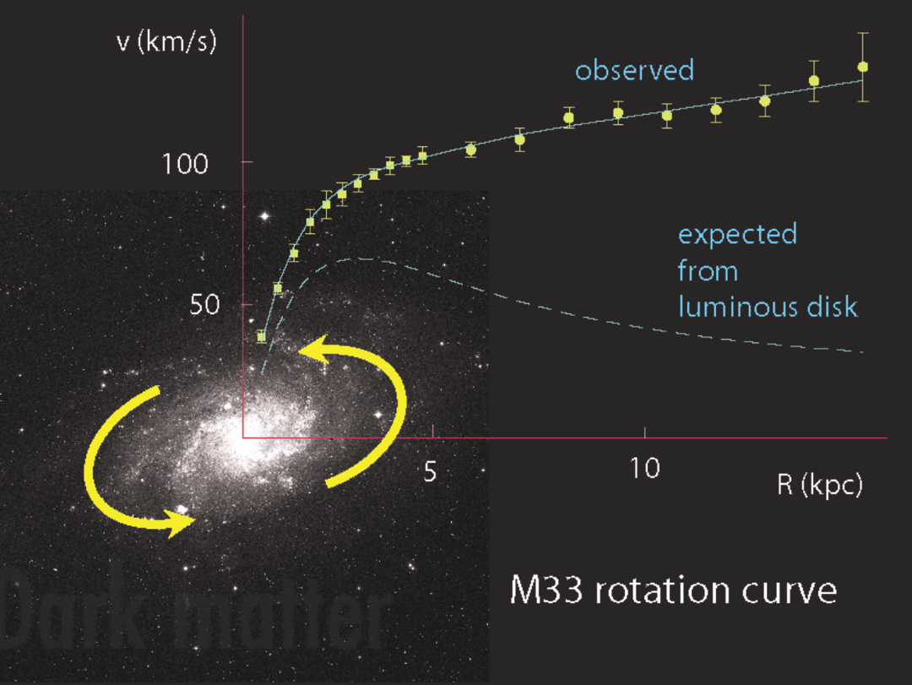
The dark side of the Universe
Long standing problem:
  We know that ordinary matter is only ~4% of the matter-energy in the Universe.
  What is the remaining 96%?
The LHC may help to solve this problem, discovering dark matter

Slide 20
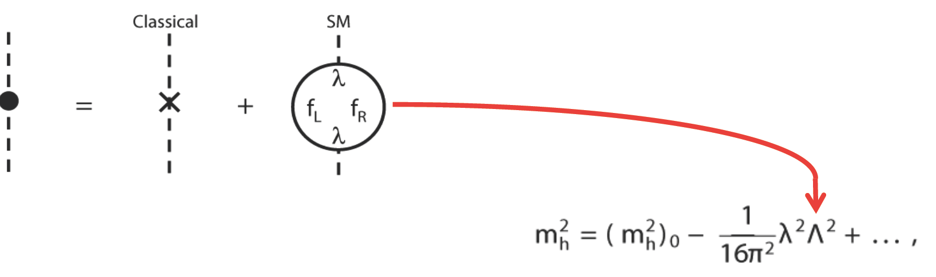
Higgs and hierarchy problem
In the SM the Higgs mass is a huge problem:
Virtual particles in quantum loops contribute to the Higgs mass
Contributions grow with Λ (upper scale of validity of the SM)
Λ could be huge – e.g. the Plank scale (10¹⁹ GeV)
Miraculous cancelations are needed to keep the Higgs mass < 1 TeV
This is known as the hierarchy problem

Slide 21
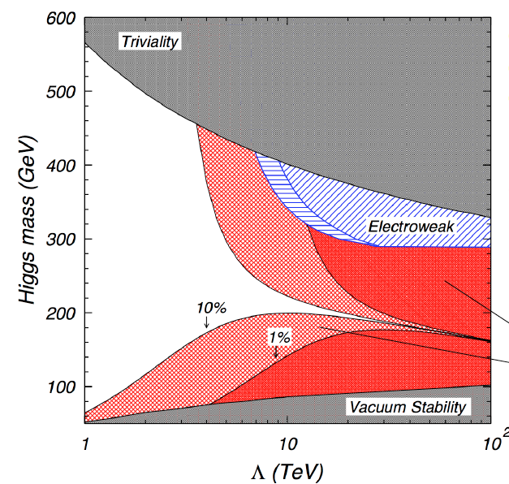
New physics at a few TeV?
Naturalness implies Supersymmetry or another ‘New Physics’ below ~ 2 TeV
125 GeV
Excluded to avoid fine-tuning
2 TeV
Λ – Scale of New Physics

Slide 22
Many possible theories
There are a large number of models which predict new physics at the TeV scale accessible at the LHC:
Supersymmetry (SUSY)
Extra dimensions
Extended Higgs Sector e.g. in SUSY Models
Grand Unified Theories (SU(5), O(10), E6, …)
Leptoquarks
New Heavy Gauge Bosons
Technicolour
Compositeness
Any of this could still be found at the LHC

Slide 23
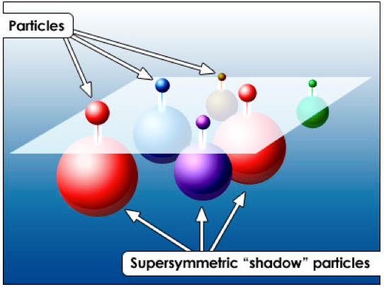
Supersymmetry
Some physicists attempting to unify gravity with the other fundamental forces have proposed a new fundamental symmetry:
  Every fermion should have a massive "shadow" boson
  and boson should have a massive "shadow" fermion.
This relationship between fermions and bosons is called supersymmetry (SUSY)
No supersymmetric particle has yet been found, but experiments are underway at CERN to detect supersymmetric partner particles.

Slide 24
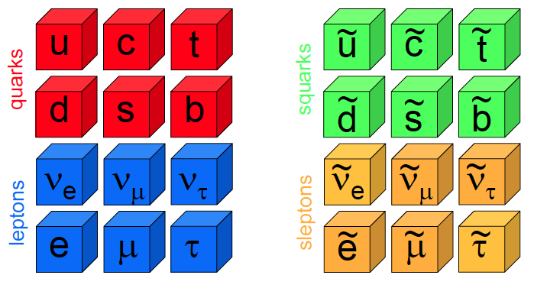
Supersymmetry
Double the whole table with a new type of matter?
Heavy versions of every quark and lepton
Supersymmetry is broken

Slide 25
Could DM be SUSY particles?
For every “normal” force quanta (boson), there are supersymmetric partners:
photon photino
W, Z bosons Wino, Zino
gluon gluino
Higgs boson higgsino
These “…inos” are prime suspects to be the galactic dark matter!
Relics from the Big Bang!

Slide 26
The temptation unification

Slide 27
SUSY and the Higgs mass
Cancellation
Higgs mass:
correction has quadratic divergence!
  Λ a cut-off scale – e.g. Planck scale
Superpartners fix this:
Need superpartners at mass ~1-2 TeV
  Otherwise the logarithmic term becomes too large, which would require more fine-tuning.

Slide 28
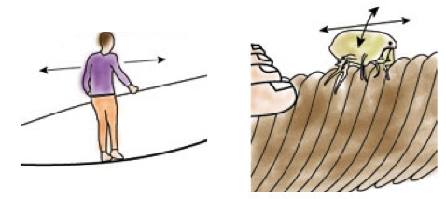
Extra dimensions
Space-time could have more than three space dimensions. The extra dimensions could be very small and undetected until now.
How can there be extra, smaller dimensions?
The acrobat can move forward and backward along the rope: one dimension
The flea can move forward and backward as well as side to side: two dimensions
But one of these dimensions is a small closed loop.

Slide 29
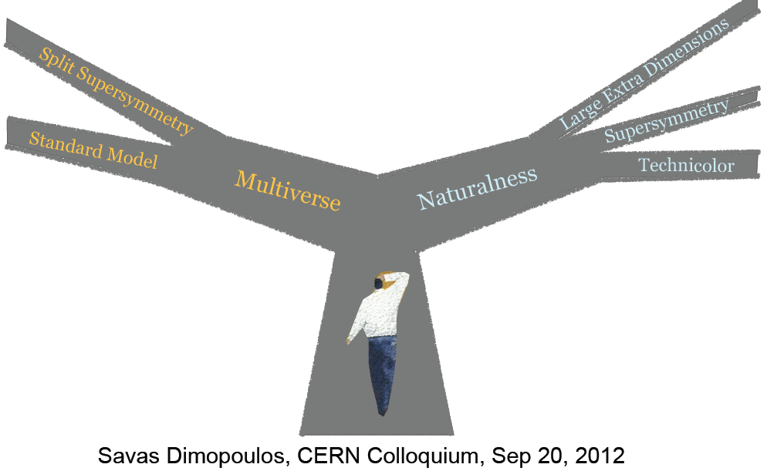
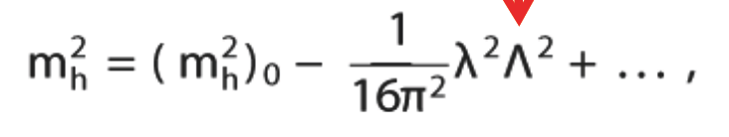
Naturalness
At a Crossroad

Slide 30
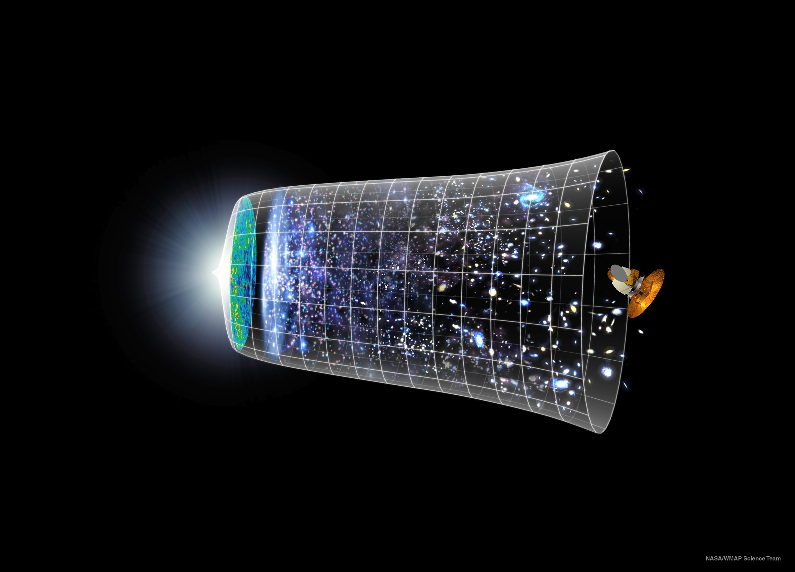
Timeline of the Universe
13.7 billion years
Big Bang
Today
LHC recreates the conditions one billionth of a second after Big Bang

Slide 31
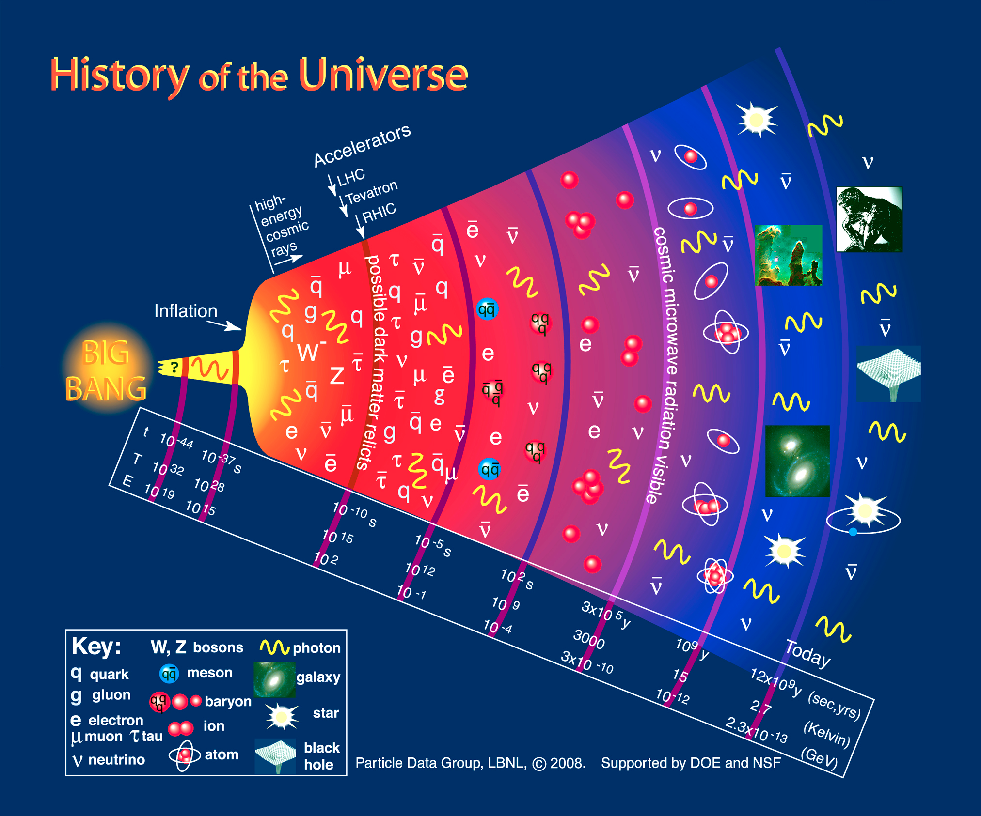
Understanding the Universe
Telescopes
Accelerators
LHC – Energy Frontier

Slide 32
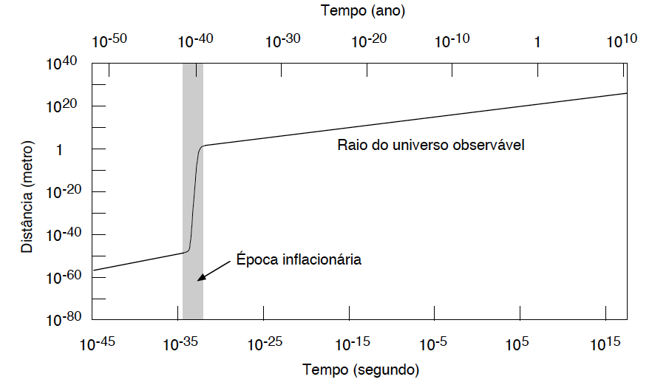
Cosmological inflation
In the very early universe, the physical vacuum undergoes a transition from a high energy state to a low energy state.
The resulting energy shift drives a dramatic exponential expansion.
Explains why the Universe has a uniform Temperature (3 K)
Time (year)
In the very early universe, the physical vacuum transitions from a high state to a low (ground?) state.
The resulting energy shift drives a dramatic exponential expansion.
It is the cosmological constant writ large!
The inflation theory was developed
independently in the late 1970’s by Alan
Guth, Alexey Starobinsky, and others
The inflation theory was developed
independently in the late 1970’s by Alan
Guth, Alexey Starobinsky, and others
Radius of observable Universe
Radius of observable Universe (meter)
Inflationary period
Time (second)

Slide 33
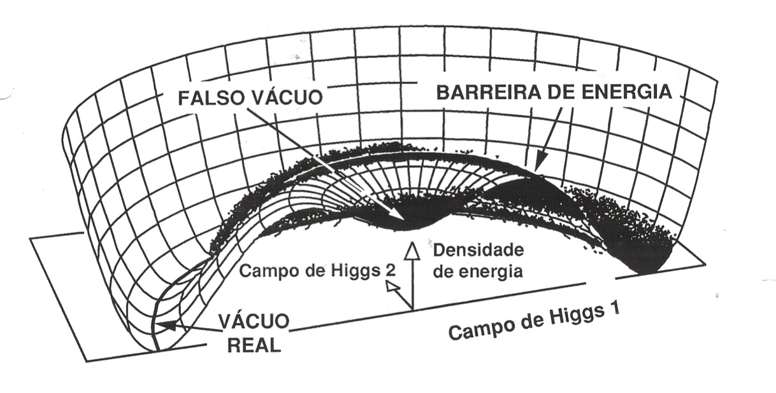
Higgs like field and inflation
Before the inflation (10⁻³⁴ s), the Higgs-like field is trapped is a state of false vacuum.
The Universe undergoes a super-cooling transition: the temperature decreases below the phase transition point but the Higgs field stays in the false vacuum state.
False vacuum
Energy barrier
Energy
density
Higgs field 2
Real
vacuum
Higgs field 1
While the energy density of the Higgs field is positive, the Universe expands at accelerated rate (inflation) and the energy stored in the Higgs field increases.
Inflation stops when the Higgs field decays to the real vacuum.
The energy released by the Higgs field is converted into matter particles.

Slide 34
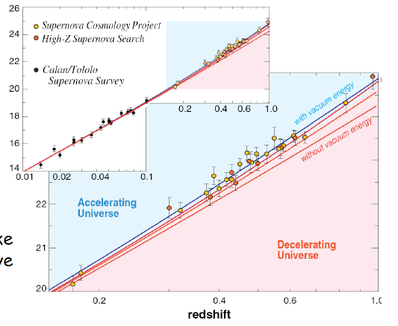
The Universe expansion is accelerating
In 1998, two groups used distant Supernovae to measure the expansion rate of the universe: Perlmutter et al. (Supernova Cosmology Project), and Schmidt et al. (High-z Supernova Team)
They got the same result:
The Universe expansion is accelerating
Some form of energy (dark energy) fills space

Slide 35
Vacuum energy density
Dark energy responsible for acceleration of expansion is very small
From particle physics we know that Vacuum has energy:
potential energy of scalar fields
energy of quantum fluctuations as predicted by quantum mechanics
This vacuum energy is 100 orders of magnitude larger than dark energy!
This huge discrepancy is known as the vacuum catastrophe.

Slide 36
The Terascale
The Standard Model would fail at high energy without the Higgs particle or other ‘new physics’
Based on the available data and on quite general theoretical insights it was expected that the ‘new physics’ would manifest at an energy around
  1 Tera-electronVolt = 10¹² electronVolt
accessible at the LHC for the first time

Slide 37
End of Lecture 1

