Slide 1




Higgs Physics – Lecture 4
Higgs Physics at the LHC – suppressed and exotic channels, future directions
Ricardo Gonçalo – LIP
Course on Physics at the LHC – LIP, 11 May 2015
FCOMP-01-0124-FEDER-041830.

Slide 2
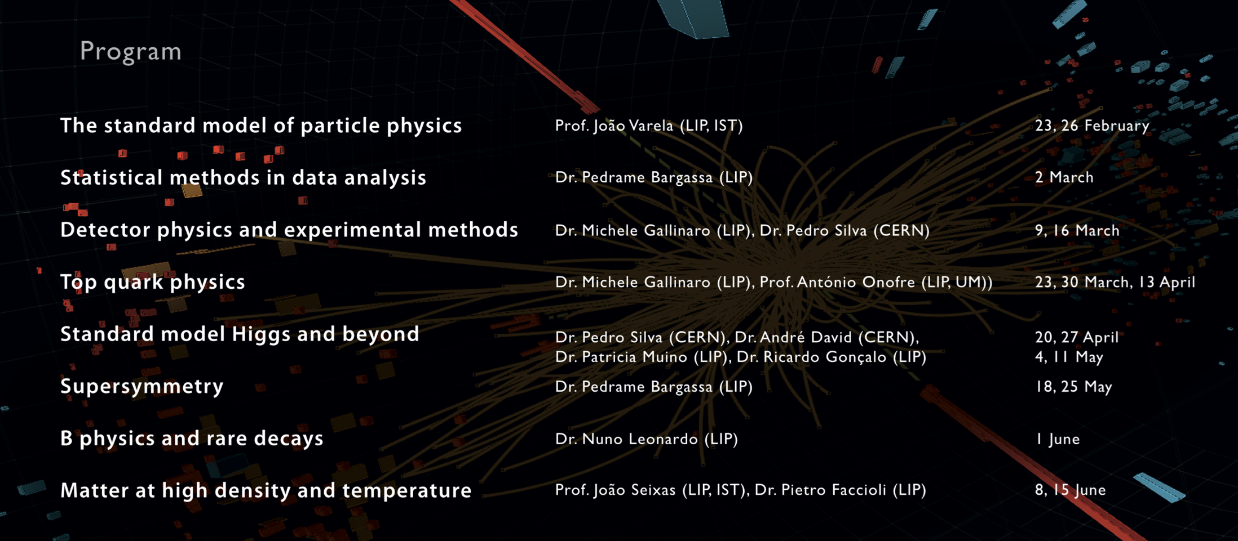
Outlook

Slide 3
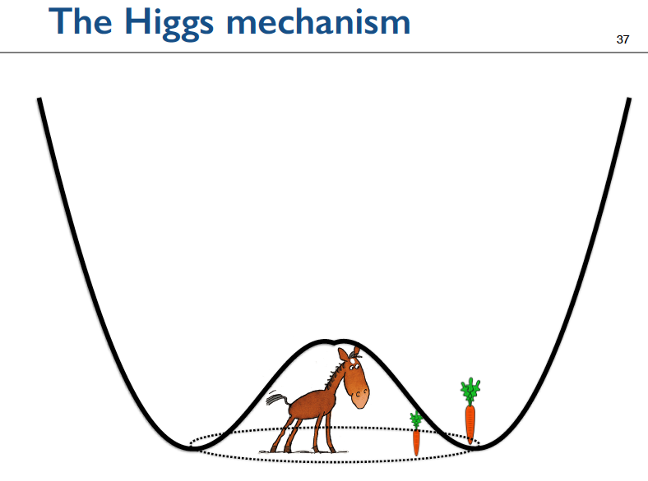
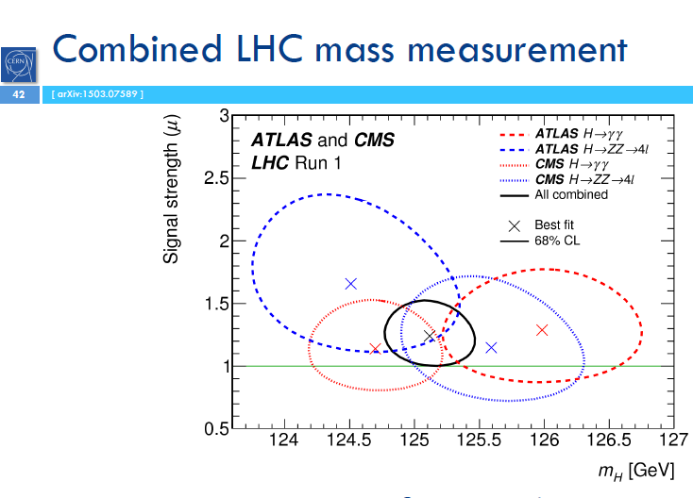
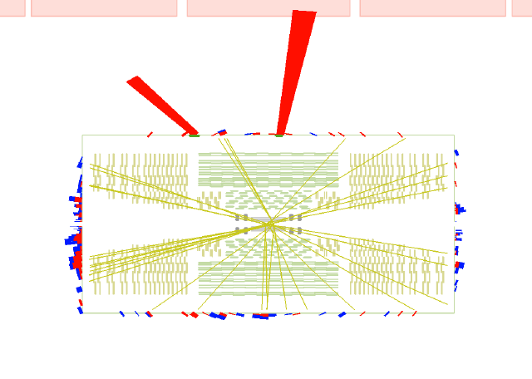
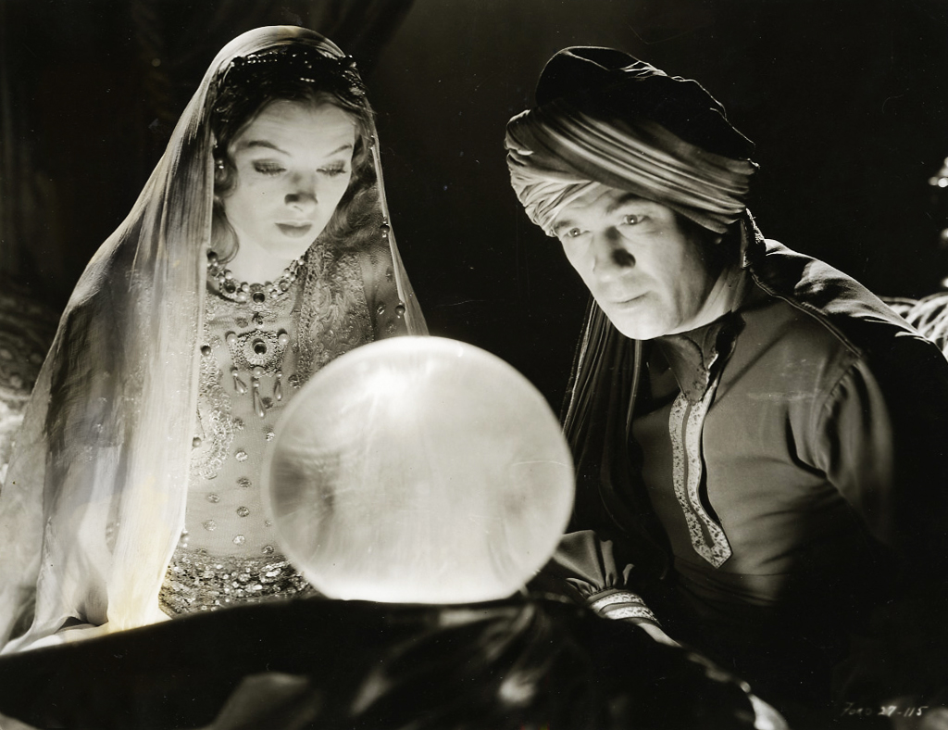
Higgs lectures so far…
Lecture 1
  Higgs & EWSB introduction
Lecture 2
  Higgs boson properties
Lecture 3
  Detailed experimental searches
This lecture
  Missing channels and the future…

Slide 4
This lecture
Recapitulation of previous Higgs lectures
  Higgs mechanism
  The state of the art
Beyond the Standard Model Higgs
  Constraints from Higgs couplings – 2HDM
  Exotic channels: invisible Higgs
  Rare channels: Higgs decay to J/Ψ plus γ
Future of Higgs physics at the LHC
  Higher luminosity and higher energy
  Precision and new measurements

Slide 5
Recap of previous lectures

Slide 6
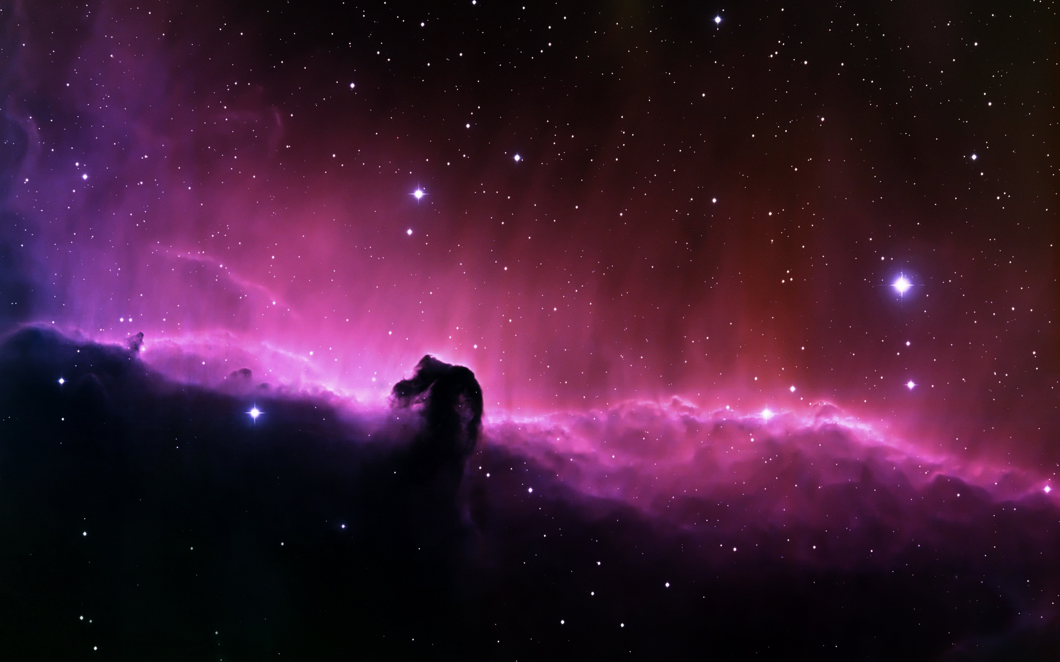
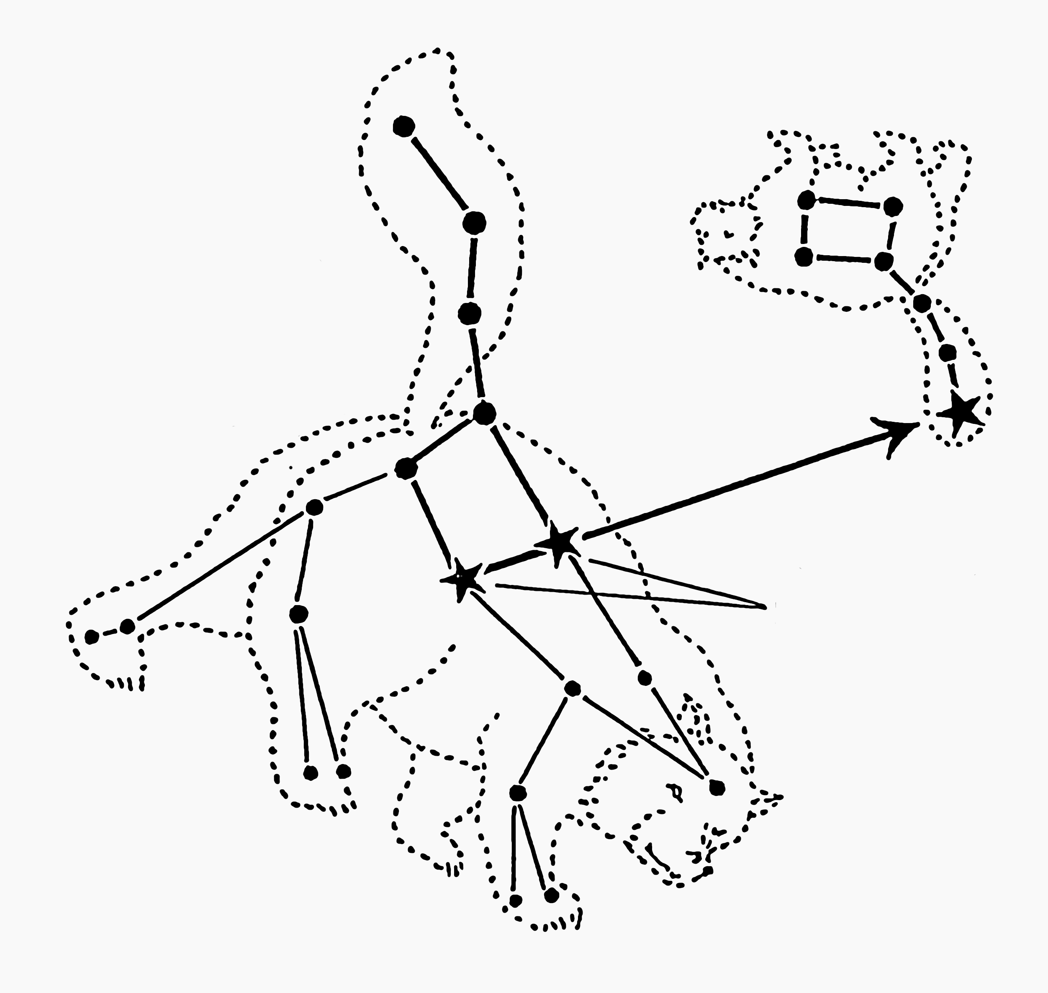

?
?
?
?

Slide 7


?
?
?
?
?

Slide 8
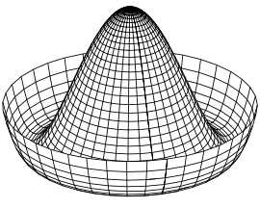
The Standard Model Higgs Mechanism
In the Standard Model with no Higgs mechanism, interactions are symmetric and particles do not have mass
The symmetry between the electromagnetic and the week interactions is broken:
  Photon does not have mass
  W, Z have a large mass
Higgs mechanism:
  mass of W and Z results from the Higgs mechanism
see J.Varela’s lecture

Slide 9
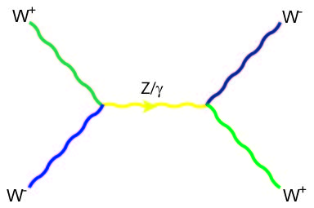
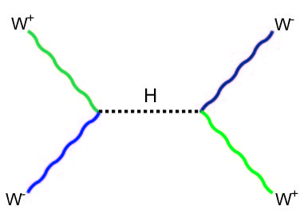


Added bonus
Non-zero average value of the Higgs field can also give masses to the quarks, electrons and muons – to all point-like particles.
Old theoretical problem affecting the quantum theory of the weak force :
  the probability of two W’s interacting becomes larger than 1 at high energies (> 1 TeV).
Solved by the Higgs field!
+

Slide 10
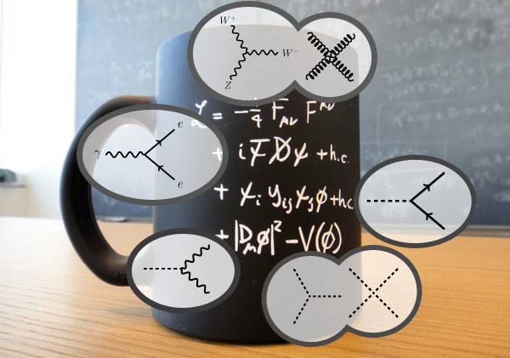
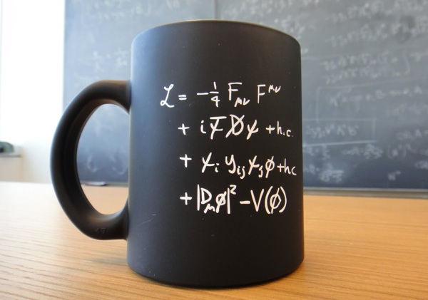
Lagrangians and coffee mugs
Throughout history, we have been looking mostly at the second line
Interactions between fermion matter particles transmitted by force carriers
I.e. all of chemistry and most of physics
Disclamer: gravity not on the mug

Slide 11
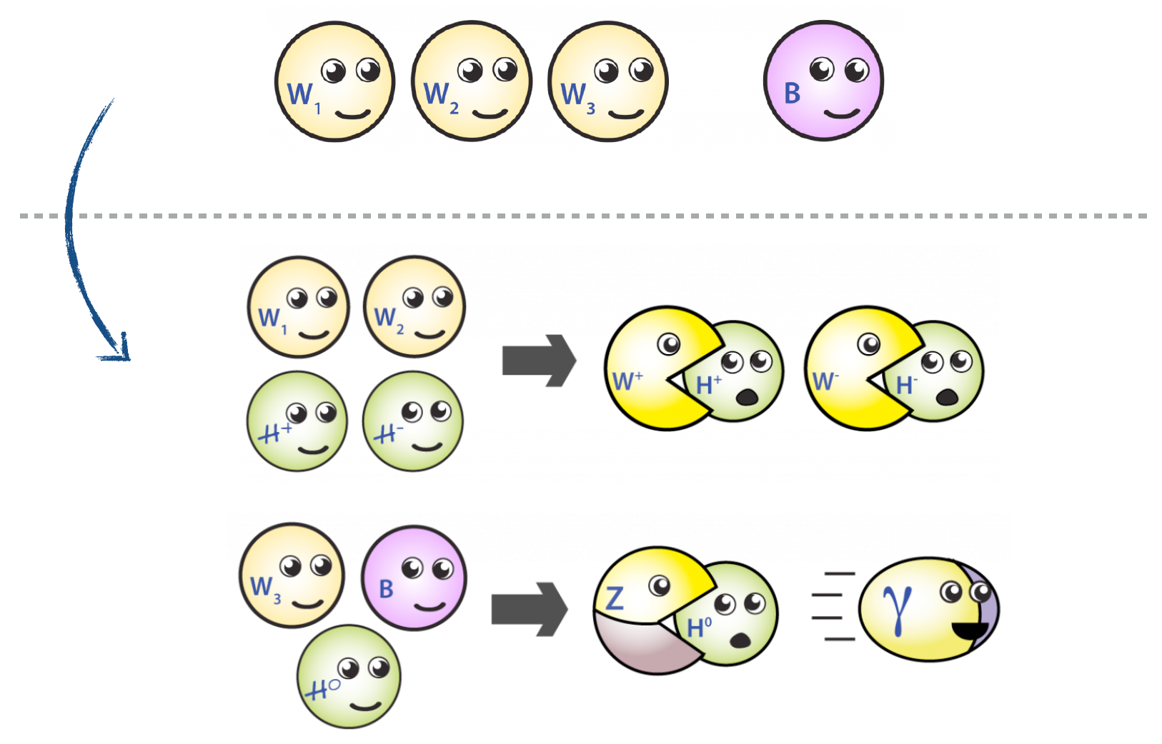
Electroweak symmetry breaking
see P.Silva’s lecture

Slide 12



Wikipedia wisdom
Electroweak Lagrangian before spontaneous symmetry breaking
Electroweak gauge bosons: B⁰ W⁰ W±
Fermion kinetic terms
Higgs term (note: vacuum expectation value zero before symmetry breaking)
Yukawa interaction term between Higgs field and fermions

Slide 13

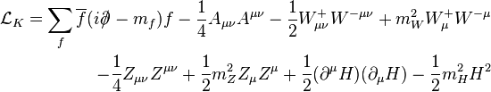
Wikipedia wisdom
After electroweak symmetry breaking
Spontaneous symmetry breaking:
New bosons γ and Z⁰ from W⁰ and B⁰
Kinetic terms: notice boson masses for Z⁰,W±, H

Slide 14
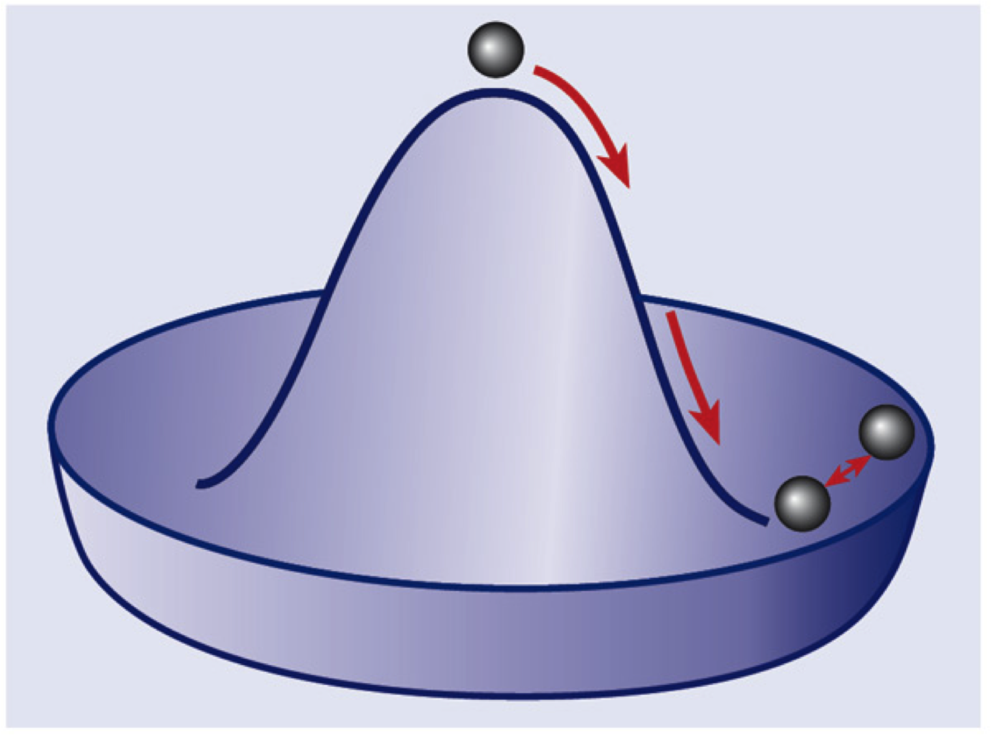


Wikipedia wisdom
Higgs boson mass: transverse oscillation modes
Higgs boson 3- and 4-point self-interaction
Yukawa interactions between Higgs and fermions: note fermion masses!

Slide 15
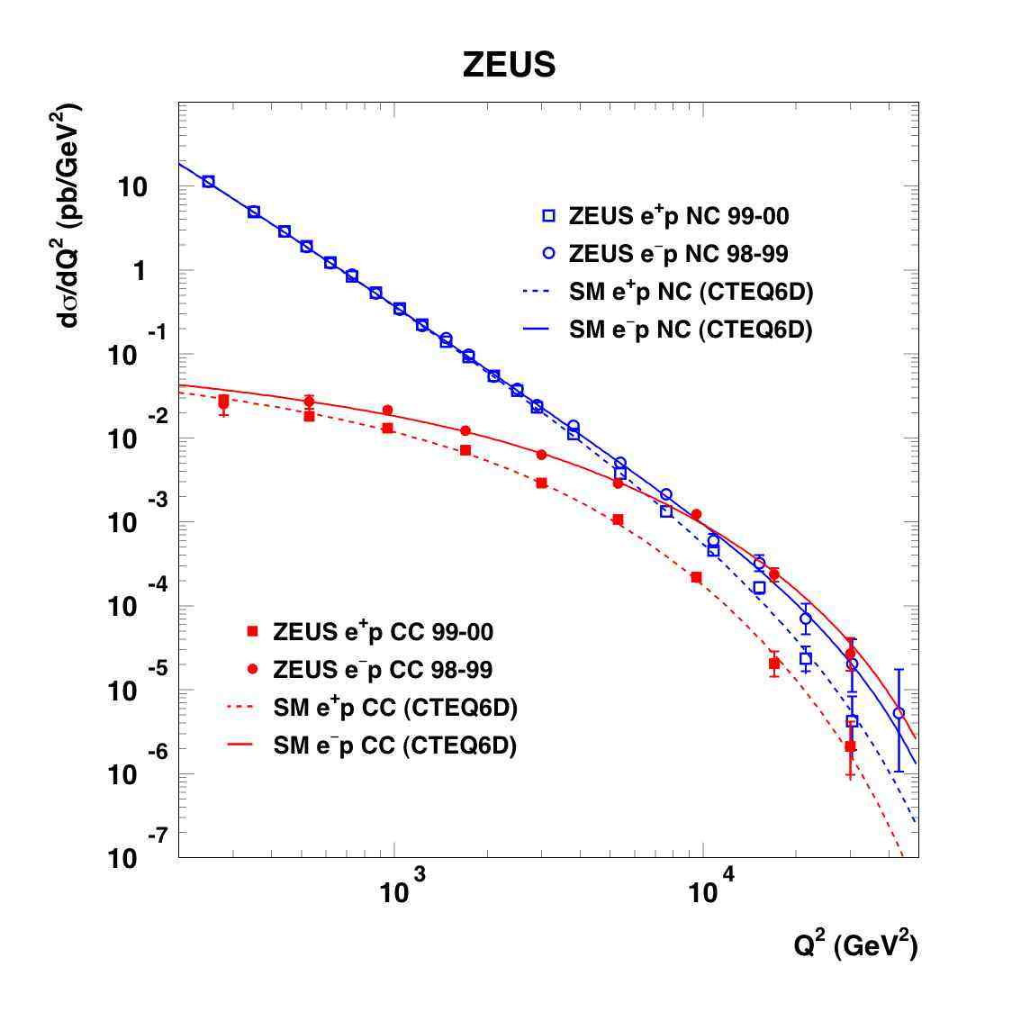
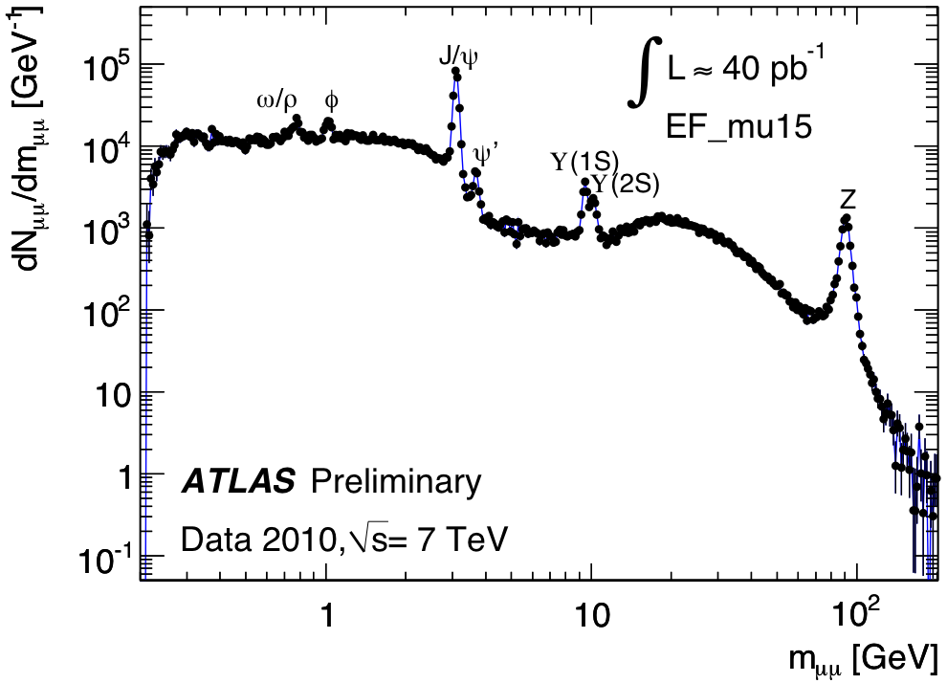
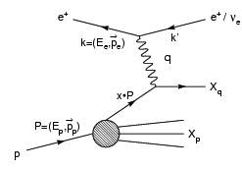
Why does it matter?
Because it’s real!
  Data shows Higgs mechanism (or something like it) needed in the theory
Because it may lead us to new discoveries and a new understanding of Nature!
  “There is nothing so practical as a good theory” (Kurt Lewin)
Z/γ
W±
http://www-zeus.desy.de/physics/sfew/PUBLIC/sfew_results/preliminary/dis04/

Slide 16


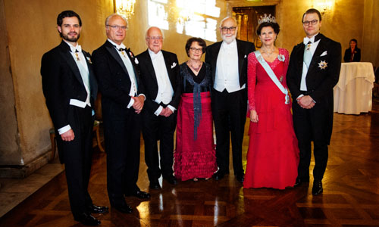

http://www.nobelprize.org/

Slide 17
Going beyond the standard model
But the Standard Model is not complete; there are still many unanswered questions.
Why do we observe matter and almost no antimatter if we believe there is a symmetry between the two in the universe?
What is this "dark matter" that we can't see that has visible gravitational effects in the cosmos?
Are quarks and leptons actually fundamental, or made up of even more fundamental particles?
Why are there exactly three generations of quarks and leptons? What is the explanation for the observed pattern for particle masses?
How does gravity fit into all of this?

Slide 18
Many possible theories
There are a large number of models which predict new physics at the TeV scale accessible at the LHC:
Supersymmetry (SUSY)
Extra dimensions
Extended Higgs Sector e.g. in SUSY Models
Grand Unified Theories (SU(5), O(10), E6, …)
Leptoquarks
New Heavy Gauge Bosons
Technicolour
Compositeness
Any of this could still be found at the LHC

Slide 19
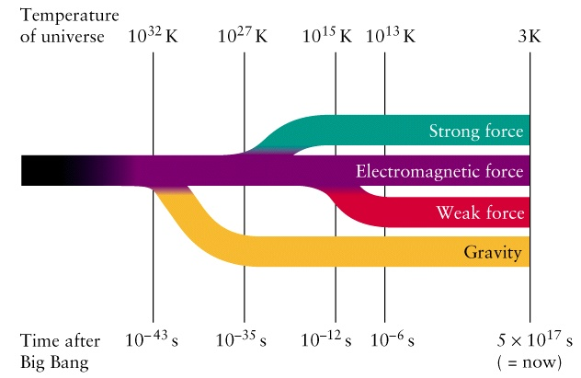
Forces and expansion of the Universe
E=k. T
k=8.62 10⁻⁵ eV K⁻¹
LHC

Slide 20
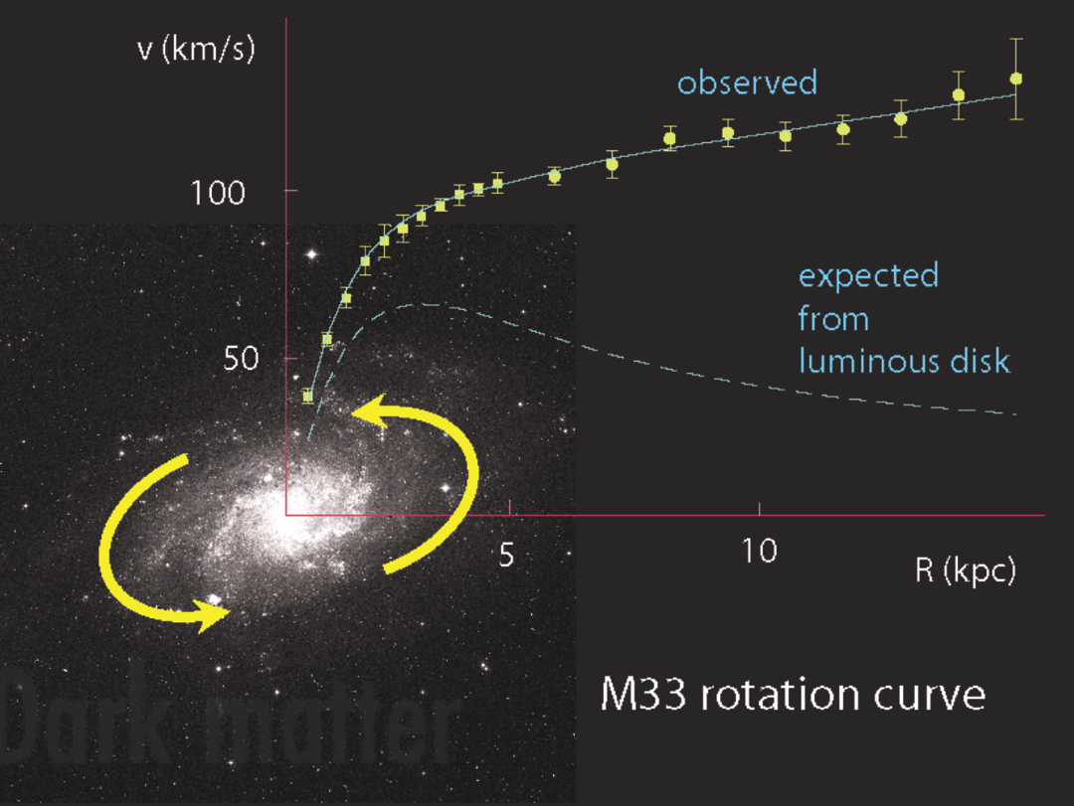
The dark side of the Universe
Long standing problem:
  We know that ordinary matter is only ~4% of the matter-energy in the Universe.
  What is the remaining 96%?
The LHC may help to solve this problem, discovering dark matter

Slide 21
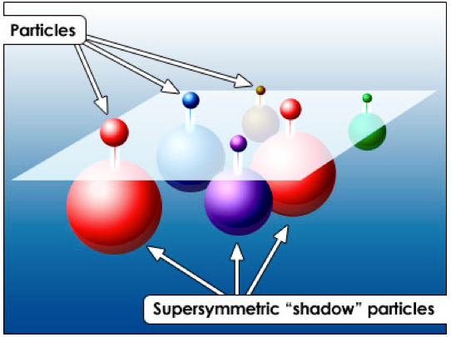
Supersymmetry
Some physicists attempting to unify gravity with the other fundamental forces have proposed a new fundamental symmetry:
  Every fermion should have a massive "shadow" boson
  and boson should have a massive "shadow" fermion.
This relationship between fermions and bosons is called supersymmetry (SUSY)
No supersymmetric particle has yet been found, but we will now explore a much bigger kinematic region … more news soon!

Slide 22
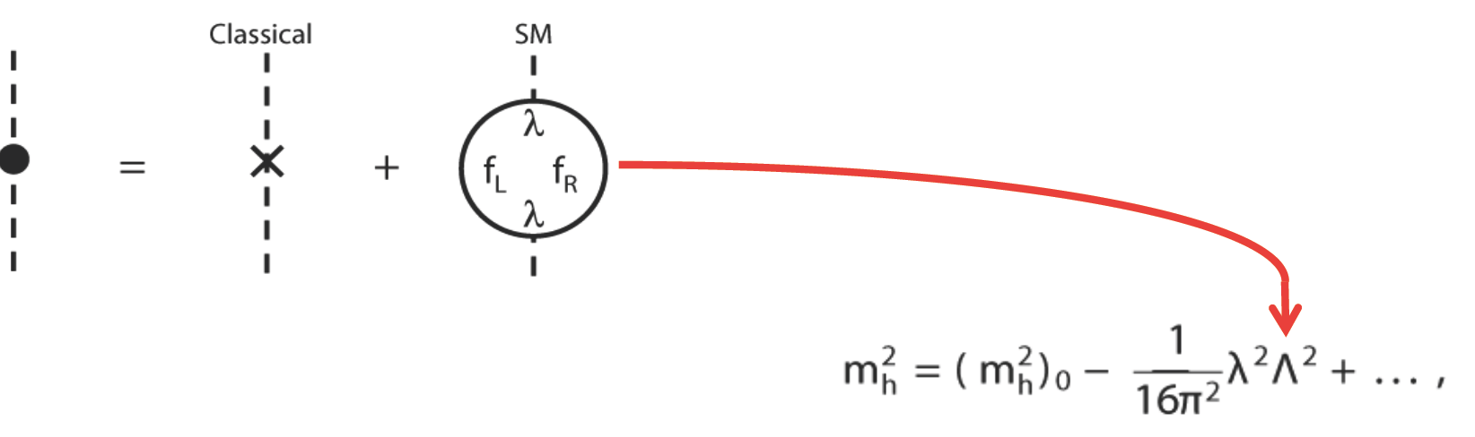
Higgs and hierarchy problem
In the SM the Higgs mass is a huge problem:
Virtual particles in quantum loops contribute to the Higgs mass
Contributions grow with Λ (upper scale of validity of the SM)
Λ could be huge – e.g. the Plank scale (10¹⁹ GeV)
Miraculous cancelations are needed to keep the Higgs mass < 1 TeV
This is known as the hierarchy problem

Slide 23
SUSY and the Higgs mass
Cancellation
Higgs mass:
correction has quadratic divergence!
  Λ a cut-off scale – e.g. Planck scale
Superpartners fix this:
Need superpartners at mass ~1-2 TeV
  Otherwise the logarithmic term becomes too large, which would require more fine-tuning.

Slide 24
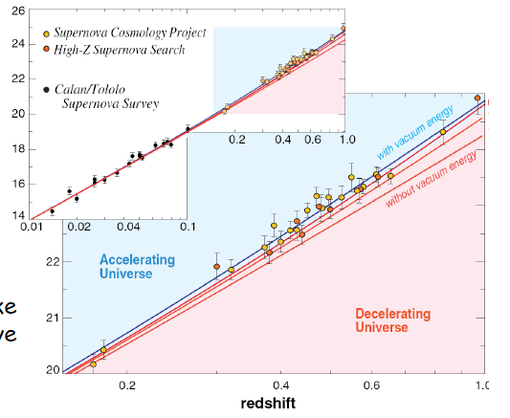
The Universe expansion is accelerating
In 1998, two groups used distant Supernovae to measure the expansion rate of the universe: Perlmutter et al. (Supernova Cosmology Project), and Schmidt et al. (High-z Supernova Team)
They got the same result:
The Universe expansion is accelerating
Some form of energy (dark energy) fills space

Slide 25
Vacuum energy density
Dark energy responsible for acceleration of expansion is very small
From particle physics we know that Vacuum has energy:
potential energy of scalar fields
energy of quantum fluctuations as predicted by quantum mechanics
This vacuum energy is 100 orders of magnitude larger than dark energy!
This huge discrepancy is known as the vacuum catastrophe.

Slide 26
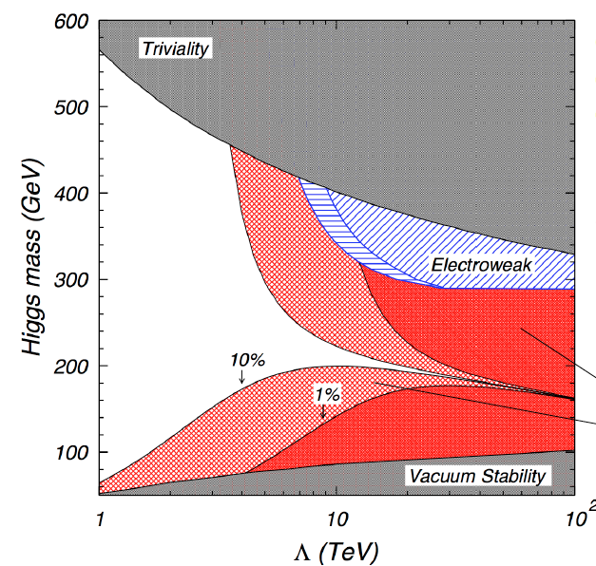
New physics at a few TeV?
Naturalness implies Supersymmetry or another ‘New Physics’ below ~ 2 TeV
125 GeV
Excluded to avoid fine-tuning
2 TeV
Λ – Scale of New Physics

Slide 27
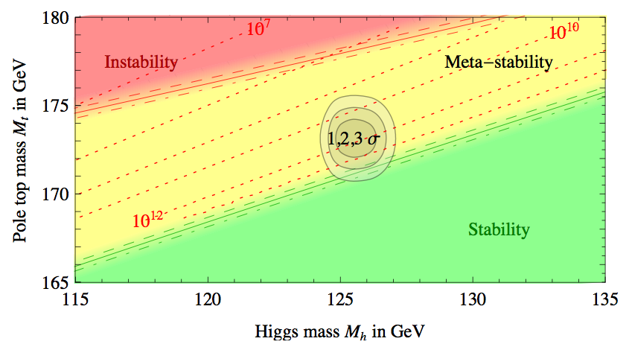
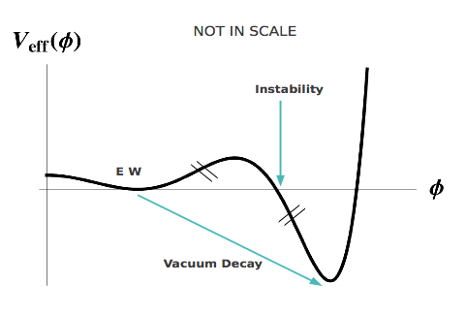
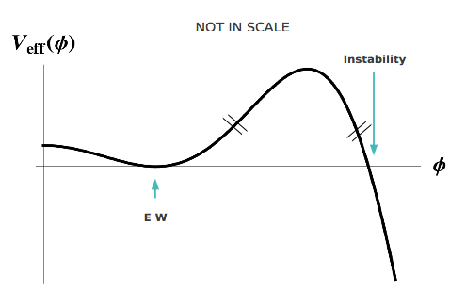
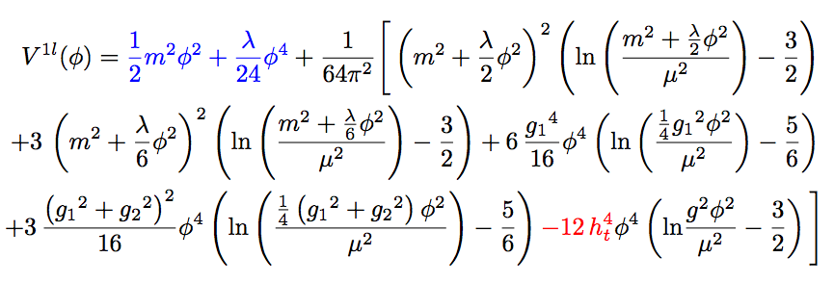
A bit of fun…
1-loop effective potential
RG-improved potential
What if…
  At higher orders, Higgs potential doesn’t have to be stable
  Depending on m_{t} and m_{H} second minimum can be lower than EW minimum ⇒ tunneling between EW vacuum and true vacuum?!
“For a narrow band of values of the top quark and Higgs boson masses, the Standard Model Higgs potential develops a shallow local minimum at energies of about 10¹⁶ GeV, where primordial inflation could have started in a cold metastable state”, I. Masina, arXiv:1403.5244 [astro-ph.CO]
  See also: V. Brachina, Moriond 2014 (Phys.Rev.Lett.111, 241801 (2013)), G. Degrassi et al, arXiv:1205.6497v2; R.Contino, Workshop sulla fisica p-p a LHC, 2013

Slide 28
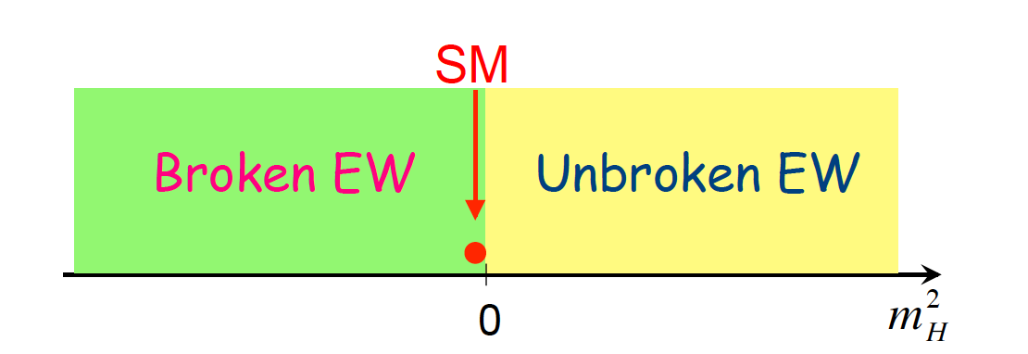

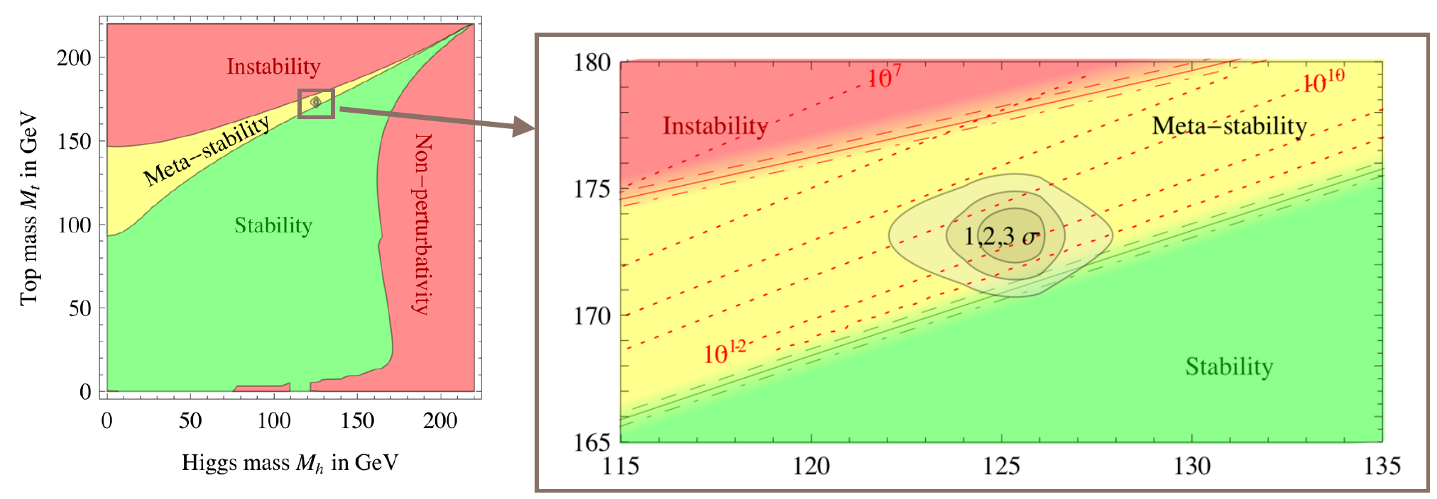
The universe seems to live near a critical condition
JHEP 1208 (2012) 098
Why?!
Explained by underlying theory?
Anthropic principle?

Slide 29
?
?
?
?
?
?
Back to the big questions!!

Slide 30
In the meantime at the LHC…

Slide 31
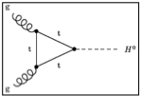
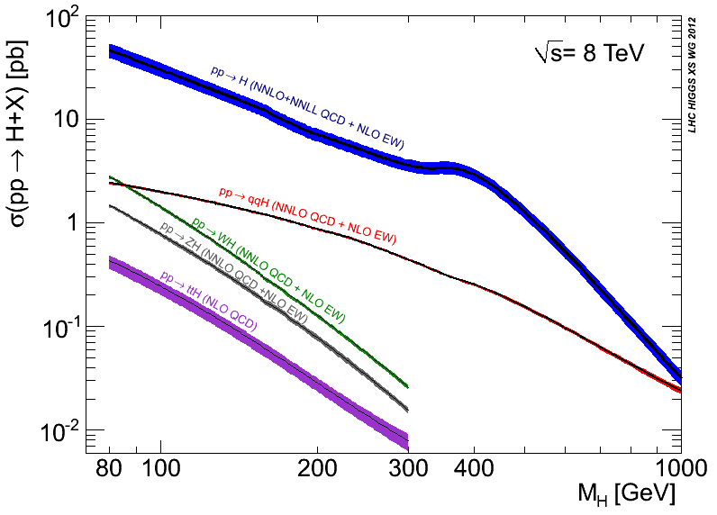
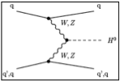
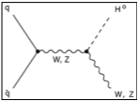
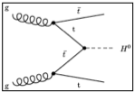
https://twiki.cern.ch/twiki/bin/view/LHCPhysics/CrossSections
gluon-fusion
VBF
WH
ZH
ttH
See previous lectures
Notes:
Main production channels: gluon fusion, Vector Boson Fusion, associated production with vector bosons, associated production with ttbar pair
Animation

Slide 32
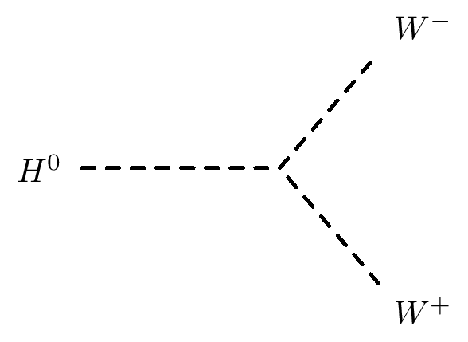
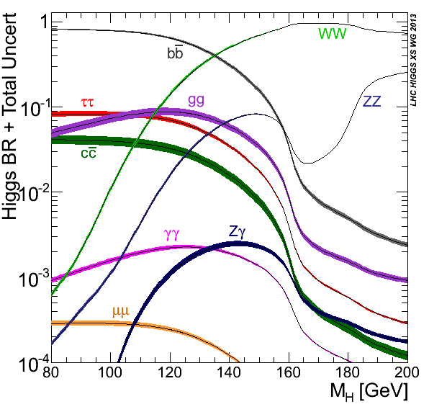
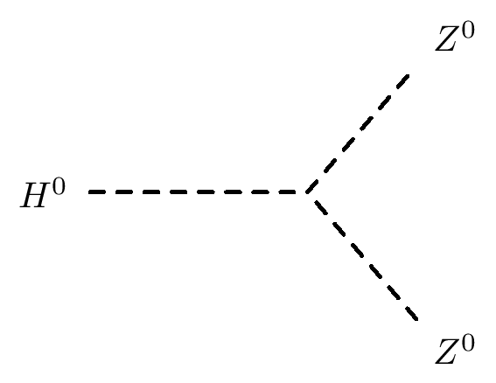
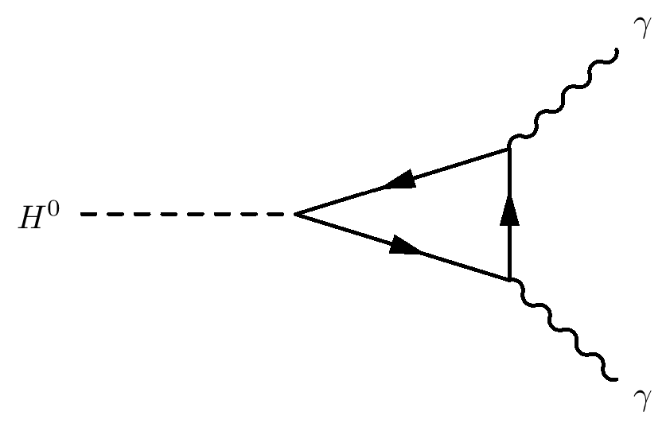

Slide 33
Where do we stand?

Slide 34
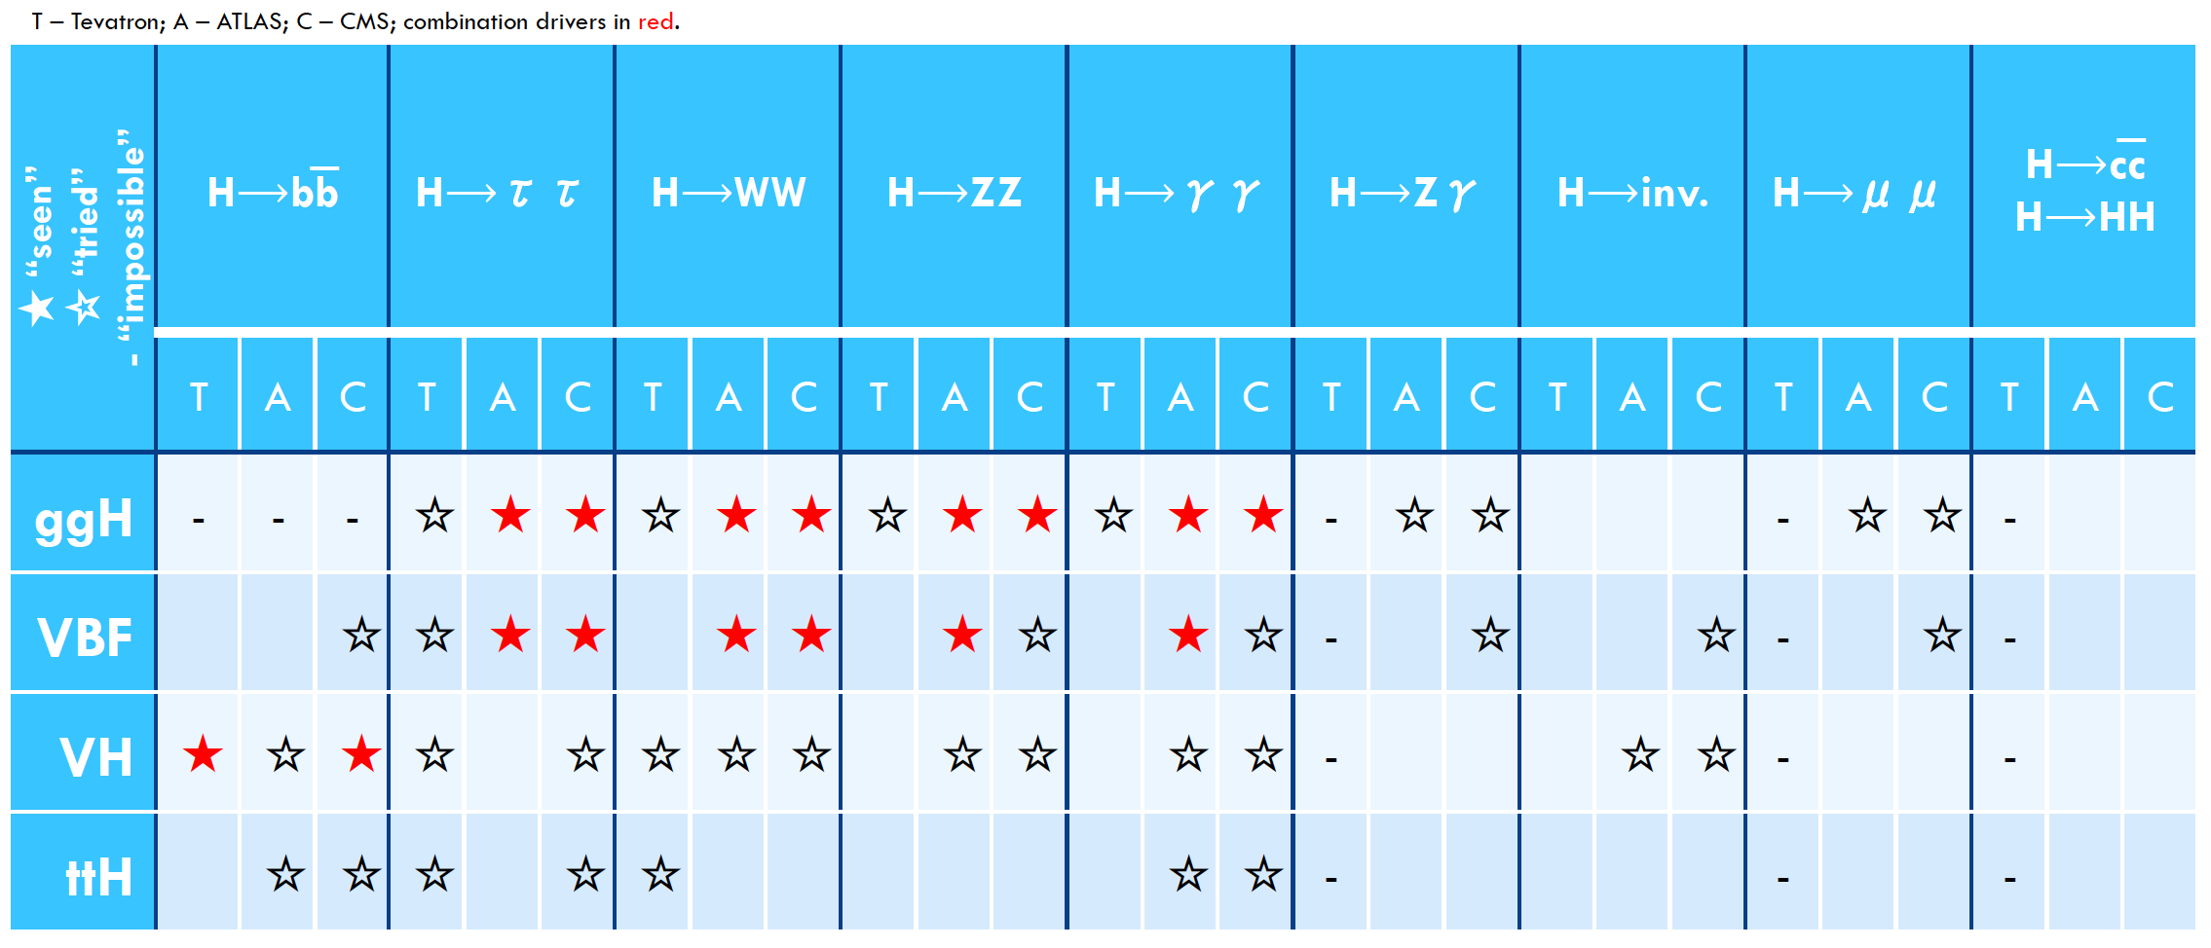
Most modes available with current lumi explored
Precision: obvious signal in bosonic decays
  Mass around 125GeV
  Signal strength consistent with SM – some questions
  Main alternatives to J^{P} = 0⁺ discarded – questions remain
Fermion couplings seen in H➞ττ (4σ)
Evidence for VBF production (3σ)
Mainly indirect sensitivity to ttH coupling through loops
Many direct searches for other Higgses turned out nothing (yet)
 | H➞γγ | H➞WW | H➞ZZ | H➞bb | H➞ττ | H➞Zγ | H➞μμ | H➞cc | H➞HH | H➞inv
ggF | ✔ | ✔ | ✔ |  | ✔ | ✔ | ✔
VBF | ✔ | ✔ | ✔ |  | ✔ | ✔ | ✔ |  |  | ✔
VH | ✔ | ✔ | ✔ | ✔ | ✔ |  |  |  |  | ✔
ttH | ✔ | ✔ | ✔ | ✔ | ✔
See A.David and P.Conde’s lectures

Slide 35
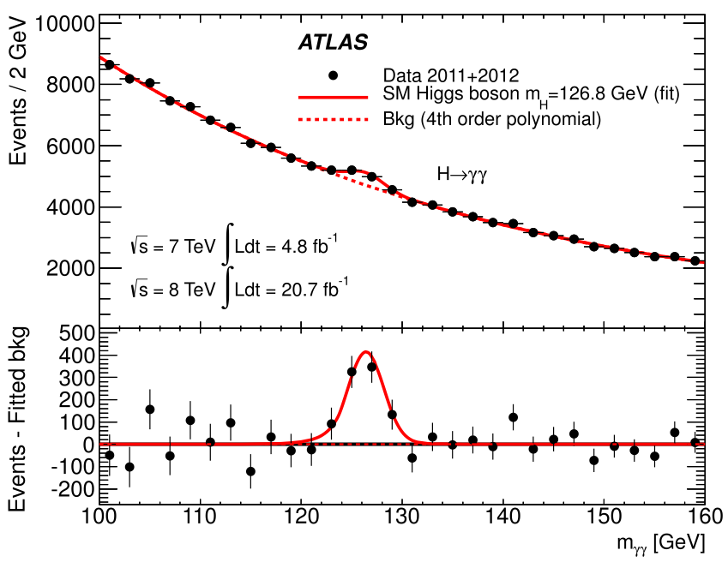
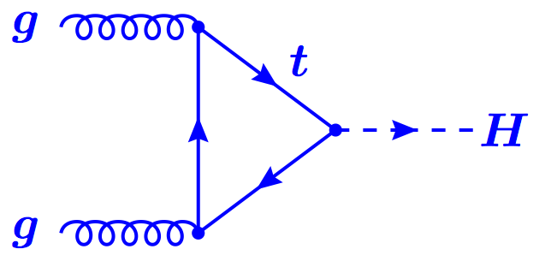
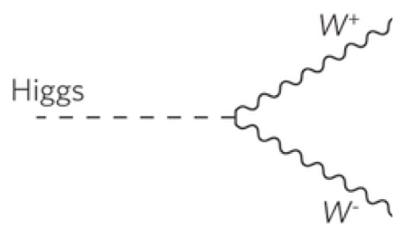
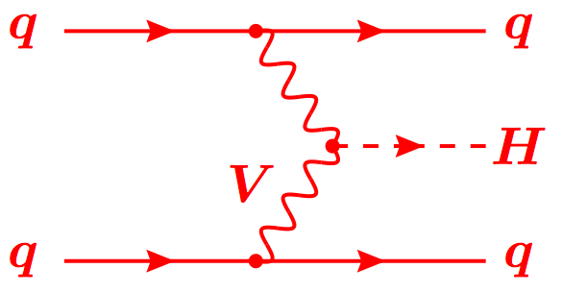
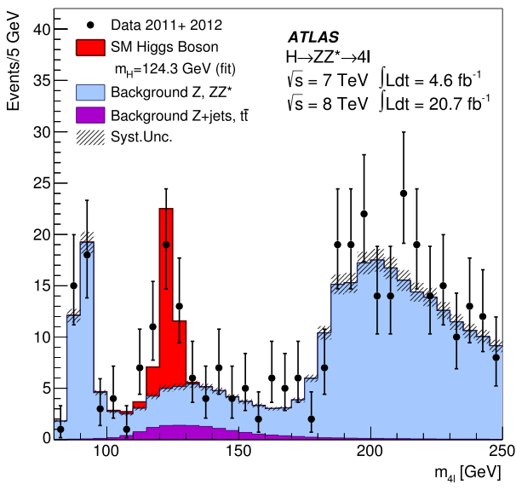
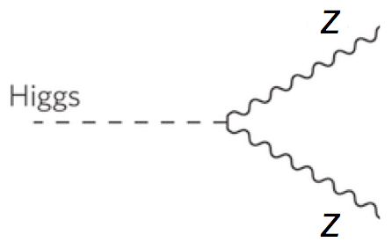
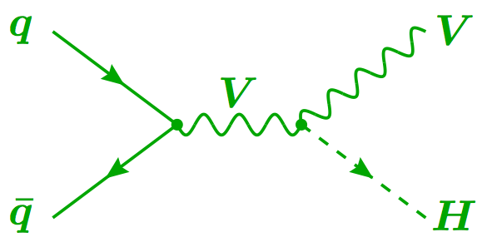
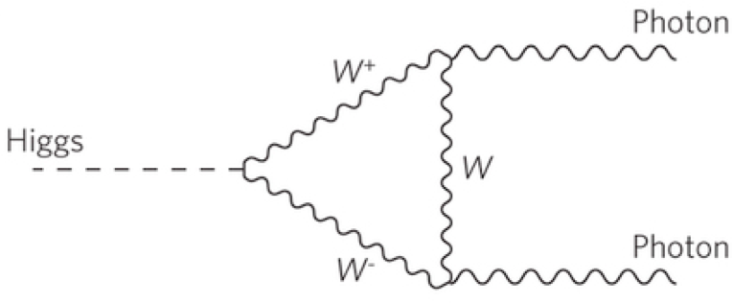
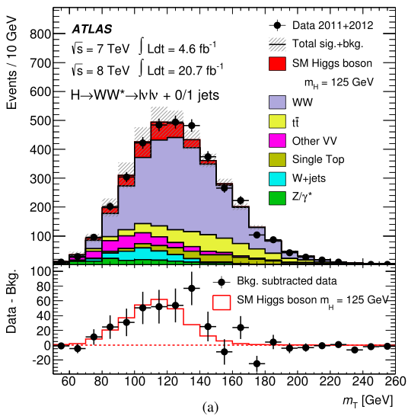

Combining Higgs Channels
Production
Decay
H->γγ
FIT
×
H->ZZ
H->WW
t
t
t
Backgrounds +
See A.David’s lecture

Slide 36
A bit more technically
Assumptions:
  Single resonance (at m_{H} = 125.5GeV)
  No modification of tensor structure of SM Lagrangian:
    i.e. H has J^{P} = 0⁺
  Narrow width approximation holds
    i.e. rate for process i ➔ H ➔ f is:
Free parameters in framework:
  Coupling scale factors: κ_{j}²
  Total Higgs width: κ_{H}²
  Or ratios of coupling scale factors: λ_{ij} = κ_{i} / κ_{j}
Tree-level motivated framework
  Useful for studying deviations in data with respect to expectations
    E.g. extract coupling scale factor to weak bosons κ_{V} by setting κ_{W} = κ_{Z} = κ_{V}
  Not same thing as fitting a new model to the data

Slide 37

Higgs boson mass
Mass: around 125GeV
  Used to be the only unknown
  SM-Higgs parameter, remember? ☺
ATLAS: arXiv:1307.1427
  m_{H}^{H->4l} = 124.3 ±0.6(stat) ±0.5(sys)
  m_{H}^{H->γγ} = 126.8 ±0.2(stat) ±0.7(sys)
  Assuming single resonance:
  m_{H} = 125.5 ±0.2(stat) ^{+0.5}_{-0.6}(sys)
Tension between channels!
  Compatibility P=1.5% (2.4σ)
  Rises to 8% with square syst.prior
BUT:
CMS: arXiv:1312.5353
  m_{H}^{H->4l} = 125.6 ±0.4(stat) ±0.6(sys)
CMS: CMS-PAS-HIG-13-005
  m_{H}^{H->γγ} = 125.4 ±0.5(stat) ±0.6(sys)
Doesn’t look like two different resonances!...
  ATLAS: arXiv:1307.1427
CMS

Slide 38



Spin and Parity
Pure J^{P} = 0⁻, 1⁺, 1⁻, and 2⁺ excluded with 97.8, 99.97, 99.7, and 99.9% Confidence Level (ATLAS arXiv 1307.1432)
But note: Higgs could have CP-violating component!
H->γγ – ATLAS arXiv 1307.1432

Slide 39



Direct Evidence of Fermion Couplings
Challenging channels at the LHC!
  Huge backgrounds (H->bb,H->ττ)
  Or low rate: H->μμ
ATLAS:
  4.1σ evidence of H->ττ decay 3.2σ exp.
  μ = σ_{obs.}/σ_{SM} = 1.4 ±0.3(stat) ±0.4(sys)
CMS:
  Combination of H->bb and H->ττ:
  3.8σ evidence (obs.) 4.4σ (expected)
  μ = σ_{obs.}/σ_{SM} = 0.83 ±0.24
ATLAS-CONF-2013-108
CMS 1401.6527
CMS 1401.6527

Slide 40




Higgs Width
Total width not measurable at the LHC
  Hadronic decays invisible in huge jet background
Sensitivity can be achieved through “interferometric” measurement
  Use gg➞H➞ZZ with H on- or off-shell
Proof of principle done, although still very far from theoretically expected value (4MeV)
  Γ_{H} < 22 MeV at 95% CL
http://arxiv.org/pdf/1405.3455.pdf

Slide 41


Signal strength
Take-home messages:
Need more data!
Always run two experiments!

Slide 42


Fermion and Boson couplings from fit
Set one scale factor for all fermions (κ_{F} = κ_{t} = κ_{b}= κ_{τ} =…) and one for all vector bosons (κ_{V} = κ_{Z} = κ_{W})
Assume no new physics
Strongest constraint to κ_{F} comes form gg->H loop
ATLAS and CMS fits within 1-2σ of SM expectation (compatibility P=12%)
Note ATLAS and CMS κ_{V} different – see signal strength below
ATLAS 1307.1427
CMS public page

Slide 43

Production Modes
Combination of channels allows consistency checks
Evidence for VBF production (3σ)
Sensitivity to top Yukawa coupling only through loops so far

Slide 44


New Physics in the Loops?
W
New heavy particles may show up in loops
  Dominant gluon-fusion through a (mostly) top loop production for H->ZZ, H->WW and H->γγ
  H->γγ decay through top and W loops (and interference)
Assume no change in Higgs width and SM couplings to known particles
Introduce effective coupling scale factors:
  κ_{g} and κ_{γ} for ggH and Hγγ loops
W
t
t
t
ATLAS 1307.1427
Best fit values: κ_{g} = 1.04 ± 0.14, κ_{γ} = 1.20 ± 0.15
Fit within 2σ of SM (compatibility P=14%)

Slide 45
Going beyond the Standard Model

Slide 46

Two Higgs Doublet Model (2HDM)
No reason for simplest Higgs sector scenario to be true!
One of the simplest alternatives: 2 Higgs doublets
Leads to 5 different Higgs bosons:
  CP even (scalar): h, H
  CP odd (pseudoscalar): A
  charged: H⁺, H⁻
  Two doublets => two vacuum expectation values (mean field strength in the vacuum) – v₁ and v₂

Slide 47

Two Higgs Doublet Model (2HDM)
Free parameters:
  4 masses (Do we know one? Assume it’s m_{h})
  tan β = v₁/v₂ ratio of v.e.v.’s
  Mixing angle of h and H: α
4 possible Yukawa coupling arrangements (“types”)
Most common SUSY benchmark (MSSM) is based on Type II
If cos(β-α) = 0, h = Standard Model H⁰

Slide 48

Constraints from SM channels
What can our data already say about the 2HDM?
  If it exists in Nature, then some of the measured rates (signal strength) are modified
  Existing measurements can already rule out many possibilities
  Used final states γγ, ZZ, WW, bb, ττ
ATLAS-CONF-2014-010

Slide 49



Invisible Higgs
Direct searches for Dark Matter usually hidden in deep caverns for low noise. But there is another way…
  Dark matter has mass! Should couple to the Higgs. Do we see it?
  Weakly interacting particles would leave no trace in detector – “Invisible” Higgs decays
  Could be e.g. neutralinos in SUSY scenario
  Would contribute to total Higgs width

Slide 50


Invisible Higgs
Require dileptons from Z
Back to back with Missing E_{T} and p_{T}(ll)
No jets
Main backgrounds ZZ, WZ
Claire Shepherd-Themistocleous - 26th Rencontres de Blois 2014

Slide 51

Z(H -> Invisible): Analysis Strategy
R.Vanguri, Lake Louise Winter Institute 2015

Slide 52


Invisible Higgs
90% CL limits
Upper limit Br to inv. 75%
Upper limit interpreted as limit on DM-nucleon scattering cross section
Fox et al. Phys. Rev. D 85 050611
DM scenarios scalar, vector or Majorana fermion
Higgs-nucleon coupling 0.33 ^{+0.30}_{-0.07} Djouadi et al. Phys. Lett. B 709 65 (2012)

Slide 53




Invisible Higgs
Other search channels:
Search in VBF and ZH , Z → ll and bb
VBF mode requires 2 jets in forward region
( Δη_{jj} > 4.2 ) , E_{t}^{miss} > 130 GeV
Central jet veto on any jet p_{T} > 30 GeV.
Dominant beckgrounds
Z(νν) + jets, W(lν) + jets

Slide 54


Invisible Higgs
7 TeV 4.9 fb⁻¹ 8 TeV ~ 19 fb⁻¹
Upper limit on Br to invisible
0.58 for Higgs mass 125 GeV
m_{H}/2
Higgs nucleon coupling 0.33 (range 0.26 - 0.63)
DM scenarios scalar, vector or Majorana fermion

Slide 55

Rare decays
Only way to probe Higgs decays to charm – charm Yukawa coupling – at LHC
Deviations in coupling from SM value can lead to increase in branching fraction
Analysis also probes Z decays to J/Ψ or ϒ(nS) plus γ – improved LEP limits by 2

Slide 56

Backgrounds

Slide 57

Results
Upper limit set on branching fraction of H decay to J/Ψ plus γ at 95% confidence:
Br (J/Ψ γ ) < 1.5 x 10⁻³ (expected 1.2^{+0.6}_{−0.3} x 10⁻³ )
540 ≈ SM Expectation

Slide 58
Looking into the future

Slide 59

Future LHC Running

Slide 60



Not only more luminosity
Higher centre of mass energy gives access to higher masses
Hugely improves potential for discovery of heavy particles
Increases cross sections limited by phase space
  E.g. ttH increases faster than background (factor 4)
But may make life harder for light states
  E.g. only factor 2 increase for WH/ZH, H➞bb and more pileup
  Could be compensated by use of boosted jet techniques (jet substructure)
http://www.hep.ph.ic.ac.uk/~wstirlin/plots/plots.html

Slide 61

Run II/High-Lumi LHC Programme
Precision AND searches!
Precision:
  Continue to look for deviations wrt Standard Model
Differential cross sections:
  New physics in loops could modify event kinematics
Complete measurement of properties:
  E.g. CP quantum numbers:
  Sensitivity in H➞ZZ and VBF
  Search for CP violation in Higgs sector
Search for rare decay modes:
  H➞HH to access self coupling (long term!)
Search for additional Higgs bosons:
  E.g. 2-Higgs Doublet Model is a natural extension and predicted in SUSY

Slide 62



Higgs differential cross sections
Get access to the loop structure where there may be new physics
ATLAS H→γγ and ZZ so far – more to come in run 2
W
W
W

Slide 63






Another example: ttH
Indirect constraints on top-Higgs Yukawa coupling from loops in ggH and ttH vertices
  Assumes no new particles contribute to loops
Top-Higgs Yukawa coupling can be measured directly
  Allows probing for New Physics contributions in the ggH and γγH vertices
Top Yukawa coupling Y_{t} = √2M_{t}/vev = 0.996±0.005
  Does this mean top plays a special role in EWSB?

Slide 64


Sensitivity to New Physics
Degrande et al. arXiv:1205.1065
Effective top-Higgs Yukawa coupling may deviate from SM due to new higher-dimension operators
  Change event kinematics – go differential!
ttH sensitive new physics: little Higgs, composite Higgs, Extra Dimensions,…
In the presence of CP violation, Higgs-top coupling have scalar (κ_{t})and pseudoscalar (˜κ_{t})components
  Strong dependence on ttH cross section
  Note: Indirect constraints from electron electric dipole moment not taken into account (give |˜κ_{t}| < 0.01)
Ellis et al. arXiv:1312.5736

Slide 65
Summary
Recapitulation:
  Electroweak symmetry breaking
  Higgs boson in Electroweak Lagrangian
  Higgs boson production and decay at the LHC
  The landscape at the end of LHC run I
The Higgs sector beyond the Standard Model
  Constraints from current data
  Examples of rare and exotic channels
Future Higgs measurements at LHC and beyond
  Fundamental questions at the end of run I
  Future LHC running – luminosity, energy, and physics reach
  Higgs physics in future LHC analyses – Precision and Searches
  An example: associated production with top-quark pair – SM and BSM

Slide 66



The End

