Slide 1


LIEBE project: WP3 – Construction and tests Project coordination meeting – 30/01/2015
M. Delonca on behalf of the WP3 contributors

Slide 2
Outline
Design:
Modifications since the Design Study report
Remaining open points
Prototyping:
LBE shower tests – results
HEX test – plan
Other prototype to be planned
Open points/conclusion

Slide 3
Design… … modifications since the Design Study report and open points

Slide 4
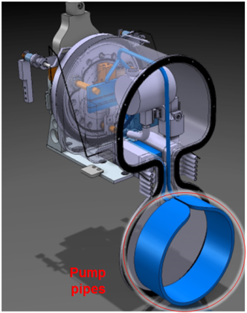
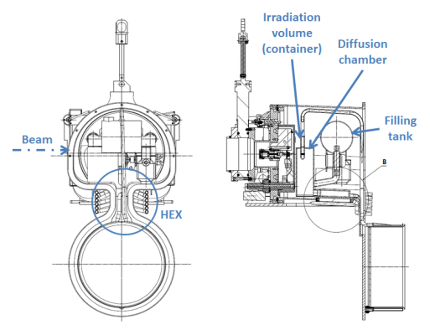
Proposed design – at the review

Slide 5
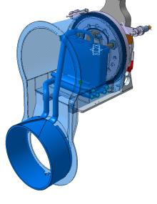
Proposed design – modifications (1)
HEX
Weight too high: an important part comes from the LBE in the diff chamber and in the HEX.

Slide 6
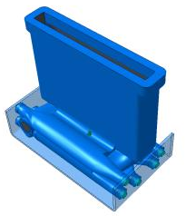
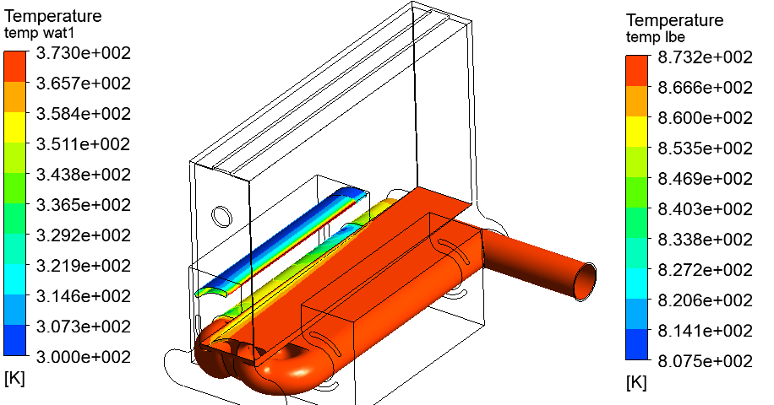
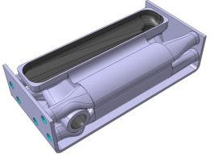
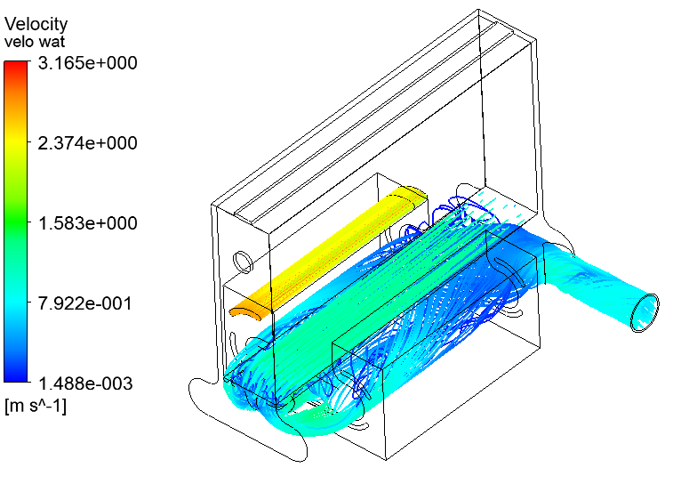
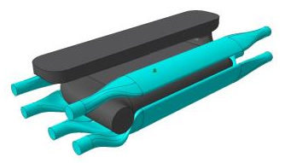
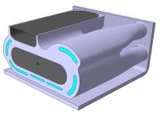
Proposed design – modifications (2)
HEX – detailed design – design validated by numerical analysis
Temperatures repartitions foo LBE and water
@ 600 ˚C – CFX analysis
No double confinement anymore!
Part built by additive manufacturing!
Velocity streamlines fro LBE and water @ 600 ˚C
CFX analysis

Slide 7
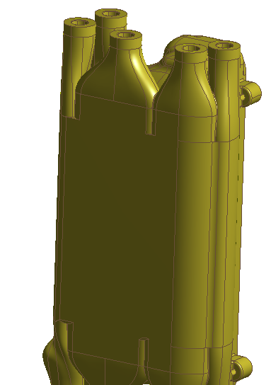
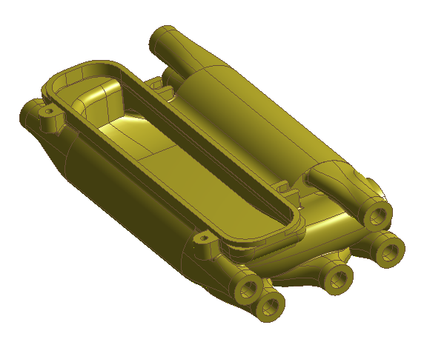
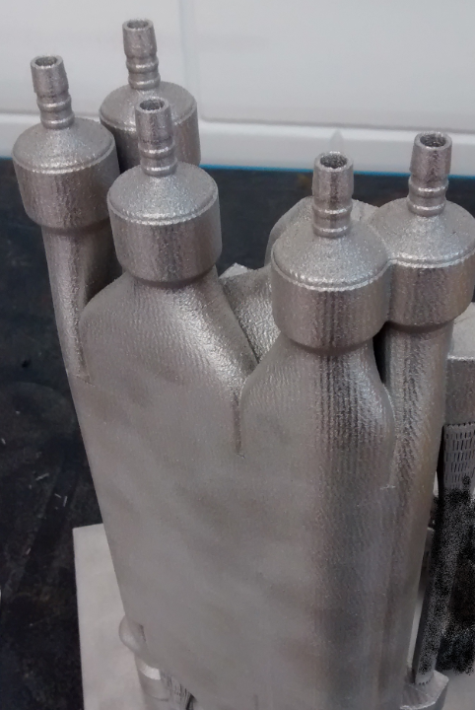
Proposed design – updates (3)
HEX – part already ordered for test – should be received next week
Part tested at 16 bars by the company
X-ray analysis provided as well
Chemical treatment for finer roughness inside the channel

Slide 8
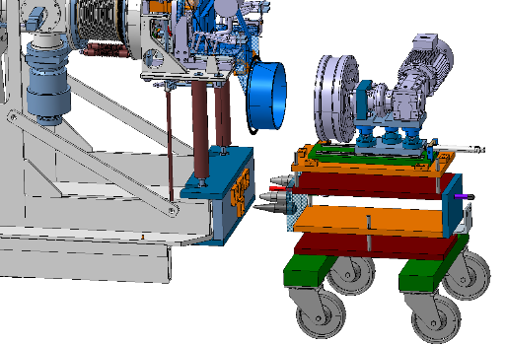
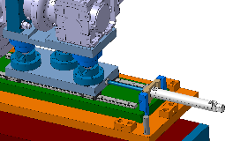
Proposed design – updates (4)
Coupling of the pump part and the main loop part – system proposed
positioning of the trolley regarding to the front end,
coupling of the trolley thanks to pre-guiding and guiding system,
translation of the engine/magnets part thanks to an actuator and sliding guide.
3
1

Slide 9
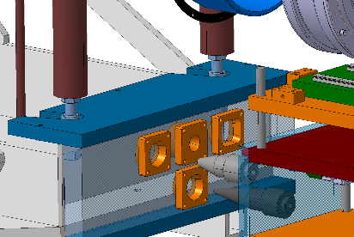
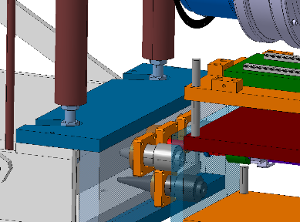
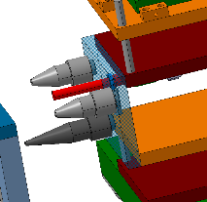
Proposed design – updates (5)
Coupling of the pump part and the main loop part – system proposed
positioning of the trolley regarding to the front end,
coupling of the trolley thanks to pre-guiding and guiding system,
translation of the engine/magnets part thanks to an actuator and sliding guide.
2
2

Slide 10
Proposed design – open points
Open points on the design:
Monitoring elements to be implemented,
filling procedure,
emptying procedure,
coupling to the Front end
Simulations remaining:
Shock waves coupled with flow (?),
Casserole integrity,
And validation of proposed design with prototype!

Slide 11
Prototyping… … LBE shower test - results

Slide 12
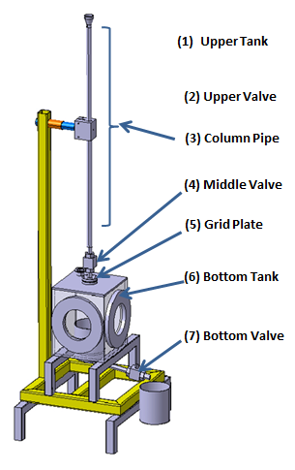
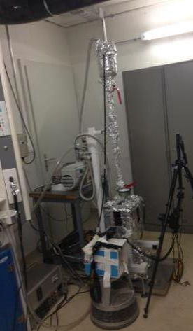
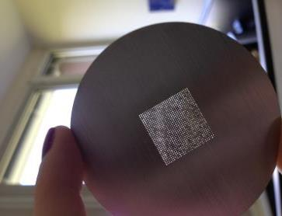
Prototypes – LBE shower test (1)
What is the proper spacing with LBE?
Volume of LBE per shower known (between the upper and middle valve)
4 grids to be tested (different spacing from 1 mm up to 0.4 mm), holes diameter of 0.1 mm.
5 showers per grids (repeatability)
Camera to take picture (3 per second)
Grid samples
Vacuum pump
Camera
Courtesy D. Grenier & T.M. Mendonca, CERN

Slide 13
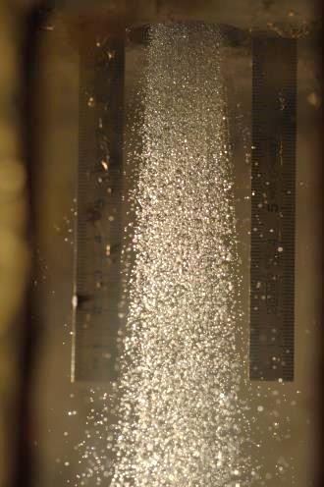
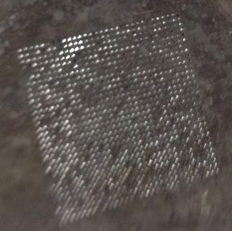
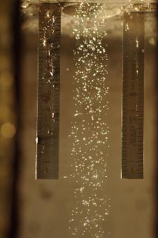
Prototypes – LBE shower test (2)
Observations:
Shower feasibility proven: smallest spacing between holes of 0,5 mm for 0,1 mm holes
Oxidation prevent a proper operation of the grid (analysis of the grid foreseen)
Size of droplets vary between the start and the end of the shower
After the serie of shower
Clogging visible
Shower at start.
Shower at the end.

Slide 14
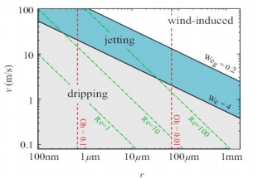
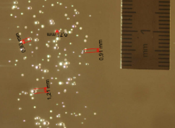
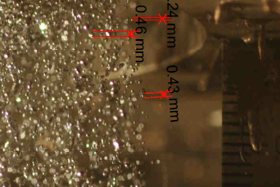
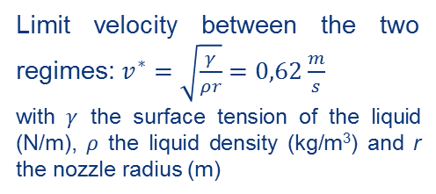
Prototypes – LBE shower test (3)
Classification of droplet formation regimes
Impact on the dimension of the droplets created
gobbling
Gobbling
Jetting
Hoeve et al. (2010) and C.Clasen et al (2008)
Limit velocity between the two regimes: $v^{∗}=\sqrt{\frac{γ}{ρr}}=0,62\frac{m}{s}$
with $γ$ the surface tension of the liquid (N/m), $ρ$ the liquid density (kg/m³) and r the nozzle radius (m)
Regime | Velocity | Calculated droplet diameter | Average droplet diameter - test
Gobbling | 0 to 0,62 m/s | ~ 1,2 mm | ~ 1 mm
Jetting | > 0,62 m/s | ~ 0,4 mm | ~ 0,4 mm
Good agreement between theory and experimental data (considering the measurements and post processing errors).
To obtain smaller droplets, the outlet velocity should be > 0,62 m/s (jetting regime).

Slide 15
Prototyping… … HEX test - plan

Slide 16
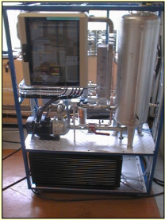
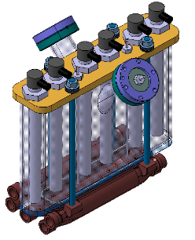
Prototypes – HEX (1)
HEX – test proposal – from Sevan Kelpentidjian
Ecal mobil unit will be borrowed from CV department
Heaters
Opening for filling
On the ECAL unit:
Pump up to 7,2 m³/h and 4 bars
HEX up to 7 kW
Control of inlet and outlet temperature
Demineralized water
ISOLDE cooling circuit:
0,8 m³/h
10 bars
Opening for vacuum pump
Thermocouples
HEX bloc with diffusion chamber, heating elements, feedthrough for thermocouples and openings.

Slide 17

Prototypes – HEX (2)
Dimensioning of an HEX:
$$P=H∗S∗{∆T}_{lm}$$
$${ with ∆T}_{lm}=\frac{{∆T}_{2}−{∆T}_{1}}{\ln\left(\frac{{∆T}_{2}}{{∆T}_{1}}\right)} and H= \frac{1}{\frac{1}{h_{1}}+\frac{1}{h_{2}}}$$
Planned tests:
Test of the HEX bloc at 16 bar with air @ CERN
Test of circulation of water inside the HEX channels, without LBE
Test with LBE at various T and under vacuum
Expected results:
Control of inlet and outlet water temperature to estimate the power extracted
Verification of mechanical integrity of the HEX bloc
Since there is no circulation of LBE, the velocity of water must be lower than for the LIEBE target to be in the same cooling condition for the water.
Might be difficult to assess with precision the power extracted!

Slide 18
Prototyping… … other prototypes to be planned

Slide 19
Prototypes – tests to be planned before the full loop test
Prototyping of coupling procedure for the main loop target and the pump/engine one – CERN
Prototyping for the coupling of the target with the front end (including the coupling of the monitoring elements and water for the HEX) – CERN
Prototyping to assess the behavior of the pipes if the LBE freeze inside (open point from the panel review) - ?
Testing of the pump (care to be put on cavitation issue) – IPUL
Testing of the robot compatibility in all situation (even in case of break up of the main loop) – CERN
Testing of the leak tightness system – CERN
Testing of the stability of LBE flow in Y-divider - ?

Slide 20
Open points - conclusion

Slide 21
Open points - conclusion
Design still requires some finalization,
Many prototypes to do,
17 recommendations have been given by the panel review: to be discussed today,
Other points?

Slide 22
Thank you for your attention!

Slide 23
Back up slides…

Slide 24
