Slide 1
Physics coordinator report:
Shifts 2014
Schedule 2015
Access, safety and courses b508 and 275
Magdalena Kowalska

Slide 2
Experiments
Physics since last meeting (Nov14)
  Beta decay of 37K at LA1
  2x COLLAPS on n-rich Zn
  LaC target tests and some physics for n-rich Ba
  27Mg for SSP
  Fr for CRIS – ISOLDE working this time
  Nano-UC: target tests and physics at IDS
  Offline Ho collections
Plans for 2015: safety clearance required before running!
  IDS – new detector frame, neutron detectors
  VITO – revive ASPIC, start on laser polarization towards b-NMR
  COLLAPS,CRIS – moving into new laser labs
  SSP – moving into new labs, Mossbauer, ASPIC, chemistry lab
  ISOLTRAP – decay spectroscopy behind MR-TOF
  TAS – plan running in 2015
  MINIBALL – frame mounting in March
Many nice photos of the hall:
link

Slide 3
Shifts 2014
Physics programme was running until December 15, 2014
Shift balance after Feb15 INTC – about 1550 shifts:
Low-energy: ca. 735
REX: ca. 130
HIE-ISOLDE: ca. 650
Delivered | 2014 | 2012 | 2011
Protons | 5.5e19 | 11.5e19 | 8.05e19
All shifts (IS+LOI+MD) | 244 | 529 | 463.5
Shifts for IS exp | 208.5 | 416 | 313.5
Shifts for LOIs | 6.5 | 15.5 | 16
REX shifts (IS +LOI) | - | 221.5 | 190.5
Average IS shifts/day | 1.55 | 1.61 | 1.55

Slide 4
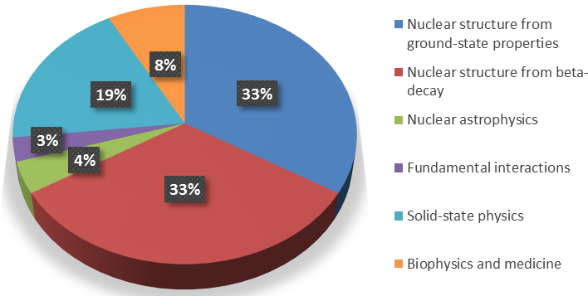
Delivered shifts 2014

Slide 5
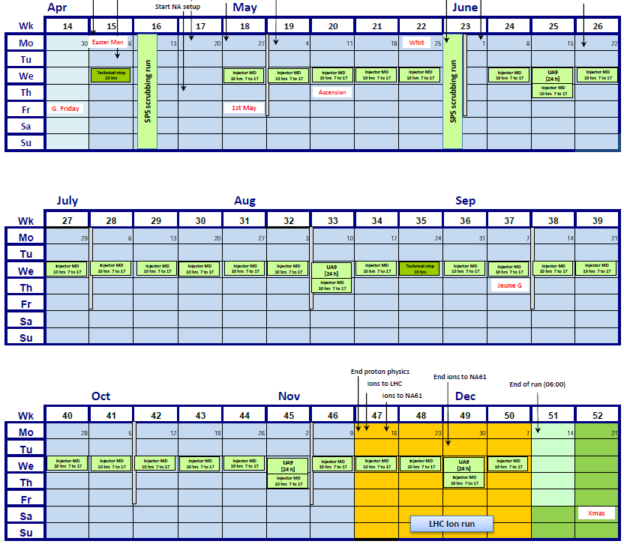
Schedule 2015
First protons: on Apr 7
Physics: a few days later
Proton stop: mid-Nov or mid-Dec:
  To be decided (including status of HIE-ISOLDE)
Stop of low-energy physics:
  Mid-Oct, when HIE-ISOLDE physics starts (unless delayed)
HIE-ISOLDE physics:
  Mid-Oct (unless delayed) till proton stop
ISOLDE schedule – low-energy beam requests sent this week, in 3 parts

Slide 6
Safety and courses
For all setups: fixed and travelling: safety clearance required before RUNNING
  Travelling setups – template will be send some weeks before running, small safety visits/checks once setting up started
  Contact your local contacts in case of questions
Courses in 2015 for all:
  Online: general and ISOLDE RP, electrical awareness
  2-h ISOLDE RP (for everybody, not only new users and new dosimeter requests)
  1.5-h ISOLDE electrical safety: NEW for all, together with RP course
Specific courses:
  2-h cryogenic course
  Soon: 2-h mechanical-workshop safety
  Soon: several-day mechanical-machine operation
  First-aid
  Crane operation
  Etc …
You are not allowed to perform operations for which you are not trained and authorized
In case of doubt – contact the coordinator

Slide 7
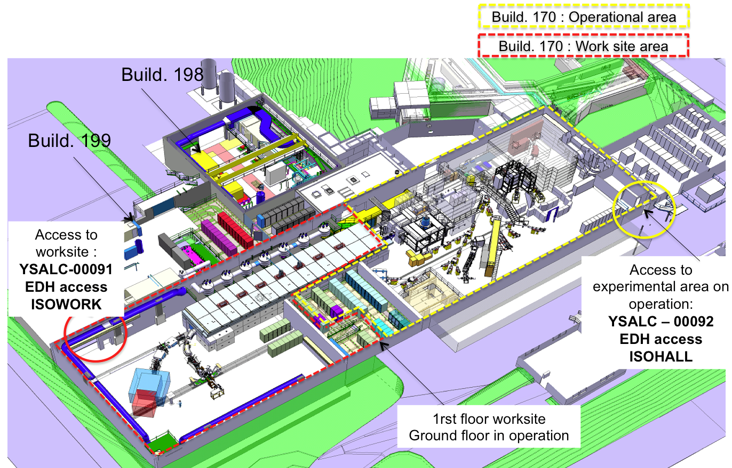
Access to ISOLDE
  Access to HIE-ISOLDE worksite: only local physicists when moving equipment
  Access for users from Jura side for all, from March: with dosimeter

Slide 8
b275
Until March we have to liberate half of the building:
  Ground-floor: shared space for test setups and setups/big equipment required close to ISOLDE
  First floor: electronics lab, detector lab, and solid-state (non-RP lab)
  Mezzanine: cupboards and shelves for experiments
Try to apply transparent rules: remaining space to be shared by all groups
  Ground floor room – big equipment which has to be accessible asap during beamtimes or is fragile
  SSP lab: space for test setups
  1st floor – shelves and several cupboards for smaller equipment
Equipment which doesn’t meet this criteria:
  Pease send it long-term storage or home-institutes
  Our associate is documenting the equipment to be shipped away
Storage of big parts, test stands?
AEGIS laser lab
g-BAR?
Test setups
Test setups
ASACUSA
test setup
SSP, detector labs
3 AD offices
Electronics lab
Shelves and cupboards for small parts

Slide 9
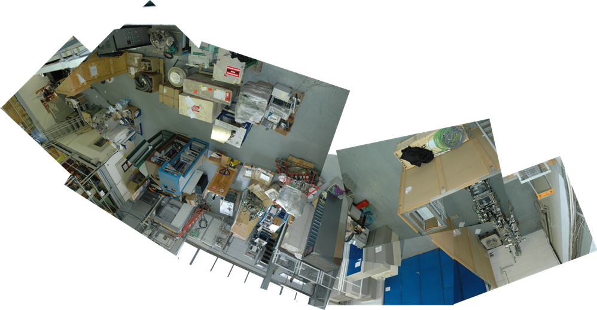
b275

Slide 10
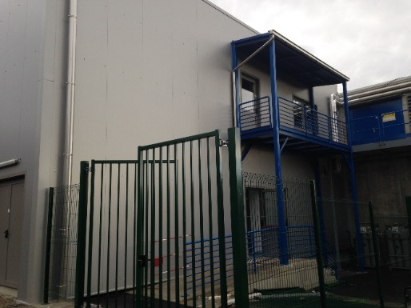
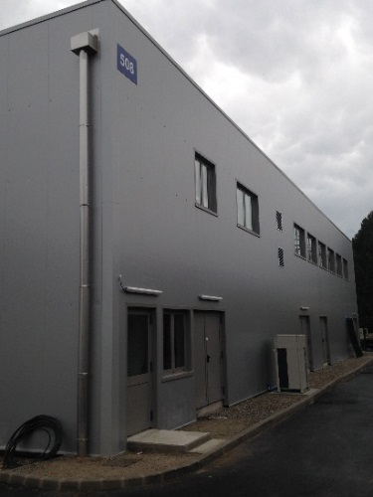
B508
Physics users are moving in
Being ordered:
  Signal cables from ISOLDE hall
  Kitchen
  Equipment for visitor and meeting room
  CERN locks
In preparations:
  Closed cooling water system
  Vacuum gas exhaust
  Opening for SSP gases and fume cupboard

