Slide 1
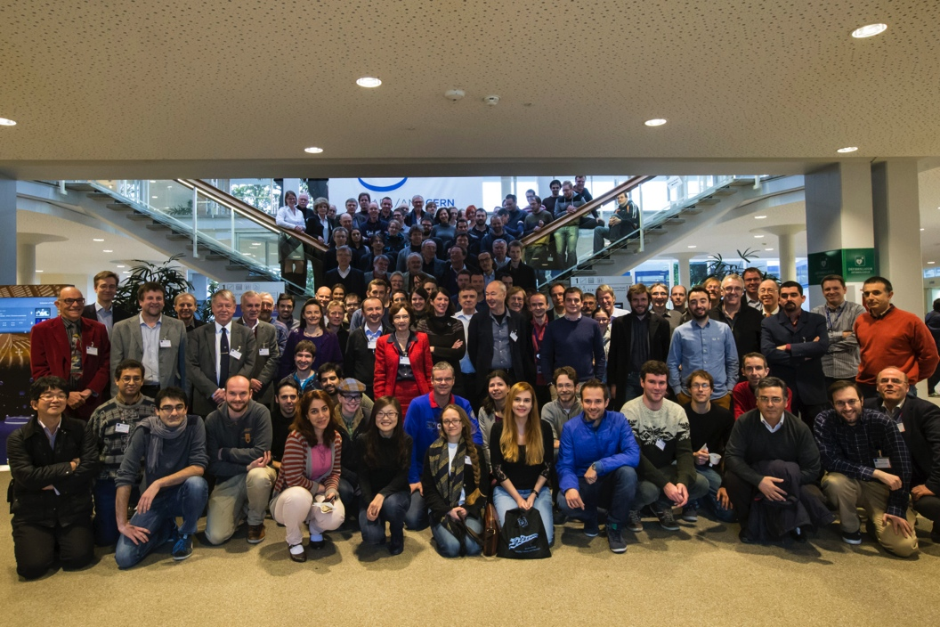
News of the Group
Maria J. G. Borge
ISOLDE Workshop 17 Dec 2014
13th February 2015

Slide 2
Outline
Fellows Associates and students
Courses and workshops during 2015
ENSAR / ENSAR 2
EURISOL MoU / EURISOL DF
Status of the Experiments: NICOLE, WITCH
Financial situation of the collaboration
User Registration and the Grey Book

Slide 3

Fellows, Associates & Students
Associates (13th March)
  Haraldur Palle Gunnlaugsson, Feb2015-Jan2016
Corresponding Associates (13th March)
  Janne Pakarinen July-Dec 2015
Fellows: (2th of March 2015)
    Monika Stachura, April 2013- March 2015 ( Applied Sciences)
    Miguel Madurga ( June 2014 – May 2016) (Nuclear structure)
    Stephan Ettenbauer (June 2014 – Jan 2017, COLLAPS, Polarisastion beams)
    Akira Miyazaki (June 2014- May 2016, SC cavities)
    Kara Lynch ( Jan 2015 – Dec 2017)
    Torben E. Molholt (Feb 2015 – Jan2017) (Applied Sciences)
    Good Candidates are requested to apply for a research fellow in March 2015
    Doctoral student:
        Doctoral Student CERN for IDS: Razvan Lica (Sep2014 – August 2017)
    Doctoral Program with Greece for life sciences (50% GR, 50% CERN):
      Stavroula Pallada (March 2014 - Feb 2017), Biophysics
    Doctoral Program with Germany
      Laura Grob (Jun2014 –May 2017), COLLAPS
      Andre Welker (feb 2015-Jan2018), ISOLTRAP
User support: Jennifer Weterings (50% Col + 50% PH) → Indefinite contract with the University of Oslo, ongoing.
Notes:
discussion with Ph to get a Limited term contract 50% collaboration + 50% PH

Slide 4
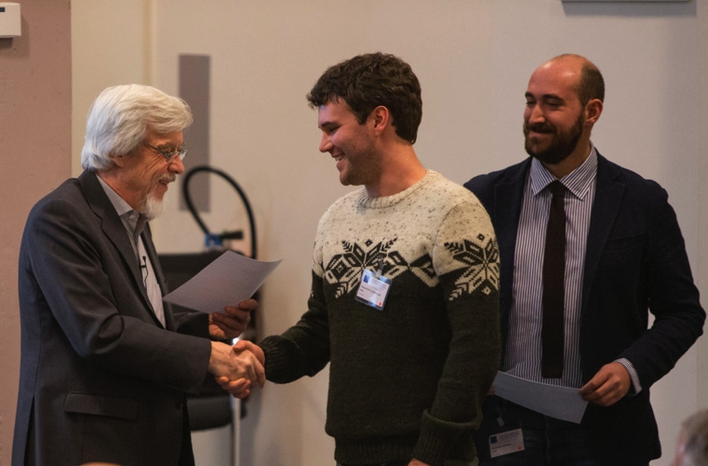
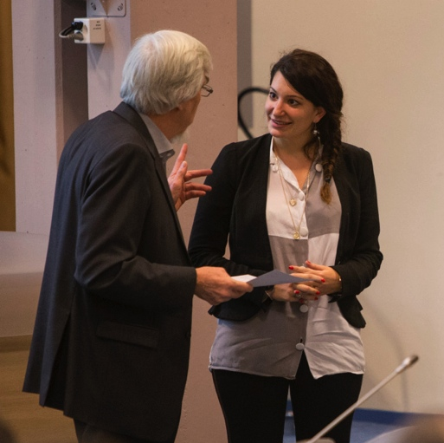
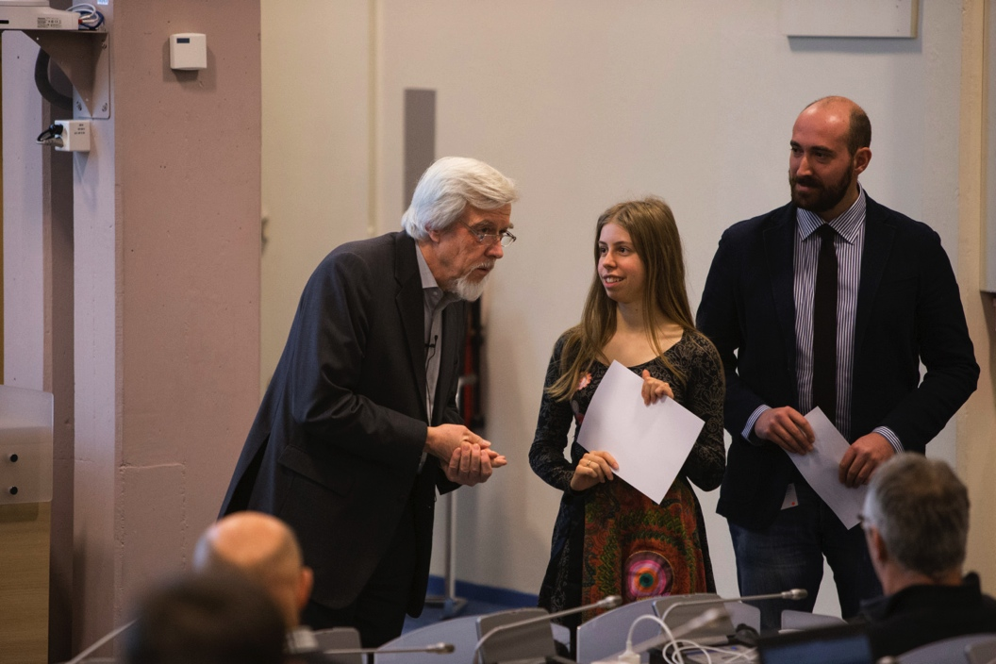
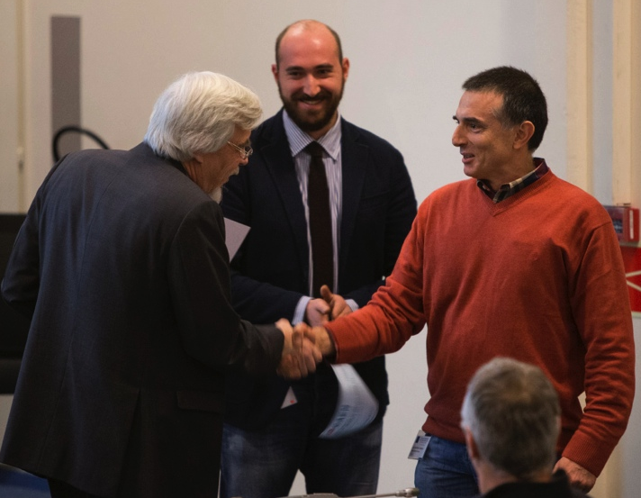
Courses / Workshops
Courses
2 Separator courses 23rd – 27th of March 2015
Workshop
Next Workshop: 2-4 December 2015
ISOLDE Workshop 15 – 17 December 2014
Golden Jubillee Session Wednesday 17th to celebrate the 50 years anniversary of ISOLDE approval.
2 Poster prizes and 2 young researchers
Video recorded:
https://indico.cern.ch/event/334117/other-view?view=standard
Photos: http://cds.cern.ch/record/1977917?ln=en
SASc-ISOLDE Spring Workshop on GEANT4 (SWG 2015),
will be held on April 26 - May 1, 2015 in Casta-Papiernicka in Slovakia. Still accepting Students.
Thomas Day Goodacre
Melanie Delonca
Stephanie Hellgartner
Marcelo B. Barbosa

Slide 5
ENSAR / ENSAR 2
ENSAR stand for European Nuclear Structure and Application Research
  Started 1st Sep 2010 ends in 31st Dec 2014
  The TNA money used this year for young newcomers : 237 days distributed this year.
    418 users got TNA money, some users several times.
    2481 days were paid
    90 projects.
ENSAR 2 Application submitted 2nd of September. Mushin Harakeh coordinator
  10 Meuros
TOTAL
    10 TNAs
    7 JRAs
    8 Nas
EC financial contribution request: 10 M€
    Transnational Access Activities: 47.5%
    Joint Research Activities: 37.2%
    Networking Activities: 15.3%
Evaluation: Jan 2015
Reserved list: 19/20
M. Mena depending of extra funds available

Slide 6

EURISOL MoU / EURISOL DF
Steps towards EURISOL:
    Conceptual Design Report (2004)
    Reference Design report & preliminary Cost Estimate (2009)
Supported by Long Range Plan 2010, A MoU was created to launch a collaborative effort to continue the development of EURISOL R&D and Cost
Parties: CERN, GANIL(2011), COPIN (Poland) (2012), BEC (Belgium) 12/7/2014, INFN(2014). Valid 3 years → July 2017
Steering Committee: M.J. G. Borge, M. Lewitowitz (project leader), A. Maj, L. Popescu, Sara Pirrone and A. Bracco (Nuppec Chair, ex-officio member)
Fee 3000 euros/ y
EURISOL DF Goals:
ISOL-based EU-projects supported, upgraded, optimized and coordinated .
Strong physics case, R&D in RIB production and instrumentation for EURISOL
Enter in ESFRI list (3 countries) and obtain funds.
  Plan for call 2018
To be define:
  Members: GANIL, ISOLDE, SPES (+ISOL@MYRRHA)
  Small scale ISOL facilities: ALTO, Jyvaskyla
Propose in Lisbon Oct2012
Discussed in York July 2014

Slide 7
Towards EURISOL-DF
ISOLDE
  Concentrate in the Intensity, purity and emittance of the radioactive beams . Target + ION SOURCE
  RFQ
  HRS new design
  Implementation of the TSR as part of the Instrumentation
      Design of new beam dumps to face the increase in energy
SPES:
  High level European Instrumentation; AGATA, FAZIA,PARIS..
  Second ISOl bunker and high intensity direct Target
  HRS 1/40.000.
  Reaccelerated bema energy upgrade
  EBIS
SPIRAL2: High Intensity accelerator as prototype of EURISOL driver
Handling of high radiactivity and maintenance
  High-power converter and big volumen Ucx Target (SpIRAL2, Phase2)
  Innovative instrumetation
ISOL@MYRRHA
  High reliability
  R&D in Bema purification
EURISOL Steering Committee integrated by M. Lewitowicz (GANIL, Chair), P. Naiorkowski (COPIN) S. Pirrone (INFN), L. Popescu (BEC), M. Borge (CERN) and Angela Bracco for NuPECC.
Notes:
Steps taken:
1. Preliminary discussion with DG-EU : Svetlomir Stavrev 17 oct 2014
Contact the Swiss representative to get their support.
Prepare a 1 page description of the project for swiss.
To be approved by Council.
Consult the CERN legal service, DG-LS: Eva Maria Groniger-Voss
Most probably CERN cannot be member of ERIC

Slide 8
News on the Beam Lines

Slide 9
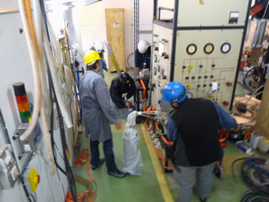
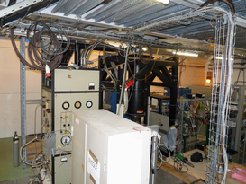
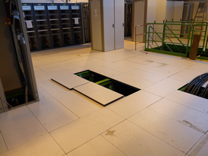
NICOLE Status
Set the fridge at the beam line roughly.
Re-assemble the main unit of the fridge.
Vacuum test at the LN2 temperature.
Next steps, 2015:
  He-transfer test with the new supports and test the fridge at He temperature.
  Connect the fridge to the beam line (fine alignment)
  (9feb2015 ) Takashi Ohtsubo: We would like to finish the entire test of NICOLE before the next meeting in June and join it. I will discuss with my collaborators to make a plan for this.
Courtesy of M. Madurga

Slide 10
Collaboration Matters

Slide 11
Income of the collaboration
Country | Amount per year (CHF) | 2013 contribution Received | 2014 contribution Received
Belgium | 60.000 | ✔ | ✔
CERN | 60.000 | ✔ | ✔
Denmark | 60.000 | ✔ | ✔
Finland | 60.000 | ✔
France | 60.000 | ✔
Germany | 60.000 | ✔ | ✔
Greece
India | 40.000
Ireland | 10.000
Italy | 60.000 | ✔ | ✔
Norway | 60.000 | ✔ | ✔
Romania | 60.000 | ✔ | ✔
Spain | 60.000 | In the way
Sweden | 60.000 | ✔ | ✔
United Kingdom | 60.000 | ✔ | ✔
Bulgaria has agreed with the ISOLDE-MoU & Sergio Bertolucci has signed the 21st of March 2014, pending the Bulgaria side.
Poland is in the process to apply.
South Africa is in the process to apply.
Algeria is interested in joining.
Problems with India and Ireland contributions
Paid 2010-2011
Notes:
The committee agrees that until Greece signs the updated MoU and has paid its outstanding fees it will no longer be considered a member of the ISOLDE collaboration.

Slide 12
Expenditure Collaboration
Contribution 2013 and 2014 to HIE-ISOLDE already transferred.
Minimum Expenditure foreseen for 2014 250.00 – 300.000
Real: 252.084 CHF /42611,58 for B508
Balance 31st December 2014 588. 466 CHF
Contribution 2012 96,2 % received
Contributions 2013 80 % received
Contributions 2014 66 % received
Contributions 2015 7,3 % received
Subsistance
2014

Slide 13
IRELANd at ISOLDE
The following is a short account of the situation regarding Ireland's membership of the ISOLDE collaboration. (martin O. Henry, 12 Feb 2015
The initial three-year funding at the reduced subscription fee was funded by Dublin City University (DCU). At the end of that period I attempted to secure funding for a further five-year period to include sources other than DCU. The ISOLDE workshop held in DCU in 2012 (strongly supported by ISOLDE personnel) was for that purpose. The level of interest in the workshop was very disappointing and the upshot is that the funding has not been secured. I had hoped that a successful Angstrom proposal under Horizon 2020 in 2014 might make a difference, but I am now of the opinion that even if we are successful with Angstrom in 2015 the situation will not improve to the extent that several years' subscription (even at the generously reduced rate) will be provided. Added to that, I am now retired (though still active in research), and as there is no evidence of other researchers in Ireland becoming involved, the liklihood is that Irish participation in ISOLDE research will diminish. Accordingly, it may be opportune to examine the case for Ireland's continued formal involvement.
I would like to acknowledge the generosity of the collaboration in establishing the reduced fee structure for cases such as Ireland's. I would also like to acknowledge the excellent support provided by ISOLDE personnel (administrative, technical and scientific) over the years, which make it always a pleasure to go there.

Slide 14
India @ ISOLDE
Ushasi Datta Pramanik India Representative ( 30 July 2014):
After a long waiting (two years), we have received our 12th plan budget
approval (2012-2017). But unfortunately, we did not get approval for
our ISOLDE-CERN project. I hear that, it is already known by
Dr. R.Voss and I hope that he already informed you.
So we shall be not able to pay the ISOLDE fees.
Susanta Lahiri (14 october 2014):
I will try to take it to the notice of the appropriate authority.
Pending further information

Slide 15
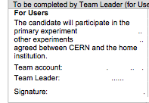
USER Office & Grey Book
The Structure for registration of ISOLDE experiments , Institutes and Collaborators, in Grey Book appears not to be adapted to current needs of experiments and Administrative work of the Grey book secretariat.
New experiments are approved and registered while the teams and their members remained largely stable. Often the Collaborators are assigned to one of the individual Isxxx experiments while working on several in parallel.
Grey Book keeps only open experiments: IS366, IS409-594

Slide 16
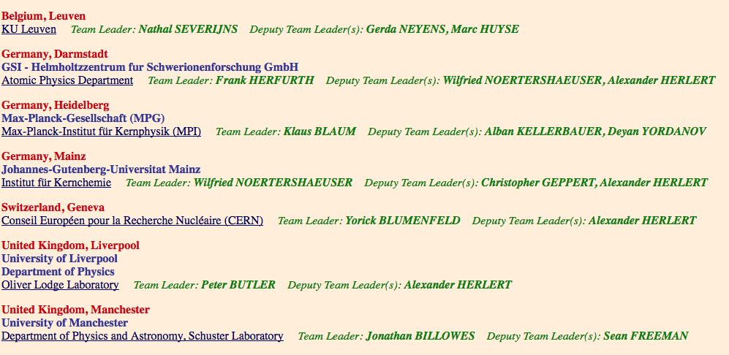

Present information in Grey Book
Example IS568: High-resolution laser spectroscopy of nickel isotopes
The authors belong to the team.
NOT Always all are presented
This information is displayed into the greybook : ISXXX-Institute XXX- person (name, surname).
IS568
http://graybook.cern.ch

Slide 17
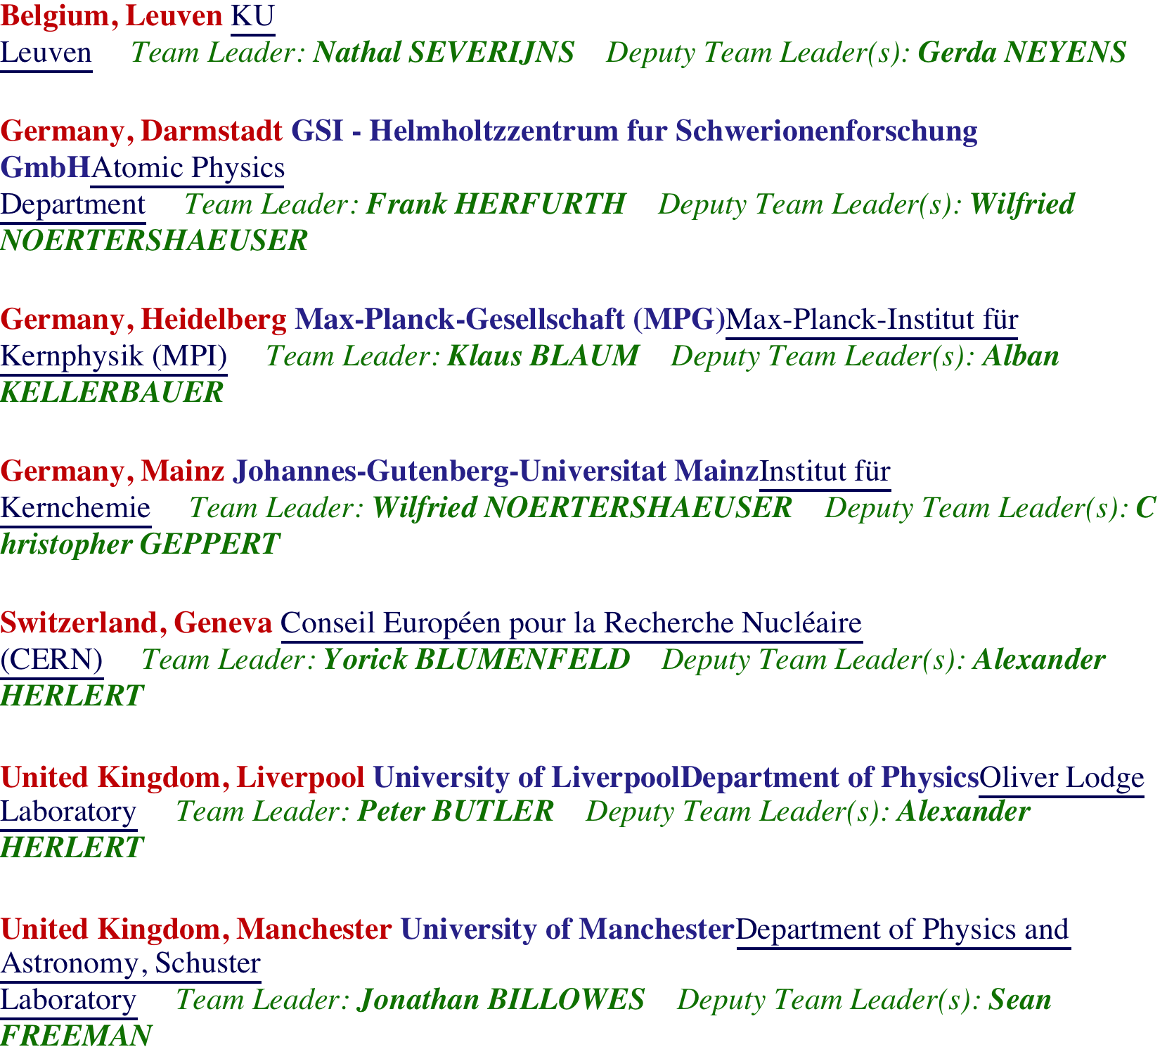
Present information in Grey Book
Example IS568: High-resolution laser spectroscopy of nickel isotopes
ISOLDE
The authors will only be link to ISOLDE and not to a specific Experiment

