Slide 1
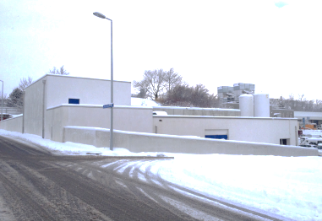

MEDICIS : status, plans, interlocks and coactivity with ISOLDE
ISOLDE ISCC 13 February 2015
Stefano Marzari EN-STI-RBS

Slide 2

Outline:
Introduction
Time line
    Up to now
    Next steps
Conclusions

Slide 3
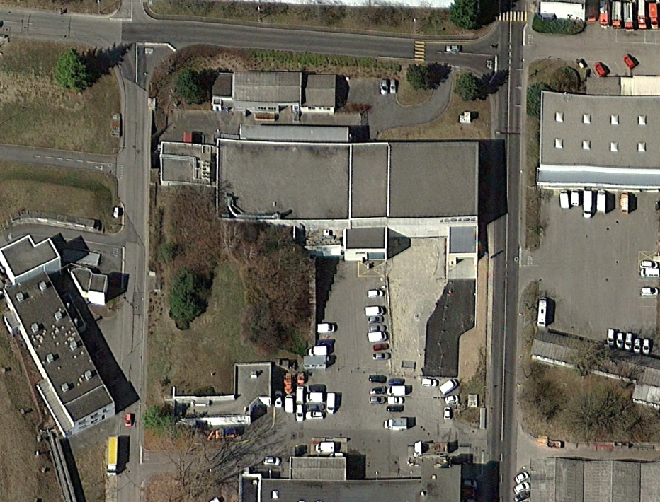
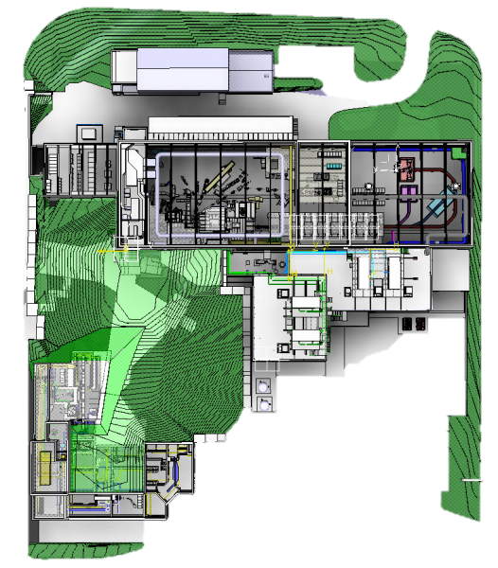

ISOLDE Area
ISOLDE experimental hall
ISOLDE Target area
Swiss – French border
CERN-MEDICIS project
ISOLDE Class A laboratory

Slide 4
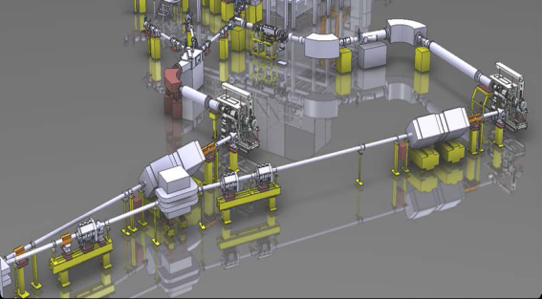
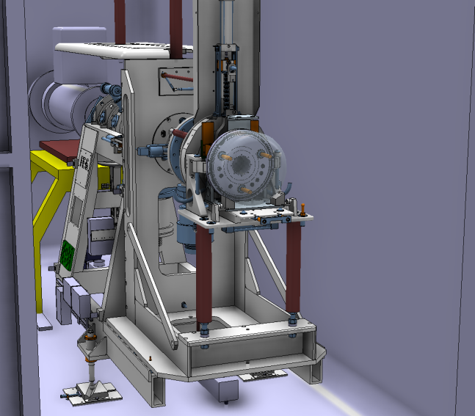
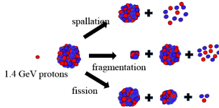
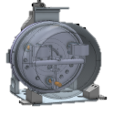
CERN-MEDICIS principle:
Use protons (~90%) normally lost into the Beam Dump
ZOOM
Isotopes for ISOLDE
ISOLDE Target station
Protons 1.4 GeV
Radio Isotopes production
Beam dump
MEDICIS Target station

Slide 5
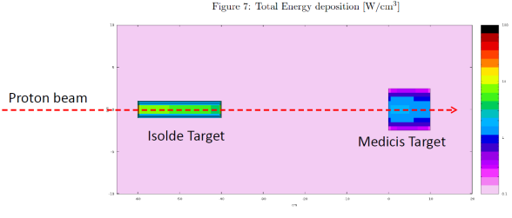
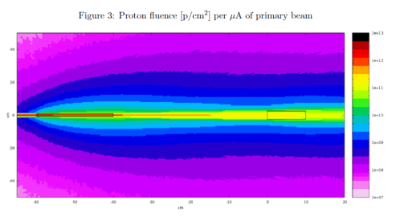
D=20 / L=200
D=50 / L=100
Simulations from R.Augusto EDMS 1289889

Slide 6
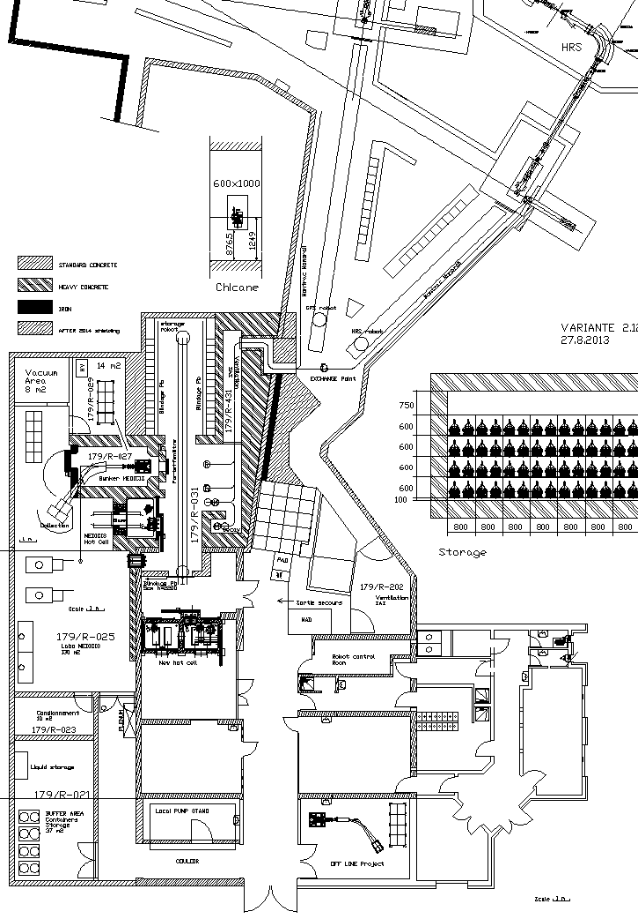

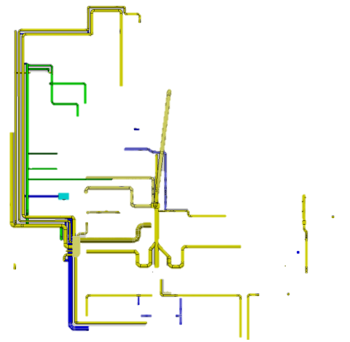



MEDICIS general layout
Existing ISOLDE buildings
Extension for MEDICIS
ISOLDE and MEDICIS irradiation points
Laboratory
Monorail transport
Robot
Hot cell
Mass separator
Chemical lab
Radioactive target storage
Additional shielding
New nuclear ventilation
Fire doors (new fire sector)
Quality control and shipping

Slide 7
What we already did in this time…
2. Time line (up to now):
Building
Shielding
Irradiation point
Ventilation
Integration
9 | 10 | 11 | 12 | 1 | 2 | 3 | 4 | 5 | 6 | 7 | 8 | 9 | 10 | 11 | 12 | 1 | 2 | 3 | 4 | 5 | 6 | 7 | 8 | 9 | 10 | 11 | 12 | 1 | 2 | 3 | 4 | 5 | 6 | 7
2013 |  |  |  | 2014 |  |  |  |  |  |  |  |  |  |  |  | 2015 |  |  |  |  |  |  |  |  |  |  |  | 2016

Slide 8
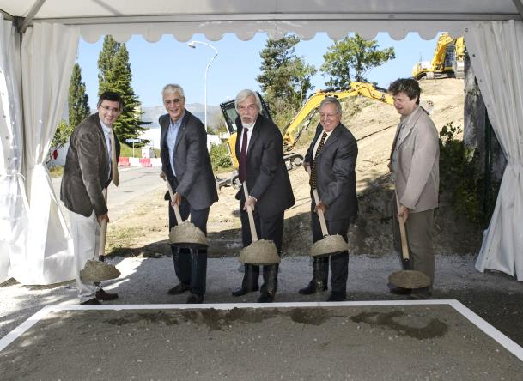





Ground breaking ceremony 4.9.2013
9 | 10 | 11 | 12 | 1 | 2 | 3 | 4 | 5 | 6 | 7 | 8 | 9 | 10 | 11 | 12 | 1 | 2 | 3 | 4 | 5 | 6 | 7 | 8 | 9 | 10 | 11 | 12 | 1 | 2 | 3 | 4 | 5 | 6 | 7
2013 |  |  |  | 2014 |  |  |  |  |  |  |  |  |  |  |  | 2015 |  |  |  |  |  |  |  |  |  |  |  | 2016

Slide 9
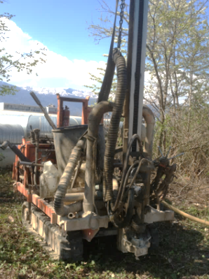
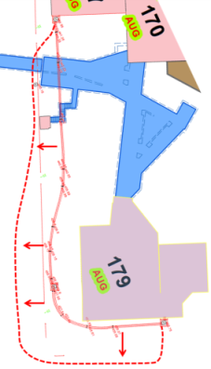
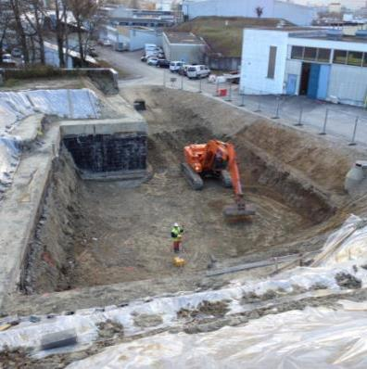
Earth works: earth samples analysis, move electrical services & 4000 m3 earth removal
Drilling machine for soil analysis by RP
9 | 10 | 11 | 12 | 1 | 2 | 3 | 4 | 5 | 6 | 7 | 8 | 9 | 10 | 11 | 12 | 1 | 2 | 3 | 4 | 5 | 6 | 7 | 8 | 9 | 10 | 11 | 12 | 1 | 2 | 3 | 4 | 5 | 6 | 7
2013 |  |  |  | 2014 |  |  |  |  |  |  |  |  |  |  |  | 2015 |  |  |  |  |  |  |  |  |  |  |  | 2016

Slide 10
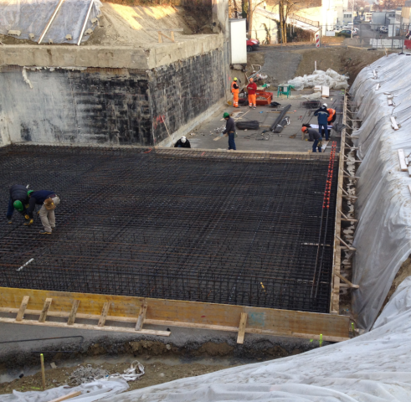
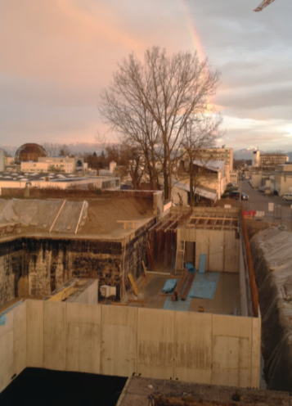
Building: concrete foundations & walls
9 | 10 | 11 | 12 | 1 | 2 | 3 | 4 | 5 | 6 | 7 | 8 | 9 | 10 | 11 | 12 | 1 | 2 | 3 | 4 | 5 | 6 | 7 | 8 | 9 | 10 | 11 | 12 | 1 | 2 | 3 | 4 | 5 | 6 | 7
2013 |  |  |  | 2014 |  |  |  |  |  |  |  |  |  |  |  | 2015 |  |  |  |  |  |  |  |  |  |  |  | 2016

Slide 11
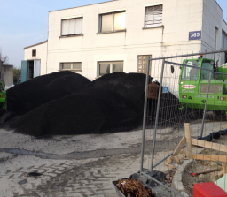
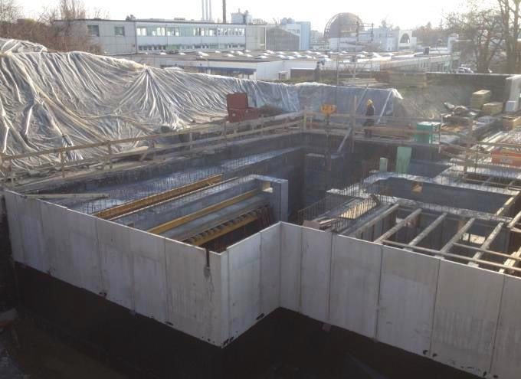
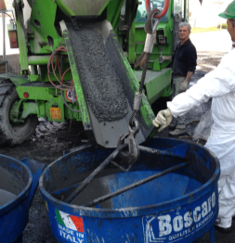
Building: Magnetite concrete walls for shielding
Magnetite concrete high density 3.9 kg/dm3 (normal concrete 2.2 kg/dm3)
Magnetite ore
Preparation
9 | 10 | 11 | 12 | 1 | 2 | 3 | 4 | 5 | 6 | 7 | 8 | 9 | 10 | 11 | 12 | 1 | 2 | 3 | 4 | 5 | 6 | 7 | 8 | 9 | 10 | 11 | 12 | 1 | 2 | 3 | 4 | 5 | 6 | 7
2013 |  |  |  | 2014 |  |  |  |  |  |  |  |  |  |  |  | 2015 |  |  |  |  |  |  |  |  |  |  |  | 2016

Slide 12
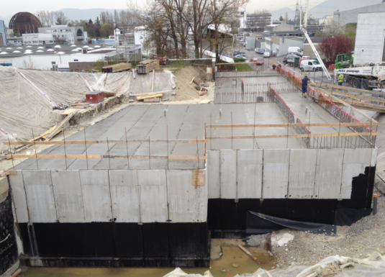
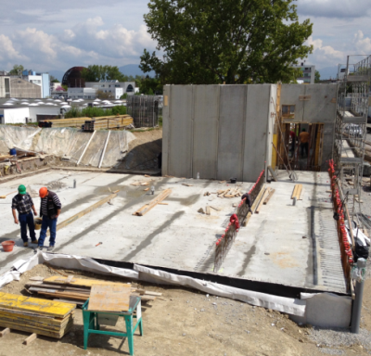
Building: Concrete roof , technical room for CV (ventilation) & laser for MEDICIS
CV & laser
9 | 10 | 11 | 12 | 1 | 2 | 3 | 4 | 5 | 6 | 7 | 8 | 9 | 10 | 11 | 12 | 1 | 2 | 3 | 4 | 5 | 6 | 7 | 8 | 9 | 10 | 11 | 12 | 1 | 2 | 3 | 4 | 5 | 6 | 7
2013 |  |  |  | 2014 |  |  |  |  |  |  |  |  |  |  |  | 2015 |  |  |  |  |  |  |  |  |  |  |  | 2016

Slide 13
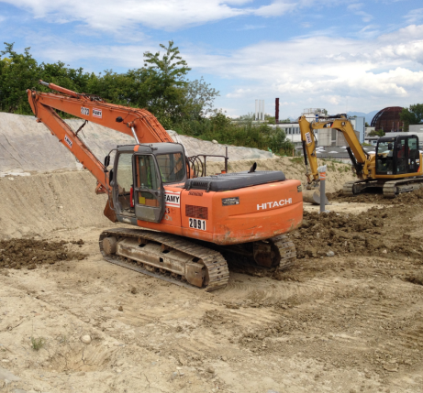
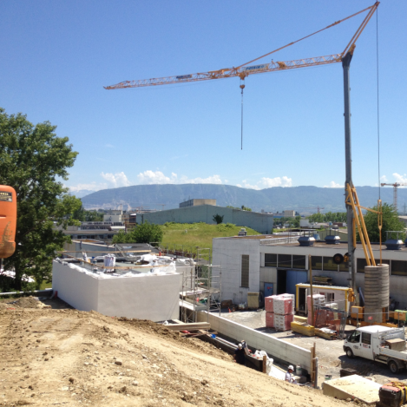
Building: Earth recover ~3000 m3
9 | 10 | 11 | 12 | 1 | 2 | 3 | 4 | 5 | 6 | 7 | 8 | 9 | 10 | 11 | 12 | 1 | 2 | 3 | 4 | 5 | 6 | 7 | 8 | 9 | 10 | 11 | 12 | 1 | 2 | 3 | 4 | 5 | 6 | 7
2013 |  |  |  | 2014 |  |  |  |  |  |  |  |  |  |  |  | 2015 |  |  |  |  |  |  |  |  |  |  |  | 2016

Slide 14
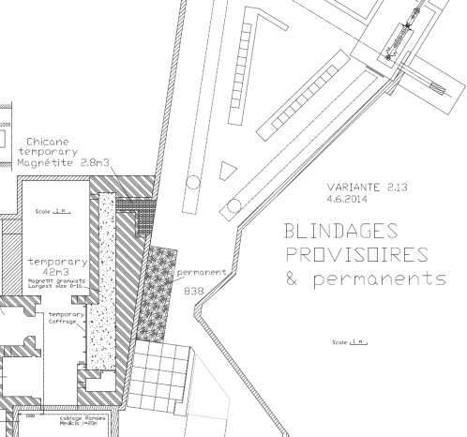
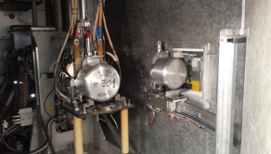
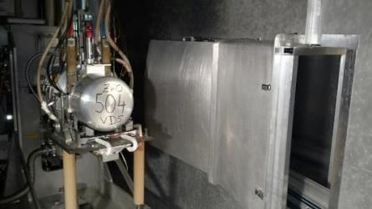
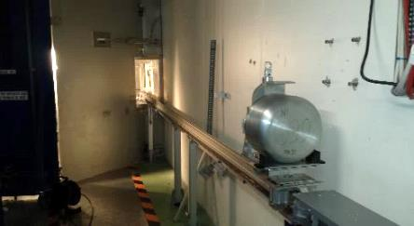
Internal: irradiation point and RCS (rail conveyor system)
Proton Beam
60 kV
Cover earthed
Tests with protons:
Done successfully !
Design by M. Vagnoni
Test
9 | 10 | 11 | 12 | 1 | 2 | 3 | 4 | 5 | 6 | 7 | 8 | 9 | 10 | 11 | 12 | 1 | 2 | 3 | 4 | 5 | 6 | 7 | 8 | 9 | 10 | 11 | 12 | 1 | 2 | 3 | 4 | 5 | 6 | 7
2013 |  |  |  | 2014 |  |  |  |  |  |  |  |  |  |  |  | 2015 |  |  |  |  |  |  |  |  |  |  |  | 2016

Slide 15
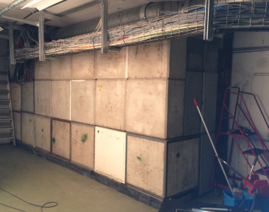
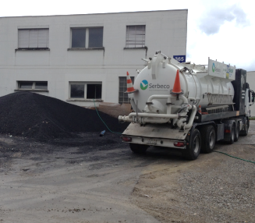
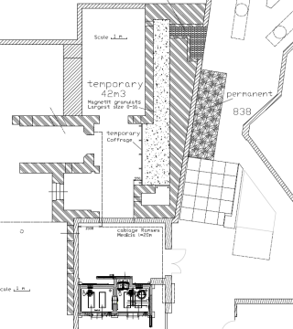
Internal: shielding (temporary and permanent)
<0.5 uSv/h during 2014/15 Isolde operation
42m³ of Magnetite ore temporary (by blowing)
22m³ blocks (magnetite, iron, concrete and barite).
Shielding Fluka optimization by Ricardo Augusto
9 | 10 | 11 | 12 | 1 | 2 | 3 | 4 | 5 | 6 | 7 | 8 | 9 | 10 | 11 | 12 | 1 | 2 | 3 | 4 | 5 | 6 | 7 | 8 | 9 | 10 | 11 | 12 | 1 | 2 | 3 | 4 | 5 | 6 | 7
2013 |  |  |  | 2014 |  |  |  |  |  |  |  |  |  |  |  | 2015 |  |  |  |  |  |  |  |  |  |  |  | 2016

Slide 16
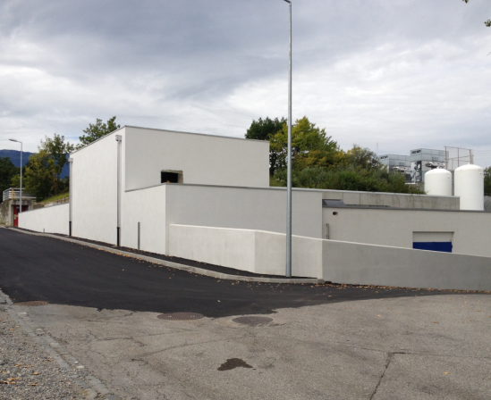


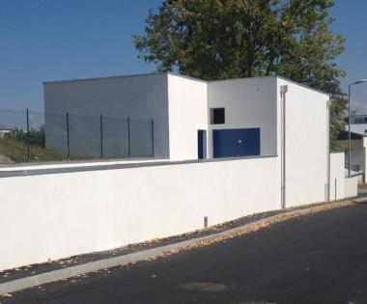
Building: external finishing and doors (fire, ventilation & sound insulation for CV technical room)
Many thanks to:
GS-SE-DOP
9 | 10 | 11 | 12 | 1 | 2 | 3 | 4 | 5 | 6 | 7 | 8 | 9 | 10 | 11 | 12 | 1 | 2 | 3 | 4 | 5 | 6 | 7 | 8 | 9 | 10 | 11 | 12 | 1 | 2 | 3 | 4 | 5 | 6 | 7
2013 |  |  |  | 2014 |  |  |  |  |  |  |  |  |  |  |  | 2015 |  |  |  |  |  |  |  |  |  |  |  | 2016

Slide 17
Next steps in this time period
2. Time line (next steps) :
Ventilation
Handling (Robot & monorail)
Integration
Shielded doors
Off-line separator
9 | 10 | 11 | 12 | 1 | 2 | 3 | 4 | 5 | 6 | 7 | 8 | 9 | 10 | 11 | 12 | 1 | 2 | 3 | 4 | 5 | 6 | 7 | 8 | 9 | 10 | 11 | 12 | 1 | 2 | 3 | 4 | 5 | 6 | 7
2013 |  |  |  | 2014 |  |  |  |  |  |  |  |  |  |  |  | 2015 |  |  |  |  |  |  |  |  |  |  |  | 2016

Slide 18
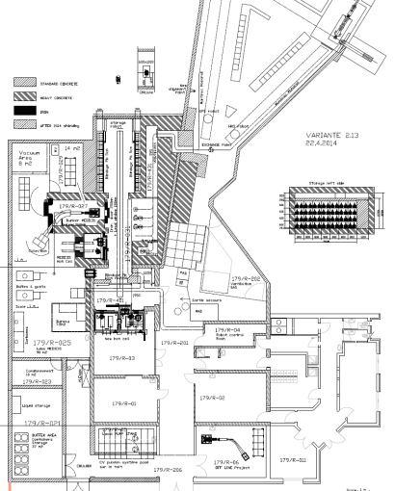
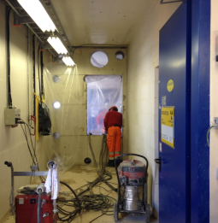
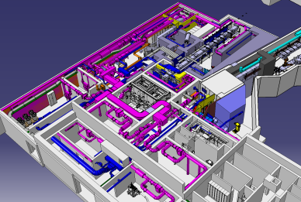
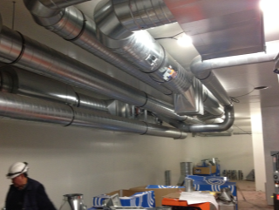
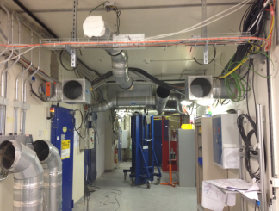
Ventilation, airlock SAS, access & connection
Coring & connection
Ventilation design & optimization EN-CV by A.Polato and A.Broche.
Airlock SAS creation
Piping…
9 | 10 | 11 | 12 | 1 | 2 | 3 | 4 | 5 | 6 | 7 | 8 | 9 | 10 | 11 | 12 | 1 | 2 | 3 | 4 | 5 | 6 | 7 | 8 | 9 | 10 | 11 | 12 | 1 | 2 | 3 | 4 | 5 | 6 | 7
2013 |  |  |  | 2014 |  |  |  |  |  |  |  |  |  |  |  | 2015 |  |  |  |  |  |  |  |  |  |  |  | 2016

Slide 19

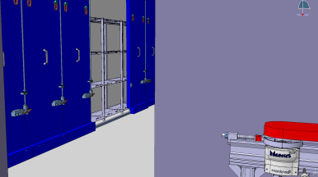
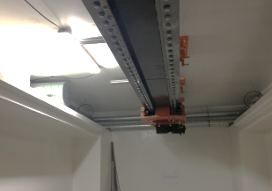
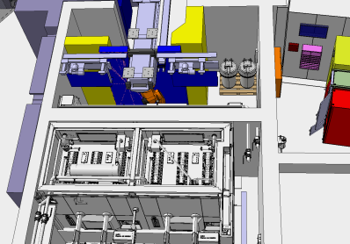
Robot, shielded doors and storage shelves (for 112 Targets)
Storage shelves (V. Barozier & Y. Garvrikov)
Robot Rail mounted (J-L. Grenard)
Shielded doors:
Delivery starts in March (K. Kershaw)
Rail mounting
9 | 10 | 11 | 12 | 1 | 2 | 3 | 4 | 5 | 6 | 7 | 8 | 9 | 10 | 11 | 12 | 1 | 2 | 3 | 4 | 5 | 6 | 7 | 8 | 9 | 10 | 11 | 12 | 1 | 2 | 3 | 4 | 5 | 6 | 7
2013 |  |  |  | 2014 |  |  |  |  |  |  |  |  |  |  |  | 2015 |  |  |  |  |  |  |  |  |  |  |  | 2016

Slide 20
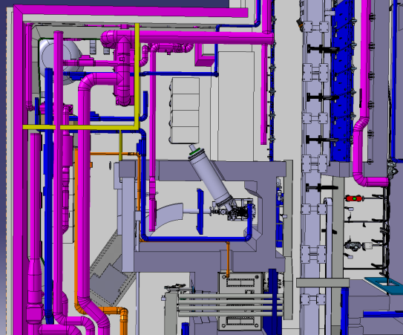
Frontend, separator, collection box and services (HT, control, vacuum)
Vacuum &
Gas storage
Power supply & HV
Controls
FE & separator
9 | 10 | 11 | 12 | 1 | 2 | 3 | 4 | 5 | 6 | 7 | 8 | 9 | 10 | 11 | 12 | 1 | 2 | 3 | 4 | 5 | 6 | 7 | 8 | 9 | 10 | 11 | 12 | 1 | 2 | 3 | 4 | 5 | 6 | 7
2013 |  |  |  | 2014 |  |  |  |  |  |  |  |  |  |  |  | 2015 |  |  |  |  |  |  |  |  |  |  |  | 2016

Slide 21
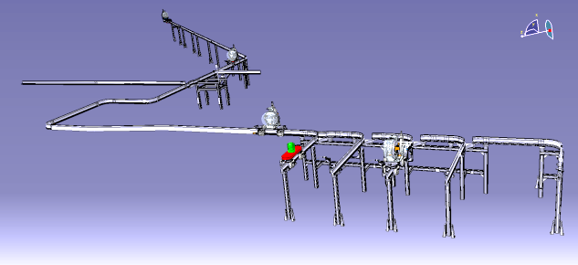
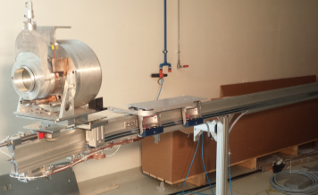
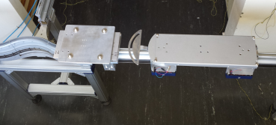
Rail Conveyor System and shielding completion & 2nd air lock SAS
HRS line and MEDICIS
GPS line
STATION
Recovery shuttle & camera inspection
Radiation Hard
Wagon
Conveyor
Design by M. Vagnoni
9 | 10 | 11 | 12 | 1 | 2 | 3 | 4 | 5 | 6 | 7 | 8 | 9 | 10 | 11 | 12 | 1 | 2 | 3 | 4 | 5 | 6 | 7 | 8 | 9 | 10 | 11 | 12 | 1 | 2 | 3 | 4 | 5 | 6 | 7
2013 |  |  |  | 2014 |  |  |  |  |  |  |  |  |  |  |  | 2015 |  |  |  |  |  |  |  |  |  |  |  | 2016

Slide 22
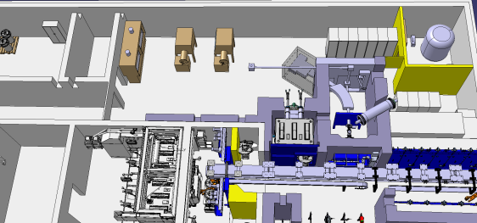
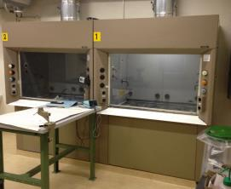
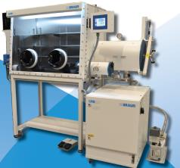
Laboratory equipment
Fume hoods
Glove boxes
9 | 10 | 11 | 12 | 1 | 2 | 3 | 4 | 5 | 6 | 7 | 8 | 9 | 10 | 11 | 12 | 1 | 2 | 3 | 4 | 5 | 6 | 7 | 8 | 9 | 10 | 11 | 12 | 1 | 2 | 3 | 4 | 5 | 6 | 7
2013 |  |  |  | 2014 |  |  |  |  |  |  |  |  |  |  |  | 2015 |  |  |  |  |  |  |  |  |  |  |  | 2016

Slide 23
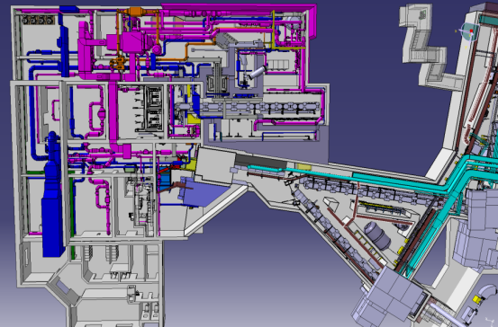
Final commissioning & start up…
Tests:
Handling (robot & conveyor)
Off line device (Frontend, separator, collection)
Access system
Safety monitoring (environment, radioprotection)
General safety (power cut, fire, ventilation…)
Start up in 2016 !
9 | 10 | 11 | 12 | 1 | 2 | 3 | 4 | 5 | 6 | 7 | 8 | 9 | 10 | 11 | 12 | 1 | 2 | 3 | 4 | 5 | 6 | 7 | 8 | 9 | 10 | 11 | 12 | 1 | 2 | 3 | 4 | 5 | 6 | 7
2013 |  |  |  | 2014 |  |  |  |  |  |  |  |  |  |  |  | 2015 |  |  |  |  |  |  |  |  |  |  |  | 2016

Slide 24
3. Conclusion :
Civil engineering schedule in LS1 was extremely tight
=> but we achieved it on time !
This shut down is also challenging with the new ventilation system and building integration
The 2015 schedule is also extremely tight !
Luckily for this project we benefit from previous experience:
  Industrial Kuka robots and failure risk analysis (like ISOLDE)
  Storage shelves and movable shielding (like ISOLDE)
  Front End and separator design (like ISOLDE)
    ISOLDE operation and maintenance (50 years of operation)

Slide 25
What are the ISOLDE benefits from MEDICIS ?
Upgrade of the nuclear ventilation system (safety)
Upgrade of the access system (safety)
Use of the RCS like a “RABIT” (for irradiation samples)
Use of the RCS for camera inspection (during handling and recovery operations)
Use of the RCS for ISOLDE targets handling (in and out)
New hot target storage 112 targets (80% for ISOLDE, more flexibility for reusing old targets)
Connection between new storage and new ISOLDE hot cell for target dismantling (remote handling without human intervention)
Use of the buffer area 37 m2 (80% for ISOLDE)

Slide 26

THANKS for your Attention !
Acknowledgements !
Roland Arnoul, Ricardo Augusto, Roger Barlow, Vincent Barozier, Michele Battistin, Ana-Paula Bernardes, Michel Bonnet, Francesco Canepa, Richard Catherall, Michal Czech, Mathieu Deschamps, Alexandre Dorsival, Jean-Louis Grenard, Keith Kershaw, Ielyzaveta Kobzeva, Camille Lemesre, Roberto Losito, Christophe Loup, Christophe Mitifiot, Rene Necca, Julien Parra-Lopez, Eliseo Perez-Duenas, Andrea Polato, Giacomo Potuto, Silvain Samson, Eva Sanchez, Christelle Saury, Alexander Stadler, Thierry Stora, Matteo Vagnoni, Francesco Venturini, Joachim Vollaire, Thijs Wijnands

Slide 28
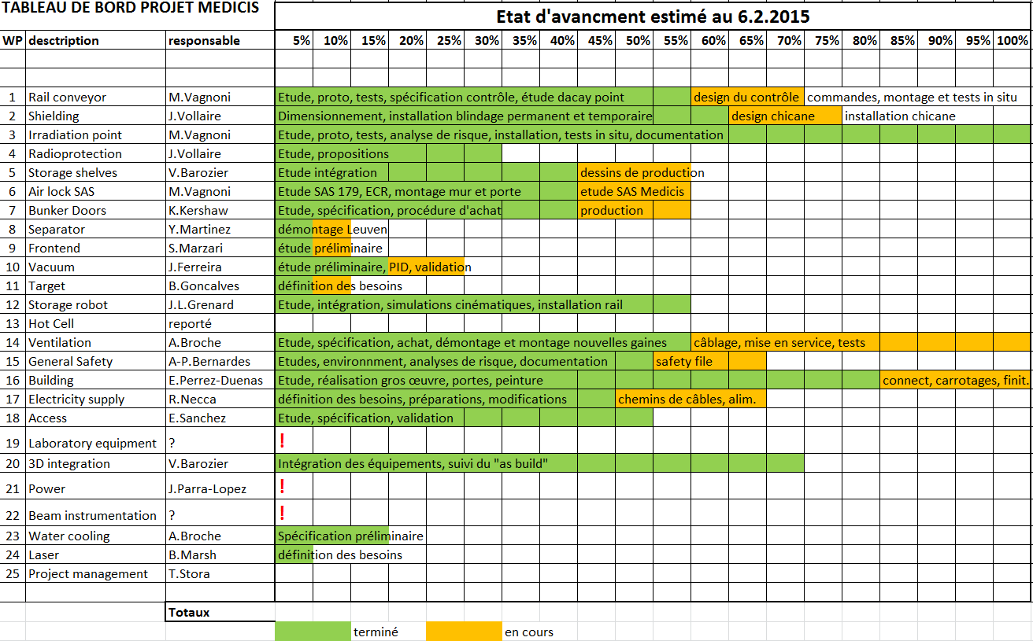

Slide 29


Slide 30

Last integration view

Slide 31

Ventilation network

