Slide 1
CLIC Technical Committee Mandate, Organization and Action Plan
Claude Hauviller

Slide 2
Mandate CLIC Technical Committee (CTC)
General objective:
Towards a Project Oriented and Cost Conscious CLIC Design in preparation for the Conceptual Design Report to be edited in 2010.
Specific responsibility:
Set-up and keep updated:
  an overall nomenclature of the components of the whole project,
  a complete and coherent CLIC Work Breakdown Structure with components specifications derived from the present design by the Parameters WG
  The related documentation structure integrating a description of all technical components
Review the ensemble of technical equipments in the present CLIC design in terms of:
  Specifications
  Technical feasibility
  Fabrication and prospective in industrialization
  Integration (machine/tunnel)
  Interface with the detectors
  Installation
  Schedule (including fabrication & installation)
  Cost (investment and exploitation)

Slide 3
Mandate CLIC Technical Committee (CTC) (2)
In close collaboration with the technical responsibles identify technical key issues requiring specific R&D or prototyping in view of the Conceptual Design Report.
Assess present R&D program and propose prioritized R&D including schedule and milestones on the various systems or components for approval by the CLIC Design & Parameters Committee
Following a value analysis of individual components or ensemble of components, suggest possible improvements towards global project optimization aiming at a performance to cost and risk ratio as high as possible
Elaborate for approval by the CLIC Design & Parameters Committee and description in the CLIC Conceptual Design Report:
  a baseline scenario and schedule including prototyping, fabrication, equipment integration, installation and HW commissioning
  a CLIC baseline complex
  possible options for improved performance and/or reduced cost and the corresponding R&D program
Organisation:
Set-up ad-hoc working groups on dedicated subjects and/or integrate existing ones.
Manage a dedicated web site with links to updated key documentation
Regularly report to the CLIC Design & Parameters Committee for approval and to the CLIC meeting for information

Slide 4
Specific responsibility
Set-up and keep up-to-date:
  an overall nomenclature of the whole project
  a complete and coherent CLIC Work Breakdown Structure with components specifications derived from the design by the Parameters WG
  the related documentation integrating a description of all technical components
  Put in place a specific Quality Assurance Working Group on a short term basis.
  Objective: freeze PBS, WBS, nomenclature, … end 2010

Slide 5
Specific responsibility
Review the ensemble of technical equipments in terms of:
  Specifications
  Technical feasibility
  Fabrication and prospective in industrialization
  Integration (machine/tunnel)
  Interface with the detectors
  Installation
  Schedule (including fabrication & installation)
  Cost (investment and exploitation)

Slide 6
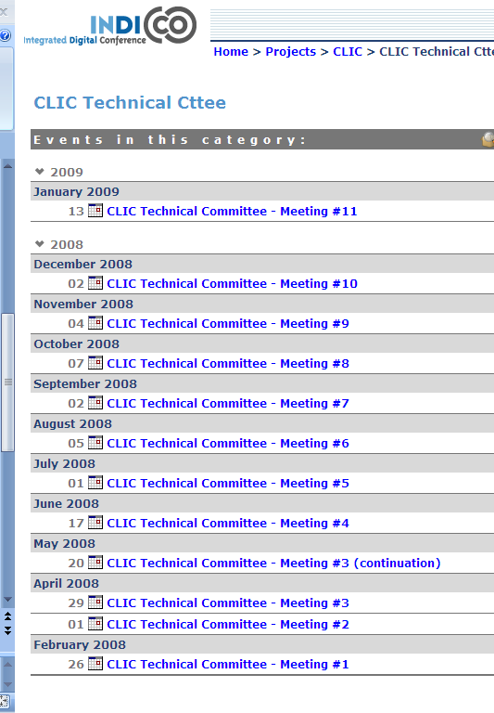
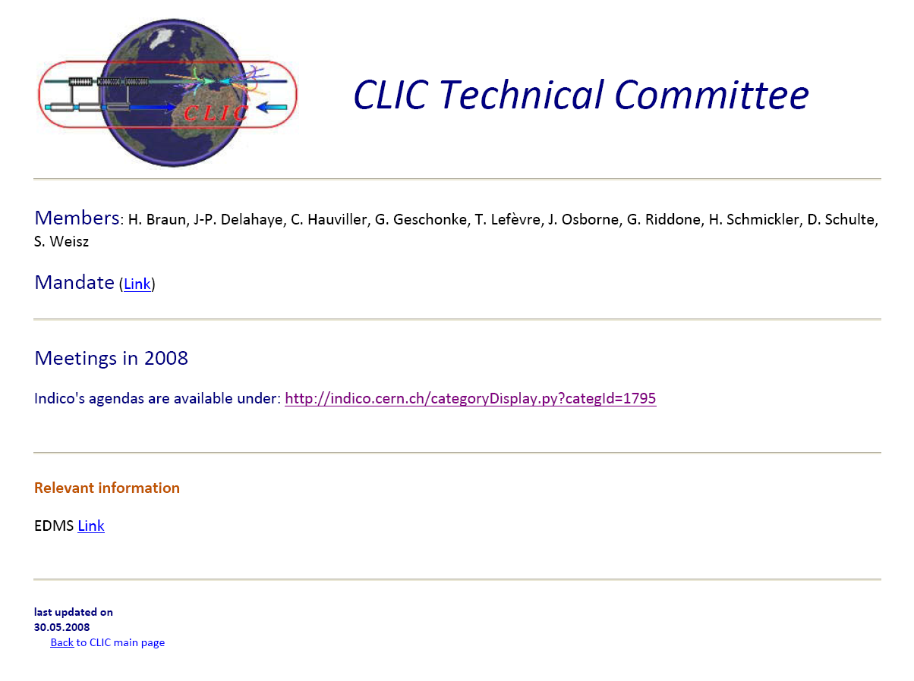
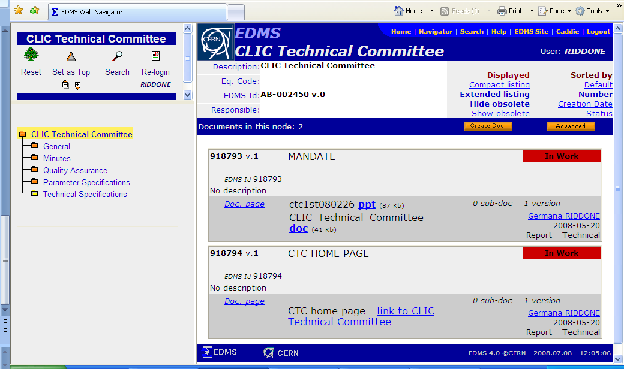
Organisation

Slide 7
Organization
Set-up ad-hoc working groups on dedicated subjects (including already existing ones)
Working Groups
Civil Engineering and Services (CES)
Two Beam Module (TBM)
Machine Detector Interface (MDI)
Machine Operation & Protection (MOP)
Stabilization (STA)
Instrumentation

Slide 8
Members
Hans Braun
Jean-Pierre Delahaye (ex-officio)
Gunther Geschonke
Claude Hauviller (Chairman)
Thibaut Lefevre
John Osborne
Germana Riddone (Scientific Secretary)
Hermann Schmickler (Deputy Chairman)
Daniel Schulte
Emmanuel Tsesmelis
Sylvain Weisz
Chairmen of the working groups

Slide 9
List of topics
Date (mm.yy) | Main topic | Responsible
06.08 | Vacuum requirements | DS
07.08 | Magnet requirements and work package | DS, HB
09.08 | Feedback form Cost and Schedule WG | SW
10.08 | Injectors and non main linac rf structures | HB, LR
11.08 | Dumping systems | HB, DS
12.08 | Outcome of Instrumentation review | TL, HS
01.09 | Outcome of Module review | GR
02.09 | Klystrons for the drive beam generation | EJ
Last update: 04.07.08
This list of topics is based on the document “list of critical issues”, EDMS#918791

