Slide 1
RF Structure Development
W. Wuensch
CLIC Design Committee Meeting 8-7-2008

Slide 2
CLIC RF Structure Development Mandate
The CLIC RF structure working group develops the high-power X-band system in the main linac and drive beam which includes the PETS, transfer network and accelerating structures. It reports to the design committee.
Specific activities include:
Design
Design accelerating structures and PETS for the CLIC parameter study based on specifications from the beam physics and design working groups and then provide specifications, based on the design of the rf system, back to the design study.
Develop the theoretical and computational tools for rf design which include such issues as beam loading, tolerances and wakefields. Apply modelling to issues raised by beam physics.
Investigate innovative solutions to different aspects of the X-band system including different damping schemes, on/off, recirculation, etc.

Slide 3
High-power
Investigate high-power rf phenomenon with the specific objective of the quantitatively determining the underlying physics. Apply results to linac and structure optimization, structure testing and the development of manufacturing and preparation techniques. Make specialized experiments such as dc-spark, fatigue and innovative diagnostics to support these investigations.
Design, prepare and supply structures for high-power rf testing.
Provide support to high-power rf testing including proposals for test structures and experiments and definition of the testing program.

Slide 4
Test areas
Design, install and coordinate the testing program of the experimental area of the two-beam test stand.
Exploit the 30 GHz mid-linac test stand.
Provide support to other high-power testing areas such as the CERN 12 GHz test stand, the TBL, NEXTEV and SLAC.

Slide 5
Technology
Coordinate the study of performance issues relating to subsystems such as vacuum, cooling, alignment and tolerances.
Lead the system integration study through the module working group. Maintain baseline and option variants of the CLIC module design. Provide information for cost studies.
And
Maintain documentation for all of the above activities.

Slide 7
Meetings
All meetings have an invitation list but anyone can join.
Structure development: Weekly on Wednesday at 14:00. Indico.
X-band collaboration: Last Friday of every month at 6:00. Webex and EDMS.
Breakdown physics: Bi-weekly on Tuesday at 10:00. Indico.
Pulsed surface heating: Bi-weekly on Friday at 14:00. EDMS.
Structure production: Weekly on Monday at 9:00. EDMS.
Mechanical design: Weekly on Monday at 10:00. EDMS.
Two-Beam Test Stand: Weekly on Thursday at 14:30. EDMS.
Module working group: Bi-Weekly on Monday at 14:30. Indico and EDMS.

Slide 8
Workshops
X-band collaboration meeting: CERN 6-2007, KEK 5-2008, SLAC spring 2009.
Breakdown workshop: HG2006, CLIC breakdown workshop 5-2008, another planned for early next year.
RF design: being planned for 12-2008 in Manchester.
RF structure working group at CLICnn workshops.

Slide 9
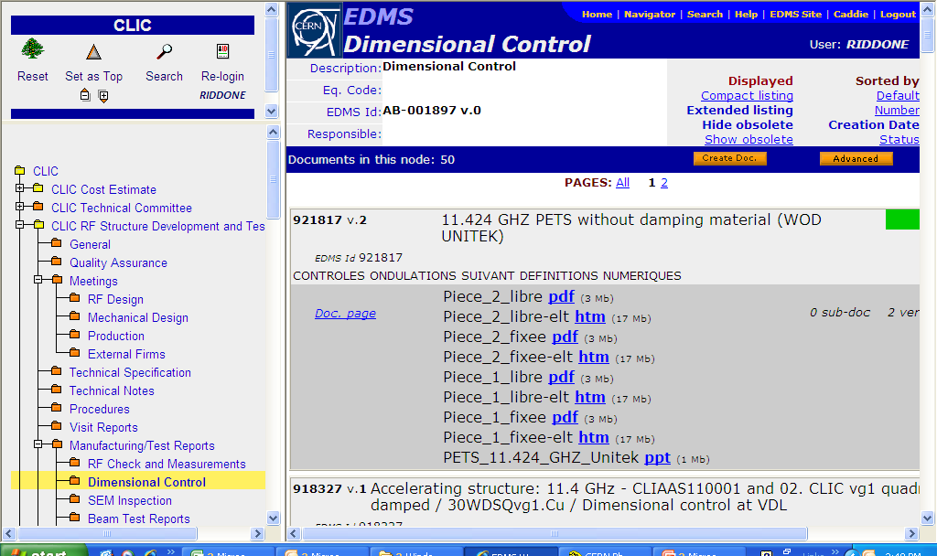
Documentation in EDMS (1/2)

Slide 10
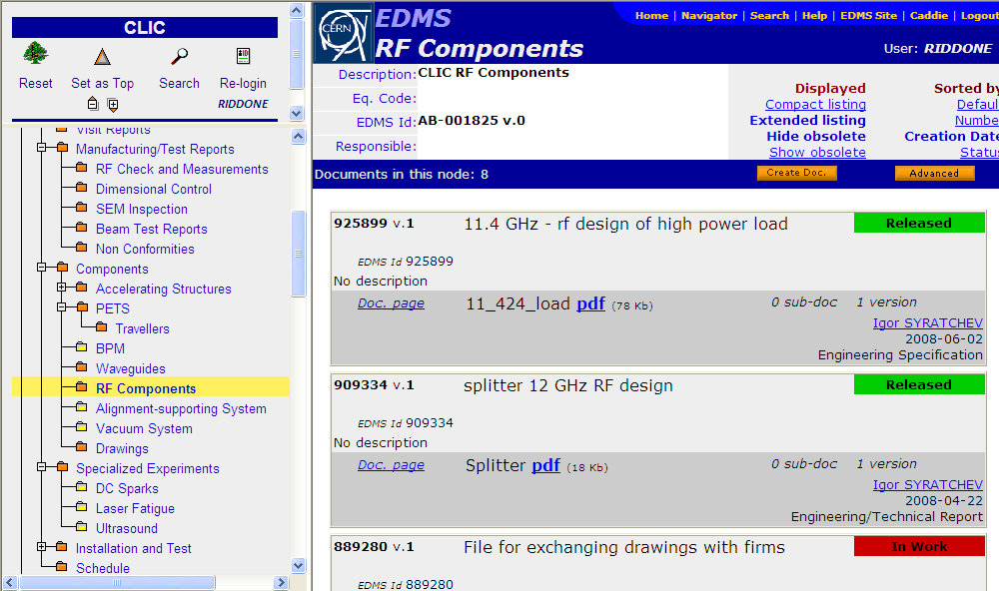
Documentation in EDMS (2/2)

