Slide 1
CLIC rf structure production (see also EDMS#844300)
G. Riddone, AB-RF
2008.07.08

Slide 2
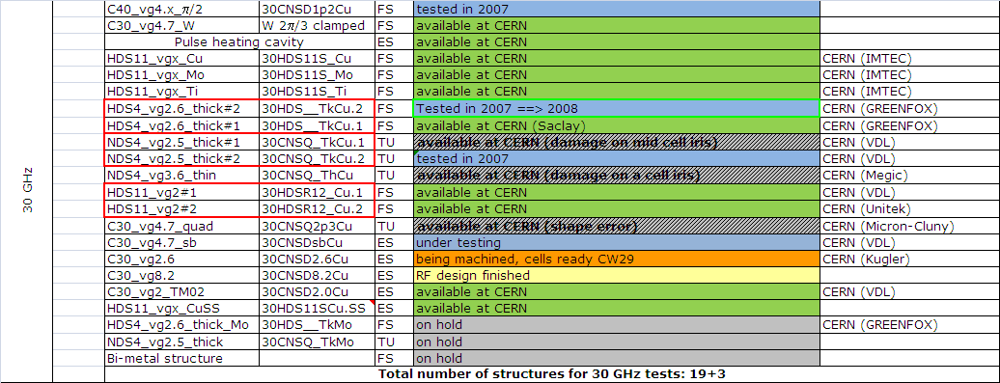
Status - 30 GHz ac. structures
Preparation started
Installation finished, ready for testing
Under fabrication

Slide 3
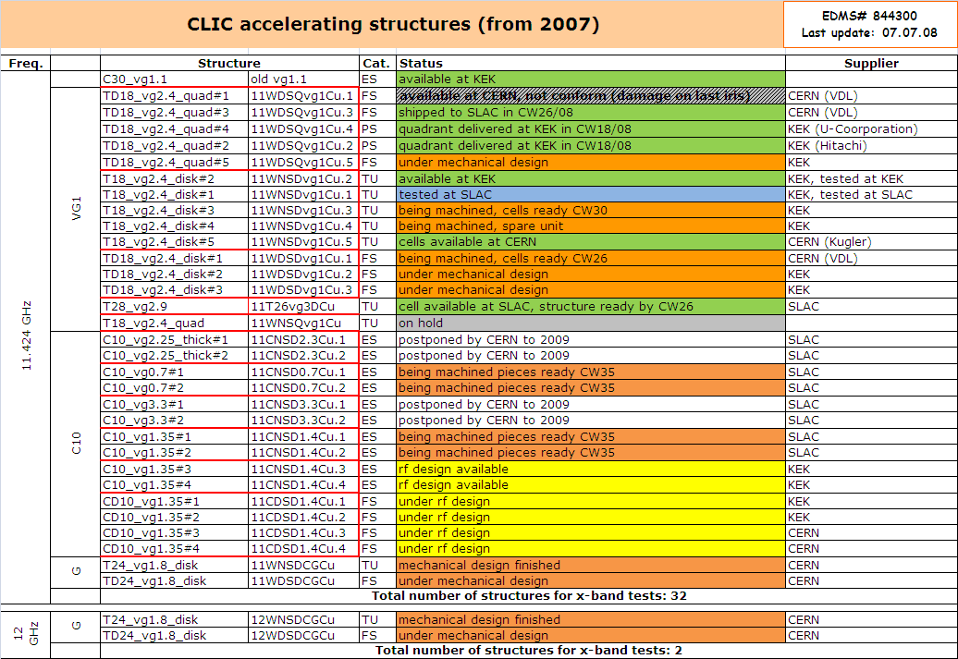
Status – x-band ac. structures

Slide 4
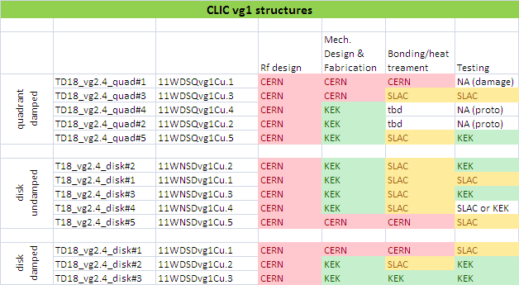
CLIC vg1 structures

Slide 5
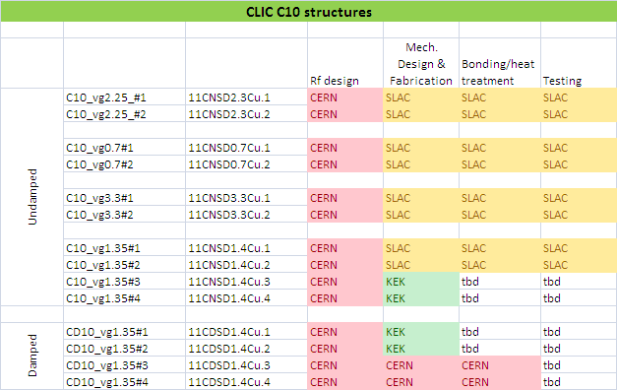
C10 damped structures

Slide 6
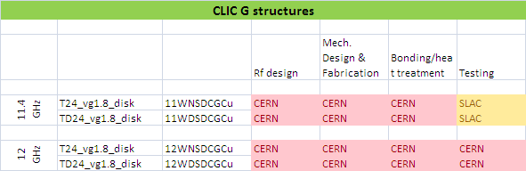
CLIC G

Slide 7
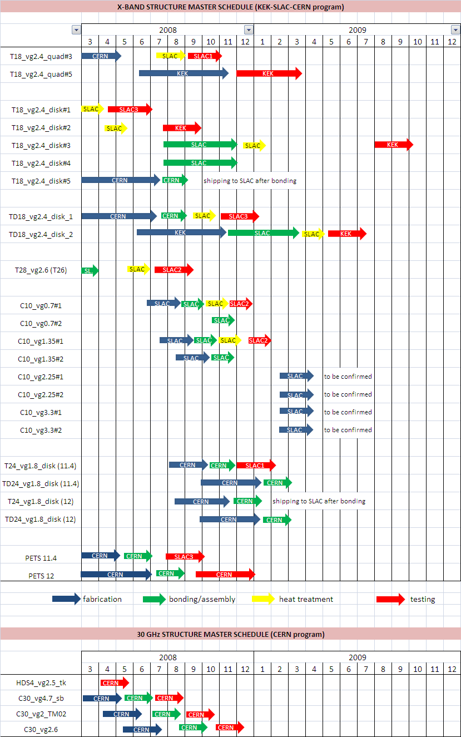
Overall schedule (Input from WebEx meeting on 04.07.08)

Slide 8
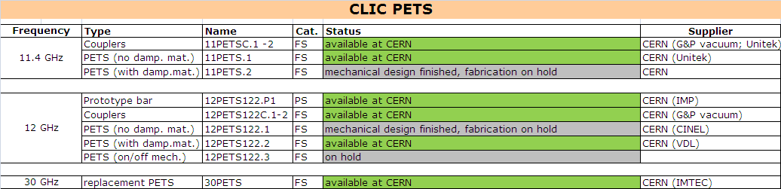
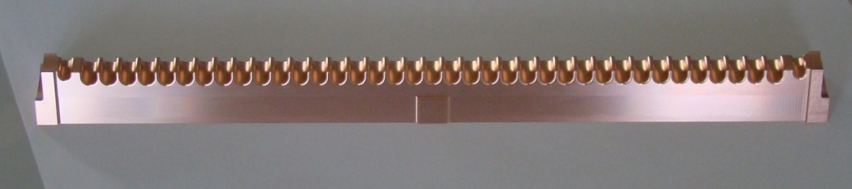
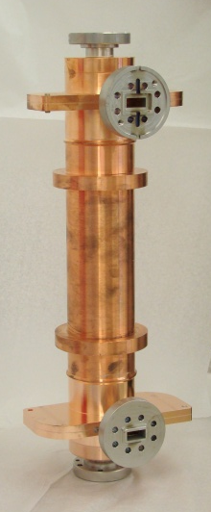
Status - PETS
12 GHz PETS: bars received in CW26,
under assembly
11.4 GHz PETS: assembly under completion, shipping to SLAC CW28

