Slide 1
Vertex 2015
Summary
Chris Parkes

Slide 2
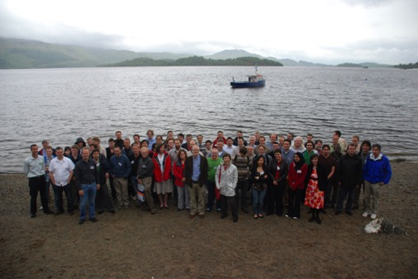
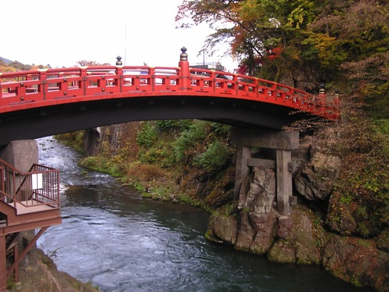
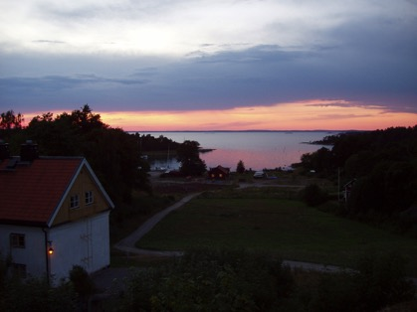
Vertex 2015…..
was always going to be interestingly different….
2014: Mácha Lake, Doksy, Czech Republic
2013 Lake Starnberg, Germany
2012 Jeju Island, Korea
2011 Rust, Lake Neusiedl Austria
2010 Loch Lomond, Scotland, UK
2009 Putten, Southern Sea, The Netherlands
2008 Uto Island, Sweden
2007 Lake Placid, New York, USA
2006 Perugia, Italy
2005 Chuzenji Lake, Nikko, Japan
2004 Menaggio Lake Como, Italy
2003 Low Wood, Lake Windermere, Cambria, UK
2002 Kailua-Kona Hawaii, USA
2001 Brunnen, Lake Lucerne, Switzerland
2000 Sleeping Bear Dunes, Lake Michigan,
…..
Scotland
Japan
Finland

Slide 3

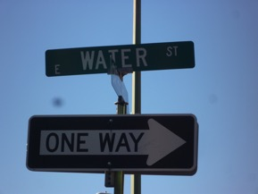
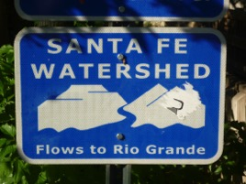
Vertex 2015…..
was always going to be interestingly different….
2014: Mácha Lake, Doksy, Czech Republic
2013 Lake Starnberg, Germany
2012 Jeju Island, Korea
2011 Rust, Lake Neusiedl Austria
2010 Loch Lomond, Scotland, UK
2009 Putten, Southern Sea, The Netherlands
2008 Uto Island, Sweden
2007 Lake Placid, New York, USA
2006 Perugia, Italy
2005 Chuzenji Lake, Nikko, Japan
2004 Menaggio Lake Como, Italy
2003 Low Wood, Lake Windermere, Cambria, UK
2002 Kailua-Kona Hawaii, USA
2001 Brunnen, Lake Lucerne, Switzerland
2000 Sleeping Bear Dunes, Lake Michigan,
…..
Scotland
Japan
Finland

Slide 4
Vertex 2015…..
was always going to be interestingly different….
2014: Mácha Lake, Doksy, Czech Republic
2013 Lake Starnberg, Germany
2012 Jeju Island, Korea
2011 Rust, Lake Neusiedl Austria
2010 Loch Lomond, Scotland, UK
2009 Putten, Southern Sea, The Netherlands
2008 Uto Island, Sweden
2007 Lake Placid, New York, USA
2006 Perugia, Italy
2005 Chuzenji Lake, Nikko, Japan
2004 Menaggio Lake Como, Italy
2003 Low Wood, Lake Windermere, Cambria, UK
2002 Kailua-Kona Hawaii, USA
2001 Brunnen, Lake Lucerne, Switzerland
2000 Sleeping Bear Dunes, Lake Michigan,
…..
Scotland
Where UK English
“interesting” and “different”
is US English for
“AWESOME”
Japan
Finland

Slide 5

Vertex 2015…..
was always going to be interestingly different….
2014: Mácha Lake, Doksy, Czech Republic
2013 Lake Starnberg, Germany
2012 Jeju Island, Korea
2011 Rust, Lake Neusiedl Austria
2010 Loch Lomond, Scotland, UK
2009 Putten, Southern Sea, The Netherlands
2008 Uto Island, Sweden
2007 Lake Placid, New York, USA
2006 Perugia, Italy
2005 Chuzenji Lake, Nikko, Japan
2004 Menaggio Lake Como, Italy
2003 Low Wood, Lake Windermere, Cambria, UK
2002 Kailua-Kona Hawaii, USA
2001 Brunnen, Lake Lucerne, Switzerland
2000 Sleeping Bear Dunes, Lake Michigan,
…..
Scotland
Where UK English
“interesting” and “different”
Is US English for
“AWESOME”
Japan
Finland

Slide 6
Vertex 2015
Detectors
Areas

Slide 7



Customary Apology
1 : Welcome
+48 : Talks
+ 1 : Excursion
+ 1 : Summary
= 51: Total
+ O (250)
Margaritas
Drink Margaritas
I will cover every detector, chip, module design, novel application, performance plot, algorithm…
Any omissions due to alien abduction

Slide 8
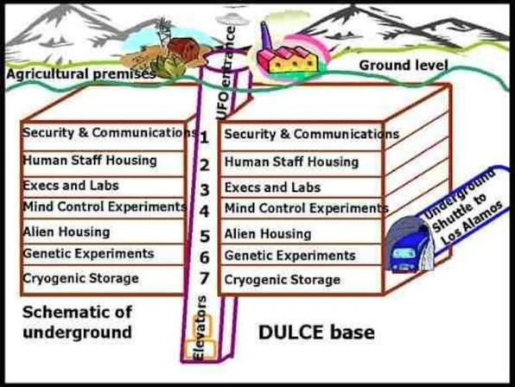
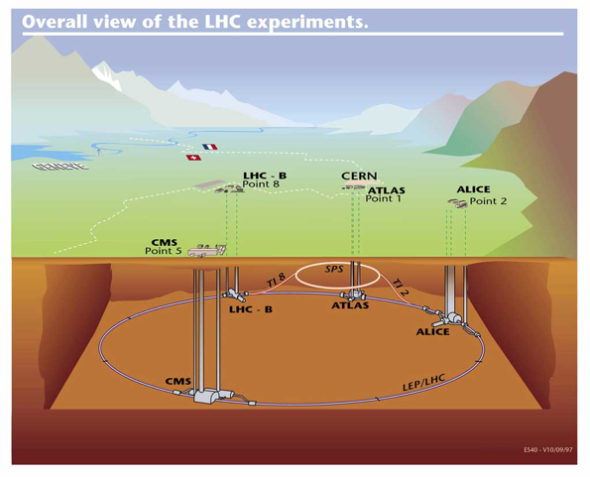
LHC Detectors In Operation
ATLAS Run 1/2 | Daniel Dobos
CMS Run 1/2 | Clemens Lange
ALICE Run 1/2 | Domenico Colella
LHCb Run 1/2 | Kurt Rinnert
LHC, France/Switzerland
Alien Base, New Mexico

Slide 9
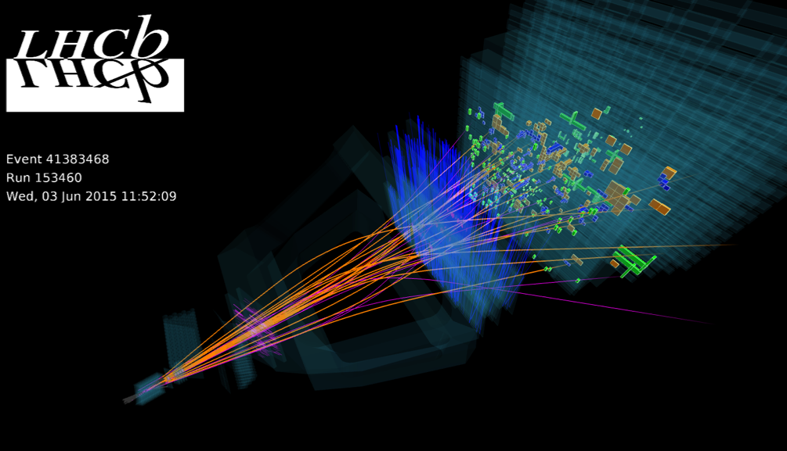
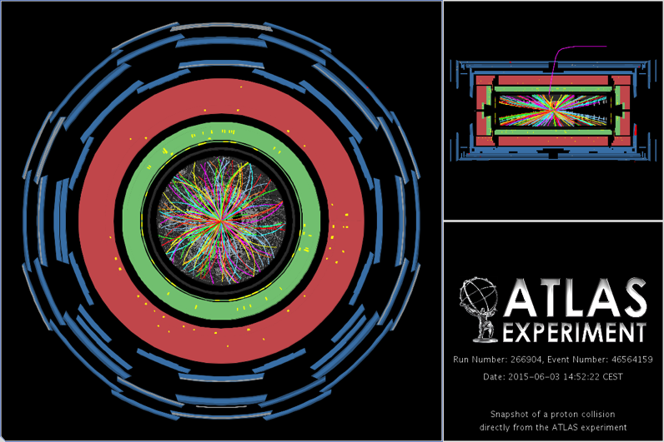
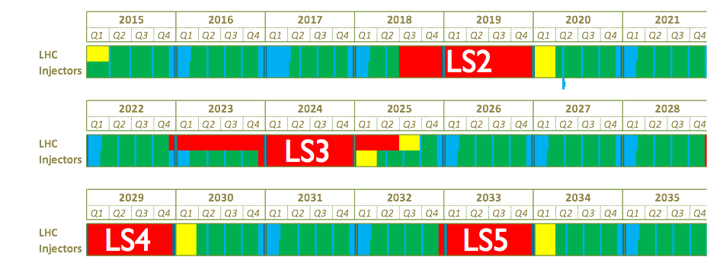
LHC Run 2 has started !
First 13 TeV
Stable Beams
Wednesday 3rd June

Slide 10
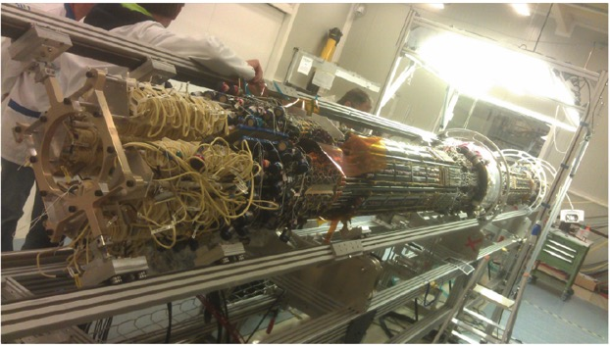
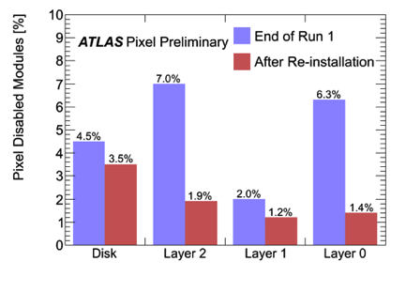
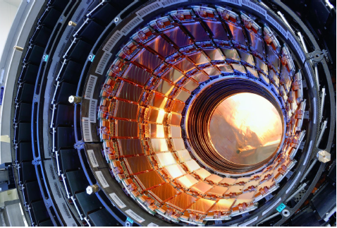
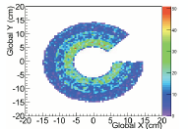
Huge Consolidation Work in shutdown
Daniel Dobos
ATLAS Pixel:
End plates – optical readout moved
Clemens Lange
CMS FPix
8% non-operational
➔99.9% operational
CMS SEU reset procedure

Slide 11
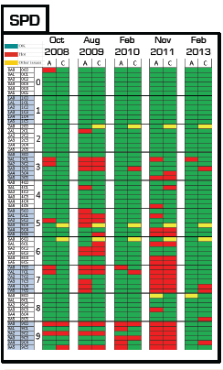
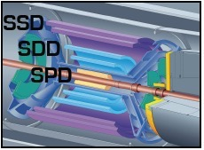
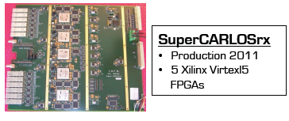
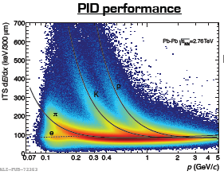
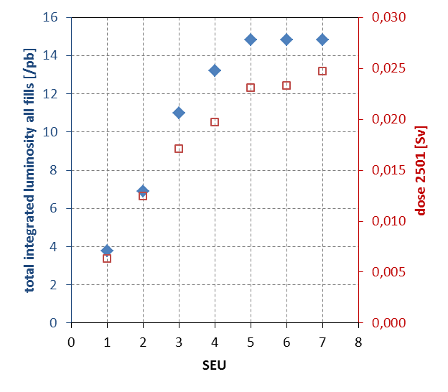
Detector Operations: ALICE
Domenico Colella
New FPGA boards
Improvements for SEU

Slide 12
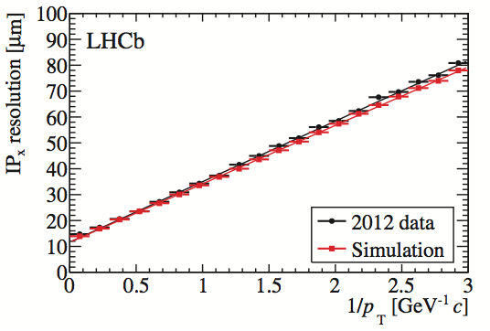
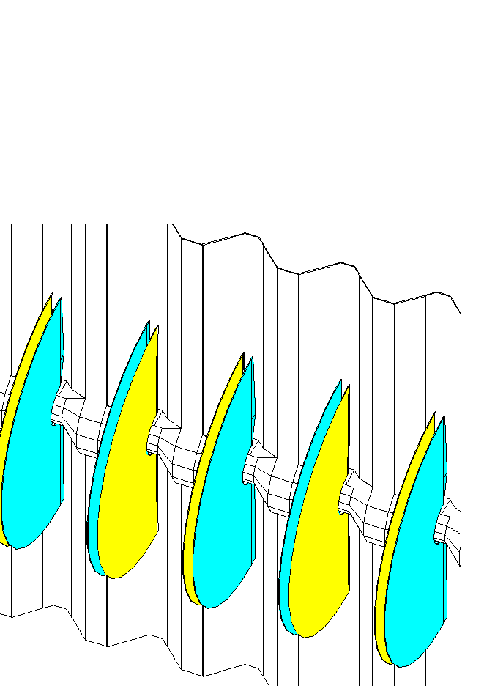
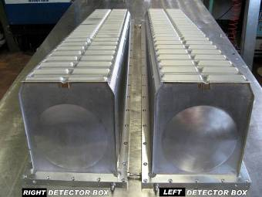
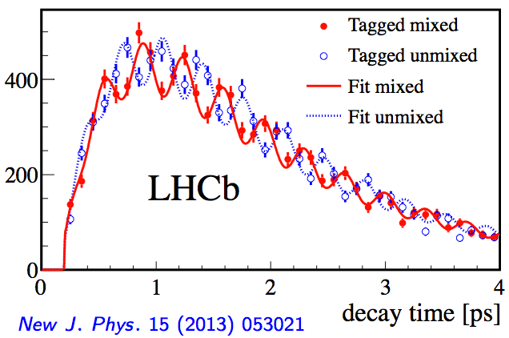
Detector Operations: LHCb VELO
Stefano Gallorini
Kurt Rinnert
RF foil modelling
Resolve B_{s} Oscillations
3 Trillion Hz !

Slide 13
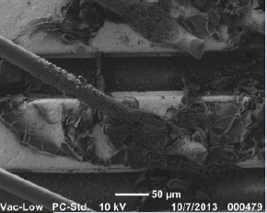
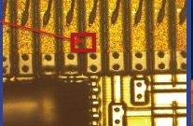
Water is never far away….
Daniel Dobos
ATLAS IBL Corrosion
Corroded bond wires due to condensation
Fabulous thing about the Vertex conference
– openly sharing and learning from problems
Clemens Lange
CMS Barrel Pixel Shorts
Suspected to be caused by condensation
In cooling box
Both cases – huge work and a
great success in fully recovering

Slide 14
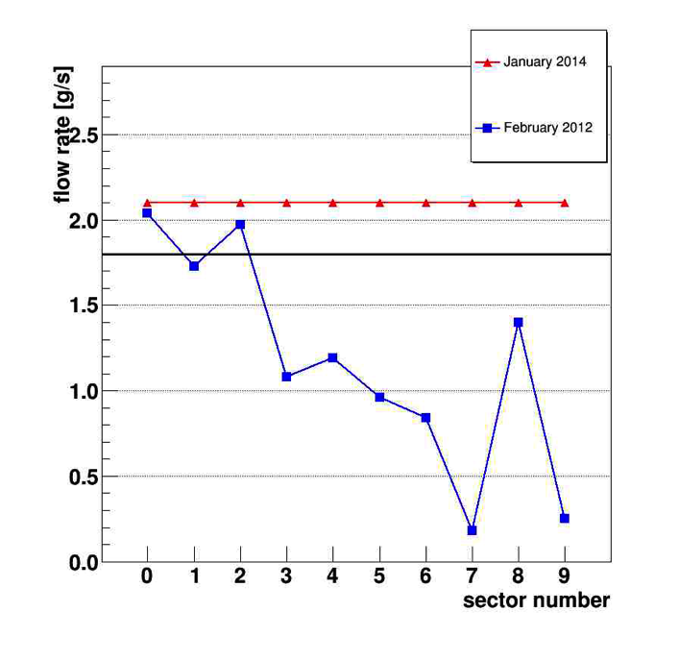
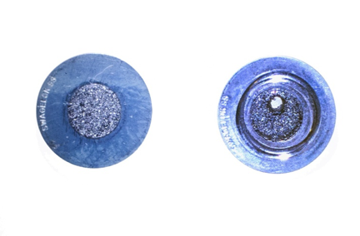
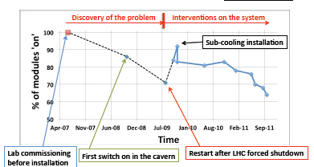
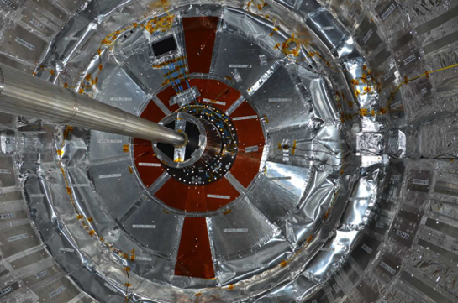
Cooling Issues
Domenico Colella
Clemens Lange
ALICE – drilling of clogged filters
Before
After
Rate
needed
CMS - Cooling improvements
Sealing & insulation
operation at lower T (-10/-15 C) in Run2
Limit radiation damage leakage currents
& reverse annealing

Slide 15

New Detectors
ATLAS Pixel Upgrade | Richard Bates
CMS Phase I Pilot | Bora Akgun
CMS Phase I Pixel | Lea Caminada
CMS Phase I Q/A | John Stupak
CMS Pixel Upgrade | Robert Stringer
LHCb VELO Upgrade | Sophie Richards
ALICE Pixel Upgrade | Monika Kofarago
Belle II Pixel | Marca Boronat
NA62 Pixel | Matthieu Perrin-Terrin
ATLAS Strip Upgrade | Zhijun Liang
CMS Strip Upgrade | Marko Dragicevic
LHCb UT Strip | JC Wang
Belle II Strip | Christoph Schwanda
CLIC | Szymon Kulis
ILC | Marcel Stanitzki

Slide 16
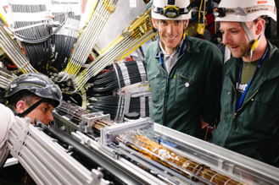
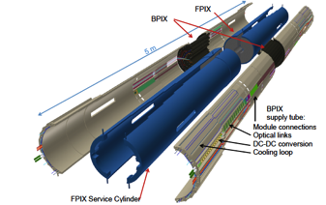
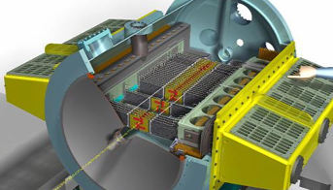
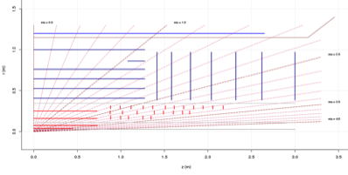
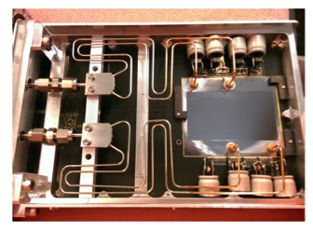
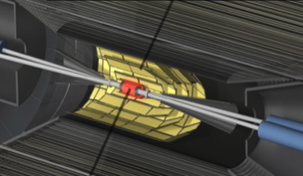
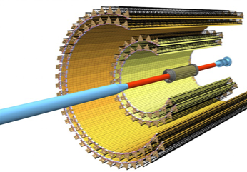
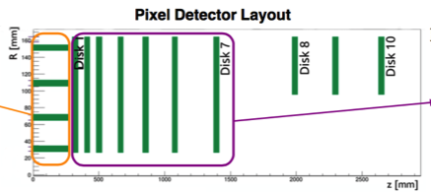
Expected Operational Date
2015
2017
2018
2016
2019
2020
2024?
20??
ATLAS IBL
Belle II
NA62
AFP/PPS
ILC/CLIC
CMS Phase I
LHCb Upgrade
ALICE Upgrade
ATLAS/CMS Phase II

Slide 17
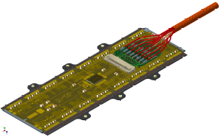
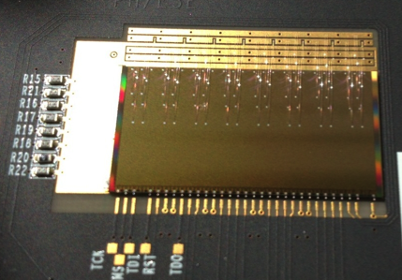
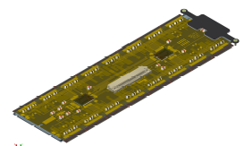
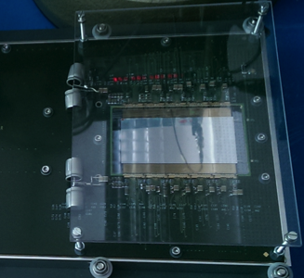
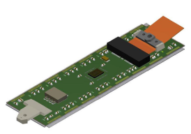
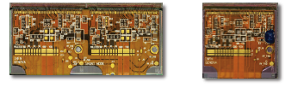
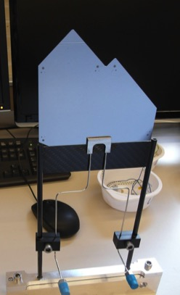
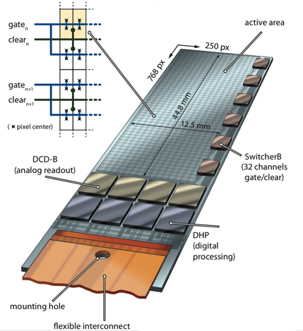
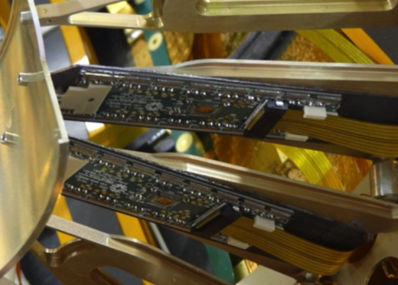
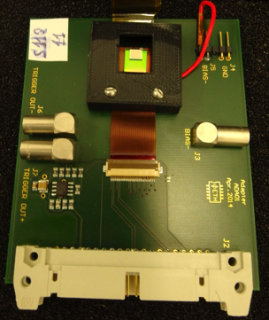
What is a module ? Pixels
ALICE pAlpide
NA62
CMS
PhaseI
ATLAS IBL
LHCb
Upgrade
CMS
Diamond
Belle II
CMS
Pilot

Slide 18
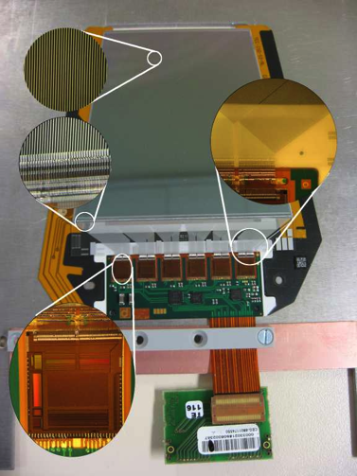
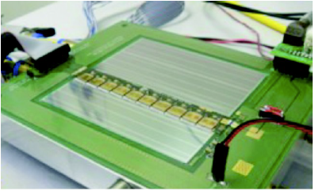
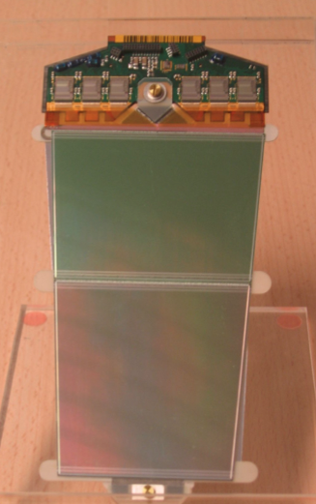



What is a module ? Strips
CMS Strip
ATLAS Upgrade Strip
ATLAS Strip
CMS Upgrade P_{T} module
LHCb UT
LHCb VELO

Slide 19


What is a module ? Strips
Belle II – Origami Module
CMS Strip
ATLAS Upgrade Strip
ATLAS Strip
Christoph Schwanda
APV25
Flex
DSSD
CMS Upgrade P_{T} module
LHCb UT
LHCb VELO
Chip (APV) mounted on sensor
Back (p-side) signals sent to front
with bent flex circuit
P⁺ strip
Sensor thickness
= 300-320μm
Si
“DSSD”
N⁺ strip

Slide 20


What is a module ? Strips
Redefining Taxonomy !
CMS Strip
ATLAS Upgrade Strip
ATLAS Strip
Marko Dragicevic
Several examples of strixels (LHCb VELO, ATLAS CMOS….)
But now CMS Strips & macro Pixels
CMS Upgrade P_{T} module
LHCb UT
LHCb VELO
For track trigger – see later

Slide 21


CMS Phase I Upgrade
Lea Caminada
Bora Akgün
John Stupak
Next LHC detector – install 2016/2017 shutdown
18M➔45M pixels
Mockup
Pilot run modules installed now

Slide 22




ATLAS/CMS Pixel Phase II
Richard Bates
Robert Stringer
Sensors: Planar (thin), 3D, CMOS
Many layers
Up to 10¹⁶ n_{eq}/cm⁻²
5Gbps/chip, electrical readout over 3m
Extend η coverage
6k-13k modules (ATLAS)
Channel Occupancies (%)
May increase pixel layers
Classic
Technical Proposal
Conical
Tilted
I-Beam

Slide 23


The Monsters: ATLAS/CMS strips
Zhijun Liang
Marko Dragicevic
All silicon trackers
190m² (ATLAS), 20k modules
Sensors: CMOS considered ATLAS
ATLAS
mCZ better annealing performance
No p-stop/p-spray preference
Thin sensors
CMS
CMS

Slide 24








ILC (CLIC)
Szymon Kulis
Marcel Stanitzki
Nick Sinev
ILC
1312 bunches
CLIC
156/312 bunches
Vertexing Option:
10ns timing
Vertexing Option:
single bunch timing (500ns), 25μm pitch
Chronopix
Mimosa Family 0.3% X⁰
Site Proposed
Statement by
Vertex 2016 ?
VIP
Working !

Slide 25






Cooling: Rise of CO₂
First Data !
ATLAS IBL 2014-
Salute the new kid on the block !
LHCb VELO 2008-
LHCb VELO Upgrade & UT
ATLAS Strip & Pixel Upgrade
CMS Strip & Pixel Upgrade

Slide 26


Cooling: Rise of CO₂ into space….
Martin Pohl
AMS
CO₂ become a default choice
Heat exchanger
Condenser
Tracker
Pump
Accumulator
Red line: CO₂ gas/liquid two phase
Blue line: CO₂ liquid phase

Slide 27






Micro-channel Cooling: NA62/LHCb
NA62 GigaTracker
Matthieu Perrin-Terrin
Time resolved hybrid pixel detector
    Coolant C₆F₁₀
LHCb VELO
Upgrade
Sophie Richards
Low material
CO₂ biphase

Slide 28






Technologies: 3D in Action !
Technologies: 3D in Action !
Jörn Lange
Now: ATLAS IBL
Soon: Forward Physics, 200m from IP. ATLASFP, CMS PPS
    Future: HL-LHC ? Can column aspect ratio be improved (cryogenic etch)
Edge performance

Slide 29





Technologies: 3D in Action ! Neutrons also
Oliver Kirstein
Shortage of ³He (good thing, blame !)
European Spallation Source under construction
Roberto Mendicino
Silicon based neutron detectors – lots of activities
3D technology applied: filling of cavities with converter material
Dream
Reality

Slide 30




Diamond in Action
Gregor Kasieczka
ATLAS Diamond Beam Monitor
IBL type pixel modules
pCVD Daimond
Integrated for Run II (some issues)
ATLAS Integration
R&D:
3D Diamond – Laser : holes diamond -> Graphite

Slide 31



Belle Pixels: DEPFET
Marca Boronat
0.2% X⁰ per layer

Slide 32




CMOS: In Action & Development
Monika Kofarago
Gene van Buren
ALICE Upgrade
STAR Tracker
7 layers
50 um thin MAPS
0.3% X⁰ per inner barrel layer
Sub-5μm resolution

Slide 33



CMOS Explosion !
Speakers: STAR/ATLAS/ALICE/CLIC/ILC
they were legion
HR/HV CMOS: Driven by technology advances
ATLAS Upgrade: Strips & Pixels
Radiation Hard (10¹⁵ n_{eq}/cm²), Fast (<25ns)
Low cost sensors: 5-10 € / cm²
Still bond to readout chip but “ASIC sinking into sensors”
Glue as well as bump-bonding investigated
Huge Potential for HEP !

Slide 34



CMOS Explosion !
Speakers: STAR/ATLAS/ALICE/CLIC/ILC
they were legion
Steve Worm
Conference Prizes for most outrageous use of powerpoint
Michael Deveaux
-
-
+
+
+
-
-
-
-
-
+
-
+
+
+
+
+
+
+
+
-
-
-
-
+
+
-
-
-
+
+
-
-
-
-
+
-
-
+
+
+
-
-
-
-
+
-
+
+
+
-
-
+
-
-
+
-
+
+
+
+
+
-
-
IBISCUS – prize for most contrived acronym ?
ILC: Challenge Combine 1μs time resolution (less?) with 3µm spatial resolution

Slide 35




Pixels with Timing – a revolution in the making ?
NA62: 200ps time resolution
Matthieu Perrin-Terrin
R&D aim 40ps
Detectors with Gain & Large Electron Drift Velocity
Abe Seiden
Marta Baselga
Multiplication reduced after irradiation (for Boron)
Also see Chris Kenney Tixel >30ps

Slide 36



Other Applications
Photon Science | Chris Kenney
Neural Vision | Alan Litke
Neutron Science | Oliver Kirstein
AMS | Martin Pohl
Fermi LAT | Eric Charles
AEgIS | Angela Gligorova
Chris Kenney’s
Non-flying saucers
Alan Litke:
“How does it respond to black & white dots ?”

Slide 37






Opportunities
HEP benefitting large range of scientific applications
Photon Science
50 eV ➔ 50 GeV
Absorption in Si: 10nm ➔1 cm
Chris Kenney
LCLS
XFEL
2017
Alan Litke
100Myr old
Brain/visual system
Strong science case for
100keV-1GeV Instrument
High Energy Cosmic Ray Detector for Chinese Space Station
Compton
Pair conversion
Silicon- Tungsten
Tracker
Eric Charles
Martin Pohl

Slide 38


R&D
Ultra-fast | Abraham Seiden
3D | Joern Lange
Neutron detectors | Roberto Mendicino
CMOS | Herve Grabas
HR-CMOS | Steven Worm
HV-CMOS | Mattheiu Benoit
MAPS | Michael Deveaux
Radiation Defects | Timo Peltola
Rad. Hard Technology | Marta Bacardit
Diamond | Gregor Kasieczka
TCT | Vladimir Cindro
Rad damage monitoring | Sally Seidel

Slide 39







Radiation Hardness (RD50)
Timo Peltola
Highly effective simulations available up to 1.5 x 10¹⁵ n_{eq} cm⁻²
200μm
300μm
Marta Baselga
n-in-p no annealing
Charge multiplication
Irradiation facility

Slide 40







Souvenir ?

Slide 41




Souvenir ?
Transient Current Technique
Vladimir Cindro
Commercially available
Impressive array of measurements

Slide 42




LHC Operation – radiation damage
Sally Seidel
Currents good agreement
Hamburg model
Kurt Rinnert
Automated Data Collection
Huge number of data points for
n+-on-n sensors + n+-on-p

Slide 43

Electronics
RD53 | Maurice Garcia-Sciveres
VeloPix | Kurt Rinnert
McDonalds in Roswell

Slide 44




New Rad Hard LHC ASICs
RD53 – Hybrid pixel chip for HL-LHC
ATLAS & CMS
(Not a real 8-bit logo
made up for this slide)
65nm Technology
50x50μm pixels
5 Gbps per chip drive electrical signals up to 6m long
~ 1MHz trigger rate
Maurice Garcia-Sciveres
Velopix – Medipix (Timepix) family (spin-back?)
LHCb
130nm Technology (TSMC)
55x55μm pixels
20 Gbps per chip (5Gb/s serializer)
40MHz triggerless
Kurt Rinnert
Test chip design
GWT Serializer/Transmitter

Slide 45

Tracking & Alignment
LHCb Tracking | Stefano Gallorini
Track-trigger CMS | Marco De Mattia
Track-trigger ATLAS | Guido Volpi
Tracking ATLAS | Gabriel Facini
Tracking STAR | Gene van Buren
Vertexing & Tracking | Rudi Frühwirth
Real-time alignment | Giulio Dujany
Alignment ATLAS Run II | Pierfrancesco Butti

Slide 46




Track Trigger
Marco De Mattia
Guido Volpi
FPGA (+ ASIC) Pattern recognition / tracking
CMS approach: Double layer modules output stubs
Phase II upgrade ~2025
ATLAS approach: Full tracking for L1 triggered events
for use in HLT, install during Run 2
Level 1 track trigger upgrade for Phase II
LHCb Upgrade: Readout full detector 40MHz all in CPU
CMS
ATLAS

Slide 47


Tracking & Vertexing
Gabriel Facini
Rudi Frühwirth
For Run II Evolution not Revolution
BUT many × “small” = big improvement
Factor 4 in speed (PU=70)
Upto factor 6 in Fake rate
New: Shareable Clusters between Tracks
Significant B tagging improvement

Slide 48



Online: Automatic Alignment & Calibration
Minimise Online / Offline differences
  Improve effective trigger performance
Automatic evaluation at regular intervals
  Vertex Locator (VELO) alignment as example
  O(1 min) CPU, update immediately
G. Dujany
Half misalignment per fill in 2010
Max deviation ~ 10μm
Another Potential Revolution: Discard Raw Data in Trigger ?

Slide 49


ATLAS IBL Alignment
Pierfrancisco Butti
Bowing with T due to CTE mismatch on stave (10μm/ºC)
Parametrised distortion
ΔT=2ºC during stable operation ➔ 2μm bowing, negligible impact
In addition try to add bowing DOFs to alignment procedure
Notes:
Condensation
Few um per deg C

Slide 50

Online: Automatic Alignment & Calibration
Thanks to Silvia Borghi
Minimise Online / Offline differences
  Improve effective trigger performance
Automatic evaluation at regular intervals
  Vertex Locator (VELO) alignment as example
  O(1 min) CPU, update immediately
G. Dujany
Relative alignment of VELO halves
Half misalignment per fill in 2010
Breaking News…..
First Result from LHC Run II
Indeed from 4 hours time !
18:06 Friday 5th June
Max deviation ~ 10μm
Another Potential Revolution: Discard Raw Data in Trigger ?

Slide 51






Summary of Summary of Summaries
Some (personal) thematic highlights
  LHC experiments still improving
  (detectors & algorithms)
  Large number new detectors planned
  (inter- experiment collaboration)
  Alternative Technologies in action
  (3D, Diamond, soon DEPFET)
  Microchannel cooling in action
  Pixels with Timing
  HV/HR CMOS Explosion
Tremendously productive meeting in a spectacular location

Slide 52


Non
S

Slide 53




Vertex 2016
La Biodola,
Isola d’Elba

Slide 54


Many Many Many Thanks
Heather
Sally
Not forgetting all the hotel staff and definitely the chef !

