Slide 1
Chronopixel project status
N. B. Sinev
University of Oregon, Eugene
In collaboration with J.E.Brau, D.M.Strom (University of Oregon, Eugene, OR), C.Baltay, W.Emmet, D.Rabinovitz (Yale University, New Haven, CT)
EE work is contracted to Sarnoff Corporation

Slide 2
Outline of the talk
Very brief reminder of Chronopixel concept:
  Chronopixel is a monolithic CMOS pixel sensor with enough electronics in each pixel to detect charge particle hit in the pixel, and record the time (time stamp) of each hit.
Specifications
History
Prototype 1 test results
Prototype 2 features and test results
Changes in prototype 3
Sensor options discussion
Some results of prototype3 tests
  main problem discovered in prototype 2 is solved !
  noise, calibration, etc.
Results discussion
Summary and plans

Slide 3
Specifications
Chronopixel sensor has to be designed for Vertex Detector in the ILC Beam environment.
  Bunch crossing rate (Collisions rate) ~3 MHz
  Number of bunches in bunch train ~3000
  Bunch trains interval – 200 ms
Vertex detector for ILC should have
  5 layers, with innermost layer radius about 2.4 cm, and outermost layer radius ~ 10 cm. The length of the detector ~ 20 cm. There will be forward discs also.
  Pixel size should be less than 15x15 µ² (space point resolution ~3.5µ).
  Each pixel should have 2x12 bit memory buffer to record 2 time stamps in case 2 hits occur in same pixel during bunch train.
  It should operate at room temperature with forced air cooling with non-turbulent air flow. It limits power dissipation for entire Vertex Detector to ~ 100 W.
  Sparse readout should be implemented to allow full sensor readout in 200 ms.
  S/N ratio should be more than 30 (noise less than 25 e⁻ ).

Slide 4
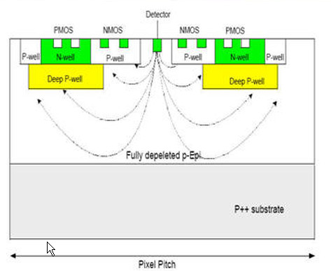
Our initial ultimate design concept
Ten years ago we thought, that to provide full charge collection by the sensor electrode, we need DEEP PWELL implemented by manufacturer, to prevent competing charge collection by bodies of PMOS transistors.
However, for the first prototype we didn’t need to implement deep P-well

Slide 5
History
February, 2012
  Submitted to MOSIS for production at TSMC. (48x48 array of 25 µm pixel, 90 nm process)
  Modification of the test stand started as all signal specifications were defined.
June 6, 2012
  chips delivered to SLAC
  Tests at SLAC started
March 2013
  Test results are discussed with Sarnoff and prototype 3 design features defined
April 2014
  Design submitted for fabrication
August 13, 2014
  prototype 3 chips arrived at SLAC
October 2014
  first round of tests completed
2004 – talks with Sarnoff Corporation started.
  Oregon University, Yale University and Sarnoff Corporation collaboration formed.
January, 2007
  Completed design – Prototype 1
    2 buffers, with digital calibration
May 2008
  Fabricated 80 5x5 mm chips, containing 80x80 50 μm Chronopixels array (+ 2 single pixels) each
  TSMC 0.18 μm ⇒ ~50 μm pixel
    Epi-layer only 7 μm
    Low resistivity (~10 ohm*cm) silicon
October 2008
  Design of test boards started at SLAC
March 2010
  Tests completed, report written
May 2010
  contract with Sarnoff for developing of second prototype signed

Slide 6
Prototype 1 summary
Tests show that general concept is working.
Noise figure with “soft reset” was within specifications ( 0.86 mV/35.7μV/e = 24 e, specification is 25 e).
Comparator offsets spread 24.6 mV expressed in input charge (690 e) is 2.7 times larger required (250 e).
Sensors leakage currents (1.8·10⁻⁸A/cm²) is not a problem.
Sensors timestamp maximum recording speed (7.27 MHz) is exceeding required 3.3 MHz.
No problems with pulsing analog power.
Pixel size was 50x50 µm² while we want 15x15 µm² or less.
However, CMOS electronics in prototype 1 could allow high charge collection efficiency only if encapsulated in deep p-well. This requires special process, not available for smaller feature size?
Digital comparators offset compensation circuit limited our ability to reach required accuracy

Slide 7
Prototype 2 features
Design of the next prototype was extensively discussed with Sarnoff engineers. In addition to fixing found problems, we would like to test new approach, suggested by SARNOFF – build all electronics inside pixels only from NMOS transistors. It can allow us to have 100% charge collection without use of deep P-well technology, which is expensive and rare. To reduce all NMOS logics power consumption, dynamic memory cells design was proposed by SARNOFF.
New comparator offset compensation (“calibration”) scheme was suggested, which does not have limitation in the range of the offset voltages it can compensate (analog vs digital in 1st prototype).
We agreed not to implement sparse readout in prototype 2. It was already successfully tested in prototype 1, however removing it from prototype 2 would save some engineering efforts. It will be returned into final device.
In September of 2011 Sarnoff suggested to build next prototype on 90 nm technology, which will allow to reduce pixel size to 25µ x 25µ
We agreed to have small fraction of the electronics inside pixel to have PMOS transistors. Though it will reduce charge collection efficiency, but will simplify comparator design. It is very difficult to build good comparator with low power consumption on NMOS only transistors.

Slide 8
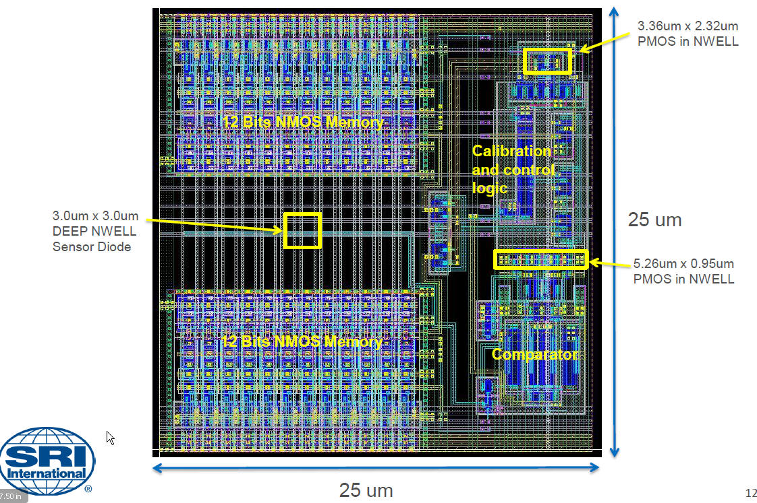
Prototype 2 pixel layout
All N-wells (shown by yellow rectangles) are competing for signal charge collection. To increase fraction of charge, collected by signal electrode (DEEP NWELL), half of the pixels have it’s size increased to 4x5.5 µ² .

Slide 9
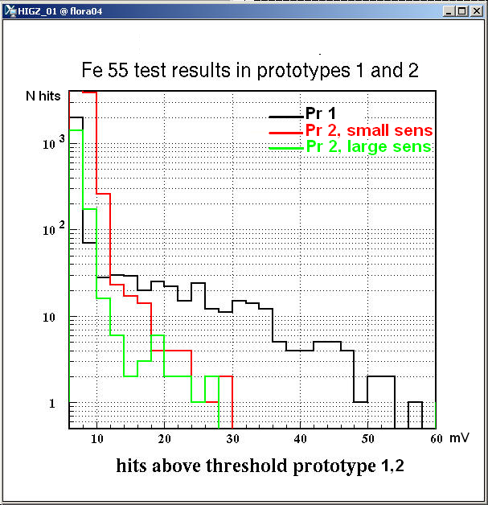
Prototype 2 test results – sensor capacitance
Comparison of the Fe 55 signal distributions for prototype 1 and 2. Sensor diode size in prototype 1 was ~100 µ² Prototype 2 has 2 sensor size options – 9 µ² and 22 µ² (“small” and “large” on the plot) . The maximum signal value is slightly larger for sensor of smaller size, as one would expect, though we would expect larger difference in maximum signal values here. But capacitance of the sensor from this measurements (~9 fF) appeared much larger than our expectation (~1-2 fF).

Slide 10
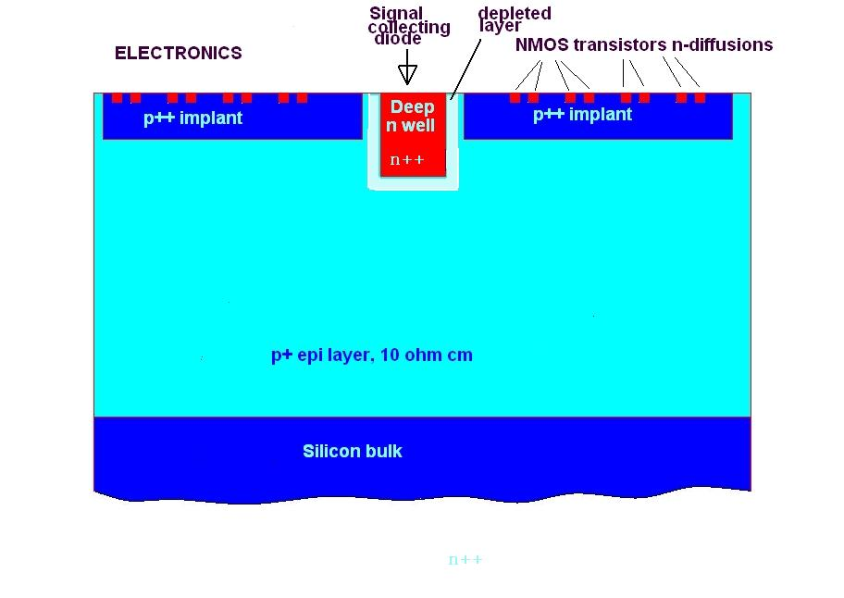
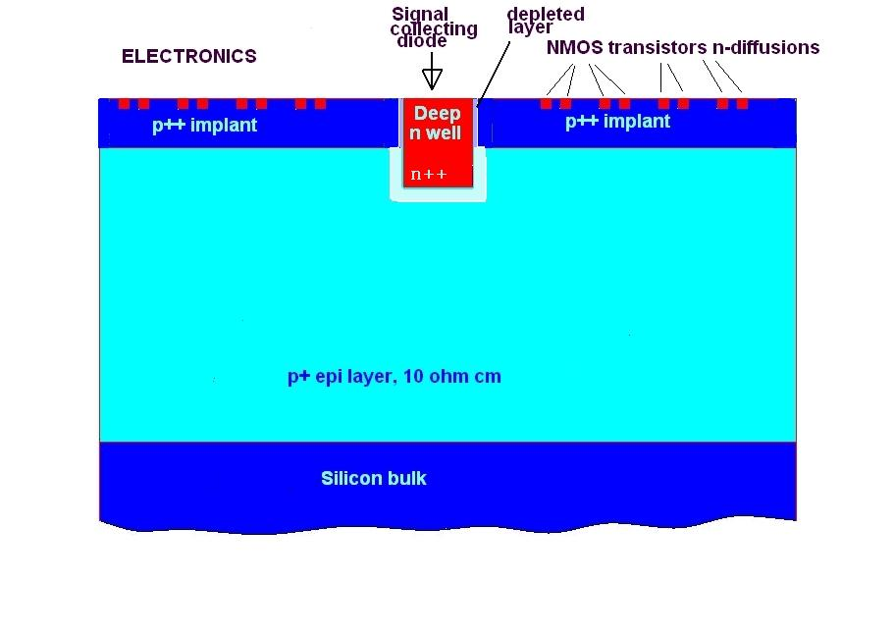
What got wrong?
We hoped, that pixel cross-section will look like what is shown on left picture. But it appeared, that in 90 nm design rules it is not allowed to have window in the top p++ implant around deep n-well, which forms our sensor diode. Resulting pixel cross-section is shown on right picture. Very high doping concentration of p++ implant leads to very thin depletion layer around side walls of deep n-well, which creates additional large capacitance.

Slide 11
Summary of prototypes 1 and 2 tests
From both, first and second prototype tests we have learned:
  1. We can build pixels which can record time stamps with 300 ns period
  (1 BC interval) - prototype 1
  2.We can build readout system, allowing to read all hit pixels during
  interval between bunch trains (by implementing sparse readout) - prototype 1
  3.We can implement pulsed power with 2 ms ON and 200 ms OFF, and this will not ruin comparator performance - both prototype 1 and 2
  4. We can implement all NMOS electronics without unacceptable power
  consumption - prototype 2. We don't know yet if all NMOS electronics
  is a good alternative solution to deep P-well option.
  5. We can achieve comparators offset calibration with virtually any
  required precision using analog calibration circuit.
  6. Going down to smaller feature size is not as strait forward process as
  we thought. Sensor capacitance became an issue, limiting signal/noise ratio. And the main problem here seems to stem from 90 nm process design rules.

Slide 12
Sensor options in prototype 3
6 different sensor options were implemented on the same chip – 8 column allocated for each option:
  1 – same as in prototype 2 – for comparison
  2 – deep NWELL diode in the window in P++ layer – this violate design rules, but the waver for design rules was accepted by TSMC
  3 – shallow NWELL diode also in the window – also violates design rules, but waver was accepted
  4 – “Natural transistor” (NTN) allowed by design rules to be in the P++ layer window – transistor is formed directly on P+ epi layer. Large source and drain diffusion areas, gate connected to both source and drain and form sensor output
  5 – also NTN but with 2 fingers, source and drain are narrow, gate also connected to both, as in option 4
  6 – same as 5, however gate is not connected to source and drain, but connected to external bias voltage.

Slide 13
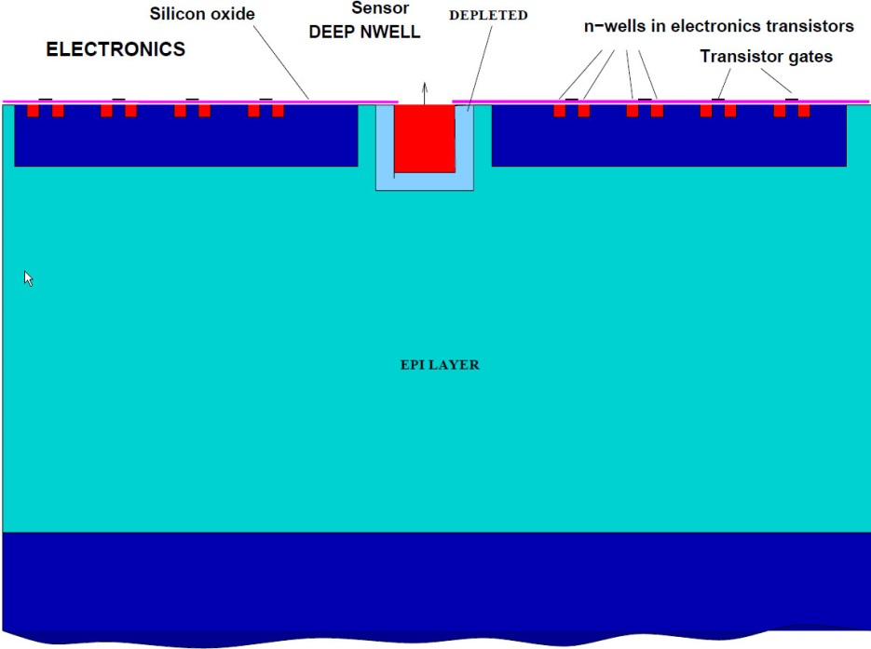
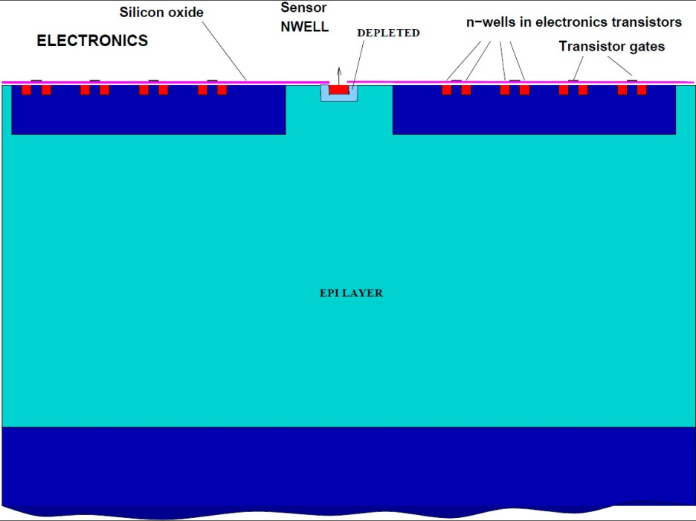
Options with NWELL diode – violating design rules
It will be interesting to compare deep and shallow Nwells. Deep has larger area, so larger charge collection efficiency, however, larger capacitance. Shallow option has smaller area, but because P++ acts as charge reflector, the charge collection efficiency may be defined not by diode size, but by window size. It depends on how deep is P++ implant, of course.

Slide 14
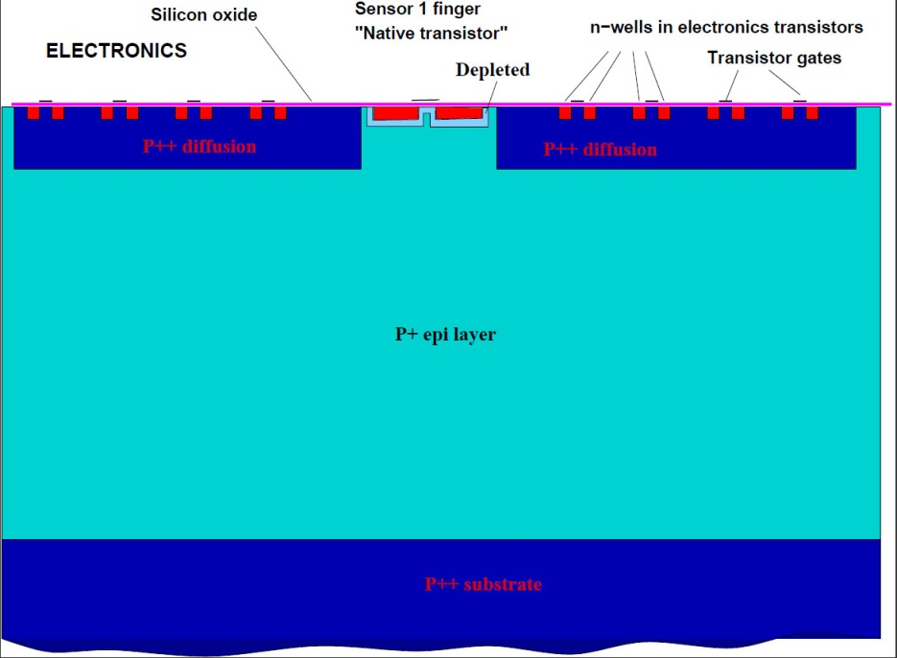
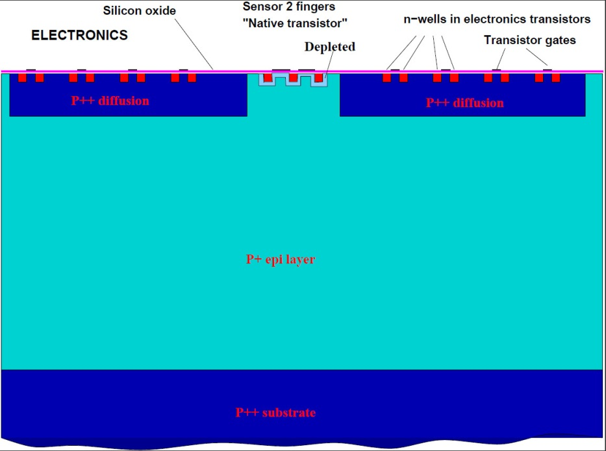
Options with “Natural transistor”
In 1 finger option the size of nwells forming source and drain is larger, so we
can hope for better charge collection efficiency. However, sensor capacitance may be larger also. There is 2 2-finger options – one with gates connected to source and drain, another – to external bias. It will be interesting to see how these two options behave

Slide 15
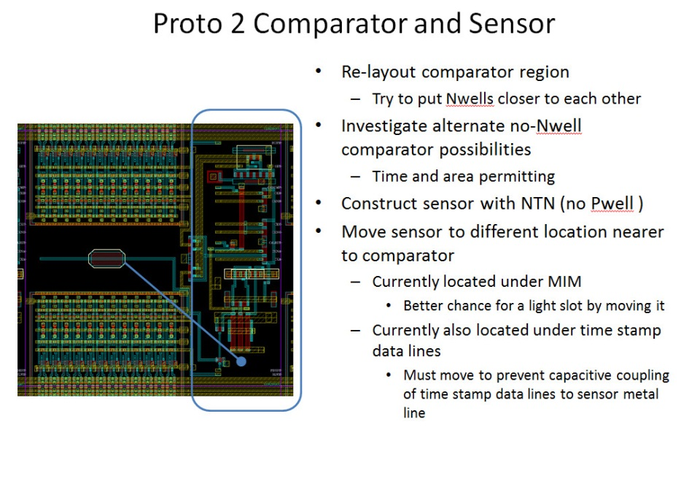
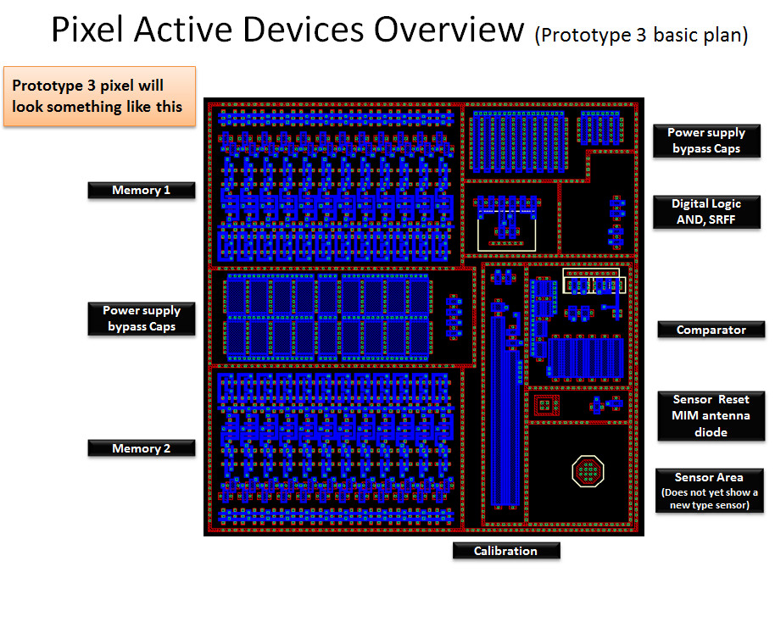
Difference in proto 2 and 3 layouts
Here are 2 slides from SRI showing their plan to address prototype 2 crosstalk problems

Slide 16
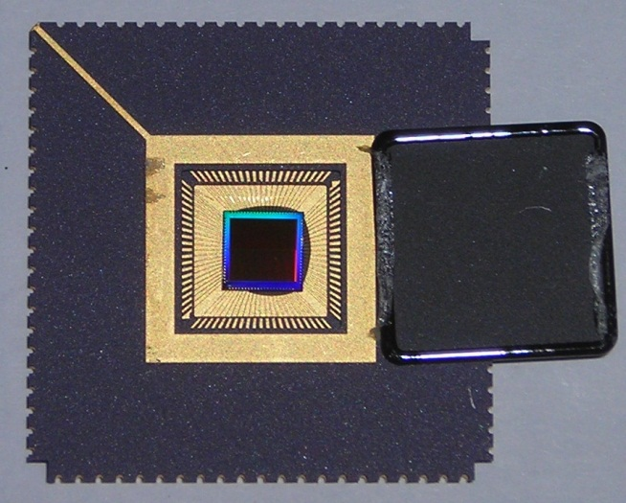
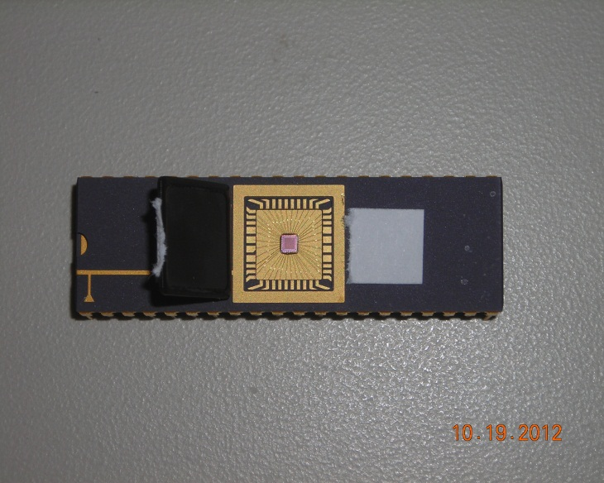
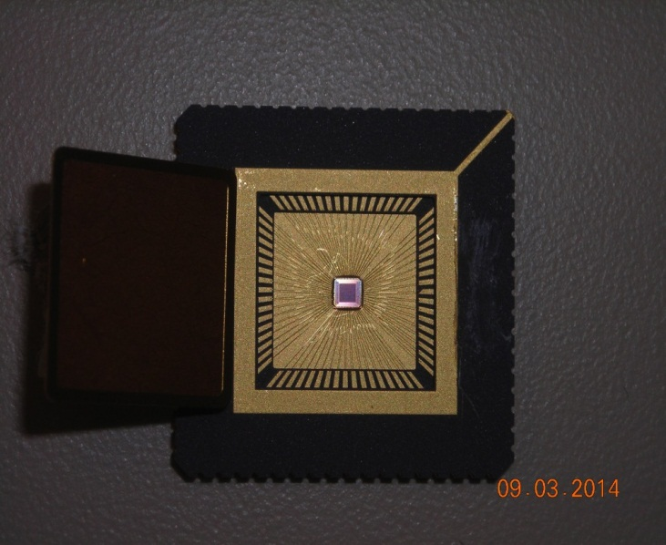
Prototypes photos
Prototype 1(top) 2 (right top) and 3 (right bottom). The chip size for prototype 3 was the same as in prototype 2 (1.3x1.3 mm² ), but package is different, it has 68 pins instead of 40 in prototype 2 thanks to new technology, allowing reduce pitch of contact pads on the chip. Larger number of pins allowed to get rid of row/column address multiplexing and separate analog and digital power inputs.

Slide 17
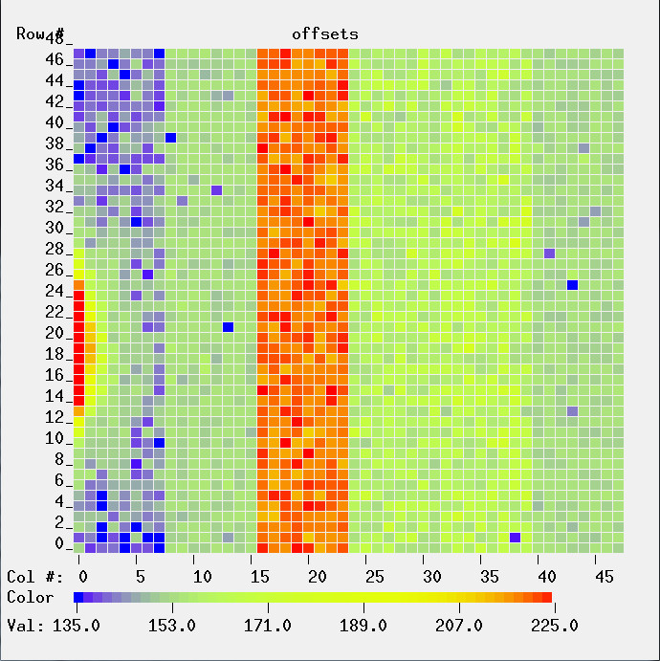
How different sensor options perform
It was assumed, that we can achieve smaller capacitance of a sensor, compare to prototype 2. But which option can give the smallest capacitance was not obvious. And, in general, how small this capacitance can be depends not only on the sensor capacitance, but also on the parasitic capacitances of reset transistor and source follower.
First hint on the values of the sensor capacitance could be seen on the picture at right – here are color coded values of the voltage change on the sensor due to reset pulse coupling. Because the coupling capacitance between reset transistor gate and sensor is the same for all sensor modifications, such coupling will be larger for the sensors with smaller capacitance. We see, that sensor option 3 has the larges value of coupling – means smallest capacitance

Slide 18
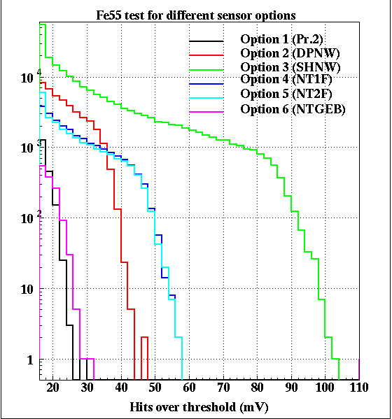
Fe55 test
More precise method of measuring sensor capacitances consist in the observation of signal from radioactive source Fe55. It emits low energy (5.9 KeV) X-rays. Such X-rays are absorbed in the silicon, and all their energy goes into creation of electron-hole pairs. The energy to create one such pair is well known, and is 3.66 eV for Si. So, from maximum observed signal we can calculate capacitance. Taking into account, that Fe55 has about 10% of decays with energy 6.49 KeV, we can get following capacitances:
Opt. 1 – 9.04 fF, opt 2 – 6.2 fF, opt 3 – 2.73 fF, opt 4 and 5 4.9 fF and option 6 – 8.9 fF

Slide 19
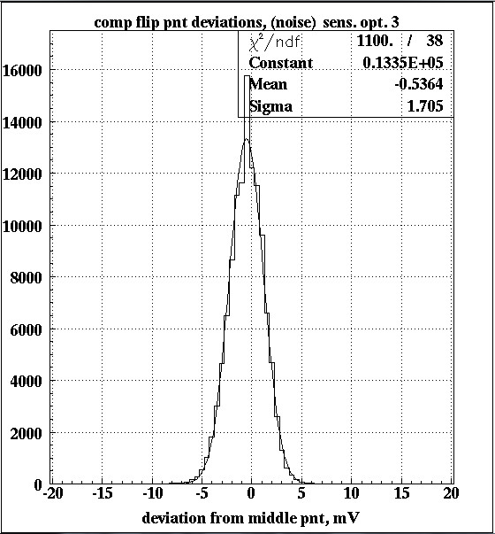
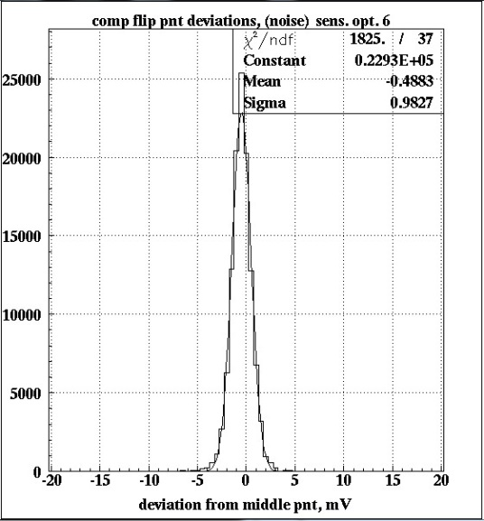
Sensor noise measurements
Plots above show noise measurements for sensor options with minimum capacitance (option 3, C=2.73 fF) on left, and maximum capacitance (option 6, C=8.9 fF) on right. Qualitatively they agree with expectation – larger capacitance – smaller noise, but they are larger, than expected from KTC noise formula. That means, that there are additional noise pick up, and table on the next page will give you estimated values of such pick up.

Slide 20
Noise observed vs expected
Table at the right shows measured noise values (mV) for different sensor options, and comparison with expected values from KTC noise formula and computed from Fe55 test capacitances. Interesting to notice. that extra noise pick up is largest for smallest capacitance, which is not a surprise, if pick up occurs through capacitive coupling to the sensor. Option 1 seems does not follow this rule – it has largest capacitance, but not smallest pick up. However, it can be understood from the fact, that these pixels are closest to the sensor edge, where most pulsed control signals are formed.
Option | sigma obs. | sigma exp. | Sqrt (δ²_{ob} - δ²_{ex)}
1 | 1.12 | 0.67 | 0.9
2 | 1.08 | 0.8 | 0.73
3 | 1.7 | 1.21 | 1.2
4 | 1.21 | 0.9 | 0.8
5 | 1.23 | 0.9 | 0.84
6 | 0.98 | 0.67 | 0.72
We hoped, that reduction in the photodiode reset pulse amplitude can reduce noise. However, recent tests have sown that it does not help.

Slide 21
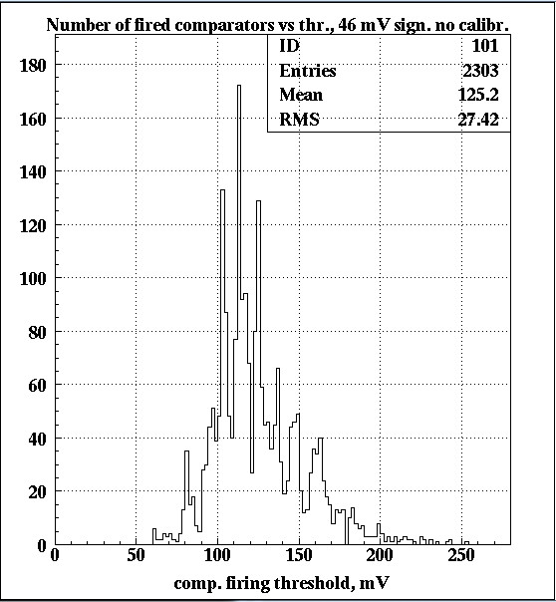
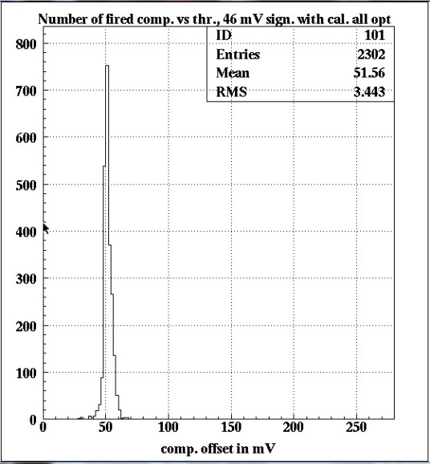
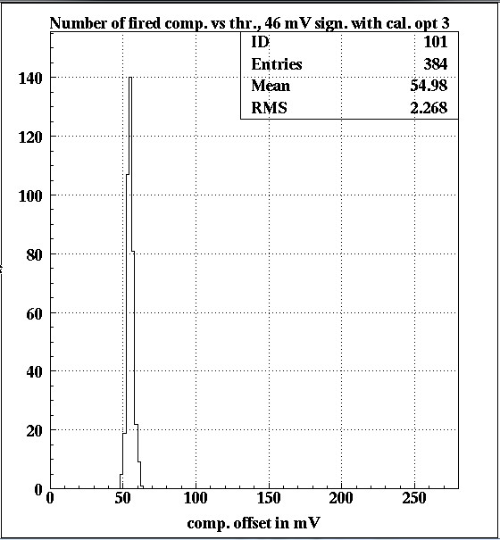
Comparator offset compensation
Left picture shows distribution of comparator offsets before compensation (we call it calibration), middle – the same after compensation for all pixels, right – after compensation for pixels with sensor option 3. From the fact, that signal of 46 mV fires comparators at slightly larger threshold, and that this difference is different for different sensor options we can conclude, that such calibration is affected by additional noise pick up.

Slide 22
Discussion
Looks like option 3 – shallow diode violating design rule provides best performance – smaller capacitance, larger signal. However, we should remember, that sensor area in that case is only 2.74 µ², while options 4 and 5 – natural transistors – have sensor (n+ diffusion area) 19.36 µ² . And sensor area is important for charge collection efficiency, because we have competing n-wells in our pixels with total area of ~13 µ² . However, there may be another factors here. For example, if small sensor diode sits inside large hole in p++ implant, it is possible, that for most electrons, entered this hole probability to diffuse back and be collected by parasitic NWELLs is much smaller, than to be collected by diode, sitting in the hole. However, that depends on how large is depleted region, and if they not captured by oxide border.
In any case, we need more tests with minimum ionizing tracks to find what the charge collection efficiency for different option is. And so far, native transistor option may appear as the best choice.

Slide 23
Summary and plans
Chronopixel R&D are moving forward, we have solved many problems and proved that concept is valid.
Looks like the problem with large capacitance of sensors in 90 nm technology is solved!
Much more work is needed to fully understand details of sensor operations. We absolutely need to measure sensor efficiency for minimum ionizing particles.
Cross talk issues were addressed in prototype 3 by separating analog and digital powers and putting small decoupling capacitors into each pixel. However, we still see some effect of cross talks. It is not a show-stopper, as effect is relatively small, but we need to think about minimizing it.
For final design we need thicker epi layer (larger signal) and higher resistivity of it – larger depletion depth will increase charge collection efficiency. The challenge for final design is also chip size. Prototype 3 has ~1.2x1.2 mm² active area, we will need few cm² .
We could start thinking about final design, but need funding for it.

