Slide 1


VeloPix: The Pixel ASIC for the LHCb VELO Upgrade
Kurt Rinnert (University of Liverpool)
On behalf of the LHCb VELO group
5.6.2015
VERTEX 2015, Santa Fe, NM, USA

Slide 2
Outline
Introduction
VeloPix vs Timepix3
Readout Architecture
GWT Serializer
Summary

Slide 3
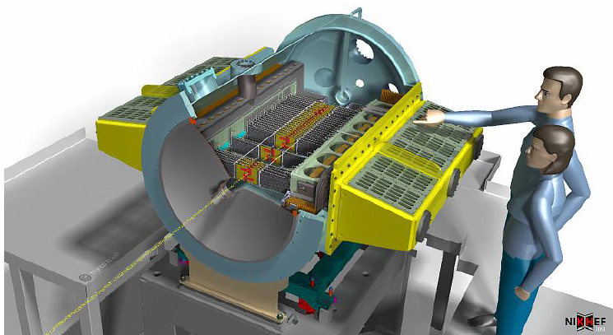
Introduction
VeloPix: Hybrid pixel detector Readout ASIC for the LHCb VELO upgrade
The ASIC reads out all bunch crossings at 40 MHz
The VELO upgrade:
Approx. 2.85 Tbit/s
26 module pairs
624 ASICs
41 Mpixels
Artistic impression of
new VELO [1]
VeloPix
ASICs

Slide 4
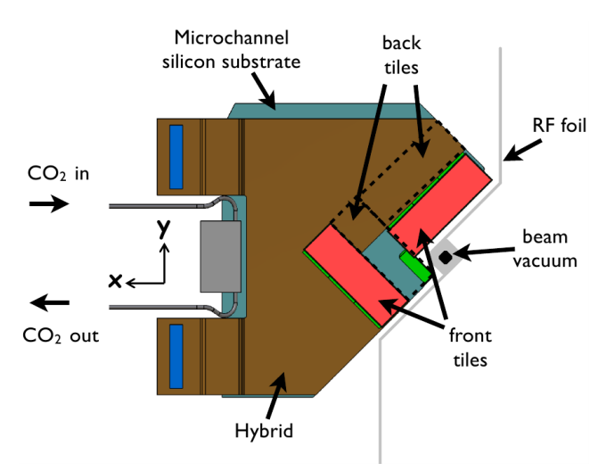
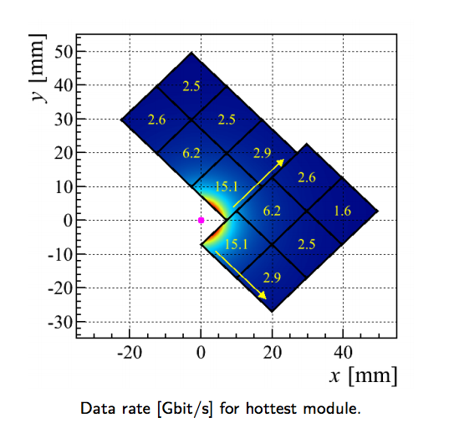
VeloPix ASIC module (12 ASICs)
Module of 12 VeloPix ASICs [1]:
Track rates for module [2]:
ASIC
ASIC
ASIC
Sensor
ASIC
ASIC
Sensor
ASIC
Highly non-uniform radiation dose:
8 x 10¹⁵ to 2 x 10¹⁴ n_{eq}/cm²
Peak rates:
Hottest chip 15.1 Gbits/s
hottest module: 61.2 Gbits/s
See Sophie Richards’ overview of the VELO upgrade:
“LHCb VELO Upgrade”

Slide 5
VeloPix ASIC specifications
Feature | VeloPix | Timepix3 [2]
Readout type | Continuous, trigger-less, binary | Continuous, trigger-less, ToT
Timing resolution/range | 25 ns, 9 bits | 1.5625 ns, 18 bits
Power consumption | < 1.5 W cm⁻² | < 1.0 W cm⁻²
Pixel matrix, pixel size | 256 x 256, 55 um x 55 um | 256 x 256, 55 um x 55 um
Radiation hardness | 400 Mrad, SEU tolerant | -
Peak hit rate | 900 Mhits/s/ASIC 50 khits/s/pixel | 80 Mhits/s/ASIC 1.2 khits/s/pixel
Sensor type | Planar silicon, e- collection | Various, e- and h+ collection
Max. data rate | 20.48 Gbps | 5.12 Gbps
Technology | 130 nm CMOS | 130 nm CMOS
> x 10
x 4

Slide 6
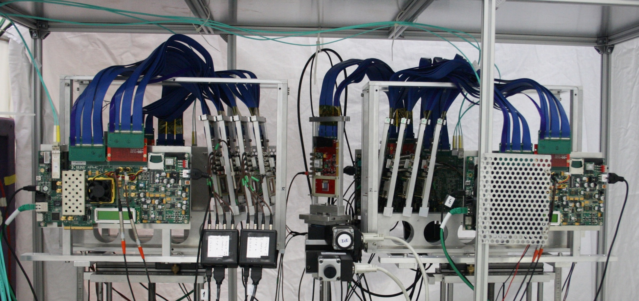
Timepix3 Test Beams
8x Timepix3 telescope
Several successful test beams with different DUTs.
SPIDR readout
Timepix3 DUT
Mechanics: CERN
See [4] for more about Timepix3.

Slide 7
VeloPix
Architecture
128 double columns (14.08 mm)
SP63
SP63
SP63
SP63
SP63
SP62
SP62
SP62
SP62
SP62
SP61
SP61
SP61
SP61
SP61
Super pixel:
2x4 pixels to
reduce the data
rates
30% reduction
vs. single-pixel
PixelHit
Processor
256 rows (14.08 mm)
super pixel logic
SP2
SP2
SP2
SP2
SP1
SP1
SP1
SP1
SP0
SP0
SP0
SP0
SP0
EoC
EoC
EoC
EoC
EoC
2-3 mm
router
DACs
PLL
serial
serial
SLOW CONTROL
serial
serial
TIMING, FAST CTRL

Slide 8
VeloPix Pixel Schematic
1 pixel
Common for 8 pixels
Front-end (Analog)
Front-end (Digital)
Super pixel (Digital)
Leakage
Current
compensation
8
23 bits
ToT
Threshold
FIFO
Input
pad
3 fF
4-bit Local
Threshold
Valid
event
handshake
9 bits
23 bits
Preamp
Synch.
&
Clock
gating
6-bit
LFSR
Counters
&
Latches
CLOCK
manager
Data node
TestBit
~43 mV/ke⁻
(Cdet = 50 fF)
MaskBit
23 bits
handshake
TpA
TpB
Global threshold
BX ID
To next
node
clock
(40MHz)

Slide 9
Packet Format
30% data reduction from sharing the BX ID and super pixel address
among multiple pixels.
30 bits
Packet:
BX ID 9b
SP addr 13b
Hitmap 8b
No ToT!
Range obtained
from simulations
Grouping 8 hits into one packet
Identify 2x4
SP region
(6 bits at column level)
BX ID = bunch crossing ID/
time stamp/time-of-arrival

Slide 10
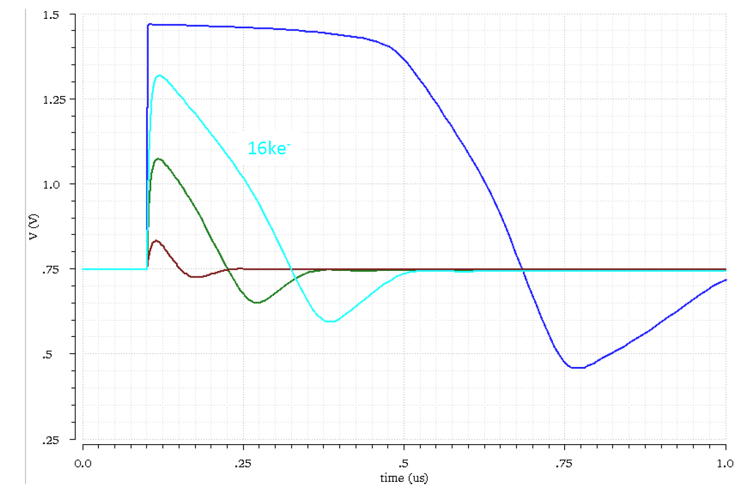
Analog Front-End Amplifier Response
Input charges:
2 ke-
10 ke-
16 ke-
50 ke-
~225 ns @ 16 ke-
175 ns

Slide 11
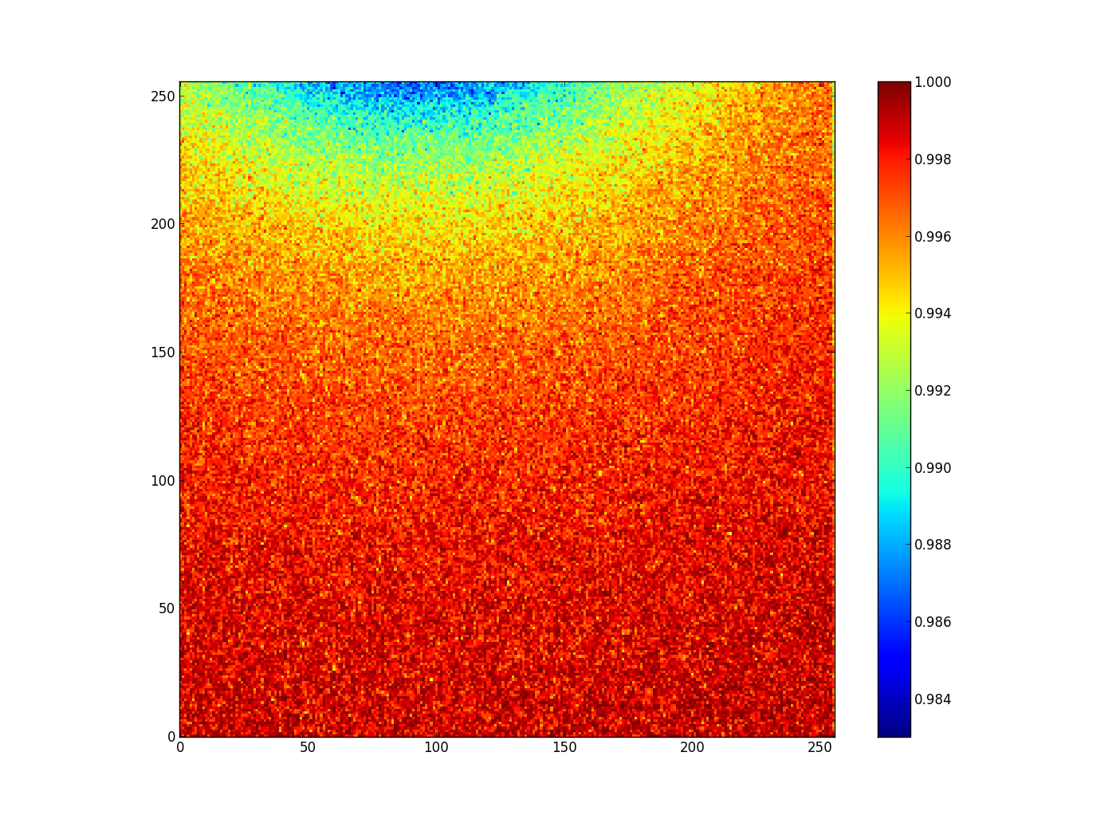
Analog Front-End Pile-Up
Up to 1.6% losses
Rates up to 50 kHz per pixel
Front-end efficiency (x 100%)

Slide 12
Double Column Architecture
Rate: Up to 305 kHz
Previous
Node
Sensor
8 analog
Front-ends
8 digital
Front-ends
FIFO
Node
FIFO
Data
FIFO
Node
0 1
Arbiter
64 FIFOs
FIFO
Node
Register
FIFO
Node
Next
Node
Size = 2
Up to 13.3
Mpackets/s
See [5] for more
details.

Slide 13
Simulation: Latency & BX ID Length
Trigger-less architecture:
Latency must be < BX ID range. Otherwise
ambiguities in BX identification.
9-bit BX ID
(512 clocks)
sufficient!
Peak at 64 (highest
hit rate in SP 63)
Simulation results:
Efficiency: 99.99%*
Hit rate: 840 Mhits/s
Packet rate: 505 M/s
Data rate: 16.2 Gbps
Hits per packet: 1.66
*No analog pile-up included.

Slide 14
End-of-Column (EoC) Data Fabric
Pixel Matrix
64 EoCs
64 EoCs
Center
Node
Left
Data Fabric
Right
Data Fabric
4.8 Gbps per bus
19.20
Gbps
Architecture equalizes data
traffic in column direction!
Data Node
FIFO
Router/
Output logic

Slide 15
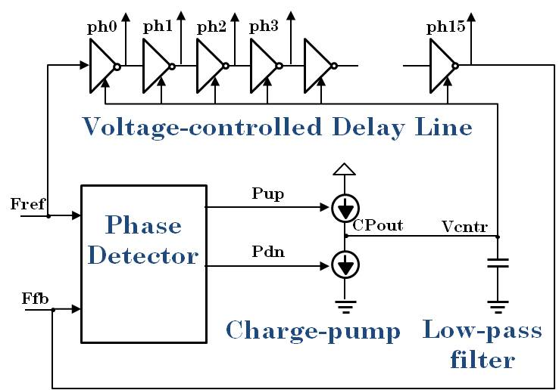
GWT : a 60-mW 5.12 Gbps Serializer/Transmitter
…as opposed to GBTX with shift register, which uses much more power
data
8bit @ 320MHz
Reg <8:15>
MUX
16 phases
Serialized data
@ 5.12 Gbps
pre-emphasis
posedge
Reg <0:15>
data_out
1bit @ 5.12GHz
0.05mW
1m
low-mass
flex cable
data
8bit @ 320MHz
Reg <0:7>
Shift Register
D0
Q0
MUX
D1
Q1
MUX
D2
Q2
MUX
D3
Q3
MUX
D4
Q4
MUX
D14
Q14
MUX
D15
Q15
negedge
Sel
0.05mW
2mW
100 Ω
Multi-phase DLL
Edge-
combiner
PLL
320MHz → 5.12GHz
Driver
∆U =
± 450mV
ph_0
45 mW
ph_1
sel_0
ph_2
sel_1
ph_3
sel_15
clock
(320MHz)
ph_14
16 x 195ps
= 1 / 320MHz
ph_15
10mW
0.6mW

Slide 16
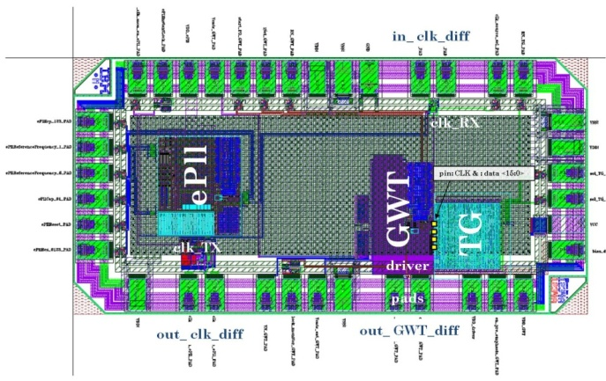
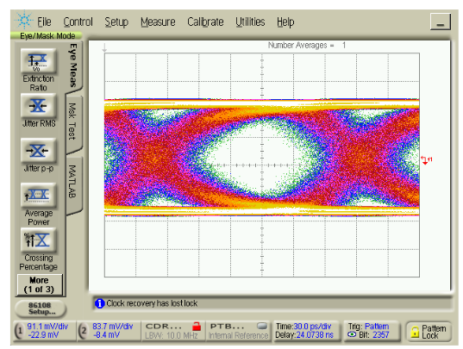
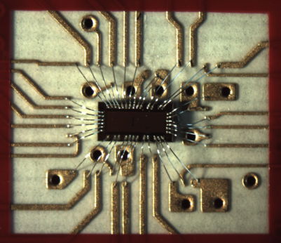
Velo_GWT Test Chip in 130nm CMOS Technology
SEU tests performed with different ions (Nickel, Argon, Neon)
Tested simple patterns: 01010101, 000FFF
Analysis pending, results coming soon
1 mm x 2 mm test chip in 130 nm CMOS technology
Power : 5.12 Gbps serializer: 15 mW, wireline driver: 45 mW
Eye diagram: +/- 200 mV is 60 ps (pseudo-random pattern)

Slide 17
Simulation: Data transfer efficiency
0.99
The VELO upgrade
expected rate
7-bit
BX ID
*no front-end pile-up
taken into account
GWT x4
maximum

Slide 18
Downstream Data Flow
8 bits (4 parity bits)
4 x 30 bits = 120 bits
Header
Packet 0
Packet 1
Packet 2
Packet 3
BX ID 9b
SP addr 13b
Hitmap 8b
Time Ordering (FPGA)
Event Builder (PC)
VELO tracking
budget 2 ms
Software Event Filter

Slide 19

Diversion: Pixel Clustering
Clustering on CPU was deemed too slow.
FPGA implementation very complex.
In fact, CPU clustering is feasible:
  Algorithm well known in graphics applications.
  Optimize for isolated Super Pixels flagged by FPGA.
8-way flood fill algorithm as
commonly used in computer
graphics applications. [6]
About 10% of VELO tracking

Slide 20
Power Consumption
Block | P (mw) | #Blocks | Total power
Analog front-end | 0.014 | 65536 | 917.5
Digital front-end | 0.002 | 65536 | 131.1
SP column (avg) | 3.6 | 128 | 460.8
Slow control | 50 | 1 | 50*
EoC block | 2 | 128 | 256*
Periphery clock tree | 100 | 1 | 100*
EoC fabric | 300 | 1 | 300*
PLL | 5.5 | 1 | 5.5*
GWT | 60 | 4 | 240
 |  | Total (mW): | 2460.9
 |  | W/cm^2 | 1.09
*estimated/budgeted

Slide 21
Summary
Trigger-less readout ASIC architecture
Design driven by rate and power requirements
  Reads out > 900 Mhits/s/ASIC
  consuming < 1.5 W/cm²
VeloPix builds on expertise learned during the Timepix3 design
GWT serializer (5.12Gbps/60mW) demonstrated to work, SEU tests to be analyzed

Slide 22
References
[1] LHCb VELO Upgrade TDR. CERN LHCC 2013-021. 2013.
[2] L. Eklund, “The LHCb VELO Upgrade”, ICHEP 2014
[3] T. Poikela. “Design and Verification of Digital Architecture of 65K Pixel Readout Chip for High-Energy Physics.”, 2010.
[4] T. Poikela et al. “Timepix3: a 65K channel hybrid pixel readout chip with simultaneous ToA/ToT and sparse readout”, 2014
[5] T. Poikela et al. “Digital column readout architectures for hybrid pixel detector readout chips“, 2014.
[6] "Recursive Flood Fill 8 (aka)" by André Karwath aka Aka - Own work. Licensed
under CC BY-SA 2.5 via Wikimedia Commons -
http://commons.wikimedia.org/wiki/File:Recursive_Flood_Fill_8_(aka).gif#/media/File:Recursive_Flood_Fill_8_(aka).gif

Slide 23
Why 2x4 super pixel?
Table: Data rates for different super pixel dimensions:
Binary encoded packets (no ToT)
Super Pixel Geometry | Data rate (Gbps) | Packet size (#bits) | Reduction (%)
256 x 256 | 14.785 | 28 + N x 16 | 38.179
4 x 4 | 16.477 | 28 + N x 4 | 31.105
2 x 4 | 16.806 | 28 + N x 3 | 29.729
2 x 4 | 16.945 | 33 | 29.148
1 x 4 | 17.758 | 30 | 25.748
2 x 2 | 17.857 | 30 | 25.335
1 x 4 | 18.283 | 28 + N x 2 | 23.553
2 x 2 | 18.373 | 28 + N x 2 | 23.177
4 x 4 | 18.661 | 40 | 21.973
1 x 2 | 19.703 | 29 | 17.616
1 x 2 | 19.878 | 28 + N x 1 | 16.884
 | 23.916 | 28 | 0.000
Chosen format
No super pixel
grouping
N = number of pixel hits in a packet

Slide 24
Super Pixel Power Estimation
Power for SP hitmap buffers:
Target rate approx. 300 kHz
Power approx. 20 uW
Hand-crafted clock gating (CG) works!
Power for transporting the packets:
Target rate 5 MHz
Power 66 uW
128 x 64 = 8192 Super pixels
per chip!!

