Slide 1
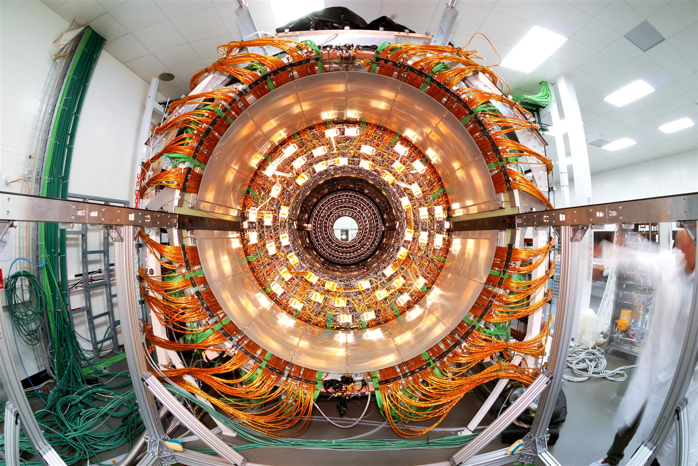
Upgrade of the CMS Tracker for the High Luminosity LHC
VERTEX2015: Santa Fe

Slide 2
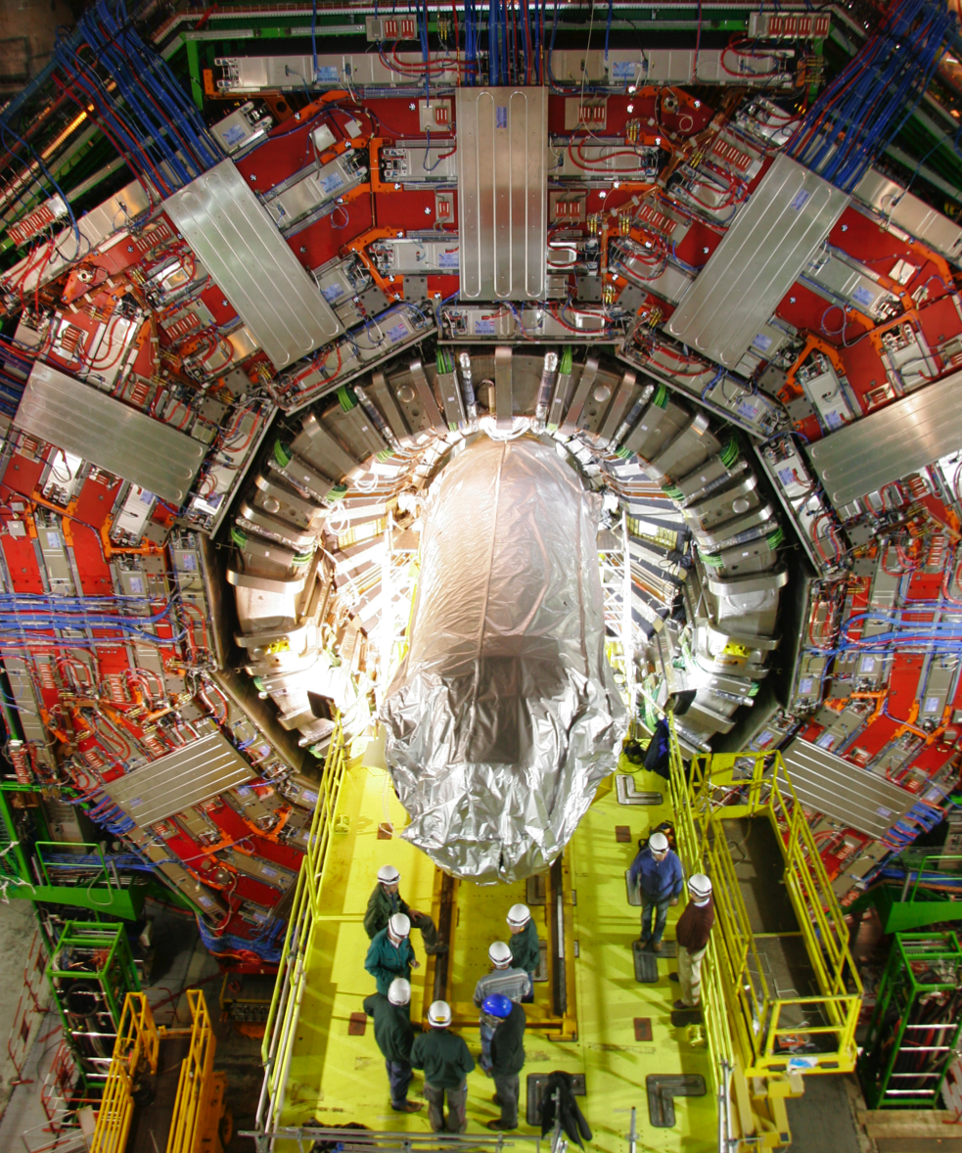
Outline
Introduction
Challenges for the CMS Tracker
Rad-Hard Sensors
Track Trigger Modules
Tracker Layout
Prototyping of Sensors and Modules

Slide 3
Out of Scope
Introduction
CO₂ Cooling
Powering
Mechanics
Track Trigger
  Thursday, 4 June at 09:00
  ”CMS developments for track-triggers”
  Marco De Mattia
CMS Pixel Upgrade
  Earlier today, 1 June at 14:00
  ”CMS pixel upgrade for the HL-LHC”
  Robert Stringer

Slide 4
The High Luminosity LHC and CMS
Introduction
Upgrade of the LHC by 2020 to achieve 5x the current design luminosity: 5 x 10³⁴ cm⁻²s⁻¹
  Original LHC integrated luminosity: ~500 fb⁻¹
  Integrated luminosity with upgrade: ~ 3000 fb⁻¹
Significant gain in collected events!
Current CMS Tracker was designed to operate for 10 years in LHC environment
  End of lifetime reached by 2022
→ Replacement necessary to keep CMS running

Slide 5

Challenges
Introduction
Higher density of tracks
  Increase granularity of sensor elements
Increase in radiation
  Radiation hard components, in particular sensors
L1 Trigger needs input from tracker
  Transmitting full tracker information at 40 MHz not possible
  Data selection inside the tracker

Slide 6
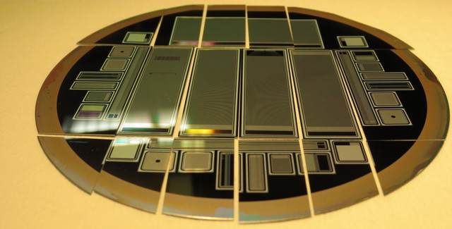
Radiation tolerant silicon sensors

Slide 7
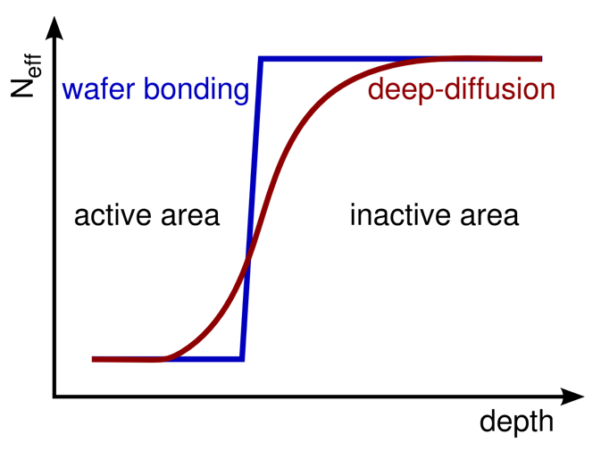
Radiation tolerant sensor materials
Sensors
Wafer layout with 34 different structures
  Small strip and pixel sensors
  Dedicated test structures
Produced by Hamamatsu on
  FZ: 200 and 320 µm thickness
  ddFZ*: 120 and 200 µm active thickness
  MCz: 200 µm thickness
  Epi: 50 and 100 µm thickness
Each material processed with
  p-on-n
  n-on-p (pspray)
  n-on-p (pstop)
FZ200 in all three processes with 2nd metal layer
Total of 164 wafers
Extensive irradiation and measurement campaign
* ddFZ = deep diffused FZ

Slide 8
Irradiation Targets
Sensors
radius | proton Φ_{eq} [cm⁻²] | neutron Φ_{eq} [cm⁻²] | total Φ_{eq} [cm⁻²] | Active thickn.
40 cm | 3 ∙ 10¹⁴ | 4 ∙ 10¹⁴ | 7 ∙ 10¹⁴ | ≥ 200 μm
20 cm | 1 ∙ 10¹⁵ | 5 ∙ 10¹⁴ | 1.5 ∙ 10¹⁵ | ≥ 200 μm
Fluences target 20 and 40 cm radius in the outer tracker after 3000 fb⁻¹
Highest fluence for innermost layers of the outer tracker at
1.5 x 10¹⁵ n_{eq}cm⁻²

Slide 9
Collected Charge
Sensors
N-type sensors (hole collection) show higher signal degradation than p-type
Beyond ~10¹⁵ n_{eq}cm⁻² 200 µm of active silicon show a similar signal to 300 µm

Slide 10
Random Ghost Hits (RGH)
Sensors
Very high charge collected in highly irradiated n-type silicon
Not originating from charge created by a particle
Not observed in p-type silicon!
Adds non-Gaussian noise
Noise above threshold will show as “hits”
Similar to micro-discharges
  but assumed not to be the same effect
RGH rate = 0%
RGH rate = 3%

Slide 11
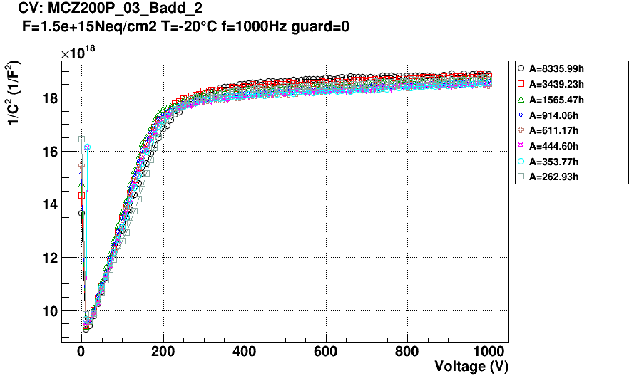
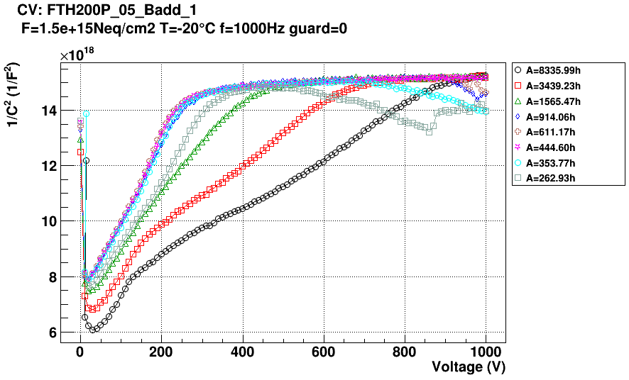
Annealing
Sensors
Charge collected in 200 µm sensors stays relatively constant up to 20w@RT
  Thick sensors show more pronounced loss
mCZ shows no loss (even gain) after 20w@RT
  Full depletion voltage stays constant
Annealing in mCZ would decrease leakage current (and therefore noise) with no loss in signal
20w@RT

Slide 12
Baseline for the Phase II Outer Tracker
Sensors
P-type materials (n-on-p) are the baseline
  Slower signal degradiation
  No Random Ghost Hits (RGH)
200 µm active thickness is preferred
  Collected charge similar to 300 µm after high fluences
  Lower dark current
200 µm physical thickness is preferred
  Less material
mCZ is preferred
  No change in the V_{depl} with annealing
Not shown: P-spray and p-stop show sufficient strip isolation after high fluences

Slide 13
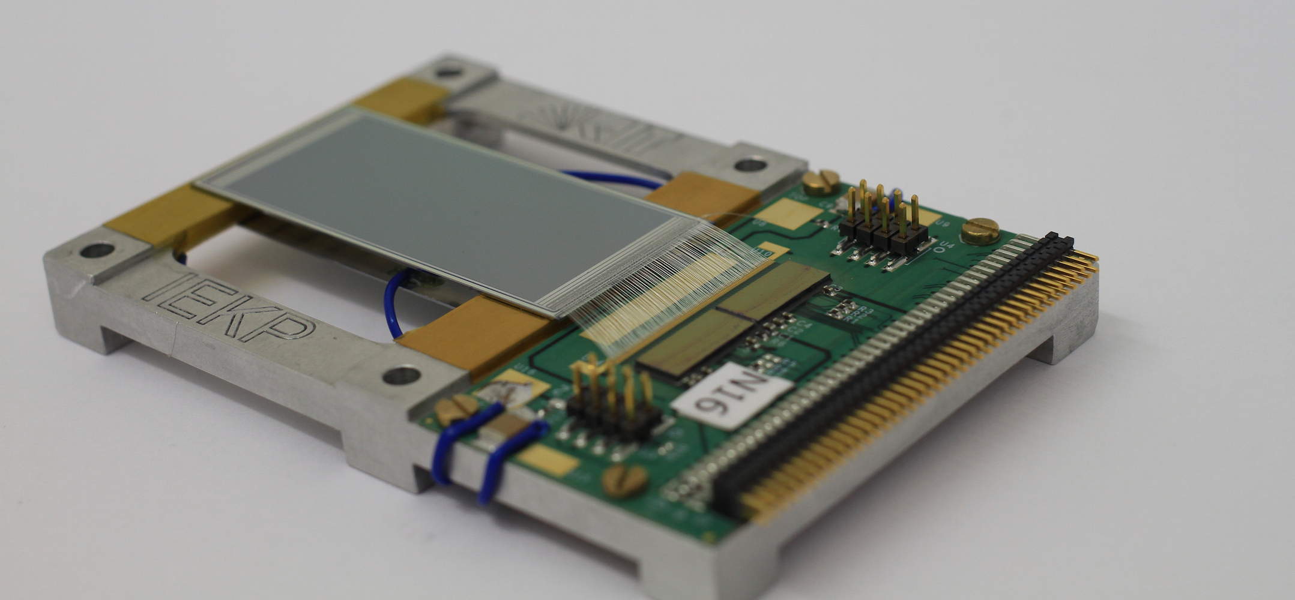
Detector Modules

Slide 14
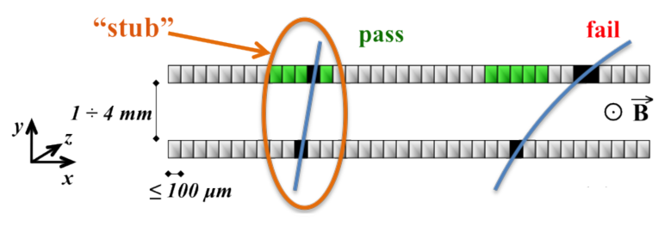
Detector modules with data filtering
Modules
On-module data reduction by only sending hits from particles with a transverse momentum p_{t} of > a few GeV/c
At given magnetic field the track curvature depends on the particle’s p_{t}
Different curvature results in different incident angles at a given radius
Estimate incident angle from hit displacement over a short distance
→ two parallel sensor planes

Slide 15
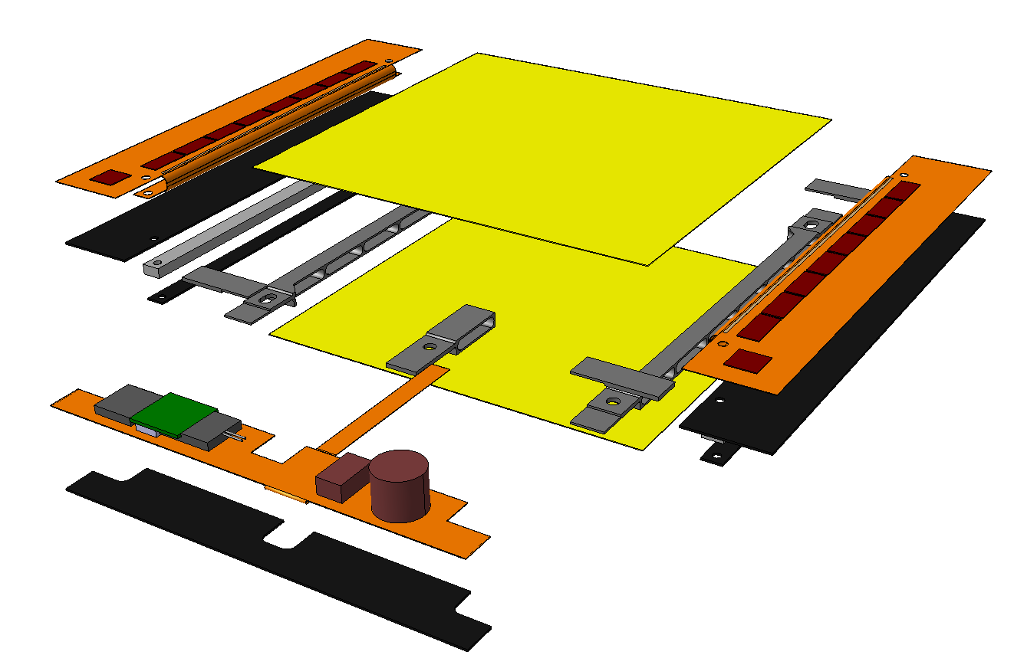
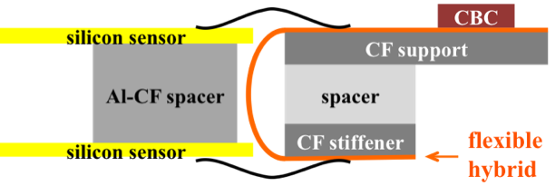
The p_{t} Module Concepts
Modules
The 2S Module
2 x Strip sensors: 2S sensor
  Size: 10 x 10 cm²
  Pitch: 90 µm
  Length: 5 cm
  No. of strips per sensor: 2x1016
2 x 8 CMS Binary Chips: CBC
  2x127 channels per chip
  Bump bonded to flexible hybrid
  Connects to top and bottom sensors
  Interchip communication via hybrid
Concentrator ASIC: CIC
  collects data from 8 CBCs (half module)
Low Power GigaBit Transceiver LP-GBT
  Bandwidth: 3.2 Gb/s (4.8 Gb/s raw)
2-stage DCDC powering
  12 V to
    2.5 V (opto)
    1.2 V (ASICS)

Slide 16
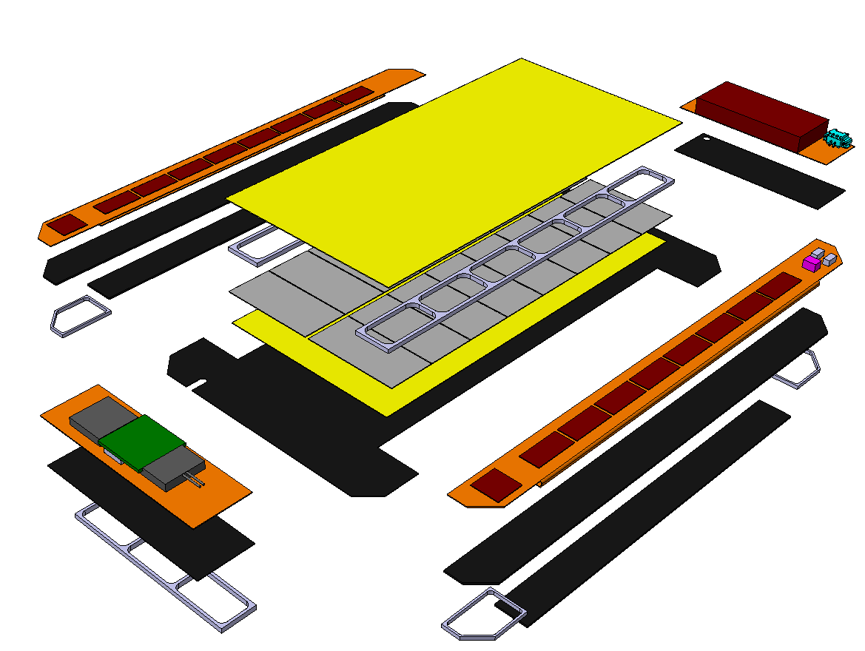
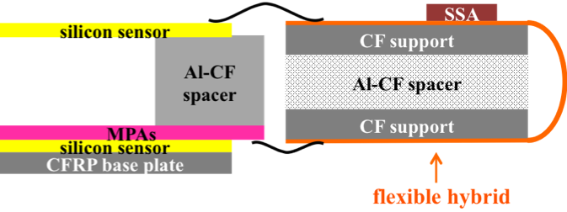
The p_{t} Module Concepts
Modules
The PS Module
MacroPixel sensor: PS-p sensor
  Size: 5 x 10 cm²
  Pitch: 100 µm
  Length: 1.5 mm
  No. of pixels: 32x960
Strip sensors: PS-s sensor
  Size: 5 x 10 cm²
  Pitch: 100 µm
  Length: 2.5 cm
  No. of strips: 2x960
2 x 8 Short Strip ASIC: SSA
  120 channels per chip
  Sends hits to MPA
  Bump bonded to flexible hybrid
16 MacroPixel ASIC: MPA
  120 x 16 pixels per chip
  Bump bonded to MacroPixel sensor
  Includes correlation logic
Concentrator ASIC: CIC
  collects data from 8 MPAs
Low Power GigaBit Transceiver LP-GBT
  Bandwidth: 3.2 Gb/s (4.8 Gb/s raw)
2 stage DCDC powering
  12 V to
    2.5 V (opto)
    1.2 V (ASICS)
    0.8 V (ASICS)

Slide 17
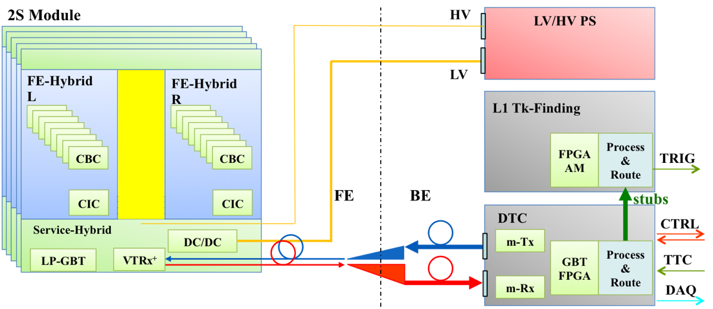
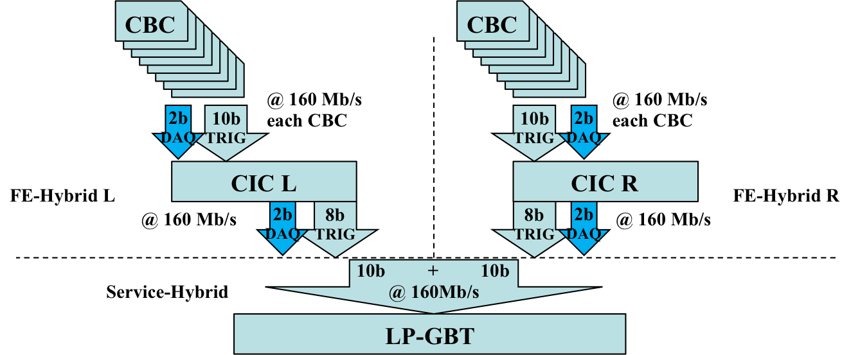
Electronic system
Modules
Readout chain for 2S and PS identical from CIC onwards
Front to back end transmission using optical fibres at 4.8 Gb/s (raw)
Clock, data and control use the same system
Main dataflow now to Trigger (80-90%) and not to DAQ
Exact specifications not yet fixed, eg.:
  Dynamic or fixed allocation of bandwidth for TRG and DAQ
  Asymmetric bandwidth for up- and downstream in LP-GBT

Slide 18
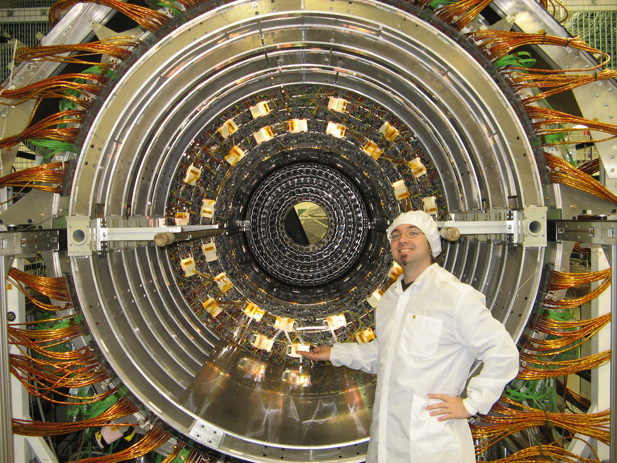
Tracker Layout

Slide 19
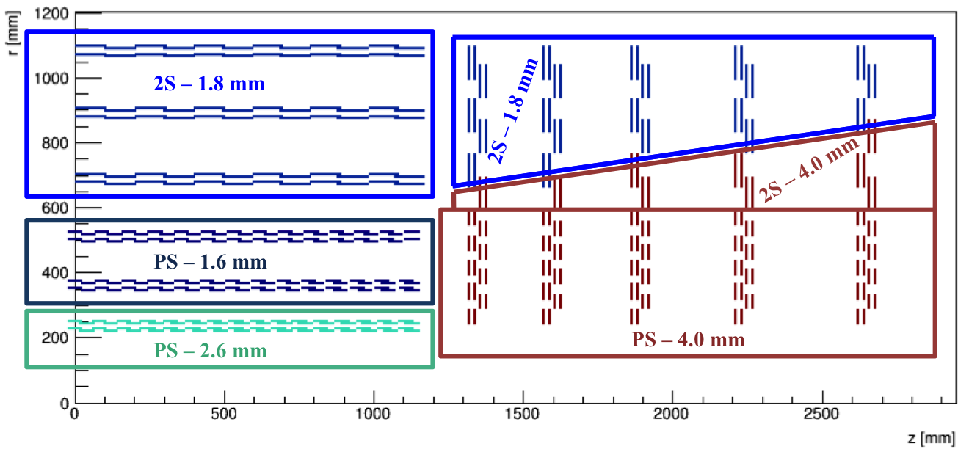
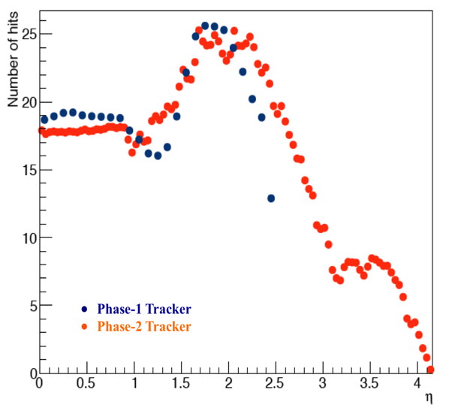
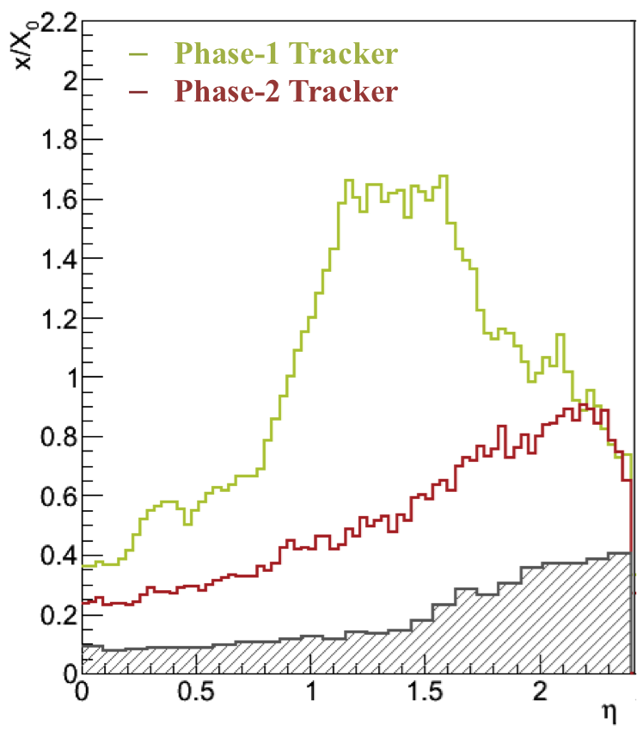
Tracker Layout Concept: Baseline
Layout
Barrel and endcap geometry
2S modules for r > 60 cm
PS modules for r < 60 cm
Sensor spacings optimised with 2 (2S) or 3 (PS) groups
2 module types in 2 (3) flavours (sensor spacing) sufficient to built barrel and endcaps!
Similar number of hits vs. η at larger coverage than existing tracker
At lower material budget than existing tracker
  CO₂ cooling
  DCDC powering
  No dedicated control electronics
2S Modules
PS Modules
Pixel

Slide 20
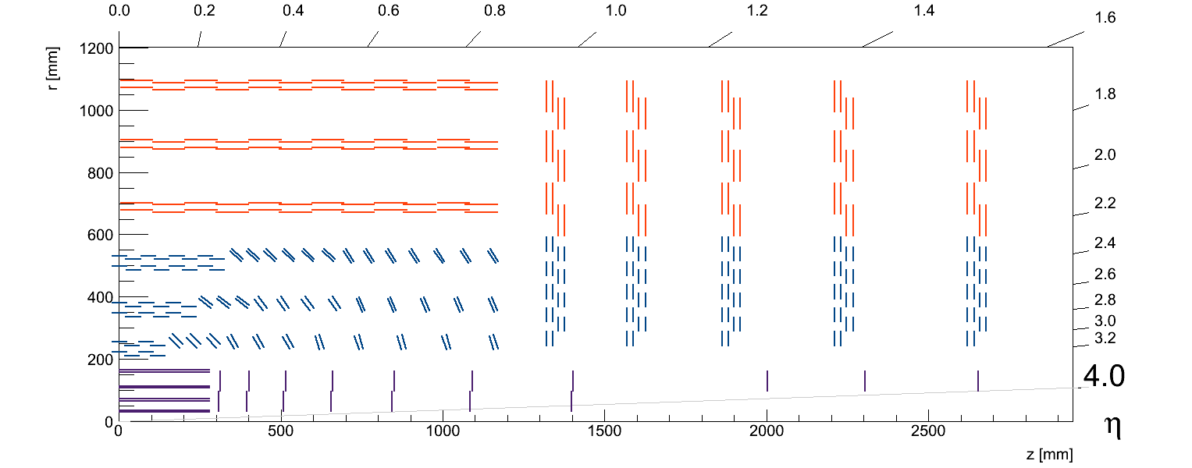
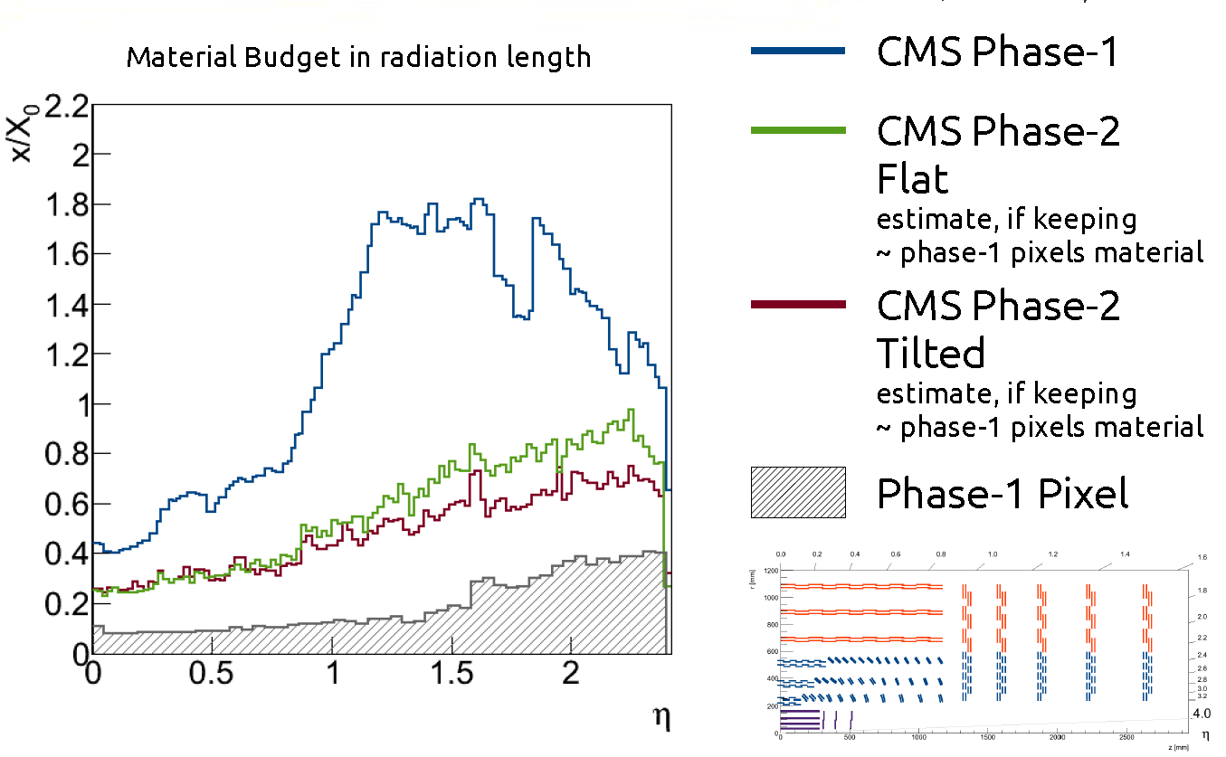
Layout Concept: Tilted Barrel
Layout
PS modules in inner barrel tilted “towards” IP
Reduction of number of modules/sensors
  From ~7000 to ~5700 PS modules
Significant reduction in material budget
Safes costs
Significant increase of mechanical engineering required!

Slide 21
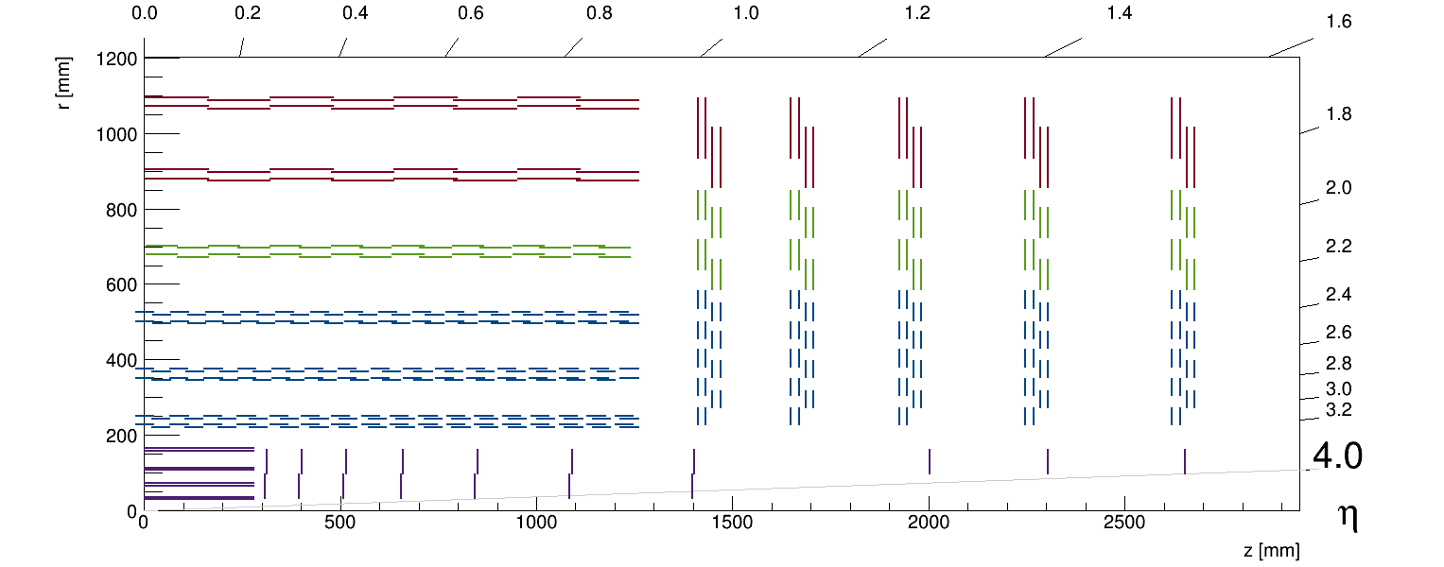
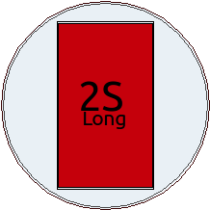

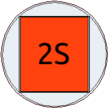

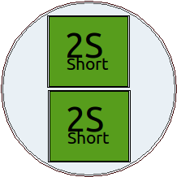
Layout Concept: 8” Sensors
Layout
Costs per area on 8” is significantly cheaper than on 6”
Keep electronics identical for 6” and 8”
3 PS sensors per wafer
Elongate 2S sensor from 10 x 10 cm² to 10 x 15 cm²: 2S long
High occupancy in innermost 2S layer
  Shorten sensor to 10 x 7.5 cm² and cut two from one wafer: 2S short
Break even if cost per wafer
  8” < 1.5 x 6”

Slide 22
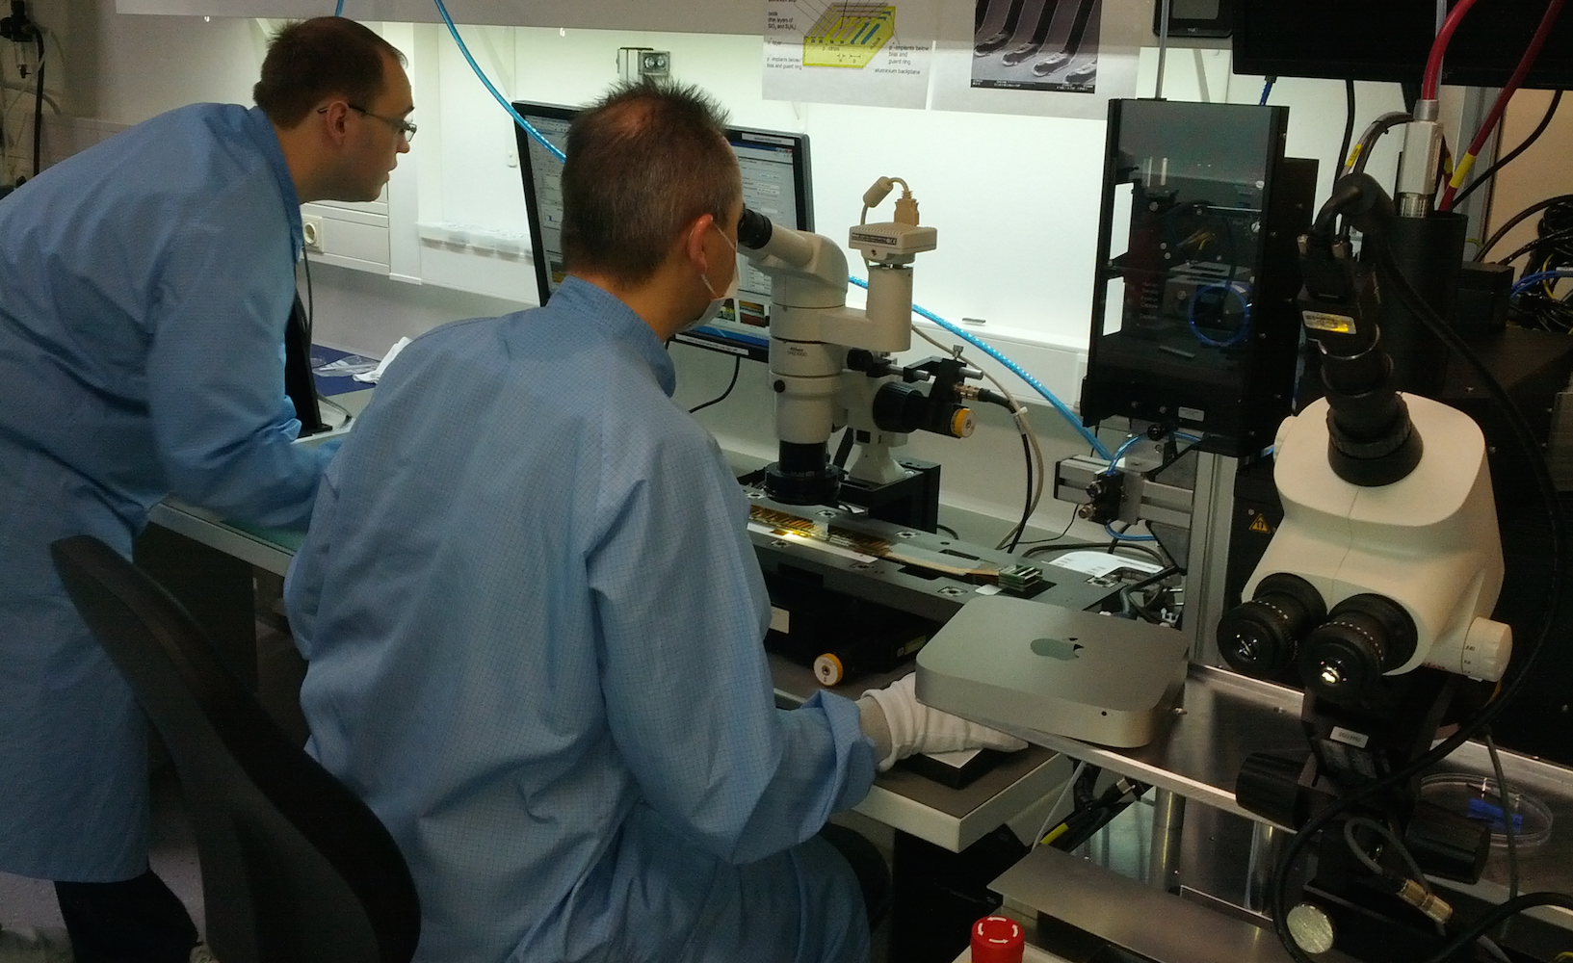
Prototyping

Slide 23
From Proposals to Prototypes
Prototypes
Technical Proposal (TP) for the Phase II Tracker is ready
  Full CMS Phase II TP will be published soon
First prototypes are being procured and built
  Starting with sensors and modules

Slide 24
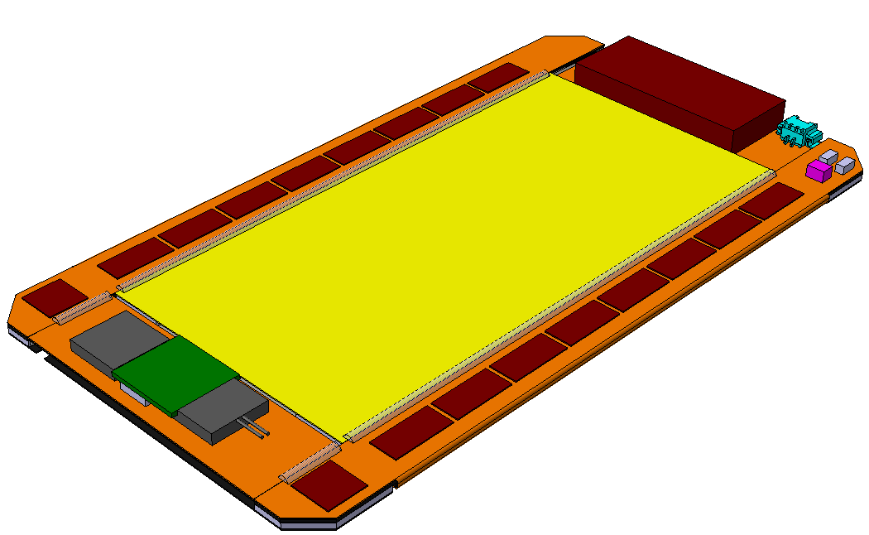
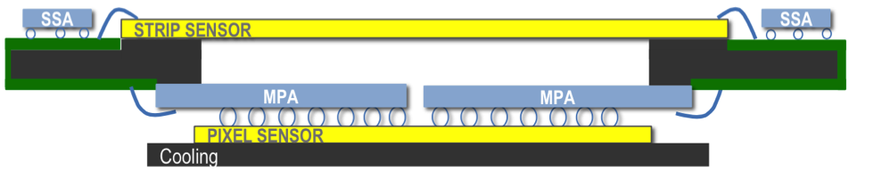
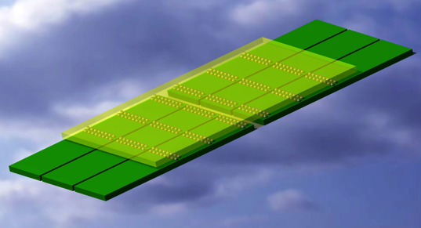
Small size PS Prototype: MAPSA light
Prototypes
MacroPixel SubAssembly: MaPSA
Scaled down version of the pixel part of the PS module
MPA light chip
  # of pixels: 3 x 16
  Pixel size: 100 x 1446 µm
  Chip size 1.7 x 6.5 mm²
  Process: 65 nm TSMC
PS-p light sensor
  Material: FZ p-type
  Thickness: 200 µm
  # of pixels: 48 x 6
  ≅ 6 x MPA-light chips
  Sensor size 7.8 x 12 mm²
  Produced at: CiS,
  Erfurt DE
PS Module
Pixelated part: MaPSA
Small prototype: MAPSA light

Slide 25
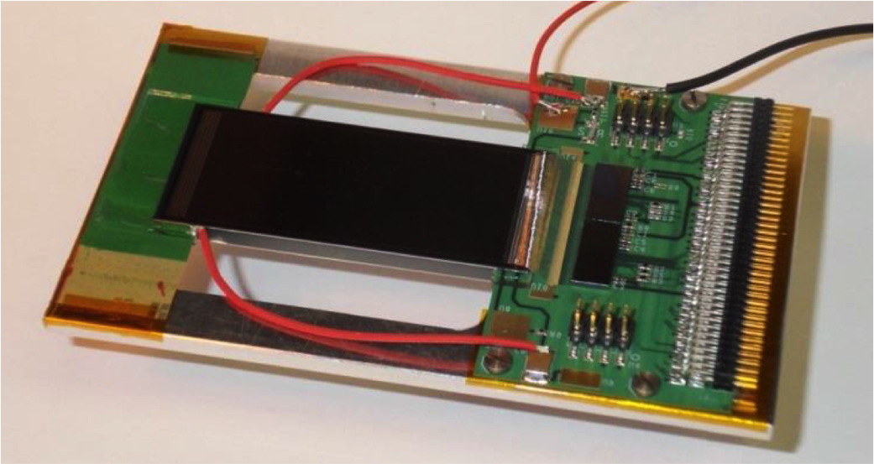
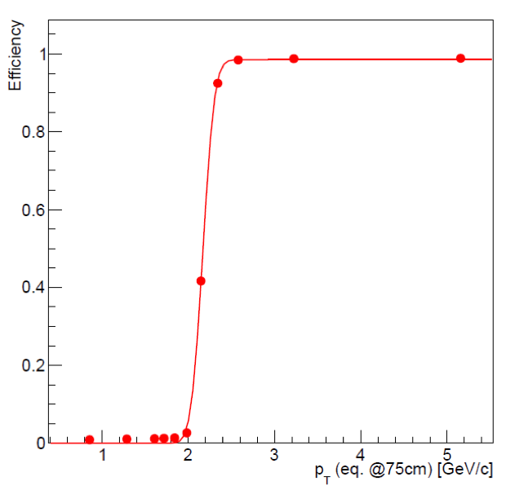
Early 2S prototypes
Prototypes
First mini 2S prototype modules were built in 2013
  Two 5 x 2.3 cm² sensors with 256 strips from Infineon or CNM
  2 x CBC2 readout chips bumped to hybrid
Beam test at DESY in 2013
Demonstrate stub finding efficiency
  Angle between sensor surface and beam was changed
  Translated into an equivalent p_{T} at a radius of 75 cm
p_{T} Threshold
Nominal:
2.14 GeV
Measured:
2.2 GeV ± 0.1 GeV

Slide 26
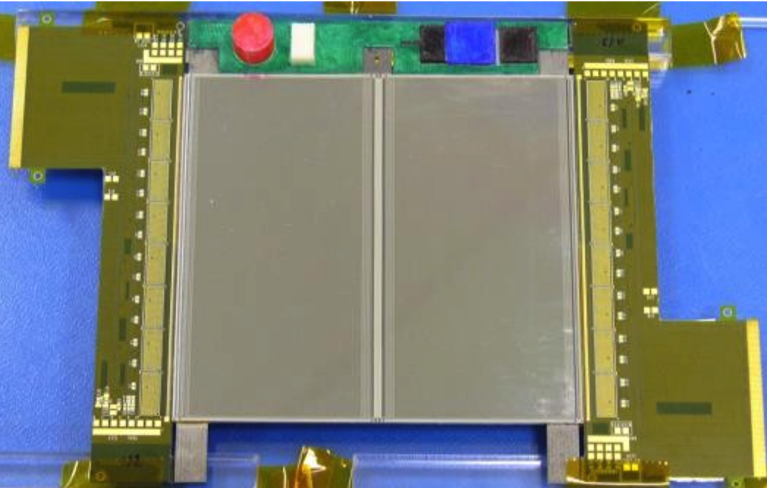
Full size 2S Prototypes
Prototypes
Dummy modules built for assembly studies
  Prototype readout hybrids without chip
  Inactive dummy sensors
Functional module to be built next
  Prototype readout hybrids with 8xCBC2
  Fully functional sensors
  Realistic mechanical components
  No CIC, DCDC or GBT

Slide 27
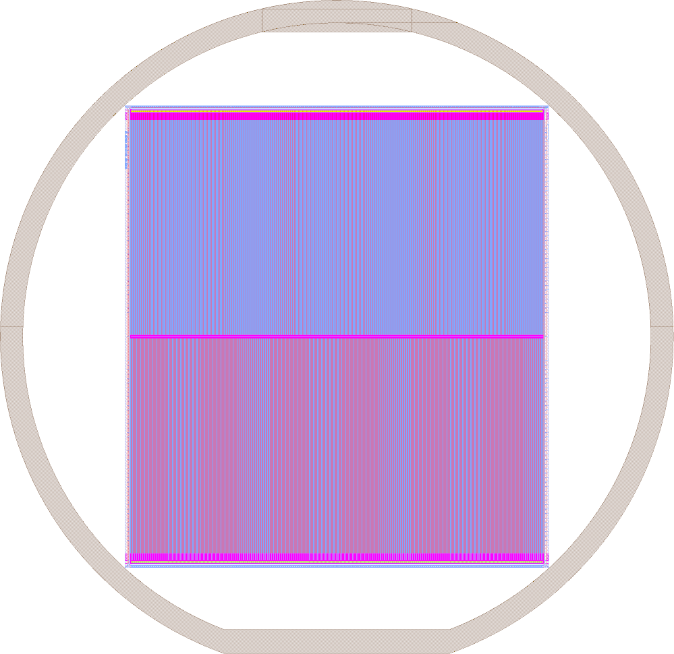
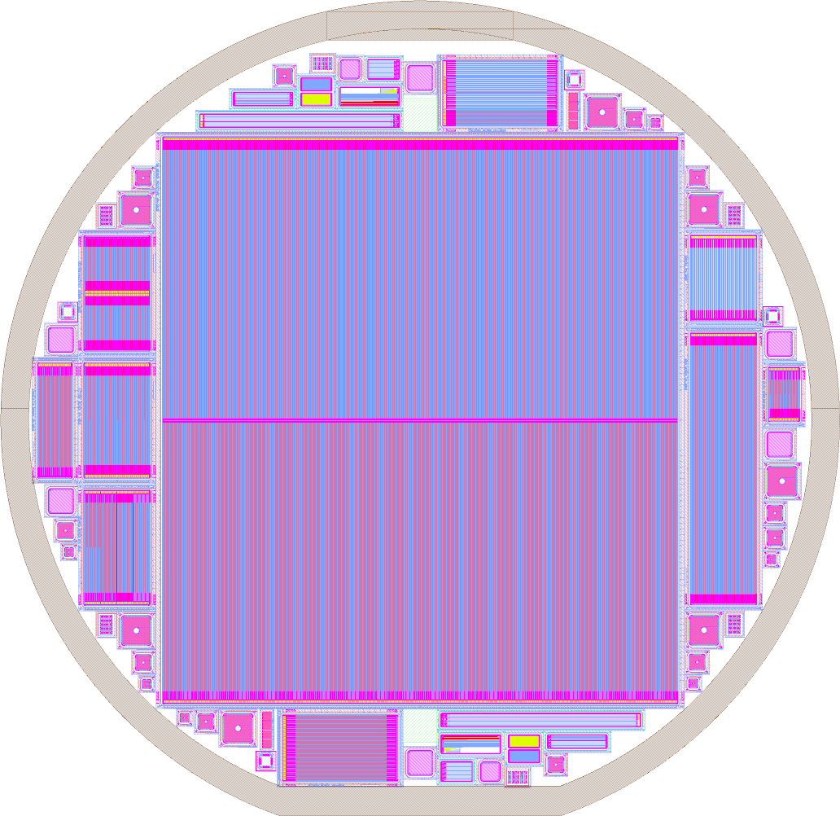
  Baseline Design 2S Sensor
Prototypes
Wafer
  Wafer diameter (6” wafer): 150 mm
  Forbidden margin 5 mm -> 140 mm usable
Sensor
  N-on-p
  Strips: 2032 (2 x 8 x 127)
  Strip Pitch: 90 µm
  Width/Pitch: ~ 0.25
  P-stop: Atoll
2S Sensor size
  Sensor width: 94.183 mm
  Sensor length: 102.7 mm
  Active size: 100.6 x 91.5 mm²
And more …
  Test sensors to evaluate design options
  Test structures (Diodes, MOS, Sheet, Van-der-Pauw, Cross-Bridge-Kelvin-Resistors, etc …)
PStopGeo
140 mm
5 mm
CenterBias
NoPStop
150 mm
KITtest
2S Sensor
PSlight
Irrad
102.7 mm
Baby
SegArea
PCommon
94.183 mm

Slide 28


2S Sensor Production
Prototypes
Production at HPK
Material
  20 x mCZ with 320 µm physical thickness
  20 x ddFZ with 240 µm active thickness
Strip isolation
  Both materials split 15 x p-stop and 5 x p-spray
Status
  Layout adapted by HPK
  Production started recently
  ETA: End of August 2015
Production at Infineon
Material
  30 x FZ with 200 µm physical thickness
Strip isolation
  P-stop and p-spray, details to be decided
Status
  Layout to be adapted by CMS in the coming weeks
  Production start envisaged for July
  ETA: Autumn 2015

Slide 29
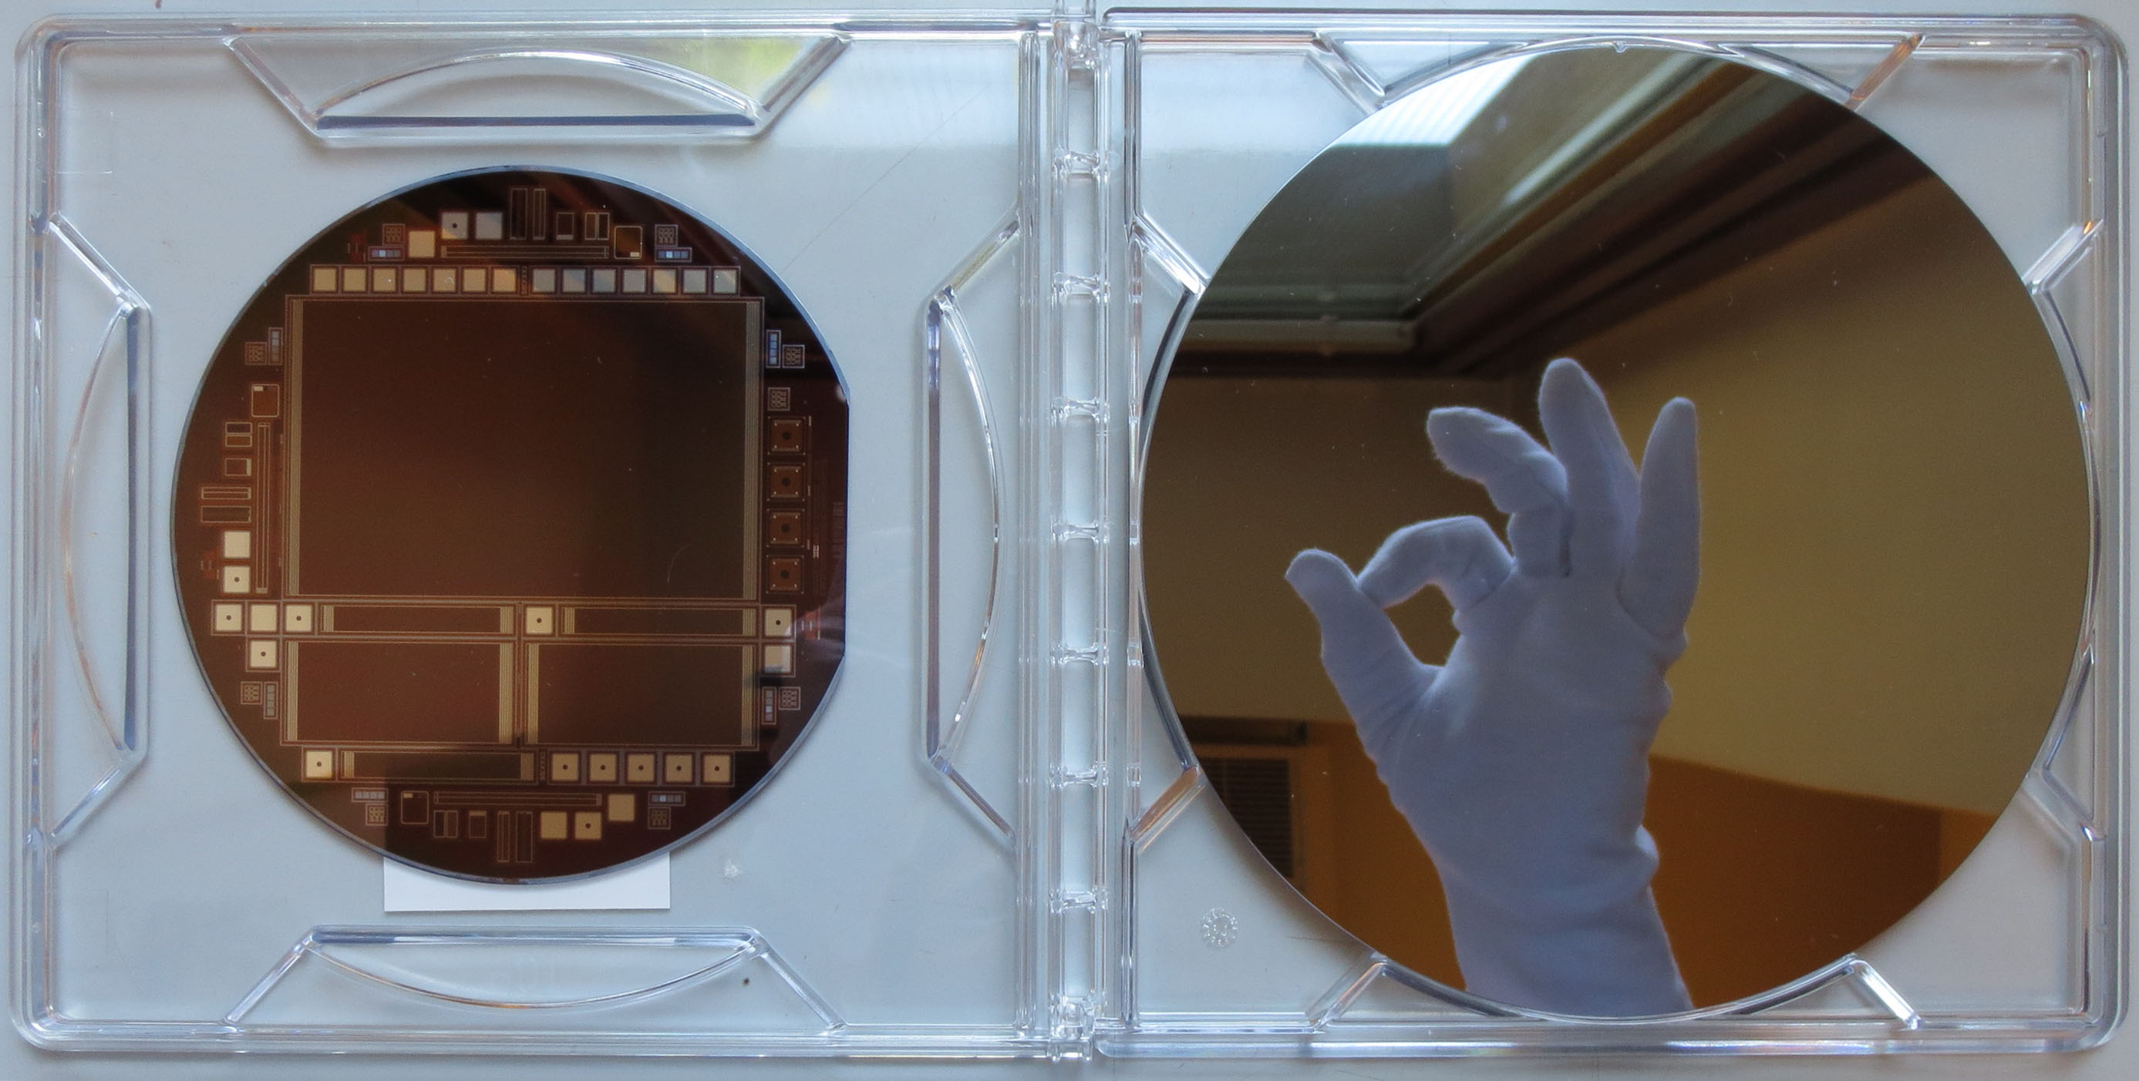

8” Sensors from Infineon

Slide 30
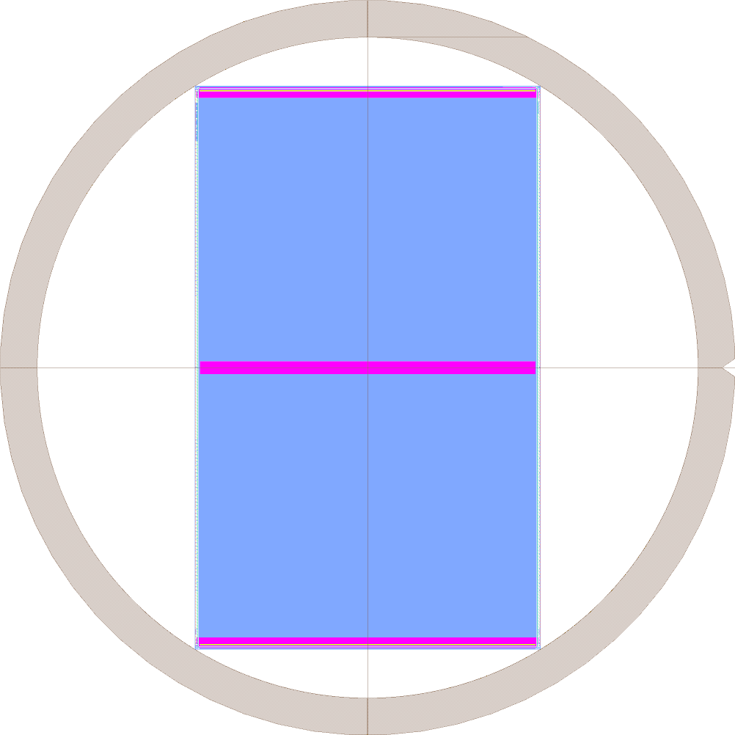
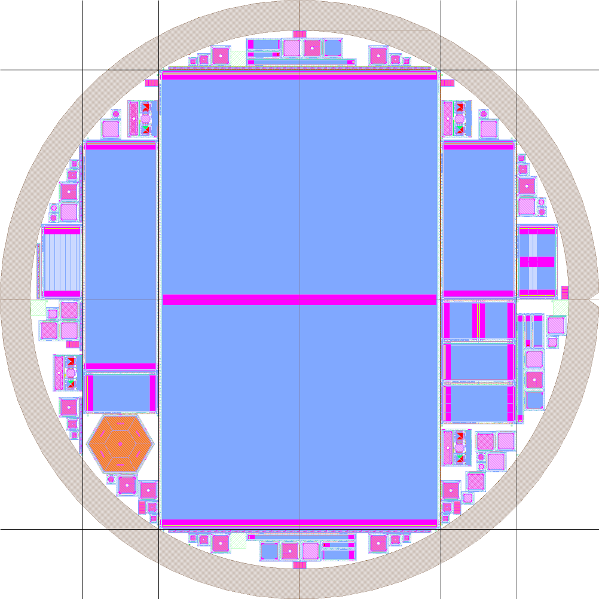
  Baseline Design 2S Sensor (8” version)
8” Sensors
Wafer:
  Wafer diameter (8” wafer): 200 mm
  Forbidden margin 10 mm -> 180 mm usable
  FZ with 200 µm physical thickness
  Resistivity ~ 7 kΩcm
Sensor
  Same as the 6” version but elongated
  N-on-p
  Strips: 2032 (2 x 8 x 127)
  Strip Pitch: 90 µm
  Strip length: 75.6 mm
  Width/Pitch: ~ 0.25
  P-stop: Atoll
2S Sensor size
  Sensor width: 94.183 mm
  Sensor length: 153.4 mm
Status
  In production at Infineon
  ETA: September 2015
153.4 mm
102.7 mm
94 mm
94 mm

Slide 31
Summary
A consistent concept of Phase II Outer Tracker has been presented
Feasibility of the main ingredients have been demonstrated
  Radiation hardness of the sensors
  Track trigger capabilities of the modules
Decisions between open design options and detailed engineering on-going
  Prototype sensors and modules to be built in 2015 will facilitate these decisions

Slide 32
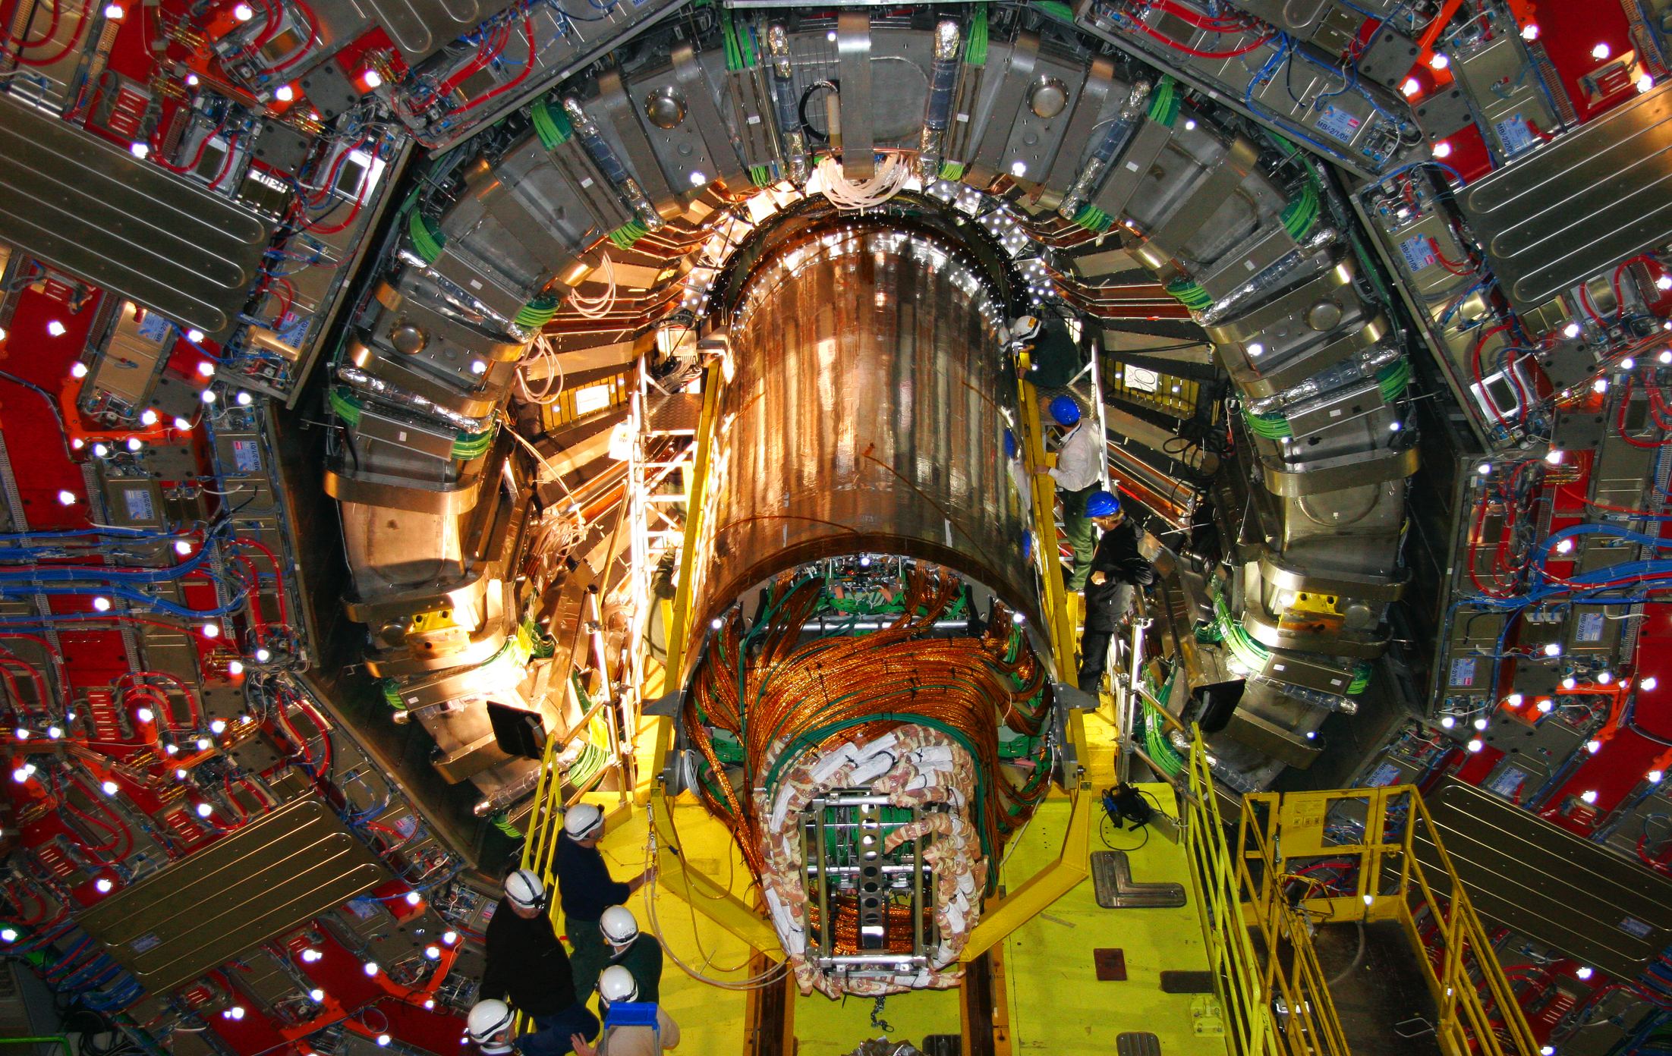
Thank you for your attention!

Slide 33
Random Ghost Hits
Occurrence of RGH Depends on bias voltage, irradiation, annealing, temperature and strip geometry
Simulations suggest an increase of electric field maxima with Q_{ox} at strip edges for n-type sensors
For p-type sensors the maxima goes down with an increase in Q_{ox}

Slide 34
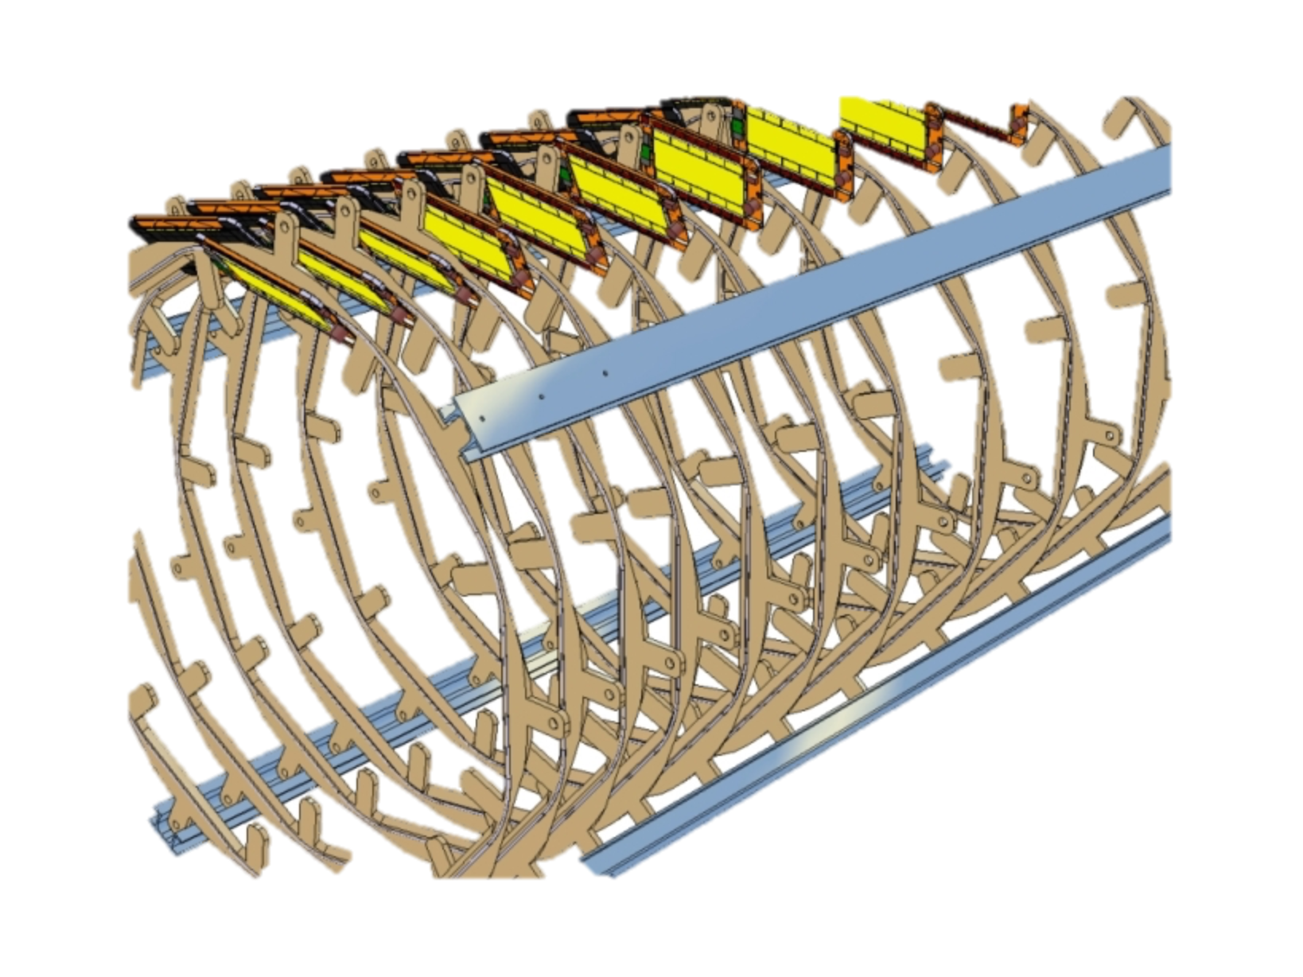
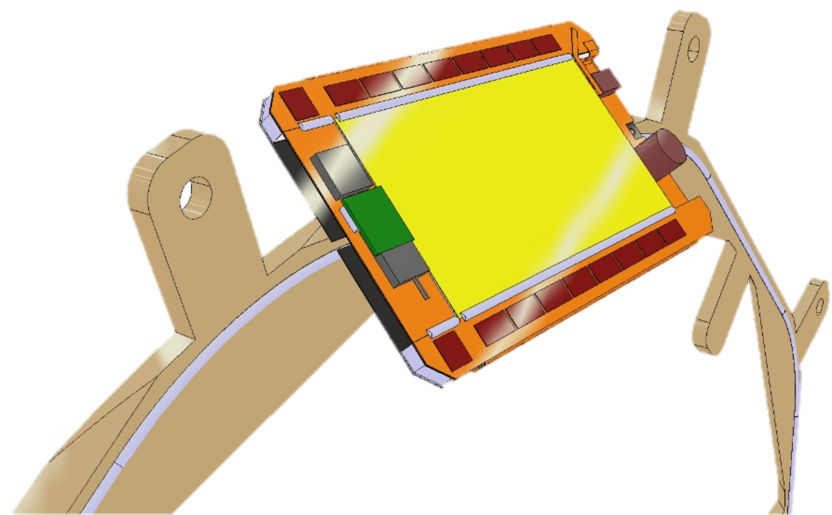
Tracker Layout: tilted IB
Modules supported by Rings
Rings joined by longitudinal bars.
Cooling supply pipes, wires and fibres routed along the bars.

