Slide 1
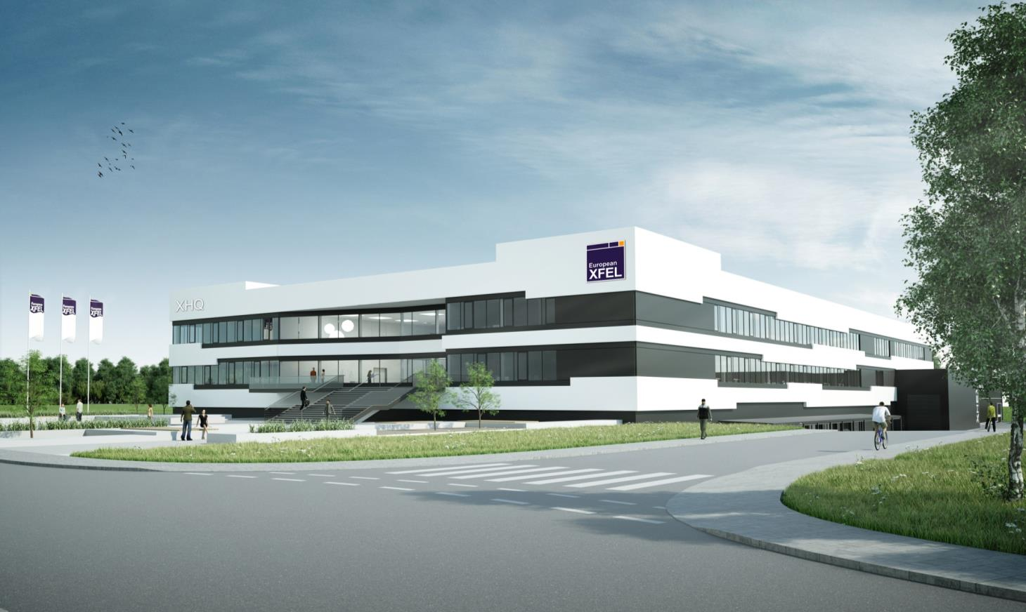












Detectors for the
European XFEL
Markus Kuster
4th EIROforum School on Instrumentation 2015
ESO Garching
June, 18 2015

Slide 2
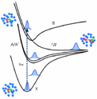
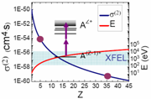

The Science Instruments at XFEL.EU
SPB Single Particles, Clusters and Biomolecules and Serial Femtosecond Crystallography
Structure determination of single particles: atomic clusters, bio-molecules, virus particles, and cells.
MID Materials Imaging & Dynamics
Structure determination of nano-devices and dynamics at the nanoscale.
FXE Femtosecond X-ray Experiments
  Time-resolved investigations of the dynamics of solids, liquids, gases
HED High Energy Density Matter
Investigation of matter under extreme conditions using hard X-ray FEL radiation, e.g. probing dense plasmas
SQS Small Quantum Systems
  Investigation of atoms, ions, molecules and clusters in intense fields and non-linear phenomena
SCS Soft X-ray Coherent Scattering/Spectroscopy
Electronic and real structure, dynamics of nano- systems and of non-reproducible biological objects
Hard X-Rays
Soft X-Rays

Slide 3
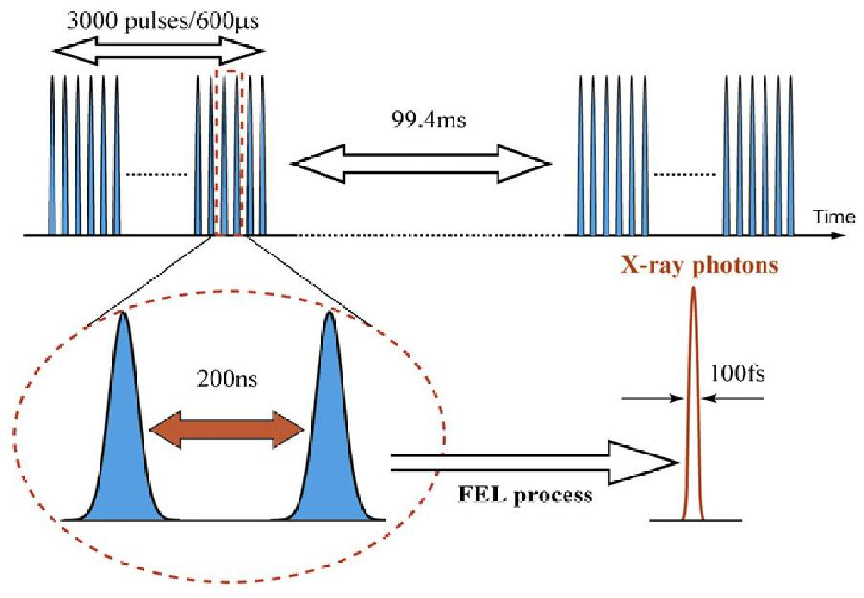
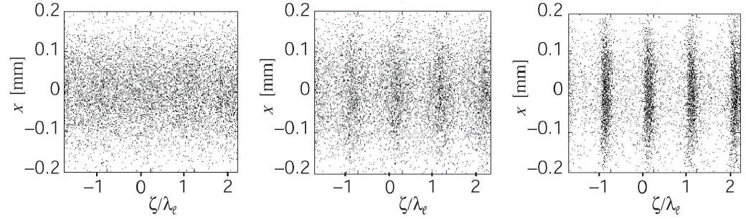
European XFEL Time Structure
  The European XFEL unique features poses strict constraints on detectors.
  One of the main issues are the intensity and distinctive XFEL time structure.
  Most of the time the use of commercial detectors is excluded.
  Most applications require 4.5 MHz repetition rate detectors
e⁻ Bunch and X-ray Pulse Structure
  On average up to 27.000 pulses/s
  Pulse duration
  < 100 fs
  High peak intensities
  up to 10¹² photons/pulse
  Various different pulse patterns possible
  1 pulse per train
  n pulses per train …
  Linear, logarithmic or random dis-tribution
e⁻ Bunch Train
2700 Bunches 600 μs
99.3 ms
X-ray Photons
220 ns
< 100 fs
FEL Process

Slide 4
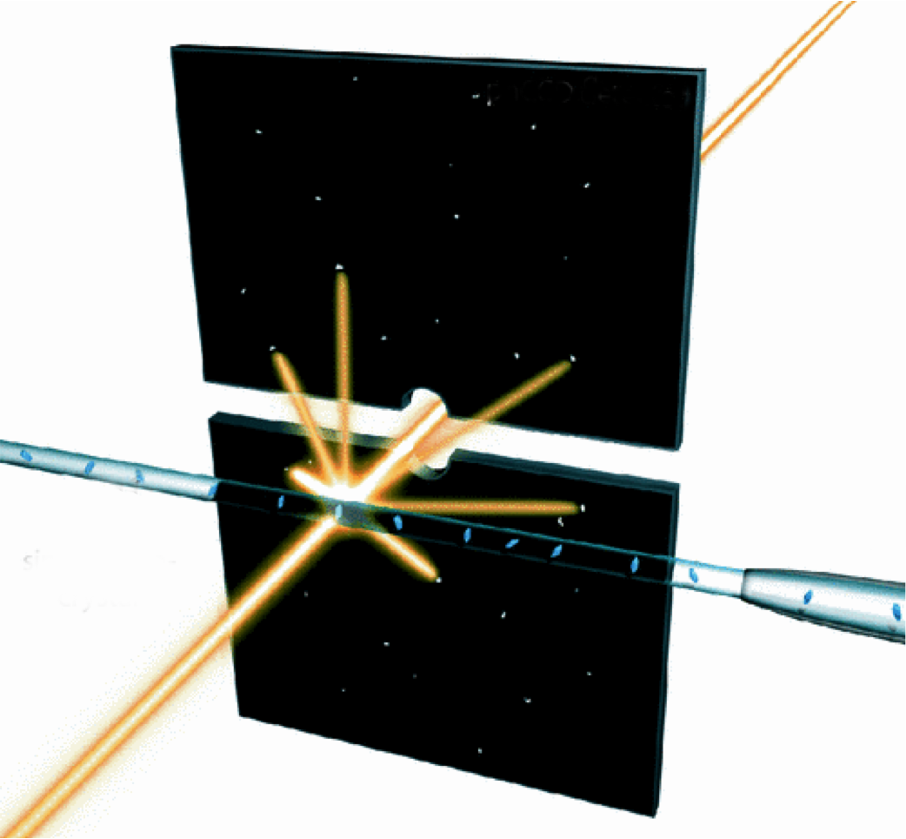
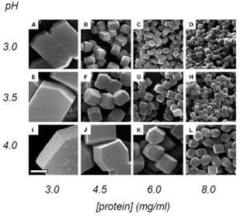
SPB/SFX-I: Serial Femtosecond Crystallography
2D Imaging Detector
Lysozyme Crystals
Bragg Spots
Single Nano-Crystals
Liquid Jet
Falkner, J. C., et al., Chem. Mater. 17, 2679-2686 (2005)
  Experiment Parameters
  Photon Energy Range ≈ 3 – 6 keV
  Sample Size 0.1 – 2 μm
  Desired max. Resolution 2 Å
  Injection Method Liquid Jets
  Exp. Environment
  Vacuum 10⁻⁴ – 10⁻⁶ mbar
FEL Beam
After Lukas Lomb et al., Phys. Rev. B 84, 214111 (2011)
Notes:
Lysozymes, also known as muramidase or N-acetylmuramide glycanhydrolase, areglycoside hydrolases. These are enzymes (EC 3.2.1.17) that damage bacterial cell walls by catalyzing hydrolysis of 1,4-beta-linkages between N-acetylmuramic acid and N-acetyl-D-glucosamine residues in a peptidoglycan and between N-acetyl-D-glucosamine residues in chitodextrins. Lysozyme is abundant in a number of secretions, such as tears, saliva, human milk, and mucus. It is also present in cytoplasmic granules of the macrophages and the polymorphonuclear neutrophils (PMNs). Large amounts of lysozyme can be found in egg white. C-type lysozymes are closely related to alpha-lactalbumin in sequence and structure, making them part of the same family. In humans, the lysozyme enzyme is encoded by the LYZ gene.

Slide 5
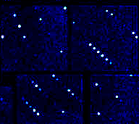
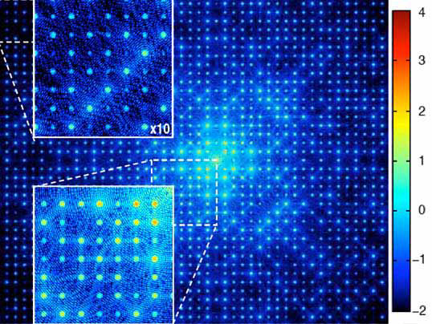
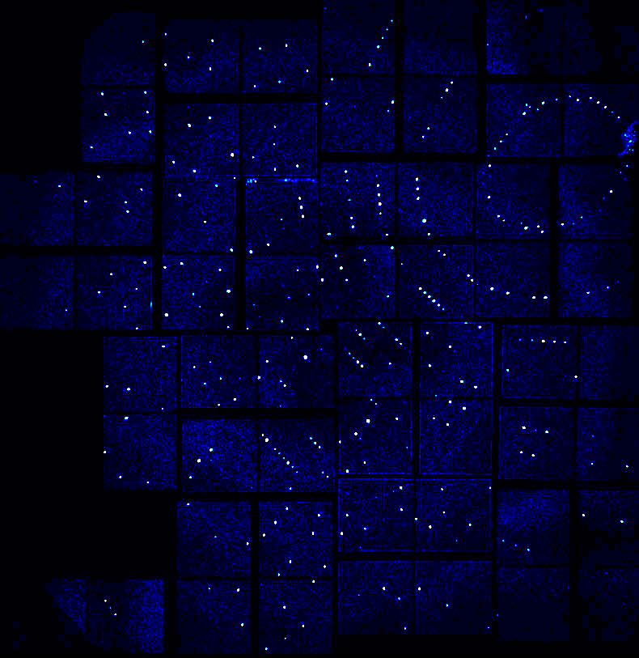
SPB/SFX-I: Serial Femtosecond Crystallography
Diffraction Image of a Single Lysozyme Crystal
Very Bright Spots
Diffraction Pattern Substructure
Bragg Spots
  Experiment Parameters
  Typical samples
  Protein nanocrystals
  Required #Images per Dataset > 10⁴
  Signal level of interest at detector
  10² - 10⁵ ph/pixel/pulse
  Required sampling points
  per Bragg order Ideally >10, at least >5
  Information extracted from single frame
  Integrated Bragg peak intensity + location
Very Weak Signal
Kewish, et al. New J. of Phys. 12 (2010) 035005
Barty, A. et al. J. Appl. Cryst. (2014) 47, 1118-1131
Notes:
One individual frame of background-corrected diffraction from a single lysozyme nanocrystal at the LCLS;
Fig. III.5. Simulated ptychographic diffraction [4] of a 2d-crystal of the membrane protein aquaporin-1. The projected
electron density (above) is sampled with an XFEL pulse (1012 photons at 12 keV, focused to a spot
100 nm in diameter), producing the simulated scattering pattern shown below. Note the coherent diffraction
features between the Bragg peaks (insets).

Slide 6
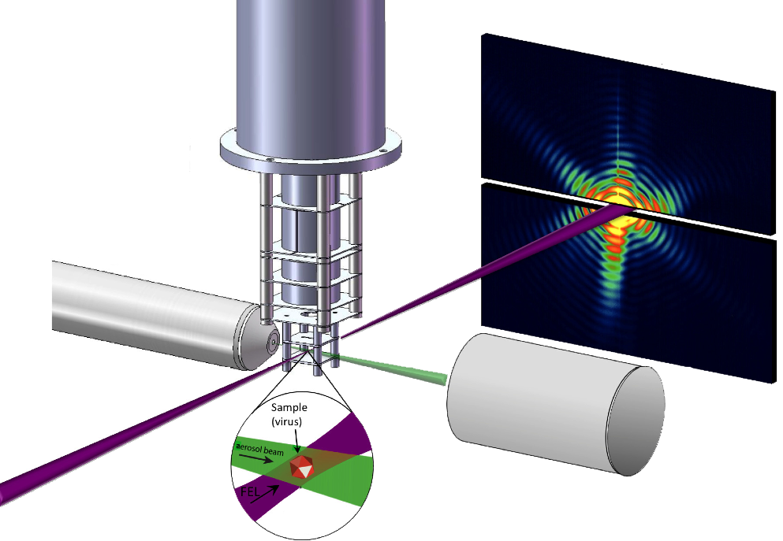
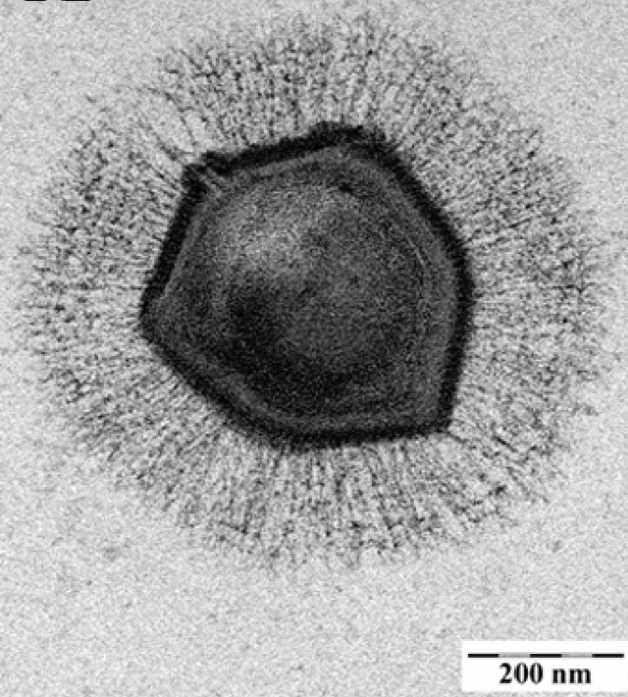
SPB/SFX-I: 2D Single Particle Imaging
Mimivirus
iToF Spectrometer
2D Imaging Detector
Bragg Spots
Aerosol Injector
Ghigo E et al.. PLoS Pathog 4(6) (2008)
  Experiment Parameters
  Photon Energy Range ≈ 3 – 6 keV
  Sample Size 0.1 – 4 μm
  Desired max. Resolution 2 Å
  Injection Method
  e.g. Aerosol Injector
  Experimental Environment
  Vacuum 10⁻⁴ – 10⁻⁶ mbar
FEL Beam
Sample re-catcher system
Aerosol Beam
Sample (Virus)
After Andreasson, J. et al., Optics Express, 22(3), 2497-2510 (2014)
Notes:
Typical samples of interest:
Biological organelles and small cells

Slide 7
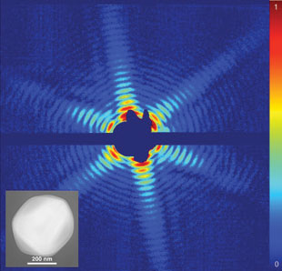
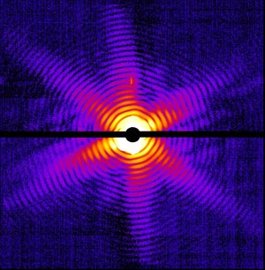
SPB/SFX-I: 2D Single Particle Imaging
Diffraction Pattern of a Mimivirus
Single photon hits at high scattering angles
Very high intensity at central beam region
Hole for central FEL beam
  Experiment Parameters
  Typical Samples
  Biological organelles, small cells
  Required #Images per Dataset 1
  Signal level of interest at detector
  1 – 10⁸ ph/pixel/pulse and higher
  Required sampling points
  per speckle >4
  Information extracted from single frame
  Full diffraction pattern
Courtesy: J. Hajou

Slide 8
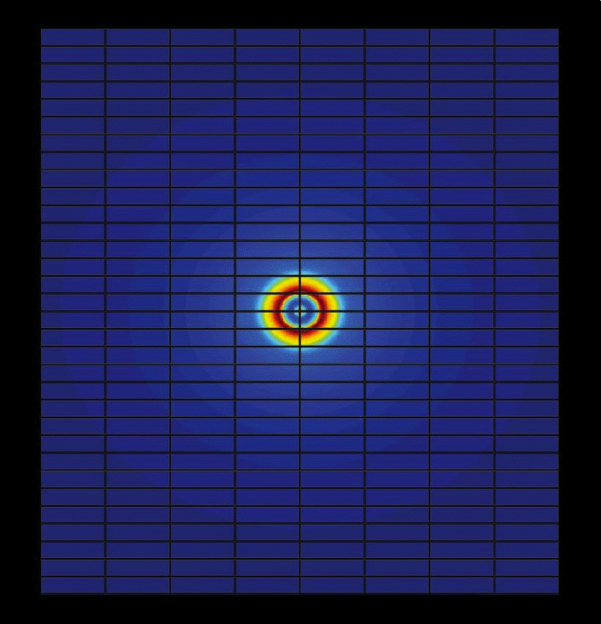
Detector Geometry Requirements
  Central path for direct beam
  Modularity
    Independent movable “qua-drants” to allow adaption to sample size and experiment geometry
    Repeating exposures to account for gaps between tiles
    Slit configuration to reduce background signals (e.g. water jet signature)
    Small and easy replaceable modules to simplify main-tenance in case of damage
  Small single module detectors for second detection plane or as in-dependent detectors

Slide 9
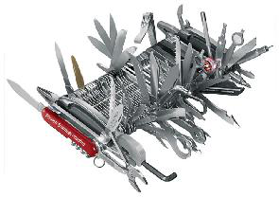
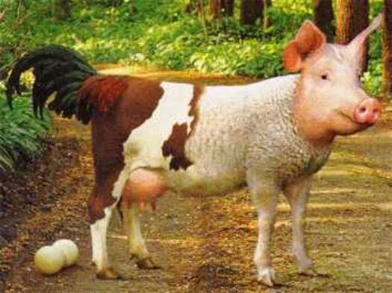
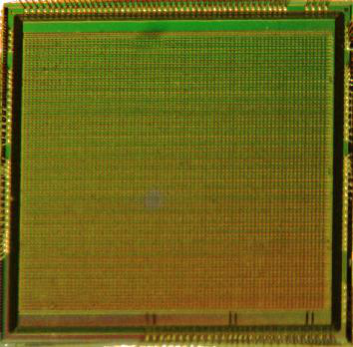
2D Imaging Detector Requirements
XFEL Pulse Structure
  Single pulse imaging
  Recoding 100 fs, readout 220 ns
  Storage of complete pulse train 2700 images
Angular Resolution
  7 mrad for FDE experiments
  4 μrad for XPCS
  (worst case at 10 cm distance)
  Pixel size: 700 μm to 16 μm
  (XPCS at 4 m distance)
  Dynamic Range
  Single photon counting
  (high q/single particle scattering)
  Integration of up to 10⁵ ph/pixel/pulse and more …
  Angular Coverage/
  Sensor Size
  Diffraction experiments require resolution of 0.1 nm
  Scattering angles of 60° (120°)
  Multiple detector segments
  Sensitive Energy Range
  0.25 (SQS, SCS) – 25 keV (MID, HED)
  Ideally with same detector
  Optimized entrance window for low photon energy
Radiation Hardness
  Integrated energy dose over 3 years of operation
  1 MGy – 1 GGy
  Damage effects depend on energy range!
  Graafsma, JINST 4 (2009) pp. 2011
  Main Scientific Applica-tions
  MID, SCS, FXE, SPB and SQS
  Match the environmental conditions
  Vacuum Ambient operation

Slide 10
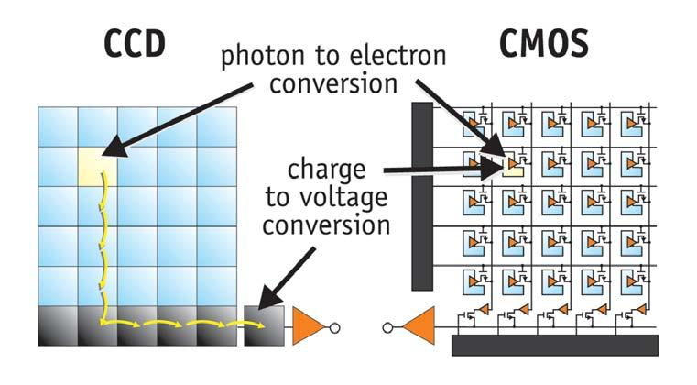
Sensor Technology CMOS vs. CCD
History
Both technologies developed in the late 1960s and early 1970s
Lithography limited at that time
→ CMOS performance limited
→ CCDs dominated the market
Situation changed when 250 nm, 180 nm, 130 nm processes became available
Transfer Time
D. Litviller, Photonics Spectra 2005
Active Pixel Sensors (CMOS)
Fast readout up to MHz
Reduced power consumption
Various readout modes possible
(any region on the sensor)
Signal processing in pixel
→ storage, AD conversion, amplification
Charge Coupled Device (CCD)
Slow readout
  few Hz to approx. 100 kHz possible
Low noise
Radiation hard
(e.g. pnCCD technology)
High fill factor
Notes:
On the on hand we expect applications which require single photon sensitivity, on the other hand a photon interaction at 12-15 keV (3000-4000) generates several thousand electron hole pairs in the pixel.
A detection system with linear gain response would result in a significant reduction of the effective dynamic range of the detector.
- In oder to achieve single photon counting and coverage of high intensities at the same time, non linear response characteristics of the detectors is required.
- That means that for small signals we require high detection precision while for large signals we are dominated by Poissonian noise, and a precision below sqrt(n) is sufficient.
Such a non-linear response can be realized by an “intelligent” front-end which provides a non-linear gain.
Different concepts with different pro and cons are possible to realize such a system
1) Sensor intrinsic non-linear gain response
2) Front end with multiple linear pre-amplifier stages; intelligent switching scheme based on the measured signal height
3) Multiple linear parallel gain stages → parallel pipelines
Pros/Cons
1) single result; no offline conversion;
2) single result; no offline conversion; systematic errors: gain uncertainty, uncertainty at range decision point;
3) multiple results → offline conversion; systematic errors: gain uncertainty only
All three concepts are novel approaches!!

Slide 11
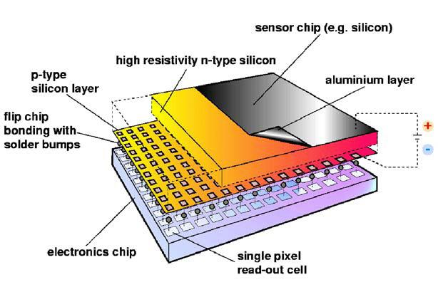
Sensor Technology CMOS vs. CCD
Hybrid Pixel Sensor
History
Both technologies developed in the late 1960s and early 1970s
Lithography limited at that time
→ CMOS performance limited
→ CCDs dominated the market
Situation changed when 250 nm, 180 nm, 130 nm processes became available
Active Pixel Sensors (CMOS)
Fast readout up to MHz
Reduced power consumption
Various readout modes possible
(any region on the sensor)
Signal processing in pixel
→ storage, AD conversion, amplification
Charge Coupled Device (CCD)
Slow readout
  few Hz to approx. 100 kHz possible
Low noise
Radiation hard
(e.g. pnCCD technology)
High fill factor
Notes:
On the on hand we expect applications which require single photon sensitivity, on the other hand a photon interaction at 12-15 keV (3000-4000) generates several thousand electron hole pairs in the pixel.
A detection system with linear gain response would result in a significant reduction of the effective dynamic range of the detector.
- In oder to achieve single photon counting and coverage of high intensities at the same time, non linear response characteristics of the detectors is required.
- That means that for small signals we require high detection precision while for large signals we are dominated by Poissonian noise, and a precision below sqrt(n) is sufficient.
Such a non-linear response can be realized by an “intelligent” front-end which provides a non-linear gain.
Different concepts with different pro and cons are possible to realize such a system
1) Sensor intrinsic non-linear gain response
2) Front end with multiple linear pre-amplifier stages; intelligent switching scheme based on the measured signal height
3) Multiple linear parallel gain stages → parallel pipelines
Pros/Cons
1) single result; no offline conversion;
2) single result; no offline conversion; systematic errors: gain uncertainty, uncertainty at range decision point;
3) multiple results → offline conversion; systematic errors: gain uncertainty only
All three concepts are novel approaches!!

Slide 12
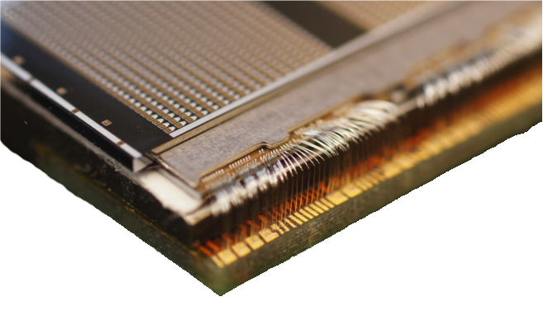
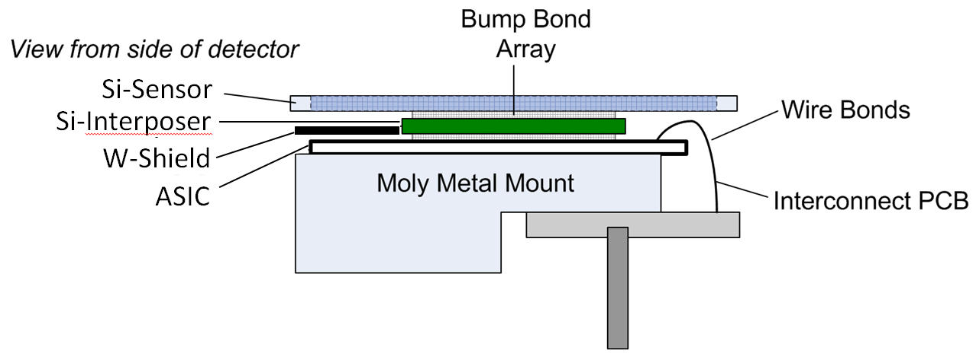
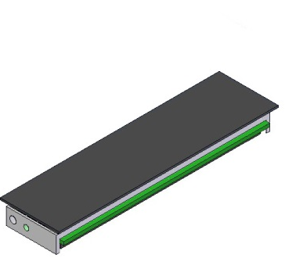
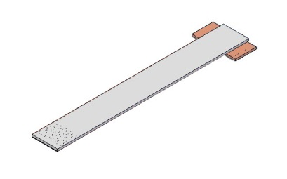
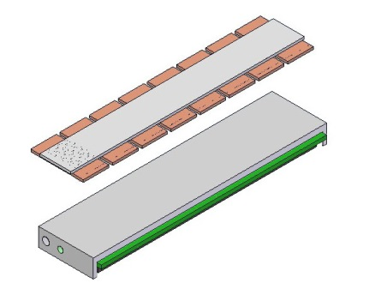
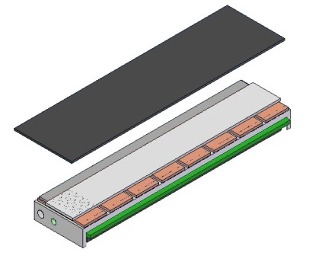
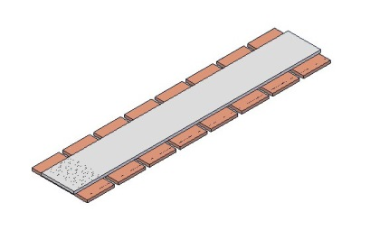
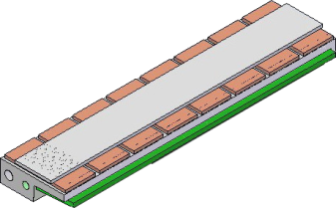
What Do You Need to Build a Sensor Module?
Example LPD Sensor Module
Wire bond and gold stud interconnect
Sensor Module
Si Interposer
Si Sensor
Molybdenum
Base Plate
ASICs
Images: LPD Collaboration

Slide 13
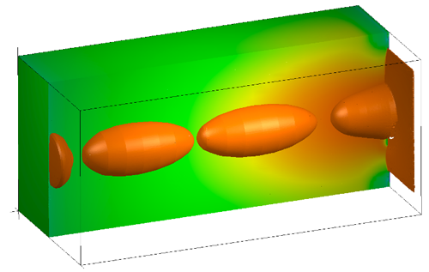
Charge Transport in Silicon
13
Photon Interaction
  Electron hole pair creation at interaction point mainly through photoelectric absorp-tion.
  Motion of charge carriers due to external electric field and the resulting charge density gradient leads to
  Drift Current Density
  Diffusion Current Density
  Similar equations hold for holes, not shown here.
e⁻ Cloud
Electron density
Drift Direction
Mobility
Fully Depleted Sensor Bulk
Electric field
Diffusion constant
Electron density
gradient
Charge Collection
Node
Courtesy: WIAS Berlin

Slide 14
Charge Transport in Silicon
14
Photon Interaction
  Drift Velocity
  Mobility
  Typical values for Si at 300 K
  The local drift velocity only depends on the electric field in the depleted volume.
  Drift velocity defines the time until the charges reach the readout node.
Electric field
Mobility
Electron charge
Mean free time
between collisions
e⁻ Cloud
Eff. Mass of
electrons
Drift Direction
Fully Depleted Sensor Bulk
S.M. Sze, Semiconductor Devices , J. Wiley & Sons, 1985
Charge Collection
Node
Courtesy: WIAS Berlin
Notes:
The local velocity of a charge carrier is given by : v(x) = μ E(x) μ = mobility
v(x) does not depend on the time during which the charge carrier is accelerated, as in normal ballistic motion.
The carriers are always in equilibrium with the crystal lattice, because characteristic times for phonon excitation are much smaller than transport times.
The carrier velocity is only a function of the electric field at every position in the depletion volume.

Slide 15
Charge Collection Time
15
Photon Interaction
  Charge Collection Time
  Typical values in n-type Si with a resistivity of 10 kΩ cm
  t_{c,n} ≈ 30 – 50 ns
  Approximate size of the charge cloud
  Typical values for a bias voltage of 300 V and 450 μm thick fully depleted sensitive volume
  R_{el}≈ 20 – 30 μm
e⁻ Cloud
Drift Direction
Fully Depleted Sensor Bulk
Charge Collection
Node
Courtesy: WIAS Berlin
Notes:
The local velocity of a charge carrier is given by : v(x) = μ E(x) μ = mobility
v(x) does not depend on the time during which the charge carrier is accelerated, as in normal ballistic motion.
The carriers are always in equilibrium with the crystal lattice, because characteristic times for phonon excitation are much smaller than transport times.
The carrier velocity is only a function of the electric field at every position in the depletion volume.

Slide 16
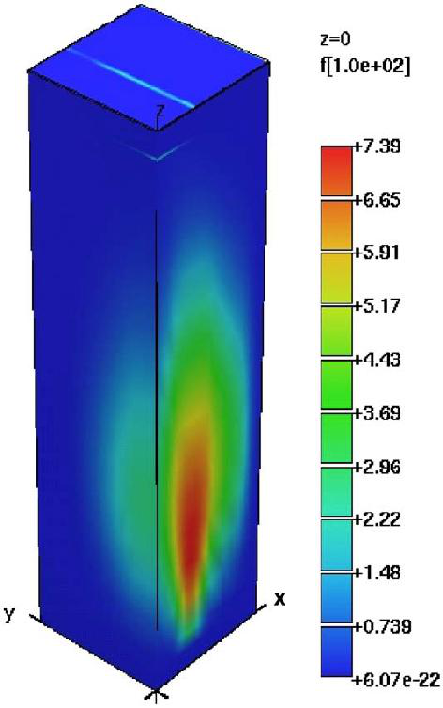
Charge Transport in Silicon
16
e⁻ Charge Density
  Plasma Regime
  XFEL pulse duration < 100 fs
  → energy deposition is instantaneous
  At XFEL intensities electron hole pairs are not independent any more
  → plasma effects dominate
  Plasma is quasi neutral
  → Ambipolar diffusion dominates over
  drift of charge carriers.
Effects dominate at high charge carrier densities, negligible at low charge carrier densities
→ influence on PSF/charge sharing
→ influence on charge collection time
Charge Collection Node
150 μm
Drift Direction
Photon Interaction
Strüder et al. NIM A (2010) vol. 614 pp. 483
Notes:
Image on the left:
Results of a charge cloud calculation using a numerical three-dimensional time-dependent model. The distribution of electrons is shown in colour coded units of the intrinsic charge carrier density n_{i} = 1.4 􏰀x 10¹⁰ per cm³. The footprint in x and y is 37.5 􏰀x 37.5 μm², in z it is 150 μm. The full expansion of the electrons is prevented by the non-optimal boundary conditions of the partial, non-linear differential (van Roosbroeck equations). 1.3ns after its generation, the original charge cloud with an initial diameter of 5mm has expanded to a size of 25 μm x 􏰀65 μm. A study which solves the symmetry related cloud compression is underway.

Slide 17
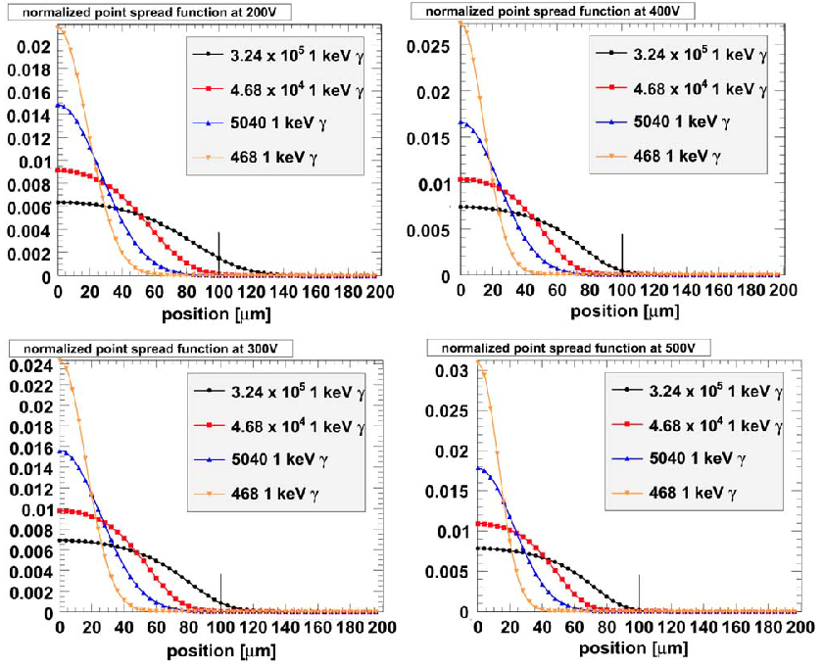
Charge Transport in Silicon – Plasma Regime
17
1 keV Point Spread Function (I, V_{bias})
  Parameter Dependance
High intensity > 10³ ph/pix/pulse
→ more electron hole pairs
→ diameter of the PSF in- creases
Higher photon energy
→ more electron hole pairs
→ diameter of the PSF in- creases
Higher bias voltage
→ stronger electric field
→ shorter drift time
→ diameter of the PSF decreases
V_{bias}= 200V
V_{bias}= 400V
Intensity
Increases
V_{bias}= 300V
V_{bias}= 500V
J. Becker et al. NIM A (2009) vol. 615 pp. 230

Slide 18
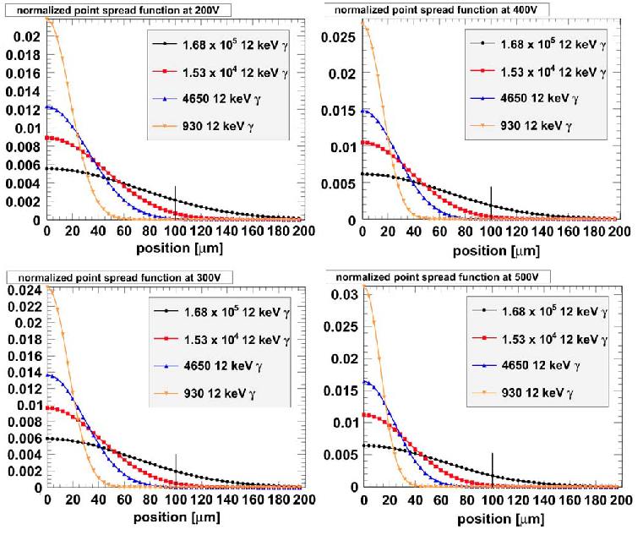
Charge Transport in Silicon – Plasma Regime
18
12 keV Point Spread Function (I, V_{bias})
  Parameter Dependance
High intensity > 10³ ph/pix/pulse
→ more electron hole pairs
→ diameter of the PSF in- creases
Higher photon energy
→ more electron hole pairs
→ diameter of the PSF in- creases
Higher bias voltage
→ stronger electric field
→ shorter drift time
→ diameter of the PSF decreases
V_{bias}= 200V
V_{bias}= 400V
Watch Here
V_{bias}= 300V
V_{bias}= 500V
J. Becker et al. NIM A (2009) vol. 615 pp. 230

Slide 19
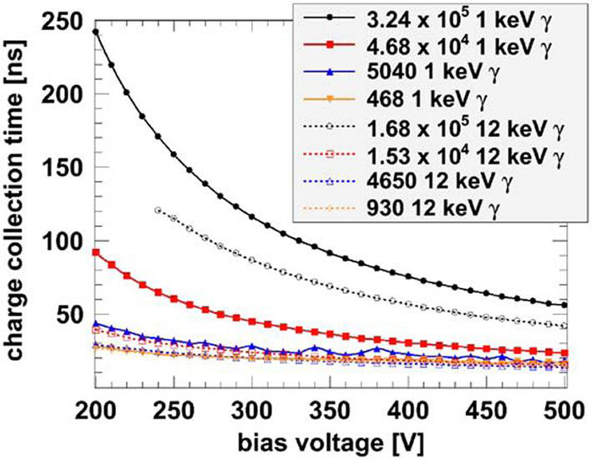
Charge Transport in Silicon – Plasma Regime
19
Charge Collection Time
  Parameter Dependance
High intensity > 10³ ph/pix/pulse
→ more electron hole pairs
→ diameter of the PSF in- creases
Higher photon energy
→ more electron hole pairs
→ diameter of the PSF in- creases
Higher bias voltage
→ stronger electric field
→ shorter drift time
→ diameter of the PSF decreases
  Conclusions
→ At photon intensities > 10³ ph/pix/pulse the spatial resolution is dominated by plasma effects not by the pixel size
→ Charge collection time is significantly longer in comparison to low intensity regime
→ Operating at higher bias voltage can partially compensate for the observed effects
→ For pixel sizes > 200 x 200 μm² ob- served effects are not critical, fine tuning is possible
  Remember
  Due to XFEL time structure the total time available is
  t_{collection} + t_{amplification}+ t_{storeage} = 220 ns
J. Becker et al. NIM A (2009) vol. 615 pp. 230

Slide 20
European XFEL Time Structure
  The European XFEL unique features poses strict constraints on detectors.
  One of the main issues are the intensity and distinctive XFEL time structure.
  Most of the time the use of commercial detectors is excluded.
  Most applications require 4.5 MHz repetition rate detectors
e⁻ Bunch and X-ray Pulse Structure
Data Transfer
Processing
Data Storage
Single shot imaging requires ultra fast read out and processing of the signal:
Charge collection
60-70 ns
Charge clearing
60-70 ns
Read-out
40-70 ns
On sensor electronics
+ memory
e⁻ Bunch Train
2700 Pulses 600 μs
99.3 ms
Charge Collection
Amplification
Storage
X-ray Photons
220 ns
< 100 fs
FEL Process

Slide 21
Dynamic Range
  Ability of a detector system to record simul-taneously very low signals alongside very intense signals.
  Definition
  Noise performance determines dynamic range at low intensities and full well capacity at high intensities.
Maximum de-tectable signal
Total noise
  Typical Values
Detector | Full Well Capacity [e⁻] | Read Noise [e⁻] | Dynamic Range
Human Eye |  |  | 10² (stat) 10¹⁴ (dyn)
Modern CCDs | 30.000-500.000 | 2 – 25 | ≈1.000 – 50.000

Slide 22
The Dynamic Range
Single Linear Amplifier + ADC
  The Problem
  Measure single photons and high inten-sities (10⁴-10⁵ ph/pixel/pulse) in the same image at the same time (no averaging).
  Single Linear Amplifier + ADC
  Adjust output voltage range of amplifier to input of ADC.
  → equidistant sampling of whole dynamic
  range
  Example: detect 1 and 10.000 photons
  Use a 12 Bit ADC → 4096 sampling steps
  Low Intensities
  Tune amplifier such that LSB corresponds to 1 photon and bin width = 1 photon
  → saturation at max. of 4096 photons
Digital Output
Number of Incident Photons
Digital Output
Number of Incident Photons
Digital Output
Number of Incident Photons

Slide 23
The Dynamic Range
Single Linear Amplifier + ADC
  Example (continued …)
  High Intensities
  Tune amplifier such that MSB corresponds to 10.000 photons
  Since large signals are dominate by Pois-sonian/shot noise
  → use bin width corresponding to 100
  photons
  → problem at low end of the dynamic range
  Conclusion
  Small signals need to be measured with high precision
  distinguish 1, 2, 3, 4 … photons
  Large signals need to be measured with low precision not better than
Digital Output
Number of Incident Photons
Digital Output
Number of Incident Photons
Digital Output
Number of Incident Photons

Slide 24
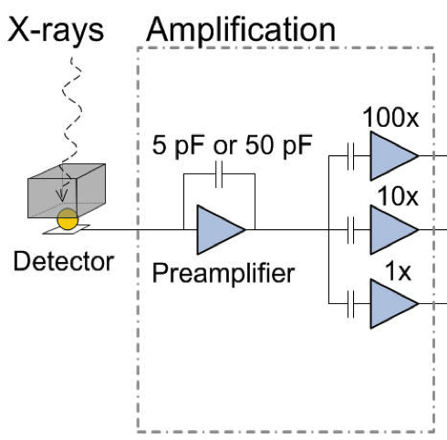
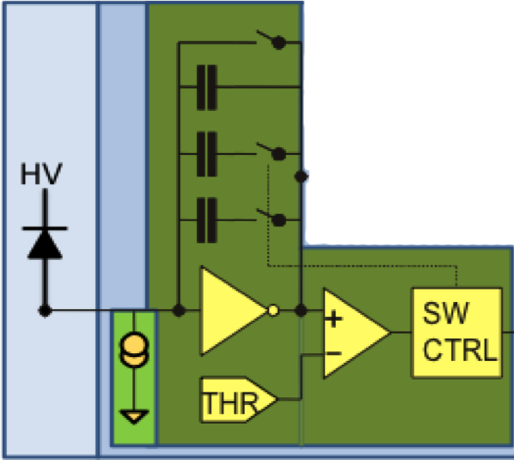
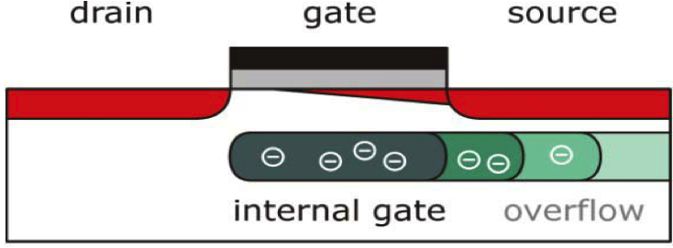
The Dynamic Range
Mult. Linear Amplifiers + ADC
  Possible Solutions
  Multiple
  parallel amplification
  stages
  Gain switching or charge resetting mechanism
  Non linear component on front-end or sensor level (sensor, preamplifier)
High
Medium
Low
Digital Output
Number of Incident Photons
Mult. Switching Amplifiers + ADC
Image:RAL
Digital Output
Number of Incident Photons
None Linear System + ADC
Image: AGIPD Collaboration
Digital Output
Number of Incident Photons
Image: DSSC Collaboration

Slide 25
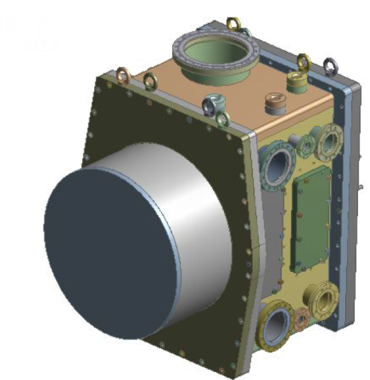
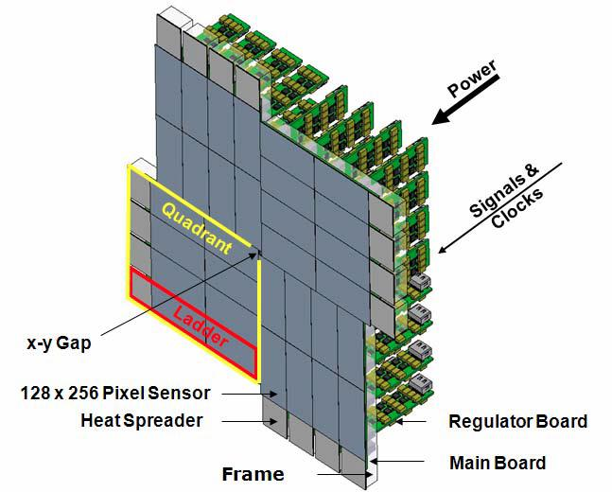
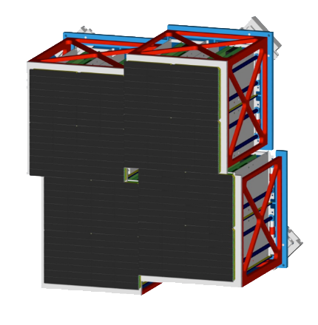
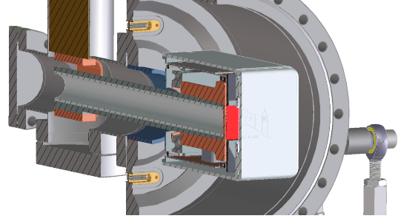
Detectors for Day One Operation at XFEL.EU
Adaptive Gain Integrating Pixel De-tector (AGIPD)
DePFET Sensor with Signal Compre-ssion (DSSC)
4.5 MHz
4.5 MHz
  Energy Range
  3 – 13 (25) keV
  Dynamic Range
  10⁴ ph/px/pulse@12 keV
  Single Photon Sens.
  Yes
  Memory ≈380 images
  Pixel Size 200×200 μm²
  Energy Range
  0.5 – 6 (25) keV
  Dynamic Range
  6000 ph/px/pulse@1 keV
  Single Photon Sens.
  Yes
  Memory ≈800 images
  Pixel Size 236×236 μm²
Large Pixel Detector (LPD)
FastCCD
4.5 MHz
  Energy Range
  3 – 13 (25) keV
  Dynamic Range
  10⁵ ph/px/pulse@12 keV
  Single Photon Sens.
  Yes
  Memory ≈512 images
  Pixel Size 500×500 μm²
  Energy Range
  0.25 – 6 keV
  Dynamic Range
  ≈100 ph/px/pulse@0.5 keV
  Single Photon Sens.
  Yes
  Memory No
  Pixel Size 30×30 μm²
Notes:
Before you start editing the slides of your talk change to the Master Slide view:
Menu button “View”, Master, Slide Master:
Edit the following 2 items in the 1st slide:
1) 1st row in the violet header:
Delete the existent text and write the title of your talk into this text field
2) The 2 rows in the footer area: Delete the text and write the information
regarding your talk (same as on the Title Slide) into this text field.
If you want to use more partner logos position them left
beside the DESY logo in the footer area
Close Master View

Slide 26
Detectors for Day One Operation at XFEL.EU
Adaptive Gain Integrating Pixel De-tector (AGIPD)
DePFET Sensor with Signal Compre-ssion (DSSC)
AGIPD Adaptive Gain Integrating Pixel Detector Consortium (AGIPD)
Project Leader: H. Graafsma, DESY
PSI/SLS Villingen, Universität Bonn, Universität Hamburg, DESY
DEPFET Sensor with Signal Compression Consortium (DSSC)
Project Leader: M. Porro, MPE
Universität Heidelberg, Politecnico di Milano, Università di Bergamo, DESY, European XFEL GmbH, pnSensor GmbH
4.5 MHz
4.5 MHz
  Energy Range
  3 – 13 (25) keV
  Dynamic Range
  10⁴ ph/px/pulse@12 keV
  Single Photon Sens.
  Yes
  Memory ≈380 images
  Pixel Size 200×200 μm²
  Energy Range
  0.5 – 6 (25) keV
  Dynamic Range
  6000 ph/px/pulse@1 keV
  Single Photon Sens.
  Yes
  Memory ≈800 images
  Pixel Size 236×236 μm²
Large Pixel Detector (LPD)
FastCCD
4.5 MHz
  Energy Range
  3 – 13 (25) keV
  Dynamic Range
  10⁵ ph/px/pulse@12 keV
  Single Photon Sens.
  Yes
  Memory ≈512 images
  Pixel Size 500×500 μm²
  Energy Range
  0.25 – 6 keV
  Dynamic Range
  ≈100 ph/px/pulse@0.5 keV
  Single Photon Sens.
  Yes
  Memory No
  Pixel Size 30×30 μm²
Large Pixel Detector Consortium (LPD)
Project Leader: M. French, RAL/STFC
Rutherford Appleton Laboratory/STFC
University of Glasgow
Fast CCD
Peter Denes, John Joseph, Dionisio Doering, Nord Andersen LBNL
Notes:
Before you start editing the slides of your talk change to the Master Slide view:
Menu button “View”, Master, Slide Master:
Edit the following 2 items in the 1st slide:
1) 1st row in the violet header:
Delete the existent text and write the title of your talk into this text field
2) The 2 rows in the footer area: Delete the text and write the information
regarding your talk (same as on the Title Slide) into this text field.
If you want to use more partner logos position them left
beside the DESY logo in the footer area
Close Master View

Slide 27
Detectors for Day One Operation at XFEL.EU
27
Adaptive Gain Integrating Pixel De-tector (AGIPD)
DePFET Sensor with Signal Compre-ssion (DSSC)
4.5 MHz
4.5 MHz
  Energy Range
  3 – 13 (25) keV
  Dynamic Range
  10⁴ ph/px/pulse@12 keV
  Single Photon Sens.
  Yes
  Memory ≈380 images
  Pixel Size 200×200 μm²
  Energy Range
  0.5 – 6 (25) keV
  Dynamic Range
  6000 ph/px/pulse@1 keV
  Single Photon Sens.
  Yes
  Memory ≈800 images
  Pixel Size 236×236 μm²
Large Pixel Detector (LPD)
Other Detectors
4.5 MHz
  Energy Range
  3 – 13 (25) keV
  Dynamic Range
  10⁴ ph/px/pulse@12 keV
  Single Photon Sens.
  Yes
  Memory ≈512 images
  Pixel Size 500×500 μm²
  1D detectors for high repetition rate applications
  Small area, low repetition rate, low energy 2D detectors
  CCDs for low speed imaging
  Point like detectors for veto applications
Notes:
Before you start editing the slides of your talk change to the Master Slide view:
Menu button “View”, Master, Slide Master:
Edit the following 2 items in the 1st slide:
1) 1st row in the violet header:
Delete the existent text and write the title of your talk into this text field
2) The 2 rows in the footer area: Delete the text and write the information
regarding your talk (same as on the Title Slide) into this text field.
If you want to use more partner logos position them left
beside the DESY logo in the footer area
Close Master View

Slide 28
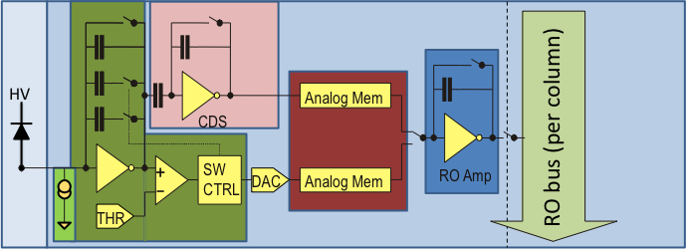
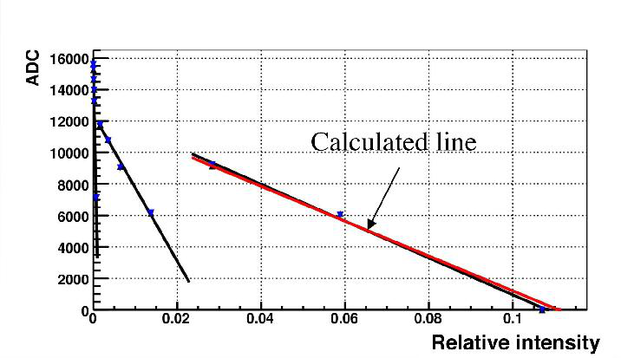
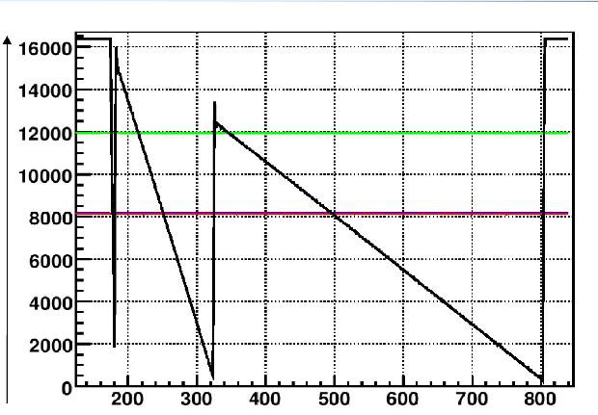
AGIPD – Gain Switching Concept
Gain Switching
Gain Linearity

Slide 29
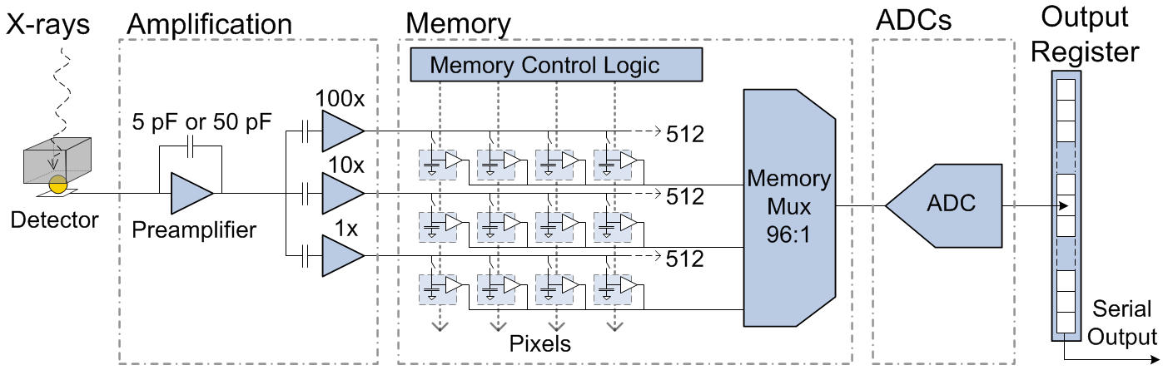
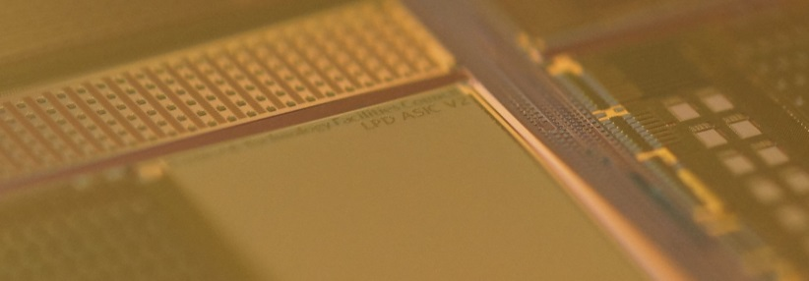
Large Pixel Detector – Pixel Cell and ASIC
LPD ASIC V2
Adjustable dynamic range
3 fold multi-gain concept and analog storage (1x,10x,100x)
512 images memory depth with veto (trigger)
16x 12 Bit on chip ADCs
Images: LPD Collaboration

Slide 30
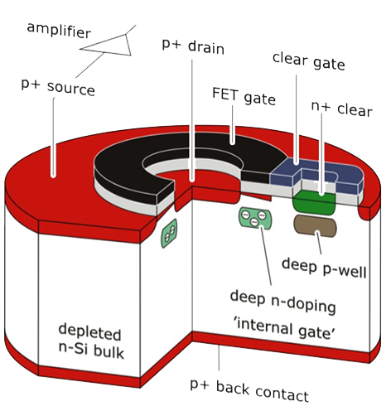
Standard DePFET without Signal Compression
DePFET Working Principle
Linear System Response
ΔI
Current Change
-
-
-
+
Photon
+
Signal Charge
Q_{Sig}
J. Kemmer G. Lutz, NIM A. 253, Nr. 3,1987
  Measure I_{SD} which is proportional to the signal charge
  Signal clearing is required to remove signal e⁻ and e⁻ from leakage current
  Advantages
  Low internal capacitance → low noise
  Non destructive measurement
  Source drain current is steered by the amount of free charge carriers in the external gate
  Incident photon produces electron hole pairs
  Electrons drift to potential minimum at internal gate, holes to back contract
  Mirror charges created in external gate steer I_{SD}

Slide 31
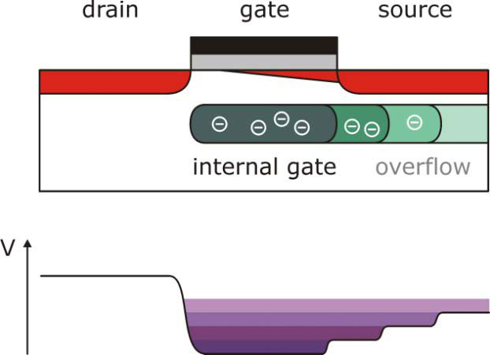
DSSC DePFET with Signal Compression
Non Linear System Response
DSSC DePFET Working Principle
Non Linear System Response
ΔI
Current Change
Photon Irradiation
Signal Charge
Q_{Sig}
  Extend internal gate towards source region
  Only charges collected under external gate contribute to I_{SD}
  Small Signals
  All charge is collected at internal gate under the external gate
  → full steering of I_{SD} → high gain
  Large Signals
Charge spills over into extended source region
No or little contribution to I_{SD} → low gain
Porro et al. NIM A (2010) vol. 624 pp. 509

Slide 32
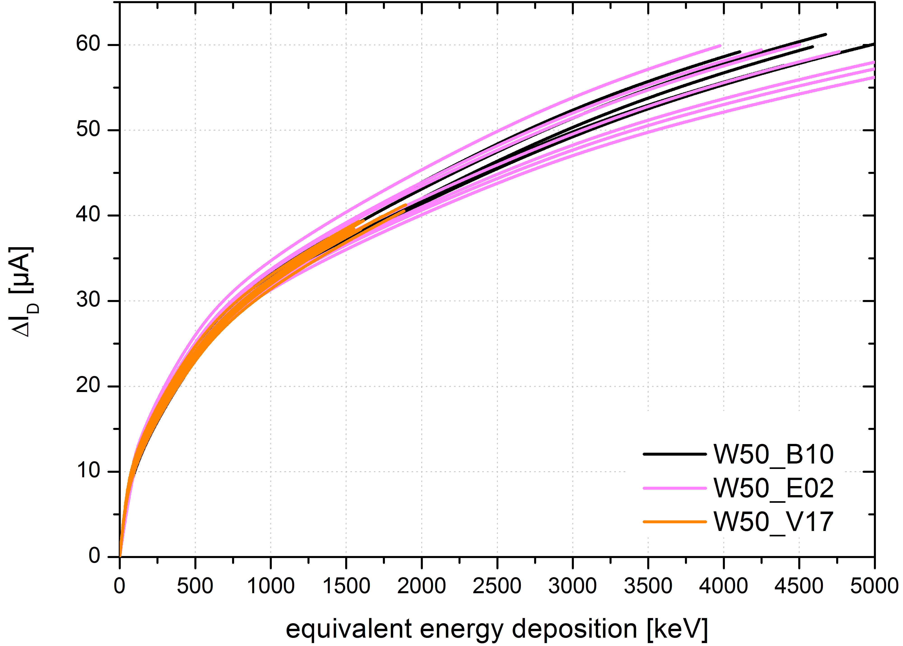
DSSC DePFET with Signal Compression
DSSC DePFET Working Principle
Measured System Response
ΔI [μA]
Photon Irradiation
S. Aschauer, PNSensor
Equivalent Energy Deposition [keV]
  Extend internal gate towards source region
  Only charges collected under external gate contribute to I_{SD}
  Small Signals
  All charge is collected at internal gate under the external gate
  → full steering of I_{SD} → high gain
  Large Signals
Charge spills over into extended source region
No or little contribution to I_{SD} → low gain
Porro et al. NIM A (2010) vol. 624 pp. 509

Slide 33
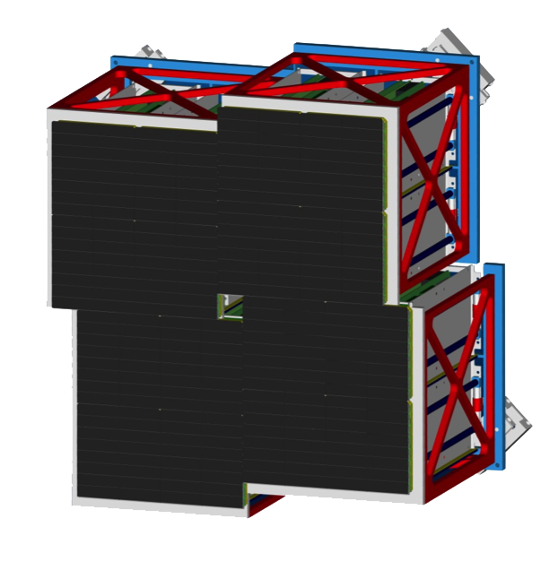

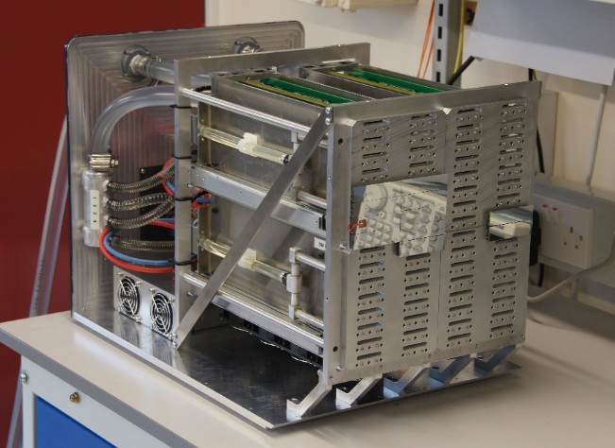

LPD – Detector Systems
16 Super Modules
256 Detector Tiles
2048 ASICs
2-Tile System | ¼ Megapixel Detector | Megapixel Detector
Small flexible test system (32 x 256 pixels) Used for firmware tests, tests at beamlines, veto tests, … | Test system at XFEL.EU (512 x 512 pixels) Temp. stabilized (water cooling) Connected to XFEL DAQ system | Final system (1024 x 1024 Pixels) Movable Quadrants Currently under construction at STFC

Slide 34


LPD – Detector Systems
16 Super Modules
256 Detector Tiles
2048 ASICs
2-Tile System | ¼ Megapixel Detector | Megapixel Detector
Small flexible test system (32 x 256 pixels) Used for firmware tests, tests at beamlines, veto tests, … | Test system at XFEL.EU (512 x 512 pixels) Temp. stabilized (water cooling) Connected to XFEL DAQ system | Final system (1024 x 1024 Pixels) Movable Quadrants Currently under construction at STFC

Slide 35


AGIPD – Direct Beam Measurements at PETRA III
Intensity Distribution
Image of the Direct Beam
Primary intensity 10⁴ photons/pulse
Single photon sensitivity
Operated at 4.5 MHz
J. Becker et al. arXiv 1303.2502V1
Notes:
AGIPD 01 after 1 MGy
- Noise slightly increases
- Gain slightly changes
- Dynamic gain switching still fully functional
- Preamp works after 10 Mgy, noise and gain after 1MGy OK

Slide 36



Large Pixel Detector – Performance
Diffraction Experiment at LCLS
at 9 keV
Sample Titanium dioxide (TiO₂) on Kapton
Detectors CSPAD and
LPD Two Tile system
LPD Super Module

Slide 37



Large Pixel Detector – Performance
Performance tests at Diamond, LCLS, Petra III and in our Lab
Single photon sensitivity demonstrated down to 12 keV
Noise 0.35 photons @ 12 keV
Tests with final hardware at ESRF and APS this fall
Photon Spectrum at 18 keV
Noise Peak
1 Photon
Counts per Bin
2 Photons
3 Photons
4 Photons
Imaging and Charge Sharing Properties
Energy [ADU]
Column
Column
Row
Row

Slide 38


Large Pixel Detector – Performance
Performance tests at Diamond, LCLS, Petra III and in our Lab
Single photon sensitivity demonstrated down to 12 keV
Noise 0.35 photons @ 12 keV
Tests with final hardware at ESRF and APS this fall
Photon Spectrum at 18 keV
Noise Peak
1 Photon
Counts per Bin
2 Photons
3 Photons
4 Photons
Spatial Resolution
Energy [ADU]

Slide 39


Image Corrections – Example AGIPD
X-ray of a Pen Drive
Mean of 10.000 images with an integration time of 50 μs
After dark field correction
After correcting for gain variation of different amplifiers
Intensity [Arbitrary Units]

Slide 40

LPD – 1 Mpx Detector Power Dissipation
Detector Head
1344 W
213 W
x16 = 3408W
LPD 48V Power
1500 W
Chiller
7680 W
480W
7680 W
x16 = 7680 W
15°C
LPD water
20-25°C
XFEL water
Total power dissipated to air and water
≈ 13 kW
→ Liquid cooling mandatory
M. Hart, LPD Collaboration

Slide 41


Expected Data Rates
Readout rate driven by bunch structure
  10 Hz train frequency
  4.5 MHz pulse frequency in trains
Data rate driven by detector type
Challenges
Gathering, calibrating and storing data of many detectors
Data analysis, data reduction and processing
Data long term storage and more …
Day one 2016/17 10 PB offline disk storage.
Notes:
Before you start editing the slides of your talk change to the Master Slide view:
Menu button “View”, Master, Slide Master:
Edit the following 2 items in the 1st slide:
1) 1st row in the violet header:
Delete the existent text and write the title of your talk into this text field
2) The 2 rows in the footer area: Delete the text and write the information
regarding your talk (same as on the Title Slide) into this text field.
If you want to use more partner logos position them left
beside the DESY logo in the footer area
Close Master View

Slide 42

Data Flow and Scientific Data Products
Notes:
Before you start editing the slides of your talk change to the Master Slide view:
Menu button “View”, Master, Slide Master:
Edit the following 2 items in the 1st slide:
1) 1st row in the violet header:
Delete the existent text and write the title of your talk into this text field
2) The 2 rows in the footer area: Delete the text and write the information
regarding your talk (same as on the Title Slide) into this text field.
If you want to use more partner logos position them left
beside the DESY logo in the footer area
Close Master View

Slide 43







Detectors for the European XFEL
Pixel
Size
LPD
4.5 MHz
4.5 MHz
500 μm
DSSC
4.5 MHz
AGIPD
4.5 MHz
200 μm
pnCCD
MCP
Gotthard V2
FastCCD
4.5 MHz
4.5 MHz
75 μm
50 μm
30 μm
SASE 3 (0.25 – 3 keV)
SASE 1/2 (2.3 – 25 keV)
0.2
1.0
10
20
30
Energy [keV]
Notes:
Before you start editing the slides of your talk change to the Master Slide view:
Menu button “View”, Master, Slide Master:
Edit the following 2 items in the 1st slide:
1) 1st row in the violet header:
Delete the existent text and write the title of your talk into this text field
2) The 2 rows in the footer area: Delete the text and write the information
regarding your talk (same as on the Title Slide) into this text field.
If you want to use more partner logos position them left
beside the DESY logo in the footer area
Close Master View

Slide 44

Thank you for your attention!
There is a bright light at the end of the tunnel … 2017 …
… and we will see it …
Notes:
Finally let me close with the sentence “There is a bright light at the end of the tunnel and we are convinced that it will be shining from 2017 on”

Slide 45




Detector Group at the European XFEL
Thank you for your attention!

Slide 46

SQS: Resonant Inelastic X-Ray Scattering
Excite sample with a short laser
→ probe sample with X-rays at after
different times
Study RIXS signal in two dimensions (dispersive/beam)
→ The time evolution of a pump
laser excitation
→ Study emission from different posi-
tions along the sample (non-linear
phenomena)
Requires measurement of single photons in two dimensions at 4.5 MHz
the dispersion direction (energy)
the beam direction along the sample (position equivalent to time)
  Experiment Parameters
  Photon Energy Range
  ≈ 0.2 – 2 keV
  Sample Size 0.1 – 4 μm
  Desired max. Resolution
  sub eV
  Experimental Environment
  Vacuum 10⁻⁶ – 10⁻⁸ mbar

Slide 47

SQS: Soft X-ray Single Shot Spectrometer
Experiment Setup
Rowland geometry + detector at grazing incidence
Wolter optics design allows mag-nification in the imaging direction by factor ≈ 8
Two gratings to cover different energy ranges
  Experiment Parameters
  Required #Images per Dataset
  few tens
  Signal level of interest at detector
  1 – 10² ph/pulse
  Information extracted from single frame
  Full 2D spectrum
Wolter Mirror Pair
Grating
Courtesy: M. Meyer (SQS Leading Scientist)

Slide 48


SQS: Soft X-ray Single Shot Spectrometer
Experiment Setup
Rowland geometry + detector at grazing incidence
Wolter optics design allows mag-nification in the imaging direction by factor ≈ 8
Two gratings to cover different energy ranges
Wolter I Optics
Wolter Mirror Pair
Grating
Courtesy: M. Meyer (SQS Leading Scientist)

Slide 49

SQS: Soft X-ray Single Shot Spectrometer
Experiment Setup
Rowland geometry + detector at grazing incidence
Wolter optics design allows mag-nification in the imaging direction by factor ≈ 8
Two gratings to cover different energy ranges
Wolter Mirror Pair
Grating
Courtesy: M. Meyer (SQS Leading Scientist)

Slide 50


MCP Detector with DLD Readout
MCP Detector with Delay Line Readout
4.5 MHz compatible Si based imaging detectors with pixel sizes < 100 μm are not available.
Use micro-channel plate to convert single photons to 10³–10⁴ electrons
  Advantage
Fast detector for single shot imaging
Reasonable sensitivity
Good spatial resolution
  Limitations
Dead time of a single pore is much longer than μs
→ use Wolter optics to distribute signal
Spatial resolution
50 μm (║ DL) x 156 μm (┴ DL)
Working Principle of a Micro Channel Plate
Channel diameter
≈ 20 μm
X-ray/VUV Photons
Delay Line Readout
Dispersive Direction
Imaging Direction
e⁻ Avalanche
Notes:
Capable of a max. count rate of ≈ 100 counts per frame

Slide 51



Experiments in Photon Science
Differences to other communities as seen from the detector point of view
  Detector performance needs to cover a broad range of scientific cases
  Frequently performance requirements are contradictory from the technology point of view
  Limits potential to optimize detector performance if budget is finite
  User operation
  Duration of an experiment is typically a fraction of a second up to minutes
  Different users have different ideas
    Experiment setups can change frequently (weekly)
    Detectors must be user friendly (control, DAQ, analysis)
Detectors can get damaged frequently
    Need spare parts and design that allows quick and easy repair + budget
Learning Flexibility

Slide 52

Notes:
Before you start editing the slides of your talk change to the Master Slide view:
Menu button “View”, Master, Slide Master:
Edit the following 2 items in the 1st slide:
1) 1st row in the violet header:
Delete the existent text and write the title of your talk into this text field
2) The 2 rows in the footer area: Delete the text and write the information
regarding your talk (same as on the Title Slide) into this text field.
If you want to use more partner logos position them left
beside the DESY logo in the footer area
Close Master View

Slide 53

Radiation Hard Sensor Design
Damage Mechanisms
Bulk damage
  Not expected for E < 300 keV
Surface and Interface Damage
  Higher leakage current
  Charge losses at interfaces
  Larger inter pixel capacitance
  Lower break down voltage
  Higher depletion voltage
Needs optimized sensor design
Large guard rings (15 for AGIPD)
Radiation tolerant up to 1 GGy
but
Non sensitive area between detector modules
Module Layout
1200 μm
Guard
Rings
Last Sensor Pixel
Module Edge
J. Schwandt et al. JINST 8 C12015 (2013)
Notes:
Measurement Results of AGIPD01
laser intensity scan → gain linearity
Current source → gain switching

Slide 54

MCP + Delay Line Read Out (Surface Concept)
Array of 128 parallel delay lines, at a dis-tance of 156 μm to cover the active area of 50 x 20 mm².
Each DLD can acquire 1 to 2 photons per pulse, 2 of coming at a distance on the DLD of more than 5 mm (in the 50 mm direction)
Expected # of photons per 10¹² ph/pulse
a few hundred
Resolution: 50 μm in the imaging direc-tion, 156 μm in the dispersive direction
Resolution in imaging direction can be im-proved by a factor 3 to 10 if charge shar-ing between DLD is used (reduced multi-hit capability)
Detector can run at 4.5 MHz
MCP Sensor
Dispersive Direction
Delay Line Readout
Imaging Direction

Slide 55


Laser Testing – Gain
LPD operating with 100MHz master clock
ASIC amplifier current = Default
Number of trains per point = 50
5
4
1
2
3
Pixel 1 – Output for all gain stages and front end gain modes
ADUs
Intensity (19uJ)

Slide 56

Notes:
Before you start editing the slides of your talk change to the Master Slide view:
Menu button “View”, Master, Slide Master:
Edit the following 2 items in the 1st slide:
1) 1st row in the violet header:
Delete the existent text and write the title of your talk into this text field
2) The 2 rows in the footer area: Delete the text and write the information
regarding your talk (same as on the Title Slide) into this text field.
If you want to use more partner logos position them left
beside the DESY logo in the footer area
Close Master View

Slide 57


Slide 58


Radiation Tolerance – Sensor/ASIC
1 MGy entrance dose agreed with XFEL
ASIC circuit blocks proven to be radiation tolerant up to 5 MGy @ 12keV with first generation sensors
Exposed to 0.6 MGy entrance dose on X-ray set, 0.4 MGy dose at pixel contacts.
  Equivalent to 986% 12keV XFEL requirement
  83% 20keV XFEL requirement
Extrapolated to 1 MGy → leakage current is 0.8 photons @ 12keV
Observed effect can be corrected for by re-calibration
M. Hart, presentation at the 15th DAC meeting 2013

Slide 59


Slide 60




Facility Overview
Schenefeld
Osdorfer Born
DESY-Bahrenfeld
Experiment hall
Laboratories
Offices
Electron beam to photon beamlines
Undulator systems begin
Electron source
Linear accelerator begins
  FEL Parameters
  Baseline photon energy
  0.4–20 keV
  Pulse duration
  < 100 fs
  Pulse energy
  a few mJ
  Semiconducting linac
  14 – 17 GeV
DESY
Campus
3400 m
Notes:
The European XFEL consists of a linear electron accelerator which is about 2 km long, with its injector being located on the DESY campus in Hamburg Bahrenfeld. The electrons organized in bunches will have an energy between 14 and 17 GeV when they arrive at the switchyard building in Osdorfer Born. There they are distributed into the undulator sections, where the electron bunches are forced on a zig-zag path by strong magnetic fields and finally will emit coherent X-rays with an energy between 0.4 and 20 keV. These X-rays will then be used at the photon beam lines for a variety of scientific experiments in the HQ building in Schenefeld.

Slide 61
Sensor Technology – CCD and CMOS
  History
  Both technologies developed in the late 1960s early 1970s
  CCD W. Boyle, G. E. Smith 1969 at AT&T Bell Laboratories
  Lithography processes were limited at that time
  → CMOS performance limited
  → CCD dominated the market
  Situation changed when 250 nm, 180 nm became available
W. Boyle, G. E. Smith 1969 at AT&T Bell Laboratories
G. E. Smith, Nobel Lecture, December 8, 2009

Slide 62
Sensor Technology – CCD and CMOS
CCD Principle
  History
  Both technologies developed in the late 1960s early 1970s
  CCD W. Boyle, G. E. Smith 1969 at AT&T Bell Laboratories
  Lithography processes were limited at that time
  → CMOS performance limited
  → CCD dominated the market
  Situation changed when 250 nm, 180 nm became available
Photon to e⁻ Conversion
Imaging Area
Readout Register
Partially Column Parallel
Column Parallel

Slide 63
Frame Storage Area
Imaging Area
Frame Storage Area

Slide 64
Detectors for Day One Operation at XFEL.EU
Pixel
Size
LPD
4.5 MHz
4.5 MHz
500 μm
DSSC
4.5 MHz
AGIPD
4.5 MHz
200 μm
MCP
Gotthard V1
FastCCD
4.5 MHz
75 μm
50 μm
30 μm
SASE 3 (0.25 – 3 keV)
SASE 1/2 (2.3 – 25 keV)
0.2
1.0
10
20
30
Energy [keV]
Notes:
Before you start editing the slides of your talk change to the Master Slide view:
Menu button “View”, Master, Slide Master:
Edit the following 2 items in the 1st slide:
1) 1st row in the violet header:
Delete the existent text and write the title of your talk into this text field
2) The 2 rows in the footer area: Delete the text and write the information
regarding your talk (same as on the Title Slide) into this text field.
If you want to use more partner logos position them left
beside the DESY logo in the footer area
Close Master View

Slide 65





CCD Technology - FastCCD
Achieved Progress
Flexible thermal and mechanical camera interface defined with LBNL
DAQ and control interface defined and agreed on
Beam hole of chip and camera agreed on
Updated schedule for milestones
Detector integration into SCS experiment
  Definition of thermal and mechanical interface for SCS beam line close to finalization
  Thermal interface for beam line setup
  and laboratory setup decided
SCS Experiment Chamber Setup
Lab Chamber Setup
Open Issues
Detector integration activities for the FastCCD have been delayed due to delayed hiring of new detector scientist for WP75, not on the critical path.
Notes:
Before you start editing the slides of your talk change to the Master Slide view:
Menu button “View”, Master, Slide Master:
Edit the following 2 items in the 1st slide:
1) 1st row in the violet header:
Delete the existent text and write the title of your talk into this text field
2) The 2 rows in the footer area: Delete the text and write the information
regarding your talk (same as on the Title Slide) into this text field.
If you want to use more partner logos position them left
beside the DESY logo in the footer area
Close Master View

Slide 66
Notes:
Before you start editing the slides of your talk change to the Master Slide view:
Menu button “View”, Master, Slide Master:
Edit the following 2 items in the 1st slide:
1) 1st row in the violet header:
Delete the existent text and write the title of your talk into this text field
2) The 2 rows in the footer area: Delete the text and write the information
regarding your talk (same as on the Title Slide) into this text field.
If you want to use more partner logos position them left
beside the DESY logo in the footer area
Close Master View

Slide 67


Slide 68


Slide 69


Slide 70
Detector Group at the European XFEL
Thank you for your attention!

Slide 71



Mid and Long Term Plans 10 to 15 Years
Sensor and ASIC
  Improve spatial resolution while maintaining 4.5 MHz support reasonable dynamic range and on chip storage capacity
    reduce pixel size to approx. 50 x 50 μm²
      Higher integration density on ASIC level
      3D wafer stacking technologies
      Access to radiation tolerant 65 nm ASIC technology
  More compact sensor modules
    High density packaging and cooling technology
  Reduce insensitive gaps between sensor modules
    Four side edgeless sensor modules
    Sensor R&D
  High energy hybrid pixel detectors for E > 25 keV
    High Z sensor material (EU activity HIZPAD)
AGIPD ASIC
DSSC Ladder Module
Notes:
Before you start editing the slides of your talk change to the Master Slide view:
Menu button “View”, Master, Slide Master:
Edit the following 2 items in the 1st slide:
1) 1st row in the violet header:
Delete the existent text and write the title of your talk into this text field
2) The 2 rows in the footer area: Delete the text and write the information
regarding your talk (same as on the Title Slide) into this text field.
If you want to use more partner logos position them left
beside the DESY logo in the footer area
Close Master View

Slide 72


Slide 75


Slide 76

SPB/SFX-II: 3D Single particle imaging

Slide 77

Notes:
From brilliance to number of counts on detector to dynamic range and radiation hardness

Slide 78


SCS-I: Single Shot X-ray Holography
Using Fourier transform holography, obtain real-space image of magnetic domains.
Diffraction from a single x-ray pulse (~5 mJ/cm², or up to 10000 photons on detector)
We can combine this with pump-probe techniques to make time-resolved movies!
Wang, Zhu, Wu et al. PRL 108, 267403 (2012)

Slide 79




SCS-II: Time-resolved resonant diffraction
Graves et al., Nature materials 12, 293 (2013)

Slide 80

Notes:
Before you start editing the slides of your talk change to the Master Slide view:
Menu button “View”, Master, Slide Master:
Edit the following 2 items in the 1st slide:
1) 1st row in the violet header:
Delete the existent text and write the title of your talk into this text field
2) The 2 rows in the footer area: Delete the text and write the information
regarding your talk (same as on the Title Slide) into this text field.
If you want to use more partner logos position them left
beside the DESY logo in the footer area
Close Master View

Slide 81



DSSC 1 MPixel Detector Module
DEPFET Detector Module
Key Detector Parameters
Goal: Single photon sensitivity
5 σ @1 keV and 4.5 MHz
Energy range
0.5 – 6 (25) keV
Dynamic range
> 6000 photons/pixel/pulse @1 keV
Single photon sensitivity
5 σ @ 1 keV (5 MHz)
5 σ @ 0.5 keV (≤ 2.5 MHz)
Number of storage cells 576
Smallest detector unit “ladder
128 x 512 pixels
4 ladders built on quadrant
4 quadrants = 1k x 1k detector
Quadrant
Ladder
Notes:
Operating temperature -30° C
Energy range 0.5 ... 25 keV (optimized for 0.5 ... 4 keV)
Number of pixels 1024 x 1024
Sensor Pixel Shape Hexagonal
Sensor Pixel pitch ~ 204 x 236 μm2
Dynamic range / pixel / pulse > 6000 photons @1 keV
Resolution (S/N >5:1)
Single photon @ 1 keV (5 MHz) Single photon @ 0.5 keV (≤ 2.5 MHz)
Electronics noise < 50 electrons r.m.s.
Frame rate 0.9-4.5 MHz
Stored frames per Macro bunch ≥ 512
Operating temperature -30 ̊C optimum, RT possible

Slide 82


Option for Low Energy/Low Rep. Rate/Small Pix
LBNL Fast CCD
Fully depleted CCD, 2 MPix
Pixel size 30 μm x 30 μm
Max. frame rate 100 Hz (full frame)
Energy range 0.25 < E < 6 keV
Dynamic range 10⁵ e⁻ (120 ph @3 keV)
Noise 25 e⁻ at high gain
12 Bit ADC, 3 gain settings
Fixed central hole
200 μm Si sensor
pnCCD, HLL Munich
1 or 2 Mpx device
Pixel size 75 μm x 75 μm
Max. frame rate up to 200 Hz
Energy range 0.05 < E < 20 keV
Dynamic range 10³ ph @ 12 keV
Noise 2 e⁻ at high gain
14 bit ADC, 10 MHz
Two halves with central gap
450 μm Si sensor
Strüder et al. NIM A 614 (2010) 483

