Slide 1
Measurement of the super-allowed branching ratio of ¹⁰C
B. Blank, M. Aouadi, P. Ascher, M. Gerbaux, J. Giovinazzo, T. Goigoux,
S. Grévy, T. Kurtukian Nieto, C. Magron
CEN Bordeaux-Gradignan, France
P. Delahaye, G.F. Grinyer, J. Grinyer, J.-C. Thomas
GANIL Caen, France
M.R. Dunlop, R. Dunlop, P.E. Garrett, A.T. Laffoley, C.E. Svensson
University of Guelph, Canada
G.C. Ball
TRIUMF, Vancouver, Canada
P. Finlay
K.U. Leuven, Belgium
Beam time requested: 21 shifts on LA1

Slide 2
• • • Nuclear beta decay
0⁺
0⁺ → 0⁺ :
T_{1/2}
K
Ft = ft (1 + δ_{R}’ ) (1 – δ_{c} + δ_{NS} ) = = cnst
g
2
(1 + Δ_{R})
M
2
f(Z, Q_{EC}) ~ 1.5%
V
F
Q_{EC}
f(nucl. structure) ~ 0.3-1.5%
BR
f(weak interaction) ~ 2.4%
0⁺
➔ ➔ V_{ud} = g_{V} / g_{μ}
Precision measurements required: 10⁻³
Q_{EC} → mass measurements: f ~ Q_{EC}⁵
T_{1/2} , BR → β-decay studies: t = T_{1/2} / BR

Slide 3
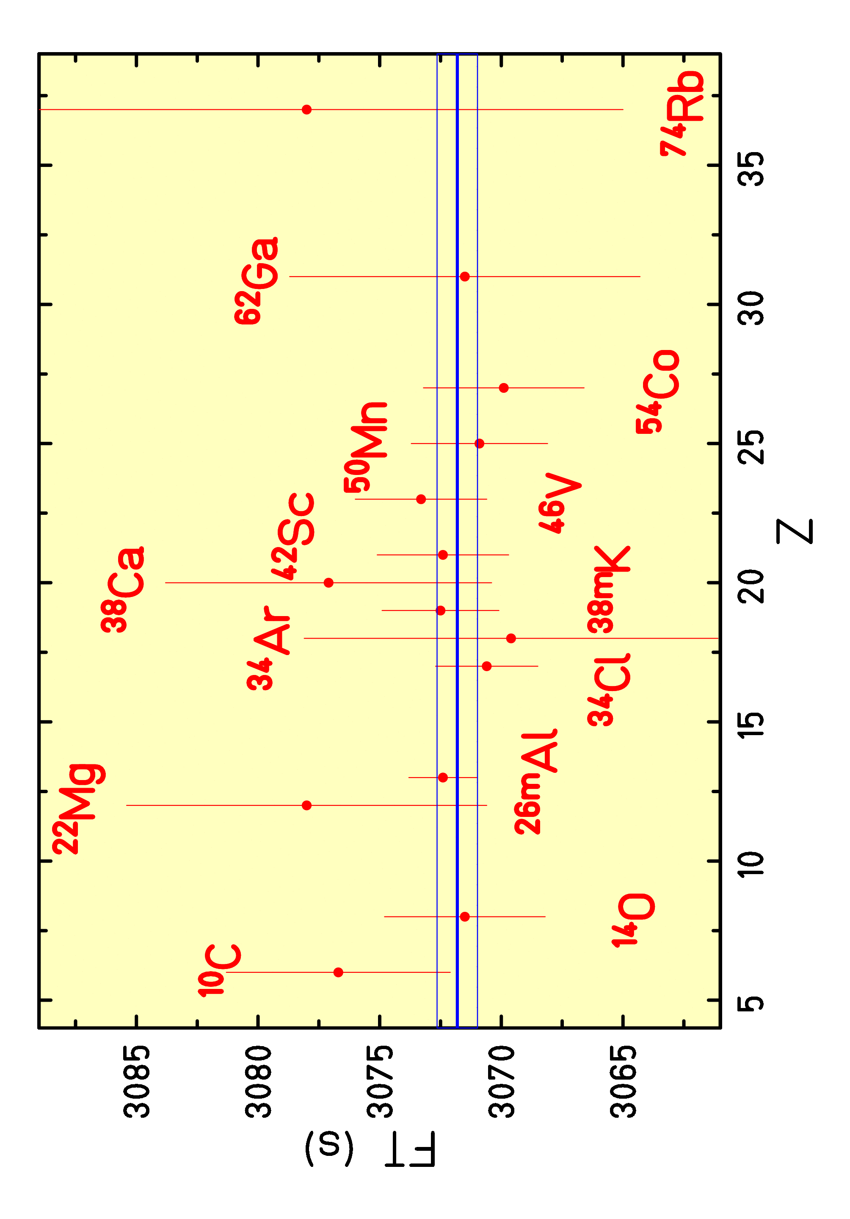
• • • 0⁺ → 0⁺ decays: status
B. Blank et al., EPJA 51 (2015) 8: T_{1/2} & BR of ³⁸Ca
14 nuclei measured with precision of order 10⁻³
V_{ud} = 0.97417 ± 0.00021, Σ V_{ux} = 0.99978 ± 0.00055

Slide 4
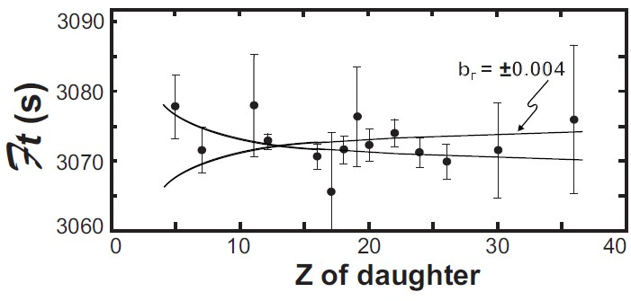
• • • 0⁺ → 0⁺ decays: limits on exotic currents
assumption: only vector current
limit on scalar currents:
b_{F} = Re( (C_{s} + C’_{s}) / C_{v} ) = 0.0026(42) (90% CL)
limit on scalar current
from β decay:
|C_{s} / C_{v} | ≤ 0.065
➔➔ improve on low-Z
nuclei
Severijns et al.
Hardy & Towner

Slide 5
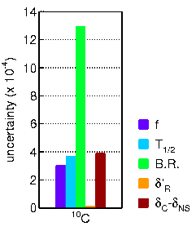
• • • 0⁺ → 0⁺ decays: ¹⁰C error budget
BR by far largest error
two precise measurements
  Savard et al.: 1.4625(25)%
  (PRL 74 (1995) 1521)
  Fujikawa et al.: 1.4665(38)%
  (PLB 449 (1999) 6)
  measurements with Ge
  multi-detector array
our approach:
high-precision
single-crystal
germanium detector

Slide 6
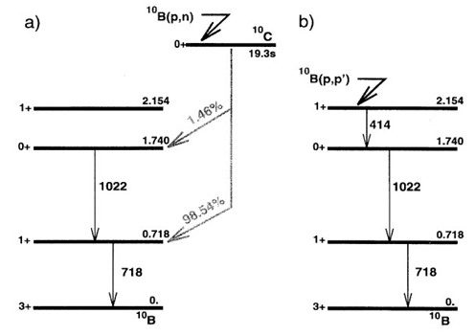
• • • ¹⁰C decay scheme

Slide 7
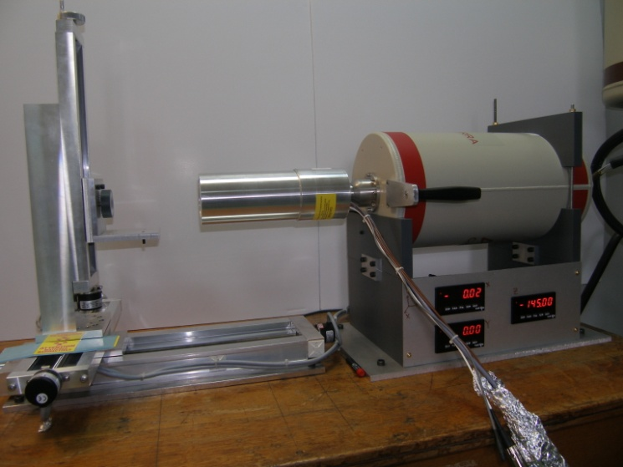
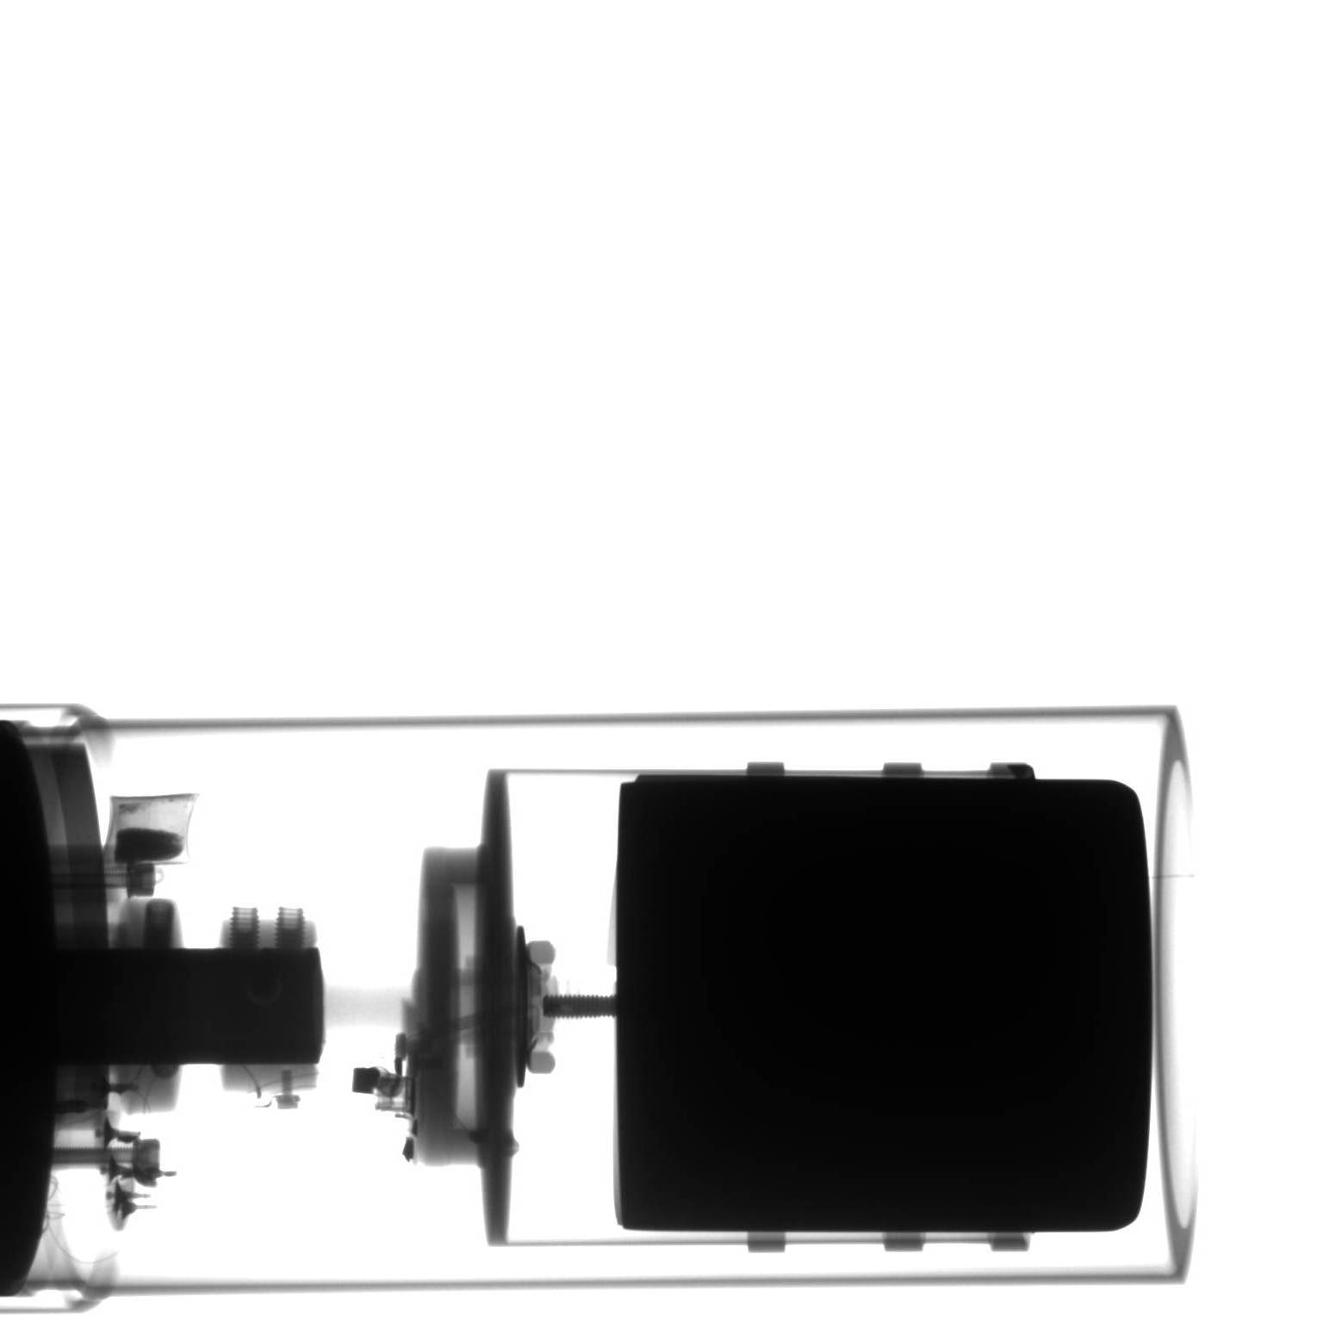
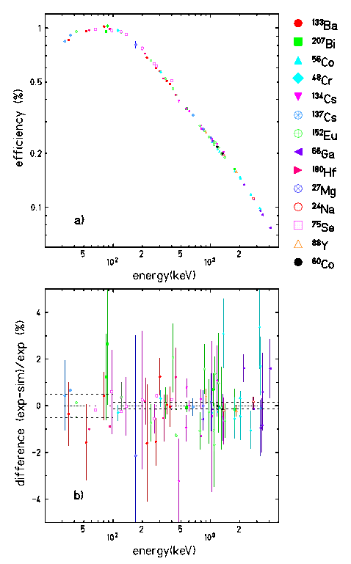
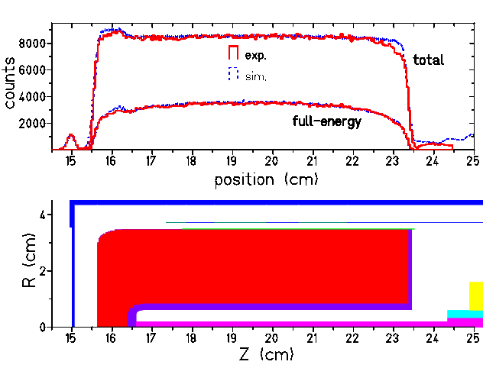
• • • Calibration of germanium detector
Δε_{rel} = 0.1%, Δε_{abs} = 0.15%
calibration programme of a
HP Ge detector:
- x-ray photography of detector
- scan of the crystal at CSNSM
- source measurements
- MC simulations: CYLTRAN, GEANT4
X-ray
photography
B. Blank et al., NIMA776 (2015) 34
Scan at
CSNSM
Branching ratios:
²⁴Na, ²⁷Mg, ⁴⁸Cr, ⁵⁶Co, ⁶⁰Co, ⁶⁶Ga, ⁷⁵Se,
⁸⁸Y, ¹³³Ba, ¹³⁴Cs, ¹³⁷Ce, ¹⁵²Eu, ¹⁸⁰Hf, ²⁰⁷Bi
Peak/total: ²²Na, ⁴¹Ar, ⁵¹Cr, ⁵⁴Mn, ⁵⁷Co, ⁵⁸Co,
⁶⁵Zn, ⁸⁵Sr …ISOLDE sources

Slide 8
• • • Experimental setup
15 proton pulses per minute (30%)
nanoCaO + VD7 or molten NaF:LiF salt targets + VD7
GPS or HRS to LA1
➔ ➔ ¹⁰CO
“continuous” beam
15 cm

Slide 9
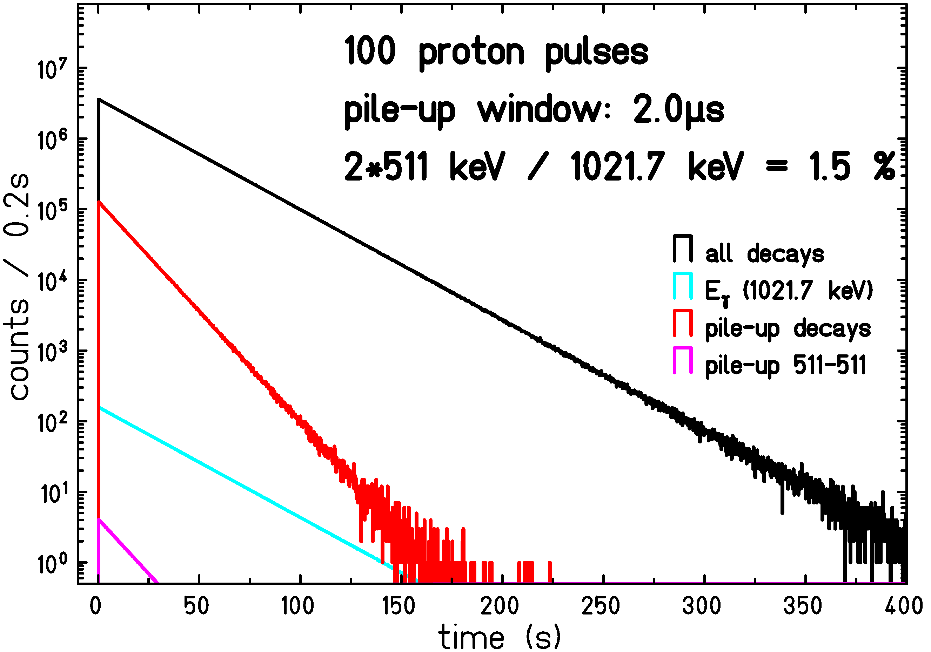
• • • Rate estimates: ¹⁰C
Count rate for 1021.7 keV γ ray:
5*10⁵ ¹⁰C per pulse * 15 pulses/min * 60 min * 20 h * 3 d = 2.7*10¹⁰ ¹⁰C decays
* 0.0146 (BR) * 0.0028 (ε(1022keV)) = 1.1*10⁶ γ’s at 1022 keV
➔ statistical precision of 0.1%
511 keV – 511 keV pile-up:
ε(511 keV) = 0.4 %, pile-up window: 2μs, 5*10⁵ ¹⁰C produced instantaneously
1.5 % of 1.022 MeV peak
from 511 – 511 pileup
➔➔ 3 days

Slide 10
• • • Rate estimates: ¹⁹Ne
¹⁹Ne decay - 511 keV – 511 keV pile-up:
ε(511 keV) = 0.4 %, pile-up window: 2μs, 5*10⁵ ¹⁹Ne produced instantaneously
5*10⁵ ¹⁹Ne per pulse * 15 pulses/min * 60 min * 20 h = 0.9*10¹⁰ ¹⁹Ne decays
* 2 (511) * 0.004² (ε(511 keV)) * 2μs (pile-up window) = 5400 counts at 1022 keV
➔ statistical precision of 1.3 %
➔➔ 1 day
2 days:
¹⁰C measurement at different distances
1 day:
debugging, setting-up, optimisation

Slide 11
• • • Summary of request
starting the experiment, setting-up separator
and experimental setup: 1 day
measurement with ¹⁰C in optimal conditions: 3 days
measurement with ¹⁹Ne: 1 day
¹⁰C measurement at a different distances: 2 days
--------------------------------------------------------------------------------------
Total: 7 days
Thanks for your attention

Slide 13
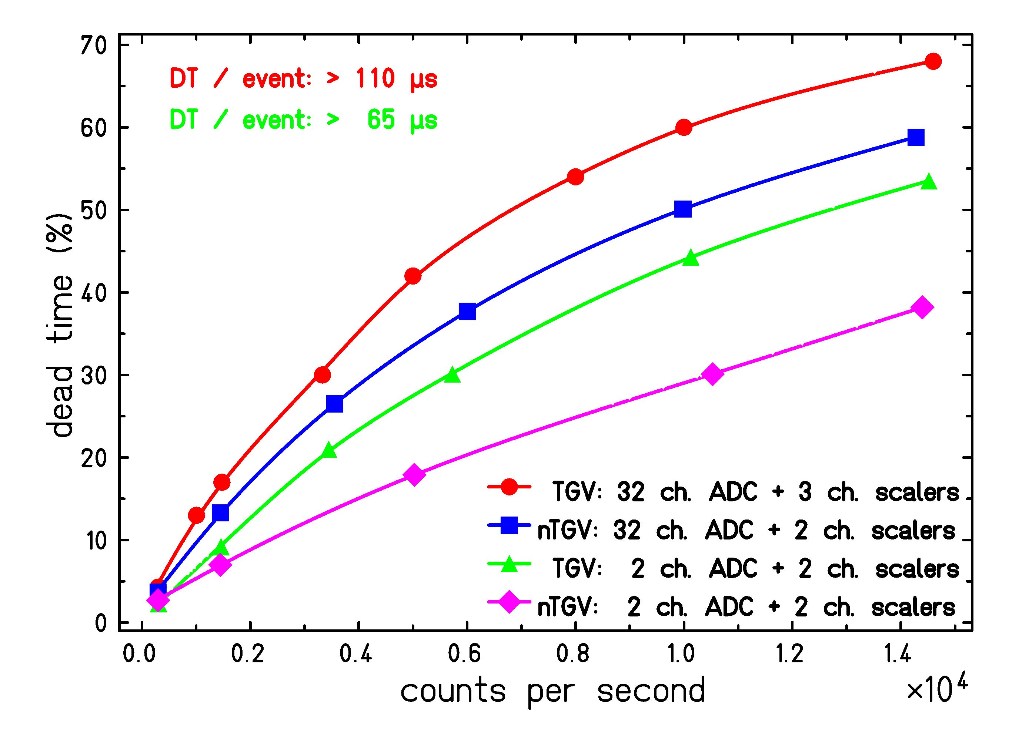
• • • DAQ dead-time

Slide 14
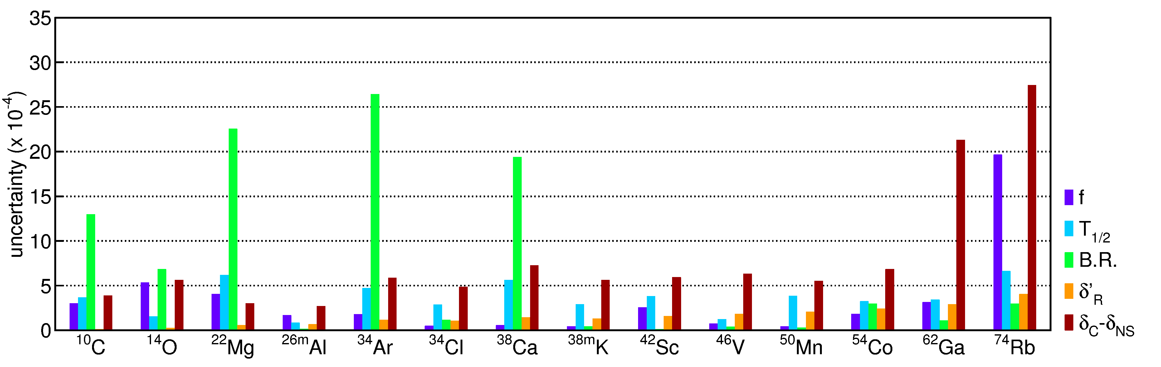
• • • 0⁺ → 0⁺ uncertainties

Slide 15
• • • Fierz term b_{F}
additional term in statistical rate function f: (1+b_{f} * γ₁ / W)
γ₁= sqrt( 1 – (α * Z)²)
W increases with Z
➔ ➔ largest sensitivity for small Z

