Slide 1

VITO status report
M. Stachura
on behalf of the VITO collaboration

Slide 2

Nov 2013 – Jan 2015
  VITO Beamline & End Stations
  Collaboration
  Students & Fellows
  Safety Clearance
  Website
  First experiments
  Schedule for 2015

Slide 3
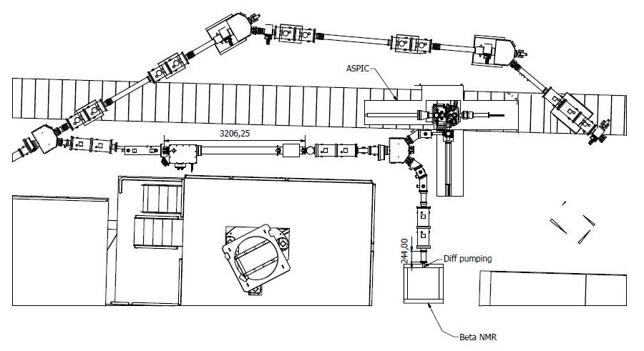
VITO Project
  Goal of the project:
Establish dedicated beam line for experiments using laser-induced nuclear orientation at ISOLDE
Versatile and multidisciplinary experiments (solid state physics, biophysics, nuclear physics etc..)
ASPIC + β-NMR setups

Slide 4
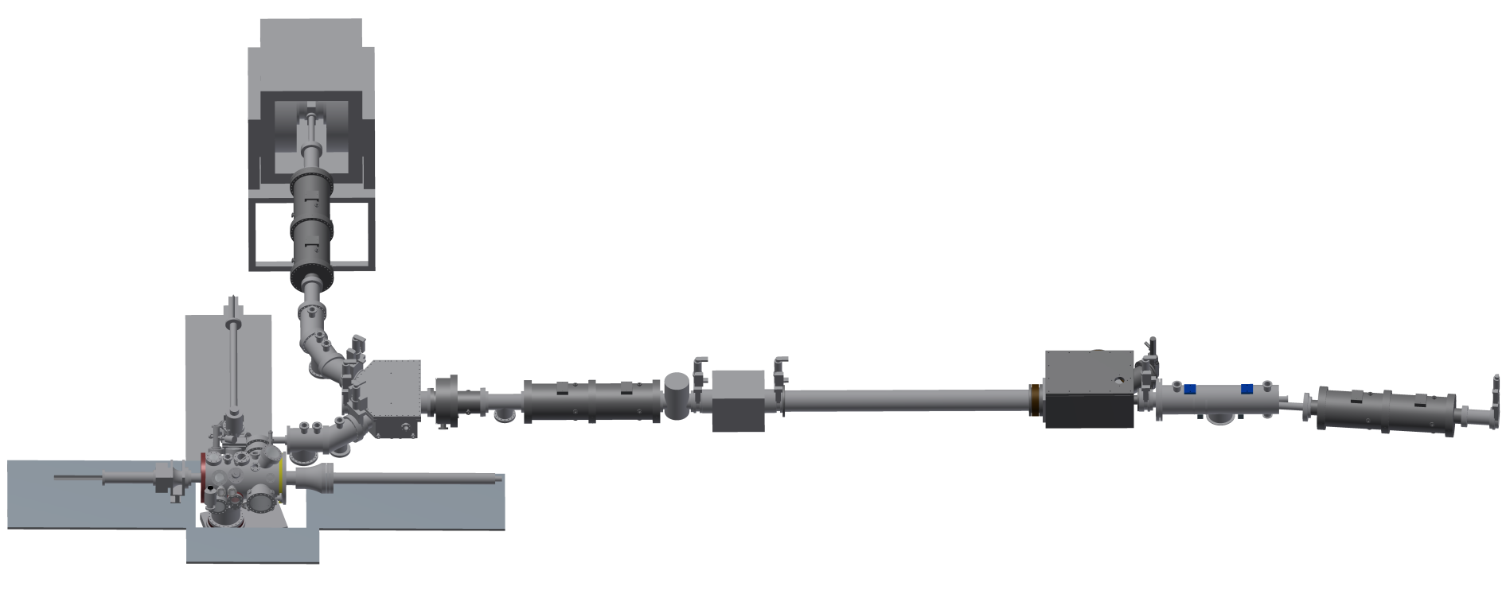
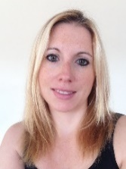
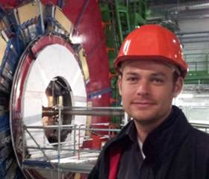
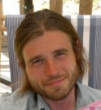
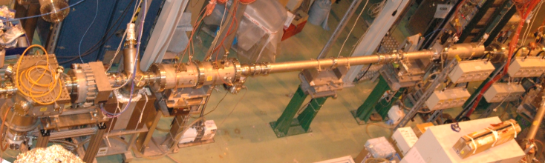
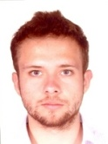
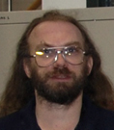
VITO UHV Beamline
β-NMR end-station
5° deflector
M. Stachura
A. Gottberg
polarizer from COLLAPS
ASPIC end-station
M. Bissell
R. Garcia
spacer for the polarizer
M. Pearson

Slide 5
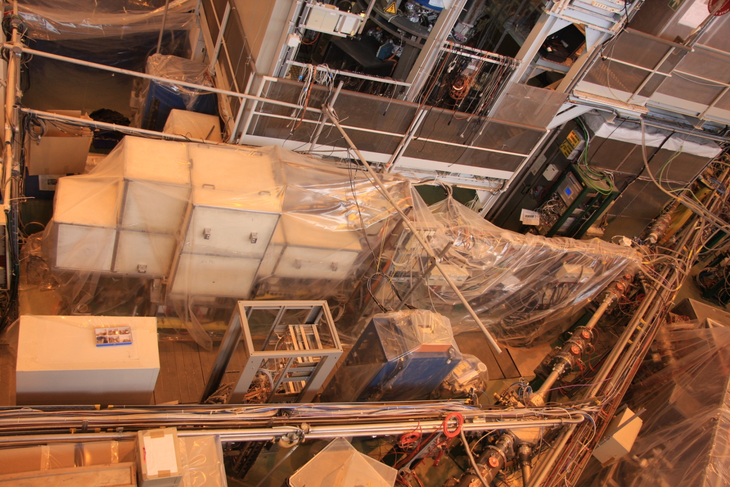
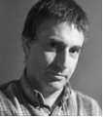
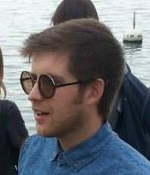
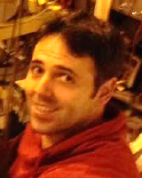
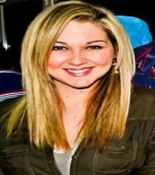
VITO Beamline (March 2014)
A. Gottberg
G. Correia
A. Fenta
A. Costa
L. Pallada

Slide 6
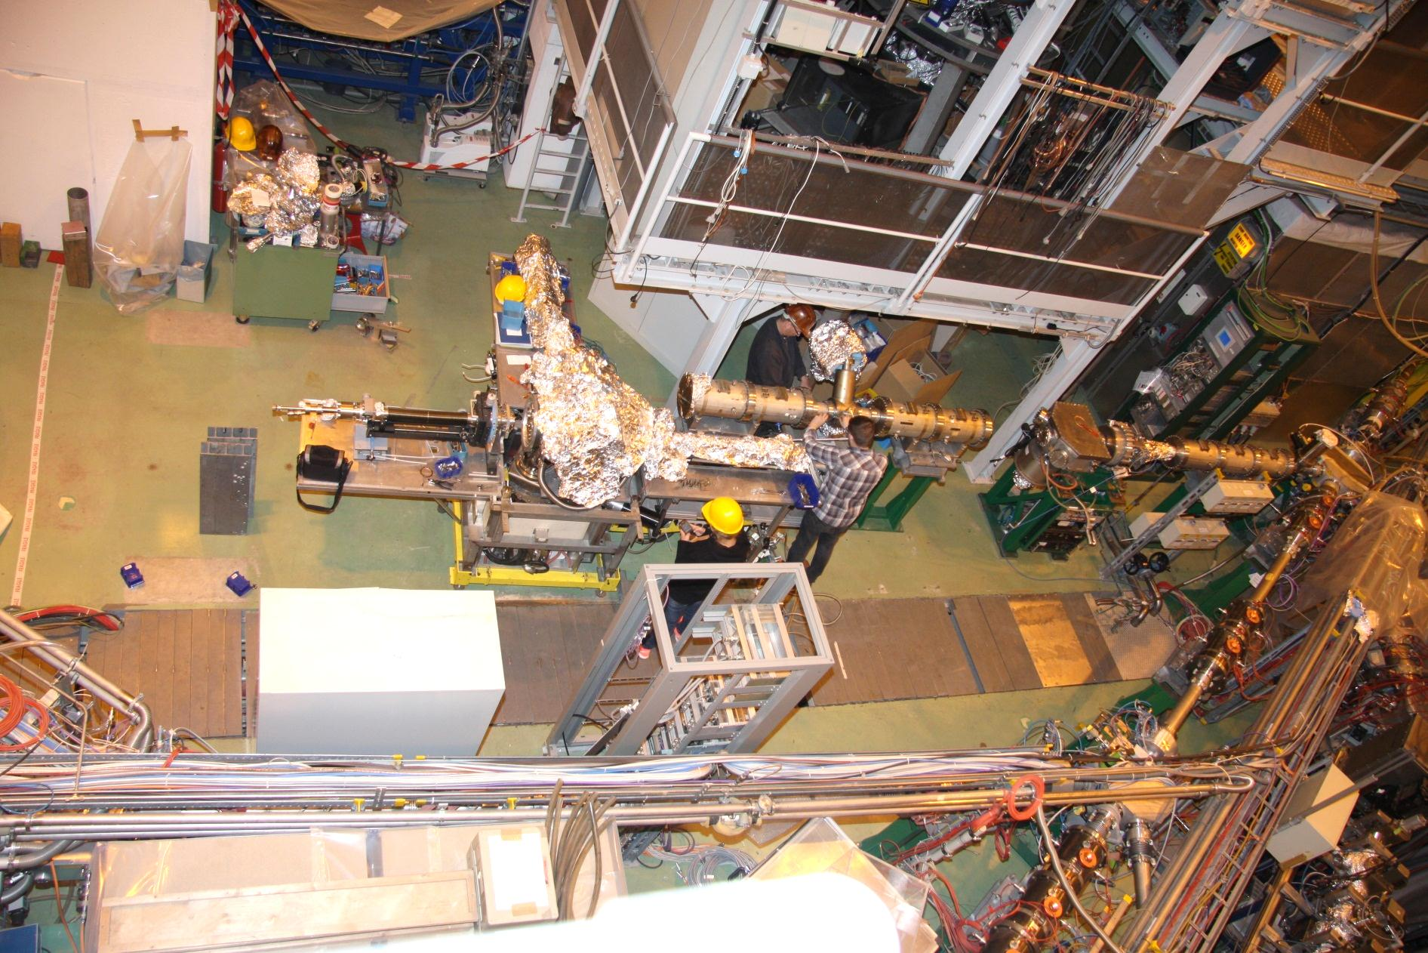
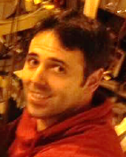
VITO Beamline
A. Gottberg
G. Correia
A. Fenta
A. Costa
L. Pallada
6

Slide 7
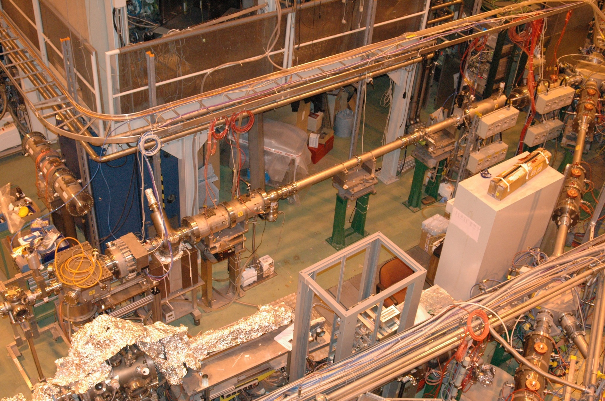
VITO Beamline (November 2014)
A. Gottberg
G. Correia
A. Fenta
A. Costa
L. Pallada
7

Slide 8
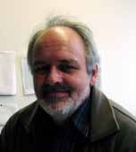
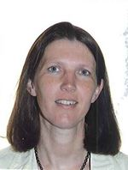
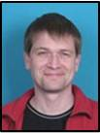

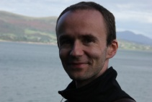
VITO Collaboration
Steering committee:
Members of the collaboration:
Vitor Amaral, University of Aveiro, PT
Mark L. Bissell, IKS Leuven, BE
Joao Guilherme Correia, University of Lisbon, PT
Martin Dehn, University of Munich, DE
Abel Fenta, University of Aveiro, PT
Attila Jancso, University of Szeged, HU
Karl Johnston, University of Saarland, DE
Robert Kiefl, University of British Columbia, CA
Magdalena Kowlaska, ISOLDE-CERN, CH
Andrew MacFarlane, University of British Columbia, CA
Stavroula Pallada, ISOLDE-CERN, CH
Matt Pearson, TRIUMF, CA
Lino Pereira, IKS Leuven, BE
Zaher Salman, PSI, CH
Monika Stachura, ISOLDE-CERN, CH
Natal Severijns, IKS Leuven, BE
Peter W. Thulstrup, University of Copenhagen, DK
Dalibor Zakoucky, ASCR, CZ
Manfred Deicher
University of Saarland Saarbrücken, DE
Gerda Neyens
IKS, Leuven
Leuven, BE
Lars Hemmingsen
University of Copenhagen
Copenhagen, DK
VITO Coordinators and Spokespersons:
Monika Stachura
ISOLDE-CERN
Geneva, CH
Karl Johnston (co-spokesperson)
University of Saarland Saarbrücken, DE

Slide 9
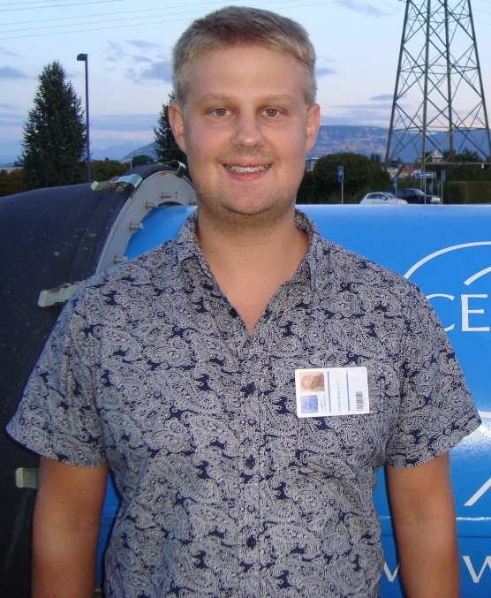
VITO Collaboration
Steering committee:
Members of the collaboration:
Vitor Amaral, University of Aveiro, PT
Mark L. Bissell, IKS Leuven, BE
Joao Guilherme Correia, University of Lisbon, PT
Martin Dehn, University of Munich, DE
Abel Fenta, University of Aveiro, PT
Attila Jancso, University of Szeged, HU
Karl Johnston, University of Saarland, DE
Robert Kiefl, University of British Columbia, CA
Magdalena Kowlaska, ISOLDE-CERN, CH
Andrew MacFarlane, University of British Columbia, CA
Stavroula Pallada, ISOLDE-CERN, CH
Matt Pearson, TRIUMF, CA
Lino Pereira, IKS Leuven, BE
Zaher Salman, PSI, CH
Monika Stachura, ISOLDE-CERN, CH
Natal Severijns, IKS Leuven, BE
Peter W. Thulstrup, University of Copenhagen, DK
Dalibor Zakoucky, ASCR, CZ
New VITO Coordinator
Manfred Deicher
University of Saarland Saarbrücken, DE
Gerda Neyens
IKS, Leuven
Leuven, BE
Lars Hemmingsen
University of Copenhagen
Copenhagen, DK
VITO Coordinators and Spokespersons:
Torben Esmann Mølholt
Monika Stachura
ISOLDE-CERN
Geneva, CH
Karl Johnston (co-spokesperson)
University of Saarland Saarbrücken, DE

Slide 10
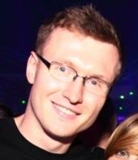
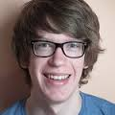
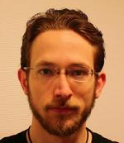
VITO Students & Fellows
PhD students:
MA students:
Stavroula Pallada
ISOLDE-CERN (HERMES program)
supervisor: M. Stachura
Tomasz Wlodarski
University of Science and Technology, PL
supervisor: M. Stachura
Abel Fenta
University of Aveiro, PT
supervisor: G. Correia
Martin Dehn
University of Munich, DE
supervisor: R. Kiefl
Wouter Gins
KU Leuven, BE
supervisors: G. Neyens, N. Severijns
Post docs:
Philippe Velten
KU Leuven, BE
supervisors: G. Neyens, N. Severijns
Monika Stachura
TRIUMF, CA
supervisor: R. Kruecken

Slide 11
Proposals & LoIs
IS582: β-NMR with Mg isotopes (13 shifts)
IS583: β-NMR with Cu isotopes (17 shifts)
IS585: ASPIC graphene (16 shifts)
I147: ASPIC semiconductors (4 shifts)
IS426: ³⁵Ar (15 shifts) (letter of clarification)
IS427: PAC with Cu isotopes (letter of clarification)

Slide 12
Safety Clearance
Safety Files
VITO Beamline – sent to A. Henriques
ASPIC end station – included in the VITO Beamline
β-NMR end station – in preparation
Safety Clearance
VITO Beamline – pre-cleared for running, to be validated within 2 weeks
ASPIC end station – on-going (Torben)
β-NMR end station – on-going (Lina)

Slide 13
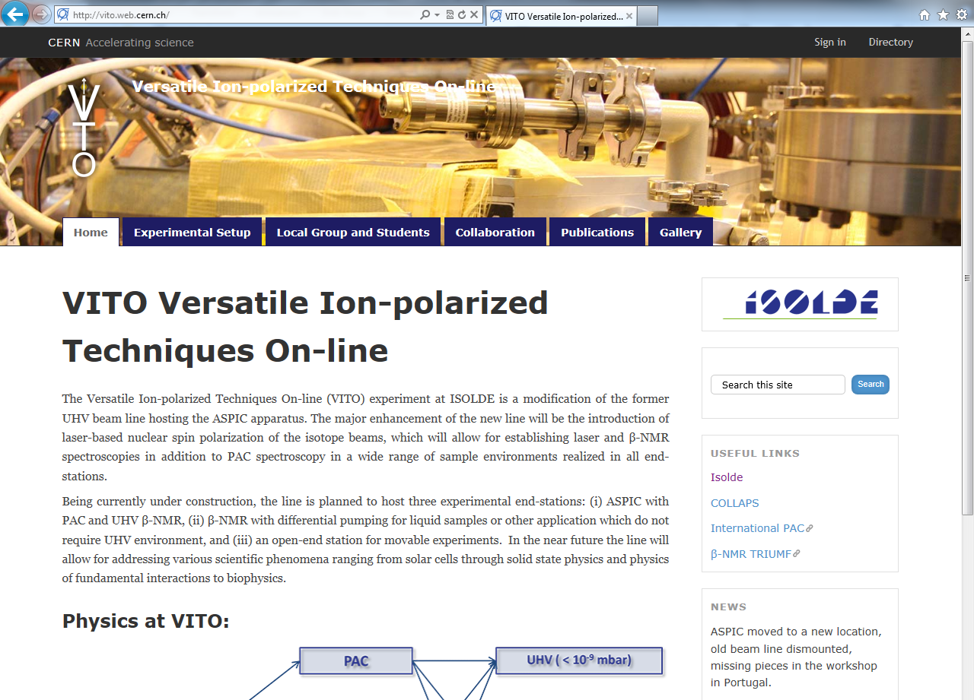
VITO Website (vito.web.cern.ch)
ISCC meeting, 24 June 2014
VITO Versatile Ion-polarized Techniques On-Line

Slide 14
First Stable Beam Tuning (28 Nov 2014)
²⁷Al at 40keV
< 6 hours of tuning (partly manual, partly automatic)
96% of transmission to the last FC on the beamline
Transmission confirmed with a new set of voltages and with stable Cu beam
More stable beam for tuning required in 2015
Localization of the bottleneck on the beamline
Good transmission, now focus on the laser-beam overlap

Slide 15
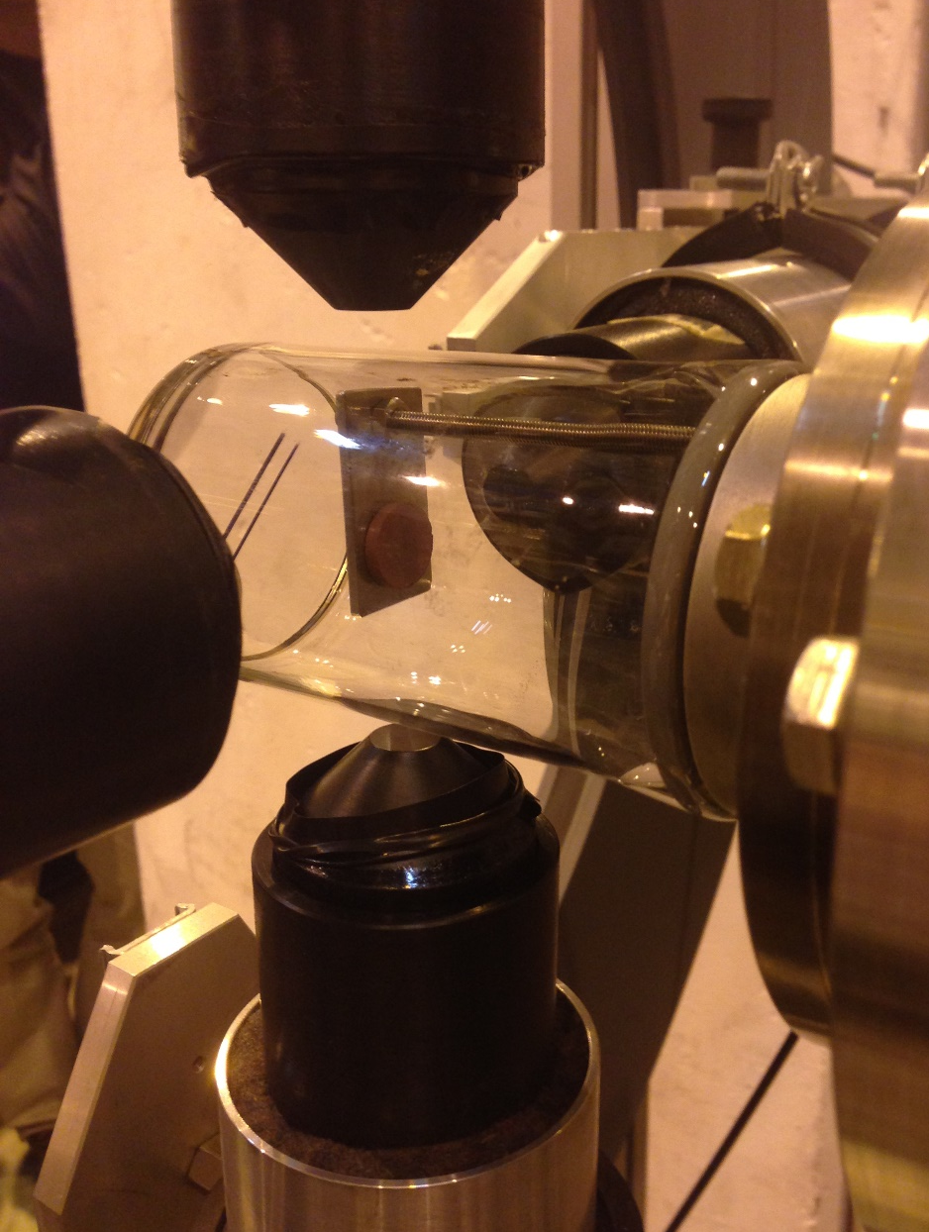
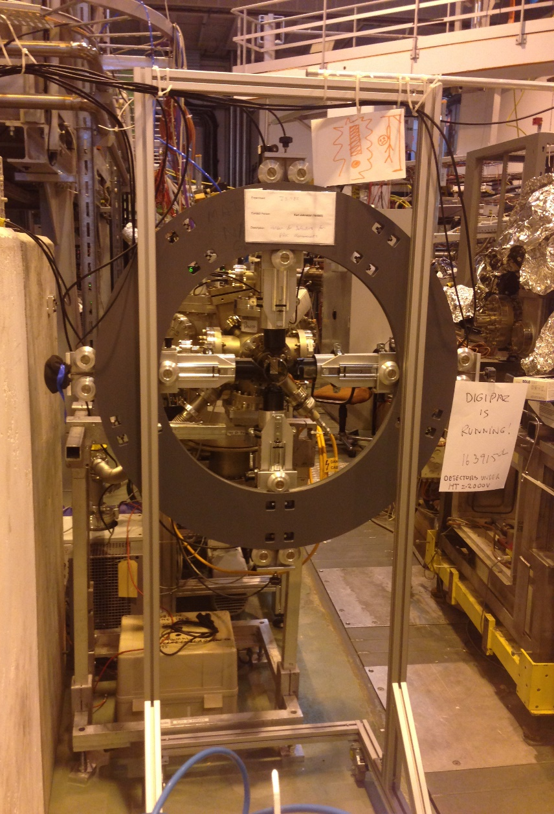
First Radioactive Beam (8 Dec 2014): ^{68m}Cu-PAC

Slide 16
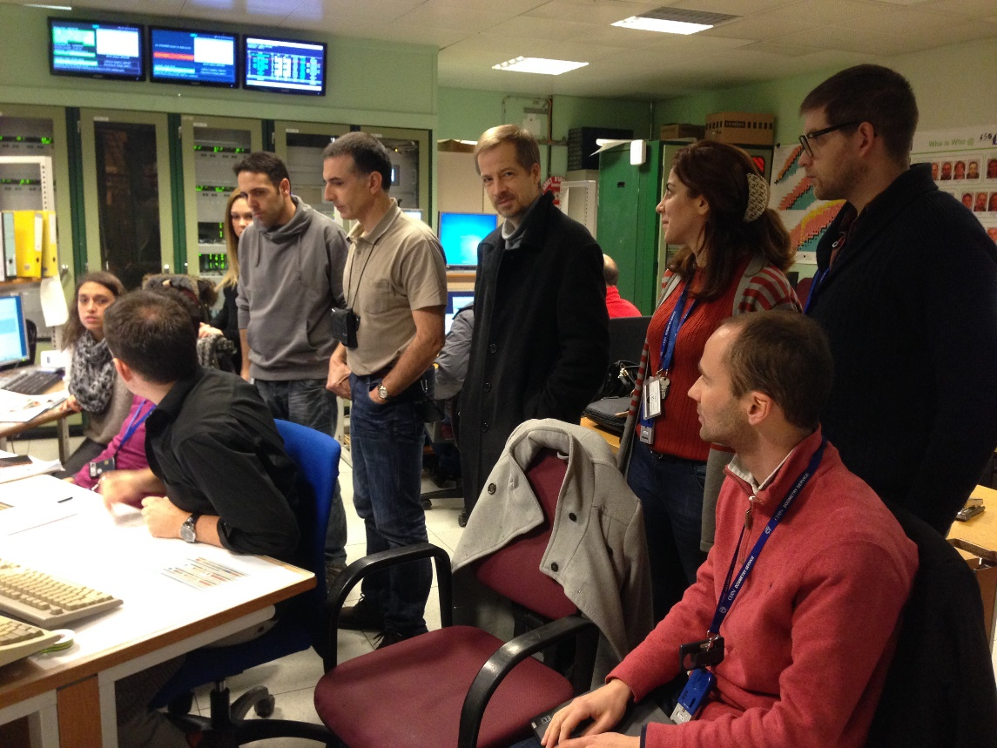
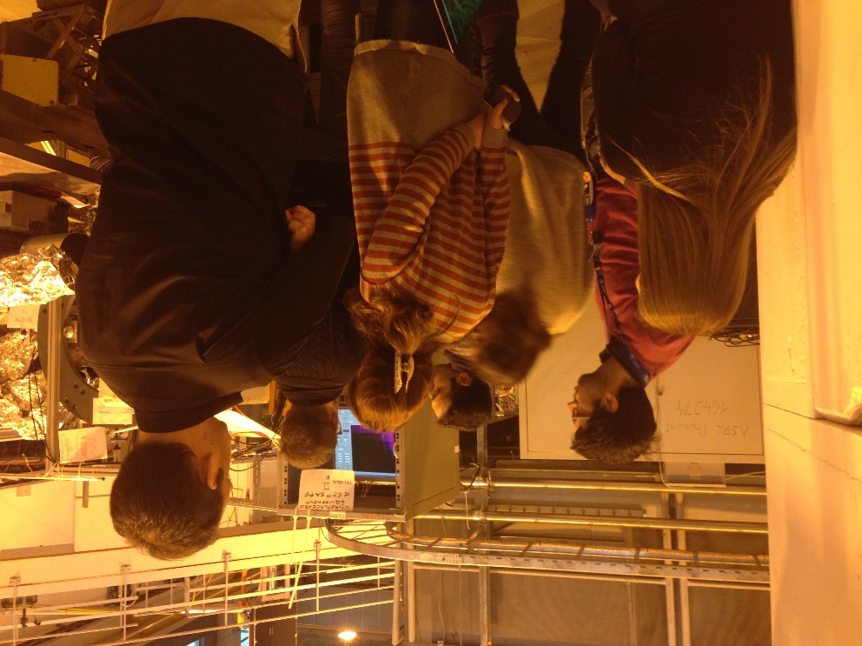
First Radioactive Beam (8 Dec 2014): ^{68m}Cu-PAC

Slide 17
First Radioactive Beam (8 Dec 2014): ^{68m}Cu-PAC

Slide 18
Schedule (Preliminary)
2015
Jan
Feb
Mar
Apr
May
Jun
Jul
Aug
Sep
Oct
Nov
Dec
Safety files, hardware tests,
PAC data analysis
ASPIC maintenance & reconnection
ASPIC ready for experiments!
Setting up the polarization system:
deflectors, lasers from COLLAPS, guiding field, polarization monitor
Setting up β-NMR station
On-line polarization tests
Production of the He-cell
Implementation of the vacuum remote operation system of the entire beamline (ASPIC & β-NMR if possible)
β-NMR experiments (?)

Slide 19
Acknowledgements
Richard Catherall, EN-STI-RBS
Dalibor Zakoucky, WITCH
Miguel Da Silva, CUNHOL
Eleftherios Fadakis, BE-OP-PSB
Michal Dudek, TE-EPC-CCS
Julien Parra-Lopez, TE-EPC-FPC
Mateusz Boruchowski, CERN survey team
ISOLTRAP team
RILIS team
Thank you!

Slide 20
VITO Timeline
Idea of lasers in ASPIC
M. Bissell
A. Gottberg
INTC committee
INTC committee
26.06.2013
23.10.2013
ENDORSED
Technical Review
COLLAPS collaboration meeting
4.09.2013
ISCC committee
APPROVED
29.01.2013
9.07.2013
ON HOLD
Oct 2012
Nov 2012
Dec 2012
Jan 2013
Feb 2013
Mar 2013
Apr 2013
May 2013
Jun 2013
Jul 2013
Aug 2013
Sept 2013
Oct 2013
Nov 2013
ASPIC transfer
ISCC committee
15.07.2013
22.10.2013
APPROVED
Clarifying ASPIC ownership -> exp. work on hold
VITO project on hold (again)
VITO starts
Upgrade, collaboration, physics program

