Slide 1
Reflections “from around the block.”
(Security)
Ian Neilson
GridPP Security Officer
STFC RAL

Slide 2
Reflections “from around the block.”
Who am I?
Where did I come from?
What am I doing here?
Reflective bit in the middle ….
Where might we be going?

Slide 3
Who am I?
“Forgive me but ….”
  Neolithic: commercial scientific programming
    geophysics: signal processing, a.k.a turning tape a.f.a.p
    *nix systems + esoterica
  Bronze age: programming/er management
  Iron age: Security @ CERN/WLCG/EGEE
  Lignin age: bespoke furniture maker
  Present: …….

Slide 4
Where did I come from?
CERN (2002 – 2008)
Don’t mention fabric management tools
LCG/EGEE Security Officer
  Lead OSCT
  CERN CA manager
  LCG VO+DTEAM VOMS services team
  Security Policy Group
  Middleware Security Group
CERN Site Security Team
  Grid contact point
Monitoring Group Co-ordination
  SAM, Nagios framework, AMQ ….

Slide 5
What am I doing here?
UK NGI security team: support and advice to the GridPP Operations Team and the UK Tier1/Tier2 centres
Lead security incident response in GridPP
Represent the UK in the EGI CSIRT and WLCG security operations
Monitor vulnerabilities in collaboration with Operation Centres, Security Incident Response bodies and the EGI Software Vulnerability Group
Advise GridPP and SCD system administrators, middleware and application developers on appropriate action in the event of a security incident and assist in the forensic analysis of security incidents
Prepare and maintain documentation on best security practices
Perform risk analyses and devise appropriate methods for managing identified risks
Collaborate with similar activities in other IT infrastructure projects both nationally and internationally
Participation in the development and maintenance of policy and liaison with international bodies coordinating security policy and operations.
Don’t panic ….

Slide 6
Reflective bit in the middle…
Then
Now
Lots developing/deploying
  OSCT, GOCDB, GGUS, APEL, Policy
The same but different …..
  EGI CSIRT, GOCDB, GGUS, APEL, more Policy!
Vision:
  Middleware “ecosystem”
  Resilience through diversity?
Practice(?):
  Experiment frameworks
  CERNVM “ecosystem”
VMs on the horizon:
    “Great stuff! If something happens we can just throw it away and start clean.”
VMs appearing everywhere:
  “Who endorsed this VM? Do we have the logs?”
  “Has it been patched? Who has root access?”
Maybe pilot jobs + glexec
“GlideIn VMs”
Forecast: sunny intervals
    “Clouds are something to do with Amazon aren’t they?”
Forecast: Federations of Clouds
    “How do I trust this user?”
Log and Accounting Records
Personal Data
  Directive 2002/58/EC on privacy
  and electronic communications ….
Threats: Motivated by ego
  “Because I can.”
Threats: Motivated by $$$
  “Because he’s paying me a lot.”
  Malware frameworks

Slide 7
Where might WE be going?
GridPP already a well organised community
  Build on community support
  Targeted technical training
  Improve communications if necessary
  Improve quality of information where necessary
Incident Handling
  Trust, Information, Process
  Preparation/Tests: simple ticketing -> complex “challenges”
Foster a more secure infrastructure
  Best Practice
    Fabric management
    Logs and monitoring
  Understand, mitigate risks of new models
….. ?

Slide 8
Worth Noting
Incident Handling
  https://www.gridpp.ac.uk/wiki/Report_Security_Incident
Good Information
  https://www.gridpp.ac.uk/wiki/Security_Information
    Including previous presentations
    Lessons from previous Security Service Challenges

Slide 9
  “Security is a process not a deliverable.”
  “Complexity is the enemy of security.”
  “Security isn’t something you add on, it’s something you build in.”
  All authors acknowledged.

Slide 10
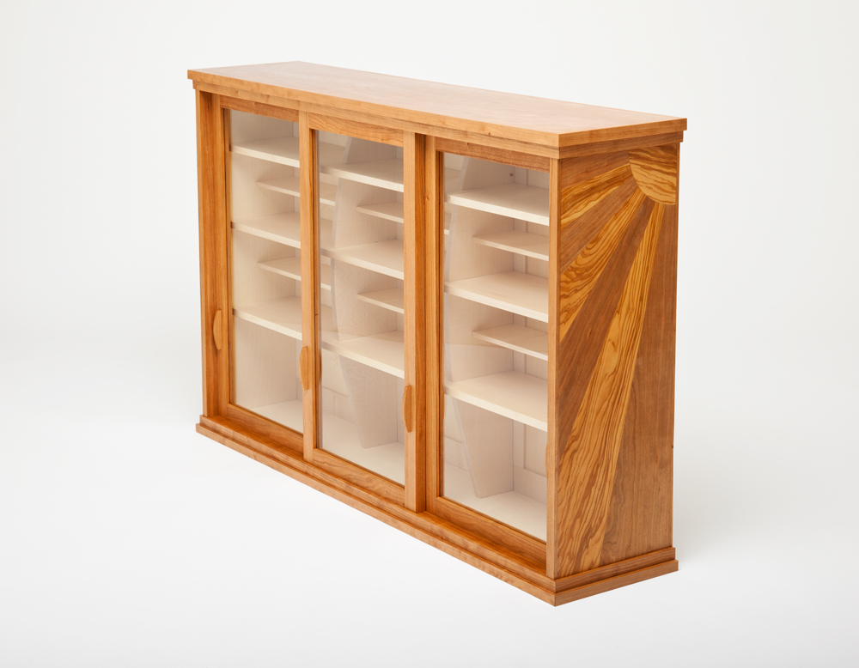
Thank You
Questions?
Ian Neilson

