Slide 1
Review of MDI Parameters
FCC-hh MDI meeting
Jan. 30th 2015

Slide 2
Dec. 2014 MDI Parameters
For the FCC Machine:
L* [25, 40]m
For the FCC Experiments:
L_{peak} [5x10³⁴ , 2x10³⁵] cm⁻²s⁻¹
→ N_{pileup} [150, 600] at 25ns
→ N_{pileup} [30, 120] at 5ns
L_{int} [3, 20] ab⁻¹

Slide 3
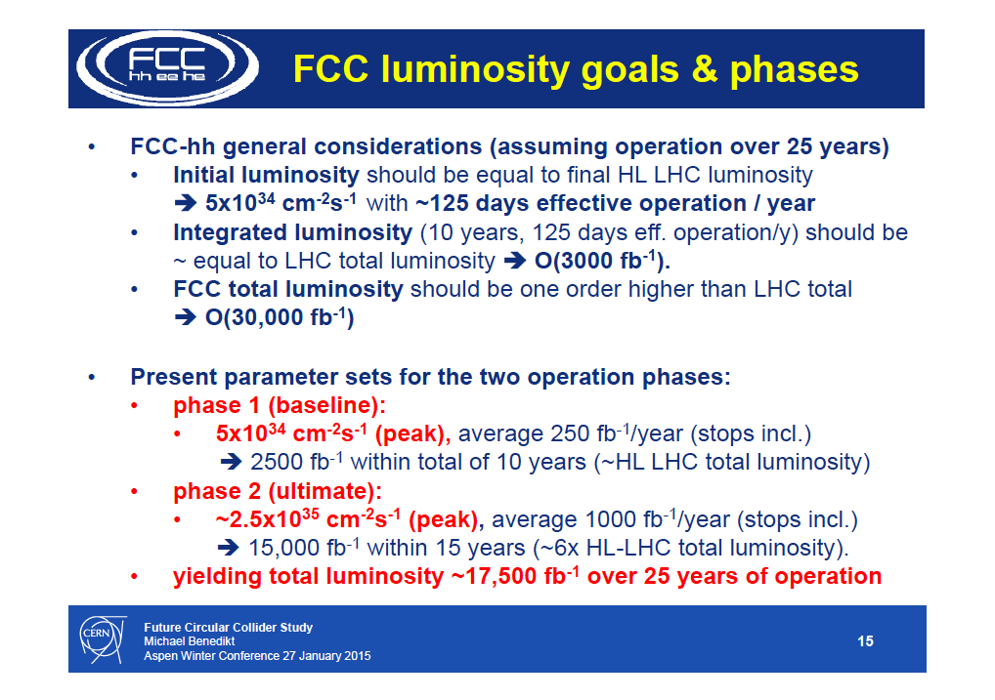

Slide 4
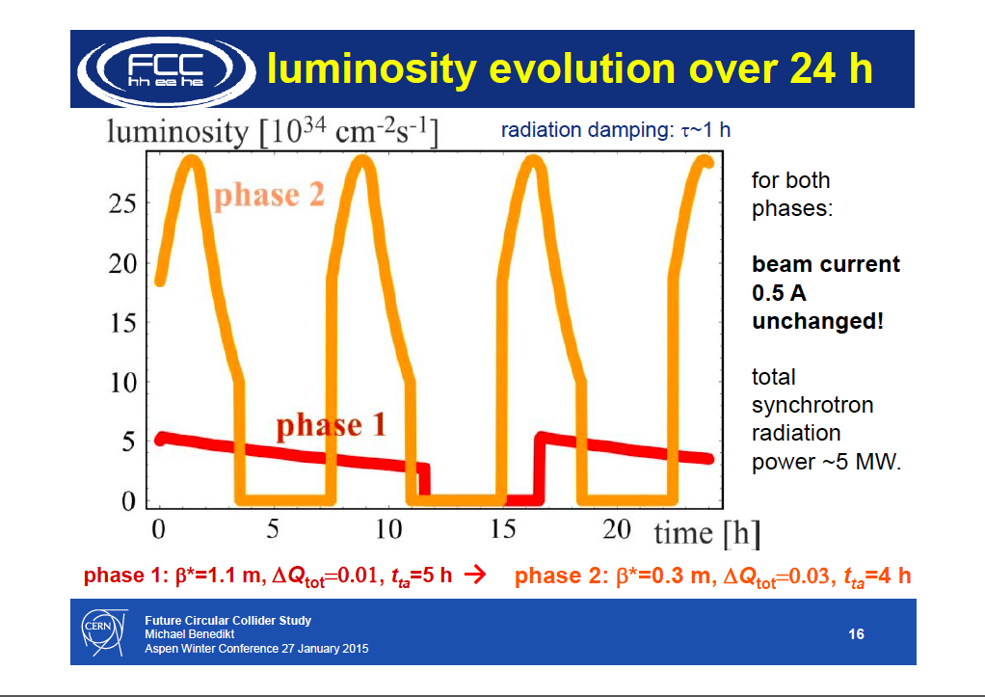

Slide 5
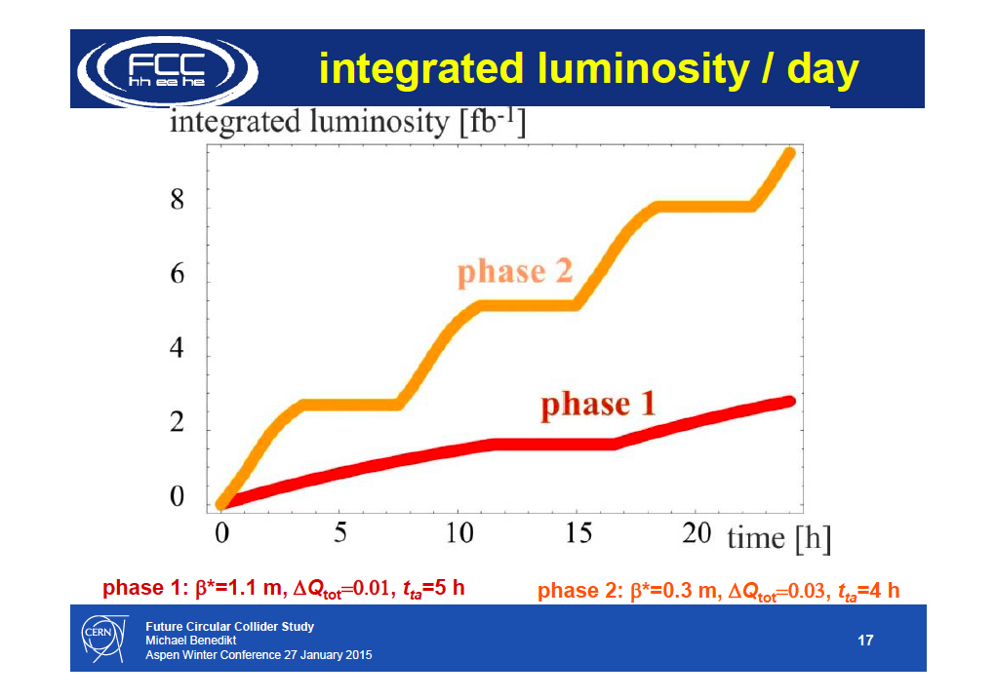

Slide 6
Dec. 2014 MDI Parameters
L* [25, 40]m
The FCC-hh machine was mainly studied for L* around 36m, however they accepted to use these numbers for further studies.
L_{peak} [5x10³⁴ , 30x10³⁴] cm⁻²s⁻¹
→ N_{pileup} [150, 900] at 25ns
→ N_{pileup} [30, 180] at 5ns
L_{int} [3, 30] ab⁻¹
Thes L_{peak} and L_{int} upper and lower numbers should now be seen as [Phase I, Phase II] numbers !

