Slide 1
Summary
Data Practices Report
Peter Wittenburg
Max Planck Data & Compute Center former MPI for Psycholinguistics

Slide 2
Topics for Data Science
Relevance of Data
Trends in Data Domain
Requirements for Data Domain
Data Practices

Slide 3

Why talking about data?
data is the oil driving research and economy
data is key to understanding big challenges
crowd sourcing
observations
conclusions
store
experiments
simulations
combination
analysis
visualization

Slide 4
Why talking about data?
data is the oil driving research and economy
data is key to understanding big challenges
if this is true for most disciplines ...
... can we observe trends?
... can we specify requirements?
... can we correlate with practices?
crowd sourcing
observations
conclusions
store
experiments
simulations
combination
analysis
visualization

Slide 5
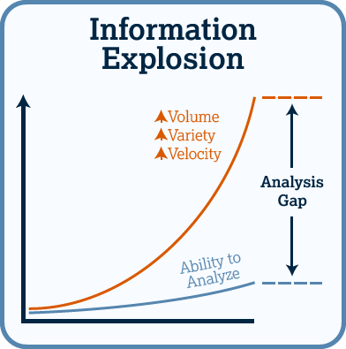
Trends I – 3 Vs
well known:
Volume
Variety
Velocity

Slide 6

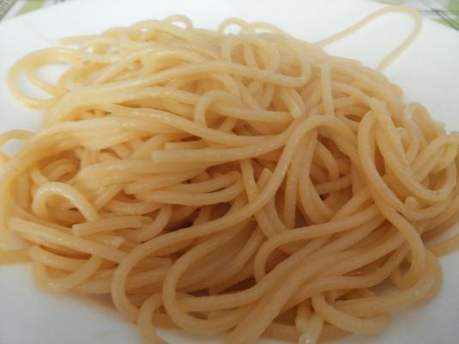
Trends II – Complexity
from simple structures ...
not so often mentioned:
lots of different relationships and dependencies
relationships at data object level and at content level
reproducibility gap
... towards complex relationships

Slide 7
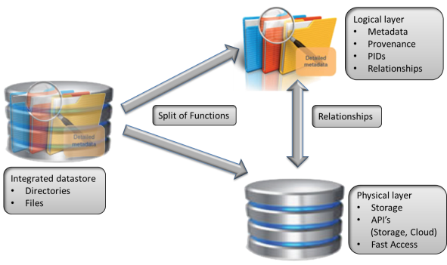
Trends III – Change in Approach
split into Physical Layer to optimize performance
(files, clouds, etc.)
split into Logical Layer to optimize finding, tracing relationships, managing access, etc.

Slide 8

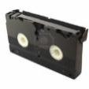
Trends IV - Anonymity
direct exchange between known colleagues
new mechanisms of building trust needed
Domain of Repositories

Slide 9
Trends V – Re-Usage
Domain of
trusted
Repositories
Data will be re-used in different contexts
Data needs to be findable, accessible, combinable and interpretable for others

Slide 10
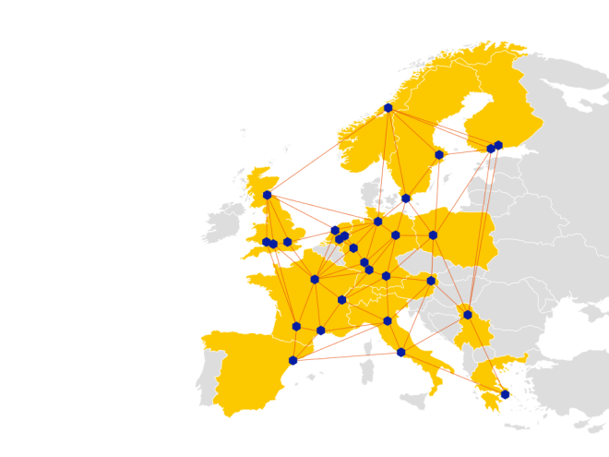
Trends VI – large federations
EUDAT example to
domain of registered data
exchange data
manage and preserve data
bring data close to HPC
and strong clusters
offer improved data services
all across disciplines and countries in EU

Slide 11
Trends VII – large federations in Humanities
one of the
languages
DOBES Example
~70 international teams collaborating + 1 archive
changed culture in community
remote language archives
large data centers with copies

Slide 12
Requirements for Data Science
let’s use the G8 formulations – data should be
  searchable -> create useful metadata
  accessible -> deposit in trusted repository and use PIDs
  interpretable -> create metadata, register schema and semantics
  re-usable -> provide contextual metadata
  persistent -> provide persistent repositories
let’s use the Knowledge Exchange formulations
  promote data sharing norms and standards -> make all explicit
  support services enabling effective sharing -> build infrastructure
  provide a deposit infrastructure -> build infrastructure
  develop flexible access mechanisms -> build infrastructure
  allow linking between publications and data -> use PIDs and citation MD

Slide 13
Requirements for Funders
Naoyuki Tsunematsu (Senior Advisor, JST)
Question 1: what is the value proposition for publically funded research?
  Publically funded research is about stimulating competitiveness
  new strand for competitiveness:
  Knowledge Discovery based on smart data collection
role of funders seems to change:
  build infrastructures to make data visible and accessible
  invest in human capacity
Notes:
one aspect of funding rational – new strand is added

Slide 14
Requirements for Culture
Naoyuki Tsunematsu (Senior Advisor, JST)
Question 2: is culture of sharing a relevant issue?
  need for data exchange (and thus the need for proper data management) are yet difficult to convey in Japanese Science
  parallel trends observed for Japanese Science
    not so often included in collaborations anymore
    not so often represented in the top papers
    decrease in international ranking
  serious worries about counterproductive lack of openness
this concern seems to be relevant for all of us
G8 Open Data Report: UK 90, US/CA 80, FR 65, IT 35, JP 30, DE 25, RU 5

Slide 15
Data Practices I – Commons
many obstacles for sharing (mostly well–known)
  cultural, sociological -> technological
  lacking widely used mechanisms
  lack of proper mechanisms and incentives
  research is about competition & collaboration
even more obstacles for re-using
  often doubted whether useful in particular across disciplines
  Big Data claims are controversial
  lack of trust, information, quality, etc.
  too time consuming frequently

Slide 16
Data Practices I – Survey
~120 Interviews/Interactions
2 Workshops with Leading Scientists (EU, US)
too much manual work or via ad hoc scripts
still creating huge amounts of legacy formats
(no PID, MD, lack of explicitness)
there are positive project examples etc. but ...
  DM and DP not efficient and too expensive
  (Biologist for 75% of his time data manager)
  federating data incl. logical information much too expensive
  hardly usage of automated workflows and lack of reproducibility

Slide 17
Data Practices I – Survey
~120 Interviews/Interactions
2 Workshops with Leading Scientists (EU, US)
too much manual work or via ad hoc scripts
still creating huge amounts of legacy formats
(no PID, MD, lack of explicitness)
there are positive project examples etc. but ...
  DM and DP not efficient and too expensive
  (Biologist for 75% of his time data manager)
  federating data incl. logical information much too expensive
  hardly usage of automated workflows and lack of reproducibility
many researchers can’t participate
pressure towards DI research is high, but only some departments are fit for the data challenges
Senior Researchers: can’t continue like this!
  need to move towards proper data organization and automated workflows is evident
  but changes now are risky: lack of trained experts, guidelines and support

Slide 18
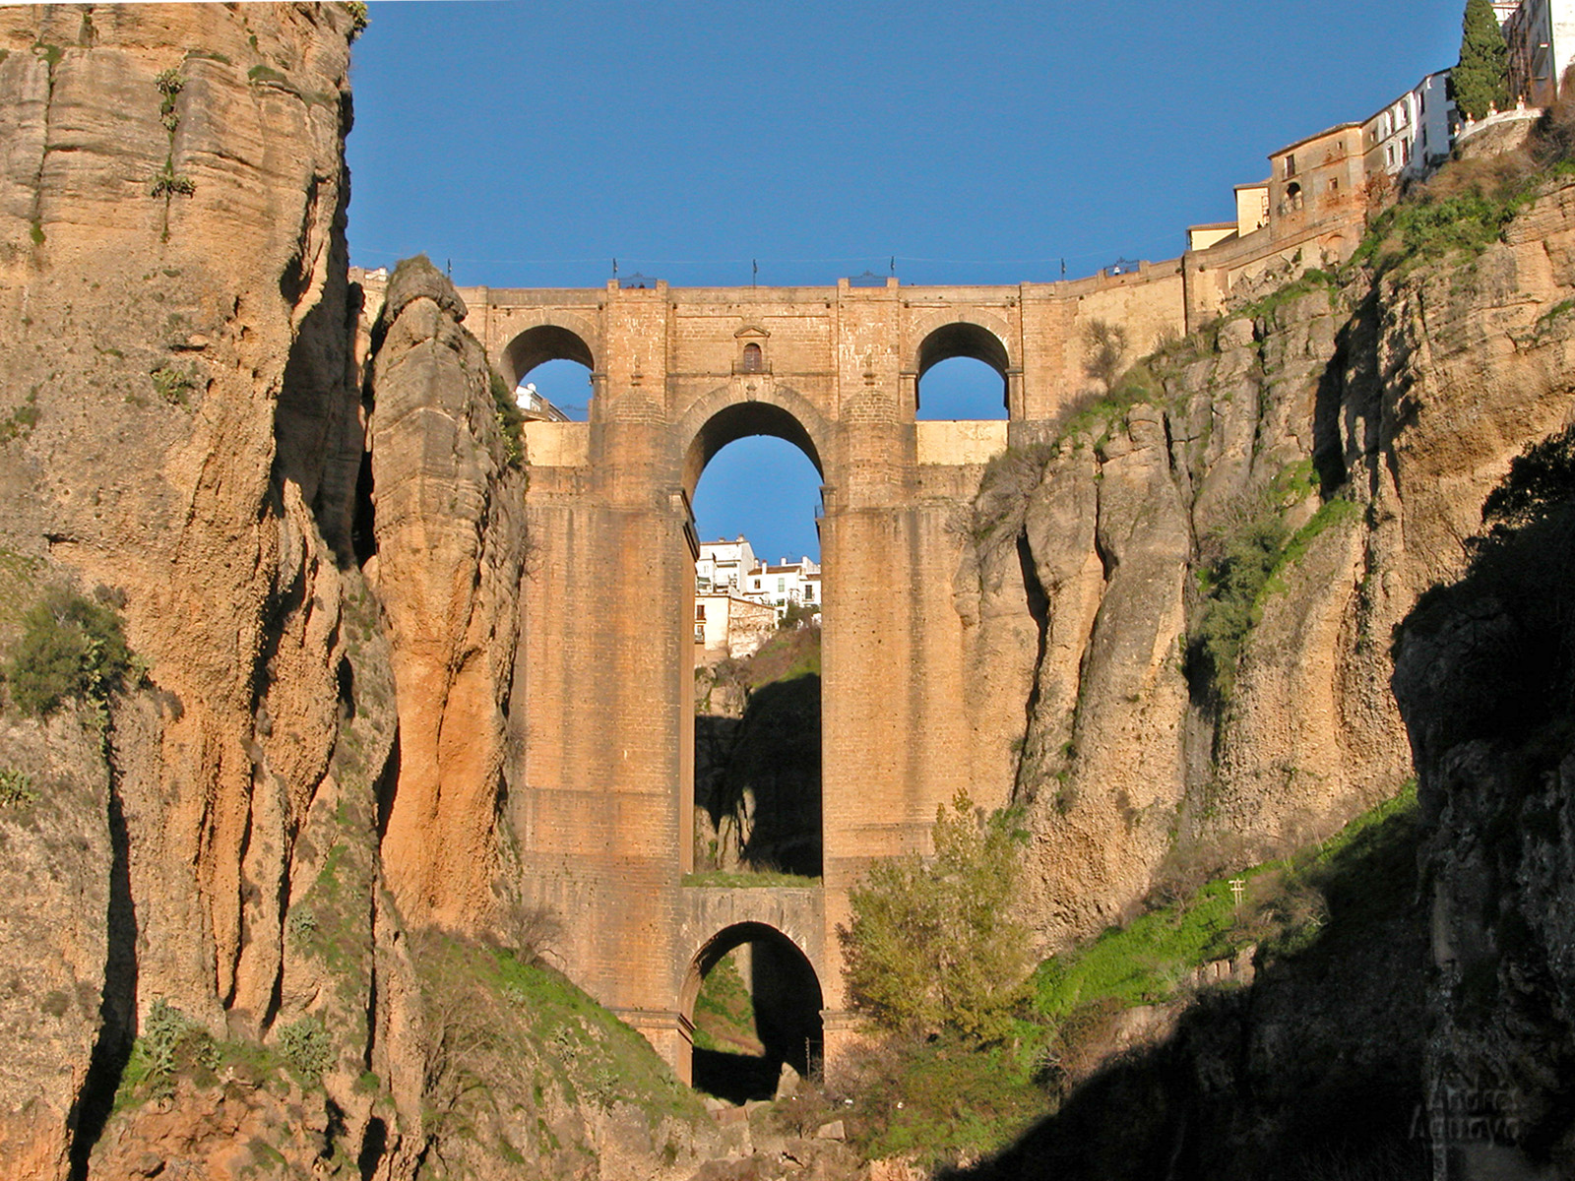
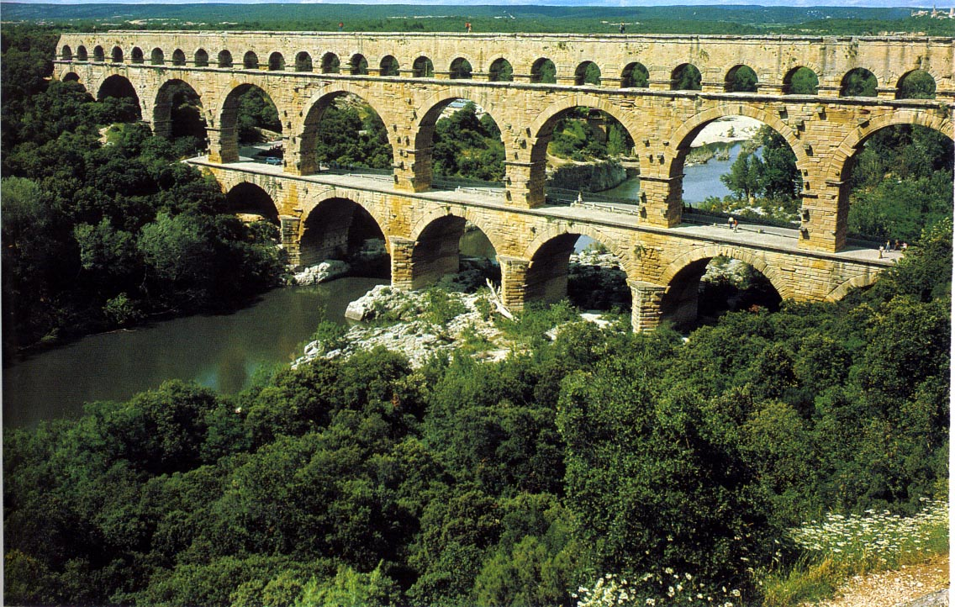
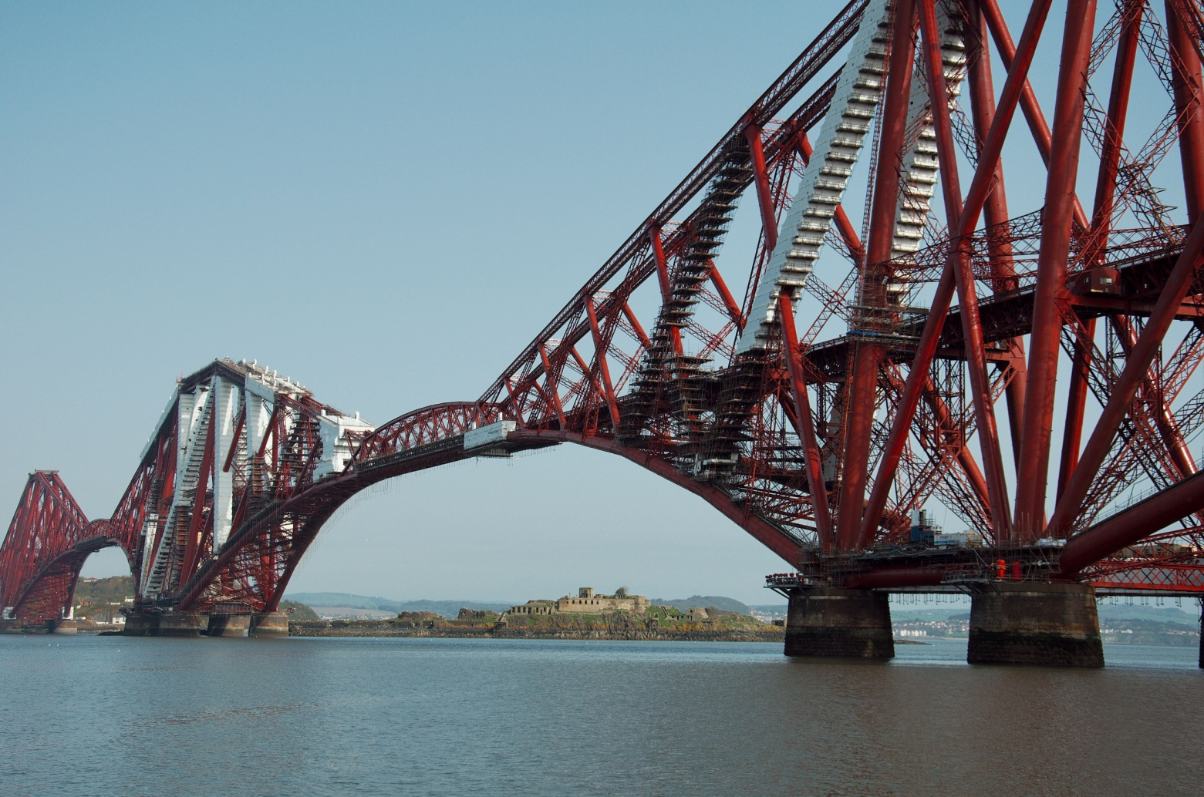
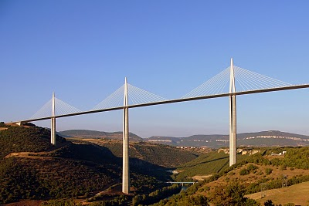
Promiss of RDA
how much time to we have?
15-20 years from TCP/IP to Connectivity
RDA to accelerate processes
  RDA is about building the social and technical bridges that enable global open sharing and re-use of data.
  Researchers, scientists, data practitioners from around the world are invited to work together to achieve the vision
  Funders: NSF, EC, AU, Japan, Brazil, DE?, UK?, ZA?, FI?, etc.

Slide 19
Thanks for your attention.
http://www.rd-alliance.org
http://europe.rd-alliance.org
Next RDA Plenary P6: 23-25. September Paris

Slide 20
Data Practices III – DOBES Example
~ 70 teams, ~ 100 languages
DOBES changed culture
  researchers agreed to deposit and share pre-final versions
  researchers agreed on basic access mechanisms and layers
  researchers started with cross-language analysis work using collections
  agreement on data structuring and metadata principles
  researchers used broadly modern technology
  archivists established archiving principles and technology
  technology all built on Open Standards
  result is a large online data archive with many open resources
all fine?
  NO - could not solve archive sustainability issue yet in a smooth way

Slide 21
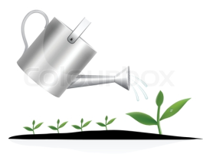
Summary
science is changing and data accessibility will be crucial
trends of working with data requires culture change
currently working with data is inefficient, expensive and mostly non-reproducible
  data intensive science is limited to power institutes
essential components must be persistent
connecting nodes cost 15-20 years
RDA founded to accelerate towards
efficient data science
still RDA is a very young initiative
it is a chance

