Slide 1


JUAS ADVISORY BOARD meeting
Louis Rinolfi
23rd and 24th April 2015

Slide 2
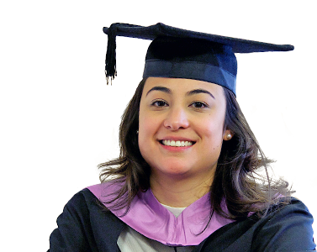


Thanks to
F. Demolis, M. Gauthier, B. Holland, H. Hoffmann, M. Romand for ESI support
M. Bozzo and E. Métral for JUAS Selection Committee
C. Welsch for the organization of this meeting

Slide 4
Welcome
by Carsten Welsch

Slide 5




Welcome to Liverpool !
Prof. Carsten P. Welsch

Slide 6
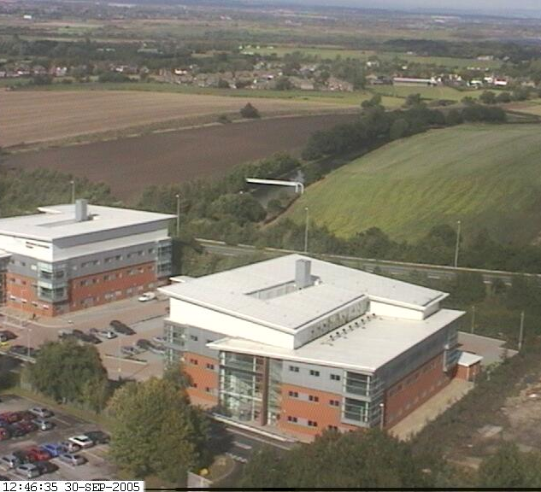
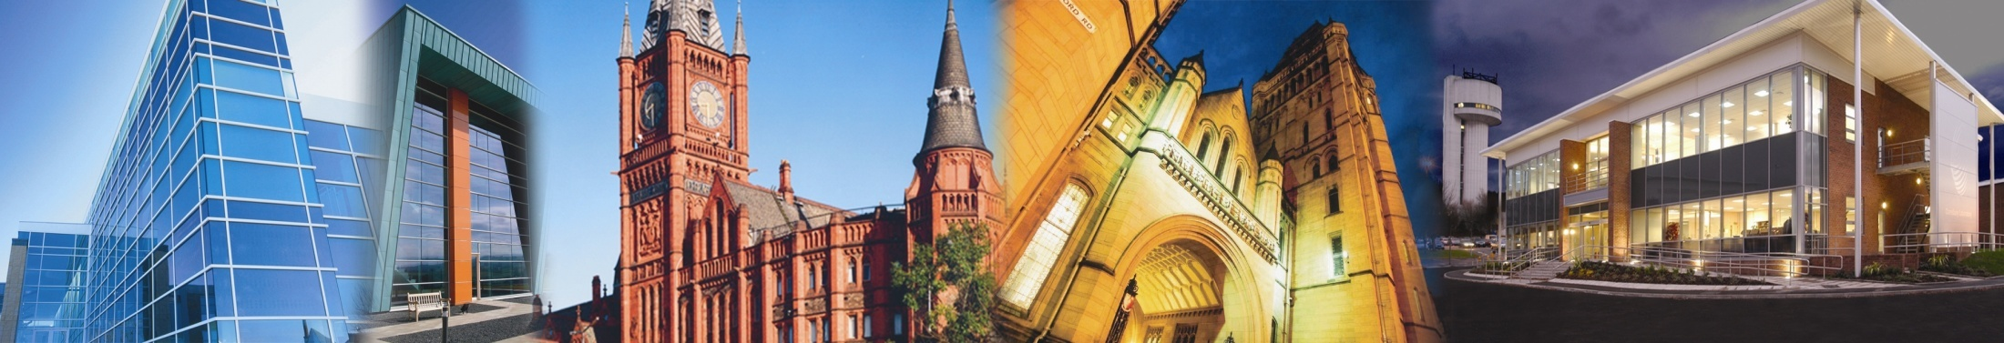




The Cockcroft Institute

Slide 7
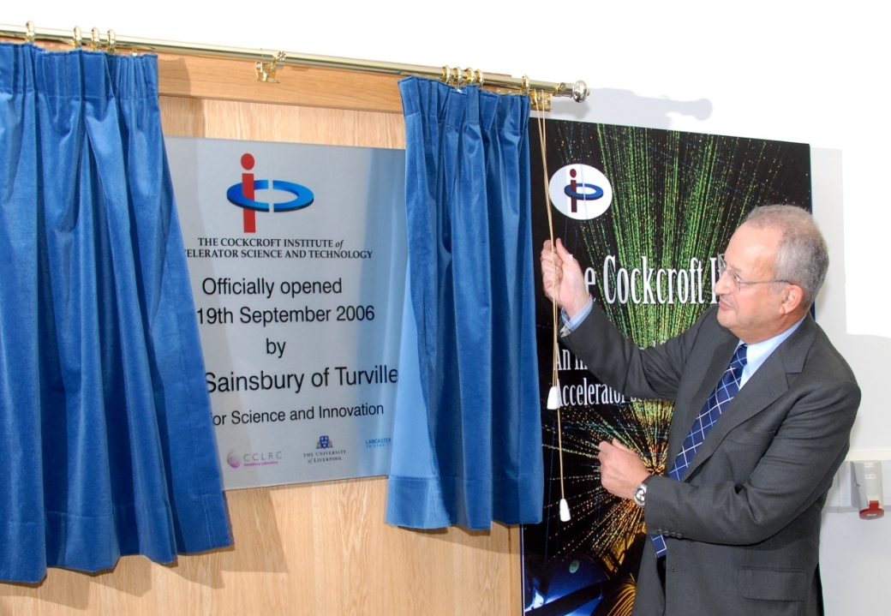
Inauguration in 2006
The Opening of the Cockcroft Institute
by the Minister of Science, Lord Sainsbury
“When we talk about world-class science we need look no further than the North West and the Cockcroft Institute”
- Prime Minister, Tony Blair (2006)

Slide 8
The Mission
Generic R&D at the frontier of Accelerator Science and Technology;
Project-specific R&D in Accelerator Science and Technology;
Leadership and management of national deliverables to international facilities;
Support in design, construction and operation of national and international facilities;
Technology transfer to (and Knowledge Exchange with) industry;
Seamless involvement of the Universities and Research Councils ;
Education and training to ensure a flourishing next generation of scientists.

Slide 9
The Cockcroft Model
(Universities) + (STFC: ASTeC and elements at DL) + (NWDA)
+
(Integration of all the above)

Slide 10
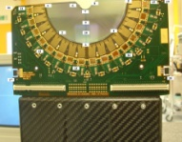
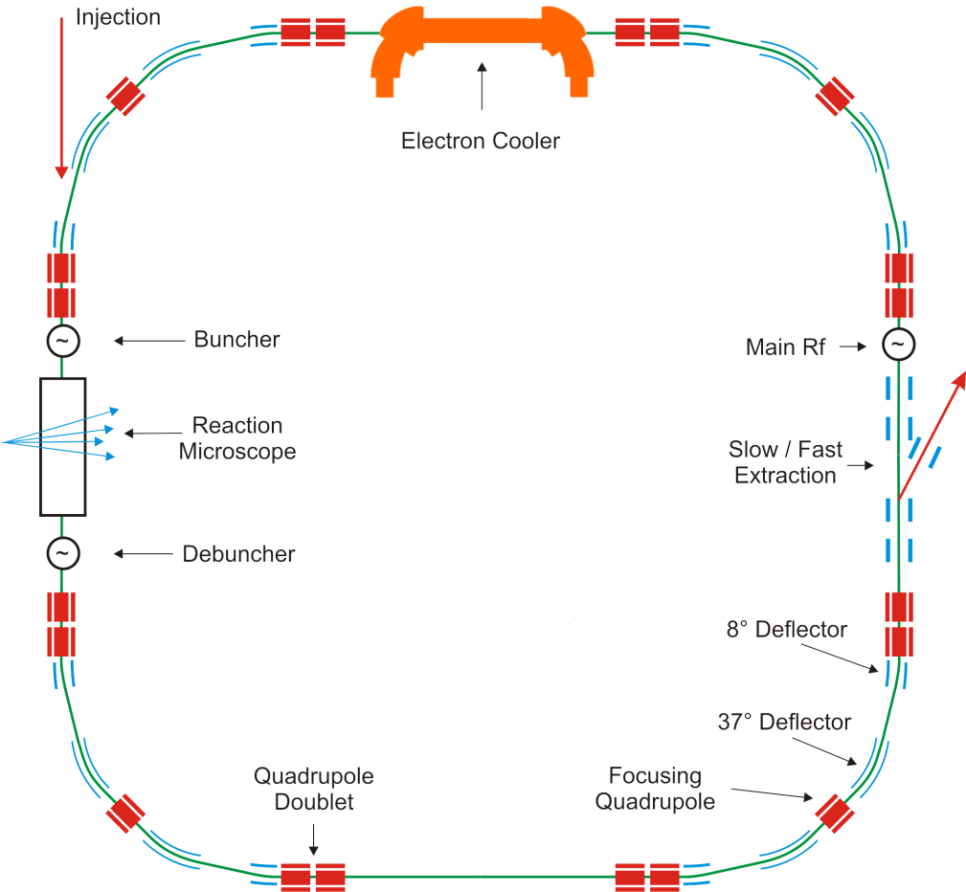
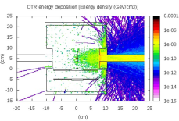
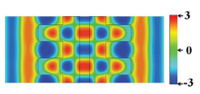
Overview of QUASAR R&D
Diag
medical
lasers

Slide 11
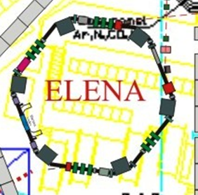
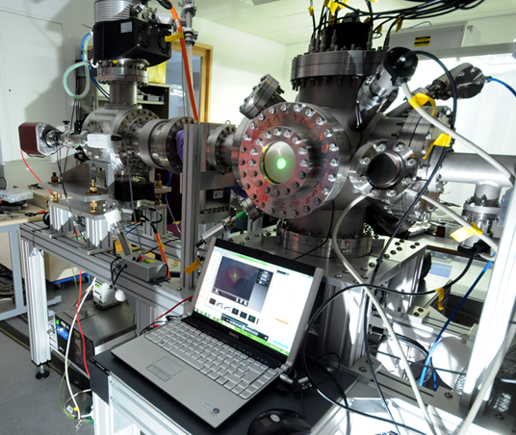

QUASAR Research
Next generation antimatter facilities
  Facility design and optimization
  Beam life time studies
  Beam stability and transmission optimization
  Novel beam diagnostics for exotic beams
  Commissioning and operation

Slide 12
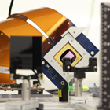
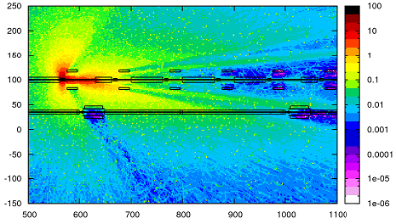
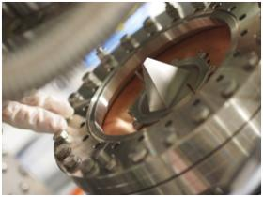
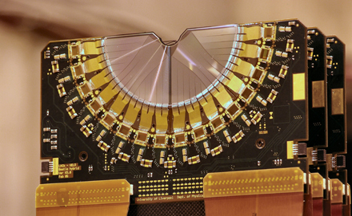
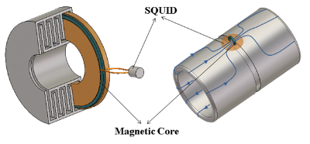
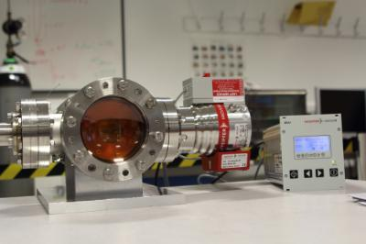
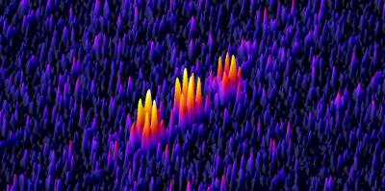
Our R&D into Diagnostics
@Cockcroft Institute and CERN
Excellent lab infrastructure

Slide 13
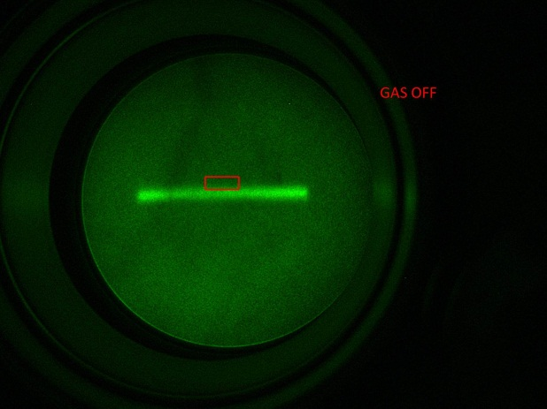
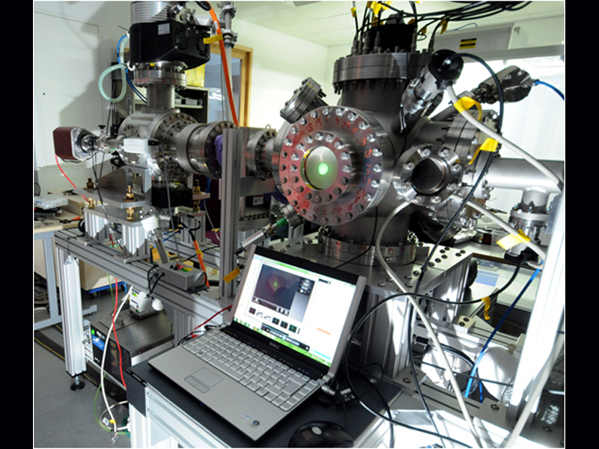
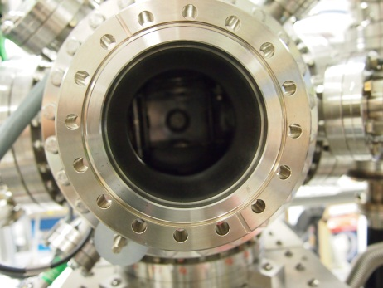
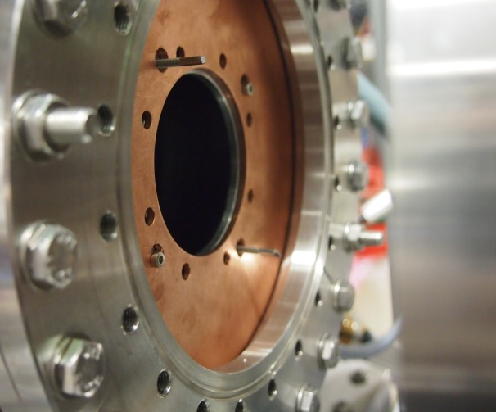

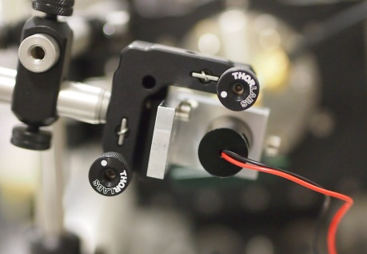
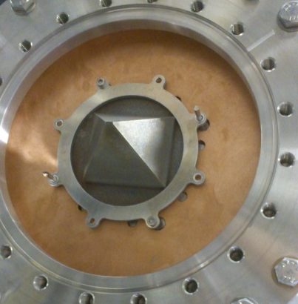
Gas Jet R&D
V. Tzoganis, et al.,
APL 104 204104 (2014)

Slide 14

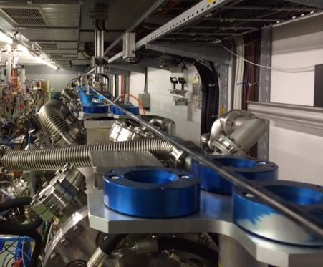
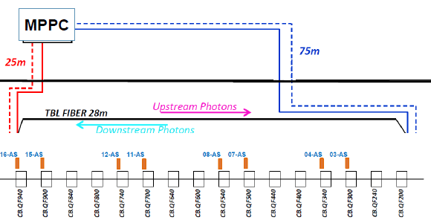
BLMs@TBL
Pure Silica 200 μm core multimode fibre
25 (75) meters of read-out fibre downstream (upstream)
14k pixel 25 μm, 3x3 mm² Hamamatsu MPPCs
Trans-impedance amplifier (opAmp THS3601 GBW 300 MHz) with Rf = 500 Ω

Slide 15

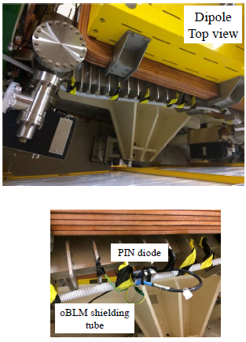
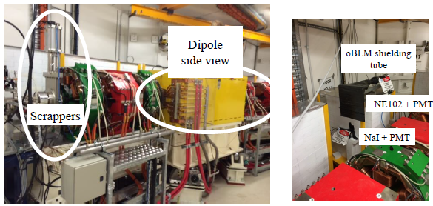
Australian Synchrotron
Installation of several prototypes in the AS
Two (one) 7 m (5 m) optical fibres with 365 μm (200 μm) SiO2 core:
  Multi Pixel Photon Counter (MPPC)
  Photon Multiplier Tube (PMT)
  Avalanche Photon Diode (APD)
Pin diode, NaI and NE102 scintillators in neighbouring locations for comparison

Slide 16
Novel Accelerators
Studies into relativistic and non-relativistic structures ongoing
Multi-parameter studies yielded optimum structure parameters
Measurements planned in close collaboration with CI partners
Computing techniques important basis for future AWAKE work
A. Aimidula, et al., Nucl Instrum Methods Phys Res A (2013)
A. Aimidula, et al., Physics of Plasmas, Vol.21, Issue 2 (2014)

Slide 17

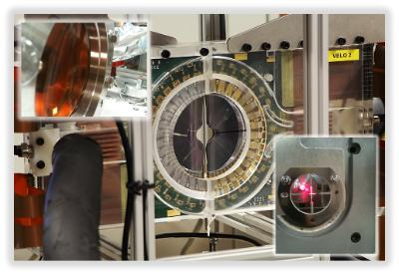
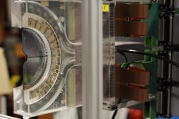
Medical Applications
Clatterbridge Cancer Centre
T. Cybulski, et al., 'A Non-Invasive Beam Monitor for Hadron Therapy Beams‚
Proc. IBIC, Phys. Rev. STAB and Nucl. Instr. Meth. A, in prep.

Slide 18



Training: EU Projects
Initiator and Coordinator of 3 Marie Curie ITNs:
  (2008-2012...)
  4.2 M€, 20 Fellows, 32 partners
  Since 2011
  4.6 M€, 17 Fellows, 35 partners
  Since 2011
  6 M€, 22 Fellows, 34 partners
Largest Marie Curie networks in accelerator community.

Slide 19
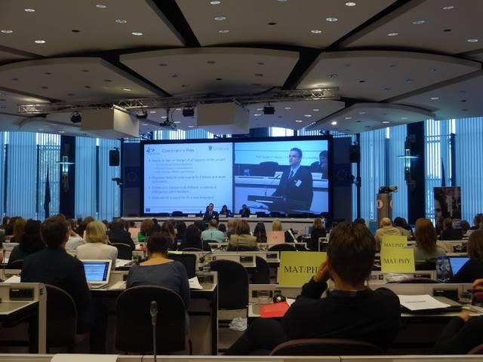
‚Success stories‘ (EC)
Fellow R&D
Researcher skills training
Dissemination and Outreach
Project Coordination & Management
Also recognized as ‚best practice‘ by HEA, UKRO, etc.

Slide 20
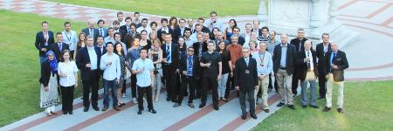
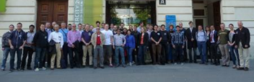
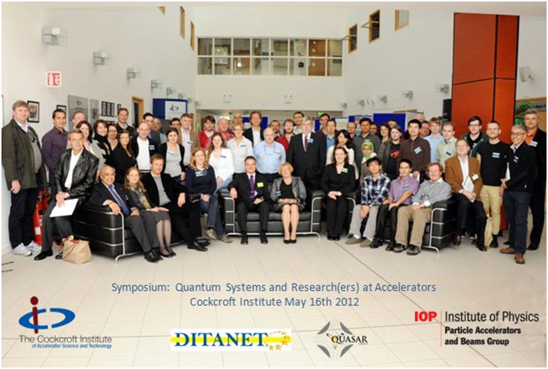
Many International Events
International Schools
Salamanca, London, Stockholm, etc.
Indico: 297045, etc.
~100 participants and lecturers
Topical Workshops
CI, France, Slovenia, Seville, Hamburg, etc.
Indico: 243336, 293158, etc.
70-120 participants
Conference and Symposium
Seville, Mallorca and Liverpool, UK

Slide 21
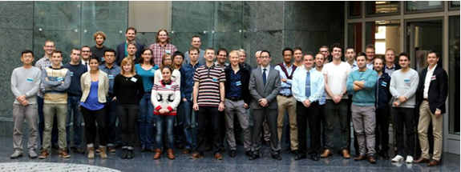
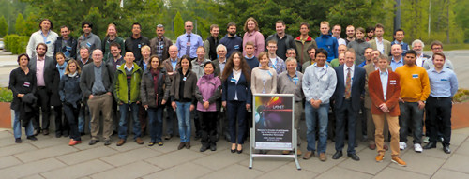
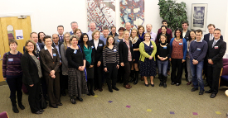
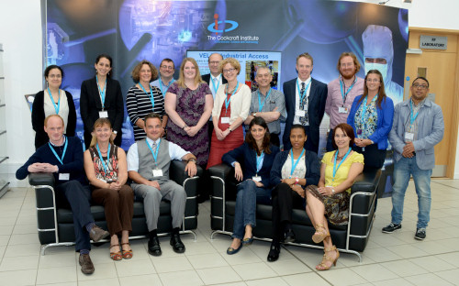
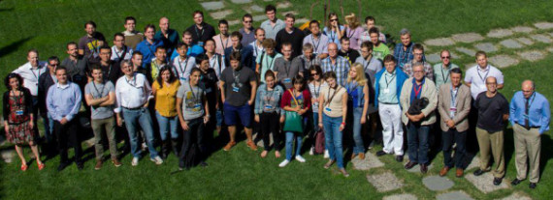
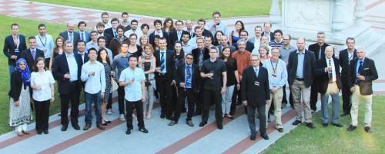
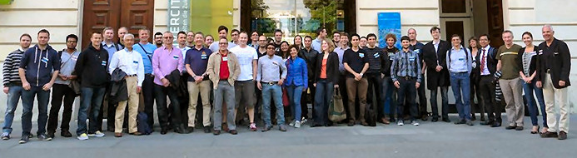
Events led in 2014
Laser Acceleration
HEA Workshop
Scientists go Industry Workshop
EU Project Administration Training Day
Laser Applications School
oPAC School
Beam Diagnostics

Slide 22





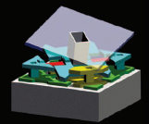



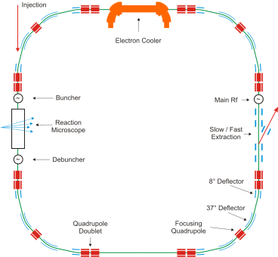

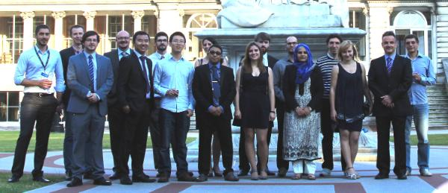
Overview of Activities
www.quasar-group.org
– Adam – Alejandro - Alexandra (2x) – Blaine - Carsten – Eduardo – James – Javier – Hao – Lee – Maria – Miguel – Oleg – Ralph – Ricardo – Rob – Samina - Sehar - Sergey – Tomasz - Vasilis – Vinod – Yelong –

Slide 23
Welcome
by Hans Hoffmann

Slide 24

ESI in a few words . . .
ESI today
    >20 years of thematic schools on scientific tools and methods and their industrial, medical and societal applications: particle accelerators, instrumentation for particle detection, bio-health computing, scientific computing.
    For whom?
Master and PhD students studying sciences, mostly in European universities, and young professionals
With whom ?
CERN and CERN’s network of many hundreds of university institutes, other scientific institutions, university hospitals or medical centres, industrial firms, . . .
    What’s different to other places of formation
      CERN’s scientific approach (collaborative, open, innovative, international) applied to teaching and knowledge transfer
      modular, intensive, state of the art courses presented by specialists
      students and teachers work together in a “campus” environment
Juas
Advisory Committee Liverpool
23-04-2015

Slide 25
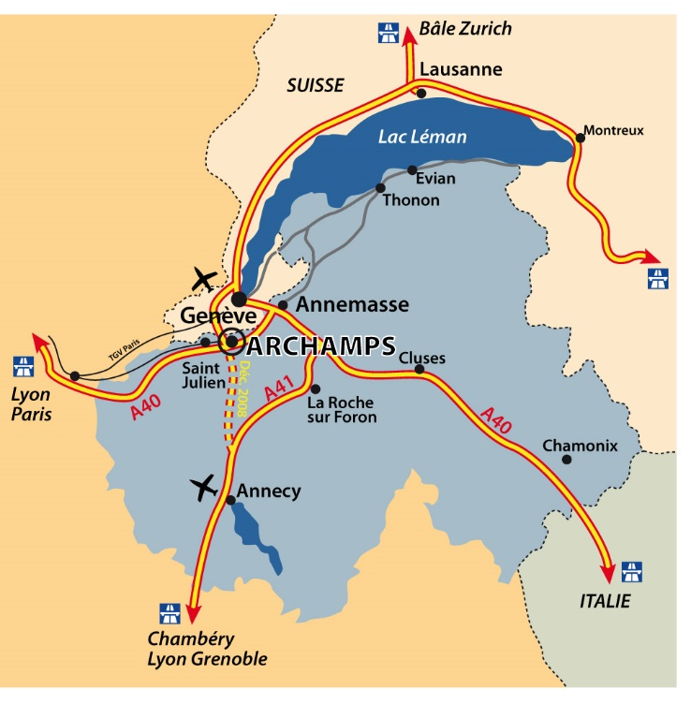
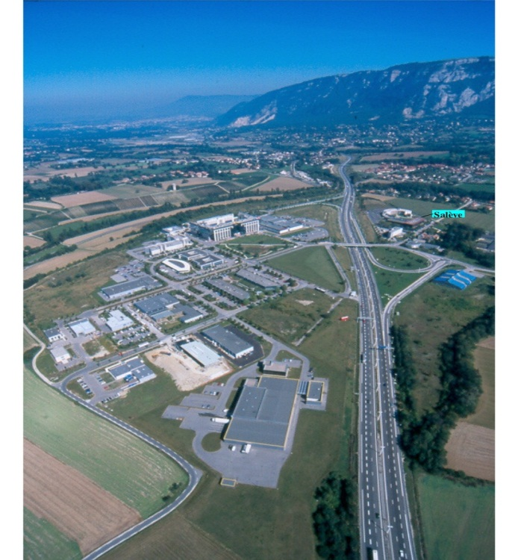
Geneva area
25
Notes:
25

Slide 26
ESI is 17 km South of CERN
CERN
ESI

Slide 27
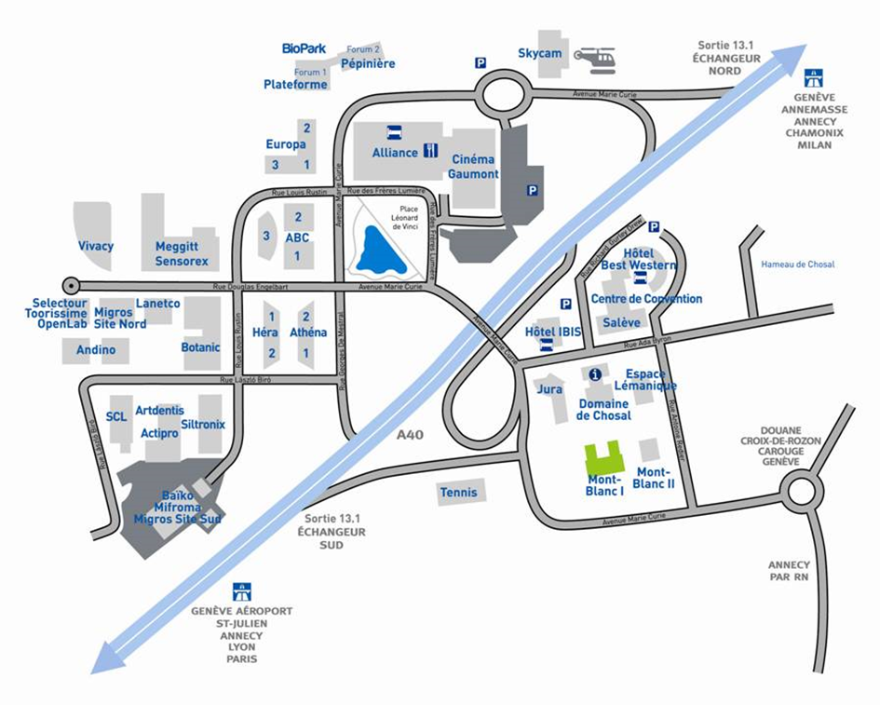
Archamps Technopole area

Slide 28
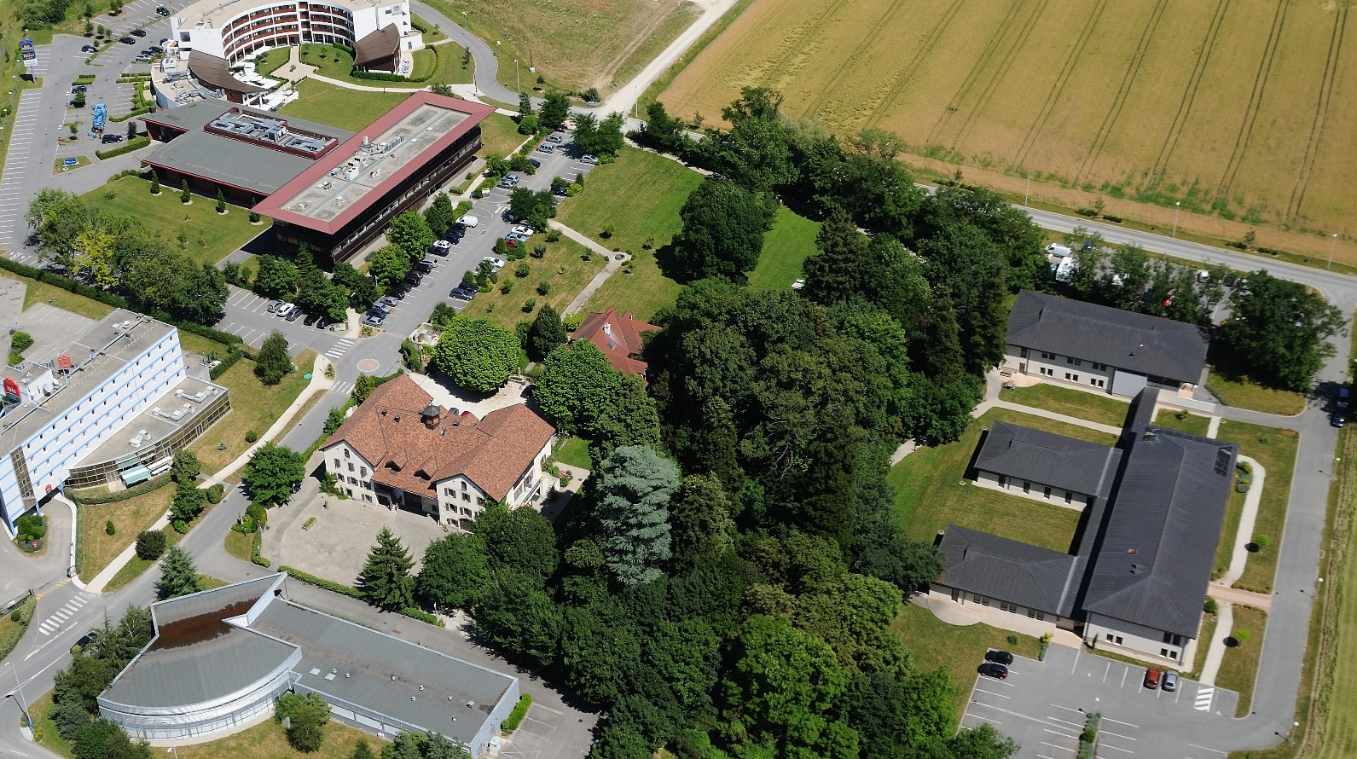
Mont Blanc 1 building
JUAS school

Slide 29

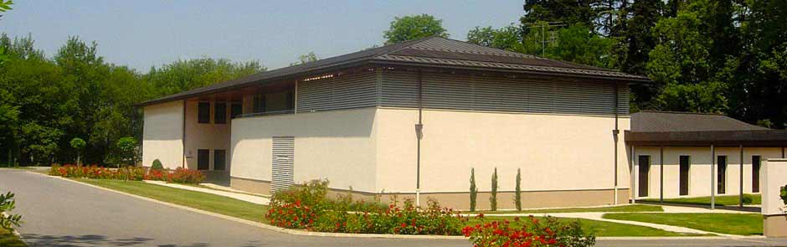
Bâtiment Mont Blanc 1
61 rue Antoine Redier
Archamps Technopole
F-74166 Saint-Julien-en-Genevois Cedex
Tél: +33 4 56 44 81 40

Slide 30


Main sponsors of the
European Scientific Institute (ESI)
The “Conseil Général de Haute Savoie” provides financial support to ESI which organizes JUAS
“Archamps Technopole” provides ESI with facilities for organization of the school including amphitheaters and computing room

Slide 31

  Director : Dr. Louis RINOLFI (ret. CERN)
  22nd edition : January - March 2015
  56 students - 17 nationalities
  16 Master
  15 PhD
  25 professionals
  45 lecturers, inc. 20 from CERN
  15 European partner universities
  (France, Germany, Italy, Spain, UK)
  19 Sponsors (research facilities, companies
  International Advisory Board (hosted in 2015 by University of Liverpool)
  visits to CERN, PSI, Geneva University Hospital, ESRF & practical sessions at CERN, PSI and Bergoz Instrumentation.
Juas
Advisory Committee Liverpool
23-04-2015

Slide 32

  Director : Prof. Johann COLLOT
  (University of Grenoble)
  2nd edition: January - March 2015
  12 students - 8 nationalities
  7 Master
  4 PhD
  1 Professional
  42 lecturers
  University partnership (Grenoble, Strasbourg … Uppsala-Sweden, Helsinki-Finland, Casablanca/Rabat-Morrocco …)
  Guest lecturers for special sessions open to a wider audience
  Visits and practical sessions at CERN
Juas
Advisory Committee Liverpool
23-04-2015

Slide 33

  Director : Prof. Philippe SABATIER
  University of Grenoble
  2nd edition of BioHC summer school, August 2015
  Integrated Medicine for Chronic Diseases
    15 students enrolled in the Erasmus Mundus Master programme
      (France, Spain, Italy, Romania, China, Korea and India)
      Interdisciplinary (biology, mathematics, informatics, medicine)
    12 lecturers from partner universities
    9 intensive days including lectures and group work on complex problem solving around a case study of Chronic Obstructive Pulmonary Disease
    New schools under development : Big Data for Healthy Living; Predictive toxicology for Nanoparticles
Juas
Advisory Committee Liverpool
23-04-2015

Slide 34

  2013-2014 : process of change, no school in 2014
  1. Medical Computing P. Arce, CIEMAT
  2. Diagnostic & Interventional Radiology K. Geleijns, Leiden University Hospital
  3. Non-Ionising Radiation Imaging J. Alger, UCLA
  4. Nuclear Medicine & Molecular Imaging L. Bidaut, University of Dundee
  5. External Radiotherapy U. Oelfke, ICR/Royal Marsden NHS ; B. McClean, Trinity College Dublin
  6. Brachtherapy A. Rijnders, Europe Hospitals Brussels ; A. Carlsson-Tedgren, Karolinska
  Progressively introduce preparation via « distance learning » here: radio-protection manuals from IAEA
Juas
Advisory Committee Liverpool
23-04-2015

Slide 35
ESI investing in the future
    New ESI Website: www.esi-archamps.eu
    New computer room ready for ESMP 2015
    35 PCs – 3 year leasing contract
    Technical support
    Link to virtual machines at CERN for certain software applications
    (External-) Server for other software
Polycom Visio conferencing in meeting room
Available from May 2015
Increase frequency of coordinator meetings at no extra cost
ESI “promotes” a student hostel at Archamps
Juas
Advisory Committee Liverpool
23-04-2015

Slide 36
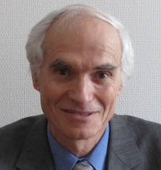
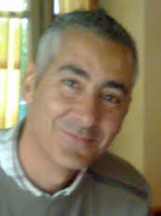




Dr. Louis Rinofli, JUAS Director
Dr. Elias Metral, JUAS Deputy
Marie Gauthier, ESI Administrator
(in charge of relations with lecturers)
Marjorie Romand, ESI Training and Events Manager
(in charge of relations with students)
Filiz Demolis, ESI Administrative Assistant
(in charge of the welcome office)
Dr.Hans Hoffmann, ESI President

Slide 37
JUAS 2015

Slide 38

JUAS 2015 opens Monday 12th January, following the day of the massive French demonstration after the terrorist attack against “Charlie Hebdo” newspaper
Benoit Simony (JUAS 2014 student) drew this picture for us

Slide 39

Brief history of JUAS
JUAS was founded in 1994 simultaneously with ESI at Archamps – Haute-Savoie –
JUAS Directors :
1994 – 2000 : Marcelle Rey-Campagnolle
2001 – 2005 : Joël Le Duff
2006 – 2010 : François Méot
2011 – today : Louis Rinolfi
Close to 130 lecturers have taught at the school since 1994
Close to 900 students have been trained since 1994

Slide 40


JUAS logos
1994 - 2011
M. Rey-Campagnolle / ISN
2011 - 2014
T. Kehrer / CERN
From 2014
V. Guyony / Indélébile Création

Slide 41


JUAS 2014
20th years anniversary
Brochure
Celebration at LPSC - University of Grenoble
LPSC = Laboratoire de Physique Subatomique et de Cosmologie
Friday 25th April 2014
July / August 2014
Article in the CERN Courier about this anniversary

Slide 42
Newsletter
May 2014
Celebrating 20 years of JUAS
Published on 2014-05-21 12:29:00
oPAC Coordinator Prof. Carsten P. Welsch participated in the annual Joint Universities Accelerator School (JUAS) Advisory Board meeting and the special celebrations for the School’s 20th anniversary. Both were held between the 23rd-25thApril 2014 in Grenoble at the Laboratoire de Physique Subatomique et de Cosmologie (LPSC).
oPAC has supported JUAS during the last years and many oPAC Fellows have had the chance to profit from this first class Accelerators School. During the last year oPAC Fellow Michele Carla stood out being one of the best two students in the final exam and winning a grant to visit IPAC’14.
Next year’s JUAS Advisory Board meeting will be hosted by oPAC at the University of Liverpool/Cockcroft Institute.

Slide 43





Slide 44



All presentations are available on the JUAS web site: www.cern.ch/juas
Special thanks to our partners in this event:

Slide 45
JUAS in the French Newspaper
  January - March 2015
Comité bipartite CG74-CERN
26-02-2015

Slide 46
JUAS 2014 Advisory Board
Grenoble University
Photos
Follow-up actions

Slide 47


Dinner at restaurant “Les 2 Savoies” at Grenoble
During the meeting at Grenoble INP

Slide 48
Follow-up actions
Assuming that new seminars could be accommodated in the Timetable, members of the Advisory Board are invited to send to Louis, titles and names (of speakers) for future seminars.
Done
Meeting of all lecturers :
Mauro suggests that all lecturers should be invited to join the discussion of the last day during the examination week with the students.
Done but all lecturers can not be present
Louis decides to try to organize a meeting at CERN. Marie will send a doodle to every lecturers in order to find a possible date.
Done
The lectures notes remains a point not completely satisfying for the students as it is printed in black and white and 4 slides per page, but ESI will look into it in order to improve this service.
=> Done, upgrade to colour materials
Terry suggests to go to EPS (European Physical Society) with the proposal to get budget
=> Done

Slide 49
Follow-up actions
Louis recalls that all lecturers will receive their own marking (with the average per criteria).
=> On going
The question of the opportunity to organize a second JUAS
=> Is ongoing: see Nordic PAS in Summer 2016; see request from Barcelona,….
The members point out the importance of staying in contact with the students after JUAS (former students’ network): ESI is willing to work on this task this year.
=> Ideas to use Facebook, Lindekhin + proposal to use the IPAC repository data base
The members advise to take off the question about written document from the Evaluation Form for the seminars, to avoid a bad mark on this criteria (as they are no written documentation given to the students for seminars).
Not done !
The members ask to obtain in the future a feedback on comments as well.
Job opportunities : Jean-Marie suggests to contact the CNRS secretariat to make sure JUAS is on the distribution list to receive the CNRS open position.
Not done !

Slide 50
Review of Advisory Board members 2015

Slide 51
















France
Germany
15 partner universities
Spain
Italy
United Kingdom

Slide 52
15 European Universities partners in 2015
Universities | Members of Advisory Board | Since
Université Joseph Fourier Grenoble | Jean-Marie De Conto | 1994
Technische Universität Darmstädt | Joachim Enders | 1994
Karlsruher Institut fur Technologie | Anke-Susanne Müller | 1994
Universitat Politècnica de Catalunya | Youri Koubychine | 1994
Universitat Autonoma de Barcelona | Antoni Mendez | 1994
Institut Polytechnique de Grenoble | Elsa Merle-Lucotte | 1994
Università degli studi di Napoli “Federico II” | Vittorio Vaccaro | 1994
Università degli studi di Roma “La Sapienza” | Mauro Migliorati | 1994
Università degli studi di Genova | Marco Bozzo | 2002
Technische Universität Berlin | Heino Henke | 2002
Universitat de Valencia | Angeles Faus-Golfe | 2002
University of Liverpool | Carsten Welsch | 2011
Université Paris-Sud Orsay | Sophie Kazamias | 2012
University of Rostock | Ursula van Rienen | 2013
University of Oxford | Andrei Seryi | 2014

Slide 53
11 representatives from Institutes in 2015
Institutes | Members of Advisory Board
ESI President | Hans Hoffmann
ESI administrator | Marie Gauthier
JUAS Director | Louis Rinolfi
JUAS Deputy Director | Elias Métral
CERN | Bernard Holzer
Oxford University | Chris Prior
ESRF (European Synchrotron Radiation Facility) | Jean-Luc Revol
PSI (Paul Scherrer Institute) | Terry Garvey
GSI (GSI Helmholtzzentrum für Schwerionenforschung) | Peter Forck
DESY (Deutsches Elektronen-Synchrotron) | Winfried Decking
BNL (Brookhaven National Laboratory) | François Méot

Slide 54
Professors and assistants 2015

Slide 55
Professors and assistants 2015 –Session 1
Professors / Assistants | Lecture | Home
P. Bryant | Introduction to Accelerators | Retired CERN
H. Henke | Relativity & Electromagnetism | University Berlin
J.M. De Conto | Particle optics | University J. Fourier
A. Latina / J. Resta Lopez / R. Alemany | Transverse Beam Dynamics | CERN
G. Sterbini / N. Fuster | MADX | CERN / Valencia Uni.
E. Métral / E. Benedetto | Longitudinal Beam Dynamics | CERN
J.B. Lallement / V. Dimov | Linacs | CERN
Y. Papaphilippou | Linear imperfections + Non linear effects | CERN
M. Migliorati | Space charge + Instabilities | University Roma
R. Bartolini | Synchrotron radiations | Oxford University
F. Chautard | Cyclotrons | GANIL
T. Perron | Injection / Extraction | ESRF

Slide 56

JUAS lecturers at the Welcome lunch
Guido Sterbini
Andrea Latina
Elias Métral

Slide 57
Professors and assistants 2015 – Session 2
Professors / Assistants | Lecture | Home
F. Caspers / M. Wendt | RF engineering including superconductivity | CERN
P. Chiggiato / R. Kersevan | Vacuum | CERN
Tommasini / Russenschuck | Magnets design | CERN
T. Zickler / J. Bauche | Normal conducting magnets | CERN
M. Wilson / P. Ferracin | Superconducting magnets | Retired / CERN
P. Forck | Beam instrumentation | GSI - Darmstadt
T. Thuillier | Particle sources | LPSC Grenoble
E. Zimoch | Accelerator control | PSI - Villigen
W. Mondelears | Low energy electron accelerators | Gent university
W. Kleeven | Accelerators for industrial & medical appl. | IBA - Belgium
S. Bousson | High current proton linacs | IN2P3/IPNO - Orsay
R. Miralbell | Therapeutic applications | HUG - Geneva
S. Meyroneinc | Particle therapy and accelerators | Institut Curie - Paris
X. Queralt | Radiation safety | ALBA - Barcelona

Slide 58
Seminars in 2015 – Session 1
Professors | Lecture | Home
U. Amaldi | History of particle accelerators as a tool for discoveries | TERA
L. Rinolfi | Future high energy colliders | CERN / JUAS
Seryi | Sciences and art of inventiveness | JAI / Oxford
R. Assmann | Laser plasma acceleration | DESY
Seminars in 2015 – Session 2
Professors | Lecture | Home
E. Prat | Free electron laser | PSI
M. Steck | Techniques of beam cooling | GSI

Slide 59
Overview of JUAS courses
Session 1 : Sciences and Physics of Particle Accelerators
Session 2 : Technology and Applications of Particle Accelerators
 | Number of professors + assistants | Lectures | Tutorials | Seminars | Total
Session 1 | 21 | 68 h | 40 h | 4 h | 112 h
Session 2 | 21 | 63 h | 21 h | 2 h | 86 h
 |  | Visits (CERN, ESRF, PSI, HUG) | Practical works at CERN | Practical works at BERGOZ | Grand total
Session 1 | 112 h | 8 h | - | - | 120 h
Session 2 | 86 h | 16 h | 12 h | 6 h | 120 h

Slide 60
JUAS students in 2015

Slide 61
Master students in 2015
C1 = Session 1
C2 = Session 2

Slide 62
PhD students in 2015

Slide 63
Professionals students in 2015

Slide 64
Overview of students status
2015 | Masters | PhD | Professionals | Total | Presented exam
Course 1 | 13 | 11 | 12 | 36 | 24
Course 2 | 13 | 6 | 16 | 35 | 18
2014 | Masters | PhD | Professionals | Total | Presented exam
Course 1 | 12 | 19 | 3 | 34 | 30
Course 2 | 16 | 10 | 5 | 31 | 25
2013 | Masters | PhD | Professionals | Total | Presented exam
Course 1 | 13 | 20 | 12 | 45 | 30
Course 2 | 12 | 9 | 18 | 39 | 19
2012 | Masters | PhD | Professionals | Total | Presented exam
Course 1 | 20 | 4 | 13 | 37 | 25
Course 2 | 21 | 8 | 11 | 40 | 28

Slide 65
JUAS students 2015 by countries

Slide 66
2012
2013
2014

Slide 67
Presentation Session 1
Sciences & Physics of Particle Accelerators

Slide 68

Students JUAS 2015 – Session 1
Sciences & Physics of Particle Accelerator

Slide 74



Visit at CERN
Friday 16th January 2015
Programme:
13:00 Lunch at CERN
13:30 Bookshop (if you want)
14:00 Presentation of CERN (L. Rinolfi)
14:45 Film
15:00 Bus start for CMS detector (Point 5 in Cessy)
15:30 Start CMS visit (4 groups)
17:30 End of CMS visit

Slide 75




CLIC Test Facility (CTF3) at CERN
W. Farabolini as a guide
Inside the CLIC Show Room
The 12 GHz accelerating structures
The 120 MeV Linac for the Probe Beam

Slide 76

ESRF at Grenoble
Unfortunately, in 2015, ESRF closed rather early and it was impossible to visit it

Slide 77
EXAMINATION
Each student who gets an average mark of 10/ 20 (or above) can receive ECTS credits recognized by the partner Universities.
There are 5 topics, each of them lasts 1.5 hour:
Session 1: Session 2:
* Transverse Beam Dynamics * RF
* Longitudinal Beam Dynamics * Magnets
* Synchrotron Radiations * Beam Instrumentation
The remaining 2 exams are announced the week 4 and 9 (weeks before the exams)
For each examination, all written documents are permitted and a pocket calculator.
It is strictly forbidden to have an electronic device (iPhone, Portable, etc…) during the exam

Slide 78

Students 2015 during the exam

Slide 79
Presentation Session 2
Technology & Applications of Particle Accelerators

Slide 80

Students JUAS 2015 – Session 2
Technology & Applications of Particle Accelerator

Slide 86




CERN visits
In front of LHC magnet
Inside the Linac 4
Inside the Linac 3 (Ions)
LEIR

Slide 87




PSI visit
The Cyclotron at PSI

Slide 88


HUG visit
Inside the radiotherapy room
Lecture by Prof. Miralbell

Slide 89
New in 2015:
Two practical days at CERN
Thursday 26th February and Friday 27th February
Each student was able to work on 2 different topics to be chosen between: RF, Magnets, Vacuum, Superconductivity

Slide 90




Practical days at CERN: RF group

Slide 91




Practical days at CERN: Magnets group

Slide 92




Practical days at CERN: Vacuum group

Slide 93




Practical days at CERN: Superconductivity group

Slide 94
Practical day
Bergoz
Wednesday 11th March 2015

Slide 95



Practical day at Bergoz
Goubau Line
Soldering printed circuits for a Wi-Fi meter

Slide 96

Reports from students

Slide 97
JUAS certificates

Slide 98

JUAS certificate of examination
for session 1
Each student who obtains a mark equal (or above) to 10 / 20 received such certificate

Slide 99

JUAS certificate of attendance for session 1
Each student who followed more than 90% of the course received such certificate

Slide 100
European Credit Transfer System (ECTS)
Students passing the exam of:
- Session 1 (“Physics of Accelerators”)
- Session 2 (“Technology of Accelerators”)
can receive ECTS credits from their universities

