Slide 1
500 MSPS status

Slide 2
Outline
Roadmap up to now
RF-distributor
ADC board
VFC-HPC integration
  The JESD204 Rx block
  Results
Commercial options
Summary

Slide 3
Roadmap up to now
From simulations:
  ~17 ns Gaussian pulse
  500 MSPS, ENOB ~ 10.5, DC coupled
  To get an accuracy < 1% for
Market survey => FMC-500 from Innovative, but the board never existed…
Decide to move to a development board from AD with the AD9680 ADC => AD9680-EVM:
  300 MSPS – 1 GSPS
  ~10.8 ENOB (@ 10 MHz)
  AC coupled
  Serial JESD204 data transmission
  Received by mid November
Signal conditioning needed to tune the signal timing and work with safe voltage ranges for the sampling system => Rf-Distributor board

Slide 4
RF-Distributor
ADC-FMC outputs:
  Non reflective Gaussian filter with 55 MHz BW
  Output voltages tuned to work safely with the Innovative FMC-500 analog input stage (± 1Vp)
  Offset control available
System A output similar to the old one, but with some modifications:
  Changed clamping diodes
  Input buffer changed

Slide 5
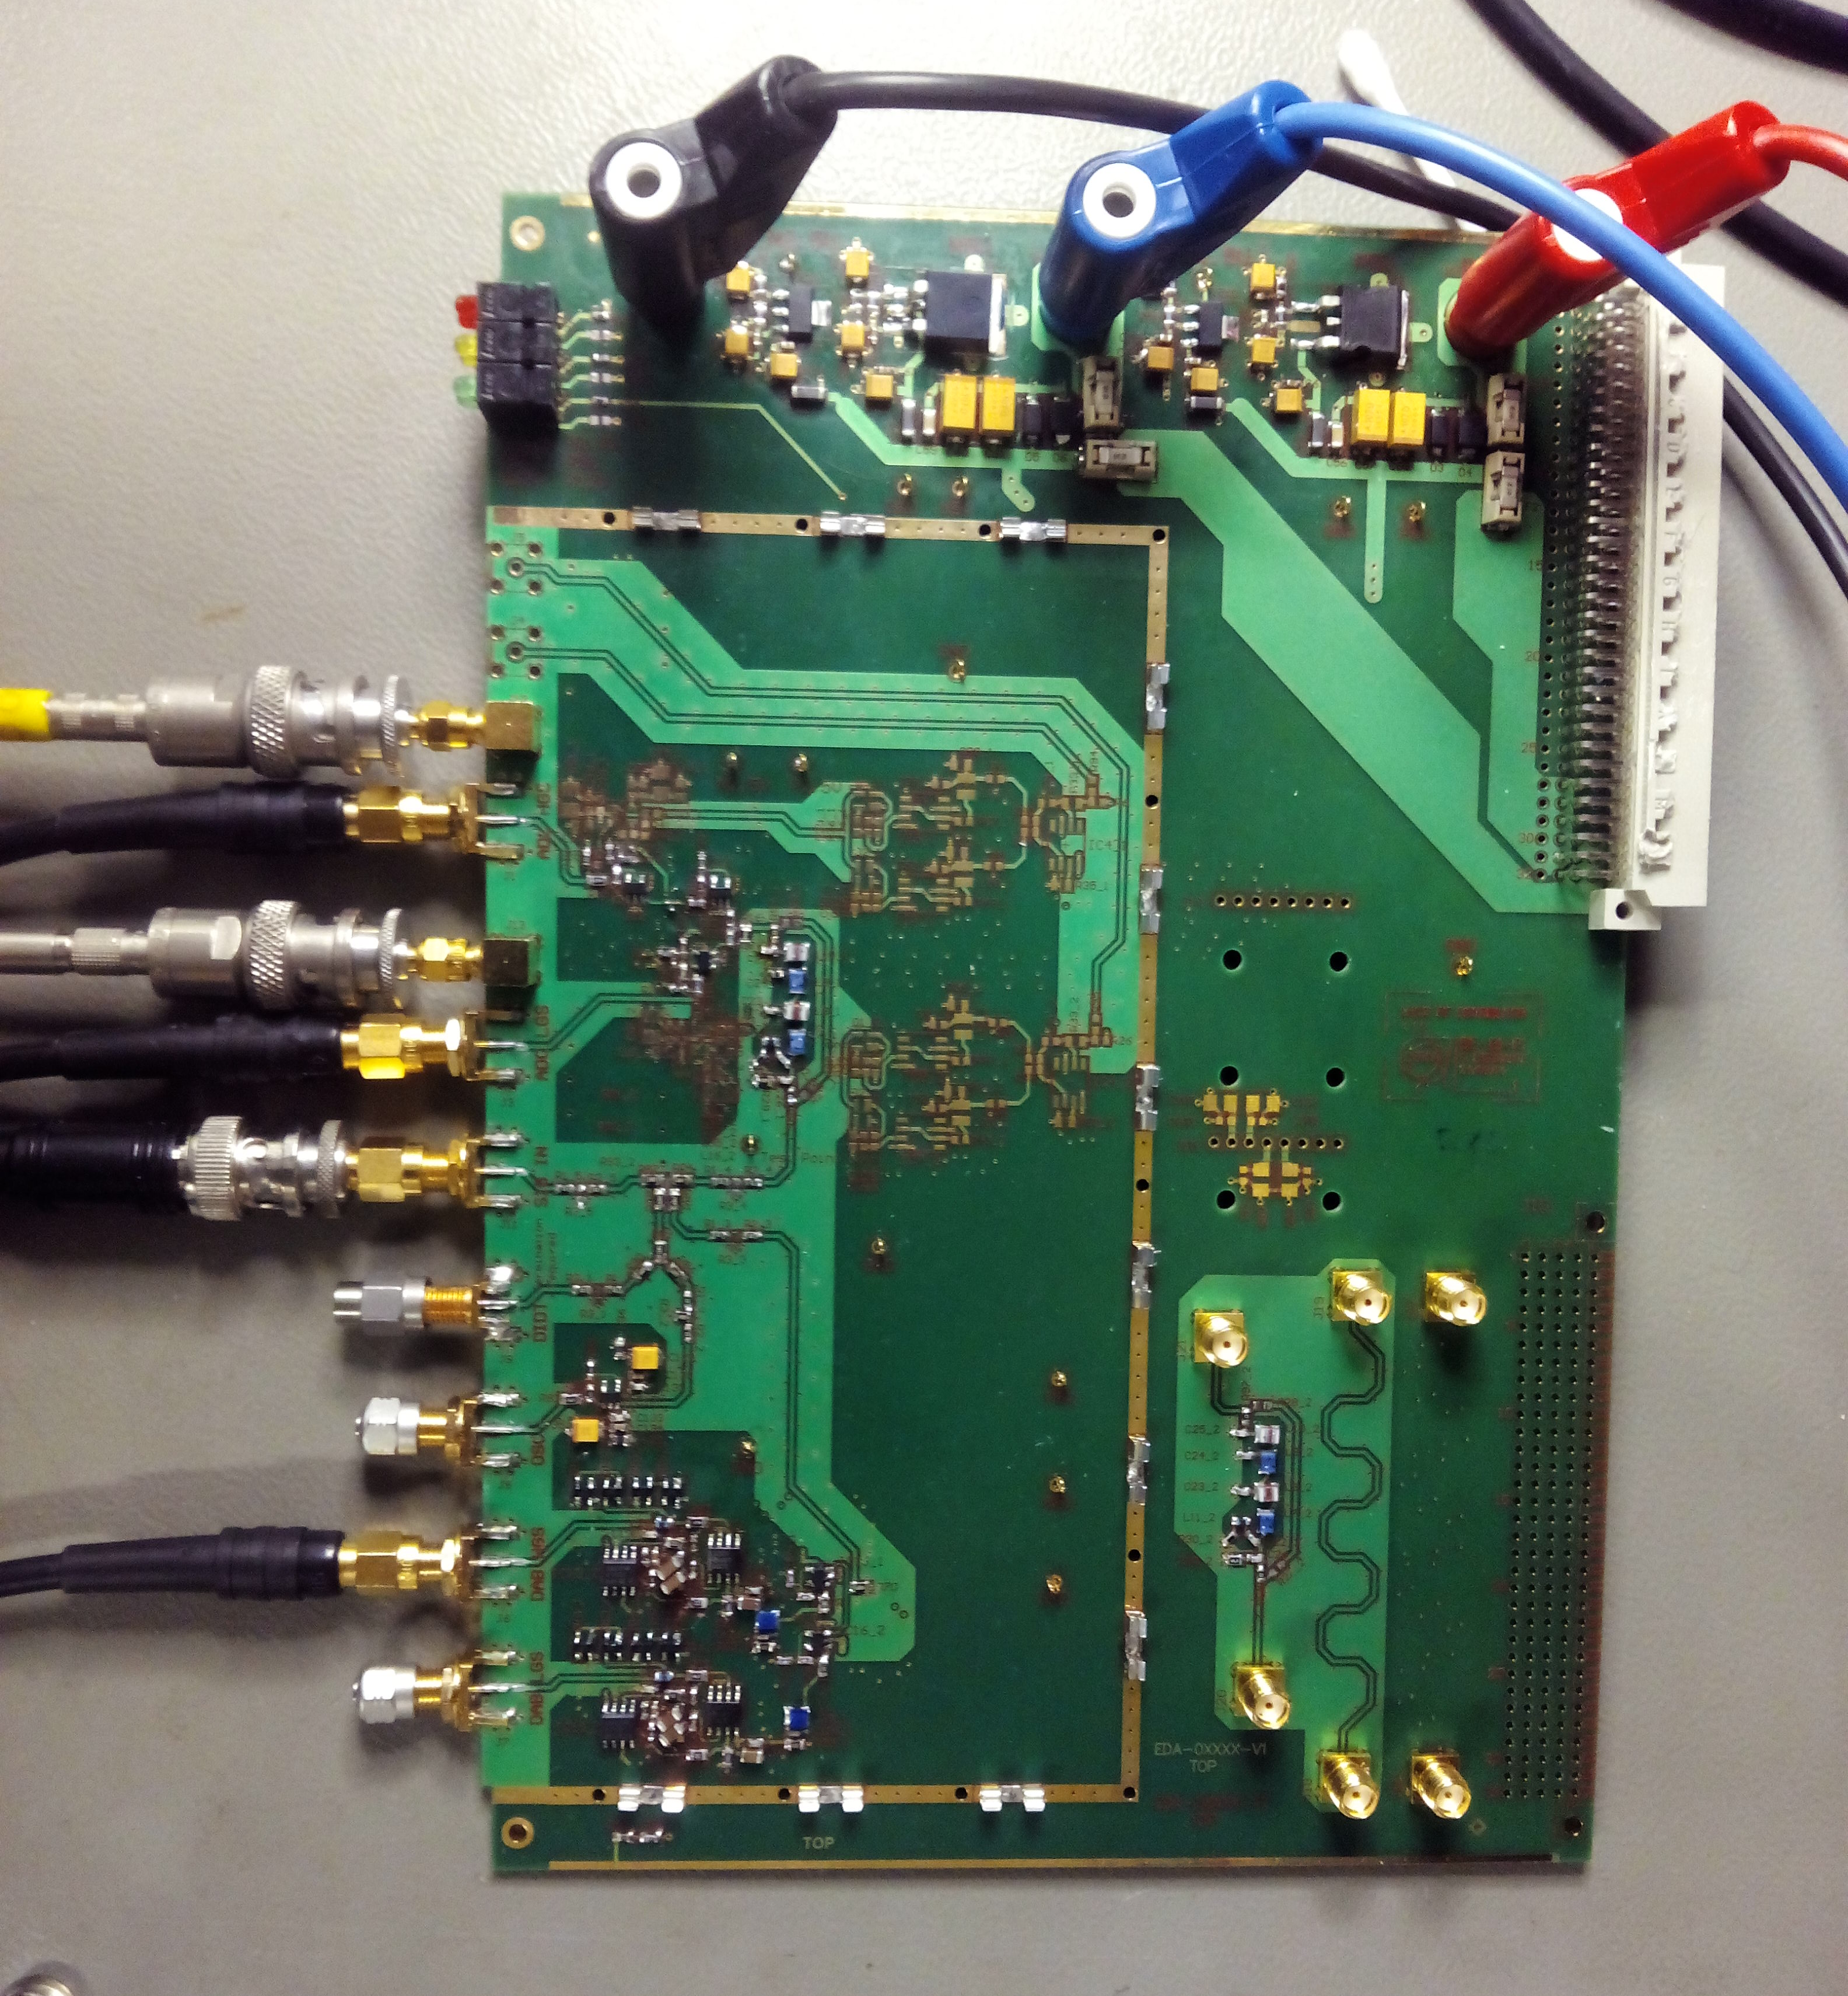
Rf-Distributor
V1 built and tested:
  Scattering parameters
  Pulse shape in time domain
  Linearity
  Noise
  External offset control
Some minor errors found
Fixes done and V2 being assembled

Slide 6
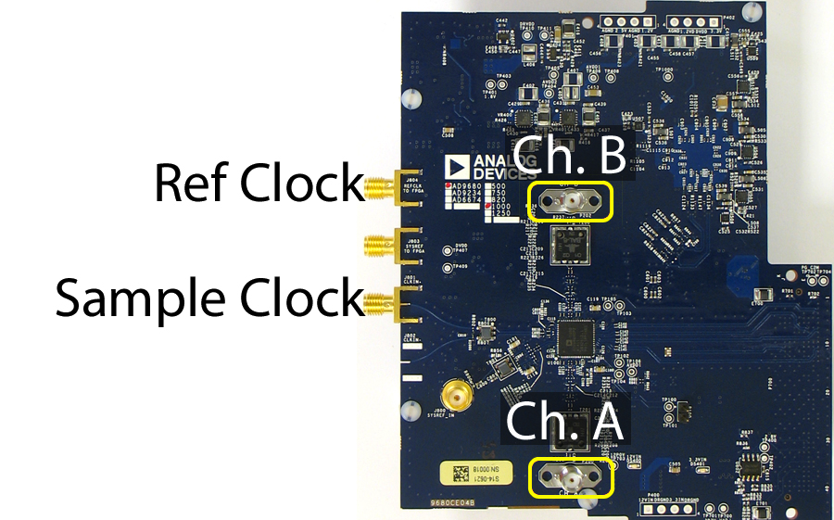
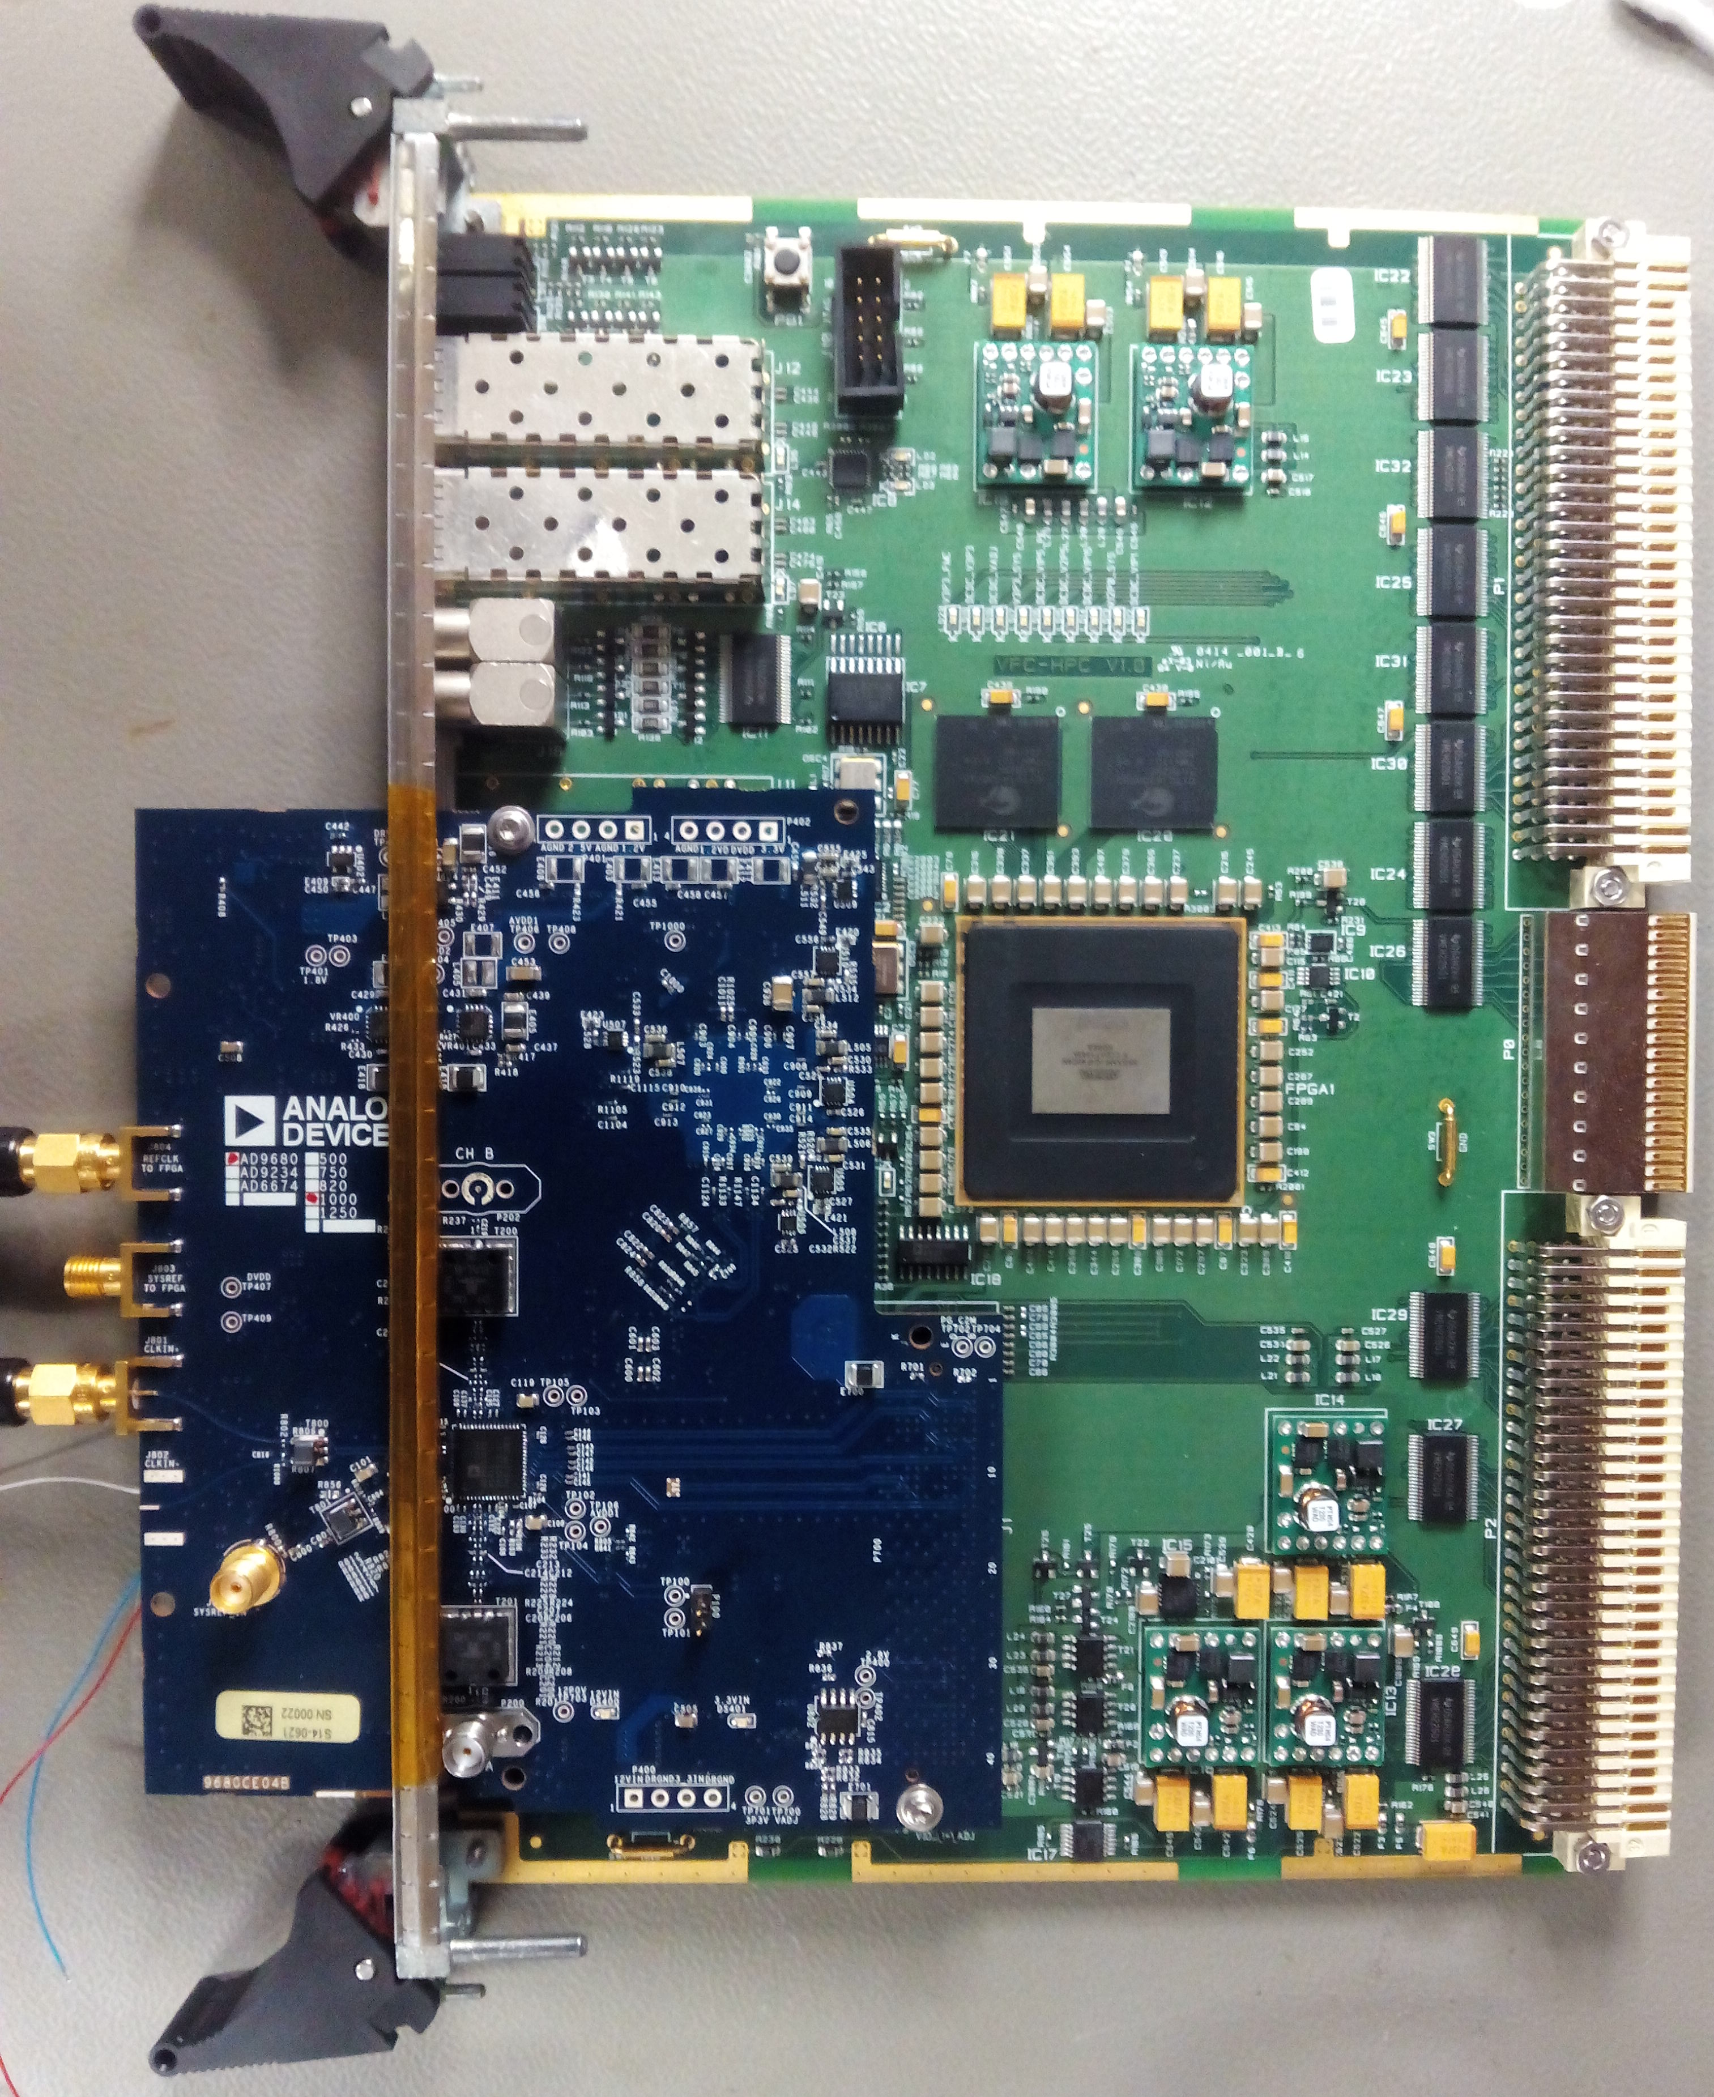
ADC-Board
Needs two external source synchronous low jitter clocks:
  Sample Clock = 500 MHz (to AD9680)
  Ref Clock = 125 MHz (to FPGA)
Serial data output in 4 lanes (JESD204 protocol)

Slide 7
VFC-HPC integration
Overview of the system

Slide 8
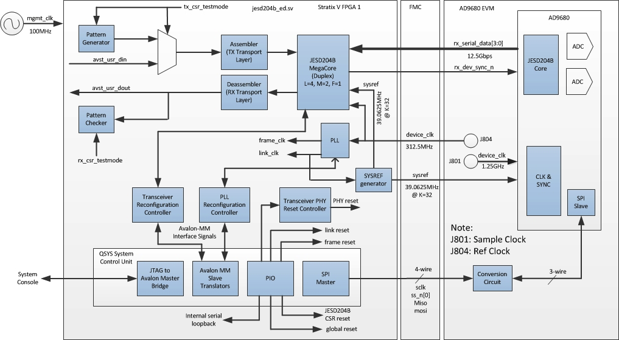
VFC-HPC integration – JESD204
Adapt project from Altera for the AD9680 ADC using a Stratix V: change clock frequencies, rebuild all the IP cores for the Arria V, modify pinout and add some pieces of code
75 MHz
5 Gbps
125 MHz
500 MHz
15.625 MHz

Slide 9
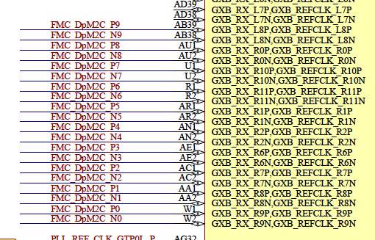
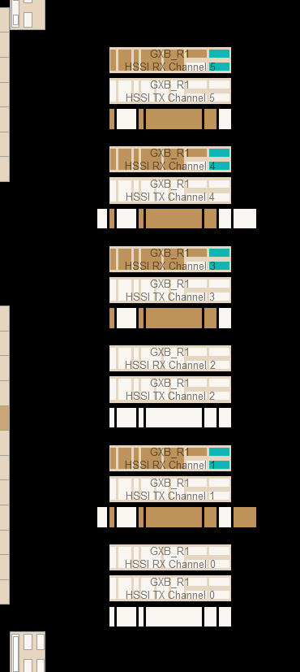
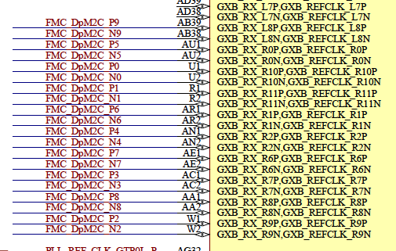
VFC-HPC integration – JESD204
I got quite jammed because I was using a schematic with a wrong pinout…
And in fact, the wrong-old pinout was better to accommodate the GX transceivers
With the new one the Duplex core doesn’t fit => had to modify the code => no internal loopback to test the deserialization disentangling machinery
In addition one fuse was blown…
Wrong pinout
Actual pinout

Slide 10
VFC-HPC integration – JESD204
Loop-back modified. This has some consequences…
75 MHz
5 Gbps
RX
125 MHz
500 MHz
15.625 MHz

Slide 11
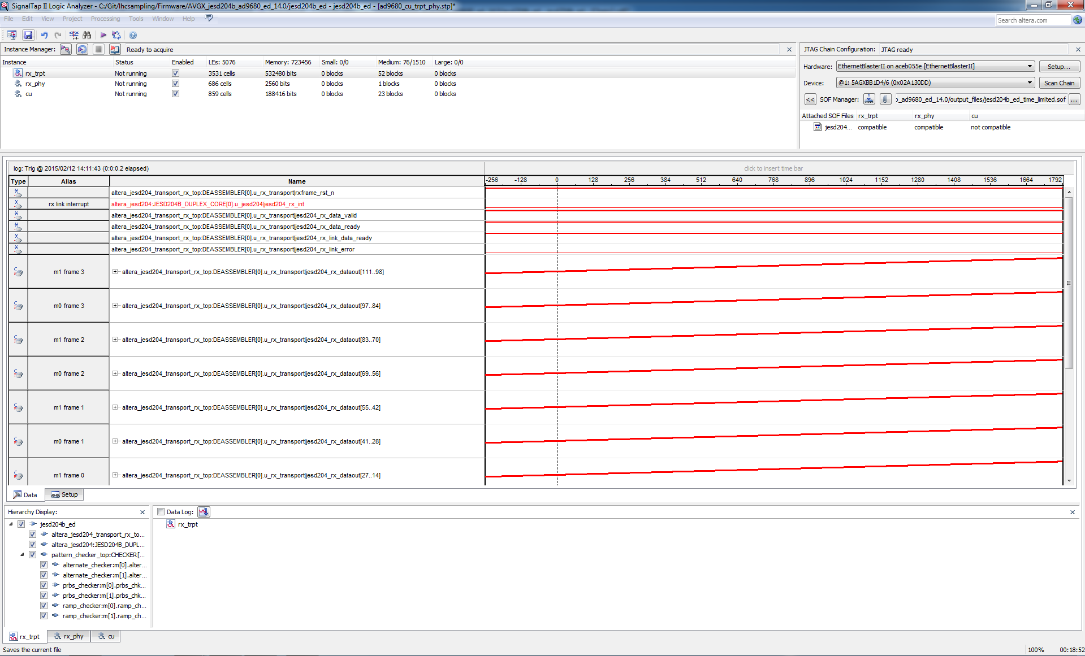
Firs results
They really showed me that I keep being a naive dreamer… Things never work in the firs trial, despite it may seem so…
Data at 500 MSPS, “ramp” test pattern. It looks nice…, but cautiousness led me to verify in detail the link status, and surprise!!…

Slide 12
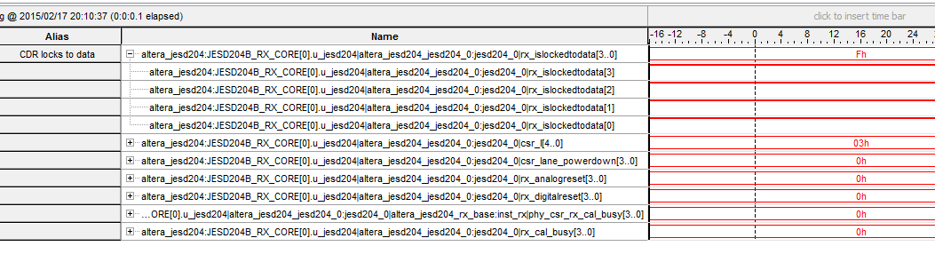
Firs results
The physical layer seems to work

Slide 13
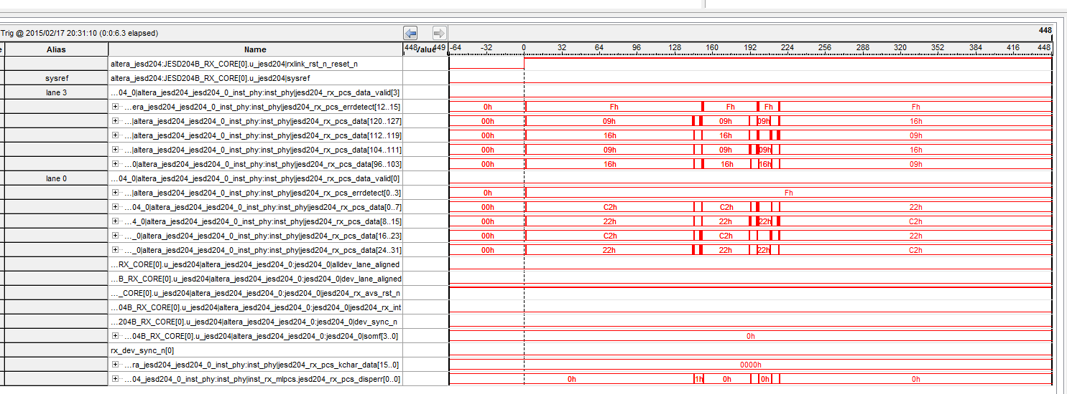
Firs results
But the link layer doesn’t.
How is it that I could see the ramp?? Well I had a bug in the code and the internal loop was by default enabled => At least we know that the Transport layer does work ☺
The source of the problem not identified yet… and not easy. The Duplex core would have helped a lot here…

Slide 14
Now we are using the development board, but for the future we should look for a commercial FMC mezzanine:
  Innovative (UK) => latest news is FMC-1000 for March. It houses the AD9680. The RF-Distributor outputs were designed to fit with their analog input requirements.
  Delphi engineering (US) => reply from few days ago: “Delphi is quoting 16 week delivery on orders we are receiving now for the quad channel, 1.0 Gs/s 14 bit ADC FMC using the AD9680 ADC from ADI.”
On the other hand, Innovative claims that they already have since very recently an FMC-500 with parallel readout.
  I’m not going to express my opinion about this…

Slide 15
Summary
The RF-Distributor to be tested soon, and with some luck it will work properly.
Still work to do in the JESD204 link synchronization block. A lot. I’m debugging it getting some support from Altera, but any help is welcome. This part is essential for the system to work like a charm…
In addition I had a bunch of ideas on how to do the signal processing that I should document. Already started time ago, but no time to finish it…
Purchase decision to be taken:
  Cross-check again the technical details (analog and digital signals)
  And pray to have one before summer…
Due to the bad experience with mismatched version of documents, maybe we should really think about an unified methodology of working using SVN or Git.
New Fellowship, Jiri Kral, is taking over these tasks.

Slide 16
Thank you for your attendance

Slide 17
BACKUP

Slide 18
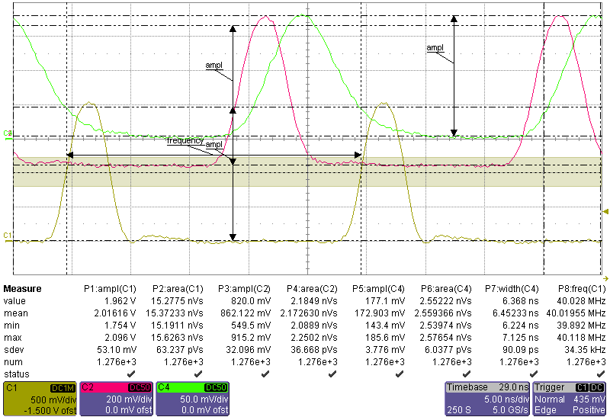
2V input, dab_lgs, dimfss_lgs

Slide 19
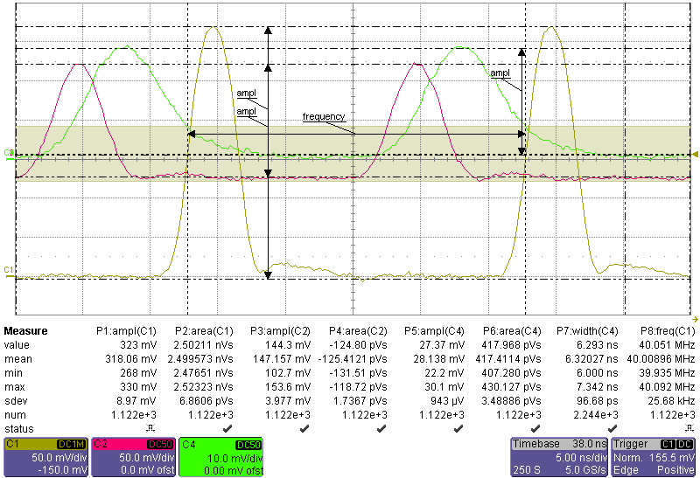
1V, 10dB att, dab_hgs, dimfss_hgs

Slide 20
Spectrum analyzer
Spectrum analyzer noise figure: ~ -152 dBm
Measurements, no shield, not all lines loaded
Output | "@ 60MHz" | "@ 200MHz" | "@ 600MHz" |  |  | "@ 60MHz" | "@ 200MHz" | "@ 600MHz"
Dimfss-HighGainStage | -137,8 | -138,1 | -149,8 |  |  | 28,806 | 27,828 | 7,236
Dimfss-LowGainStage | -155,7 | -154,6 | -151,8 |  |  | 3,668 | 4,164 | 5,748
Dab-HighGainStage | -126,9 | -129,2 | -142,2 |  |  | 101,038 | 77,533 | 17,357
Dab-LowGainStage | -144,5 | -146,5 | -152,5 |  |  | 13,319 | 10,58 | 5,303
 |  |  |  | dBm/Hz |  |  |  |  | nV/sqrt(Hz)
Resonance: 933 MHz

Slide 21
Linearity tests Low Gain Stage

Slide 22
Linearity tests High Gain Stage

